Slide 1
AI TOOLING SEMINAR · LECTURE 7
Neo4j Agent
Memory
SDKs, MCP, and graph-native persistence
Choose the retrieval system by the question it must answer.
Notes:
This lesson moves from retrieval concepts to integration mechanics, then reads the repository's SDK and MCP implementation. The repository is a Neo4j Labs project and describes itself as experimental and community supported.
[Sources]
- https://github.com/neo4j-labs/agent-memory
- https://github.com/neo4j-labs/agent-memory/blob/main/README.md
[/Sources]

Slide 2
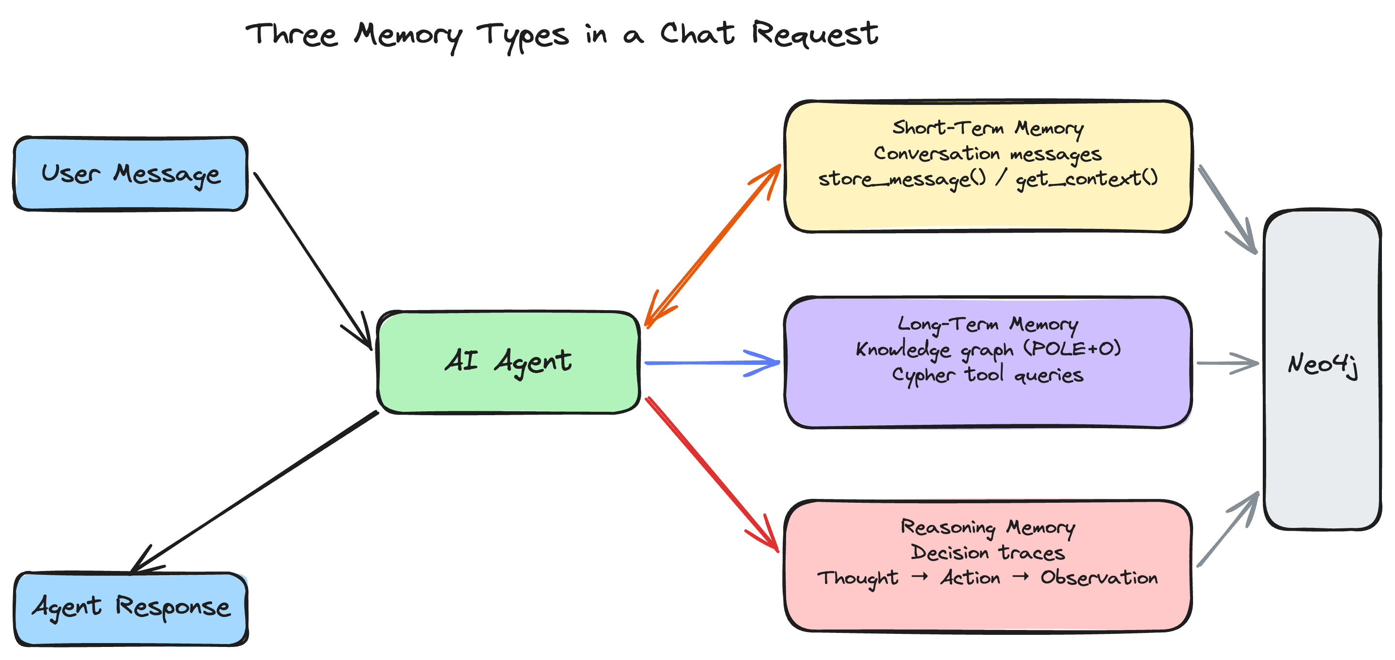
NEO4J AGENT MEMORY
One Memory Graph Serves Apps and Agents
Neo4j Agent Memory persists conversations, entities, relationships, and reasoning traces in Neo4j. Applications call an SDK; compatible AI hosts can discover the same capabilities through MCP.
Slides 3–17 build the memory, SDK, and MCP concepts without relying on this repository. Slide 18 maps each concept back to its source.
AGENT MEMORY · AI SEMINAR, LECTURE 7
02
Notes:
Flag the standalone-background pattern. The architecture image is copied from the repository and used under its Apache-2.0 license.
[Sources]
- https://github.com/neo4j-labs/agent-memory/blob/main/README.md
- https://github.com/neo4j-labs/agent-memory
[/Sources]

Slide 3
BACKGROUND · PERSISTENCE
A Model Call Does Not Persist Experience
A model receives an input, produces an output, and ends. Durable memory exists only when an external system writes state and retrieves it on a later run.
RUN 1
PERSIST
RUN 2
observation exists
only in this context
write identity, content,
relationships, and time
retrieval reconstructs
relevant prior state
Persistence is a storage-and-retrieval contract—not a property of a single completion.
AGENT MEMORY · AI SEMINAR, LECTURE 7
03
Notes:
Distinguish model weights, one-run context, and application-managed durable state. The rest of the background focuses on the retrieval structures that make persisted state useful.

Slide 4
BACKGROUND · RETRIEVAL
Retrieval Begins with the Question Shape
ORDER
What happened immediately before this?
sequence / timestamp
WORDS
Where did this exact name or phrase appear?
inverted text index
MEANING
Which stored item is semantically similar?
vector nearest neighbors
CONNECTION
How are these entities related?
graph traversal
A memory system can combine indexes, but each index still answers a different question.
AGENT MEMORY · AI SEMINAR, LECTURE 7
04
Notes:
This matrix is the conceptual anchor for the next four slides. Sequence, lexical, vector, and graph retrieval overlap in applications but should not be treated as interchangeable.
[Sources]
- https://neo4j.com/docs/cypher-manual/current/indexes/semantic-indexes/
[/Sources]

Slide 5
BACKGROUND · TEXT LOOKUP
Text Indexes Recover Tokens and Phrases
A full-text index maps terms to the stored documents or graph elements that contain them. It is strongest when the query includes identifiers, names, acronyms, or exact wording.
Ada → {doc 2, doc 9}
engine → {doc 4, doc 9}
Bernoulli → {doc 9}
What it preserves
Spelling, token boundaries, phrase occurrence, and field-level filters. Ranking may score lexical proximity, but the index does not infer that “calculation device” means “computer.”
Use lexical retrieval when exactness is evidence, not noise.
AGENT MEMORY · AI SEMINAR, LECTURE 7
05
Notes:
Neo4j full-text indexes use Lucene and can index string properties on nodes or relationships. The background claim is general: text lookup is the reliable path for exact names, identifiers, and wording.
[Sources]
- https://neo4j.com/docs/cypher-manual/25/indexes/semantic-indexes/full-text-indexes/
[/Sources]

Slide 6
BACKGROUND · VECTORS
Vector Search Recovers Semantic Neighbors
An embedding model maps text to a fixed-length numeric vector. A vector index returns stored vectors close to the query under a configured similarity measure.
1 · ENCODE
2 · COMPARE
3 · RANK
“calculation device”
→ [0.18, −0.42, …]
query vector against stored vectors with cosine, dot product, or Euclidean distance
return approximate nearest neighbors with similarity scores
Similarity is model- and configuration-dependent; it is not proof of a factual relationship.
AGENT MEMORY · AI SEMINAR, LECTURE 7
06
Notes:
Vector indexes support similarity retrieval over stored embeddings. The embedding model and dimensionality are part of the index contract; changing models can invalidate the index configuration.
[Sources]
- https://neo4j.com/docs/cypher-manual/current/indexes/semantic-indexes/vector-indexes/
- https://neo4j.com/docs/cypher-manual/current/indexes/semantic-indexes/
[/Sources]

Slide 7
BACKGROUND · GRAPHS
Graph Memory Recovers Connected Structure
Notes on
Bernoulli numbers
AUTHORED
DESCRIBES
Ada
Lovelace
Analytical
Engine
Nodes carry properties; typed edges preserve who or what connects them. Traversal answers path, neighborhood, and pattern questions that similarity alone cannot.
AGENT MEMORY · AI SEMINAR, LECTURE 7
07
Notes:
Graph retrieval preserves entities and explicit relationships. A path is evidence that edges exist under the stored schema; it is not automatically evidence that every inferred causal or semantic claim is true.

Slide 8
BACKGROUND · HYBRID SEARCH
Hybrid Retrieval Combines Independent Signals
TEXT
VECTOR
GRAPH
exact terms
semantic rank
relationships
Rank each retrieval source on its own terms, then fuse or filter the results. Raw scores from different index types are not directly comparable.
AGENT MEMORY · AI SEMINAR, LECTURE 7
08
Notes:
Neo4j documents using full-text and vector indexes together for hybrid search and cautions that independent sources should be ranked independently rather than by comparing raw scores.
[Sources]
- https://neo4j.com/docs/cypher-manual/current/indexes/semantic-indexes/
[/Sources]

Slide 9
BACKGROUND · MEMORY OPERATIONS
Memory Quality Depends on the Write Lifecycle
PROVENANCE
Who asserted this, from which event, and when?
IDENTITY
Does a new mention refer to an existing entity?
ISOLATION
Which user, tenant, or session may read it?
TEMPORALITY
Is it still valid, superseded, archived, or expired?
EVALUATION
Did retrieval return useful, faithful context?
“Store everything forever” is a retention policy with privacy and accuracy costs.
AGENT MEMORY · AI SEMINAR, LECTURE 7
09
Notes:
Persistence introduces governance work: provenance, deduplication, scoping, temporality, and evaluation. These concerns recur in the repository's issues and production-oriented APIs.
[Sources]
- https://github.com/neo4j-labs/agent-memory/issues
[/Sources]

Slide 10
BACKGROUND · SOFTWARE DEVELOPMENT KITS
An SDK Packages a Supported Integration Path
A software development kit is application code that imports into your process. It turns a service or subsystem into language-native types, methods, errors, and lifecycle operations.
TYPES
METHODS
TRANSPORT
LIFECYCLE
ERRORS
request and response objects
named operations and signatures
HTTP, sockets, database drivers
connect, close, retry, cleanup
stable failure categories
The SDK chooses defaults and abstractions; your application still owns product behavior and data policy.
AGENT MEMORY · AI SEMINAR, LECTURE 7
10
Notes:
Use this as the working definition for the course. The next slides distinguish the SDK from the API it calls and the protocol used between separate processes.

Slide 11
BACKGROUND · SDK CALL PATH
SDK Calls Cross Several Contracts
APP
SDK
TRANSPORT
SERVICE
RESULT
language-native call
validate + serialize
send + authenticate
execute operation
parse or raise
Debugging requires locating the failing contract: application input, SDK validation, transport, server behavior, or response parsing.
AGENT MEMORY · AI SEMINAR, LECTURE 7
11
Notes:
An SDK is not a monolith. Separating these layers makes version skew and provider-specific failures diagnosable.

Slide 12
BACKGROUND · INTERFACE VOCABULARY
API, SDK, and Protocol Name Different Boundaries
API
SDK
PROTOCOL
The operations a component exposes: names, inputs, outputs, and error semantics. An API may be local or remote.
A language-specific package that helps an application call an API. It may add types, defaults, helpers, retries, or adapters.
Rules two independent participants follow on the wire: message shapes, lifecycle, capabilities, and transport behavior.
One product can expose an API, ship multiple SDKs, and participate in more than one protocol.
AGENT MEMORY · AI SEMINAR, LECTURE 7
12
Notes:
This distinction prevents a common vocabulary collapse. MCP is a protocol; its official language packages are SDKs; the tools/resources/prompts exposed by a server are APIs at the application level.
[Sources]
- https://modelcontextprotocol.io/docs/2026-07-28/learn/architecture
[/Sources]

Slide 13
BACKGROUND · MODEL CONTEXT PROTOCOL
MCP Separates Host, Client, and Server
HOST
SERVER
AI application
CLIENT
declares capabilities
exposes focused primitives
executes its own logic
does not receive every host detail
owns the model conversation
creates clients
applies consent and policy
aggregates context and tools
one stateful session
with one server
AGENT MEMORY · AI SEMINAR, LECTURE 7
13
Notes:
A host can create multiple clients, with each client maintaining one connection to one server. The host remains the container and coordinator; servers focus on narrow capabilities.
[Sources]
- https://modelcontextprotocol.io/docs/2026-07-28/learn/architecture
- https://modelcontextprotocol.io/specification/2025-06-18/architecture
[/Sources]

Slide 14
BACKGROUND · MCP LAYERS
MCP Has Data and Transport Layers
DATA LAYER
TRANSPORT LAYER
JSON-RPC message shapes
Lifecycle and capability negotiation
Tools, resources, prompts
Notifications and errors
Connection and framing
Local stdio streams
Remote Streamable HTTP
Authorization for networked use
The same MCP method can travel over different transports; transport does not change the method's meaning.
AGENT MEMORY · AI SEMINAR, LECTURE 7
14
Notes:
The current MCP architecture documentation separates a JSON-RPC data layer from the transport layer. Stdio is common for local servers; Streamable HTTP is the current remote transport described by the documentation.
[Sources]
- https://modelcontextprotocol.io/docs/2026-07-28/learn/architecture
[/Sources]

Slide 15
BACKGROUND · MCP LIFECYCLE
An MCP Session Negotiates Before It Calls
1
2
3
4
5
INITIALIZE
READY
DISCOVER
INVOKE
RESULT
exchange versions, identities, capabilities
initialized notification completes setup
tools/list, resources/list, prompts/list
tools/call or resource/prompt retrieval
structured success, content, or error
Capability negotiation prevents participants from assuming optional features that were never declared.
AGENT MEMORY · AI SEMINAR, LECTURE 7
15
Notes:
Initialization exchanges a protocol version and capabilities. Discovery methods are dynamic, so a client lists primitives before using them rather than relying only on a hard-coded catalog.
[Sources]
- https://modelcontextprotocol.io/docs/2026-07-28/learn/architecture
[/Sources]

Slide 16
BACKGROUND · MCP PRIMITIVES
MCP Primitives Assign Different Controllers
user-controlled
PROMPTS
reusable message templates chosen by the user
application-controlled
RESOURCES
context data the host attaches or reads
model-controlled
TOOLS
executable functions the model may request
“Model-controlled” means the model can request a tool; it does not remove host authorization or server validation.
AGENT MEMORY · AI SEMINAR, LECTURE 7
16
Notes:
The MCP server-primitives overview describes prompts as user-controlled, resources as application-controlled, and tools as model-controlled. Control here describes selection, not unlimited authority.
[Sources]
- https://modelcontextprotocol.io/docs/2026-07-28/learn/architecture
[/Sources]

Slide 17
BACKGROUND · MCP TRUST BOUNDARY
MCP Standardizes Access—not Orchestration
MCP DEFINES
THE HOST STILL OWNS
• initialization and capability negotiation
• primitive discovery
• JSON-RPC methods and results
• transport-compatible sessions
• which servers may connect
• what context crosses the boundary
• approvals and permissions
• orchestration, stop policy, success criteria
A protocol can make an unsafe capability interoperable. Safety still requires scoping, consent, validation, and audit.
AGENT MEMORY · AI SEMINAR, LECTURE 7
17
Notes:
The host coordinates the LLM integration and security policy. MCP improves composability but does not decide the next action or define the product's success contract.
[Sources]
- https://modelcontextprotocol.io/docs/2026-07-28/learn/architecture
- https://modelcontextprotocol.io/specification/2025-06-18/architecture
[/Sources]

Slide 18
BRIDGE · CONCEPTS → SOURCE
The Repository Makes Each Background Choice Concrete
TEXT · VECTOR · GRAPH
Neo4j indexes plus typed entity relationships
Slides 5–8
MEMORY LIFECYCLE
extraction, resolution, consolidation, scoping, audit
Slide 9
SDK
Python MemoryClient and TypeScript MemoryClient
Slides 10–12
MCP
server profiles register tools over the same memory model
Slides 13–17
From this slide onward, every mechanism is tied to a repository file, class, or function.
AGENT MEMORY · AI SEMINAR, LECTURE 7
18
Notes:
This is the explicit bridge required by the course format. The remaining slides identify exact repository paths and public APIs.
[Sources]
- https://github.com/neo4j-labs/agent-memory
- https://github.com/neo4j-labs/agent-memory/blob/main/README.md
[/Sources]

Slide 19
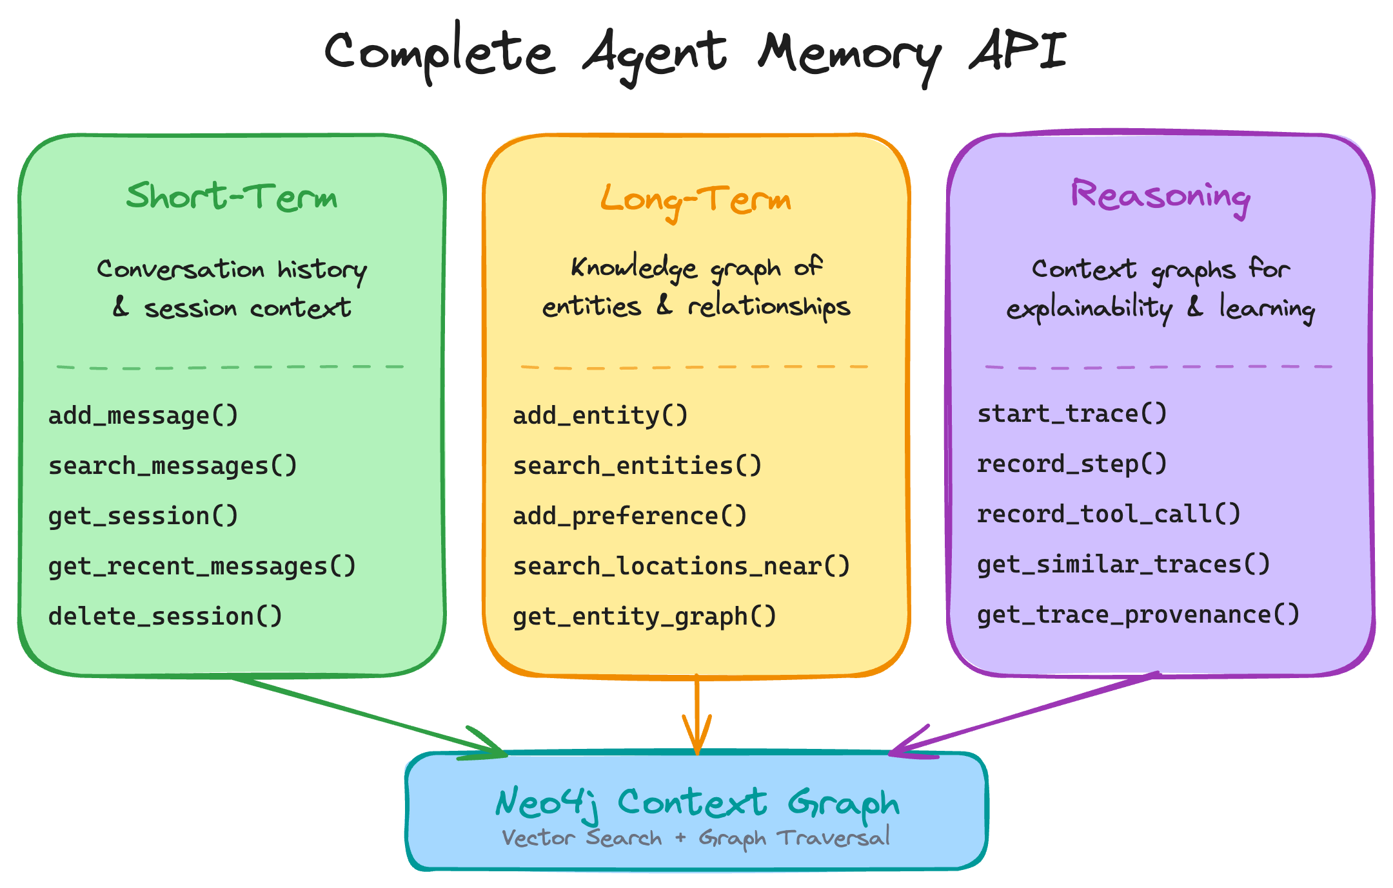
NEO4J AGENT MEMORY
← Background · Slides 4 + 9, Retrieval · Lifecycle
Three Memory Types Share One Graph
SHORT-TERM
Conversations and messages; ordered, session-scoped history.
LONG-TERM
Entities, facts, preferences, and typed relationships across sessions.
REASONING
Traces, steps, tool calls, observations, and outcomes.
AGENT MEMORY · AI SEMINAR, LECTURE 7
19
Notes:
The repository implements short-term, long-term, and reasoning memory as connected graph structures. The image is copied from the repository and used under Apache-2.0.
[Sources]
- https://neo4j.com/labs/agent-memory/explanation/memory-types/
- https://github.com/neo4j-labs/agent-memory/blob/main/README.md
[/Sources]

Slide 20
NEO4J AGENT MEMORY
← Background · Slide 12, API · SDK · Protocol
The Repository Is Polyglot, with Python at the Root
.github/ CI + release workflows
benchmarks/ retrieval evaluation utilities
docs/ Antora documentation source
examples/ runnable apps and integration demos
img/ architecture diagrams
src/ Python package
tests/ Python unit, integration, typing tests
typescript/ TypeScript SDK + its tests/docs
pyproject.toml Python package 0.5.0
uv.lock locked Python environment
src/neo4j_agent_memory/
├── __init__.py MemoryClient + get_graph()
├── config/ settings + backend selection
├── graph/ driver, schema, Cypher
├── memory/ short_term / long_term / reasoning
├── mcp/ server, tools, resources, prompts
├── nams/ hosted REST backend
├── integrations/ agent framework adapters
└── llm/ provider protocols + adapters
AGENT MEMORY · AI SEMINAR, LECTURE 7
20
Notes:
The root listing follows the repository's current GitHub contents order as checked on 13 August 2026. The code map then narrows to the Python package paths used in later slides. The repository commit inspected for this deck was 231d60eac9401ab156ba194b519d89dd644dadb8.
[Sources]
- https://github.com/neo4j-labs/agent-memory
- https://github.com/neo4j-labs/agent-memory/blob/main/src/neo4j_agent_memory/__init__.py
- https://github.com/neo4j-labs/agent-memory/blob/main/pyproject.toml
[/Sources]

Slide 21
NEO4J AGENT MEMORY
← Background · Slides 10–11, SDK Contract
MemoryClient Selects a Backend at Connect Time
settings = MemorySettings(...)
async with MemoryClient(settings) as memory:
await memory.long_term.add_entity(...)
graph = await memory.get_graph(
memory_types=["long_term"]
)
BOLT
NAMS
Direct Neo4j driver
Client initializes schema, indexes, extraction, resolution, and graph export.
Hosted REST service
Server manages embedding, extraction, and resolution; some bolt methods are unavailable.
The public accessors stay stable—short_term, long_term, reasoning, and query—while backend capability differs.
AGENT MEMORY · AI SEMINAR, LECTURE 7
21
Notes:
MemoryClient.connect dispatches to bolt or NAMS. On bolt it opens Neo4j, configures schema, and wires concrete memory classes. NAMS wires protocol-compatible REST accessors and marks bolt-only features unsupported.
[Sources]
- https://github.com/neo4j-labs/agent-memory/blob/main/src/neo4j_agent_memory/__init__.py
- https://neo4j.com/labs/agent-memory/sdks/python/
[/Sources]

Slide 22
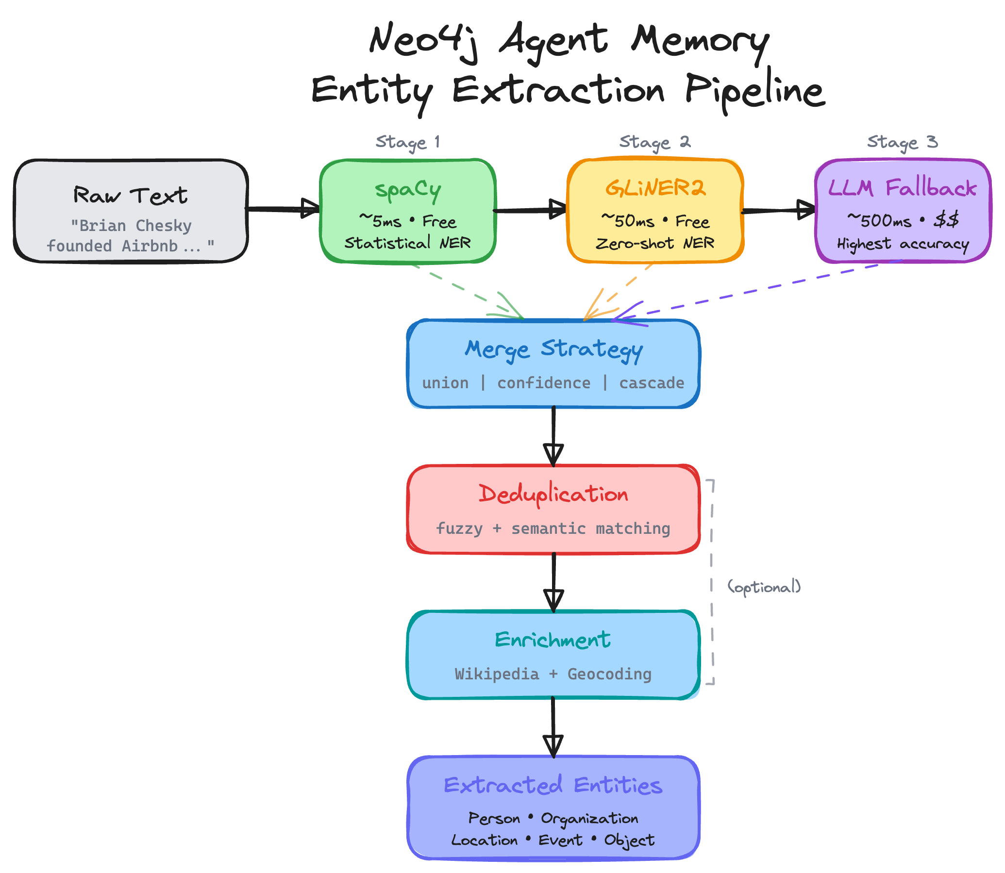
NEO4J AGENT MEMORY
← Background · Slides 6–7 and 9, Vector + Graph + Lifecycle
add_entity() Turns an SDK Call into a Graph Write
1
TYPE
normalize POLE+O entity type
2
RESOLVE
choose canonical identity
3
EMBED
optional vector + dedup
4
WRITE
dynamic labels + Cypher
5
LINK
typed relationships, provenance
add_relationship(source, target, type) stores type on a RELATED_TO edge between the two entity IDs.
AGENT MEMORY · AI SEMINAR, LECTURE 7
22
Notes:
LongTermMemory.add_entity normalizes the entity type, may resolve identity, may generate an embedding and check duplicates, then executes a Cypher write. add_relationship persists a RELATED_TO edge whose type property carries the semantic relationship label. The image shows the repository's broader extraction pipeline.
[Sources]
- https://github.com/neo4j-labs/agent-memory/blob/main/src/neo4j_agent_memory/memory/long_term.py
- https://neo4j.com/labs/agent-memory/explanation/poleo-model/
- https://github.com/neo4j-labs/agent-memory/blob/main/README.md
[/Sources]

Slide 23
NEO4J AGENT MEMORY
← Background · Slide 7, Graph Memory
get_graph() Produces Browser-Ready Nodes and Edges
graph = await memory.get_graph(
memory_types=["long_term"],
include_embeddings=False,
)
return graph.model_dump(mode="json")
{
"nodes": [
{"id": "…", "labels": ["Entity"],
"properties": {"name": "Ada", "type": "PERSON"}}
],
"relationships": [
{"type": "WROTE_ABOUT",
"from_node": "…", "to_node": "…"}
],
"metadata": {"node_count": 2}
}
The export omits embeddings by default and is designed for visualization libraries. In 0.5.0, this convenience method is bolt-only.
AGENT MEMORY · AI SEMINAR, LECTURE 7
23
Notes:
MemoryClient.get_graph queries each requested memory type and returns MemoryGraph with GraphNode and GraphRelationship models. The method explicitly raises NotSupportedError for NAMS and recommends hosted-side alternatives.
[Sources]
- https://github.com/neo4j-labs/agent-memory/blob/main/src/neo4j_agent_memory/__init__.py
[/Sources]

Slide 24
NEO4J AGENT MEMORY
← Background · Slides 4–8, Retrieval Systems
Search Methods Select a Retrieval Mechanism
search_entities(query)
embed query → vector index → optional type filter
search_preferences(query)
vector index; category fallback when no embedder
get_related_entities(entity)
graph neighborhood traversal
query.cypher(query, params)
validated read-only Cypher for custom patterns
get_context(query, session)
assemble selected memory layers into prompt context
Neo4j's semantic indexes are not invoked automatically by ordinary Cypher; code must call the relevant index or method.
AGENT MEMORY · AI SEMINAR, LECTURE 7
24
Notes:
The source makes retrieval choice visible in method bodies. search_entities returns an empty list without an embedder; get_related_entities uses graph relationships; query.cypher exposes parameterized read-only traversal. Neo4j documents that semantic indexes require explicit use.
[Sources]
- https://github.com/neo4j-labs/agent-memory/blob/main/src/neo4j_agent_memory/memory/long_term.py
- https://neo4j.com/docs/cypher-manual/current/indexes/semantic-indexes/
[/Sources]

Slide 25
NEO4J AGENT MEMORY
← Background · Slides 15–16, Discovery + Tools
MCP Tool Profiles Trade Breadth for Context Cost
CORE PROFILE · 6 TOOLS
EXTENDED PROFILE · 16 TOOLS
memory_search
memory_get_context
memory_store_message
memory_add_entity
memory_add_preference
memory_add_fact
Core plus history, entity details, graph export, relationship creation, reasoning traces, observations, and read-only Cypher.
A smaller catalog reduces tool-description tokens and selection ambiguity; a larger catalog exposes more graph operations.
AGENT MEMORY · AI SEMINAR, LECTURE 7
25
Notes:
The README and MCP server source define a six-tool core profile and a sixteen-tool extended profile. The tool list is dated to the repository state checked on 13 August 2026; treat it as version-specific.
[Sources]
- https://github.com/neo4j-labs/agent-memory/blob/main/README.md
- https://neo4j.com/labs/agent-memory/reference/mcp-tools/
- https://github.com/neo4j-labs/agent-memory/blob/main/src/neo4j_agent_memory/mcp/server.py
[/Sources]

Slide 26
NEO4J AGENT MEMORY
← Background · Slides 10–17, SDK + MCP
SDK and MCP Use the Same Memory Differently
SDK PATH
MCP PATH
Your application imports MemoryClient, calls typed async methods, and owns connection lifecycle, input validation, routes, and user experience.
An MCP host discovers tools, presents eligible schemas to a model, validates the requested call, and sends it to a memory server process.
ONE
MEMORY
GRAPH
Choose the SDK when your code owns the workflow. Choose MCP when an external compatible host should discover and invoke the capability.
AGENT MEMORY · AI SEMINAR, LECTURE 7
26
Notes:
The MCP functions in _tools.py call the same integration/client memory operations used by application code. The difference is caller, discovery, lifecycle, and authorization—not a second memory model.
[Sources]
- https://github.com/neo4j-labs/agent-memory/blob/main/src/neo4j_agent_memory/mcp/_tools.py
- https://github.com/neo4j-labs/agent-memory/blob/main/src/neo4j_agent_memory/mcp/server.py
- https://github.com/neo4j-labs/agent-memory/blob/main/src/neo4j_agent_memory/__init__.py
[/Sources]

Slide 27
NEO4J AGENT MEMORY
← Background · Slide 11, SDK Contracts
Released SDKs Differ from Main-Branch Source
Python package
neo4j-agent-memory 0.5.0
PyPI import verified on Python 3.12
TypeScript package
@neo4j-labs/agent-memory 0.4.1
npm ESM import verified on Node 26
Repository main
commit 231d60e…
contains changes after published tags
Bolt backend
direct Neo4j
graph export, schema, geospatial, write Cypher
NAMS backend
hosted REST
server-managed layers; method support differs
This slide was checked on 13 August 2026. Re-run the install and capability checks before teaching it again.
AGENT MEMORY · AI SEMINAR, LECTURE 7
27
Notes:
The Python published version matched pyproject.toml at 0.5.0 and imported in a clean Python 3.12 environment. npm reported 0.4.1 and the package imported as ESM. GitHub main contained unreleased changes. This is deliberately date-stamped.
[Sources]
- https://pypi.org/project/neo4j-agent-memory/
- https://www.npmjs.com/package/@neo4j-labs/agent-memory
- https://github.com/neo4j-labs/agent-memory/blob/main/pyproject.toml
- https://github.com/neo4j-labs/agent-memory/blob/main/CHANGELOG.md
[/Sources]

Slide 28
NEO4J AGENT MEMORY
← Background · Slides 9 + 17, Lifecycle · Trust
Experimental Memory Still Has Isolation and Time Risks
PROJECT STATUS
Neo4j Labs, experimental, community supported
APIs and defaults may move
USER ISOLATION
open issues describe unscoped long-term reads
enforce tenant identity in application policy
GRAPH POISONING
shared entity neighborhoods can cross trust boundaries
scope writes, reads, and merge behavior
TEMPORAL OVERWRITE
facts can change or conflict across time
preserve validity and supersession evidence
BACKEND SKEW
bolt and NAMS do not expose every method equally
capability-test instead of version-assuming
Open-issue evidence is a limitation signal, not proof that every deployment is exploitable in the same way.
AGENT MEMORY · AI SEMINAR, LECTURE 7
28
Notes:
As of 13 August 2026, open issues included long-term user isolation (#137), graph-memory poisoning (#155), and a bitemporal supersession RFC (#177). Issue counts and status are volatile; the slide names concrete risks and avoids claiming universal exploitability.
[Sources]
- https://github.com/neo4j-labs/agent-memory/blob/main/README.md
- https://github.com/neo4j-labs/agent-memory/issues/137
- https://github.com/neo4j-labs/agent-memory/issues/155
- https://github.com/neo4j-labs/agent-memory/issues/177
[/Sources]

Slide 29
NEO4J AGENT MEMORY
← Background · Slides 21–26, SDK · Graph
Assignment: Build a Persistent Memory Map
BROWSER
FASTAPI
MEMORYCLIENT
NEO4J
form + SVG graph
neighbor lookup
validated routes
async lifecycle
entities + edge
get_graph + Cypher
named volume
survives restart
Required proof: store → render → stop app → restart → retrieve the same relationship.
AGENT MEMORY · AI SEMINAR, LECTURE 7
29
Notes:
The assignment starter supplies the browser, routes, and local Neo4j configuration. Students implement SDK writes, graph export, and parameterized one-hop traversal, then prove persistence across an application restart. The instructor reference was designed against published Python 0.5.0.
[Sources]
- https://github.com/neo4j-labs/agent-memory/blob/main/src/neo4j_agent_memory/__init__.py
- https://github.com/neo4j-labs/agent-memory/blob/main/src/neo4j_agent_memory/memory/long_term.py
- https://github.com/neo4j-labs/agent-memory/blob/main/README.md
[/Sources]

Slide 30
NEO4J AGENT MEMORY
Conclusion
1
MATCH RETRIEVAL TO THE QUESTION
Text preserves words; vectors rank meaning; graphs traverse relationships.
2
USE THE SDK INSIDE YOUR APP
It packages typed async calls, backend selection, errors, and lifecycle.
3
USE MCP ACROSS HOST BOUNDARIES
It standardizes discovery and invocation while the host retains policy.
4
PROVE PERSISTENCE AND ISOLATION
A memory feature is only as reliable as its write, scope, and retrieval evidence.
NEXT · python3 quiz.py --mode post · agent_memory_assignment.md
AGENT MEMORY · AI SEMINAR, LECTURE 7
30
Notes:
Route students to the post-lesson quiz and the Memory Map assignment. The assignment ends with a persistence demonstration and a comparison between SDK and MCP integration surfaces.
[Sources]
- https://github.com/neo4j-labs/agent-memory
[/Sources]

