Slide 1
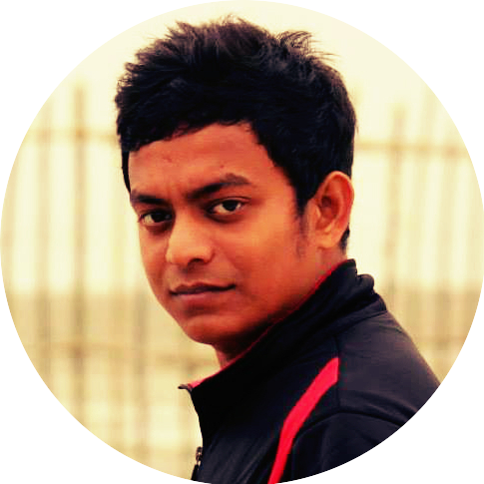



Kaiser Hamid Rabbi
github.com/kaiser-hamid-rabbi
kaiser-hamid-rabbi.github.io
linkedin.com/in/kaiserhamidrabbi/
WORK EXPERIENCE
SOFTWARE ENGINEER - TIGERIT BANGLADESH LTD​​ | Banani, Dhaka | October 2019 – Present
- Debugged existing Vehicle Number Plate Recognition System, annotated the number plate for the Detection System & tested the recognition system with its own model. Worked with Education Board academic data (70 million & additional 2.5 million records every year) to find out frauds and provide enterprise solutions for National Election Commission & Government Law Enforcement agencies.
- Due to COVID-19, our organization had to develop Masked Face detection and recognition features in the existing Facial Recognition System. Implemented MTCNN for face detection, and alignment and MOBILEFACE architecture for face recognition. Learned Multiprocessing and Threading in PYTHON for parallel computing of CPU bound tasks and I/O bound tasks and applied that into the FRS pipeline and improved the execution time up-to 12x time faster in 4.2 million National ID Card image data cluster, with the collaboration of National Crime Records Bureau & Election Commission.
- Implemented Facebook’s MSG3D PYTORCH model and MMSkeleton for Action Recognition System using PYTHON. Trained model from scratch for our own custom action video data set. Learned CUDA programming on the fly and implemented that for optimization and able to improve the training time up-to 4x time faster by running them on 4 parallel GPU’s. Got 40% accuracy recognizing actions from 400 action classes. This project is in progress and more exciting stuff is coming!
DATA SCIENTIST - UPSKILLABLE Inc.​ | Gulshan, Dhaka | July 2019 - September 2019
- Designed 2 separate Recommendation System to recommend relevant jobs to the relevant candidates and vice-versa using Auto-Encoder & Boltzman Machine in Python and Flask and it helped them to find out the right job for the best-suited candidate. Also responsible for generating valuable insights from candidate’s data and their behavioral activities over time using SQL & PYTHON.
SOFTWARE ENGINEER - DREAMERZ LAB | Lalmatia, Dhaka | January 2019 - June 2019
- Created 2 games in Unity, one is Multiplayer First Person Shooting game named “Battle of Hatirjhil” and another one is an Augmented Reality game named “Demon Slayer”. Experimented different AI algorithms in the game-play to make the game fun! Also worked on an Augmented reality application named “Attire LabAR” based on cloth fitting instead of using the Trail room in the shopping mall.
EDUCATION
OTTO-VON GUERICKE UNIVERSITY​
MASTER OF SCIENCE | DATA AND KNOWLEDGE ENGINEERING
October 2015 - 2018 | Magdeburg, Germany
Extensive Elective Coursework in:
- Machine Learning, Data Mining, Big Data Storage and Processing, Recommendation System, Information Retrieval, Distributed Database Management, and Advanced Database Model.
AHSANULLAH UNIVERSITY OF SCIENCE AND TECHNOLOGY
BACHELOR OF SCIENCE | COMPUTER SCIENCE AND ENGINEERING
Graduated October 2014 | Dhaka, Bangladesh CGPA: 3.268
Successfully completed Coursework in:
- Data Structure, Algorithms, Numerical Methods, Artificial Intelligence, Data Communication, Computer Graphics, Pattern Recognition, Discrete Mathematics, and Object-Oriented Programming.

