Slide 1
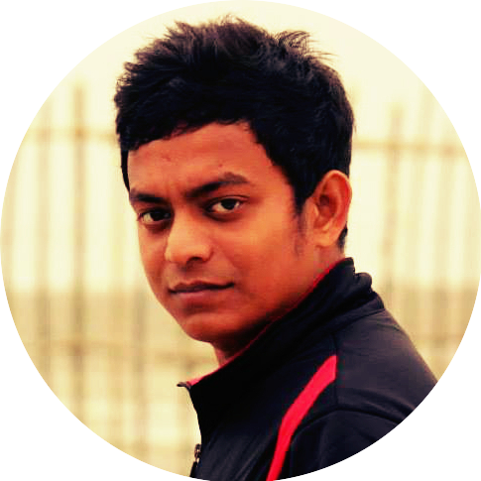
KAISER HAMID
RABBI
SOFTWARE ENGINEER
EXPERIENCE
TigerIT Bangladesh Limited​, Banani — ​ Software Engineer
October 2019 - PRESENT
Working on Enterprise Solutions for Government agencies like - Vehicle Number Plate Recognition for BRTA, Musked Face Recognition from NID images, Pose Estimation and Action Recognition.
Upskillable​, Gulshan — ​ Data Scientist
July 2019 - September 2019
Responsible for creating Recommendation System to automate the hiring process.
Dreamerz Lab​, Lalmatia — ​ Software Engineer
January 2019 - June 2019
Augmented Reality and Virtual Reality applications and Game Development in Unity3D.
Online Data Science Author​ at Udemy​ and ​ Packt​ ​ Publication Ltd​.
February 2018 - December 2018
Created several online premium courses in Machine Learning, Deep Learning & Artificial Intelligence.

