Slide 1
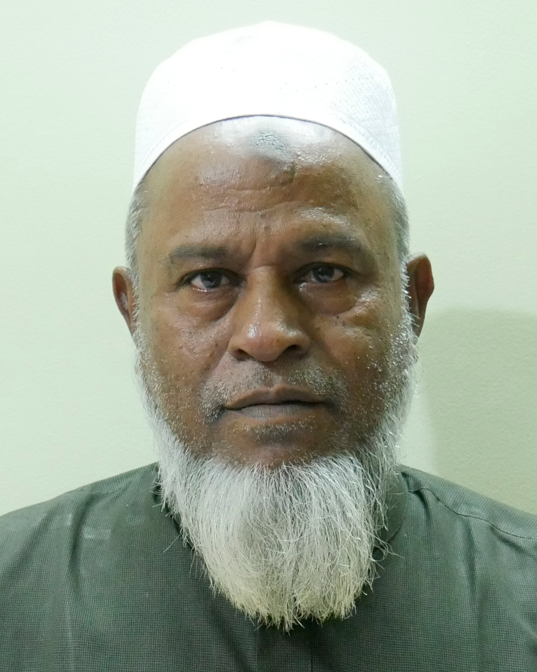
Abdul Hamid Daria
WORK EXPERIENCE
Assistant Executive Engineer/Colony Chittagong – Bangladesh Railway​​ | 12.12.2018 – 21.06.2019 (Retirement)
SSAE/Estimator – Bangladesh Railway​​ | Divisional Engineer -1, Chittagong | 06.07.2004 – 11.12.2018
SAE/WAY - Bangladesh Railway​ | Sholoshohor, Chittagong | 21.07.1994 – 05.07.2004
- Successfully passed and selected in Division written and viva exam and after completing 1 year divisional training, joined as a SAE/WAY in Sholoshohor, Chittagong.
Junior Auditor – Bangladesh Railway | T.A. Branch, Chittagong | 17.12.1987 – 20.07.1994 (Joining)
EDUCATION
Diploma Engineering (Civil) | 1986 | 1st division
Higher Secondary Certificate | 1979 | 2nd division
Secondary School Certificate | 1976 | 2nd division
PERSONAL INFORMATION
Full name: Abdul Hamid Daria
Father’s name: Late Hasan Uddin Daria
Mother’s name: Late Golejan Bibi
Present Address: Plot - 189 (Spring Field), Satarkul Road, Uttar Badda, Dhaka – 1212
Permanent Address: Village: Hatbaria, P.O: Karpara, Thana/District: Gopalganj
Date Of Birth: 21-06-1960
National ID number: 4628678247 | TIN number: 153351645867
Phone: 01727800090/ 01671926803

