Slide 1
Intro to Operating Systems
CS461 / ECE422 – UIUC Spring 2019
By Kaishen Wang

Slide 2
Educational Goals
Know about X86 instructions and understand x86 assembly programs.
Can translate simple C programs into X86 assembly code.
Understand what is stack frame and how the calling conventions work on it.
Know how to use GDB for simple purposes, like pausing program, examining memory locations & registers.
Understand how system calls are invoked and how arguments are passed to system calls.

Slide 3
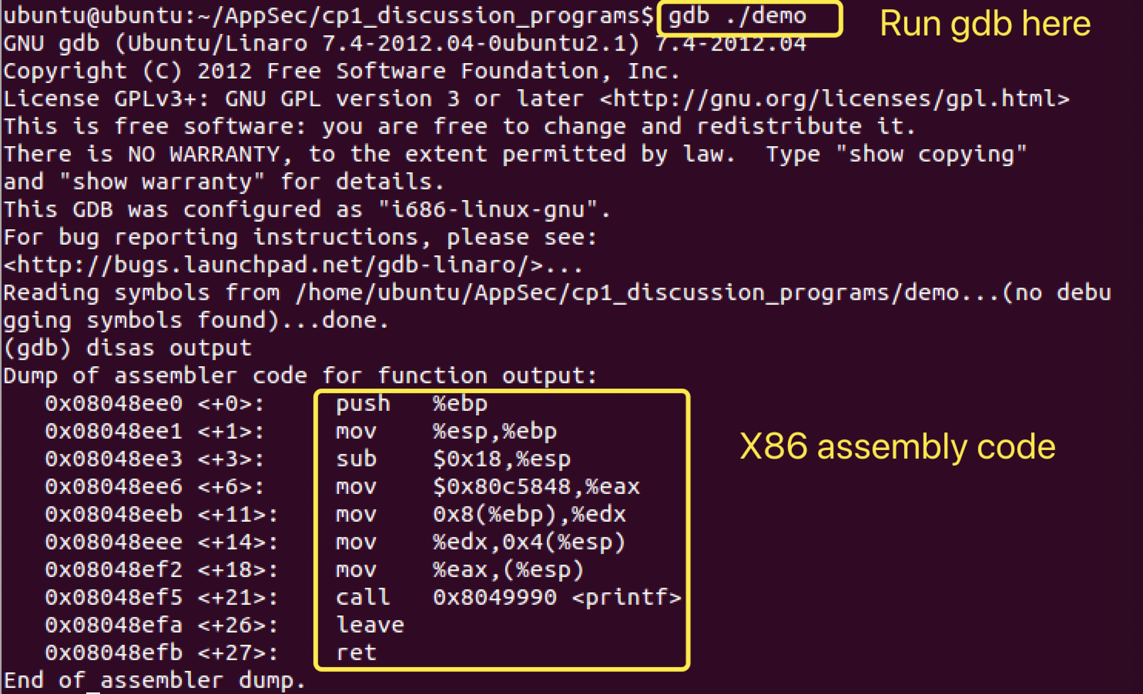
Glance on GDB and X86 Code

Slide 4
Hex
hexadecimal (hex) is a positional numeral system with a base of 16.
Every byte has 8 bits. We use two hex characters, one for the first four bits, one for the last four bits.
0x10 = 00010000 (binary), 0x3f = 00111111 (binary)

Slide 5
Registers (4 Bytes)
General Purpose: EAX, EBX, ECX, EDX, EDI, ESI
Special:
EIP: Instruction pointer
ESP: Stack pointer
EBP: Base pointer
EAX
 |  | AH | AL
AX

Slide 6
Assembly Instructions (AT&T Syntax)
Opcode-Source-Destination (AT&T, not Intel)
push, pop, jmp, call, mov, lea, xor, cmp, dec, inc, int, leave, ret, and a lot more!
cmp $0xffffff83,%eax if (%eax != $0xffffff83) { jne <label> goto <label> }
call foo same as calling foo() in C code
add %ecx,%ebx %ecx + %ebx -> %ebx
sub %ecx,%eax %eax - %ecx -> %eax
xor %ecx,%ecx %ecx xor %ecx -> %ecx (it clears %ecx)

Slide 7
Assembly Instructions (AT&T Syntax)
Opcode-Source-Destination mov $11,%eax 11 -> eax
Address calculation: displacement(base reg, offset reg, multiplier)
mov 8(%ebp),%eax M[EBP+8] -> eax
mov 12(,%edx,4),%eax M[EDX*4+12] -> eax
lea -0x10(%ebp),%eax %ebp - 0x10 -> %eax
Notes:
Start with MOV. How to do address calculation.

Slide 8
LEA VS MOV
MOV moves the content in the address
LEA loads the address itself
Check https://stackoverflow.com/questions/1658294/whats-the-purpose-of-the-lea-instruction (use intel syntax instead of at&t)
Notes:
What is instruction LEA? Many students easily get confused about LEA VS MOV.

Slide 9
32-bit x86 ISA
1 byte = 8 bits
char -> 1 byte
integer -> 4 bytes
word -> 4 bytes
long -> 4 bytes
Memory address -> 4 bytes
Pointer -> ?
Registers -> 4 bytes
Each memory location contains 4 bytes
0xdeadbeef
0xaaaaaaaa
0xface0000
0xbffe1234
0xbffe1238
0xbffe124c
Notes:
Correct this

Slide 10
Stack
Low memory address
What is Stack? It's a special region of your computer's memory that stores temporary variables created by each function (including the main() function). (from:www.gribblelab.org)
Is there other memory segments? Yes, Text, Data, Heap, BSS...
ESP(stack pointer) points to top of stack
0x00000010
0x00000020
0x0000003f
esp
Stack
Growth
High memory address

Slide 11
Stack
Low memory address
push $0x4e
What is push?
first decrements ESP by 4,
then places its operand into the contents
of the 32-bit location at address (%esp)
esp
0x0000004e
0x00000010
0x00000020
0x0000003f
Stack
Growth
High memory address

Slide 12
Stack
Low memory address
push $0x4e
pop %eax (eax contains 0x4e)
What is pop?
It first moves the 4 bytes located
at memory location (%esp) into the specified register
or memory location,
and then increments ESP by 4.
???
0x00000010
0x00000020
0x0000003f
esp
Stack
Growth
High memory address
Notes:
What will remain in the top cell? Still 0x4e.

Slide 13
Stack
Low memory address
push $0x4e
pop %eax (eax contains 0x4e)
pop %ebx (ebx contains 0x10)
???
???
0x00000020
0x0000003f
Stack
Growth
esp
High memory address

Slide 14
Stack Frame
What is the stack frame?
It is the collection of all data on the stack associated with one subprogram call.
The stack frame generally includes the following components:
The return address
Argument variables passed on the stack
Local variables
Saved copies of any registers modified by the subprogram that need to be restored.
What is EBP?

Slide 15
Stack Frame
example: main calls foo
Do stuff in main (don’t care)
Set up arguments to call foo
Set up stack frame for foo
Do stuff in foo (don’t care)
Return to main
void foo(xx, xx) {
// do some stuff like declare local variables
return;
}
void main() {
// do some stuff like declare local variables
foo(xxx,xxx);
}

Slide 16
Stack Frame
example: main calls foo
Do stuff in main
ex: int a = 5; (push $5) int b = 10; (push $10)
10 (b)
5 (a)
previous base pointer
esp
ebp

Slide 17
Stack Frame
example: main calls foo
Do stuff in main
local variables
previous base pointer
esp
ebp

Slide 18
Stack Frame
example: main calls foo
Do stuff in main
Set up arguments to call foo
ex: foo takes two integers, in main: foo(11,12); (push $12, push $11)
11
12
local variables
previous base pointer
esp
ebp
Notes:
Add some c code example

Slide 19
Stack Frame
example: main calls foo
Do stuff in main
Set up arguments to call foo
arguments to foo
local variables
previous base pointer
esp
ebp

Slide 20
Stack Frame
example: main calls foo
Do stuff in main
Set up arguments to call foo
Set up stack frame for foo
assembly: call foo … foo: push %ebp mov %esp,%ebp ...
base pointer for main
return address
arguments to foo
local variables
previous base pointer
esp
ebp
main

Slide 21
Stack Frame
example: main calls foo
Do stuff in main
Set up arguments to call foo
Set up stack frame for foo
arguments to foo
local variables
previous base pointer
esp
ebp

Slide 22
Stack Frame
Assembly:
main: call foo … foo: push %ebp mov %esp,%ebp ...
example: main calls foo
Do stuff in main
Set up arguments to call foo
Set up stack frame for foo
assembly: call foo
( push %eip;
address of foo’s first instruction -> eip)
return address
arguments to foo
local variables
previous base pointer
esp
ebp

Slide 23
Stack Frame
Assembly:
main: call foo … foo: push %ebp mov %esp,%ebp ...
example: main calls foo
Do stuff in main
Set up arguments to call foo
Set up stack frame for foo
assembly: push %ebp
base pointer for main
return address
arguments to foo
local variables
previous base pointer
esp
ebp

Slide 24
Stack Frame
Assembly:
main: call foo … foo: push %ebp mov %esp,%ebp ...
example: main calls foo
Do stuff in main
Set up arguments to call foo
Set up stack frame for foo
assembly: mov %esp,%ebp
base pointer for main
return address
arguments to foo
local variables
previous base pointer
esp
ebp
main

Slide 25
Stack Frame
example: main calls foo
Do stuff in main
Set up arguments to call foo
Set up stack frame for foo
assembly: call foo … foo: push %ebp mov %esp,%ebp ...
base pointer for main
return address
arguments to foo
local variables
previous base pointer
esp
ebp
main

Slide 26
Stack Frame
example: main calls foo
Do stuff in main
Set up arguments to call foo
Set up stack frame for foo
Do stuff in foo
local variables
base pointer for main
return address
arguments to foo
local variables
previous base pointer
esp
foo
ebp
main

Slide 27
Stack Frame
example: main calls foo
Do stuff in main
Set up arguments to call foo
Set up stack frame for foo
Do stuff in foo
Return to main
assembly: leave ret
arguments to foo
local variables
previous base pointer
esp
ebp

Slide 28
Stack Frame
example: main calls foo
Do stuff in main
Set up arguments to call foo
Set up stack frame for foo
Do stuff in foo
Return to main
assembly: leave ret
local variables
base pointer for main
return address
arguments to foo
local variables
previous base pointer
esp
ebp
main

Slide 29
Stack Frame
example: main calls foo
Do stuff in main
Set up arguments to call foo
Set up stack frame for foo
Do stuff in foo
Return to main
assembly: leave
( mov %ebp, %esp; pop %ebp)
local variables
base pointer for main
return address
arguments to foo
local variables
previous base pointer
esp
ebp
main

Slide 30
Stack Frame
example: main calls foo
Do stuff in main
Set up arguments to call foo
Set up stack frame for foo
Do stuff in foo
Return to main
assembly: leave
( mov %ebp, %esp; pop %ebp)
local variables
base pointer for main
return address
arguments to foo
local variables
previous base pointer
esp
main
ebp

Slide 31
Stack Frame
example: main calls foo
Do stuff in main
Set up arguments to call foo
Set up stack frame for foo
Do stuff in foo
Return to main
assembly: ret
( pop %eip)
local variables
base pointer for main
return address
arguments to foo
local variables
previous base pointer
esp
main
ebp

Slide 32
Calling Conventions
Caller and Callee (functions) need to meet conventions. And these are the ones we used for this MP.
The return value of a function is stored in EAX
Normal function calls (not system calls) pass the arguments on stack
System calls pass arguments by registers (or may use the help of stack in some cases)
The order of arguments in function signature is the same as the order they appear on the stack. The first argument is on top (the lowest address).
How does callee function (foo()) access arguments? (First argument: M[EBP+8])

Slide 33
Exercise - Translate to x86 Assembly
int main() { int a = 3; addnumbers(2,6); }
int addnumbers(int x, int y) { int b = 1; b = x+y;
return b; }

Slide 34
Possible Solution
main: push %ebp //setting up stack frame mov %esp,%ebp push $3 //int a = 3; push $6 //addnumbers(2,6); push $2 call addnumbers leave ret
addnumbers: push %ebp //setting up stack frame mov %esp,%ebp push $1 //int b = 1; mov 8(%ebp),%eax //b = x+y; add 12(%ebp),%eax mov %eax,(%esp) leave ret

Slide 35
GDB?
It is a Debugger. Which is a program that lets you look at another program.
It could Stop/Pause programs by setting up breakpoints.
It could Examine memory / registers.
Find bugs!
Context of MP: find vulnerabilities

Slide 36
GDB Tutorial - Important Commands
Disassemble: disas function_name
Set breakpoints: b function_name, b *0xbffebee0
Examine: x $eax, x/s 0xdeadbeef, x/2wx 0x5adface5
Look at register values: info reg
Run: r
Continue: c
Step(one instruction): si
Show current instruction: display/i $pc

Slide 37
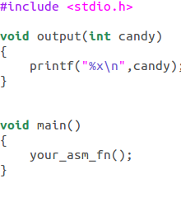
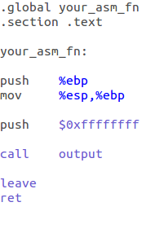
Exercise
Notes:
Show the make file

Slide 38
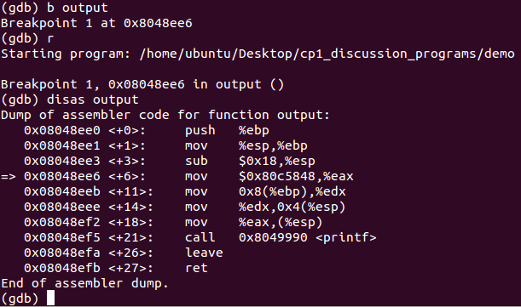

Slide 39
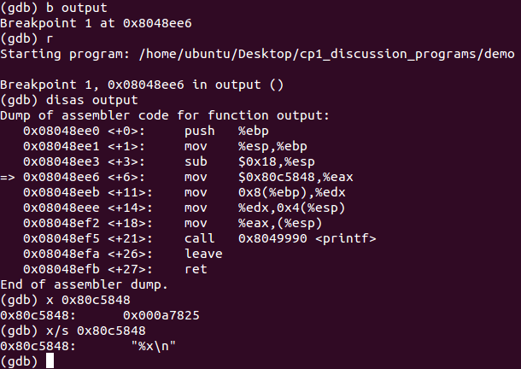

Slide 41
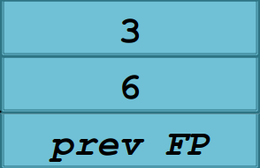
%x\n
0xffffffff

Slide 42
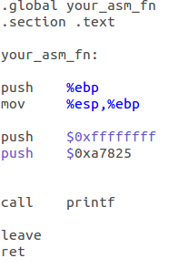

Slide 44
%x\n
%x\n
0xffffffff
0xffffffff

Slide 45
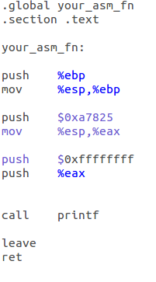

Slide 46
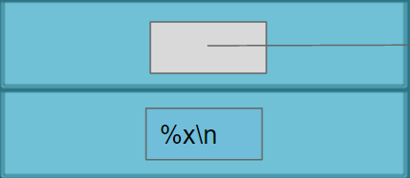
0xffffffff
%x\n

Slide 47
%x\n
0xffffffff
0xffffffff
%x\n

Slide 48
Pay Attention to this:
0x000a7825 is actually “(null)\nx%”, not “%x\n(null)”, WHY???
Answer: Endianness. See the example below.
Note: When we examine as string (“/s”) in gdb, gdb fixes the order for us.

Slide 49
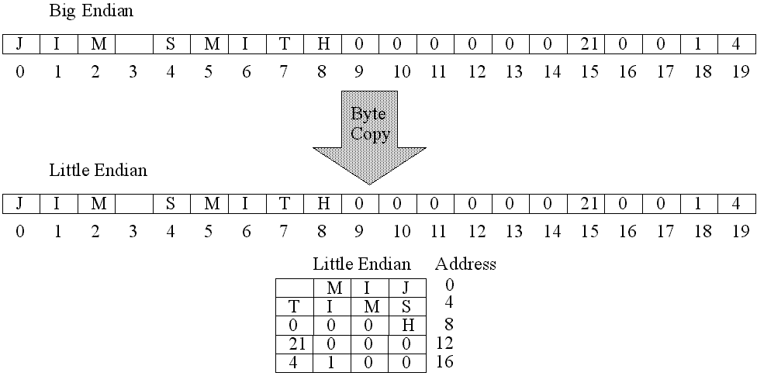

Slide 50
System Calls
Different from user function calls
Unique system call numbers stored in register %eax
Arguments are stored in %ebx, %ecx, %edx…
Invoke system call by “int $0x80”
Check https://syscalls.kernelgrok.com/
Take system call sys_mkdir as example
Sys_mkdir: 0x27 const char __user *pathname int mode
Goal: eax contains 0x27, ebx points to a place contains the directory name, ecx contains mode (which could be 0 here)
You need to complete similar task in MP 1.1.5.

