Slide 1
AppSec Checkpoint 2
CS 461 / ECE 422 Spring 2019
By: Kaishen Wang

Slide 2
Outline
Buffer overflow demo (1.2.1-1.2.3)
1.2.4 Overwriting return address indirectly
1.2.5 Beyond strings
1.2.6 Bypassing DEP
1.2.7 Variable stack position
1.2.8 Linked list exploit
1.2.9 ROP
1.2.10 Callback shell
1.2.11 Format string attack (Medium, but at the end!)

Slide 3
Buffer overflow demo
overwrite variables
overwrite return address

Slide 4
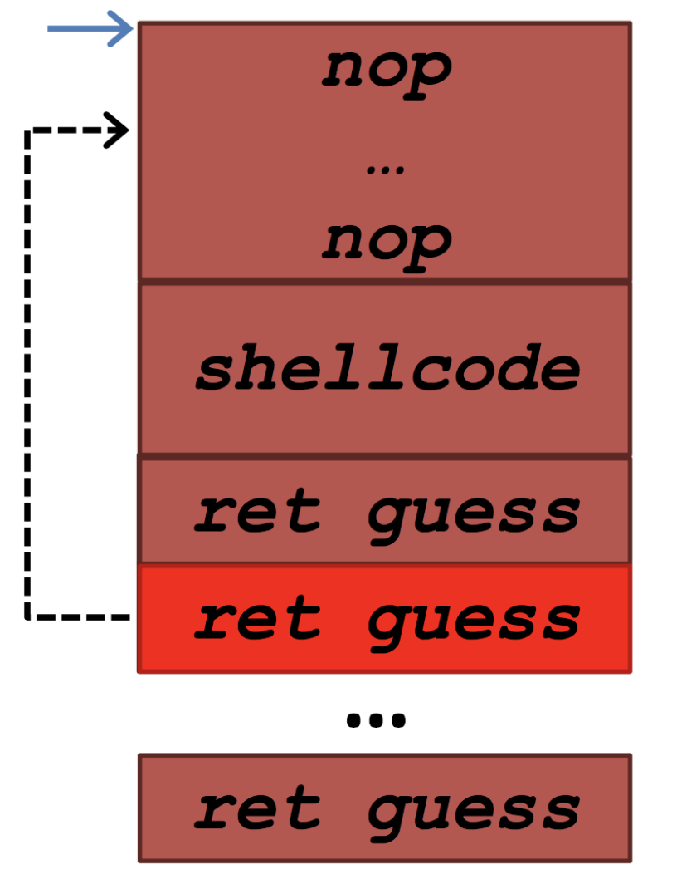
1.2.7 Variable Stack Position
Before randomization: return to specific address (injected code)
What if I don’t know the address ?
How do we deal with this uncertainty (as discussed in lecture)?
Notes:
NOP (No-OPeration) is an instruction available in most architectures that does nothing, other than occupying memory and some runtime.
Stack randomization and other runtime differences may make the address where the program will jump impossible to predict, so the attacker places a NOP sled in a big range of memory. If the program jumps to anywhere into the sled, it will run all the remaining NOPs, doing nothing, and then will run the payload code, just next to the sled.
The reason the attacker uses the NOP sled is to make the target address bigger: the code can jump anywhere in the sled, instead of exactly at the beginning of the injected cod

Slide 5
1.2.8 Linked List Exploit
We will use an example that can help you complete the assignment

Slide 6
﻿typedef struct node {
struct node *next;
} Node;
add_lineage(Node* grandparent, Node* parent, Node*child){
grandparent->next = parent;
grandparent->next->next = child;
}
main(){
node* a = create_node()
node* b = create_node();
node* c = create_node();
add_lineage(a,b,c);
}
How do you write 0xdeadbeef into address 0xbffe1234?
Hint: change b and c arguments to add_lineage
Low memory address
…
…
0xbffe1234
Notes:
Ask students to focus on the add_lineage function

Slide 7
﻿typedef struct node {
struct node *next;
} Node;
add_lineage(Node* grandparent, Node* parent, Node*child){
grandparent->next = parent;
grandparent->next->next = child;
}
main(){
node* a = create_node()
node* b = create_node();
node* c = create_node();
add_lineage(a,b,c);
}
How do you write 0xdeadbeef into address 0xbffe1234?
Hint: change b and c arguments to add_lineage
Low memory address
…
…
0xbffe1234
Notes:
Ask students to focus on the add_lineage function

Slide 8
add_lineage(Node* grandparent, Node* parent, Node*child){
grandparent->next = parent;
grandparent->next->next = child;
}
main(){
add_lineage(a,0xbffe1234,0xdeadbeef);
}
How do you write 0xdeadbeef into address 0xbffe1234?
Low memory address
…
…
0xbffe1234
Notes:
Removed the unnecessary code to focus on the important parts

Slide 9
add_lineage(Node* grandparent, Node* parent, Node*child){
grandparent->next = parent;
grandparent->next->next = child;
}
main(){
add_lineage(a,0xbffe1234,0xdeadbeef);
}
Low memory address
…
…
0xbffe1234

Slide 10
add_lineage(Node* grandparent, Node* parent, Node*child){
grandparent->next = parent;
grandparent->next->next = child;
}
main(){
add_lineage(a,0xbffe1234,0xdeadbeef);
}
Low memory address
…
…
0xbffe1234

Slide 11
add_lineage(Node* grandparent, Node* parent, Node*child){
grandparent->next = parent;
grandparent->next->next = child;
}
main(){
add_lineage(a,0xbffe1234,0xdeadbeef);
}
Low memory address
0xdeadbeef
…
…
0xbffe1234

Slide 12
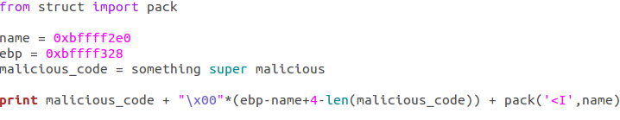
Return-oriented Programming
-Data Execution Prevention(DEP)
Cannot execute code on stack

Slide 13
Review of Sys Call
How to invoke a syscall?
Fulfill sys call number for %eax, and correct arguments in %ebx, %ecx…
Invoke “int $0x80”
Using pieces from library to fulfil %eax, %ebx, %ecx…

Slide 14
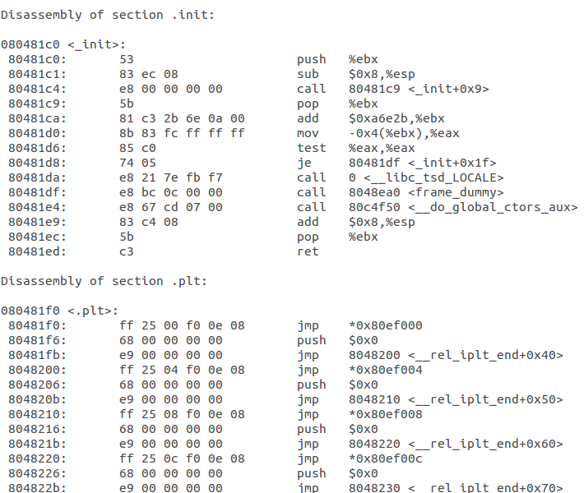
1.2.9 Return-oriented Programming
objdump -d ./program > program.txt
Original Return Address
0x80481ec
value for ebx
Next Gadget

Slide 15


Example
Original Return Address
Goal: make %eax contains 0xdeadbeef
0x8057360
0xdeadbeef(edx)
0xbfff3230(ecx)
0x12341234(ebx)
0x8055064
Next Gadget

Slide 16
1.2.9 Tips
Make sure gadgets have addresses with no null!
Read the paper (given in the handout) to find out different ways to perform a single instruction
Write down the shellcode in assembly first, then for every assembly instruction, find alternatives to it
Example: what gadget allows you to put null into %eax?
Be creative in crafting your ROP!

Slide 17
1.2.9 Tips
Make sure gadgets have addresses with no null!
Read the paper (given in the handout) to find out different ways to perform a single instruction
Write down the shellcode in assembly first, then for every assembly instruction, find alternatives to it
Example: what gadget allows you to put null into %eax?
Be creative in crafting your ROP!
0x80481ec pop %eax
inc %eax
ret
Original Return Address
0x80481ec
0xffffffff
Next Gadget

Slide 18
1.2.10 Callback Shell
Solution is similar to 1.2.4, except that you write your own shellcode – a callback shell
Create a client
Connect it to server
Redirect stdin, stdout and stderr to the connection
Invoke a shell through the connection
Write the code in x86, translate to hex

Slide 19
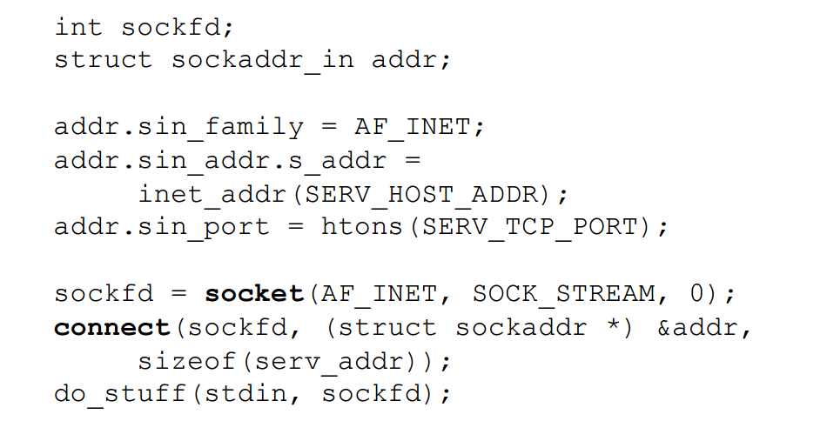
1.2.10 Callback shell
Understand what this is doing:

Slide 20
1.2.11 Format String Attack
Prototype answer: malicious_code + padding + ADDR1 + ADDR2 + “%00000x%00$hn%00000x%00$hn”
Need to find the right numbers
Formats to understand:
%8x – prints 8 characters on the screen (doesn’t matter what the chars are)
%n – writes to memory the number of characters printed
ex: print(“AAAA%n”, &i) what is the value of i ?
4$ – ‘4$’ explicitly addresses the 4th parameter on the stack.
%h – length modifier. Specifies that length is sizeof(short)
%8x%4$hn –
Notes:
%8x%4$hn: if there’s nothing before this statement, %8x will print 8 characters, and %n will write byte 8 into memory. 4$ indicates it will write the value to the 4th parameter on the stack and the length modifier h indicates it will write two byte 0x08 to the 4th parameter on the stack.

Slide 21
1.2.11 Format String Attack
Goal: overwrite return address to point to buf that contains shellcode
Proto-answer: print malicious_code + padding + ADDR1 + ADDR2 + “%00000x%04$hn%00000x%05$hn”
e.g. malicious_code at 0xbfff1234
print total of 0x1234 characters first, write to return address
print total of 0xbfff characters, write to return address+# (think about what the offset is)
Notes:
For more information, the website has a very good explanation

