Slide 1

Adaptive Security for Constrained PRFs
Kaishuo Cheng Joseph Jaeger

Slide 2
High Level Takeaway
Existing Constrained PRF Definitions
Limited Adaptivity
😢
Our Definitions
Full Adaptivity
😊
(Requires Ideal Models)
😢
Notes:
In our paper we consider a special kind of PRF called a constrained PRF. Tit has seen widespread use since being introduce in 2013, but some applications require adaptivity beyond what is captured by the standard definitions. We introduce a new strong definition to bridge this gap and show it is achieved by natural constrained PRF. That said, there’s no free lunch. Our definition inherently requires using an ideal model like the random oracle model

Slide 3



Constrained PRF
$$D$$
Constrain(k, C) = k_{C}
=k
Constrain Set C
=k_{C}
Notes:
A constrained PRF is a special kind of PRF where you can take the root key k that can evaluate the PRF on the whole domain D and create a constrained key k_C that can be used to evaluate only on some subset C.

Slide 4
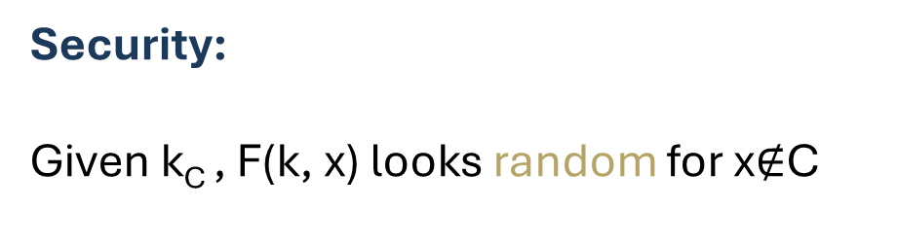
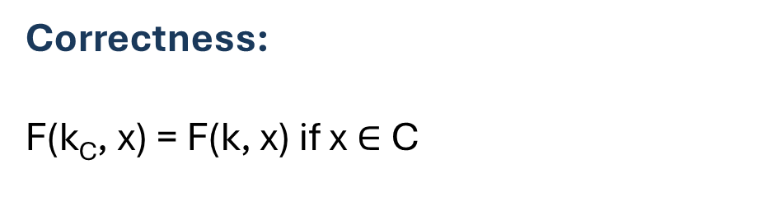
Constrained PRF
$$D$$
Constrain(k, C) = k_{C}
=k
Correctness:
F(k_{C}, x) = F(k, x) if x$∈$ C
Constrain Set C
=k_{C}
Security:
Given k_{C} , F(k, x) looks random for x$∉$C
Notes:
Correctness requires that that the constrained key and original key give the same outputs on any input in C. Intuitively, security says that if x is not in C, evaluating on x should be look random even with knowledge of constrained key k sub c

Slide 5
History
[BW13] | Constrained PRF
[BGI13] | Functional PRF
[KPTZ13] | Delegatable PRF
Notes:
Constrained PRF were independently introduce by three different papers in 2013. They also go by the names functional prf and delagatable prf.

Slide 6
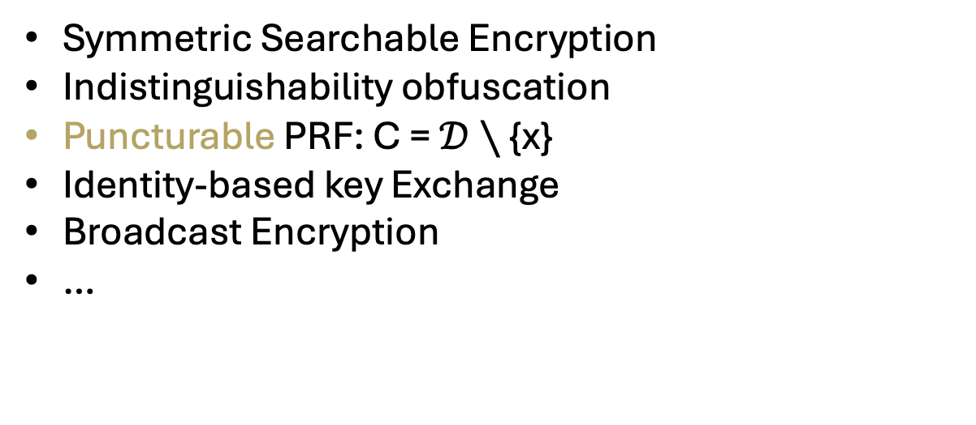
History
[BW13] | Constrained PRF
[BGI13] | Functional PRF
[KPTZ13] | Delegatable PRF
Applications:
Symmetric Searchable Encryption
Indistinguishability obfuscation
Puncturable PRF: C = $𝒟∖$ {x}
Identity-based key Exchange
Broadcast Encryption
…
Notes:
They’ve seen a variable of applications such as blah.
Some of these applications are in the form of a special case known as puncturable PRFs for which the constrained set is all of the domain except a single point.

Slide 7


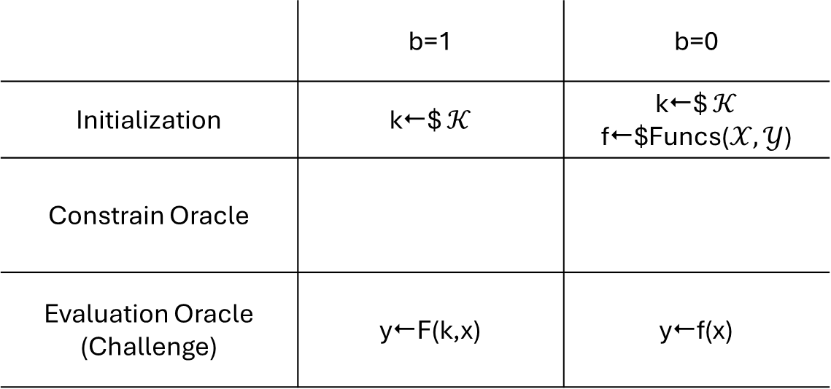
Security Game for CPRF
 | b=1 | b=0
Initialization | k$ $𝒦$ | k$ $𝒦$ f$Funcs($𝒳,𝒴$)
Constrain Oracle
Evaluation Oracle (Challenge) | yF(k,x) | yf(x)
b?
x
y
Notes:
A typical security game for Constrained PRFs involves an initialization phase, constrain oracle, and evaluation, or challenge oracle. Initialization and evaluation are similar to the security game of normal PRF. Depending on the bit sampled by the game, either an actual evaluation value for a random key or a random value is returned

Slide 8
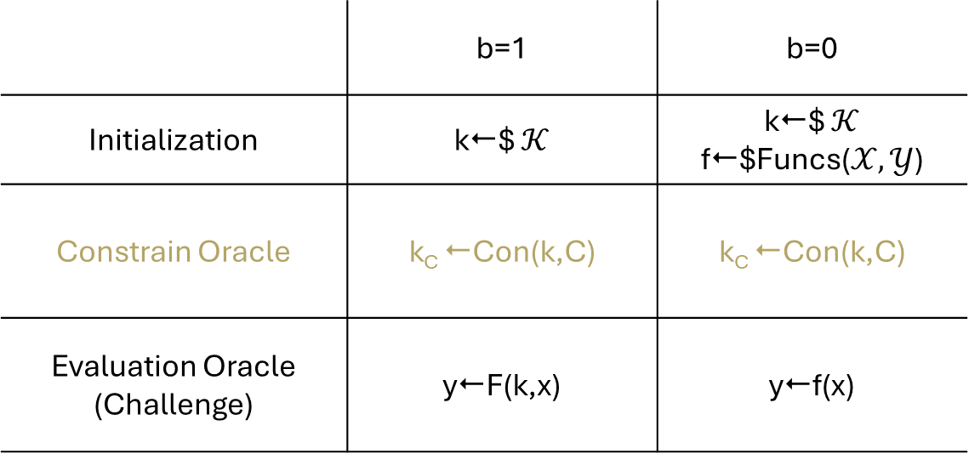
Security Game for CPRF
 | b=1 | b=0
Initialization | k$ $𝒦$ | k$ $𝒦$ f$Funcs($𝒳,𝒴$)
Constrain Oracle | k_{C} Con(k,C) | k_{C} Con(k,C)
Evaluation Oracle (Challenge) | yF(k,x) | yf(x)
b?
C
k_{C}
x
y
Notes:
For the constrain oracle, the adversary species a constrain set C ad the game will always return honestly constrained keys for that set.”

Slide 9
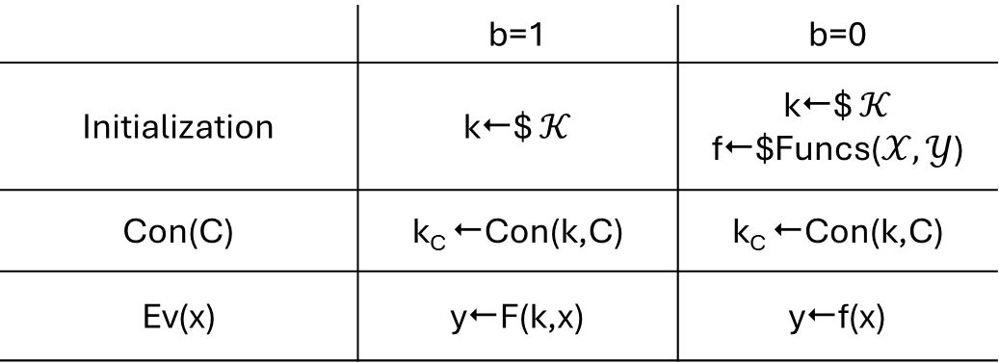
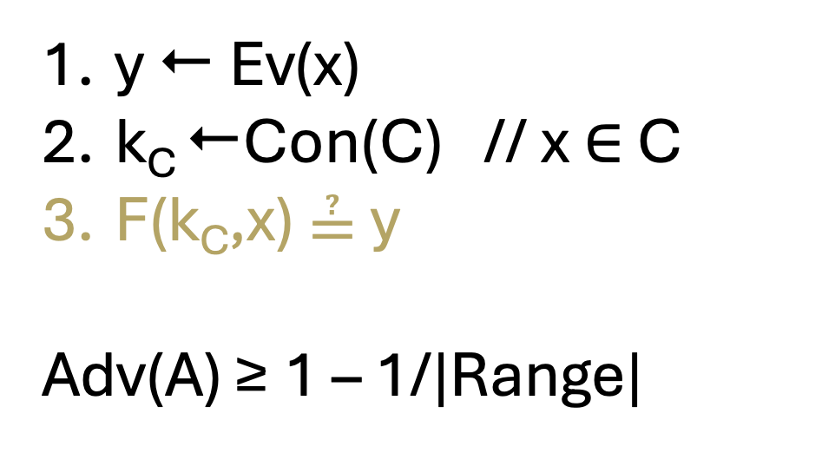
Trivial Attack
 | b=1 | b=0
Initialization | k$ $𝒦$ | k$ $𝒦$ f$Funcs($𝒳,𝒴$)
Con(C) | k_{C} Con(k,C) | k_{C} Con(k,C)
Ev(x) | yF(k,x) | yf(x)
y  Ev(x)
k_{C} Con(C) // x $∈$ C
F(k_{C},x) ≟ y
Adv(A) ≥ 1 – 1/|Range|
Notes:
There is an easy attack to the previous security game, as the attacker can simply query Evaluation query on some input x and gets output y. Later, it picks contrain set C such that x in C, and querys constrain oracle on C, and gets contrained key k sub c. Then, it checks if y equals to evaluate F using k sub c on x. When b=1, probability of equal is 1, while the probability of being equal is negligible when b=0.

Slide 10
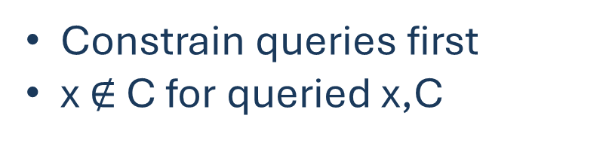
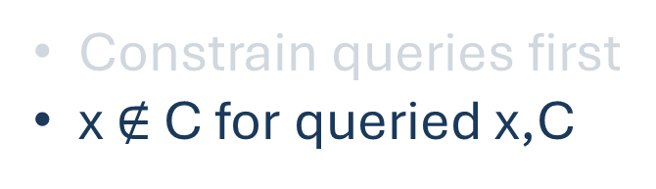
Fixes
Non-Adaptive:
Constrain queries first
x $∉$ C for queried x,C
Adaptive:
Constrain queries first
x $∉$ C for queried x,C
Notes:
In the literature, this is solved by placing restrictions on the adversary, broadly giving two definitions. Non-adaptive security requires that all constrain queries are made before any evaluation queries, then none of the later evaluation queries can be in the constrained sets. Adaptive security loosens these restrictions by allowing attackers to interweave constrain and evaluation queries.

Slide 11
(Commitment) Problem!
Not adaptive enough for some applications in reduction proofs
CPRF game
Real
F
Ideal
x
x
y
y
System
Reduction
Notes:
However, this adaptive definition (which we’ll call partially adaptive) is still not adaptive enough for some applications. Suppose an attacker is interacting with some systems that contains a constrained PRF. We want to do a reduction to switch the PRF to random, by forwarding on queries to the CPRF game.

Slide 12

(Commitment) Problem!
Not adaptive enough for some applications in reduction proofs
x
C
Real
y
k_{C}
Ideal
y  F(k_{C},x)
adversary
reduction
Notes:
The reduction adversary has two options: query constrain on a set C that contains x, and evaluates CPRF on the constrained key.

Slide 13
(Commitment) Problem!
Not adaptive enough for some applications in reduction proofs
x
x
Real
y
y
Ideal
adversary
reduction
Notes:
Or, the reduction adversary can query the evaluation oracle, and gets a response that it does not know whether is real or simulated.

Slide 14
(Commitment) Problem!
Not adaptive enough for some applications in reduction proofs
C
k_{C}
x
y  F(k_{C},x)
Real
y
OR
Ideal
x
adversary
reduction
y
C
?
k_{C}
Notes:
This dilemma boils down to the fact that the reduction adversaries does not know if they are going to later get a constrain key that can evaluate x. Prior work that ran into this avoided the problem by either not doing the analysis or manually using a random oracle on the CPRF output.. We instead tackle the problem head on.

Slide 15
Our Contribution
Fully adaptive definition
Analysis of natural CPRFs
Hashed CPRF
Goldreich-Goldwasser-Micali (GGM) / Cascade PRF
AMAC
Example applications
Searchable Symmetric Encryption (SSE) [BMO17]
Puncturable Key Wrapping (PKW) [BGP22].

Slide 16
Focus of This Talk
Fully adaptive definition
Analysis of natural CPRFs
Hashed CPRF
Goldreich-Goldwasser-Micali (GGM) / Cascade PRF
AMAC
Example applications
Searchable Symmetric Encryption (SSE) [BMO17]
Puncturable Key Wrapping (PKW) [BGP22].

Slide 17

Our Definition is Analogous to SIM-AC[JT20], SIM*-AC [J23]
x_{i}
Ev
F^{P}(k, x_{i})
$$Π$$
Real World
k
Exp
SIM*-AC-PRF
Notes:
Our new definition is analogous to the simulation under adaptive compromise (or SIM*-AC) definition that Jaeger and Tyagi introduce. Let’s consider the SIM*-AC-PRF game. In the real world, the adversary is interacting with an honest PRF scheme pi.

Slide 18
SIM*-AC [J23]
x_{i}
Ev
F^{P}(k, x_{i})
$$Π$$
Real World
k
Exp
SIM*-AC-PRF
x_{i}
Ev
$_{i}
S
Ideal World
S^{P}(x₁, $₁ , x₂, $₂ ,…)
Exp
Notes:
In the ideal world, responses to evaluation are random. Then on exposures, a simulator is told the inputs and outputs of prior queries and picks the key to return, trying to make it consistent with these.

Slide 19


SIM*-AC [J23]
x_{i}
Ev
F^{P}(k, x_{i})
$$Π$$
Real World
k
Exp
Ls
$y ←$ P($x$)
P
Primitive
$$(x,y)$$
Prog
SIM*-AC-PRF
x_{i}
Ev
$_{i}
S
Ideal World
S^{P}(x₁, $₁ , x₂, $₂ ,…)
Exp
Notes:
This would be impossible in the standard model, so the definition must use an programmable ideal primitive like the random oracle model. We model the primitive as having two interfaces: a lazy samplying interfact that on input x returns P(x) and a programming interface that on input (x,y) defines P(x)=y. The simulator can query this programming interface to make its chosen key to be consistent with prior queries. For composability purposes, we also let the adversary query this interface (that way it can, for example, internally run programming simulators).

Slide 20
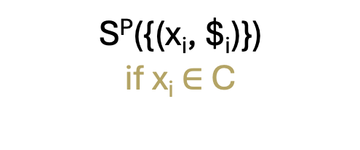
Our Definition: SIM*-AC-CPRF
x_{i}
Ev
F^{P}(k, x_{i})
$$Π$$
C
Real World
k_{C}
Con
x_{i}
Ev
If x_{i} is never constrained: $_{i}
Otherwise: S^{P}(x_{i})
Ideal World
S
Ls
P
C
Con
Prog
S^{P}({(x_{i}, $_{i})})
if x_{i} $∈$ C
Notes:
Our SIM*-AC-CPRF definition is similar. For evaluation query, if x is never constrained, a random value is returned. Otherwise, the simulator will pick the returned value with knowledge of x_i. For constrain queries, the simulator will return the constrained key after being told inputs and outputs of prior query that is in the constrained set C.

Slide 21

Our Definition: SIM*-AC-CPRF
x_{i}
Ev
F^{P}(k, x_{i})
$$Π$$
No Restrictions
on Queries!
Real World
C
k_{C}
Con
x_{i}
Ev
If x_{i} is never constrained: $_{i}
Otherwise: S^{P}(x_{i})
Ideal World
S
Ls
P
C
Con
Prog
S^{P}({(x_{i}, $_{i})})
if x_{i} $∈$ C
Notes:
It is important to stress that, our definition places no restrictions on queries, unlike prior definitions.

Slide 22
Focus of This Talk
Fully adaptive definition
Analysis of natural CPRFs
Hashed CPRF
Goldreich-Goldwasser-Micali (GGM) / Cascade PRF
AMAC
Example applications
Searchable Symmetric Encryption (SSE) [BMO17]
Puncturable Key Wrapping (PKW) [BGP22].
Notes:
Now let’s see how we use the new definition to analyze GGM,

Slide 23
Construction [GGM84]
k_{ε}
PRG
Constrained
Keys
k₀
k₁
PRG
PRG
k₀₀
k₀₁
k₁₀
k₁₁
Notes:
GGM PRF which uses a length doubling PRG to create a tree of keys, where the leaf nodes are the output of the PRF. Any internal keys can act as constrained keys, able to recover all keys under them.

Slide 24
Construction [GGM84]
[BW13]
[BGI13]
[KPTZ13]
k_{ε}
Nonadaptive Security:
PRG
Constrained
Keys
k₀
k₁
PRG
PRG
(Partially)
Adaptive Security:
[HKK23]
k₀₀
k₀₁
k₁₀
k₁₁
Notes:
The original constrained PRF papers observed this is nonadaptively secure. Adaptive security was much harder. It was recently proven using an elegant rewinding argument by Hofheinz et al in 2023.

Slide 25
Generalization Cascade [BCK96]
x₁
x₂
x_{n}
k_{ε}
f
k_{x1}
f
k_{x1x2}
f
k_{x1..xn}
Notes:
“For our analysis, we found it easier to actually work with a generalization called the Cascade PRF which iterates a PRF on one input block at a time. These intermediate keys can act as constrained keys. GGM is captured by viewing a PRG as a PRF whose domain is a single bit.

Slide 26
Generalization Cascade [BCK96]
x₁
x₂
x_{n}
k_{ε}
f
k_{x1}
f
k_{x1x2}
f
k_{x1..xn}
[BCK96]
f is PRF => Cascade is PRF
Our Work
f is SIM*-PRF => Cascade is SIM*-CPRF
Notes:
Bellare, et al showed that PRF security follows from that of the inner PRF. We show that our adaptive CPRF security of cascade follows from SIM* security of the PRF”

Slide 27
Prove via Composition
f
f
f
f
CPRF
CPRF
Notes:
We found trying to do the proof all in one go quite messy, so we take a structured approach by noticing that we can really draw a line anywhere in the middle to divide this into a CPRF whose output is fed as a key to a second CPRF.

Slide 28
Prove via Composition
f
f
f
f
CPRF
CPRF
CPRF
CPRF
CPRF
CPRF
Notes:
Then similarly, either of these CPRFs can be subdivided into further CPRFs. So, by a hybrid argument, we only need to understand the composition of two CPRFs

Slide 29
General Composed Construction
x
y
CPRF₁
CPRF₂
k_{ε}
k_{x}
k_{xy}
Notes:
We call this the composed construction. Once we’re looking just at this, the ideal behind the proof is straightforward. <>We want to switch the first

Slide 30
General Composed Construction
x
y
CPRF₁
CPRF₂
k_{ε}
k_{x}
k_{xy}
x
y
Sim₁
CPRF₂
k_{ε}
k_{x}
k_{xy}
Notes:
then the second<> constrained PRF to be random with simulated constraints. <>

Slide 31
General Composed Construction
x
y
CPRF₁
CPRF₂
k_{ε}
k_{x}
k_{xy}
x
y
Sim₁
CPRF₂
k_{ε}
k_{x}
k_{xy}
x
y
Sim₁
Sim₂
k_{ε}
k_{x}
k_{xy}

Slide 32

General Composed Construction
x
y
CPRF₁
CPRF₂
k_{ε}
k_{x}
k_{xy}
x
y
Sim₁
CPRF₂
k_{ε}
k_{x}
k_{xy}
x
y
Sim₁ evaluation
or Sim₂?
Sim₁
Sim₂
k_{ε}
k_{xy}
Notes:
This does oversimplify slightly, because there is some subtletly with this in between value which is an output of the first CPRF and an input of the second. Careful bookkeeping is needed to determine at any particular point which simulator should choose that value

Slide 33
GGM
PRF -> Nonadaptive CPRF
SIM*-PRF -> SIM*-CPRF
Similar Proof
Similar Bound
PRF -> (Partially)
Adaptive CPRF
Harder Proof
Worse Bound
Notes:
This raises an idea that we thought was philosophically interesting. Our analysis is conceptually similar and provides an analogous concrete security bound to the non-adaptive analysis of GGM (though start from a stronger assumption). The in between partially adaptive security proof was much harder and provided a worse bound.

Slide 34
Worse Bound is due to Limited Proof Techniques
rather than its true security?
GGM
PRF -> Nonadaptive CPRF
SIM*-PRF -> SIM*-CPRF
Similar Proof
Similar Bound
PRF -> (Partially)
Adaptive CPRF
Harder Proof
Worse Bound
Notes:
To us, this indicates that the worse bound is perhaps an artifact of our knowledge of how to write proofs, rather than a true reflection of its level of security.

Slide 35
Worse Bound is due to Limited Proof Techniques
rather than its true security
GGM
Our Composition
PRF -> Nonadaptive CPRF
SIM*-PRF -> SIM*-CPRF
Similar Proof
Similar Bound
Nonadaptive CPRF
SIM*-CPRF
😢
No proof
PRF -> (Partially)
Adaptive CPRF
Harder Proof
Worse Bound
✗
(Partially)
Adaptive CPRF
Notes:
In terms of our proof flow, the underlying distinction is that constrained PRFs compose nicely for non-adaptive security or our definition, but we couldn’t write a similar result for partially adaptive security

Slide 36
Focus of This Talk
Fully adaptive definition
Analysis of natural CPRFs
Hashed CPRF
Goldreich-Goldwasser-Micali (GGM) / Cascade PRF
AMAC
Example applications
Searchable Symmetric Encryption (SSE) [BMO17]
Puncturable Key Wrapping (PKW) [BGP22].
Notes:
Ok, we have discussed how to analyze GGM using our definition. To see the usefulness of our definition, let’s consider a SSE scheme.

Slide 37



Searchable Symmetric Encryption
Query
Query Token
Secret key
Response
Client
Server
Notes:
In a SSE scheme, there are two parties, client and server. The client holds a secret key, and server holds encrypted files. The client can perform queries to the server by sending an encrypted query token, and the server will reply with a response

Slide 38
Searchable Symmetric Encryption
Query
Query Token
(w,ind)
Keyword | Doc_id
Privacy | 1
Crypto | 1, 2, 3
Secret key
Response
Client
Server
Notes:
To facilitate search, the server will also store the keyword to document id table. The keywords and document ids needs to be encrypted.

Slide 39
Searchable Symmetric Encryption [BMO17]
Search(w)
(ind₁, ind₂,…)
Client
Server
Update(w, ind₃)
Notes:
Diana proposed by Bost et al provides a search query and a update query. Update allows the client to insert a document id associated a keyword, and search returns all document ids associated with a keyword.

Slide 40
Searchable Symmetric Encryption [BMO17]
I
I have seen this
keyword before…
Search(w)
(ind₁, ind₂,…)
Client
Server
Update(w, ind₃)
Notes:
If the client first searches keyword w, later trying to update another document associated with the same keyword w. We want to prevent the server from breaking secrecy of newly inserted information.

Slide 41
Searchable Symmetric Encryption [BMO17]
I
✗
Forward Secure
I have seen this
keyword before…
Search(w)
(ind₁, ind₂,…)
Client
✗
Server
Update(w, ind₃)
Notes:
Schemes that prevent such attacks are considered forward secure.

Slide 42
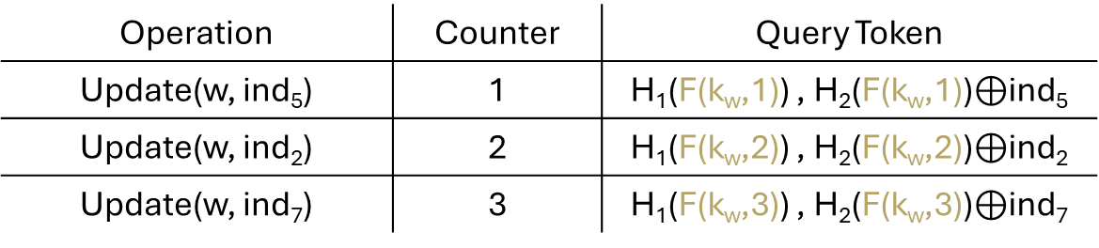
Searchable Symmetric Encryption [BMO17]
Client:
Generate unique key k_{w} for each keyword w
Operation | Counter | Query Token
Update(w, ind₅) | 1 | H₁(F(k_{w},1)) , H₂(F(k_{w},1))$⊕$ind₅
Update(w, ind₂) | 2 | H₁(F(k_{w},2)) , H₂(F(k_{w},2))$⊕$ind₂
Update(w, ind₇) | 3 | H₁(F(k_{w},3)) , H₂(F(k_{w},3))$⊕$ind₇
F is a constrained PRF, and H_{1,} H₂ are hash functions
Notes:
Let’s take a close look at Bost et al ‘s construction. Here, F is a constrained PRF, and H1, H2 are two hash functions. The client generates a unique key k_w for every keyword w. The client will keep a counter indicating how many documents the current keyword is associated with.
The client will evaluate the constrained prf using k_w and counter, using it as a key to encrypt the index. The final result are hashed and returned.

Slide 43
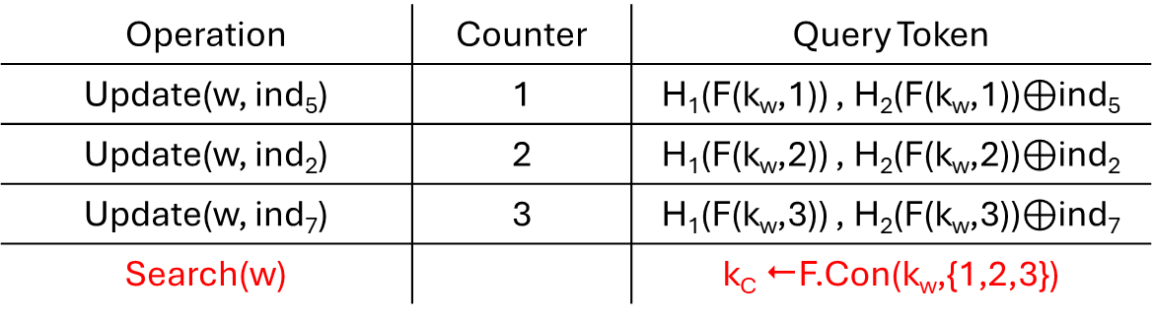
Searchable Symmetric Encryption [BMO17]
Client:
Generate unique key k_{w} for each keyword w
Operation | Counter | Query Token
Update(w, ind₅) | 1 | H₁(F(k_{w},1)) , H₂(F(k_{w},1))$⊕$ind₅
Update(w, ind₂) | 2 | H₁(F(k_{w},2)) , H₂(F(k_{w},2))$⊕$ind₂
Update(w, ind₇) | 3 | H₁(F(k_{w},3)) , H₂(F(k_{w},3))$⊕$ind₇
Search(w) |  | k_{C} F.Con(k_{w},{1,2,3})
F is a constrained PRF, and H_{1,} H₂ are hash functions
Notes:
When the client wants to perform a search operation on keyword w, it simply returns constrained key on the a set that contains all counters so far.

Slide 44

Searchable Symmetric Encryption [BMO17]
Client:
Generate unique key k_{w} for each keyword w
Operation | Counter | Query Token
Update(w, ind₅) | 1 | H₁(F(k_{w},1)) , H₂(F(k_{w},1))$⊕$ind₅
Update(w, ind₂) | 2 | H₁(F(k_{w},2)) , H₂(F(k_{w},2))$⊕$ind₂
Update(w, ind₇) | 3 | H₁(F(k_{w},3)) , H₂(F(k_{w},3))$⊕$ind₇
Search(w) |  | k_{C} F.Con(k_{w},{1,2,3})
Server can then extract
ind₅ , ind₂ , ind₇ using k_{C}
F is a constrained PRF, and H_{1,} H₂ are hash functions
Notes:
The server can then use k_c to extract ind5, 2, 7 and send back to client.

Slide 45
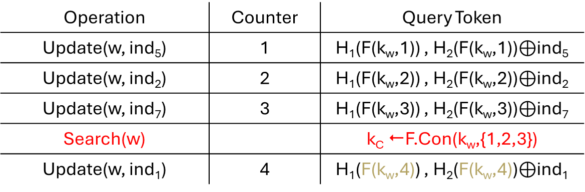
Searchable Symmetric Encryption [BMO17]
Client:
Generate unique key k_{w} for each keyword w
Operation | Counter | Query Token
Update(w, ind₅) | 1 | H₁(F(k_{w},1)) , H₂(F(k_{w},1))$⊕$ind₅
Update(w, ind₂) | 2 | H₁(F(k_{w},2)) , H₂(F(k_{w},2))$⊕$ind₂
Update(w, ind₇) | 3 | H₁(F(k_{w},3)) , H₂(F(k_{w},3))$⊕$ind₇
Search(w) |  | k_{C} F.Con(k_{w},{1,2,3})
Update(w, ind₁) | 4 | H₁(F(k_{w},4)) , H₂(F(k_{w},4))$⊕$ind₁
F is a constrained PRF, and H_{1,} H₂ are hash functions
Notes:
Now, suppose the client wants to perform another update operation on keyword w, forward secure requires the update token looks random.

Slide 46
Searchable Symmetric Encryption [BMO17]
I
Client:
[BMO17] proved H₁(F(k_{w},4)) and H₂(F(k_{w},4)) are random with knowledge k_{C}
Generate unique key k_{w} for each keyword w
Operation | Counter | Query Token
Update(w, ind₅) | 1 | H₁(F(k_{w},1)) , H₂(F(k_{w},1))$⊕$ind₅
Update(w, ind₂) | 2 | H₁(F(k_{w},2)) , H₂(F(k_{w},2))$⊕$ind₂
Update(w, ind₇) | 3 | H₁(F(k_{w},3)) , H₂(F(k_{w},3))$⊕$ind₇
Search(w) |  | k_{C} F.Con(k_{w},{1,2,3})
Update(w, ind₁) | 4 | H₁(F(k_{w},4)) , H₂(F(k_{w},4))$⊕$ind₁
F is a constrained PRF, and H_{1,} H₂ are hash functions
Notes:
Bost et al proved the update token is random by assuming hash functions are random oracles.

Slide 47
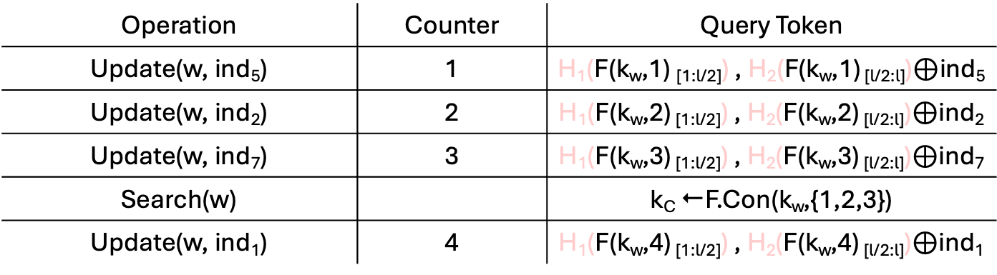
Searchable Symmetric Encryption [BMO17]
Client:
Generate unique key k_{w} for each keyword w
Operation | Counter | Query Token
Update(w, ind₅) | 1 | H₁(F(k_{w},1) _{[1:l/2]}) , H₂(F(k_{w},1) _{[l/2:l]})$⊕$ind₅
Update(w, ind₂) | 2 | H₁(F(k_{w},2) _{[1:l/2]}) , H₂(F(k_{w},2) _{[l/2:l]})$⊕$ind₂
Update(w, ind₇) | 3 | H₁(F(k_{w},3) _{[1:l/2]}) , H₂(F(k_{w},3) _{[l/2:l]})$⊕$ind₇
Search(w) |  | k_{C} F.Con(k_{w},{1,2,3})
Update(w, ind₁) | 4 | H₁(F(k_{w},4) _{[1:l/2]}) , H₂(F(k_{w},4) _{[l/2:l]})$⊕$ind₁
CPRF is enough for security!
✗
F is a constrained PRF, and H_{1,} H₂ are hash functions
with output length l
Notes:
However, you might wonder if the hash functions are necessary. What if one directly use a longer output from F. Basically, in the proof a simulator runs into the sort of commitment problem we discussed before. It has to simulate query tokens before knowing what they contain. Then it has to later pick a constrained key that looks consistent. Bost, et al achieved this having H1 and H2 be programmable random oracle.However, our definition for constrained PRFs directly allows this sort of simulation so we can directly prove security just by using outputs of F if it achieves our definition

Slide 48

What goes into rest of the paper:
Fully adaptive definition
Analysis of natural CPRFs
Hashed CPRF
Goldreich-Goldwasser-Micali (GGM) / Cascade PRF
AMAC
Example applications
Searchable Symmetric Encryption (SSE) [BMO17]
Puncturable Key Wrapping (PKW) [BGP22].
We will upload our paper to eprint soon.

