Slide 1
Autoencoder on Walk
2020/2/6

Slide 2
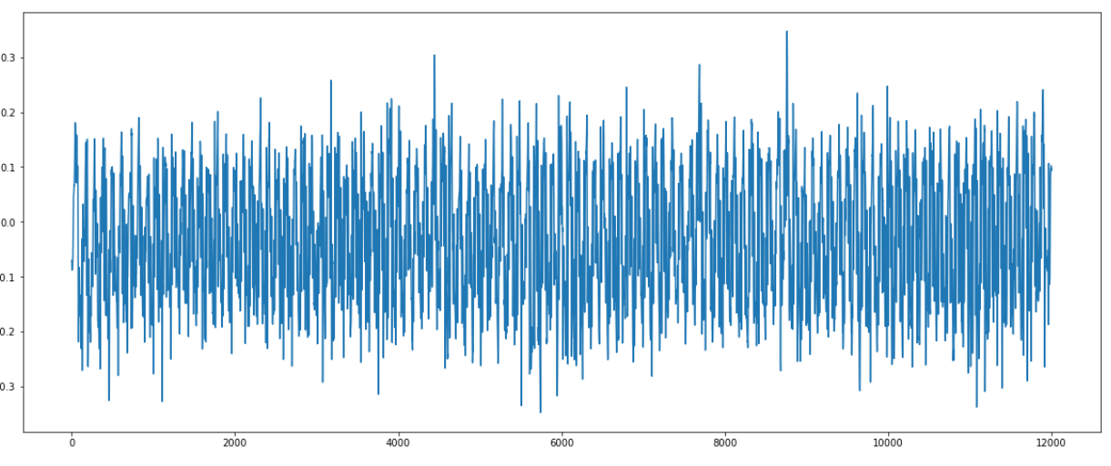
Data
Time points: 12000
Time windows(Input Features):250
Total samples:48 (shuffle=false)
Train samples:36
Test samples:12

Slide 3
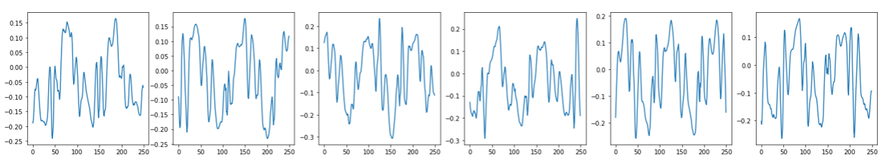
Test samples time window=250

Slide 4
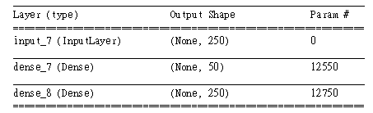
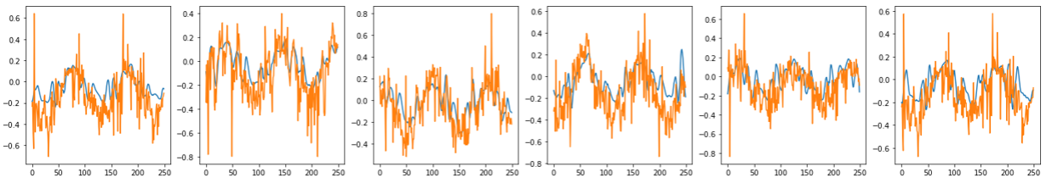
Feed-Forward AN

Slide 5
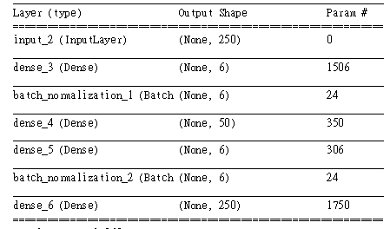
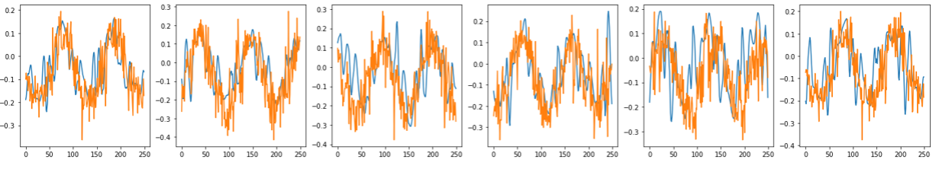
Deep AN

Slide 6
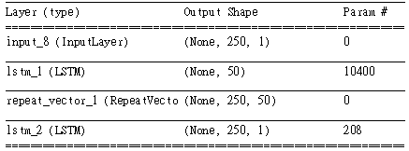
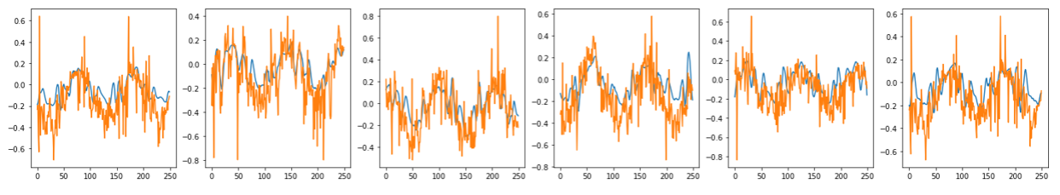
LSTM AN

Slide 7
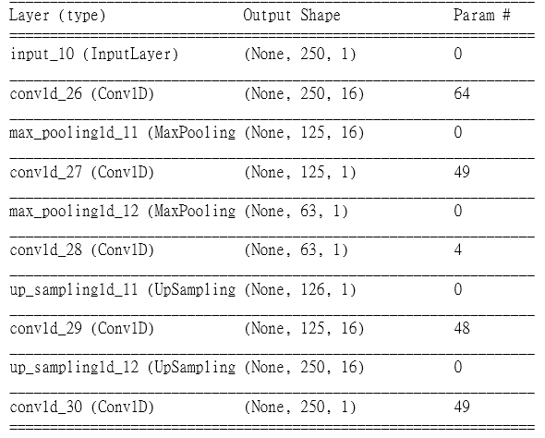
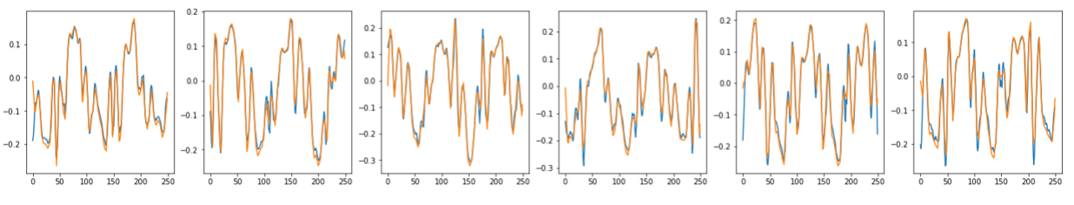
Convolutional AN

Slide 8
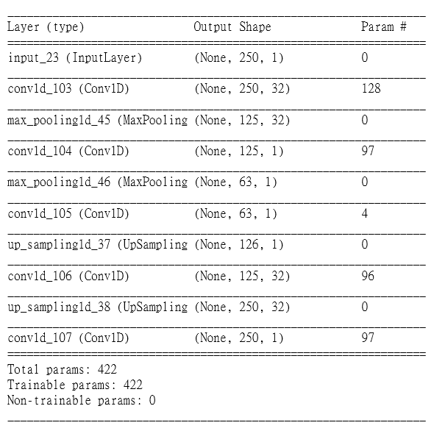
Chosen Model
Training for 1000 epochs on batch size=15
Optimization=adam, loss=binary cross entropy
Encoder: 2 Convolutional layers and 2 Maxpoolings
32 filters and kernel size=2
1 filter and kernel size=3
Padding=same for each layer
Activation function=tanh∈ [-1,1]

Slide 9
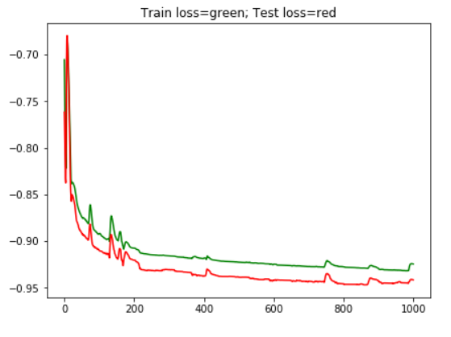
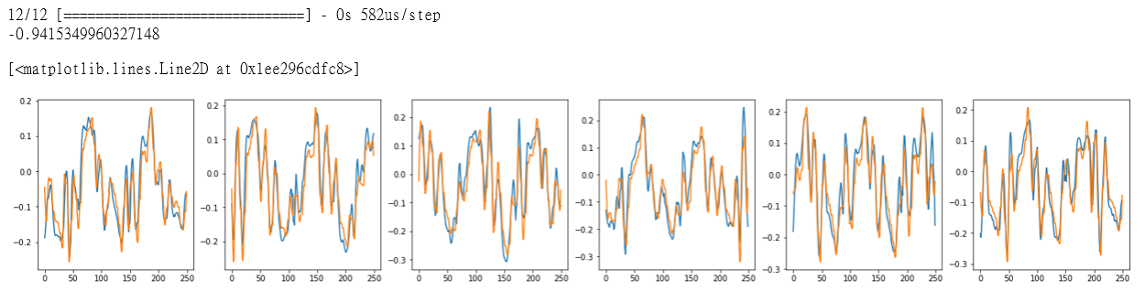
Decoding outcome

Slide 10
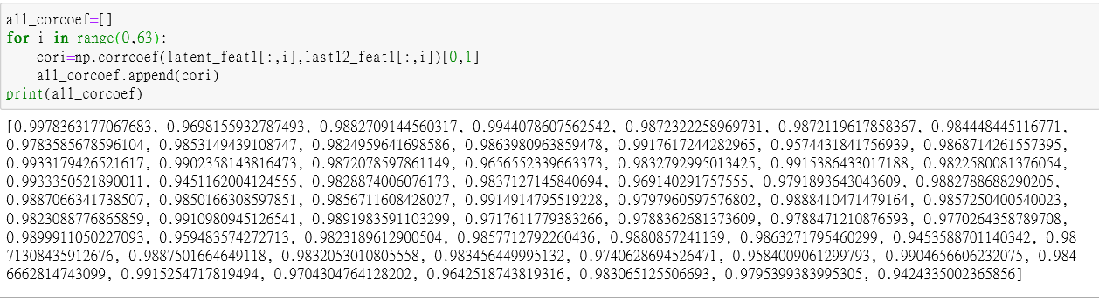
Correlation Coefficient
After choosing the model, The 63 correlation coefficients of features in the trained encoder between test data and all data are shown bellow. And all of them are highly correlated, showing it can statically apply the model furtherly to 48 windows and other patients.

