Slide 1

Welcome !
2018 Spring CS101 Introduction to Programming

Slide 2
Week 2
Programming with robots (Conditional expressions, While loops)

Slide 3
Useful resources

Slide 4

You’re alone in your dorm room trying to study…
and stuck…
How do I use random function?

Slide 5


Slide 6
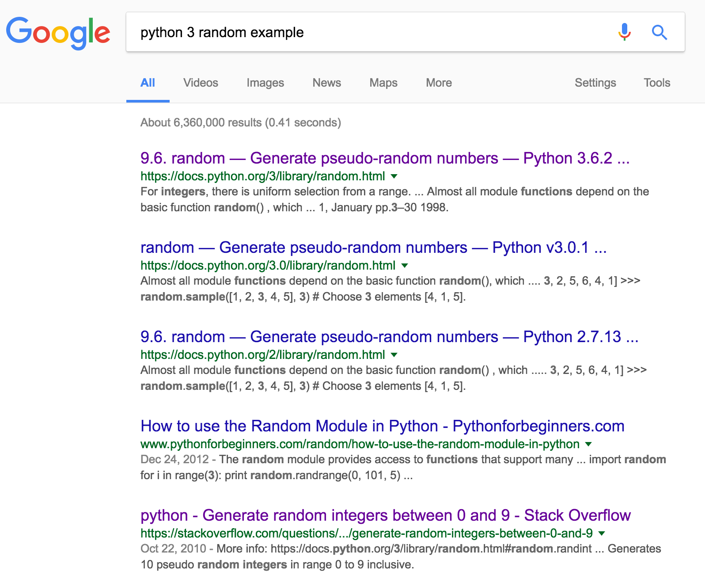

Slide 8
http://docs.python.org/3/...
These two websites are usually good signs!
http://stackoverflow.com/...

Slide 9
Useful resources
http://docs.python.org/3/
“the official python 3 documents”
http://stackoverflow.com/
“most beloved Q&A website in computer science”

Slide 10
A quick review

Slide 11
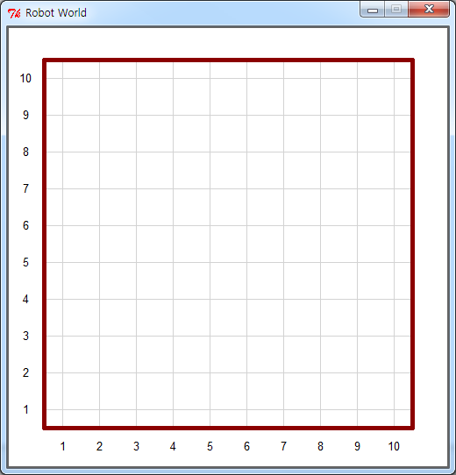
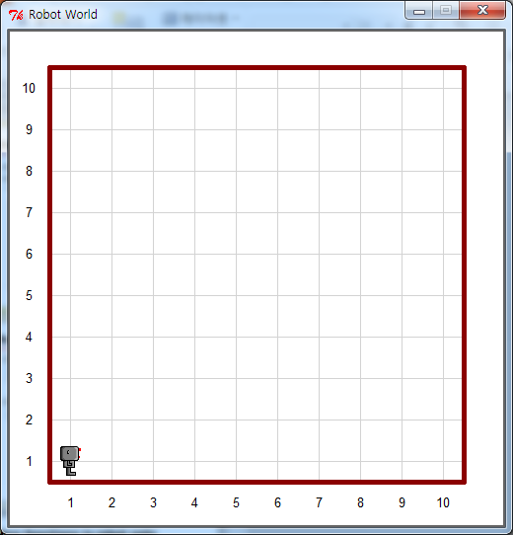
Functions we’ve seen
Creating a new world
Before creating a world, remember to import necessary modules
Then,
Create a robot named ‘hubo’
Create a default robot
Create a robot with 10 beepers
from cs1robots import *
create_world()
hubo = Robot()
hubo = Robot(beepers = 10)
Notes:
‹#›

Slide 12
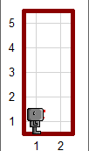
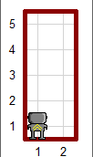
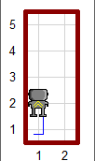
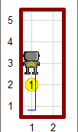

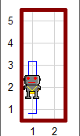
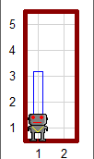
Functions we’ve seen
Drop a beeper
Pick a beeper
Before picking up a beeper, hubo should be on a beeper!
hubo.turn_left()
hubo.move()
hubo.drop_beeper()
hubo.move()
for i in range(2):
hubo.turn_left()
hubo.move()
hubo.pick_beeper()
hubo.move()
Notes:
‹#›

Slide 13
New functions !!

Slide 14
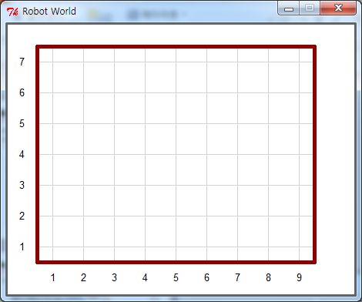
New functions
Create a custom world
‘streets’ for the number of rows
‘avenues’ for the number of columns
create_world(streets = 7, avenues = 9)
Notes:
‹#›

Slide 15
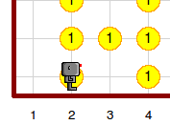
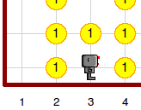
New functions
Can check if there is a beeper
hubo.on_beeper()
hubo.on_beeper() == True
hubo.on_beeper() == False
Notes:
‹#›

Slide 16
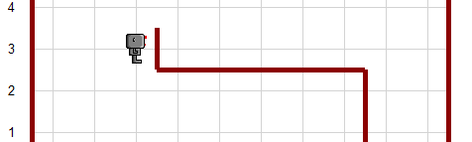
New functions
Can check if there is a wall on each of the three sides
hubo.front_is_clear()
hubo.left_is_clear()
hubo.right_is_clear()
hubo.left_is_clear() ==
True
hubo.front_is_clear() ==
False
hubo.right_is_clear() ==
True
Notes:
‹#›

Slide 17
If statements
If statements sequentially checks the conditionals
if conditional_expression_1:
works to do when conditional_expression_1 evaluates to True
elif conditional_expression_2:
works to do when conditional_expression_1 evaluates to False & conditional_expression_2 evaluates to True
elif conditional_expression_3:
works to do when conditional_expression_1 evaluates to False & conditional_expression_2 evaluates to False & conditional_expression_3 evaluates to True
…
else:
works to do when all the above conditions are False
Notes:
‹#›

Slide 18
While loops
while statement loops until the conditional evaluates to true
Be careful!
while conditional_expression:
works to do while conditional_expression evaluates to True
Iamlying = False
while (Iamlying == False) :
print (“cs101 is so much fun”)
Iamlying = True
Notes:
‹#›

Slide 19
Week 2 Today’s Tasks

Slide 20
Tasks for Today!
Read sections 10~13 in the robot notes
Five not so simple tasks
Harvest More (page 6)
Plant (page 7)
Smart Hurdles (page 8 & 9)
Harvest Even More (page 10)
Smart ZigZag (page 10)
When you have completed all the tasks, let a TA mark you off

Slide 21
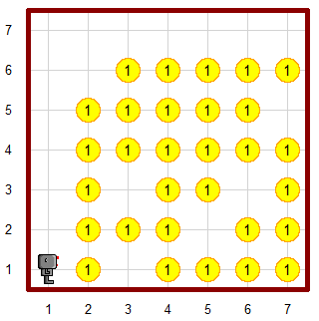
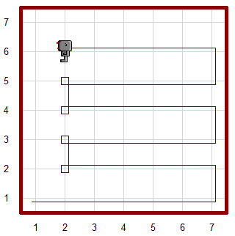
Task 1 | Conditionals – Harvest More
Modify your program from the ‘Harvest Again’ task (Week 01) so that it works for harvest3.wld load_world(“worlds/harvest3.wld”)
Before
After

Slide 22
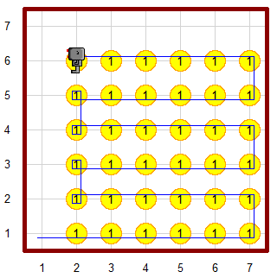
Task 2 | Conditionals – Plant
Write a program so that Hubo plants beepers in empty spots
The finished screen should look like “harvest1.wld” load_world(“worlds/harvest3.wld”)
Before
After

Slide 23
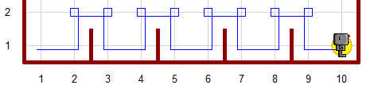
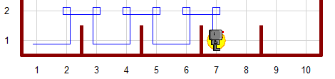
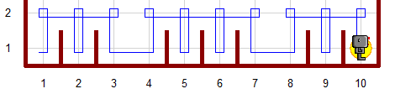
Task 3 | Conditionals – Smart Hurdles
Write jump_one_hurdle() in section 11
move_jump_or_finish() should be able to handle all three maps, “hurdles1.wld”, “hurdles2.wld” and “hurdles3.wld”. Check it yourself.
Write a new program (similar to Hurdles3 in section 11) that uses a while loop. DO NOT USE a for-loop of fixed length
It should also work for all three hurdles
hurdles1.wld
hurdles2.wld
hurdles3.wld

Slide 24

Task 4 | While loop – Harvest Even More
Modify Harvest More task
It should work even when there are more than one beeper on a spot (“harvest4.wld”)
It should also work for the previous worlds (“harvest1.wld” and “harvest3.wld”)
Have to harvest all carrots on one place

Slide 25
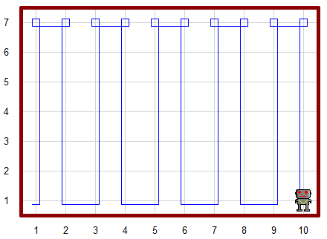
Task 5 | While loop – Smart ZigZag
Rewrite ZigZag program (Week 01) so that the robot can visit every spot in an empty world of any size in zigzag fashion
It should work for even and odd numbers of streets and avenues
m (streets, number of rows)
n (avenues, # of columns)
m and n can be any integer except for m=1 or n=1
Notes:
phising
‹#›

Slide 26
questions?

