Slide 1

Welcome !
2018 Spring CS101 Introduction to Programming

Slide 2
Week 5
Create graphical display (Practice objects and basic data types)

Slide 3
Pair programming

Slide 4
Pair Programming
Pair Programming is a software development technique in which two programmers work together at one work station
One types in code while the other reviews each line of code as it is typed in
Members
The person typing the code is called the driver
The person reviewing the code is called the navigator
Pair programming has as lot of benefits!
http://en.wikipedia.org/wiki/Pair_programming
In CS101, we do pair programming on 5, 6, 9 and 10 Lab week
Notes:
4

Slide 5
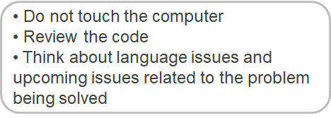
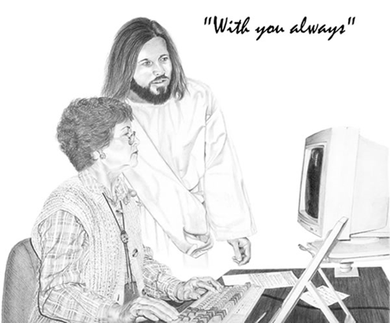
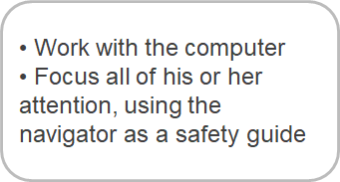
Pair Programming
The two programmers should switch roles every 20 minutes in CS101 class
Navigator
Driver

Slide 6
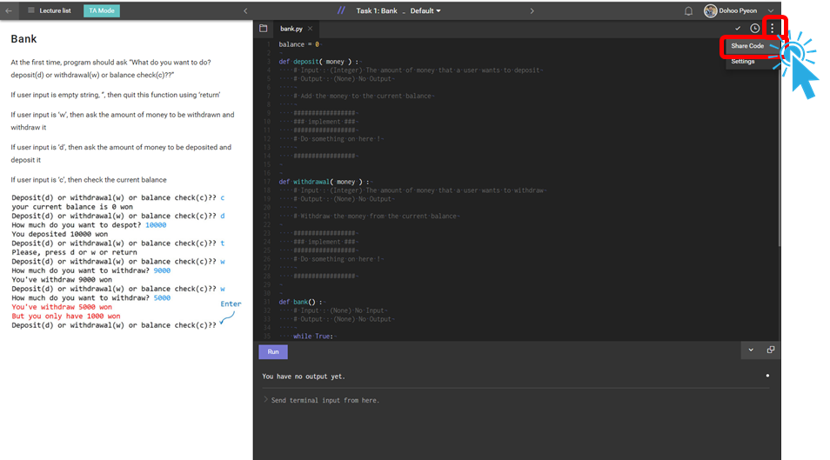
Pair Programming Setup Steps (1)

Slide 7
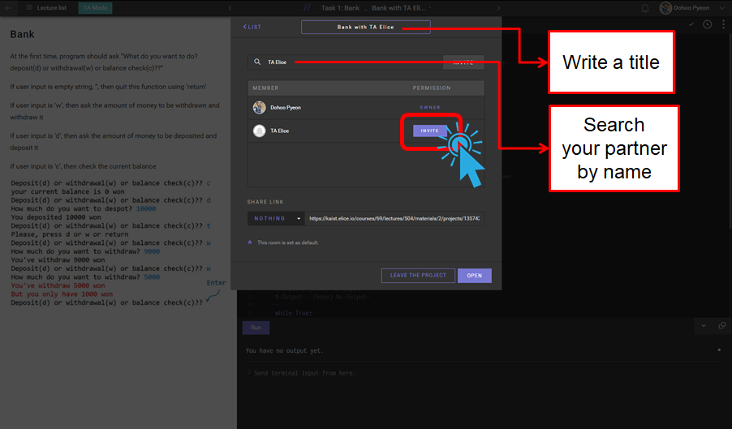
Pair Programming Setup Steps (2)

Slide 8
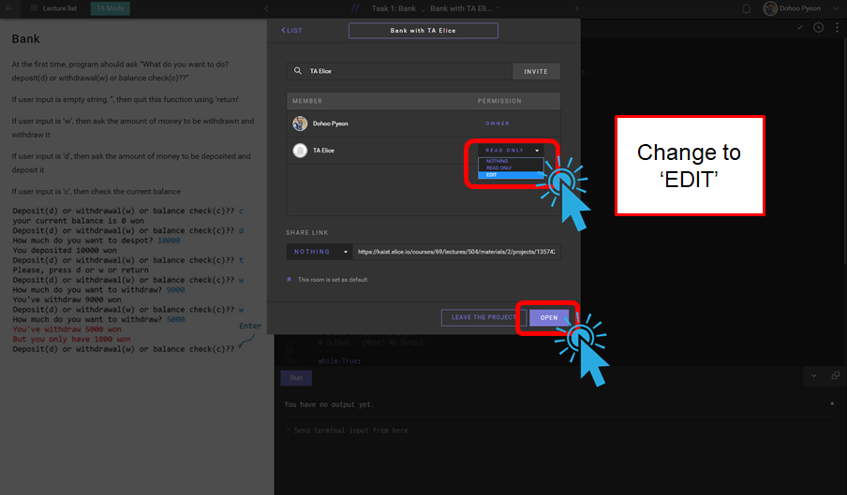
Pair Programming Setup Steps (3)

Slide 9
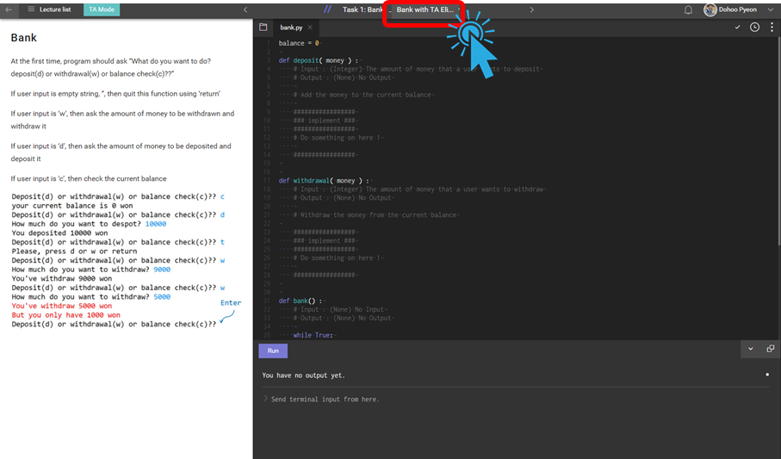
Pair Programming Setup Steps (4)

Slide 10
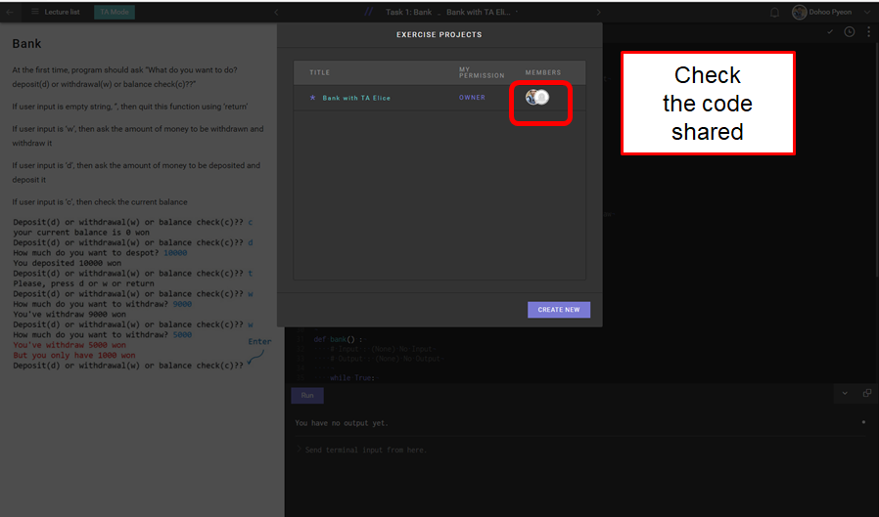
Pair Programming Setup Steps (5)

Slide 11
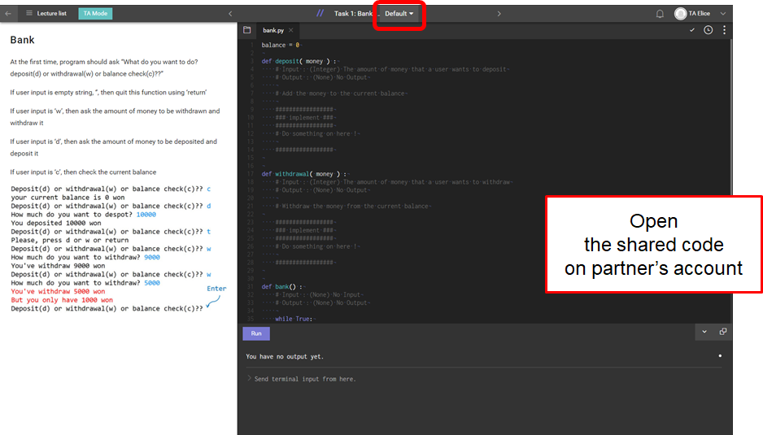
Pair Programming Setup Steps (6)

Slide 12
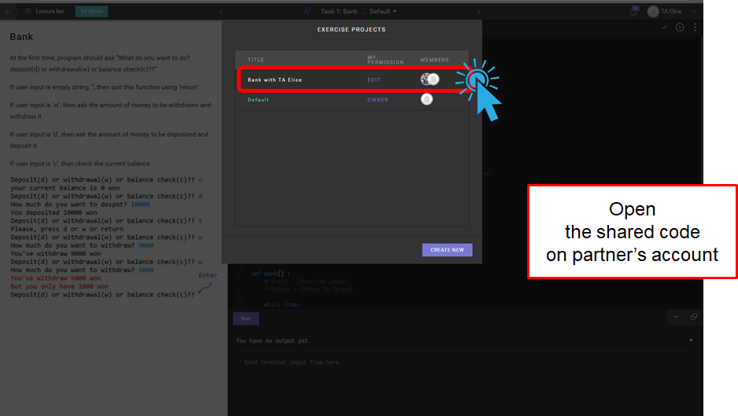
Pair Programming Setup Steps (7)

Slide 13
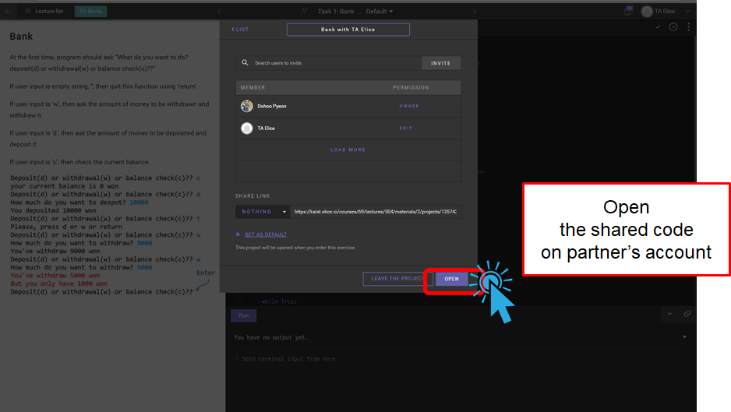
Pair Programming Setup Steps (8)

Slide 14
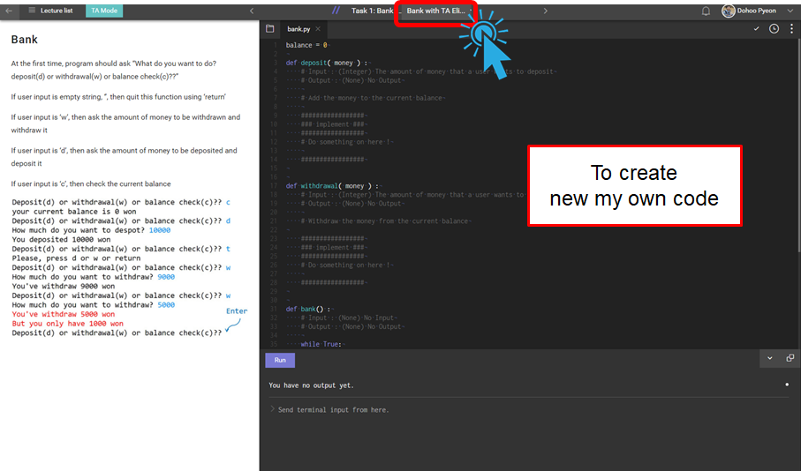
Pair Programming Setup Steps (9)

Slide 15
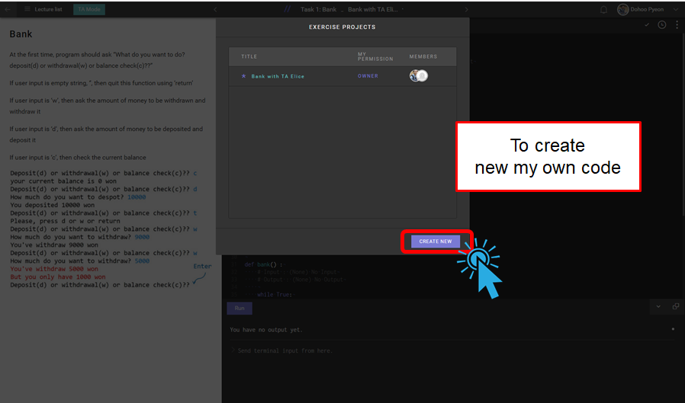
Pair Programming Setup Steps (10)

Slide 16
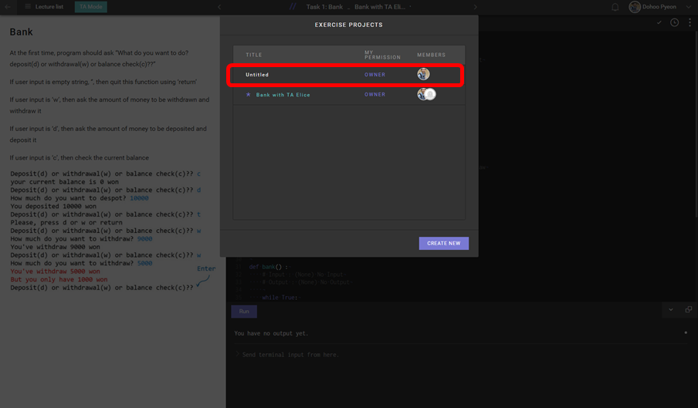
Pair Programming Setup Steps (11)

Slide 17
Week 5 Today’s Tasks

Slide 18
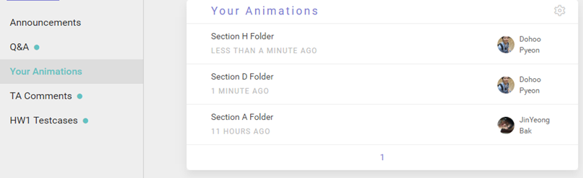
Tasks for Today!
Bank
Help!
>> help(‘print’)
Animation
After you finish, upload your file through the links on the “Your Animation” in elice

Slide 19
Task 1 | Bank
Complete ‘bank.py’
Implement functions deposit and withdrawal that change the global variable balance
def deposit:
balance = balance + money
def withdrawal
balance = balance - money
If you don’t have sufficient money, then print the amount of money that can withdraw
Implement a function bank
It first asks
“Deposit(d) or withdrawal(w) or balance check(c)??”
If user input is empty string, ‘’, then quit this function using ‘return’
If user input is ‘w’, then ask the amount of money to be withdrawn and withdraw it
If user input is ‘d’, then ask the amount of money to be deposited and deposit it
If user input is ‘c’, then check the current balance

Slide 20
Task 1 | Bank - Example
Deposit(d) or withdrawal(w) or balance check(c)?? c
Your current balance is 0 won
Deposit(d) or withdrawal(w) or balance check(c)?? d
How much do you want to deposit? 10000
You deposited 10000 won
Deposit(d) or withdrawal(w) or balance check(c)?? t
Please, press d or w or return
Deposit(d) or withdrawal(w) or balance check(c)?? w
How much do you want to withdraw? 9000
You've withdraw 9000 won
Deposit(d) or withdrawal(w) or balance check(c)?? w
How much do you want to withdraw? 5000
You've withdrawn 5000 won
But you only have 1000 won
Deposit(d) or withdrawal(w) or balance check(c)??

Slide 21
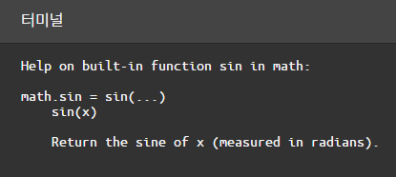
Task 2 | Help
There are hundreds of pre-defined functions.
How can programmer remember everything?
It’s impossible. We can ask for help!
Function help()
Try help(‘print’)
Try help(‘math.sin’)

Slide 22
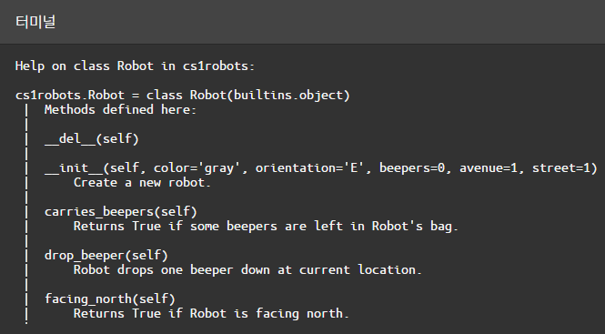
Task 2 | Help
We can also use ‘help function’ for special modules.
Try!
cs1robots
help(‘cs1robots’)
help(‘cs1robots.Robot’)
help(‘cs1robots.Robot.turn_left’)
help(‘cs1robots.create_world’)
cs1graphics
help(‘cs1graphics.Ellipse’)
help(‘cs1graphics.Color’)
help(‘cs1graphics.Text’)
help(‘cs1graphics.Square.rotate’)

Slide 23
Task 3 | Animation
Implement a function ‘draw_animal’ that draws an animal of your choice.
Your animal should be drawn on a layer
You must be able to move the entire animal by only moving the layer.
The animal must also have some moving parts, such as legs, wings, or flippers.
Write functions to change the position of these moving parts.
Write a function ‘show_animation’ that shows an animation of your animal.
It should move around and its moving parts should be moving.
You can choose others if it has some moving parts.
Ex) Cartoon character, Car, Airplane

Slide 24

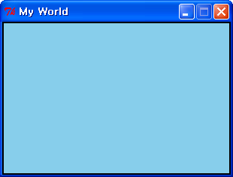
Task 3 | Graphical Display (1/4) - Animation
Canvas
A window upon which we draw
from cs1graphics import*
from time import*
paper = Canvas()
paper.setBackgroundColor('skyBlue')
paper.setWidth(300)
paper.setHeight(200)
paper.setTitle('My World')
paper = Canvas(300, 200, 'skyBlue', 'My World')

Slide 25
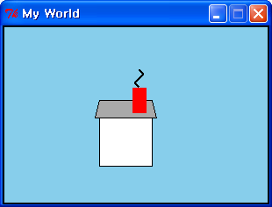
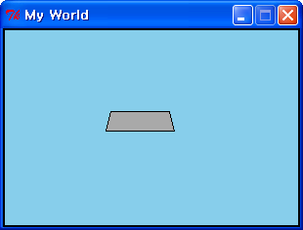
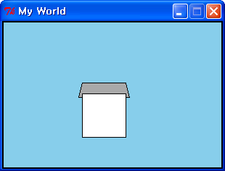
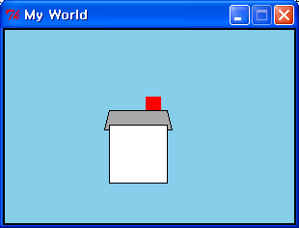

Task 3 | Graphical Display (2/4) - Animation
Drawable objects
Polygon, Square, Rectangle, Path
Depth b/w drawable objects ( Default. 50 )
roof = Polygon(Point(105, 105), Point(175, 105), Point(170, 85), Point(110, 85))
roof.setFillColor('darkgray')
roof.setDepth(30) # in front of façade
paper.add(roof)
facade = Square(60, Point(140, 130))
facade.setFillColor('white')
paper.add(façade)
chimney = Rectangle(15, 28, Point(155, 85))
chimney.setFillColor('red')
chimney.setBorderColor('red‘)
chimney.setDepth(20) # in front of roof
paper.add(chimney)
smoke = Path(Point(155, 70), Point(150, 65),
Point(160, 55), Point(155, 50))
smoke.setBorderWidth(2)
paper.add(smoke)

Slide 26
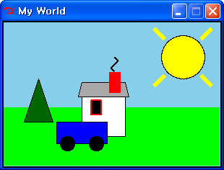
Task 3 | Graphical Display (3/4) - Animation
Layer
Group a collection of other elements as a single composite object
(e.g.) A car in the world
car = Layer()
tire1 = Circle(10, Point(-20, -10))
tire1.setFillColor('black')
car.add(tire1)
tire2 = Circle(10, Point(20, -10))
tire2.setFillColor('black')
car.add(tire2)
body = Rectangle(70, 30, Point(0, -25))
body.setFillColor('blue')
body.setDepth(60) # behind the tires
car.add(body)
car.moveTo(110, 180)
car.setDepth(20) # in front of the house
paper.add(car)

Slide 27
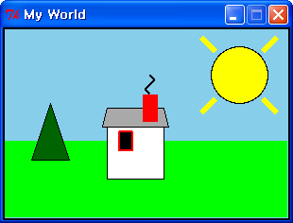
Task 3 | Graphical Display (4/4) - Animation
Animation
Give some moves to objects
(e.g.) Running car in the world
paper.add(car)
timeDelay = 5
sleep(timeDelay)
car.move(-10, 0)
sleep(timeDelay)
car.move(-30, 0)
sleep(timeDelay)
car.move(-60, 0)
sleep(timeDelay)
car.move(-100, 0)
sleep(timeDelay)

Slide 28
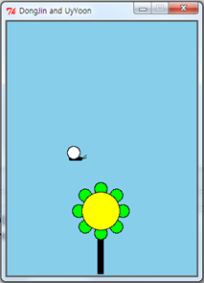
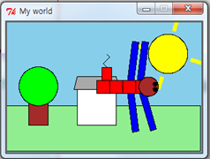
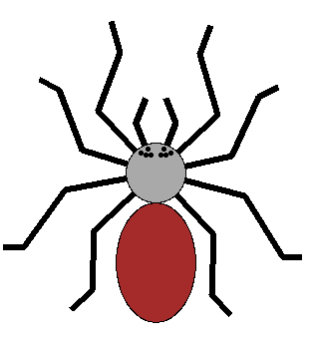
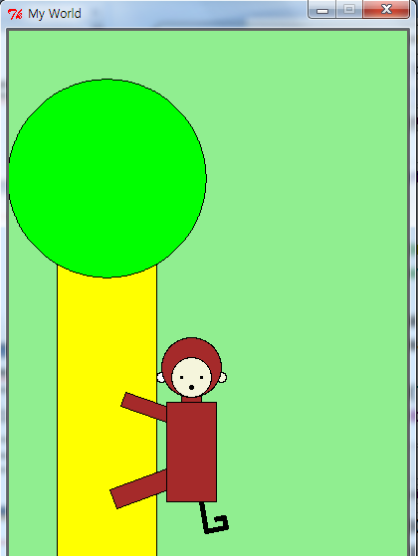
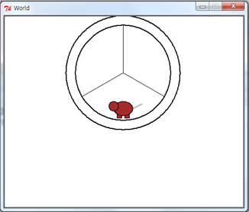
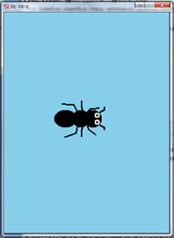
Task 3 | Example - Animation

Slide 29

Tips
Use ‘cs1graphics’ module and ‘time’ module.
After you choose an animal, simplify it and decide moving parts.
When you decide moving parts, think about the functions you can use.
Not Recommended:
Make more than 2 animals ( If you have a lot of time, it will be okay. )
Choose an animal which it is hard to simplify
Ex) Hedgehog ( 고슴도치 ), Specific person or job ( a figure skater )
Implement too simple thing.

Slide 30
Useful cs1grphics functions
Objects
Canvas, Layer
Circle, Ellipse, Square, Rectangle, Polygon, Path, Text, …
Object methods
Color
setBorderColor, setFillColor
Move
move, moveTo
Depth
setDepth
Others
rotate, scale, flip
Reference Point
getReferencePoint, adjustReference

Slide 31
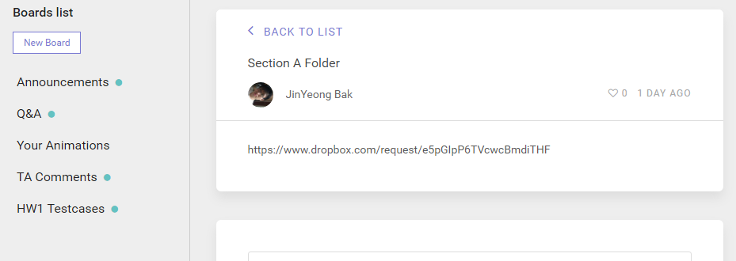

Task 3 | Animation
After you finish, upload your animation
Save your animation to text file (*.py)
Change the file name as
StudentID1_StudentName1, StudentID2_Studentname2.py
Follow the upload link on the “Your Animations” board

Slide 32
Be Creative!

Slide 33
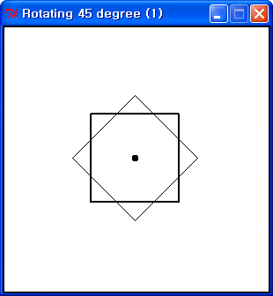
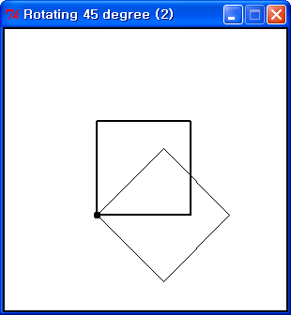
Additional Graphical Display (1/5)
Operations on drawable objects (1)
Rotating
from cs1graphics import *
width = 300
height = 300
paper = Canvas(width, height, 'white', 'Rotating’)
square1 = Square(100, Point(width/2, height/2))
square1.setFillColor('transparent')
square1.setBorderWidth(2)
paper.add(square1)
square2 = square1.clone()
square2.rotate(45)
square2.setDepth(40)
square2.setBorderWidth(1)
paper.add(square2)
square1.adjustReference(-50, 50)
square2 = square1.clone()
square2.rotate(45)
The default reference point for a square(rectangle, circle) is its center.

Slide 34
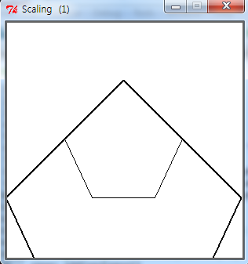
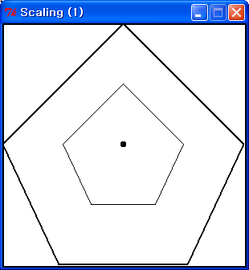
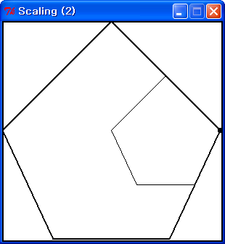
Additional Graphical Display (2/5)
Operations on drawable objects (2)
Scaling
from cs1graphics import *
width = 300
height = 300
paper = Canvas(width, height, 'white', 'Scaling (1)')
pentagon1 = Polygon(Point(width/2, height/4),
Point(width/4, height/2), Point(width/2-40,
height*3/4), Point(width/2+40, height*3/4),
Point(width*3/4, height/2))
pentagon1.adjustReference(0, height/4)
paper.add(pentagon1)
pentagon2 = pentagon1.clone()
pentagon2.scale(2)
paper.add(pentagon2)
pentagon1.adjustReference(width/4, 0)
pentagon2 = pentagon1.clone()
pentagon2.scale(2)
pentagon1.move(width/4, 0)
pentagon2.move(width/4, 0)
The default reference point for a polygon is initially aligned with the first point of the polygon.

Slide 35
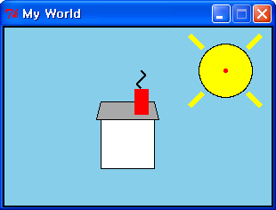
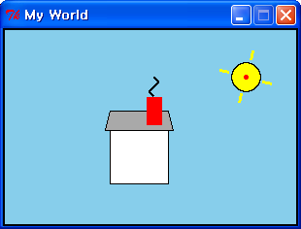
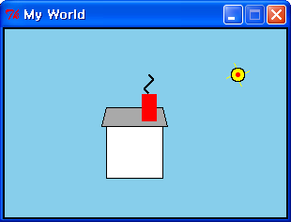

Additional Graphical Display (3/5)
How to make rotating and shrinking sun?
Rotating and Scaling
i = 0
while 0 < sun.getRadius():
if (i % 2) == 0 :
sunraySW.scale(1.1)
sunraySE.scale(1.1)
sunrayNE.scale(1.1)
sunrayNW.scale(1.1)
sun.scale(1.1)
else :
sunraySW.scale(0.9)
sunraySE.scale(0.9)
sunrayNE.scale(0.9)
sunrayNW.scale(0.9)
sun.scale(0.9)
sunraySW.rotate(30)
sunraySE.rotate(30)
sunrayNE.rotate(30)
sunrayNW.rotate(30)
i += 1
sleep(.05)
from time import sleep

Slide 36
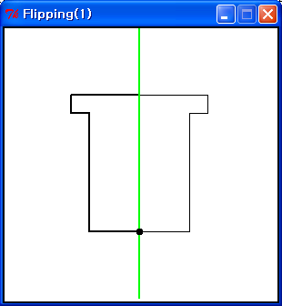
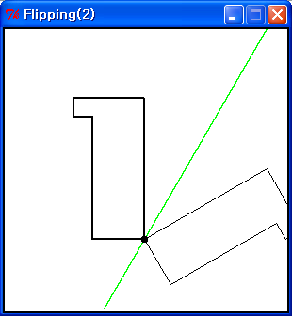
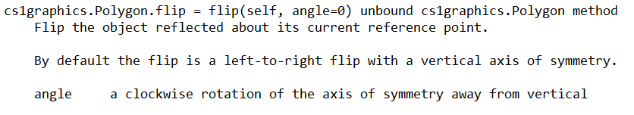
Additional Graphical Display (4/5)
Operations on drawable objects (3)
Flipping
width = 300
height = 300
paper = Canvas(width, height, 'white', 'Flipping(1)')
flag1 = Polygon(Point(width/2, height*3/4),
Point(width/2, height/4), Point(width/4, height/4),
Point(width/4, height/4+20), Point(width/4+20,
height/4+20), Point(width/4+20, height*3/4))
paper.add(flag1)
flag2 = flag1.clone()
flag2.flip()
paper.add(flag2)
flag2.flip(30)

Slide 37



Additional Graphical Display (5/5)
How to avoid finding the exact geometry of each ray?
Cloning and Flipping
These
two
sunraySW = Path(Point(225, 75), Point(210, 90))
sunraySW.setBorderColor('yellow')
sunraySW.setBorderWidth(6)
paper.add(sunraySW)
# Add the sunraySE by using Cloning and Flipping
sunRefPt = sun.getReferencePoint()
sunraySWRefPt = sunraySW.getReferencePoint()
diffX = sunRefPt.getX() - sunraySWRefPt.getX()
diffY = sunRefPt.getY() - sunraySWRefPt.getY()
sunraySW.adjustReference(diffX, diffY)
sunraySE = sunraySW.clone()
sunraySE.flip()
paper.add(sunraySE)
Let’s finish the rest of two !!!
(sunrayNE and sunrayNW)
(Hint1) Clone the sunraySE rather than sunraySW
(Hint2) Use flip function with degree
(e.g.) flip(90)

Slide 38
questions?

