Slide 1

Welcome !
2018 Spring CS101 Introduction to Programming

Slide 2
Week 6
Sequence (Lists, Strings, and Tuples)

Slide 3
Week 6 Today’s Tasks

Slide 4
Tasks for Today!
Tasks
Fibonacci number
Drawing integers
Memento game
Tip: How to get the information

Slide 5
Task 1 | Fibonacci Number
For your information, refer this definition of Fibonacci number
http://en.wikipedia.org/wiki/Fibonacci_number
Using while-loop, you should fill a list with these Fibonacci numbers which are less than 1000
Printed result of the list
We recommend you to start with two initial values, 0 and 1.
>>> [evaluate fibonacci.py] [0, 1, 1, 2, 3, 5, 8, 13, 21, 34, 55, 89, 144, 233, 377, 610, 987] >>>

Slide 6
Task 2 | Drawing Integers
drawing_integers(lb, ub, trials)
Goal: Make a list of random integers
Parameters
Range of the integers: lb <= the integers <= ub
Length of the integers: trials
Return: an integers list.
Ex) [1, 4, 3, 5, 2]
Hint: Use randint function in the random module
average_integers(num_list)
Goal: Compute the average of the integer sequence in the list
Parameter: a list which is returned from drawing_integers
Return: average value of the list

Slide 7
Task 2 | Drawing Integers
count_integers(num_list)
Goal: Count the frequency of the integers in the list
Parameter: a list which is returned from drawing_integers
Return: A list of tuples that are the integer and its frequency
Ex) [(1, 2), (2, 3), (3, 0), (4, 2)] for [4,1,2,2,4,2,1]

Slide 8
Task 2 | Drawing Integers - Example
list1 = drawing_integers(1, 6, 20) print(list1) print(average_integers(list1)) print(count_integers(list1)) print() list2 = drawing_integers(5, 12, 15) print(list2) print(average_integers(list2)) print(count_integers(list2))
Code
[6, 1, 6, 4, 5, 1, 4, 1, 1, 5, 3, 2, 3, 4, 5, 5, 5, 6, 6, 1] 3.7 [(1, 5), (2, 1), (3, 2), (4, 3), (5, 5), (6, 4)] [11, 11, 11, 8, 10, 9, 6, 5, 5, 10, 12, 6, 9, 9, 11] 8.86666666667 [(5, 2), (6, 2), (7, 0), (8, 1), (9, 3), (10, 2), (11, 4), (12, 1)]
Result

Slide 9
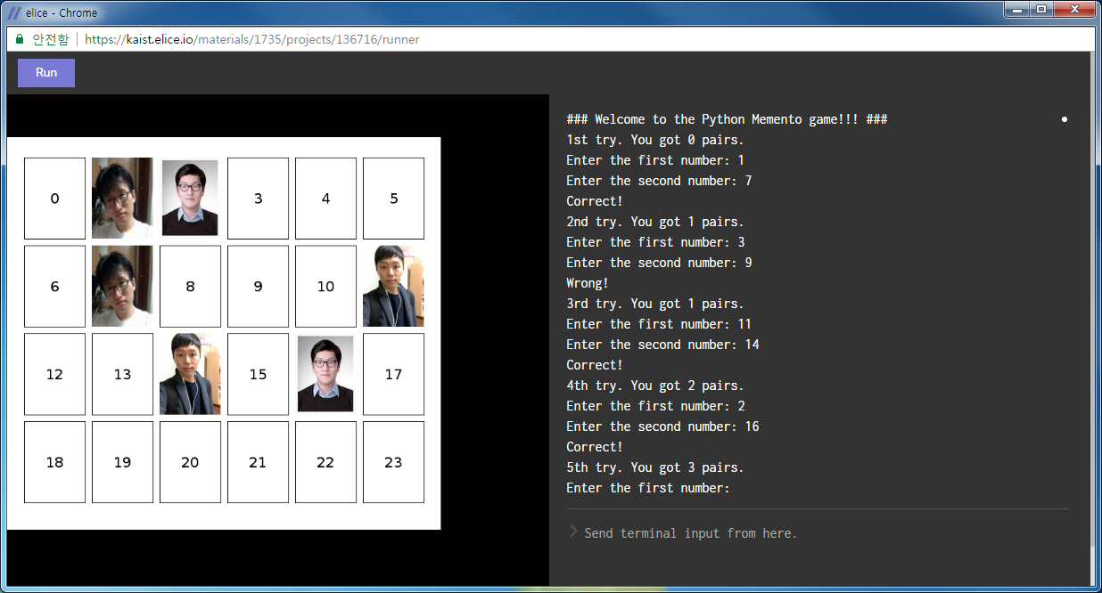
Task 3 | Memento Game
Today we’ll implement a Memory test game, “Memento”

Slide 10
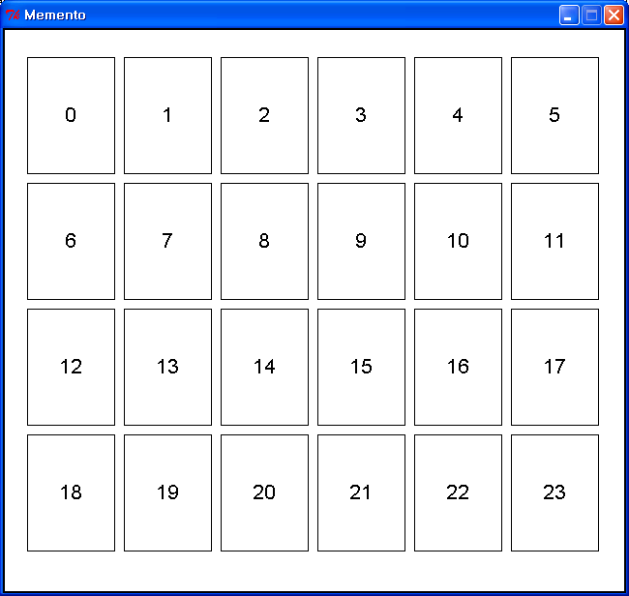
Task 3 | The Flow of Memento Game
There are 24 number pads
First, show all pictures for a while then flip them over
The user have to input 2 card numbers
The screen shows two pictures the user indicated
If the card numbers indicate the same picture
Show “Correct!” message
Add 2 numbers to correct number list
Show all the picture pairs which you have founded
If not
Show “Wrong……” message
Return the screens before
The game finishes when all pairs are founded
>>> [evaluate memento.py]
### Welcome to the Python Memento game!!! ###
1st try. You got 0 pairs.
Input the first card number :

Slide 11
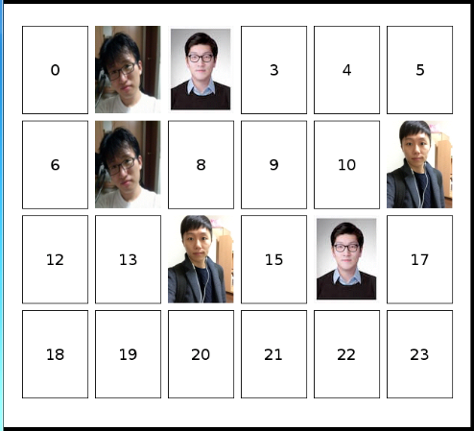



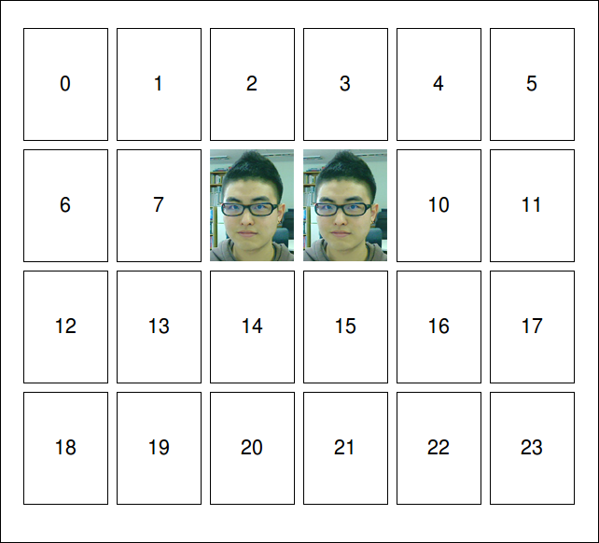
Task 3 | Three Lists
A list for managing corrected numbers
correct_list
1
7
11
Two lists for visualization
num_pads
....
Dohoo.jpg
Jinyeong.jpg
Minsuk.jpg

Slide 12
Task 3-1 | Implementation
is_valid(num1, num2)
Check if the two numbers
exist in the current correct list
are same number
are valid numbers in the given range.
Return Boolean value according to the result
check(num1, num2)
At first, visualize the screen including the two cards (num1th card and num2th card)
If two pictures of the two cards are same, put the two numbers into the correct list
If not, re-visualize the original screen
Return Boolean value according to the result

Slide 13
Task 3-2 | Implementation
Shuffle the “cards” list
Using “random” module
Modify the condition for visualization in print cards()
Modify the condition of main while-loop
Your program should be terminated if you find all pairs
Print the number of tries using the ordinal number
Update the number of trials
>>> [evaluate memento.py]
### Welcome to the Python Memento game!!! ###
1st try. You got 0 pairs.
2nd try. You got 0 pairs.
3rd try. You got 0 pairs.
….

Slide 14
Rock and Roll

