Slide 1
Week 7
String and photo processing

Slide 2
Week 7 Today’s Tasks

Slide 3
Tasks for Today!
Tasks
Number conversion - using both list and string
Skewing

Slide 4
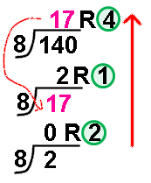
Task 1 | Number conversion
How to convert?
Use quotient & remainder
Divide the quotient by the radix base number until the quotient is 0
Write remainders in reverse order
E.g. octal equivalent of decimal number 140 is 214

Slide 5
Task 1 | Number conversion
Define two conversion functions
Use a list variable ( converted_number = [] )
Print the list to a string → use join() function
Use a string variable ( converted_number = “” )
def deci_to_any_list (n, radix) :
def deci_to_any_list (n, radix) :

Slide 6
Task 1 | Number conversion
User inputs
Number - positive number
Radix - between 2 and 16
Output
Just digits, no gap or another characters
123 (0) ‘1’ ‘2’ ‘3’ (X)
“Wrong input!!” if inputs are not in range
You must use the formatting operator % (TAs will check!!)

Slide 7
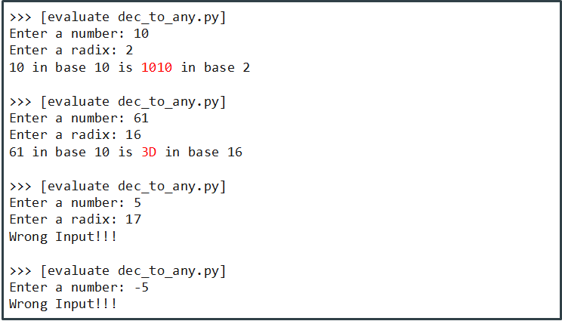
Task 1 | Number conversion

Slide 8
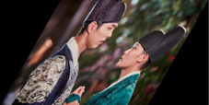

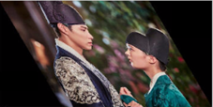
Task 2 | Skewing
Create the image skewed on an angle from the vertical
Vertical 30
Direction
Angle
img
Vertical -30
Input
Output

Slide 9
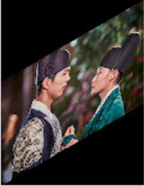
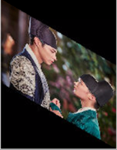
Task 2 | Skewing
Create the image skewed on an angle from the horizontal
Direction
Angle
img
Input
Horizontal 30
Horizontal -30
Output

Slide 10
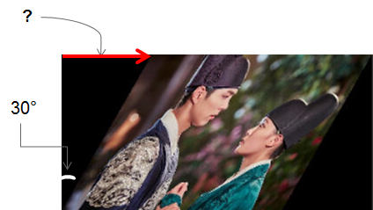
Task 2 | Skewing
Define a skewing function
User input
Direction - vertical or horizontal
Angle - between -89 and 89
Output
Show the skewed image
“Wrong input!!” if inputs are not in range
def skew (img, direction, angle) :

Slide 11
Task 2 | Skewing
You can use math functions or other built-in functions
pi, sin, cos, tan, radians, …
abs, …
Type conversion
Refer “Photo processing with cs1media” supplement

Slide 12
questions?

