Slide 1
Week 8
Text processing (Reading and writing files)

Slide 2
Week 8 Today’s Tasks

Slide 3
Tasks for Today!
Tasks
Merge a set of files into a new file
Handle coordinate information from a file
Handle temperature information from a file

Slide 4
Task 1 | Merge files
Merge a set of input files into a single output file
All contents in the input files are put into the output file
Alan Mathison Turing was a British pioneering computer scientist, mathematician, logician, cryptanalyst, philosopher, mathematical biologist, and marathon and ultra distance runner.
Alan Mathison Turing was a British pioneering computer scientist, mathematician, logician, cryptanalyst, philosopher, mathematical biologist, and marathon and ultra distance runner.
Turing is widely considered to be the father of theoretical computer science and artificial intelligence.
Turing is widely considered to be the father of theoretical computer science and artificial intelligence.

Slide 5
Task 1 | Merge files
Define a function ‘merge’ with two parameters
1st parameter : names of input files ( list of string )
2nd parameters : a name of a string output file ( string )
No output in this function
Merge input files by calling the function ‘merge’
merge ( [“kaist1.txt”, “kaist2.txt”, “kaist3.txt”], “result.txt” )
merge ( [“kaist1.txt”, “kaist2.txt”], “result.txt” )
Use elice_utils.send_file() function
Then, you can see a link to download the file

Slide 6
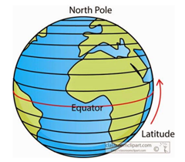
Task 2 | Handle coordinate information
Read and print data from the file ‘average-latitude-longitude-countries.csv'
Each line (except for the head) contains country code, country name, latitude and longitude, which are comma-separated
E.g. “KR”, “Korea, Republic of”, 37, 127.5
-90.0° ≤ latitude ≤ 90.0°, -180.0° ≤ longitude ≤ 180.0°
Caution: several country names contain comma.
Make two lists and print them
List of tuples → ( country code, country name )
List of tuples → ( country code, (latitude, longitude) )
Data type
country code, country name → string
latitude, longitude → float

Slide 7
Task 2 | Handle coordinate information
Print the names of all country whose location lies in the south of the equator.
Let the user enter a country code, and then print the full name of the corresponding country.
Tip. You can reuse the lists of tuples in task 2-1.
Then, you don’t need to read the file again.

Slide 8
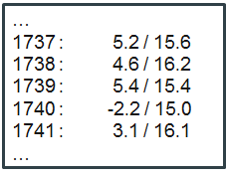
Task 3 | Handle temperature information
The file (“tpmon.txt”) includes England’s monlty temperatures information for the years 1723～1970
Read the data and print average winter and summer temperatures for each year
Winter average = ( January’s + February’s ) / 2
Summer average = ( July’s + August’s ) / 2
Print every year and winter/summer averages
in a nicely formatted table

Slide 9
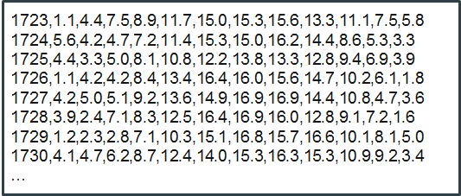
Task 3 | Handle temperature information
Write the contents in another format
To the file ‘tpmon.csv’
Each year and its 12 monthly temperatures in one line
Write in CSV format (i.e. comma-separate the data)
Try to open the file in Excel

Slide 10
questions?

