Slide 1
Week 9
User-Defined Objects
(Simple Blackjack Game)

Slide 2
Tasks for Today!
Memento2
Rewrite Memento (lab 6, remember?) using user-defined object
Simple Blackjack
Refer to lecture #9
Rules of Black jack
Winner can be either a player or a dealer
Any of them will lose the game with score higher than 21
Any of them will win the game with higher score than the other
A player gets as many cards as he/she wants
A dealer gets more cards until the sum of its cards is less than 17

Slide 3
Task 1 | Memento2
Rewrite Memento using user-defined objects.
Tasks
Copy Memento’s code that you wrote few weeks ago.
Define a Card class.
Convert all elements in cards list from tuple to Card object. This will make cards a list of Card object.
Delete all use of correct_list .
Change the way of accessing an element of the cards list.

Slide 4


Task 1 | Memento2
Convert the code from Tuple version to user-defined object version.
Before
(Lab7)
After (Today)
cards
User-defined object
Class Card(object):
“””A Memento Card.”””
pass
Minsuk.jpg
Jinyeong.jpg
List of tuple
cards (list) of Card (object)
num_pads
0
1
card.name
card.name
Minsuk.jpg
Jinyeong.jpg
List of
layer object
card.state
card.state
card.img
True
card.img
False
correct_list
0
4

Slide 5
Task 2 | Black Jack
suit: (Clubs, Diamonds, Hearts or Spades)
face: (Ace, 2, …, Jack, Queen, or King)
value: value of the card
image: image object for the card
hidden: state of a card (hidden or not)
Understand the main() function
Have to define Card class
has 5 attributes
Implement five functions. Refer to the requirements for each function definition below and complete the following functions that satisfy the requirements.
create_deck()
hand_value(hand)
card_string(card)
ask_yesno(prompt)
draw_card(dealer, player)

Slide 6
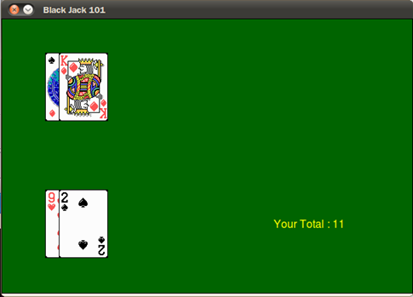
Task 2 | Black Jack
Initial prompt
Welcome to Black Jack 101!
You are dealt a 9 of Hearts.
Dealer is dealt a hidden card.
You are dealt a 2 of Spades.
Dealer is dealt a King of Diamonds.
Your total is 11.
Dealer
Hidden Card
Player
Initial two drawers

Slide 7
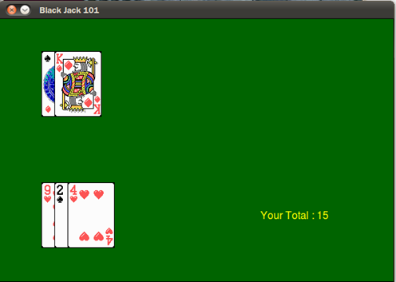
Task 2 | Black Jack
Report an error if the input is invalid.
Would you like another card? (y/n) ne
I beg your pardon!
Would you like another card? (y/n) y
You are dealt a 4 of Hearts.
Your total is 15.
Would you like another card? (y/n) n
Type “y” if you want to get another card.
Type “n” otherwise.

Slide 8
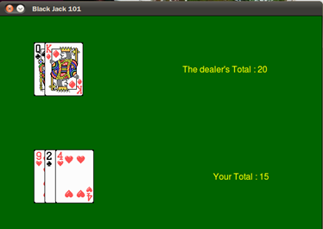
Task 2 | Black Jack
When your turn is finished, the dealer draws cards until the score reaches 17.
The dealer’s hidden card was a Queen of Spades.
Your total is 15.
The dealer’s total is 20.
You lost!
Play another round? (y/n) n
open
Show your scores as well as dealer’s and decide who wins. The game should go on unless typed “n”.

Slide 9
questions?

