Slide 1
Week 10
Objects - Animation

Slide 2
Upgrade your wonderful animal!

Slide 3
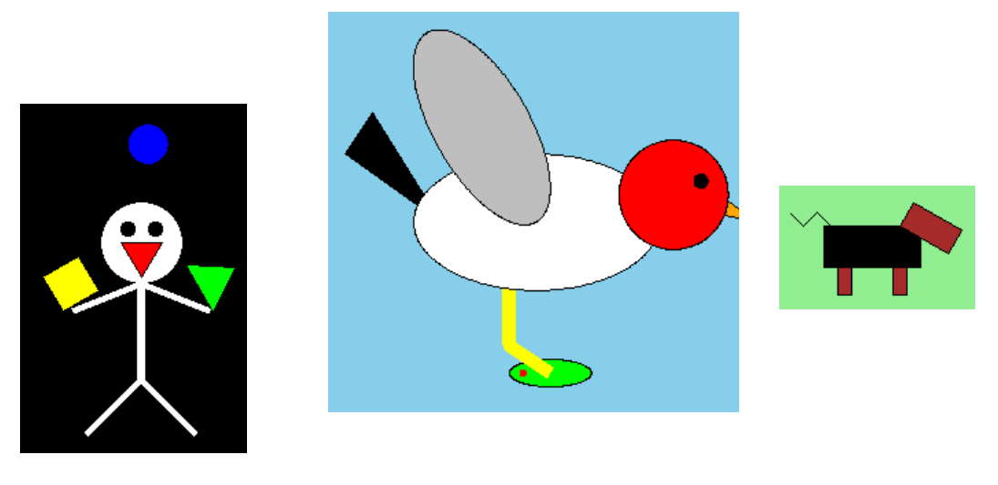
Recall the animal you created!
But this time, make it much more elegant
Use Python objects so that you can make it like Hubo in cs1robots .

Slide 4
Making the animal object
It should have parameters for the constructor
E.g.) initial position, colors, size, options, etc.
mario=Mario(‘Blue’, ‘normal’)
It must have methods that can be used to move it on the canvas, and to move its body parts.
You must not use the graphical objects outside the object
It must have at least one event method which can change the animal’s shape or do the special action
E.g.) becoming super-mario, laying eggs, transforming etc.

Slide 5
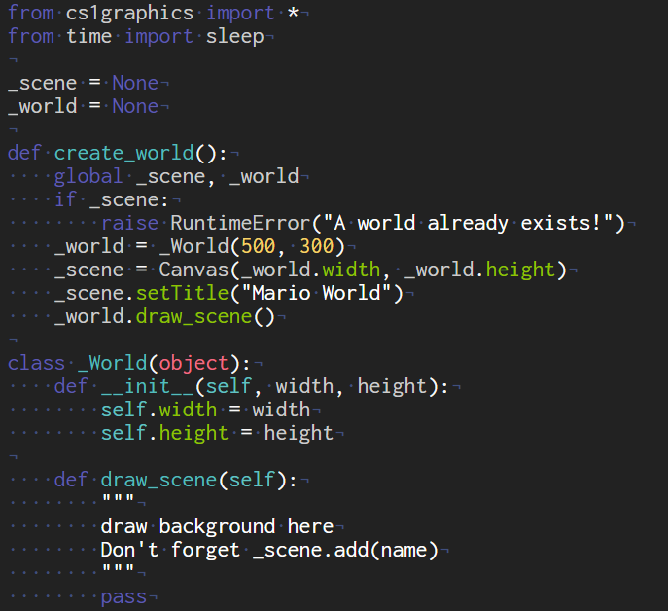
Example - Supermario
Name for the Canvas we will use
Background
Initialize your own background

Slide 6
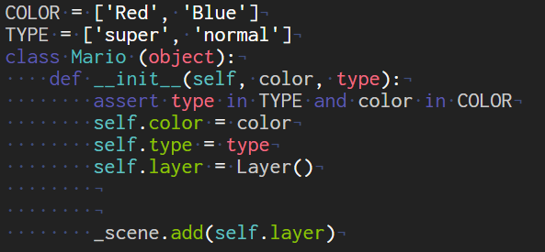
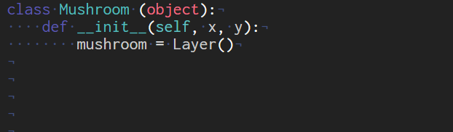
Example - Supermario
Object drawing code should be here
Don’t forget!
If you want to insert any moving object in the scene, you can make another class for that, e.g.

Slide 7
Example - Supermario
Let’s see how it works!
>>> create_world()
>>> mario = Mario(‘Blue’, ‘normal’)
>>> mushroom = Mushroom(200, 92)
>>> mario.shoe_move()
>>> mario.shoe_move()
>>> mario.move(10,0)
>>> mario.move(-10,0)
I can’t see the mushroom. Where is it?
>>> mushroom = Mushroom(200,92)
>>> mushroom.arise()
What if we want to cheat, starting as the super-mario?
>>> mario = Mario(‘Red’, ‘super’)

Slide 8
Example - Supermario
Let’s make the animation using drawable objects
create_world()
mario = Mario(‘Blue’, ‘normal’)
mushroom = Mushroom(200, 92)
t = 0.5
sleep(t)
mario.move(0, -50)
mushroom.arise()
sleep(t)
mario.move(0, 50)
mushroom.move(0,8)
sleep(t)
mushroom.move(20, 0)
mario.move(30,0)
mario.shoe_move()
sleep(t)
mushroom.move(20, 0)
mario.move(20, 0)
mario.shoe_move()
sleep(t)
mushroom.move(20, 0)
mario.move(20, 0)
mario.shoe_move()
sleep(t)
mushroom.move(20, 0)
mario.move(10, 0)
mario.shoe_move()
sleep(t)
mushroom.move(0,100)
...

Slide 9
Example - Supermario
Make it interactive!
We want to make kind of game using keyboard input:
def interactive_example():
while True:
e = _scene.wait()
d = e.getDescription()
if d == “keyboard”:
k = e.getKey()
if k == “q”:
_scene.close()
break
elif k == “w”:
mario.walk(20)
elif k == “r”:
mario.walk(40)
elif k == “j”:
mario.move(0, -50)
sleep(t)
mario.move(0, 50)
Notes:
phising
‹#›

Slide 10
Summary
Using a template file in download board
Make your own animal (or anything) object which provides following method
Moving in the canvas ( like mario.move(10, 20) )
Moving the part of body ( like mario.shoe_move() )
Special function ( like mario.supermario() )
It should have parameters for the constructor and you must not use the graphical objects outside the object
Make your own background scene
(in ‘draw_scene’ method of ‘_World’ object)
Make animation scenario
Make interactive program
Notes:
phising
‹#›

Slide 11
questions?
Be creative! Have fun!

