Slide 1
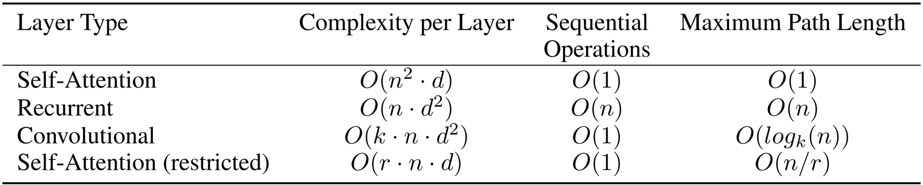
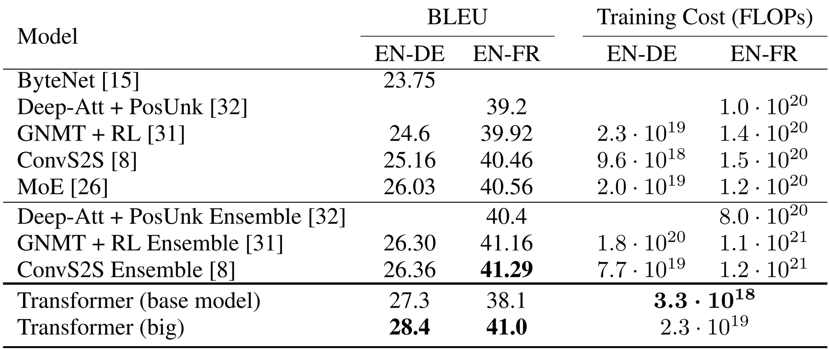
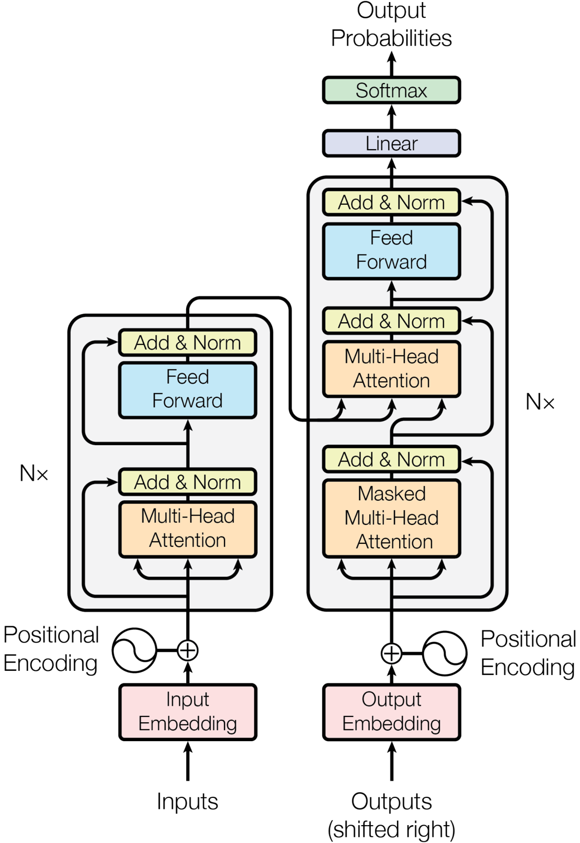
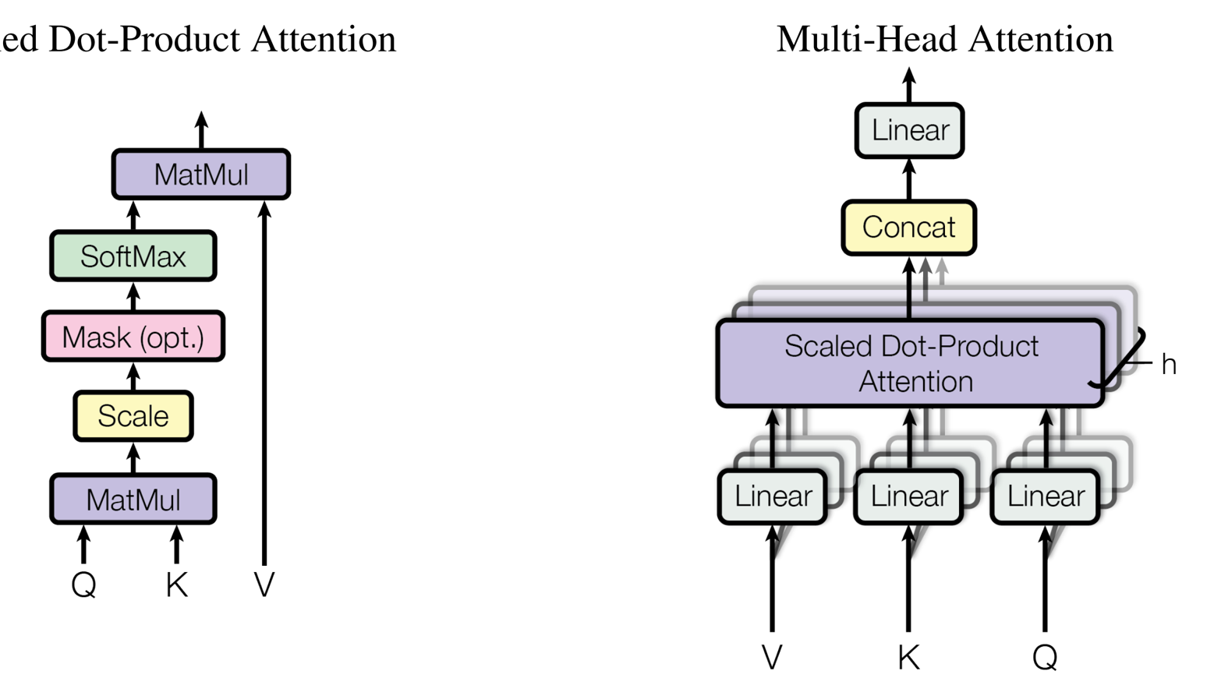
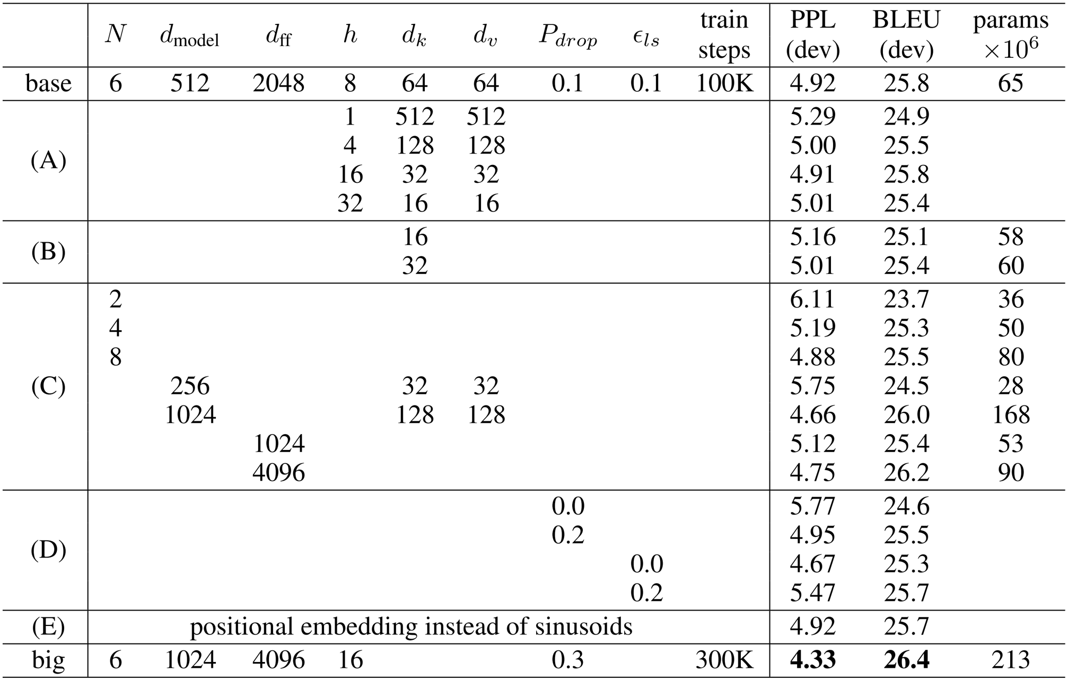
Attention Is All You Need
Ashish Vaswani¹, Noam Shazeer¹, Niki Parmar¹, Jakob Uszkoreit¹, Llion Jones¹, Aidan N. Gomez¹, Lukasz Kaiser¹, Illia Polosukhin¹
Google Brain¹, Google Research¹
Introduction
Why Self-Attention
Results
• Proposed the Transformer: a fully attention-based architecture.
◦ Eliminates recurrence and convolutions.
◦ Uses self-attention for parallel sequence modeling.
◦ Enables faster training and superior translation quality.
Machine Translation
• Self-attention enables full parallelization across input tokens.
• Achieves constant path length of one between any tokens.
• Outperforms recurrent and conv layers in long-range dependency capture.
◦ Processes all tokens simultaneously.
Model Architecture
Encoder and Decoder Stacks
Attention
• Transformer achieves 28.4 BLEU on English-to-German translation.
Training
Model Variations
Training Data and Batching
• Scaled dot-product attention enables efficient, dynamic weighting of input sequences.
◦ Computes weights via query-key compatibility.
• Trained on WMT 2014 corpus with BPE tokenization.
Hardware and Schedule
Position-wise Feed-Forward Networks
• Trained on 8 NVIDIA P100 GPUs with distributed computation.
◦ 12 hours for 100,000 steps.
• Encoder and decoder each use six identical layers.
• Position-wise feed-forward network processes each token independently.
◦ Two linear layers with ReLU activation.
Optimizer
Embeddings and Softmax
Positional Encoding
• Adam uses adaptive gradients and dynamic learning rate.
◦ Warmup: 4,000 steps linearly.
• Multi-head attention enhances representation learning by focusing on input subspaces.
◦ Larger models and optimal dropout boost accuracy.
• Shared embedding matrices improve parameter efficiency and representation consistency.
◦ Reduces trainable parameters by half via weight tying.
• Softmax ensures probabilistic output with valid token distributions.
• Uses sinusoidal positional encodings to inject token position information.
◦ Added to input embeddings directly.
• Enables generalization to longer sequences than seen in training.
Conclusion
Regularization
• Transformer replaces RNNs and CNNs with pure attention-based architecture.
◦ Enables fully parallelizable training.
• Achieves state-of-the-art accuracy in machine translation.
• Residual dropout stabilizes training by randomly dropping residual connections.

