Slide 1
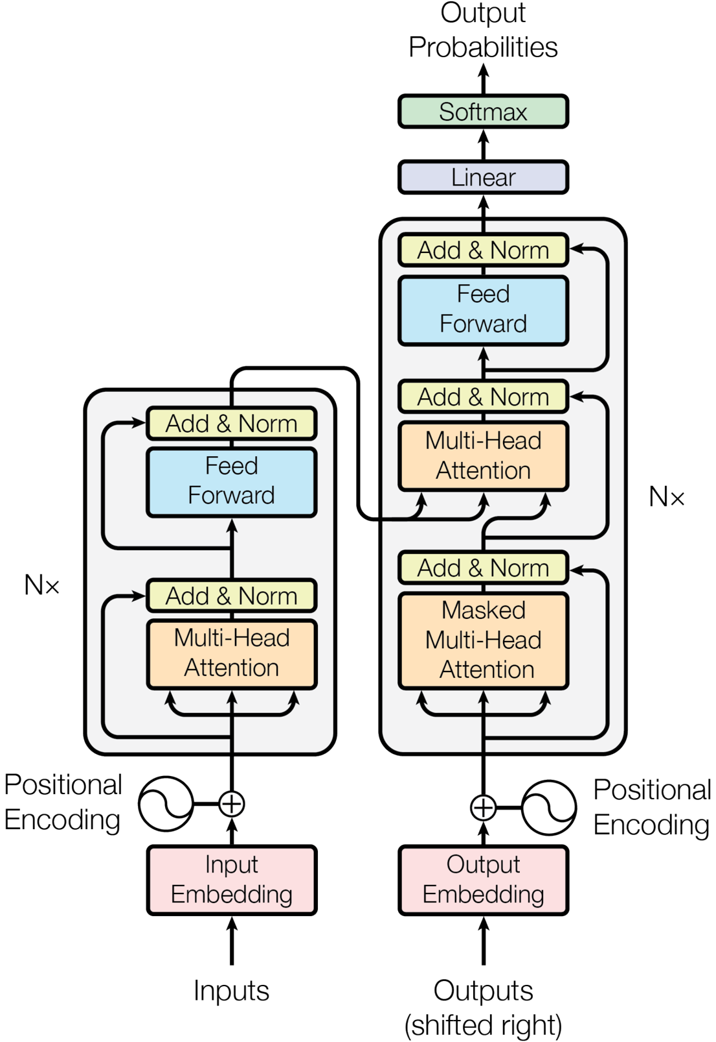
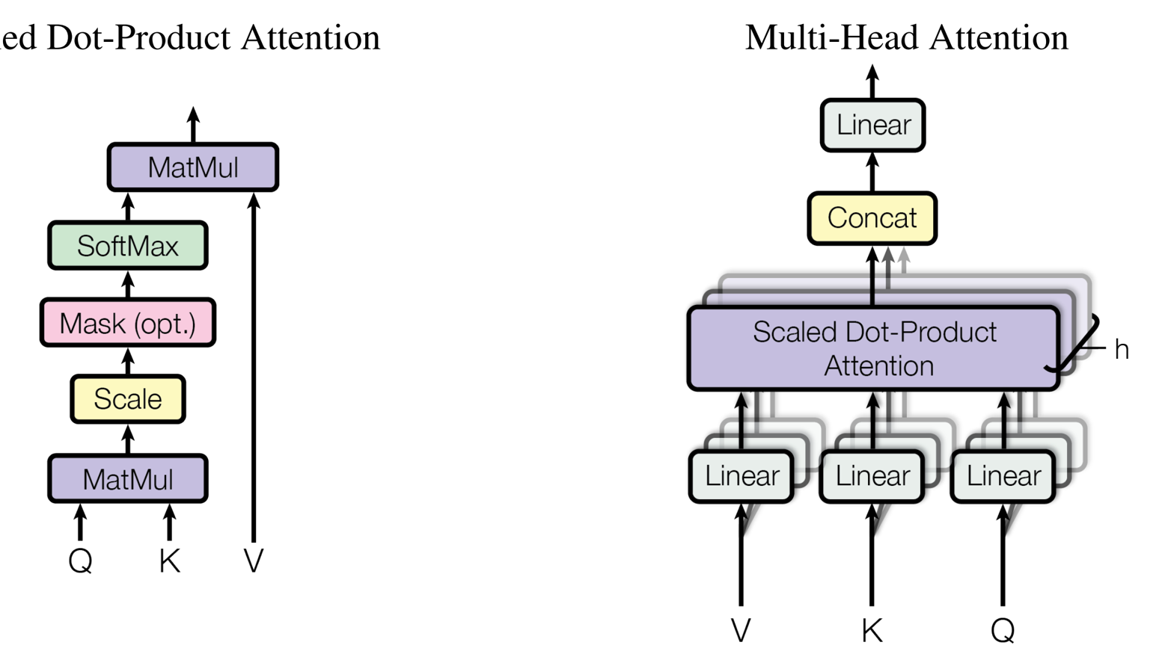
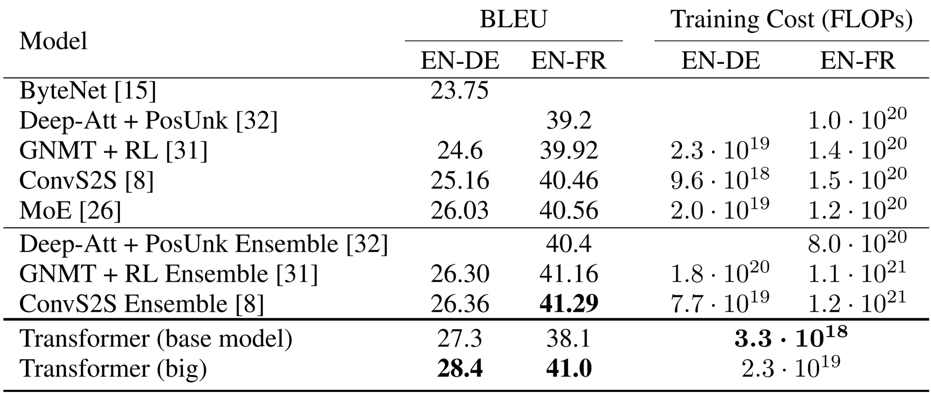
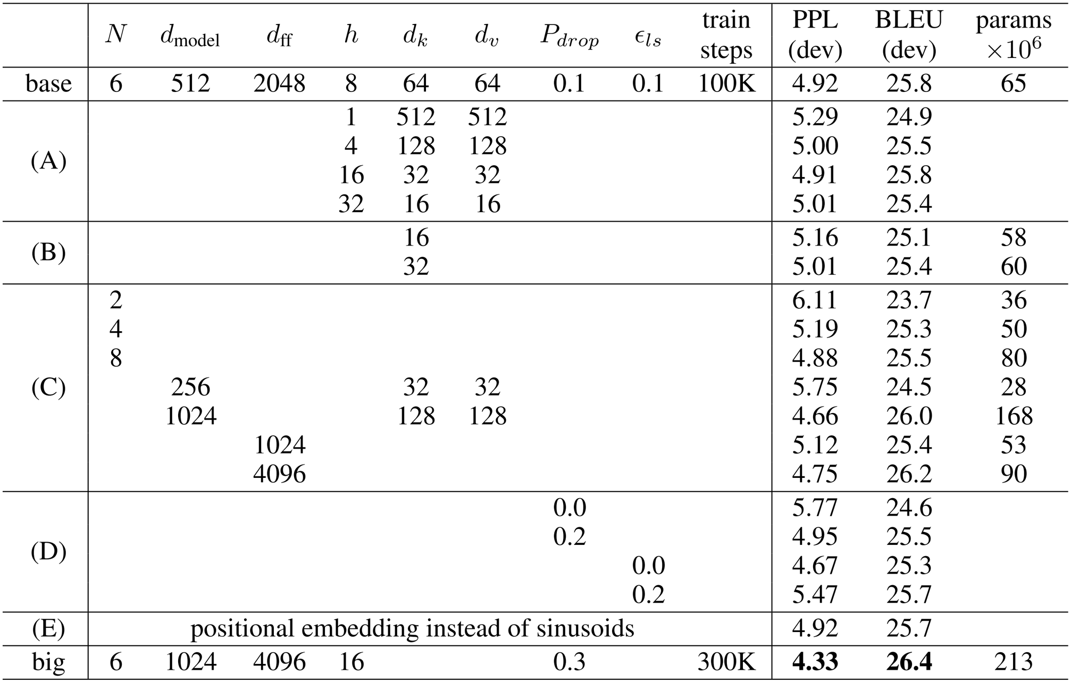
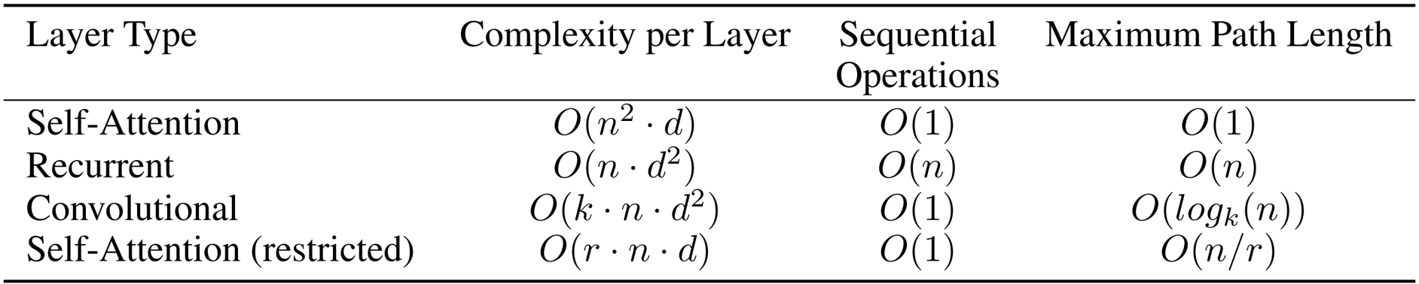
Attention Is All You Need
Ashish Vaswani¹, Noam Shazeer¹, Niki Parmar¹, Jakob Uszkoreit¹, Llion Jones¹, Aidan N. Gomez¹, Lukasz Kaiser¹, Illia Polosukhin¹
Google Brain¹, Google Research¹
Introduction
Training
• Transformer uses self-attention for full parallelization of sequence processing.
◦ Eliminates sequential computation bottlenecks.
• Achieves faster training and improved scalability for long sequences.
◦ Maintains high translation quality.
• Simplifies architecture by removing fixed-size context constraints.
Training Data and Batching
Hardware and Schedule
• Trained on WMT 2014 English-German and English-French datasets.
• Trained on eight NVIDIA P100 GPUs with parallel computation.
◦ Base: 100K steps, ~12 hours.
Model Architecture
Optimizer
Regularization
Encoder and Decoder Stacks
Attention
• Adaptive learning rate with warm-up and decay ensured stable training.
◦ Warm-up over 4,000 steps.
• Enhanced regularization with dropout on sub-layer outputs and embeddings.
• Improved generalization and reduced overfitting.
Results
Machine Translation
• Attention enables dynamic focus on relevant input parts via weighted value sums.
◦ Uses query-key compatibility to compute weights.
• Replaces RNNs and convolutions in Transformer architecture.
• Sets new SOTA BLEU scores: 28.4 (En-De), 41.0 (En-Fr).
Position-wise Feed-Forward Networks
Model Variations
• Encoder and decoder each have six identical layers.
◦ Each layer includes self-attention and feed-forward networks.
• Residual connections and layer normalization enable stable training.
• FFN enables non-linear processing at each sequence position.
◦ Uses two linear layers with ReLU activation.
• Implemented via efficient 1D convolutions for parallel processing.
Embeddings and Softmax
Positional Encoding
• Input and output tokens embedded into 512D vectors.
◦ Learned embedding matrices used.
• Shared embedding and softmax weights reduce parameters.
• Uses sinusoidal encodings to preserve sequence order.
◦ Fixed, deterministic functions enable generalization.
• Multi-head attention is essential for complex sequence modeling.
Conclusion
Why Self-Attention
• Transformer replaces recurrence and convolution with self-attention.
• Achieves state-of-the-art translation quality with faster, parallel training.
• Inspires models across NLP, vision, and multimodal tasks.
• Attention, parallelization, and scalability are now foundational.
• Enables constant path length between sequence positions.
◦ Supports full parallelization in training and inference.
• Models long-range dependencies via direct token interactions.

