Slide 1
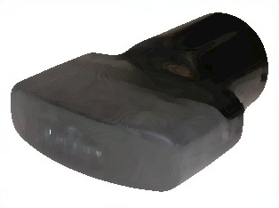
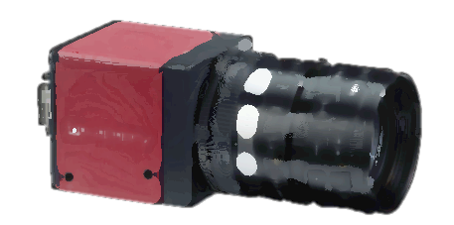
Row wise array
I
R
Y
Intensity vs Range
of one column array
Depth from
depth sensor
Camera
Z
Z
X
θ
X
Z
Y
Known depth
of pool
Sonar
Z
X
R
Y
Depth of
object from
surface
X
Y

Slide 2
Sonar
Z
X
Y
Sonar
Z
X
Y

Slide 3
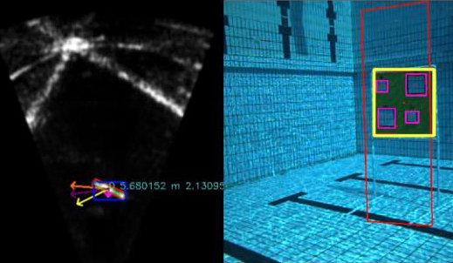
A’
B’
C’
A
B
C

Slide 4
def yVehicleThroughYSonar(self, RSonar, YSonar, Pitch, LY, LZ):
return (LY*cosd(Pitch)+LZ*sind(Pitch)+RSonar*sind(Pitch+asind(YSonar/RSonar)))
def ySonarThroughYVehicle(self, RSonar, YVehicle, Pitch, LY, LZ):
return (-RSonar*sind(Pitch+asind((LY*cosd(Pitch)-YVehicle+LZ*sind(Pitch))/RSonar)))
Depth Frame
Vehicle Frame
Pitch
Sonar Frame

Slide 5
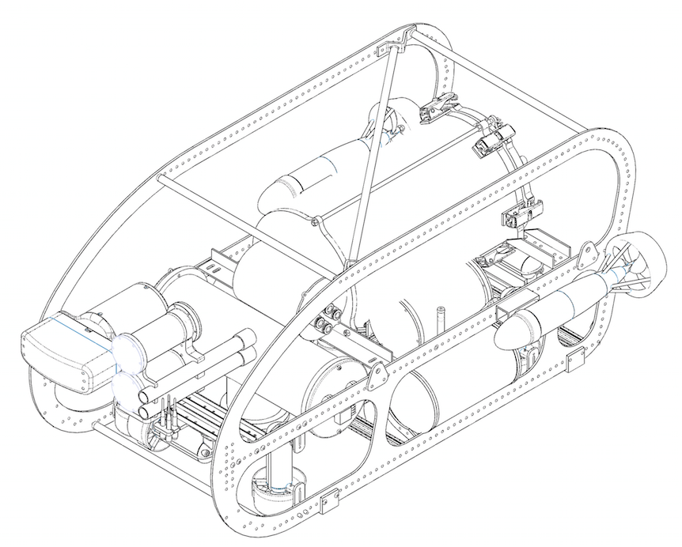
beta0 = [0.1 0.3 0.1 0 0 0 0.5 0.5];

Slide 6
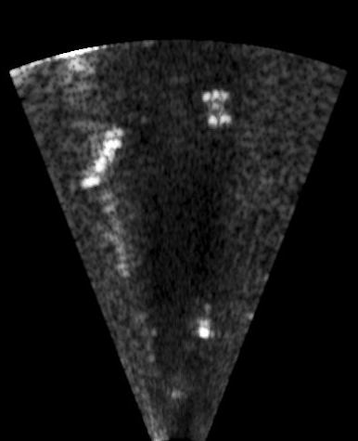
MinorAxis
.
MajorAxis
Intensity at that point

