Slide 1
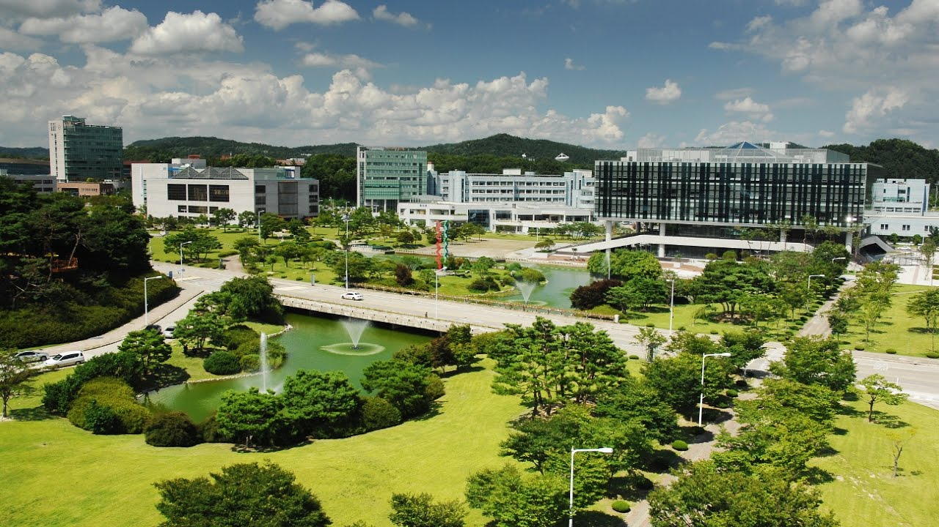
Emergency Alert System
for Campus Safety
Team CS4CS (CS for Campus Safety)
Eunhyouk Shin, Taehyung Kwon, Inyoung Cho

Slide 2

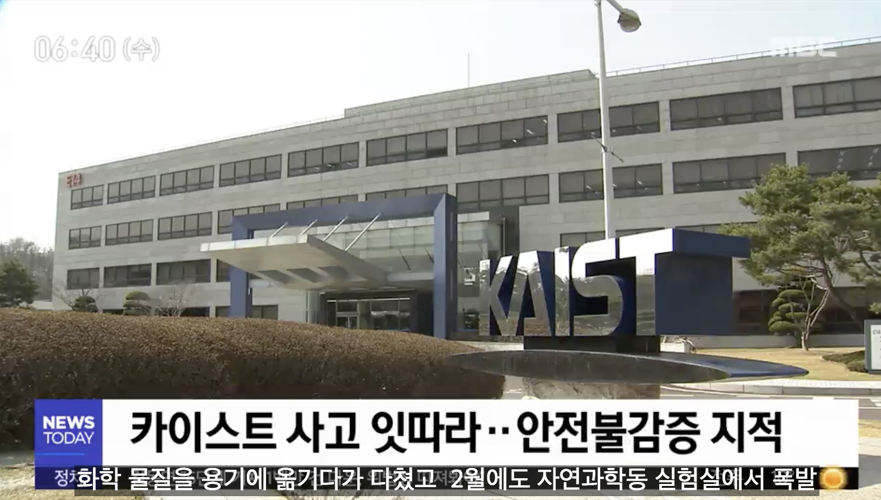
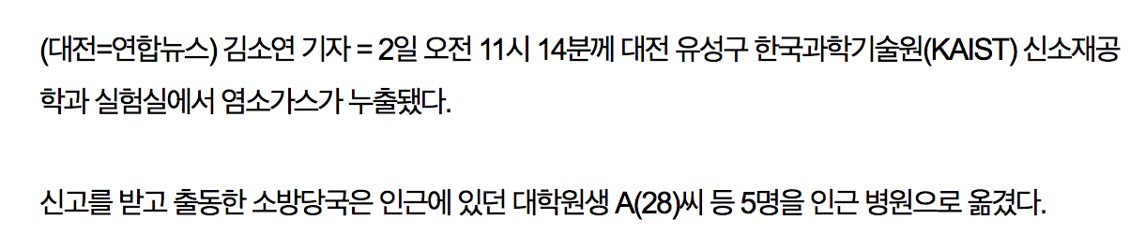
We need an alert system for our campus!
“The chlorine gas leaked at KAIST, 5 graduate students were taken to hospital.”
“Consecutive accidents at KAIST revealed insensitivity to safety.”
[Yonhap News, 2018.10.2]
[MBC News, 2018.10.3]
Notes:
인영- 전자동 사진을 또 보여줘야하나? 전자동은 그냥 말만하고 사진은 며칠 전 발생한 염소 가스 누출만 큼직하게는?

Slide 3
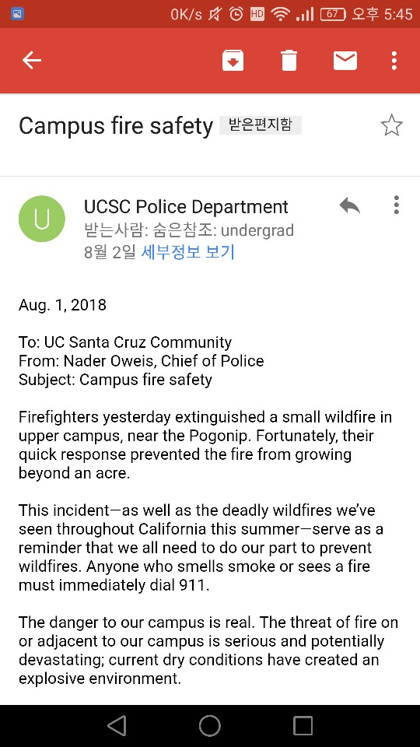

Centralized Method: UCSC CruzAlert
School officials send emails and SMS.
Risk of late alerts !!!

Slide 4


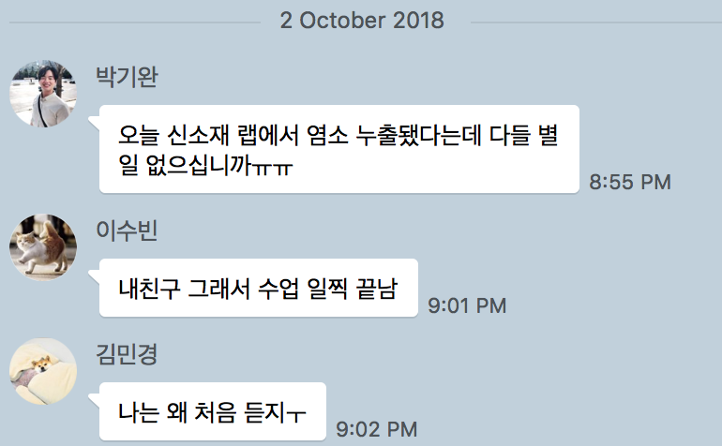

Decentralized Methods: KakaoTalk, Facebook
Typically faster than official alerts
Prone to false rumors
Notes:
문장 더 쉽게

Slide 5



Our Approach: Participatory Mobile System
Users report accident to nearby users
Faster than centralized
Manange by with safety team
More correct than decentralized
Users report accidents.
It is faster than a fully centralized method.
Officials can connect with ordinary users.
It is more reliable than a fully decentralized method.
A sound alert is sent to nearby users.
People in risk can evacuate immediately.

Slide 6
Challenges
<div class="Box position-absolute overflow-hidden d-none jump-to-suggestions js-jump-to-suggestions-container">
<ul class="d-none js-jump-to-suggestions-template-container">
<li class="d-flex flex-justify-start flex-items-center p-0 f5 navigation-item js-navigation-item">
<a tabindex="-1" class="no-underline d-flex flex-auto flex-items-center p-2 jump-to-suggestions-path js-jump-to-suggestion-path js-navigation-open" href="">
<div class="jump-to-octicon js-jump-to-octicon mr-2 text-center d-none">
<svg height="16" width="16" class="octicon octicon-repo flex-shrink-0 js-jump-to-octicon-repo d-none" title="Repository" aria-label="Repository" viewBox="0 0 12 16" version="1.1" role="img"><path fill-rule="evenodd" d="M4 9H3V8h1v1zm0-3H3v1h1V6zm0-2H3v1h1V4zm0-2H3v1h1V2zm8-1v12c0 .55-.45 1-1 1H6v2l-1.5-1.5L3 16v-2H1c-.55 0-1-.45-1-1V1c0-.55.45-1 1-1h10c.55 0 1 .45 1 1zm-1 10H1v2h2v-1h3v1h5v-2zm0-10H2v9h9V1z"/></svg>
<svg height="16" width="16" class="octicon octicon-project flex-shrink-0 js-jump-to-octicon-project d-none" title="Project" aria-label="Project" viewBox="0 0 15 16" version="1.1" role="img"><path fill-rule="evenodd" d="M10 12h3V2h-3v10zm-4-2h3V2H6v8zm-4 4h3V2H2v12zm-1 1h13V1H1v14zM14 0H1a1 1 0 0 0-1 1v14a1 1 0 0 0 1 1h13a1 1 0 0 0 1-1V1a1 1 0 0 0-1-1z"/></svg>
<svg height="16" width="16" class="octicon octicon-search flex-shrink-0 js-jump-to-octicon-search d-none" title="Search" aria-label="Search" viewBox="0 0 16 16" version="1.1" role="img"><path fill-rule="evenodd" d="M15.7

Slide 7


Handling False Positives
Should report accidents with real name and personal info.
A real estate app service “직방” introduces a real name system to prevent fake goods.
Notes:
https://s.zigbang.com/v2/web/share.png
https://news.naver.com/main/read.nhn?mode=LSD&mid=sec&sid1=101&oid=421&aid=0003513079
직방에 대해 좀 더 자세히 설명, 논리적으로
It is similar to our service in that it prevent fake information

Slide 8
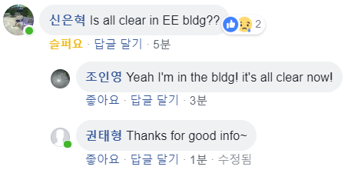

Handling False Positives
User comment board
Security team announcement
Announcement
The material in the bottle turned out to be hydrochloric acid.
OK
More Info
Notes:
To explain more about user comment board ~
similar to comment in facebook and naver
http://www.iconarchive.com/show/100-flat-icons-by-graphicloads/announcement-icon.html

Slide 9



Privacy Issue in the Previous Model
The app periodically sends the receiver’s location to the server.
The server uses the receiver’s location to determine the people to be alarmed.
Notes:
https://pngtree.com/icon-categories/maps-and-location

Slide 10


Protecting User Privacy
Instead of sending the receiver’s location to the server,
A reporter sends an accident report to the server.
Notes:
flaticon surprised person
글씨 넘 작음..

Slide 11
Protecting User Privacy
Instead of sending receiver’s location to server,
2. The server spreads the accident report to all users.
A reporter sends an accident report to the server.
Notes:
flaticon surprised person
글씨가 작다

Slide 12

Protecting User Privacy
Instead of sending receiver’s location to server,
3. Each app calculates the distance, and alerts only if the user is near the accident.
2. The server spreads the accident report to all users.
A reporter sends an accident report to the server.
Notes:
user is within a certain distance

Slide 13
Protecting User Privacy
Instead of sending receiver’s location to server,
3. Each app calculates the distance, and alerts only if the user is near the accident.
2. The server spreads the accident report to all users.
A reporter sends an accident report to the server.
The server does not need to know users’ location information!
Notes:
user is within a certain distance

Slide 14
System Overview
<div class="Box position-absolute overflow-hidden d-none jump-to-suggestions js-jump-to-suggestions-container">
<ul class="d-none js-jump-to-suggestions-template-container">
<li class="d-flex flex-justify-start flex-items-center p-0 f5 navigation-item js-navigation-item">
<a tabindex="-1" class="no-underline d-flex flex-auto flex-items-center p-2 jump-to-suggestions-path js-jump-to-suggestion-path js-navigation-open" href="">
<div class="jump-to-octicon js-jump-to-octicon mr-2 text-center d-none">
<svg height="16" width="16" class="octicon octicon-repo flex-shrink-0 js-jump-to-octicon-repo d-none" title="Repository" aria-label="Repository" viewBox="0 0 12 16" version="1.1" role="img"><path fill-rule="evenodd" d="M4 9H3V8h1v1zm0-3H3v1h1V6zm0-2H3v1h1V4zm0-2H3v1h1V2zm8-1v12c0 .55-.45 1-1 1H6v2l-1.5-1.5L3 16v-2H1c-.55 0-1-.45-1-1V1c0-.55.45-1 1-1h10c.55 0 1 .45 1 1zm-1 10H1v2h2v-1h3v1h5v-2zm0-10H2v9h9V1z"/></svg>
<svg height="16" width="16" class="octicon octicon-project flex-shrink-0 js-jump-to-octicon-project d-none" title="Project" aria-label="Project" viewBox="0 0 15 16" version="1.1" role="img"><path fill-rule="evenodd" d="M10 12h3V2h-3v10zm-4-2h3V2H6v8zm-4 4h3V2H2v12zm-1 1h13V1H1v14zM14 0H1a1 1 0 0 0-1 1v14a1 1 0 0 0 1 1h13a1 1 0 0 0 1-1V1a1 1 0 0 0-1-1z"/></svg>
<svg height="16" width="16" class="octicon octicon-search flex-shrink-0 js-jump-to-octicon-search d-none" title="Search" aria-label="Search" viewBox="0 0 16 16" version="1.1" role="img"><path fill-rule="evenodd" d="M15.7
Notes:
I will provide system overview of our final product

Slide 15
System Overview: Users
System Server
Report Receiver
Report Sender
Security & Safety Team
Notes:
There are three conceptual types of users; sender/ receiver/ security team

Slide 16
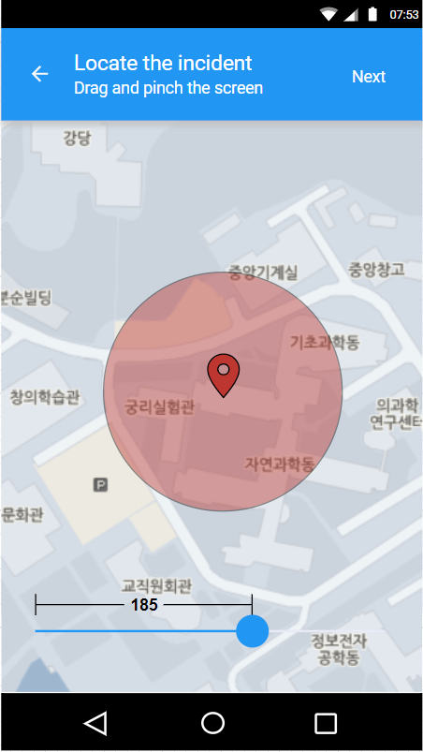

System Overview: Sender
System Server
Notify people including enough info
Report Sender
Notes:
When an accident occurs,
Users can notify people of the accident
including enough information, using our app.
First, the user can easily designate the accident site,

Slide 17
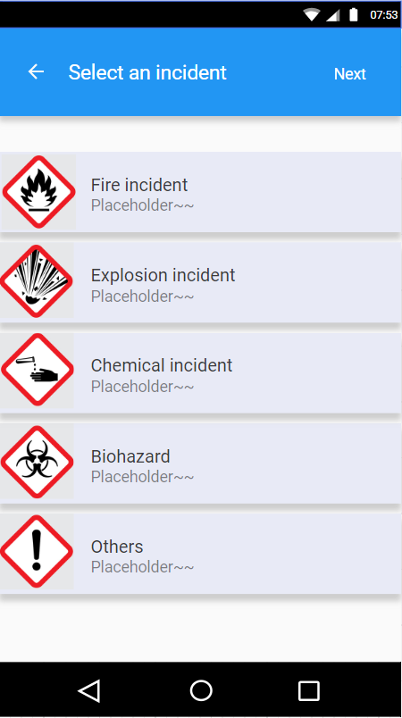

System Overview: Sender
Enter Accident Information
Title
System Server
Gas exposure
Category
Fire Explosion Chemical Biohazard Others
Accident Info.
Reporter Info.
Description
Please enter description (optional)
Photo
(optional)
+
+
+
REPORT
Report Sender
Notes:
also choose the type of accident User can also attach a short optional description and photos. This information is sent to the server. so that people can be aware of the accident and see the detail info

Slide 18

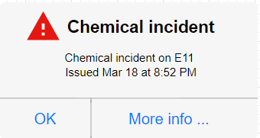
System Overview: Receiver
System Server
Accident Update
Check the location
Alert to the user
Report Receiver
Notes:
if a user is approaching near the accident site
he/she will immediately receive sound alert,
If the user wants more specific information

Slide 19
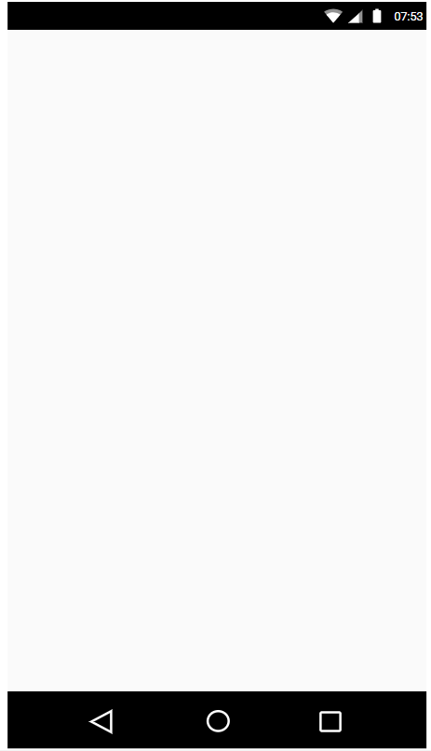
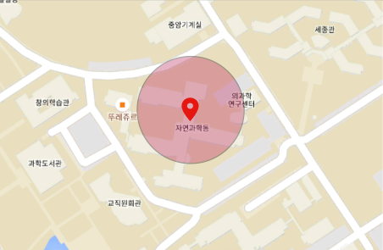




System Overview: Receiver
System Server
Accident Update
2018-03-30 14:43
Gas exposure
Chemical
Accident Info
The gas, which is supposed to be fluorine, was leaked in the 4th floor of E3-2 building … View more,
Check the location
Alert to the user
2
1
Report Receiver
Comment
Official's Notice
Accident Photos
Notes:
You can see information about the accident

Slide 20
System Overview: Receiver
System Server
User Feedback
Accident Update
2018-03-30 14:43
Gas exposure
Chemical
Accident Info
The gas, which is supposed to be fluorine, was leaked in the 4th floor of E3-2 building … View more,
Check the location
Alert to the user
2
1
Report Receiver
Comment
Official's Notice
Accident Photos
Notes:
As we mentioned, If there is another accident witness,
they can leave comments and provide additional information.
During this process, the report becomes more reliable
Users can also see notices from the security team.

Slide 21



System Overview: S&S Team
System Server
2018-03-30 14:43
Gas exposure
Accident Info.
Reporter Info.
S&S Team
Announcement
Report sender
Inyoung Cho
Chemical
Accident Info
The gas, which is supposed to be fluorine, was leaked in the 4th floor of E3-2 building ... VIew more,
2
S&S Team
Comment
Announcement
Accident Photos
Notes:
The security team's screen is slightly different,
With announcement board,
The security team can communicate with KAIST members
or announce result of investigation in real time
or They can correct the wrong information provided by users or themselves

Slide 22
System Overview: S&S Team
System Server
2018-03-30 14:43
Gas exposure
Accident Info.
Reporter Info.
S&S Team
Announcement
Report sender
Inyoung Cho
Chemical
Accident Info
The gas, which is supposed to be fluorine, was leaked in the 4th floor of E3-2 building ... VIew more,
2
Contact
Report Sender
S&S Team
Comment
Announcement
Accident Photos
Notes:
They can contact the sender as well

Slide 23
System Overview: Summary
System Server
User Feedback
Accident Info.
Reporter Info.
Accident Update
S&S Team
Announcement
Accident Info.
Reporter Info.
Check the location
Alert to the user
Contact
Report Receiver
Report Sender
Security & Safety Team
Notes:
now you can see the overall system
interacting with KAIST members and Security team

Slide 24
System Overview: Summary
Connect KAIST members and the Safety team
Provide sound alert for immediate action or evacuation
System Server
User Feedback
Accident Info.
Reporter Info.
Accident Update
S&S Team
Announcement
Accident Info.
Reporter Info.
Check the location
Alert to the user
Contact
Report Receiver
Report Sender
Security & Safety Team
Notes:
we suggest a new platform

Slide 25
Development Roadmap
Test: Google map API
Test: Triggering location-based events
Test: Server communication
Dev: Sound alerts
Dev: UI refinement
Dev: Server & clients
Dev: UI improvement
Midterm
Notes:
Since the pitch
we’ve tested the Google map API and location-based event After this presentation, we will implement sound notifications and refine the UI, and we start developing server and client machine

Slide 26
The Final Step: Evaluation
Create virtual accidents to simulate the real world
Quantify & measure user’s response speed, evacuation speed, damage, etc
Conduct surveys to test usability
Notes:
As a final step of implementation, We need to evaluate the overall product

Slide 27
Participatory & Location-based
Alert System
<div class="Box position-absolute overflow-hidden d-none jump-to-suggestions js-jump-to-suggestions-container">
<ul class="d-none js-jump-to-suggestions-template-container">
<li class="d-flex flex-justify-start flex-items-center p-0 f5 navigation-item js-navigation-item">
<a tabindex="-1" class="no-underline d-flex flex-auto flex-items-center p-2 jump-to-suggestions-path js-jump-to-suggestion-path js-navigation-open" href="">
<div class="jump-to-octicon js-jump-to-octicon mr-2 text-center d-none">
<svg height="16" width="16" class="octicon octicon-repo flex-shrink-0 js-jump-to-octicon-repo d-none" title="Repository" aria-label="Repository" viewBox="0 0 12 16" version="1.1" role="img"><path fill-rule="evenodd" d="M4 9H3V8h1v1zm0-3H3v1h1V6zm0-2H3v1h1V4zm0-2H3v1h1V2zm8-1v12c0 .55-.45 1-1 1H6v2l-1.5-1.5L3 16v-2H1c-.55 0-1-.45-1-1V1c0-.55.45-1 1-1h10c.55 0 1 .45 1 1zm-1 10H1v2h2v-1h3v1h5v-2zm0-10H2v9h9V1z"/></svg>
<svg height="16" width="16" class="octicon octicon-project flex-shrink-0 js-jump-to-octicon-project d-none" title="Project" aria-label="Project" viewBox="0 0 15 16" version="1.1" role="img"><path fill-rule="evenodd" d="M10 12h3V2h-3v10zm-4-2h3V2H6v8zm-4 4h3V2H2v12zm-1 1h13V1H1v14zM14 0H1a1 1 0 0 0-1 1v14a1 1 0 0 0 1 1h13a1 1 0 0 0 1-1V1a1 1 0 0 0-1-1z"/></svg>
<svg height="16" width="16" class="octicon octicon-search flex-shrink-0 js-jump-to-octicon-search d-none" title="Search" aria-label="Search" viewBox="0 0 16 16" version="1.1" role="img"><path fill-rule="evenodd" d="M15.7
Notes:
At the next final presentation, You will see a participatory & location based alarm system in our hands Thank you.

