Slide 1
SonicSurface Touch-Enabled Interactive Mirrors Using Sound-Based Localization
Team Brogrammers Bolat Ashim
Adi Yerembessov
Azamat Smagulov
Advised by Prof. Insik Shin

Slide 2
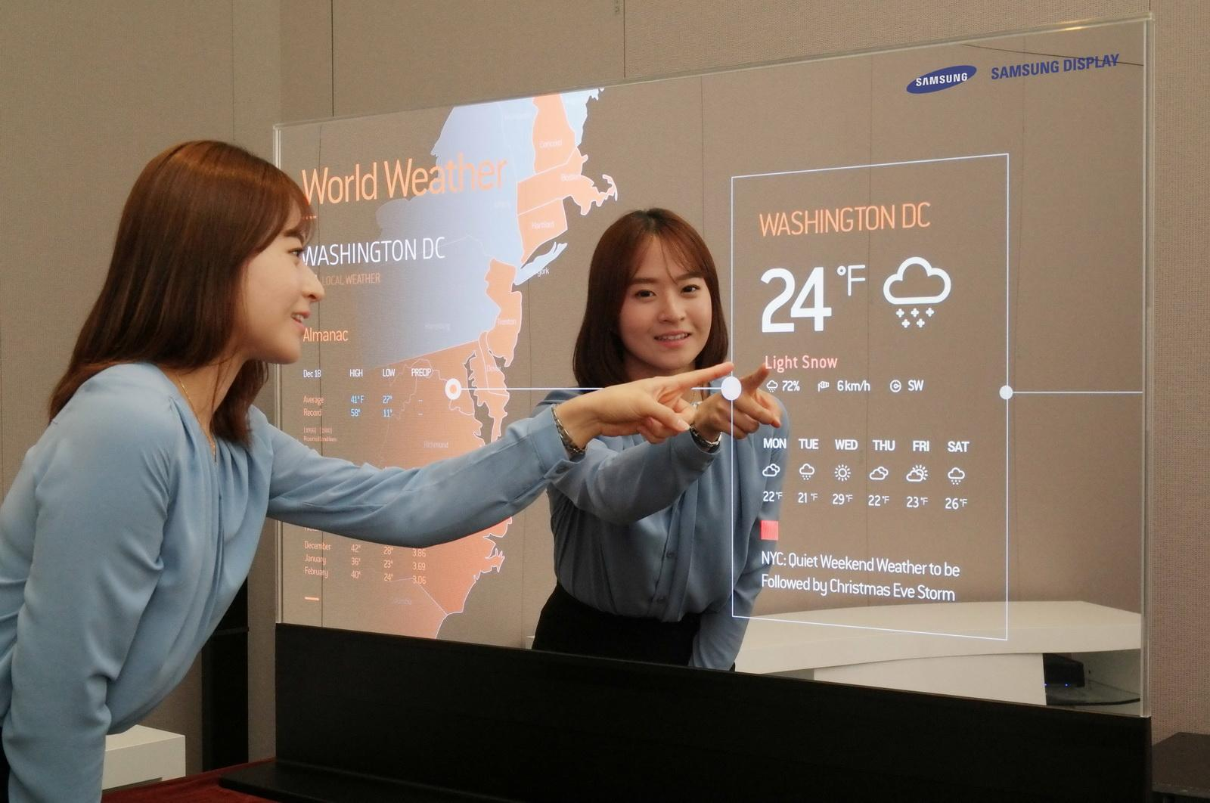
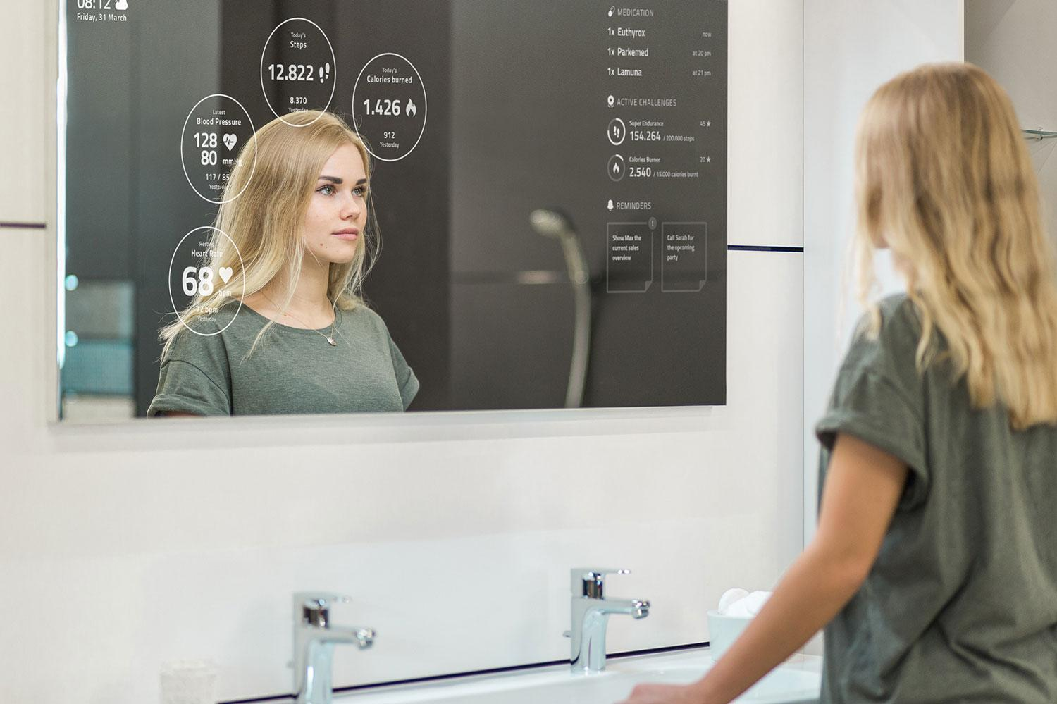
Convenience
Notes:
Importance :
convenience, multitude of applications
Ex: TV with remote vs Tablet (richness of interaction) (Because there were questions from Prof. Juho Kim regarding this, we would like emphasize that this would bring a lot of convenience and create more applications for such smart mirrors. Therefore, we are thinking about talking about a comparison between a TV with a remote control versus a tablet with touch interactions.)

Slide 3
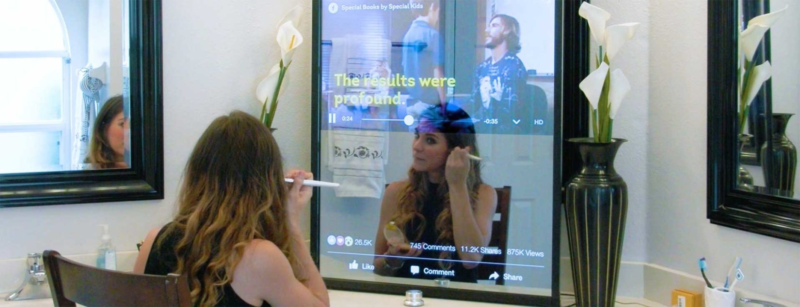
Multitasking

Slide 4
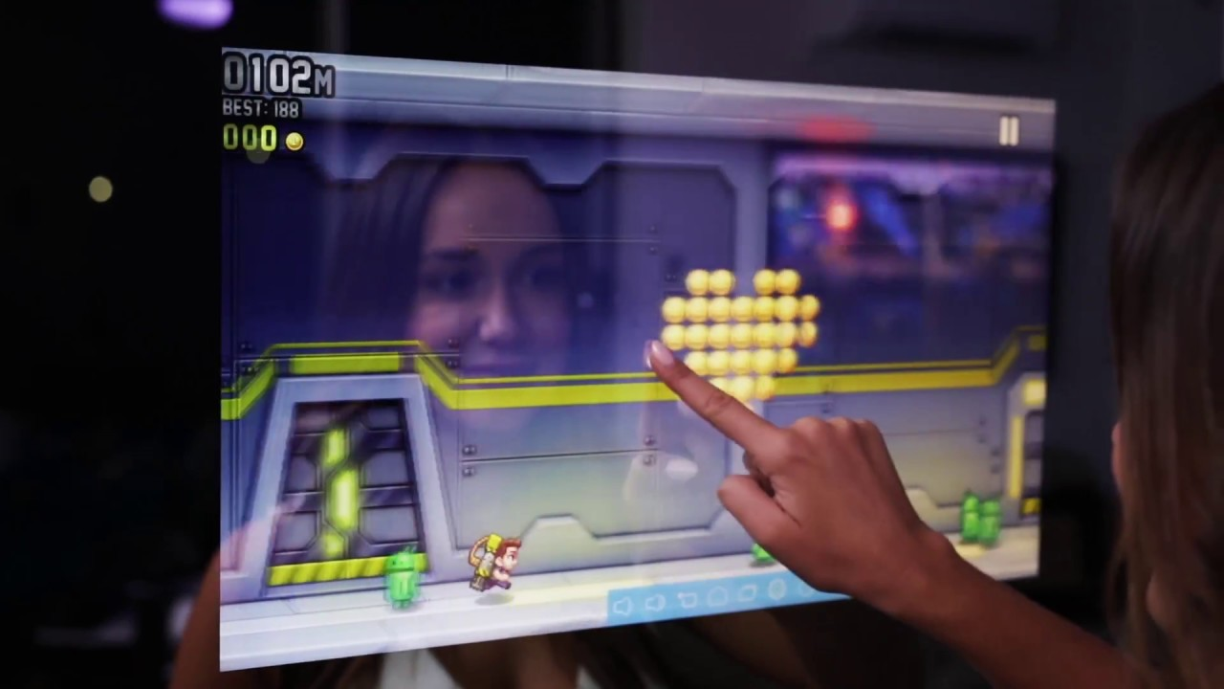
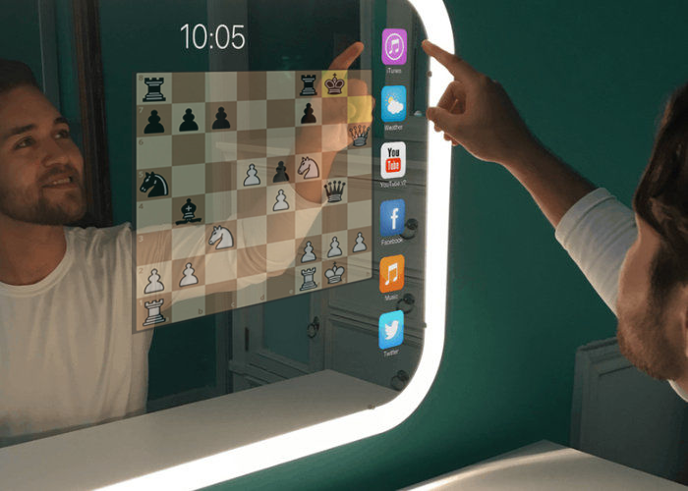
Fun

Slide 5
Problem Definition
Existing interactive smart mirrors require expensive touch surfaces
Use microphones as an alternative hardware option

Slide 6
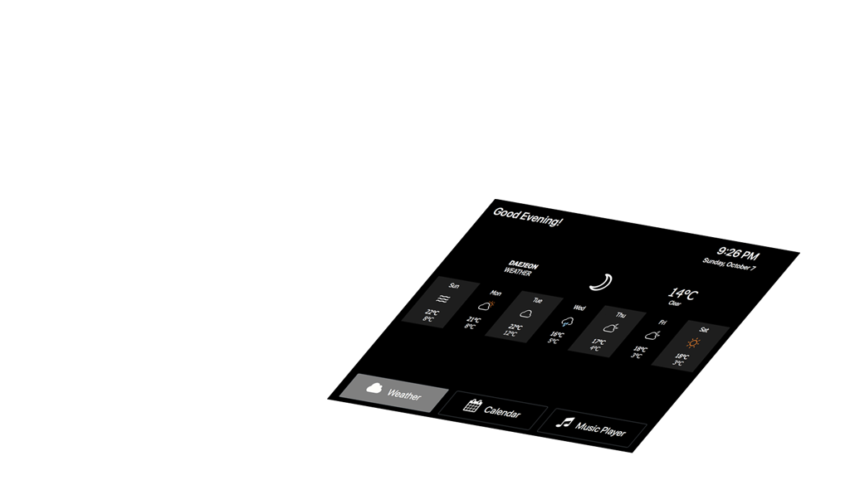
Setup
App Screen

Slide 7
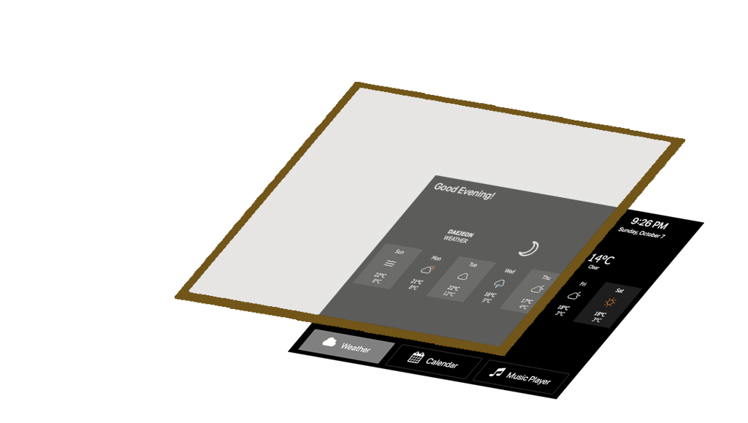
Setup
Glass
App Screen

Slide 8
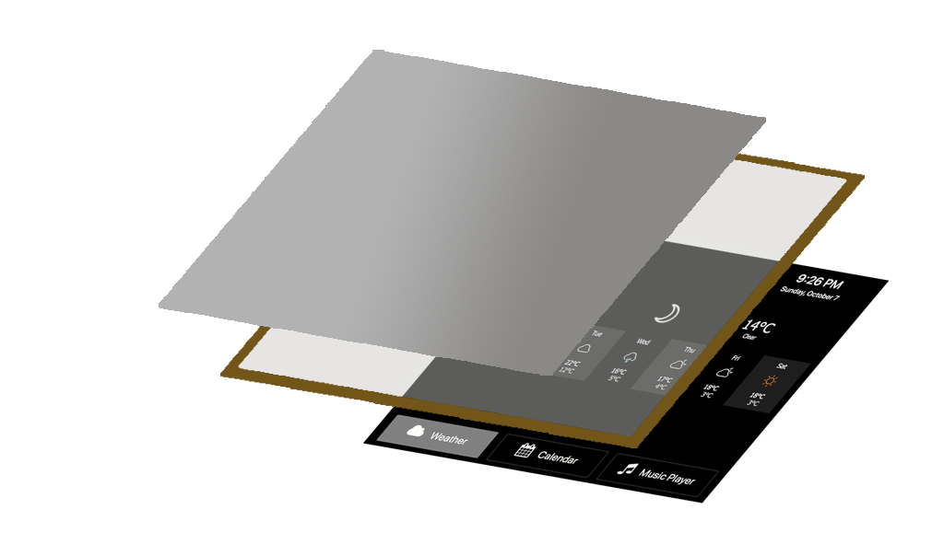
Setup
2-Way Mirror Coating
Glass
App Screen

Slide 9
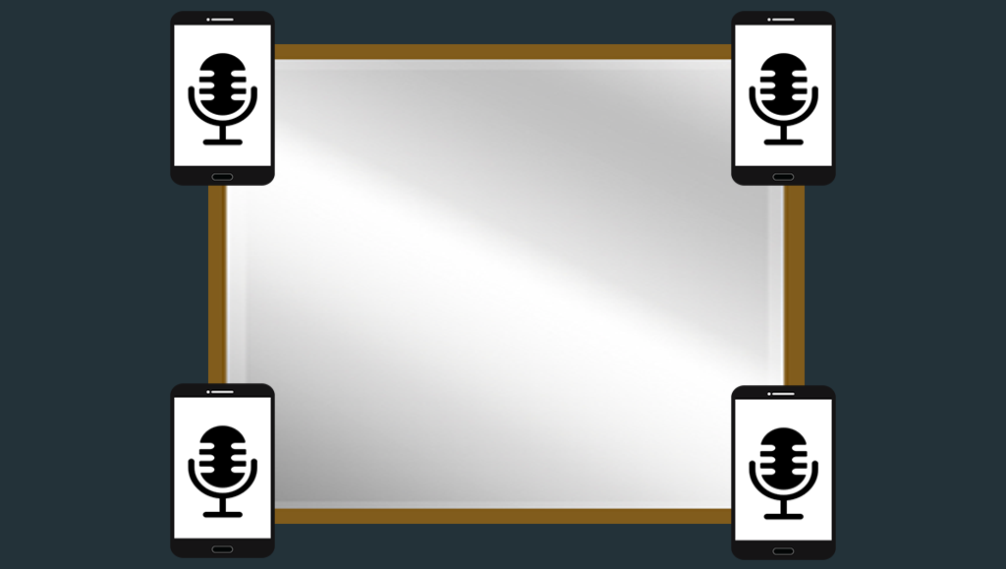
System

Slide 10
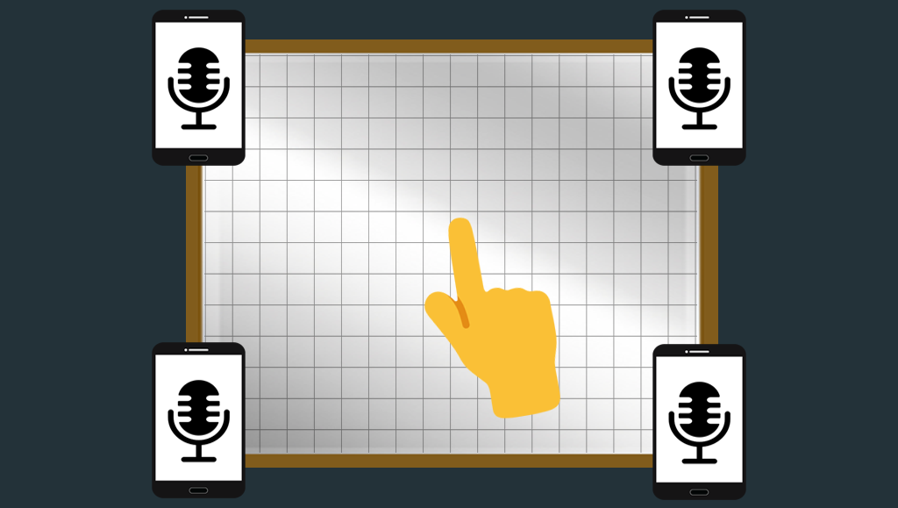
System

Slide 11
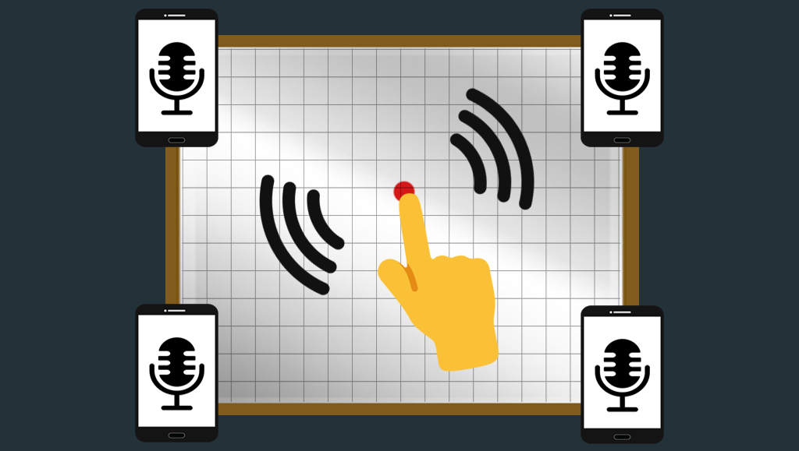
System

Slide 12


Sound Receiving
Server
Sound Localization Processor
(x, y)
screen
coordinates
Gets sound signals from microphones
Sends to processing if receives sound from all 4 mics
Maps 4 sound snippets onto (x, y) mirror coordinates

Slide 13
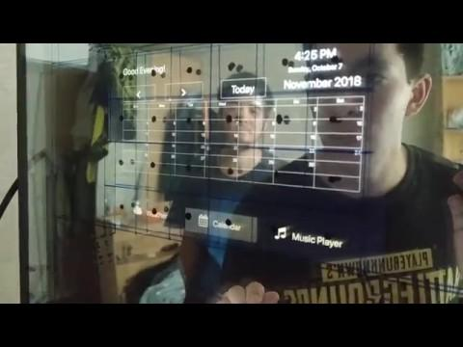
Implementation Demo

Slide 14
Limitations
Sounds louder than a given threshold are registered as taps
Trade-off between omitting taps and registering noise

Slide 15
Solution
Add vibration sensor as a better classifier of sounds into taps and external noise
Magnitude of vibrations caused by external noise is much lower than that caused by taps

Slide 16
Plan
Apply in more use cases
Test on a bigger screen
Make use of vibration detection
Test the system with actual users

Slide 17
SonicSurface
Breathing Life into Mirrors through Sound . . .

