Slide 1
Automated Instructor
for CS101 Newbs
AutomaTA
Changyoon Lee, Donghoon Han, Hyoungwook Jin
with Alice Oh

Slide 2
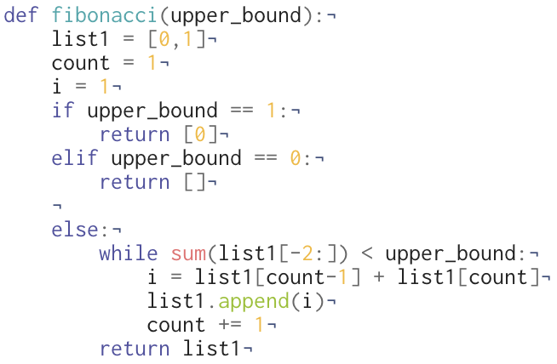
Last Time...
Computational Thinking
Programming Skill
>>
>>
Problem
Algorithm
Program
Fill a list with Fibonacci numbers less than N.
fibonacci ( N )
Case1: N is 1
output [0]
Case2: N is 0
output [ ]
Case3: other
Append the sum of the last two
numbers to the list until sum > N
Notes:
근데 질문이 다음과 같이 두 종류로 나뉨.
Goal: Teach programing skills(Language-specific rules, Language fluency, Syntactic debugging) and computational thinking (Decomposition, Abstraction,Semantic debugging)
[Diagram] Question → Abstraction(Pseudocode) → Program
Syntactic debugging
Low-level semantic error
function 묻기

Slide 3
Problem Statement
CS101 beginners ask many questions related to programming skills.
However, their questions contain not enough context
so they cannot find satisfactory answers from web searches
when self-studying.
Notes:
CS beginners who lack programming skills ask questions without contextual information. Therefore it is difficult to answer those questions
their questions lack enough context and thus they cannot get immediate answers from simple web search

Slide 4
Formative Study
Purpose | To get an idea on what types of questions programming beginners ask
Setting | Sept. 20, 9pm to 11pm, N1 102
Participants | 6 programming beginners, recruited with advertisement on ara
Process | Take a 10 minute lecture on Hubo and basic Python syntax Solve programming tasks with us as the TA
Data collected | Code revision history Voice recording of questions asked and answers
Analysis | Query contextualization with code, Question categorization

Slide 5
Categories
CS101 Goals
Computational Thinking
Programming Skills
Understanding
“I don’t get what the problem asks me to do”
Design
“How do I pick all the beepers on a position?”
Code
“How do I pop an element without removing it?”
Debug
“What is this error message and why did I get it?”
Notes:
근데 질문이 다음과 같이 두 종류로 나뉨.
Goal: Teach programing skills(Language-specific rules, Language fluency, Syntactic debugging) and computational thinking (Decomposition, Abstraction,Semantic debugging)
[Diagram] Question → Abstraction(Pseudocode) → Program
Syntactic debugging
Low-level semantic error
function 묻기

Slide 6
Subcategories
Programming Skills
Code
“How do I pop an element without removing it?”
Debug
“What is this error message and why did I get it?”
Syntax
Function Identification
Function usage
Program mechanism
Error message
Semantic error
How do I define a function?
How do I open a file?
What is the return value of readline()?
Why can’t I access this local variable?
Why do I get this error message?
Why is there an infinite loop?
Notes:
근데 질문이 다음과 같이 두 종류로 나뉨.
Goal: Teach programing skills(Language-specific rules, Language fluency, Syntactic debugging) and computational thinking (Decomposition, Abstraction,Semantic debugging)
[Diagram] Question → Abstraction(Pseudocode) → Program
Syntactic debugging
Low-level semantic error
function 묻기

Slide 7
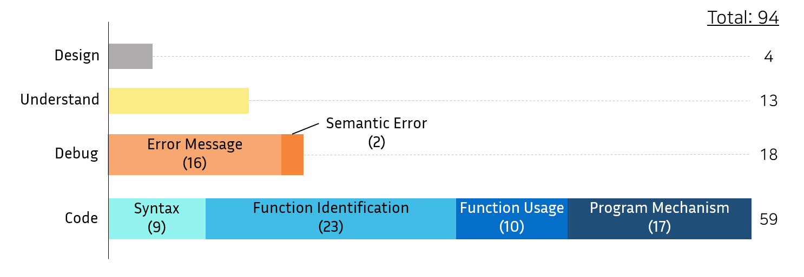
Question Data Analysis

Slide 8
Project Scope
Problems from other categories are well addressed
Students ask many questions regarding functions
Project feasibility
Very difficult to solve for all functions in python
CS101 tasks use limited range of functions

Slide 9


Comparison with Existing Solutions
Solutions | Web Search |  | Ask directly |  | AutomaTA
 |  |  |  | Teaching Assistant
User Input | Query |  | Query + Code |  | Query + Code
Search Time | Short |  | Long | Short | Short
Answer Relevance | Low |  | High |  | High
Presence | High |  | Low |  | High
Notes:
Our system takes both student’s query and code, and aims to provide highly relevant answers fast, at anytime students want.
There’re a few existing solutions.
First of all, web search is available via Google, or Stackoverflow. But it has too may irrelevant answers, so our target user may consider it hard to find the good answers.
On the other hand, the user can ask directly to the experts via StackOverflow, or Teaching Assistant.
As you know, however, StackOverflow takes too long time to get an answer, and our brilliant TAs unfortunately are not always there.
So we propose a new system automaTA, which immediately gives highly-relevant answers anytime they need.

Slide 10
Solution
To build a programming platform
which can immediately answer questions on functions by interpreting the context of those questions.
Notes:
Based on our findings from the formative study and the limitations of existing solutions, we propose to build a programming platform which can immediately answer students’ questions on functions by interpreting the context of their question, so that students can spend less time on searching which functions to use.
We will get context from students’ query and code as we could answer students’ poorly-formed questions by looking at their code during the formative study.

Slide 11
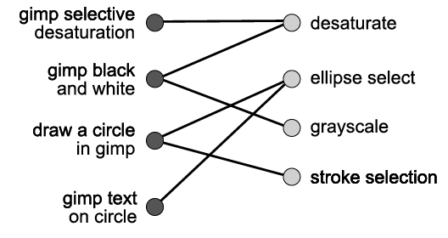
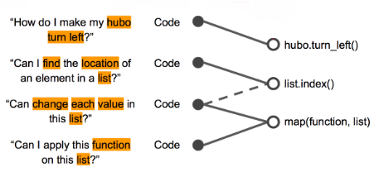
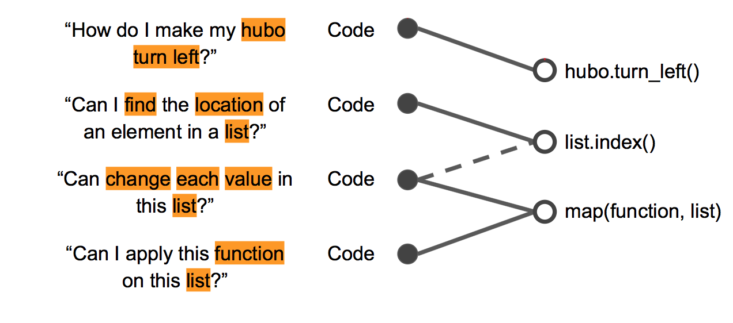
Approach 1. How to Interpret Query?
Map
Map
Sloppy Queries
System Features
Sloppy Question & Code
Function
A Query-Feature graph
handles sloppy queries.
(Fourney et al, ACM, 2011.)
A Context-Function graph
handle sloppy questions
Notes:
So, to interpret the context of the questions and to automate the QnA process, we referred to previous research.
A query feature graph maps a search query to one of the feature existing in a system, so that the system can handle sloppy questions. In our case, we will construct a context function graph, so that whenever a student asks a question on functions, the system will capture the context of the question and give the most relevant function.

Slide 12
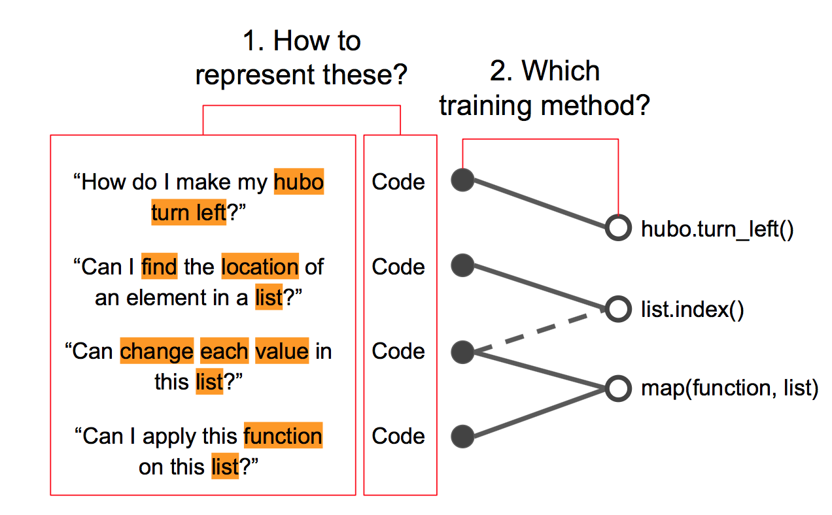
Approach 1. How to Interpret Query?
Map
Sloppy Queries
System Features
A Query-Feature graph
handles sloppy queries.
(Fourney et al, ACM, 2011.)
A Context-Function graph
handle sloppy questions
Notes:
So, to interpret the context of the questions and to automate the QnA process, we referred to previous research.
A query feature graph maps a search query to one of the feature existing in a system, so that the system can handle sloppy questions. In our case, we will construct a context function graph, so that whenever a student asks a question on functions, the system will capture the context of the question and give the most relevant function.

Slide 13
Approach 2. How to Automate Our System?
100%
ML Accuracy
...
Human Accuracy
Accuracy
0%
Time
Human TA
Machine Learning
Human
TA
ML
...
Machine
Learning
Periodic Validation with TA
Validation
Training
Automated
A long-run Human-machine hybrid workflow can train Context-Function graph
(Laput, Gierad, et al, ACM, 2015.)
Notes:
And the human-machine hybrid workflow suggested by Zensors showed that an automated system can be built from scratch with initial human help. By turn-taking between human worker and machine, high accuracy can be maintained throughout the training process. We will adopt this hybrid workflow to collect data and construct the context function graph.

Slide 14
INPUT
User has a question regarding what function to use for an operation
User Query + User Code
Dispatcher
Enough data & High Accuracy?
No
Yes
If rated low, yield to human TA
Human TA
Context Function Graph
Human Computation
Machine-learned Ranking
OUTPUT
User rates the satisfaction of the answer
Function Suggestion + Code Example
Maximum Accuracy Answer
Train
Query & Code & Answer & Rating
Notes:
Let’s look at the case when a user asks a question on functions in our system. The system takes the user query and the code and provides them to the dispatcher.
Dispatcher decides if the system has enough data and accuracy for automated process. If there is not enough data and accuracy then human TA provides the answer.
Otherwise, if the system is mature enough our query function graph provides the answer.
Therefore, the system provides maximum accuracy answer to the user.
The user rates the answer provided, and all of query, answer and rating are used to train the query function graph.
If the user is unsatisfied, the system provides another answer from human TA.

Slide 15
Prototype
1
2
3
4
5
6
7
8
9
10
11
12
13
14
15
16
17
18
19
20
from cs1robots import *
create_world()
hubo=Robot()
def hubo_right():
for i in range(3):
hubo.turn_left()
hubo_right()
if hubo.front_is_clear():
hubo.move()
How do I see how my hubo moves?
How about using these functions?
hubo.set_trace()
hubo.set_pause()
hubo.set_trace()
(“see”, “hubo”, “move”) + code
hubo.set_pause()
Example code
create_world()
hubo=Robot()
hubo.set_trace(‘blue’)
(“hubo”, “turn”, “left”) + code
hubo.set_pause()
Context Function Graph
Notes:
This is our prototype. When a user asks a question on function, the system provides a list of relevant functions. When the user clicks on of the function, the system provides code example of that function. Then, the user rates the accuracy or the satisfaction of the anwer. If the rating is low, the system provides another answer.

Slide 16

Plan
* Completed
Week 7
UI/UX Design
Prototype Design & Testing
Prototype Design & Testing
Week 9
Frontend
Implementation
Learning React & Semantic UI
Learning React & Semantic UI
Week 10-12
Backend & Training model Implementation
Data Collection & Try Different ML Models
Data Collection & Try Different ML Models
Week 13
System Testing
Deploying & Training
Week 14
Evaluation
Test Data Analysis & Final Presentation
Hoon’s Graduation!!!
(Hopefully)
Notes:
These are the milestones we will go through. We will spend about 5 weeks for implementing the system and spend the remaining 2 to 3 weeks on deploying and evaluating our final product.

Slide 17
Evaluation Plan
Conditions | Web Search | Teaching Assistant | AutomaTA
Metrics | Answer Relevance, User Satisfaction, Task Completion Time, Time Taken
Method | Within Subject

Slide 18
Any Questions?

Slide 19
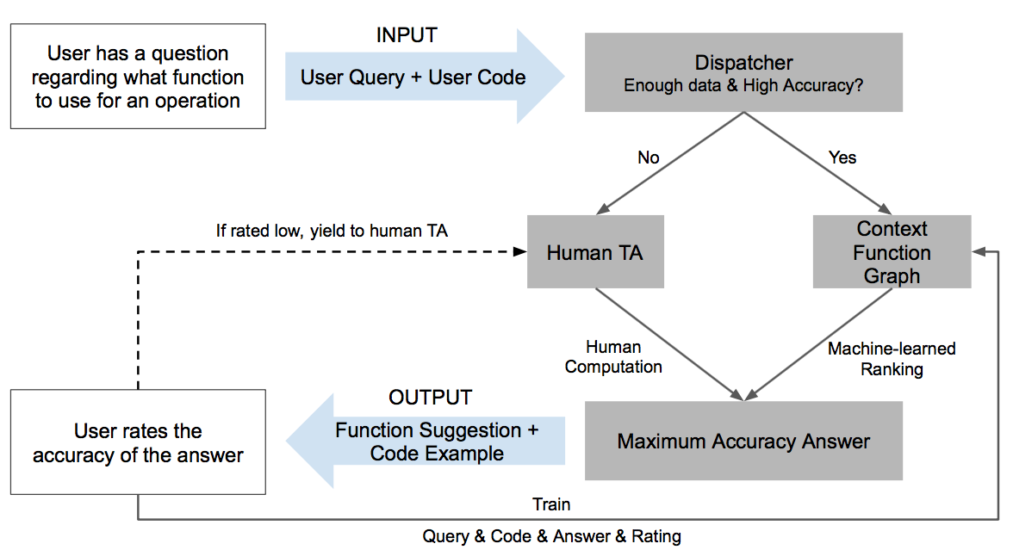
Problem Statement: CS101 beginners ask many questions related to programming skills. However, their questions contain not enough context so they cannot get satisfactory answers from existing solutions.
Pipeline
Evaluation
Metric | Answer accuracy, User satisfaction, Time taken
Conditions | Google search, AutomaTA, Human TA
Method | Within Subject

