Slide 1
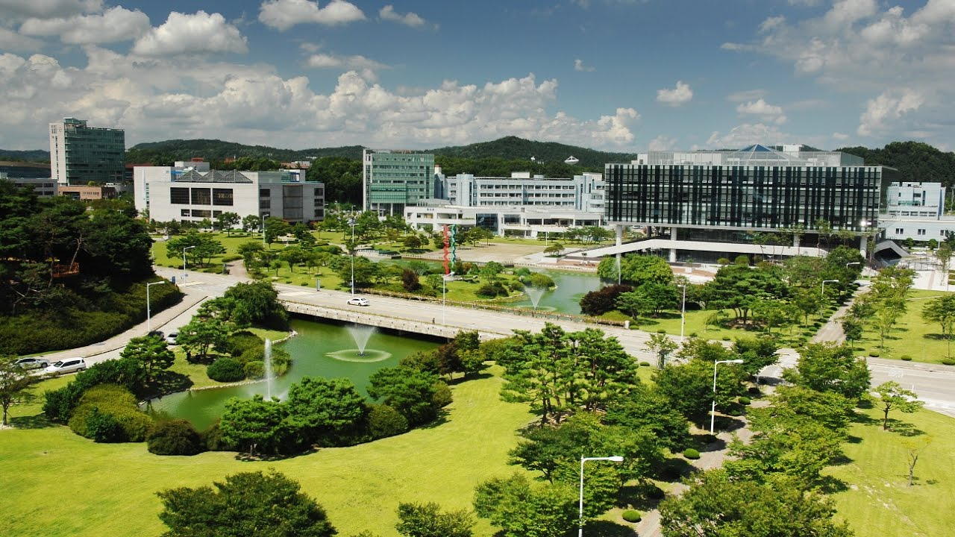
Emergency Alert System
for Campus Safety
Team CS4CS (CS for Campus Safety)
Eunhyouk Shin, Taehyung Kwon, Inyoung Cho

Slide 4


Recall: The Accident in the EE Building
HF
불산

Slide 5
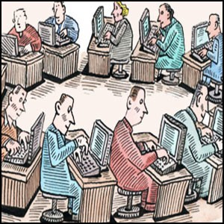






School’s Response: Inefficient

Slide 6
What can we do as CS students?
<div class="Box position-absolute overflow-hidden d-none jump-to-suggestions js-jump-to-suggestions-container">
<ul class="d-none js-jump-to-suggestions-template-container">
<li class="d-flex flex-justify-start flex-items-center p-0 f5 navigation-item js-navigation-item">
<a tabindex="-1" class="no-underline d-flex flex-auto flex-items-center p-2 jump-to-suggestions-path js-jump-to-suggestion-path js-navigation-open" href="">
<div class="jump-to-octicon js-jump-to-octicon mr-2 text-center d-none">
<svg height="16" width="16" class="octicon octicon-repo flex-shrink-0 js-jump-to-octicon-repo d-none" title="Repository" aria-label="Repository" viewBox="0 0 12 16" version="1.1" role="img"><path fill-rule="evenodd" d="M4 9H3V8h1v1zm0-3H3v1h1V6zm0-2H3v1h1V4zm0-2H3v1h1V2zm8-1v12c0 .55-.45 1-1 1H6v2l-1.5-1.5L3 16v-2H1c-.55 0-1-.45-1-1V1c0-.55.45-1 1-1h10c.55 0 1 .45 1 1zm-1 10H1v2h2v-1h3v1h5v-2zm0-10H2v9h9V1z"/></svg>
<svg height="16" width="16" class="octicon octicon-project flex-shrink-0 js-jump-to-octicon-project d-none" title="Project" aria-label="Project" viewBox="0 0 15 16" version="1.1" role="img"><path fill-rule="evenodd" d="M10 12h3V2h-3v10zm-4-2h3V2H6v8zm-4 4h3V2H2v12zm-1 1h13V1H1v14zM14 0H1a1 1 0 0 0-1 1v14a1 1 0 0 0 1 1h13a1 1 0 0 0 1-1V1a1 1 0 0 0-1-1z"/></svg>
<svg height="16" width="16" class="octicon octicon-search flex-shrink-0 js-jump-to-octicon-search d-none" title="Search" aria-label="Search" viewBox="0 0 16 16" version="1.1" role="img"><path fill-rule="evenodd" d="M15.7

Slide 7


Problem 1: Alerting Was Too Slow
Bottleneck: the decision process of officials
Notes:
copyright: Icon made by [author link] from www.flaticon.com
https://www.flaticon.com/free-icon/alarm_216295
https://www.growthsellers.com/hr_buzz/detail/84

Slide 8


Problem 2: Did Not Alert All Possible Victims
?
Emailed only to some professors and lab leaders of EE

Slide 9



Idea 1: Make a Direct Connection
! ! ! ! ! ! !
Using a mobile application
Notes:
전화 그림
서버 그림

Slide 10

Idea 2: Alert at Least People Nearby
Employing location tracking techniques of mobile devices
Notes:
‘위치트래킹’이 나타나도록 ex) 나침반
urgent people -> sth else
https://www.iconfinder.com/icons/126573/gps_location_map_pin_icon

Slide 11

Design Issues
Expanding the scope of alert targets
People with portal IDs?
Protecting privacy while locating users
Anonymous IDs? Removing location history?
Convenient UI
For emergency situation
Communication with administrators
Web application
Notes:
http://www.empreendedor.com/inventores-e-empreendedores-beneficios-e-desafios-para-uma-atuacao-conjunta/

Slide 12
Do not rely on human ability,
use CS instead.
<div class="Box position-absolute overflow-hidden d-none jump-to-suggestions js-jump-to-suggestions-container">
<ul class="d-none js-jump-to-suggestions-template-container">
<li class="d-flex flex-justify-start flex-items-center p-0 f5 navigation-item js-navigation-item">
<a tabindex="-1" class="no-underline d-flex flex-auto flex-items-center p-2 jump-to-suggestions-path js-jump-to-suggestion-path js-navigation-open" href="">
<div class="jump-to-octicon js-jump-to-octicon mr-2 text-center d-none">
<svg height="16" width="16" class="octicon octicon-repo flex-shrink-0 js-jump-to-octicon-repo d-none" title="Repository" aria-label="Repository" viewBox="0 0 12 16" version="1.1" role="img"><path fill-rule="evenodd" d="M4 9H3V8h1v1zm0-3H3v1h1V6zm0-2H3v1h1V4zm0-2H3v1h1V2zm8-1v12c0 .55-.45 1-1 1H6v2l-1.5-1.5L3 16v-2H1c-.55 0-1-.45-1-1V1c0-.55.45-1 1-1h10c.55 0 1 .45 1 1zm-1 10H1v2h2v-1h3v1h5v-2zm0-10H2v9h9V1z"/></svg>
<svg height="16" width="16" class="octicon octicon-project flex-shrink-0 js-jump-to-octicon-project d-none" title="Project" aria-label="Project" viewBox="0 0 15 16" version="1.1" role="img"><path fill-rule="evenodd" d="M10 12h3V2h-3v10zm-4-2h3V2H6v8zm-4 4h3V2H2v12zm-1 1h13V1H1v14zM14 0H1a1 1 0 0 0-1 1v14a1 1 0 0 0 1 1h13a1 1 0 0 0 1-1V1a1 1 0 0 0-1-1z"/></svg>
<svg height="16" width="16" class="octicon octicon-search flex-shrink-0 js-jump-to-octicon-search d-none" title="Search" aria-label="Search" viewBox="0 0 16 16" version="1.1" role="img"><path fill-rule="evenodd" d="M15.7

Slide 13
Reference List
<div class="Box position-absolute overflow-hidden d-none jump-to-suggestions js-jump-to-suggestions-container">
<ul class="d-none js-jump-to-suggestions-template-container">
<li class="d-flex flex-justify-start flex-items-center p-0 f5 navigation-item js-navigation-item">
<a tabindex="-1" class="no-underline d-flex flex-auto flex-items-center p-2 jump-to-suggestions-path js-jump-to-suggestion-path js-navigation-open" href="">
<div class="jump-to-octicon js-jump-to-octicon mr-2 text-center d-none">
<svg height="16" width="16" class="octicon octicon-repo flex-shrink-0 js-jump-to-octicon-repo d-none" title="Repository" aria-label="Repository" viewBox="0 0 12 16" version="1.1" role="img"><path fill-rule="evenodd" d="M4 9H3V8h1v1zm0-3H3v1h1V6zm0-2H3v1h1V4zm0-2H3v1h1V2zm8-1v12c0 .55-.45 1-1 1H6v2l-1.5-1.5L3 16v-2H1c-.55 0-1-.45-1-1V1c0-.55.45-1 1-1h10c.55 0 1 .45 1 1zm-1 10H1v2h2v-1h3v1h5v-2zm0-10H2v9h9V1z"/></svg>
<svg height="16" width="16" class="octicon octicon-project flex-shrink-0 js-jump-to-octicon-project d-none" title="Project" aria-label="Project" viewBox="0 0 15 16" version="1.1" role="img"><path fill-rule="evenodd" d="M10 12h3V2h-3v10zm-4-2h3V2H6v8zm-4 4h3V2H2v12zm-1 1h13V1H1v14zM14 0H1a1 1 0 0 0-1 1v14a1 1 0 0 0 1 1h13a1 1 0 0 0 1-1V1a1 1 0 0 0-1-1z"/></svg>
<svg height="16" width="16" class="octicon octicon-search flex-shrink-0 js-jump-to-octicon-search d-none" title="Search" aria-label="Search" viewBox="0 0 16 16" version="1.1" role="img"><path fill-rule="evenodd" d="M15.7
Campus image in slide1: https://www.youtube.com/watch?v=ZX8kJfWzvX4
Skull and crossbones image in slide 4: https://upload.wikimedia.org/wikipedia/commons/5/58/GHS-pictogram-skull.svg
Bureaucracy image in slide 5: http://sweetmanager.blogspot.com/2013/05/10-quotes-about-bureaucracy.html
Source code in slide 6, 12, 13: Github webpage https://github.com/
Alarm image in slide7, 9: https://www.flaticon.com/free-icon/alarm_216295, designed by Trinh Ho in flaticon
Discussion image in slide7: https://www.growthsellers.com/hr_buzz/detail/84
Bulb image in slide11: http://www.empreendedor.com/inventores-e-empreendedores-beneficios-e-desafios-para-uma-atuacao-conjunta/

