Slide 1
CS 267:
Introduction to Parallel Machines and Programming Models
Lecture 3
James Demmel www.cs.berkeley.edu/~demmel/cs267_Spr15/
CS267 Lecture 3
01/28/2011
Notes:
CS267 Lecture 2

Slide 2
Outline
Overview of parallel machines (~hardware) and programming models (~software)
  Shared memory
  Shared address space
  Message passing
  Data parallel
  Clusters of SMPs or GPUs
  Grid
Note: Parallel machine may or may not be tightly coupled to programming model
  Historically, tight coupling
  Today, portability is important
CS267 Lecture 3
Notes:
CS267 Lecture 2
Shared: Most common (laptops) hardest to scale
Shared address space: HW gives illusion of common memory
Message passing: biggest machine in world work this way
Data parallel: SIMD, GPUs
Cluster: hierarchical hybrids; biggest machine are hierarchical, heterogeneous
Grid: computers connected over internet
SETI@Home (“Contact” with Jodie Foster), folding@home
Portability: standards, designed by committees, eg MPI

Slide 3
A generic parallel architecture
Proc
Proc
Proc
Proc
Proc
Proc
Interconnection Network
Memory
Memory
Memory
Memory
Memory
Where is the memory physically located?
Is it connected directly to processors?
What is the connectivity of the network?
CS267 Lecture 3
Notes:
CS267 Lecture 2
Interconnect: Proc to Proc, and Proc to Mem
Interconnect: Bus? Doesn’t scale. Torus? Something else?
Edison differs from Hopper (dragonfly vs torus)

Slide 4
Parallel Programming Models
Programming model is made up of the languages and libraries that create an abstract view of the machine
Control
  How is parallelism created?
  What orderings exist between operations?
Data
  What data is private vs. shared?
  How is logically shared data accessed or communicated?
Synchronization
  What operations can be used to coordinate parallelism?
  What are the atomic (indivisible) operations?
Cost
  How do we account for the cost of each of the above?
CS267 Lecture 3
Notes:
CS267 Lecture 2
Whatever architecture or programming model, there are 3 issues to consider:
Control, data and synchronization
Atomic: what can s=s+1 do? With two procs, could get different answers
Cost: all 3 of these cost a lot more than arithmetic

Slide 5
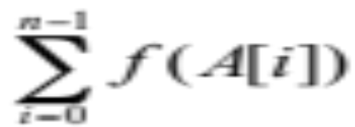
Simple Example
Consider applying a function f to the elements of an array A and then computing its sum:
Questions:
  Where does A live? All in single memory? Partitioned?
  What work will be done by each processors?
  They need to coordinate to get a single result, how?
A:
A = array of all data
fA = f(A)
s = sum(fA)
f
fA:
sum
s:
CS267 Lecture 3
Notes:
CS267 Lecture 2
“map reduce” example
Matlab-like code

Slide 6
Programming Model 1: Shared Memory
Program is a collection of threads of control.
  Can be created dynamically, mid-execution, in some languages
Each thread has a set of private variables, e.g., local stack variables
Also a set of shared variables, e.g., static variables, shared common blocks, or global heap.
  Threads communicate implicitly by writing and reading shared variables.
  Threads coordinate by synchronizing on shared variables
Shared memory
s
s = ...
y = ..s ...
i: 2
i: 5
Private memory
i: 8
P0
P1
Pn
CS267 Lecture 3
Notes:
CS267 Lecture 2
Will have concrete example of how to program this way later (pthreads, OpenMP)
Example: think of a thread as a subroutine that gets called on one processor, executed on another
Like concurrent programming on a uniprocessor (as studied in CS162).
Private variable: for example, in “for i=1:n/4”, i is private
Static variable in C: array A declared in main program, before parallel threads are called
Explanation: When P0 executes “y = …s…” it gets s from shared memory,
and when Pn does “s=…” it need to put s into shared memory

Slide 7
Simple Example
Shared memory strategy:
  small number p << n=size(A) processors
  attached to single memory
Parallel Decomposition:
  Each evaluation and each partial sum is a task.
Assign n/p numbers to each of p procs
  Each computes independent “private” results and partial sum.
  Collect the p partial sums and compute a global sum.
Two Classes of Data:
Logically Shared
  The original n numbers, the global sum.
Logically Private
  The individual function evaluations.
  What about the individual partial sums?
CS267 Lecture 3
Notes:
CS267 Lecture 2
Write some simple, naive codes, will be buggy, then debug them

Slide 8
Shared Memory “Code” for Computing a Sum
fork(sum,a[0:n/2-1]);
sum(a[n/2,n-1]);
static int s = 0;
Thread 1
for i = 0, n/2-1
s = s + f(A[i])
Thread 2
for i = n/2, n-1
s = s + f(A[i])
What is the problem with this program?
A race condition or data race occurs when:
  Two processors (or two threads) access the same variable, and at least one does a write.
  The accesses are concurrent (not synchronized) so they could happen simultaneously
CS267 Lecture 3
Notes:
CS267 Lecture 2
fork(f,a) executes subroutine f on input a on some (other) processor,
Second line sum(a[n/2,n-1]) executes on same processor

Slide 9
Shared Memory “Code” for Computing a Sum
A=
3
5
f (x) = x²
static int s = 0;
Thread 1
….
compute f([A[i]) and put in reg0
reg1 = s
reg1 = reg1 + reg0
s = reg1
…
Thread 2
…
compute f([A[i]) and put in reg0
reg1 = s
reg1 = reg1 + reg0
s = reg1
…
9
25
0
0
9
25
9
25
Assume A = [3,5], f(x) = x², and s=0 initially
For this program to work, s should be 3² + 5² = 34 at the end
  but it may be 34,9, or 25
The atomic operations are reads and writes
  Never see ½ of one number, but += operation is not atomic
  All computations happen in (private) registers
CS267 Lecture 3
Notes:
CS267 Lecture 2

Slide 10
Improved Code for Computing a Sum
static int s = 0;
Why not do lock
Inside loop?
static lock lk;
Thread 1
local_s1= 0
for i = 0, n/2-1
local_s1 = local_s1 + f(A[i])
s = s + local_s1
Thread 2
local_s2 = 0
for i = n/2, n-1
local_s2= local_s2 + f(A[i])
s = s +local_s2
lock(lk);
lock(lk);
unlock(lk);
unlock(lk);
Since addition is associative, it’s OK to rearrange order
Most computation is on private variables
  Sharing frequency is also reduced, which might improve speed
  But there is still a race condition on the update of shared s
  The race condition can be fixed by adding locks (only one thread can hold a lock at a time; others wait for it)
CS267 Lecture 3
Notes:
CS267 Lecture 2
Why not do lock inside loop?
Lock() can be very expensive, perhaps an OS call

Slide 11
Review so far and plan for Lecture 3
Programming Models Machine Models
Shared Memory
1a. Shared Memory
1b. Multithreaded Procs.
1c. Distributed Shared Mem.
Message Passing
2a. Global Address Space
2a. Distributed Memory
2b. Internet & Grid Computing
2c. Global Address Space
3. Data Parallel
3a. SIMD
3b. Vector
4. Hybrid
4. Hybrid
CS267 Lecture 3
What about GPU? What about Cloud?
Notes:
CAN STOP HERE
Recall: Programming model describe:
Control: how to express parallelism, what to do in what order
Data: what data is private vs shared, how is logically shared data accessed or communicated
Synchronization: how to coordinate different parallel tasks; depends on what operations are
atomic
Historically programming models were tied to machine models.
No longer true, for portability, but if you program ignoring costs
of basic operations in underlying architecture, your program may run slowly.
Shared memory: most common, simplest, but doesn’t scale
Message passing: scales up to largest machines, need to explicitly send/receive data
computing over whole internet (looking for aliens)
Global Address Space: best of both worlds, shared memory programming
on distributed memory machines
Data Parallel: includes GPUs
Hybrid: biggest machines combine all these
CS267 Lecture 2

Slide 12
Machine Model 1a: Shared Memory
Processors all connected to a large shared memory.
  Typically called Symmetric Multiprocessors (SMPs)
  SGI, Sun, HP, Intel, IBM SMPs
  Multicore chips, except that all caches are shared
Advantage: uniform memory access (UMA)
Cost: much cheaper to access data in cache than main memory
Difficulty scaling to large numbers of processors
  <= 32 processors typical
P1
P2
Pn
$
$
$
bus
shared $
Note: $ = cache
memory
CS267 Lecture 3
Notes:
CS267 Lecture 2
Now we switch to machine models (hardware) that support the shared memory programming model (software)
Most common model: multicore in your laptop
May be multiple levels of private/shared cache
Anything that is shared is a bottleneck, eg maintaining cache coherency
So how does this scale?

Slide 13
Problems Scaling Shared Memory Hardware
Why not put more processors on (with larger memory?)
  The memory bus becomes a bottleneck
  Caches need to be kept coherent
Example from a Parallel Spectral Transform Shallow Water Model (PSTSWM) demonstrates the problem
  Experimental results (and slide) from Pat Worley at ORNL
  This is an important kernel in atmospheric models
    99% of the floating point operations are multiplies or adds, which generally run well on all processors
    But it does sweeps through memory with little reuse of operands, so uses bus and shared memory frequently
  These experiments show performance per processor, with one “copy” of the code running independently on varying numbers of procs
    The best case for shared memory: no sharing
    But the data doesn’t all fit in the registers/cache
CS267 Lecture 3
Notes:
CS267 Lecture 2
Coherence: if multiples copies of variable s in caches, and one is written,
other caches need to be notified that their copies are out-of-date, so
need extra bits for each word to indicate status (“dirty bits”)
Embarrassingly parallel kernel, many copies, working on disjoint data sets,
Shared nothing, expect double processors to double speed, runs up to 32 processors

Slide 14
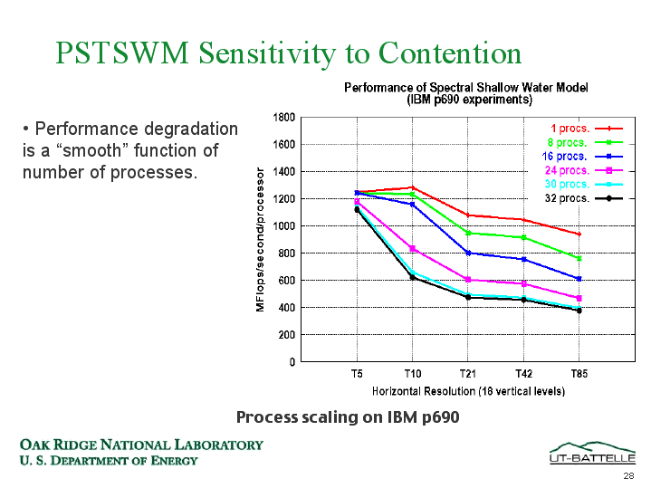
Example: Problem in Scaling Shared Memory
Performance degradation is a “smooth” function of the number of processes.
No shared data between them, so there should be perfect parallelism.
(Code was run for a 18 vertical levels with a range of horizontal sizes.)
CS267 Lecture 3
From Pat Worley, ORNL
Notes:
CS267 Lecture 2
Horizontal axis is resolution, which determines memory size
Vertical axis is speed per processor, ideally independent of p (perfect scaling)
Higher resolution => more memory => more bus/shared memory use => slower
Ideal algorithm: reorganize to bring data into cache, reuse often, avoid touching bus or main memory
not possible for this application (unlike matmul)

Slide 15
Machine Model 1b: Multithreaded Processor
Multiple thread “contexts” without full processors
Memory and some other state is shared
Sun Niagra processor (for servers)
  Up to 64 threads all running simultaneously (8 threads x 8 cores)
  In addition to sharing memory, they share floating point units
  Why? Switch between threads for long-latency memory operations
Cray MTA and Eldorado processors (for HPC)
T0
T1
Tn
shared $, shared floating point units, etc.
Memory
CS267 Lecture 3
Notes:
CS267 Lecture 2
Last model: 1-1 correspondence between threads/subroutines and processors on which they run
Programmer produces threads, can share all HW, not just memory
Each core can switch among 8 threads it could be executing, whichever one is ready
Implication for programming: if your program refers to shared data too frequently, it will run slowly,
Because time to execute cache coherency protocol much longer than getting unshared data from cache.

Slide 16
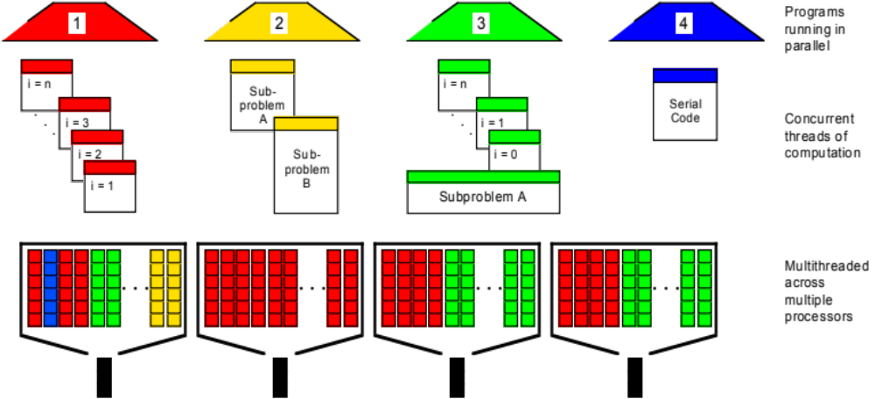
Eldorado Processor (logical view)
CS267 Lecture 3
Source: John Feo, Cray
Notes:
CS267 Lecture 2
Each of the 4 ttasks/programs has different amounts of parallelism (n,2,n+2,1 tasks),
of different sizes, can’t preassign to processor and hope for load balance,
so let them share HW resources, as long as HW can quickly switch from one
task to another.
Here, each of 4 cores can run 16 threads. Complicated HW, but possibly easier SW, load balancing etc.
Vector/SIMD machine: many functional units per instruction stream
Conventional uniprocessor: one functional unit per instruction stream
Multithreaded processor: one functional unit per many instruction streams
Here 4 cores, 16 threads each
Why should many instruction streams shared one functional unit? Sounds
Like a sequential bottleneck, but purpose is memory latency hiding: many
Memory fetches to remote (slow) shared memory going on in parallel,
So can run whichever one’s data has arrived

Slide 17
Machine Model 1c: Distributed Shared Memory
Memory is logically shared, but physically distributed
  Any processor can access any address in memory
  Cache lines (or pages) are passed around machine
SGI is canonical example (+ research machines)
  Scales to 512 (SGI Altix (Columbia) at NASA/Ames)
  Limitation is cache coherency protocols – how to keep cached copies of the same address consistent
P1
P2
Pn
Cache lines (pages) must be large to amortize overhead
➔
locality still critical to performance
$
$
$
network
memory
memory
memory
CS267 Lecture 3
Notes:
CS267 Lecture 2
Need to keep tables in hardware of what cache lines are in memory/clean/dirty/out-of-date:
Who owns location 37? In addition to getting it, need to tell other processor that it has changed.
Network not necessarily a bus, but could have varying topologies (eg 3D torus; later lecture)
Implication for programming: if your program refers to shared data too frequently, it will run slowly,
Because time to execute cache coherency protocol much longer than getting unshared data from cache.

Slide 18
Review so far and plan for Lecture 3
Programming Models Machine Models
Shared Memory
1a. Shared Memory
1b. Multithreaded Procs.
1c. Distributed Shared Mem.
Message Passing
2a. Global Address Space
2a. Distributed Memory
2b. Internet & Grid Computing
2c. Global Address Space
3. Data Parallel
3a. SIMD
3b. Vector
4. Hybrid
4. Hybrid
CS267 Lecture 3
What about GPU? What about Cloud?
Notes:
CAN STOP HERE, OR NEXT SLIDE
Recall: Programming model describe:
Control: how to express parallelism, what to do in what order
Data: what data is private vs shared, how is logically shared data accessed or communicated
Synchronization: how to coordinate different parallel tasks;
depends on what operations are atomic
Historically programming models were tied to machine models.
No longer true, for portability, but if you program ignoring costs
of basic operations in underlying architecture, your program may run slowly.
CS267 Lecture 2

Slide 19
Review so far and plan for Lecture 3
Programming Models Machine Models
Shared Memory
1a. Shared Memory
1b. Multithreaded Procs.
1c. Distributed Shared Mem.
Message Passing
2a. Global Address Space
2a. Distributed Memory
2b. Internet & Grid Computing
2c. Global Address Space
3. Data Parallel
3a. SIMD
3b. Vector
4. Hybrid
4. Hybrid
CS267 Lecture 3
What about GPU? What about Cloud?
Notes:
Recall: Programming model describe:
Control: how to express parallelism, what to do in what order
Data: what data is private vs shared, how is logically shared data accessed or communicated
Synchronization: how to coordinate different parallel tasks; depends on what operations are
atomic
Historically programming models were tied to machine models.
No longer true, for portability, but if you program ignoring costs
of basic operations in underlying architecture, your program may run slowly.
CS267 Lecture 2

Slide 20
Programming Model 2: Message Passing
Program consists of a collection of named processes.
  Usually fixed at program startup time
  Thread of control plus local address space -- NO shared data.
  Logically shared data is partitioned over local processes.
Processes communicate by explicit send/receive pairs
  Coordination is implicit in every communication event.
  MPI (Message Passing Interface) is the most commonly used SW
Private memory
s: 12
s: 14
s: 11
receive Pn,s
y = ..s ...
i: 2
i: 3
i: 1
P0
P1
send P1,s
Pn
Network
CS267 Lecture 3
Notes:
CS267 Lecture 2
Now we switch back to the next programming model.
Does scale up to many processors, eg Hopper or Edison
Call 64, or 1M, copies of some subroutine, copies of which run on each processor.
Easiest form of software: all processes start executing identical program.
By calling get_my_processor_ID_number(), they can figure out who they are,
And branch to run different programs.
Analogy to post office

Slide 21
Computing s = f(A[1])+f(A[2]) on each processor
First possible solution – what could go wrong?
Processor 1
xlocal = f(A[1])
send xlocal, proc2
receive xremote, proc2
s = xlocal + xremote
Processor 2
xlocal = f(A[2])
send xlocal, proc1
receive xremote, proc1
s = xlocal + xremote
If send/receive acts like the telephone system? The post office?
Second possible solution
Processor 1
xlocal = f(A[1])
send xlocal, proc2
receive xremote, proc2
s = xlocal + xremote
Processor 2
xlocal = f(A[2])
receive xremote, proc1
send xlocal, proc1
s = xlocal + xremote
What if there are more than 2 processors?
CS267 Lecture 3
Notes:
CS267 Lecture 2
Telephone system: possible deadlock (busy signals)
Post Office: ok, send and go on.
Both versions of send/receive in MPI
Synchronous vs. asynchronous

Slide 22
MPI – the de facto standard
MPI has become the de facto standard for parallel computing using message passing
Pros and Cons of standards
    MPI created finally a standard for applications development in the HPC community → portability
    The MPI standard is a least common denominator building on mid-80s technology, so may discourage innovation
  Programming Model reflects hardware!
  “I am not sure how I will program a Petaflops computer, but I am sure that I will need MPI somewhere” – HDS 2001
CS267 Lecture 3
Notes:
CS267 Lecture 2
Updated version of 1970’s quote:
“I don’t know what language I’ll program in, in 30 years,
but it will be called Fortran”
What about Hopper? With shared memory on one node and distributed in between?

Slide 23
Machine Model 2a: Distributed Memory
Cray XE6 (Hopper), Cray XC30 (Edison)
PC Clusters (Berkeley NOW, Beowulf)
Edison, Hopper, most of the Top500, are distributed memory machines, but the nodes are SMPs.
Each processor has its own memory and cache but cannot directly access another processor’s memory.
Each “node” has a Network Interface (NI) for all communication and synchronization.
P0
NI
P1
NI
Pn
NI
memory
memory
memory
. . .
interconnect
CS267 Lecture 3
Notes:
CS267 Lecture 2
Now we switch to machine models (hardware) that support the distributed memory programming model (software).
Note that we can always run distributed memory (message passing) software on shared memory hardware
(we implement MPI using the shared memory hardware). But the motivation for message passing software is
that it can run on much larger machines, and/or much cheaper machines, like clusters.
Replace list “Franklin, IBM SP-3, Millennium” by “most of Top 500 List”

Slide 24
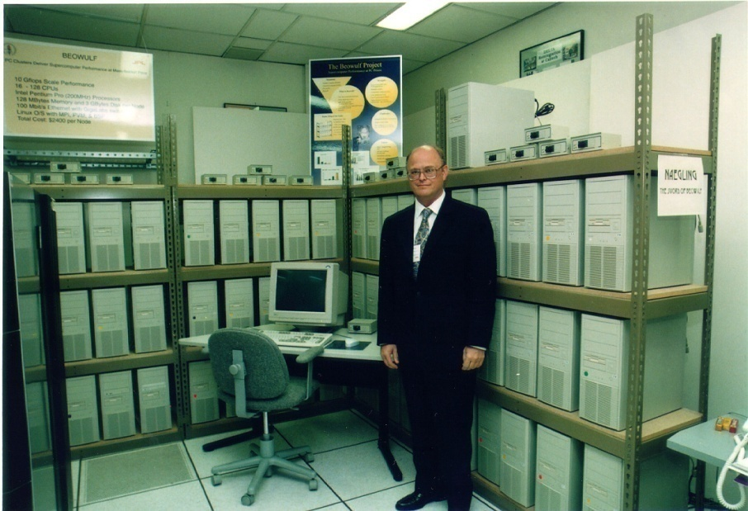
PC Clusters: Contributions of Beowulf
An experiment in parallel computing systems (1994)
Established vision of low cost, high end computing
  Cost effective because it uses off-the-shelf parts
Demonstrated effectiveness of PC clusters for some (not all) classes of applications
Provided networking software
Conveyed findings to broad community (great PR)
Tutorials and book
Design standard to rally
community!
Standards beget:
books, trained people,
software … virtuous cycle
Adapted from Gordon Bell, presentation at Salishan 2000
CS267 Lecture 3
Notes:
CS267 Lecture 2
Thomas Sterling, inventor, 1994
Why “Beowulf”? In the old English epic poem, ~1000 years old, hero Beowulf was
Described as having “30 men’s heft of grasp in his hand”, i.e. 30-way parallel
Today: (Nov 2012): 409 out of Top500 are “clusters” (been ~80% for several years)
Note: Top500 website will generate this and many other statistics

Slide 25
Tflop/s and Pflop/s Clusters (2009 data)
The following are examples of clusters configured out of separate networks and processor components
About 82% of Top 500 are clusters (Nov 2009, up from 72% in 2005),
  4 of top 10
IBM Cell cluster at Los Alamos (Roadrunner) is #2
  12,960 Cell chips + 6,948 dual-core AMD Opterons;
    129600 cores altogether
  1.45 PFlops peak, 1.1PFlops Linpack, 2.5MWatts
  Infiniband connection network
For more details use “database/sublist generator” at www.top500.org
CS267 Lecture 3
Notes:
CS267 Lecture 2
Collaborators/clients at this time:
. SLAC
. FETC
. LBNL HENP
. MSRI
. ExtremeLinux society (national labs, universities, etc)
. Millennium Project
The following slides all address performance aspects. However, our work will be just as much in ease-of-setup/admin, working with users, etc.

Slide 26
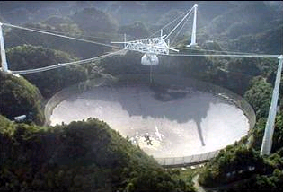
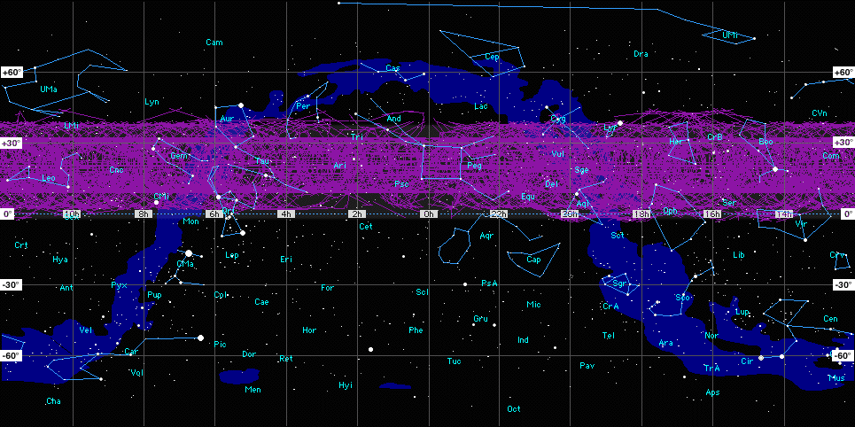

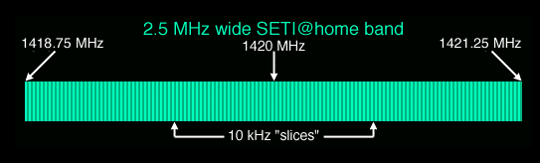
Machine Model 2b: Internet/Grid Computing
SETI@Home: Running on 3.3M hosts, 1.3M users (1/2013)
  ~1000 CPU Years per Day (older data)
  485,821 CPU Years so far
Sophisticated Data & Signal Processing Analysis
Distributes Datasets from Arecibo Radio Telescope
Next Step-
Allen Telescope Array
Google
“volunteer computing”
or “BOINC”
CS267 Lecture 4
Notes:
CS267 Lecture 2
In past have had guest lecture by David Anderson, designer of SETI@Home software
“Contact” with Jodi Foster, based on ideas from this project
BOINC = Berkeley Open Infrastructure for Network Computing
Other apps: protein folding “Folding@Home”, astronomy, chemistry, curing malaria
math (Great Mersenne Prime Search), embarrassingly parallel
google “volunteer computing” or “BOINC”
low trust: each data set analyzed redundantly (3x) to avoid errors/cheating
(machines could break too, will be likely as machines get bigger)
(Data: Jan 2012)
All BOINC projects have > 8.4M hosts (1/2013)
As of Jan 29, 2014: 245K volunteers, 554K computers, 7.7PFlop average over last 24 hours
As of Jan 25, 2015: 236K volunteers, 583K computers, 8.4 PFlop average over last 24 hours

Slide 27
Programming Model 2a: Global Address Space
Program consists of a collection of named threads.
  Usually fixed at program startup time
  Local and shared data, as in shared memory model
  But, shared data is partitioned over local processes
  Cost models says remote data is expensive
Examples: UPC, Titanium, Co-Array Fortran
Global Address Space programming is an intermediate point between message passing and shared memory
Shared memory
s[0]: 26
s[1]: 32
s[n]: 27
y = ..s[i] ...
i: 1
i: 5
Private memory
i: 8
P0
P1
Pn
s[myThread] = ...
CS267 Lecture 3
Notes:
CS267 Lecture 2
Now we switch back to a programming model (software) intended to provide some benefits of
Shared memory programming (simplicity) but run on distributed memory hardware.
We will have guest lecture on UPC.
Homework 3 in UPC (Unified Parallel C)

Slide 28
Machine Model 2c: Global Address Space
Cray T3D, T3E, X1, and HP Alphaserver cluster
Clusters built with Quadrics, Myrinet, or Infiniband
The network interface supports RDMA (Remote Direct Memory Access)
  NI can directly access memory without interrupting the CPU
  One processor can read/write memory with one-sided operations (put/get)
  Not just a load/store as on a shared memory machine
    Continue computing while waiting for memory op to finish
  Remote data is typically not cached locally
P0
NI
P1
NI
Global address space may be supported in varying degrees
Pn
NI
memory
memory
memory
. . .
interconnect
CS267 Lecture 3
Notes:
CS267 Lecture 2
Homework 3 in UPC
Danger of race conditions since processors can read/write one another’s memory without warning
Question: why not tables/local processes for cache coherency, a la distributed shared memory,
as opposed to each reference to a remote shared variable going over network at time of reference?
Answer: ability to scale up on current hardware

Slide 29
Review so far and plan for Lecture 3
Programming Models Machine Models
Shared Memory
1a. Shared Memory
1b. Multithreaded Procs.
1c. Distributed Shared Mem.
Message Passing
2a. Global Address Space
2a. Distributed Memory
2b. Internet & Grid Computing
2c. Global Address Space
3. Data Parallel
3a. SIMD
3b. Vector
4. Hybrid
4. Hybrid
CS267 Lecture 3
What about GPU? What about Cloud?
Notes:
Move on to 3. Data Parallel, eg GPUs
CS267 Lecture 2

Slide 30
Programming Model 3: Data Parallel
Single thread of control consisting of parallel operations.
  A = B+C could mean add two arrays in parallel
Parallel operations applied to all (or a defined subset) of a data structure, usually an array
  Communication is implicit in parallel operators
  Elegant and easy to understand and reason about
  Coordination is implicit – statements executed synchronously
  Similar to Matlab language for array operations
Drawbacks:
  Not all problems fit this model
  Difficult to map onto coarse-grained machines
A:
A = array of all data
fA = f(A)
s = sum(fA)
f
fA:
sum
s:
CS267 Lecture 3
Notes:
CS267 Lecture 2
Map-Reduce: f(A) is a “map”, sum is a “reduce”

Slide 31
Machine Model 3a: SIMD System
A large number of (usually) small processors.
  A single “control processor” issues each instruction.
  Each processor executes the same instruction.
  Some processors may be turned off on some instructions.
Originally machines were specialized to scientific computing, few made (CM2, Maspar)
Programming model can be implemented in the compiler
  mapping n-fold parallelism to p processors, n >> p, but it’s hard (e.g., HPF)
control processor
P1
NI
P2
NI
P3
NI
. . .
Pn-1
NI
Pn
NI
memory
memory
memory
memory
memory
interconnect
CS267 Lecture 3
Notes:
CS267 Lecture 2
SIMD = Single Instruction Multiple Data
Small processor are “slaves” of control processor
HPF = High Performance Fortran
Compilers try to find all parallelism, but not always possible
Simple example: SSE, SSE2, AVX on your Intel chip in your laptop

Slide 32
Machine Model 3b: Vector Machines
Vector architectures are based on a single processor
  Multiple functional units
  All performing the same operation
  Instructions may specific large amounts of parallelism (e.g., 64-way) but hardware executes only a subset in parallel
Historically important
  Overtaken by MPPs in the 90s
Re-emerging in recent years
  At a large scale in the Earth Simulator (NEC SX6) and Cray X1
  At a small scale in SIMD media extensions to microprocessors
    SSE, SSE2 (Intel: Pentium/IA64)
    Altivec (IBM/Motorola/Apple: PowerPC)
    VIS (Sun: Sparc)
  At a larger scale in GPUs
Key idea: Compiler does some of the difficult work of finding parallelism, so the hardware doesn’t have to
CS267 Lecture 3
Notes:
CS267 Lecture 2
Were the fastest machines for a while, Crays, then died out, now back as SIMD instructions, GPUs
Single instruction adds one vector register to another, consisting of 8 or 32 or 64 or … words, all in parallel
Difference between vector and SIMD? Same idea, new notation, since
people thought “vector processors” had died, so bad connotation,
even idea is good and has come back;
Note: special lecture on GPUs, a lot of different notation for similar ideas
(see latest edition of Patterson and Hennessy).
MPP = Massively Parallel Processors (aka clusters)
Why vectors went away and then came back?
Economics: Was cheaper to buy commodity parts and connect them than buy custom HW from Cray,
now economics is different
Moore’s Law: In Beowulf day, processors were “only” 10x faster than networks, now communication
is relatively much more expensive, and “vectors” let you take advantage of all those transistors
in a natural way.
Downside: need to map your algorithm to data parallel implementation, not always easy or efficient,
if problem irregular enough; moving data between CPU/GPU is bottleneck

Slide 33
Vector Processors
Vector instructions operate on a vector of elements
  These are specified as operations on vector registers
A supercomputer vector register holds ~32-64 elts
  The number of elements is larger than the amount of parallel hardware, called vector pipes or lanes, say 2-4
The hardware performs a full vector operation in
  #elements-per-vector-register / #pipes
r1
r2
…
…
vr1
vr2
+
+
(logically, performs # elts adds in parallel)
r3
…
vr3
…
…
vr1
vr2
+
+
+
+
+
+
(actually, performs #pipes adds in parallel)
CS267 Lecture 3
Notes:
CS267 Lecture 2
Difference between vector and SIMD? Same idea, new notation, since
people thought “vector processors” had died, so bad connotation,
even idea is good and has come back;
Note: special lecture on GPUs, a lot of different notation for similar ideas
(see latest edition of Patterson and Hennessy).

Slide 34
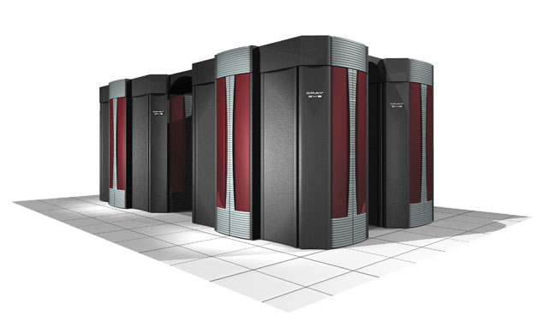
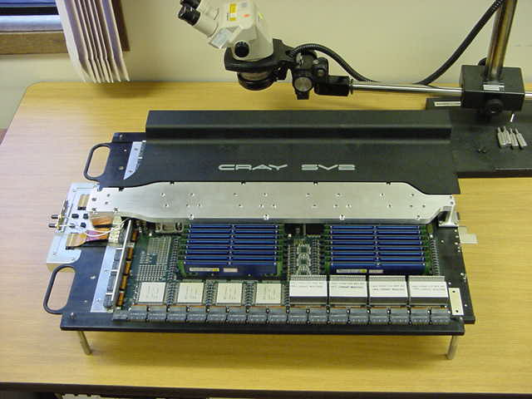
Cray X1: Parallel Vector Architecture
Cray combines several technologies in the X1
12.8 Gflop/s Vector processors (MSP)
Shared caches (unusual on earlier vector machines)
4 processor nodes sharing up to 64 GB of memory
Single System Image to 4096 Processors
Remote put/get between nodes (faster than MPI)
CS267 Lecture 3
Notes:
CS267 Lecture 2

Slide 35
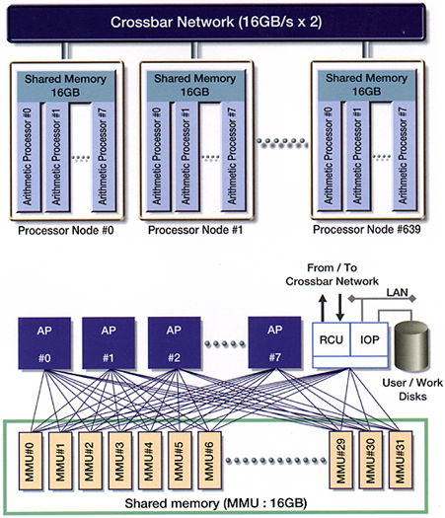
Earth Simulator Architecture
Parallel Vector Architecture
High speed (vector) processors
High memory bandwidth (vector architecture)
Fast network (new crossbar switch)
Rearranging commodity parts can’t match this performance
CS267 Lecture 3
Notes:
CS267 Lecture 2
Was #1 on Top500 for 5 lists in a row
More wires than any other machine
Fills a tennis court: NRC report committee:
Latency across machine along wires was .1 microsecond at speed of light,
Version 10 microsecond software latency, so getting close, only 100x apart
Network was not fully connected crossbar, rather hierarchical,
had special building because so many wires

Slide 36
Review so far and plan for Lecture 3
Programming Models Machine Models
Shared Memory
1a. Shared Memory
1b. Multithreaded Procs.
1c. Distributed Shared Mem.
Message Passing
2a. Global Address Space
2a. Distributed Memory
2b. Internet & Grid Computing
2c. Global Address Space
3. Data Parallel
3a. SIMD & GPU
3b. Vector
4. Hybrid
4. Hybrid
CS267 Lecture 3
What about GPU? What about Cloud?
Notes:
Biggest machines today are hybrids of first 3 kinds
CS267 Lecture 2

Slide 37
Machine Model 4: Hybrid machines
Multicore/SMPs are a building block for a larger machine with a network
Old name:
  CLUMP = Cluster of SMPs
Many modern machines look like this:
  Edison and Hopper (2x12 way nodes), most of Top500
What is an appropriate programming model #4 ???
  Treat machine as “flat”, always use message passing, even within SMP (simple, but ignores an important part of memory hierarchy).
  Shared memory within one SMP, but message passing outside of an SMP.
GPUs may also be building block
  Nov 2014 Top500: 14% have accelerators, but 35% of performance
CS267 Lecture 3
Notes:
CS267 Lecture 2
Hopper: AMD, Edison: Intel
Nov 2013 Top500 list: 10% have accelerators,
but 35% of performance
Nov 2014 Top500 list: 70/500 = 14%
but still 35% of performance

Slide 38
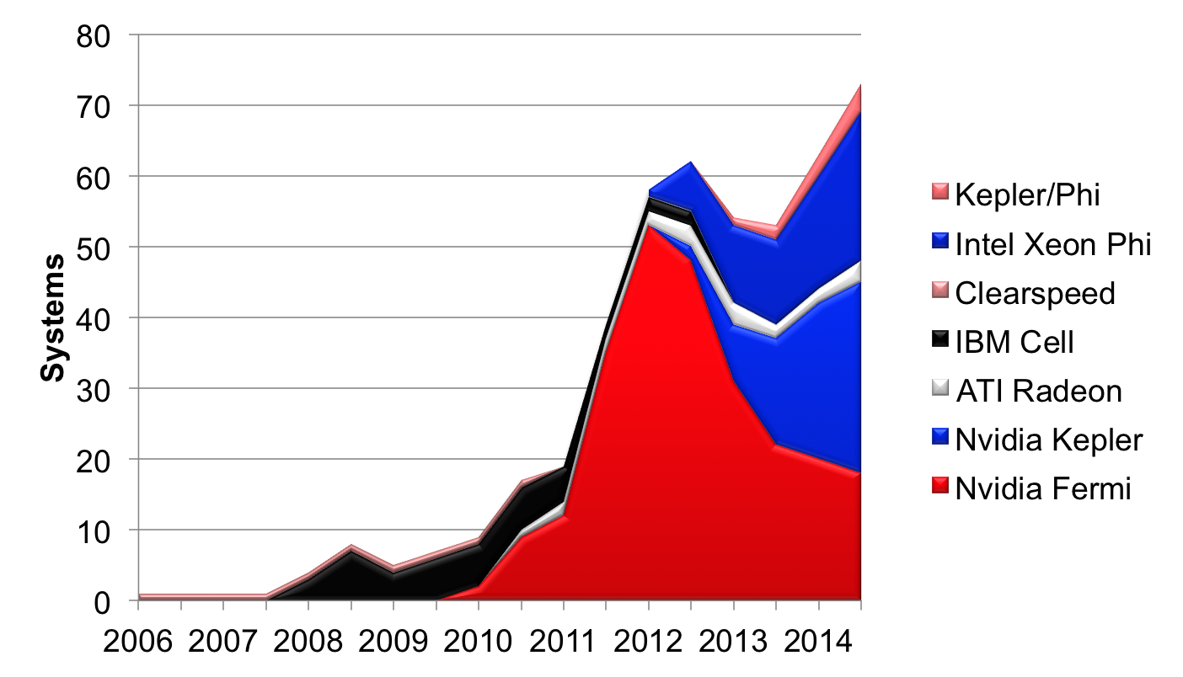
Accelerators in Top 500 (Nov 2014)

Slide 39
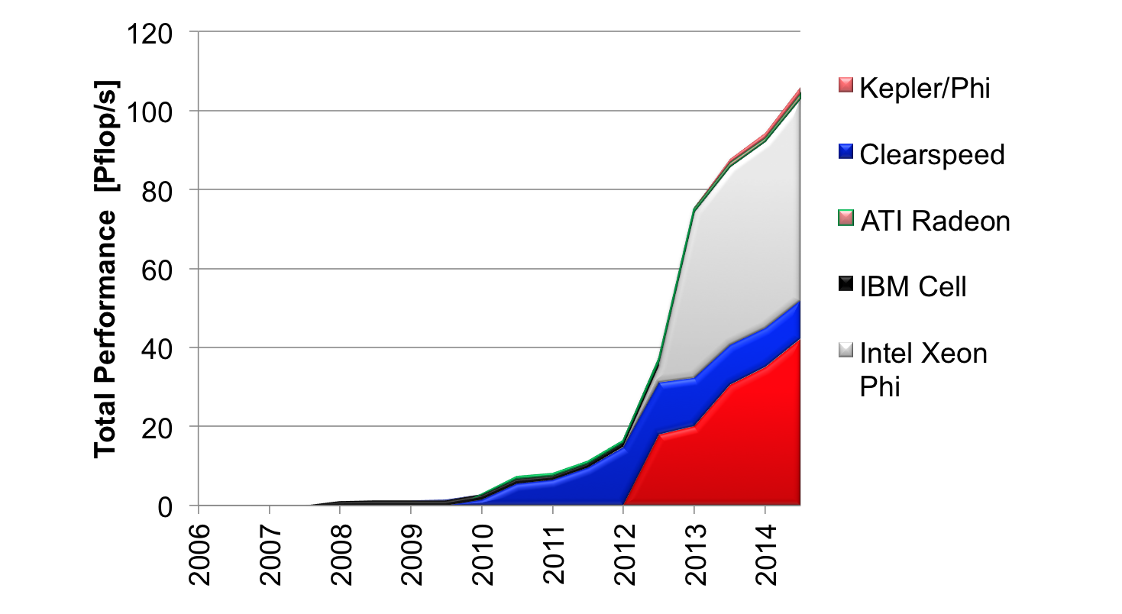
Performance of Accelerators in Top500, Nov 2014

Slide 40
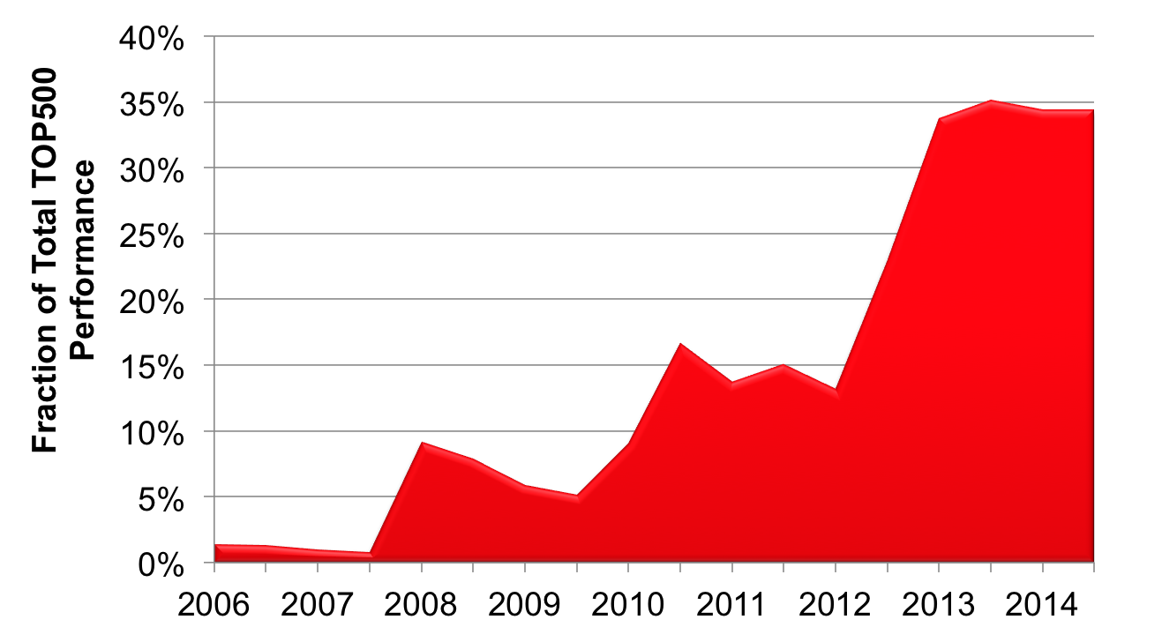
Performance Share of Accelerators in Top500, Nov 2014

Slide 41
Programming Model 4: Hybrids
Programming models can be mixed
  Message passing (MPI) at the top level with shared memory within a node is common
  New DARPA HPCS languages mix data parallel and threads in a global address space
  Global address space models can (often) call message passing libraries or vice verse
  Global address space models can be used in a hybrid mode
    Shared memory when it exists in hardware
    Communication (done by the runtime system) otherwise
For better or worse
  Supercomputers often programmed this way for peak performance
CS267 Lecture 3
Notes:
CS267 Lecture 2

Slide 42
Review so far and plan for Lecture 3
Programming Models Machine Models
Shared Memory
1a. Shared Memory
1b. Multithreaded Procs.
1c. Distributed Shared Mem.
Message Passing
2a. Global Address Space
2a. Distributed Memory
2b. Internet & Grid Computing
2c. Global Address Space
3. Data Parallel
3a. SIMD & GPU
3b. Vector
4. Hybrid
4. Hybrid
What about GPU? What about Cloud?
CS267 Lecture 3

Slide 43
What about GPU and Cloud?
GPU’s big performance opportunity is data parallelism
  Most programs have a mixture of highly parallel operations, and some not so parallel
  GPUs provide a threaded programming model (CUDA) for data parallelism to accommodate both
  Current research attempting to generalize programming model to other architectures, for portability (OpenCL)
  Guest lecture later in the semester
Cloud computing lets large numbers of people easily share O(10⁵) machines
  MapReduce was first programming model: data parallel on distributed memory
  More flexible models (Hadoop, Spark, …) invented since then
  Guest lecture later in the semester
Both may be used for class projects
CS267 Lecture 3
Notes:
GPU = Graphic Processing Unit,
think of one task per pixel, lots of parallelism
later: realized big market in HPC as well
Cloud: warehouse of O(10^5) machines, originally for Google and Amazon to
do web searches, now widely commercially available
CS267 Lecture 2

Slide 44
Lessons from Lecture 3
Three basic conceptual models
  Shared memory
  Distributed memory
  Data parallel
  and hybrids of these machines
All of these machines rely on dividing up work into parts that are:
  Mostly independent (little synchronization)
  About same size (load balanced)
  Have good locality (little communication)
Next Lecture: How to identify parallelism and locality in applications
CS267 Lecture 3
Notes:
CS267 Lecture 2
Recall: Programming model describe:
Control: how to express parallelism, what to do in what order
Data: what data is private vs shared, how is logically shared data accessed or communicated
Synchronization: how to coordinate different parallel tasks;
depends on what operations are atomic
Fortunately, commonly arising simulation problems have naturally
many independent problems, about the same size, that can
run with good locality (next lecture).

Slide 45
Class Update (2013)
Class makeup is very diverse
44 Grad Students
  15 CS, 7 EECS
  6 Mech Eng, 4 Civil Env Eng, 3 Chem Eng, 2 Physics
  1 each from Bio Eng, Business, Chem, Earth & Planetary Science, Math, Material Sci Eng, Stat
9 Undergrad Students
  6 EECS, 2 Double, 1 Applied Math
CS267 Lecture 3
Notes:
“Missing” BioStat, Nuclear Eng, IEOR
CS267 Lecture 2

Slide 46
Class Update (2011)
Class makeup is very diverse
  10 CS Grad students
  13 Application areas: 4 Nuclear, 3 EECS, 1 each for IEOR, ChemE, Civil, Physics, Chem, Biostat, MechEng, Materials
  Undergrad: 7 (not all majors shown, mostly CS)
  Concurrent enrollment: 6 (majors not shown)
Everyone is an expert different parts of course
  Some lectures are broad (lecture 1)
  Some go into details (lecture 2)
Lecture plan change:
  Reorder lectures 4+5 with lectures 6+7
  After today: 2 lectures on “Sources of Parallelism” in various science engineering simulations, Jim will lecture
  Today: finish practicalities of tuning code (slide 66 of lecture 2 slides) followed by high level overview of parallel machines
CS267 Lecture 3

Slide 47
Cray X1 Node
Cray X1 builds a larger “virtual vector”, called an MSP
  4 SSPs (each a 2-pipe vector processor) make up an MSP
  Compiler will (try to) vectorize/parallelize across the MSP
12.8 Gflops (64 bit)
custom
blocks
25.6 Gflops (32 bit)
S
S
S
S
V
V
V
V
V
V
V
V
51 GB/s
25-41 GB/s
0.5 MB
$
0.5 MB
$
0.5 MB
$
0.5 MB
$
2 MB Ecache
At frequency of
400/800 MHz
To local memory and network:
25.6 GB/s
CS267 Lecture 3
12.8 - 20.5 GB/s
Figure source J. Levesque, Cray
Notes:
CS267 Lecture 2

