Slide 1
CS 267
Sources of
Parallelism and Locality in Simulation
Lecture 4
James Demmel
www.cs.berkeley.edu/~demmel/cs267_Spr15
CS267 Lecture 4
Notes:
CS267 Lecture 2
Recall layers:
Applications (this lecture)
Algorithms
Software
Hardware

Slide 2
Parallelism and Locality in Simulation
Parallelism and data locality both critical to performance
  Recall that moving data is the most expensive operation
Real world problems have parallelism and locality:
  Many objects operate independently of others.
  Objects often depend much more on nearby than distant objects.
  Dependence on distant objects can often be simplified.
    Example of all three: particles moving under gravity
Scientific models may introduce more parallelism:
  When a continuous problem is discretized, time dependencies are generally limited to adjacent time steps.
    Helps limit dependence to nearby objects (eg collisions)
  Far-field effects may be ignored or approximated in many cases.
Many problems exhibit parallelism at multiple levels
CS267 Lecture 4
Notes:
CS267 Lecture 2
Not all problems solved on parallel machines involve simulation, but many do (eg graphics, games,…)
High level reasons, detailed example later:
object operating independently: I’m talking, you’re doing something else
billiard balls roll around independently until they collide
nearby dependence: collisions, gravity
simplify distant dependence: gravitational effect on earth by Andromeda galaxy
is one term, not billions, similar idea drops cost to O(n) from O(n^2)
Not all problems solved on parallel machines involve simulation, but many do (eg graphics, games,…)
Multiple levels: combine all these features
Use particles moving under gravity as example for first bullet
For second bullet, point out that in one time step, may only depend on nearby objects
(eg collisions)

Slide 3
Basic Kinds of Simulation
Discrete event systems:
  “Game of Life,” Manufacturing systems, Finance, Circuits, Pacman, …
Particle systems:
  Billiard balls, Galaxies, Atoms, Circuits, Pinball …
Lumped variables depending on continuous parameters
  aka Ordinary Differential Equations (ODEs),
  Structural mechanics, Chemical kinetics, Circuits, Star Wars: The Force Unleashed
Continuous variables depending on continuous parameters
  aka Partial Differential Equations (PDEs)
  Heat, Elasticity, Electrostatics, Finance, Circuits, Medical Image Analysis, Terminator 3: Rise of the Machines
A given phenomenon can be modeled at multiple levels.
Many simulations combine more than one of these techniques.
For more on simulation in games, see
  www.cs.berkeley.edu/b-cam/Papers/Parker-2009-RTD
CS267 Lecture 4
Notes:
CS267 Lecture 2
Sorted from most discrete to most continuous
Discrete event: time, objects and rules/events being simulated are discrete
Game of Life, from Scientific American
Manufacturing: assembly lines
Finance: transactions:
Circuits: digital circuits (gates, transistors) changing at clock ticks
Some (old) computer games, like Pacman
Particles: a little more continuous (time, but still discrete steps)
and positions of particles (but still a discrete set of particles)
like billiard balls bouncing, as in pinball, or stars moving under gravity, or
atoms: molecular dynamics
circuits modeled with moving electrons (running example)
slightly more modern games, like pinball
Lumped variables, discrete variables, depending continuously on connected variables,
more general than just ODE’s can have constraints (DAEs)
varying continuously with time;
Circuits (SPICE: ODEs for voltage, resistors, capacitors etc in circuit)
Star Wars: Doing correct structural mechanics simulation when Darth Vader smashed something (video later)
All continuous: time and space or other physical quantities are continuous (even though must discretize both to solve)
Heat equation: temperature(position, time), Electrostatics: Poisson eqn, Maxwell’s equations
Finance again: Black-Scholes equation for derivative pricing (Nobel Economics, 1997)
Circuits: Schroedinger Equation if you like,
Terminator 3: detailed simulation of fluid splashing around as former governor was smashing things
Another difference: Star Wars developed at Berkeley, Terminator at Stanford
Common: both won Academy Awards for Technical Achievement
James O’Brien @ UCB: Finite Element Destruction Modeling, 2015
Ron Fedkiw @ Stanford: 2008
both used in Harry Potter movies

Slide 4
Example: Circuit Simulation
Circuits are simulated at many different levels
Level | Primitives | Examples
Instruction level | Instructions | SimOS, SPIM
Cycle level | Functional units | VIRAM-p
Register Transfer Level (RTL) | Register, counter, MUX | VHDL
Gate Level | Gate, flip-flop, memory cell | Thor
Switch level | Ideal transistor | Cosmos
Circuit level | Resistors, capacitors, etc. | Spice
Device level | Electrons, silicon
Discrete
Event
Lumped
Systems
Continuous
Systems
CS267 Lecture 4
Notes:
CS267 Lecture 2
Lumped system: DAE not just ODE (Kirchoff’s Laws, Ohm’s Law etc)
Instruction level simulation: Virtual machines (business model in Silicon Valley)
Don Petersen of EECS invented Spice

Slide 5
Outline
discrete
Discrete event systems
  Time and space are discrete
Particle systems
  Important special case of lumped systems
Lumped systems (ODEs)
  Location/entities are discrete, time is continuous
Continuous systems (PDEs)
  Time and space are continuous
  Next lecture
Identify common problems and solutions
continuous
CS267 Lecture 4
Notes:
CS267 Lecture 2
Goal for next lecture and a half…

Slide 6
A Model Problem: Sharks and Fish
Illustration of parallel programming
  Original version (discrete event only) proposed by Geoffrey Fox
  Called WATOR
Basic idea: sharks and fish living in an ocean
  rules for movement (discrete and continuous)
  breeding, eating, and death
  forces in the ocean
  forces between sea creatures
6 problems (S&F1 - S&F6)
  Different sets of rules, to illustrate different phenomena
Available in many languages (see class web page)
  Matlab, pThreads, MPI, OpenMP, Split-C, Titanium, CMF, CMMD, pSather (not all problems in all languages)
Some homework based on these
CS267 Lecture 4
Notes:
CS267 Lecture 2
To teach patterns without knowing lots of physics, have made up
simple rules of sharks&fish to illustrate parallelization techniques
“fish gravity” creates schools of fish swimming around

Slide 7
Sharks and Fish
S&F 1. Fish alone move continuously subject to an external current and Newton's laws.
S&F 2. Fish alone move continuously subject to gravitational attraction and Newton's laws.
S&F 3. Fish alone play the "Game of Life" on a square grid.
S&F 4. Fish alone move randomly on a square grid, with at most one fish per grid point.
S&F 5. Sharks and Fish both move randomly on a square grid, with at most one fish or shark per grid point, including rules for fish attracting sharks, eating, breeding and dying.
S&F 6. Like Sharks and Fish 5, but continuous, subject to Newton's laws.
CS267 Lecture 4
Notes:
CS267 Lecture 2
SF1: fish ignore one another, swim around in current
SF2: fish are attracted to one another, form schools
like HW2 but no collisions, see code later
SF3: game of life
SF4: need to keep at most one fish per cell,
so need to deal with possible races, deadlock
SF6: rules, not implementation

Slide 8
Discrete Event Systems
CS267 Lecture 4
Notes:
CS267 Lecture 2

Slide 9
Discrete Event Systems
Systems are represented as:
  finite set of variables.
  the set of all variable values at a given time is called the state.
  each variable is updated by computing a transition function depending on the other variables.
System may be:
  synchronous: at each discrete timestep evaluate all transition functions; also called a state machine.
  asynchronous: transition functions are evaluated only if the inputs change, based on an “event” from another part of the system; also called event driven simulation.
Example: The “game of life:”
  Also known as Sharks and Fish #3:
  Space divided into cells, rules govern cell contents at each step
CS267 Lecture 4
Notes:
CS267 Lecture 2
Synchronous: change at every clock tick
Asynchronous: may or may not be clock

Slide 10
Parallelism in Game of Life (S&F 3)
The simulation is synchronous
  use two copies of the grid (old and new), “ping-pong” between them
  the value of each new grid cell depends only on 9 cells (itself plus 8 neighbors) in old grid.
  simulation proceeds in timesteps-- each cell is updated at every step.
Easy to parallelize by dividing physical domain: Domain Decomposition
Locality is achieved by using large patches of the ocean
  Only boundary values from neighboring patches are needed.
How to pick shapes of domains?
P4
Repeat
compute locally to update local system
barrier()
exchange state info with neighbors
finish updates
until done simulating
P1
P2
P3
P5
P6
P7
P8
P9
CS267 Lecture 4
Notes:
CS267 Lecture 2
Only need two grids: ping pong between them, avoid race conditions
Note: DD also refers to related numerical technique, here we mean just dividing the physical domain
Load balanced because each processor gets equal #grid cells
Square domains seem natural, but lots of choices in general, how choose?

Slide 11
Regular Meshes (e.g. Game of Life)
Suppose graph is nxn mesh with connection NSEW neighbors
Which partition has less communication? (n=18, p=9)
Minimizing communication on mesh ≡ minimizing “surface to volume ratio” of partition
n*(p-1)
edge crossings
2*n*(p^{1/2} –1)
edge crossings
CS267 Lecture 4
Notes:
CS267 Lecture 2
Spheres (or circles) would minimize surface-to-volume
(or perimeter-to-area) ratio, but they don’t’ “tile” the cube (or plane)
What geometric shape in plane truly minimizes surface-to-volume ratio?
Disk, but hard to tile using disks, so square approximates it

Slide 12
Synchronous Circuit Simulation
Circuit is a graph made up of subcircuits connected by wires
  Component simulations need to interact if they share a wire.
  Data structure is (irregular) graph of subcircuits.
  Parallel algorithm is timing-driven or synchronous:
    Evaluate all components at every timestep (determined by known circuit delay)
Graph partitioning assigns subgraphs to processors
  Determines parallelism and locality.
  Goal 1 is to evenly distribute subgraphs to nodes (load balance).
  Goal 2 is to minimize edge crossings (minimize communication).
  Easy for meshes, NP-hard in general, so we will approximate (future lecture)
better
edge crossings = 6
edge crossings = 10
CS267 Lecture 4
Notes:
CS267 Lecture 2
Will use graphs all semester: Graph is collection of nodes connected by edges
Nodes and edges in graph may be weighted
Optimal graph partitioning is NP-complete (define for non-CS audience)
Good graph partitioning techniques exist
More on this in a later lecture

Slide 13
Sharks & Fish in Loosely Connected Ponds
Parallelization: each processor gets a set of ponds with roughly equal total area
  work is proportional to area, not number of creatures
One pond can affect another (through streams) but infrequently
CS267 Lecture 4
Notes:
CS267 Lecture 2
Natural to assign ponds to processors
How to take advantage of likely infrequent events along narrow connectors?

Slide 14
Asynchronous Simulation
Synchronous simulations may waste time:
  Simulates even when the inputs do not change
Asynchronous (event-driven) simulations update only when an event arrives from another component:
  No global time steps, but individual events contain time stamp.
  Example: Game of life in loosely connected ponds (don’t simulate empty ponds).
  Example: Circuit simulation with delays (events are gates changing).
  Example: Traffic simulation (events are cars changing lanes, etc.).
Asynchronous is more efficient, but harder to parallelize
  In MPI, events are naturally implemented as messages, but how do you know when to execute a “receive”?
CS267 Lecture 4
Notes:
CS267 Lecture 2
Whole point is not to look in your mail box too often,
so how do you know when to check?
Problems: some natural approaches can deadlock,
Others can simulate too far ahead in time, need to fix it
if an event at an earlier time step arrives

Slide 15
Scheduling Asynchronous Circuit Simulation
Conservative:
  Only simulate up to (and including) the minimum time stamp of inputs.
  Need deadlock detection if there are cycles in graph
    Example on next slide
  Example: Pthor circuit simulator in Splash1 from Stanford.
Speculative (or Optimistic):
  Assume no new inputs will arrive and keep simulating.
  May need to backup if assumption wrong, using timestamps
  Example: Timewarp [D. Jefferson], Parswec [Wen,Yelick].
Optimizing load balance and locality is difficult:
  Locality means putting tightly coupled subcircuit on one processor.
  Since “active” part of circuit likely to be in a tightly coupled subcircuit, this may be bad for load balance.
CS267 Lecture 4
Notes:
CS267 Lecture 2
Code for conservative simulation: get all inputs from your neighbors, take minimum of all
time stamps, simulate up to that time stamp
Deadlock detection: after waiting for an incoming event for while, send out an “Are you stuck too?”
Message to the processors who take your output as input. If you ever receive such a message,
You pass it on. If you receive such a message after having sent it on, you know there is a
Cycle of deadlock, and you just take a step using the latest input value that you have.
Simulating 5 steps ahead means you need to save data from 5 steps ago.
If guess wrong often, need to back up often, inefficient
No one best way, so both used

Slide 16
Deadlock in Conservative Asynchronous Circuit Simulation
Example: Sharks & Fish 3, with 3 processors simulating 3 ponds connected by streams along which fish can move
Suppose all ponds simulated up to time t₀, but no fish move, so no messages sent from one proc to another
  So no processor can simulate past time t₀
Fix: After waiting for an incoming message for a while, send out an “Are you stuck too?” message
  If you ever receive such a message, pass it on
  If you receive such a message that you sent, you have a deadlock cycle, so just take a step with latest input
Can be a serial bottleneck
CS267 Lecture 4
Notes:
CS267 Lecture 2
Deadlock detection: after waiting for an incoming event for while, send out an “Are you stuck too?”
Message to the processors who take your output as input. If you ever receive such a message,
You pass it on. If you receive such a message after having sent it on, you know there is a
Cycle of deadlock, and you just take a step using the latest input value that you have.

Slide 17
Summary of Discrete Event Simulations
Model of the world is discrete
  Both time and space
Approaches
  Decompose domain, i.e., set of objects
  Run each component ahead using
    Synchronous: communicate at end of each timestep
    Asynchronous: communicate on-demand
      Conservative scheduling – wait for inputs
        need deadlock detection
      Speculative scheduling – assume no inputs
        roll back if necessary
CS267 Lecture 4
Notes:
CS267 Lecture 2
Domain decomposition done by graph partitioning,
to balance load and minimize communication

Slide 18
Summary of Lecture so far
Parallelism and Locality arise naturally in simulation
  So far: Discrete Event Simulation (time and space discrete)
  Next: Particle Systems, Lumped variables (ODEs), Continuous variables (PDEs)
Discrete Event Simulation
  Game of Life, Digital Circuits, Pacman, …
  Finite set of variables, values at a given time called state
  Each variable updated by transition function depending on others
  Assign work to processors (domain decomposition)
    Goals: balance load and minimize communication
    Represent problem by graph
      Nodes are states, edges are dependencies
      Partition graph (NP hard, so approximate)
  Synchronous: update all values at each discrete timestep
  Asynchronous: update a value only if inputs change, when an “event” occurs; also called event driven simulation
    Conservative vs Speculative approaches
CS267 Lecture 4
Notes:
CS267 Lecture 2

Slide 19
Particle Systems
CS267 Lecture 4
Notes:
CS267 Lecture 2
START HERE

Slide 20
Particle Systems
A particle system has
  a finite number of particles
  moving in space according to Newton’s Laws (i.e. F = ma)
  time is continuous
Examples
  stars in space with laws of gravity
  electron beam in semiconductor manufacturing
  atoms in a molecule with electrostatic forces
  neutrons in a fission reactor
  cars on a freeway with Newton’s laws plus model of driver and engine
  balls in a pinball game
Reminder: many simulations combine techniques such as particle simulations with some discrete events (Ex Sharks and Fish)
CS267 Lecture 4
Notes:
CS267 Lecture 2

Slide 21
Forces in Particle Systems
Force on each particle can be subdivided
force = external_force + nearby_force + far_field_force
External force
  ocean current in sharks and fish world (S&F 1)
  externally imposed electric field in electron beam
Nearby force
  sharks attracted to eat nearby fish (S&F 5)
  balls on a billiard table bounce off of each other
  Van der Waals forces in fluid (1/r^6) … how Gecko feet work?
Far-field force
  fish attract other fish by gravity-like (1/r^2 ) force (S&F 2)
  gravity, electrostatics, radiosity in graphics
  forces governed by elliptic PDE
CS267 Lecture 4
Notes:
CS267 Lecture 2
External force: embarrassingly parallel
Van der Waals: model of attraction of dipoles and multipoles
Gecko feet: see wikipedia, can walk upside down on ceiling
Far field: seek O(n) algorithms, not obvious O(n^2) when possible

Slide 22
Example S&F 1: Fish in an External Current
% fishp = array of initial fish positions (stored as complex numbers)
% fishv = array of initial fish velocities (stored as complex numbers)
% fishm = array of masses of fish
% tfinal = final time for simulation (0 = initial time)
% Algorithm: integrate using Euler's method with varying step size
% Initialize time step, iteration count, and array of times
dt = .01; t = 0;
% loop over time steps
while t < tfinal,
t = t + dt;
fishp = fishp + dt*fishv;
accel = current(fishp)./fishm; % current depends on position
fishv = fishv + dt*accel;
% update time step (small enough to be accurate, but not too small)
dt = min(.1*max(abs(fishv))/max(abs(accel)),1);
end
CS267 Lecture 4
Notes:
CS267 Lecture 2
current(position) is a function that returns force from current on fish
located at the given position
Algorithm: Euler = straight line approximation
One complex number gives position in 2D, same for velocity, acceleration
Timestep update: fastest fish changes its velocity by at most about 10%
Requires reduction => communication
Or: dt*norm(accel) <= .1*norm(fishv)
dt update only communication

Slide 23
Parallelism in External Forces
These are the simplest
The force on each particle is independent
Called “embarrassingly parallel”
  Sometimes called “map reduce” by analogy
Evenly distribute particles on processors
  Any distribution works
  Locality is not an issue
For each particle on processor, apply the external force
  Also called “map”
  May need to “reduce” (eg compute maximum) to compute time step, other data
CS267 Lecture 4
Notes:
CS267 Lecture 2

Slide 24
Parallelism in Nearby Forces
Nearby forces require interaction and therefore communication.
Force may depend on other nearby particles:
  Example: collisions.
  simplest algorithm is O(n²): look at all pairs to see if they collide.
Usual parallel model is domain decomposition of physical region in which particles are located
  O(n/p) particles per processor if evenly distributed.
CS267 Lecture 4
Notes:
CS267 Lecture 2
often called “domain decomposition,” but the term also refers to a numerical technique.

Slide 25
Parallelism in Nearby Forces
Challenge 1: interactions of particles near processor boundary:
  need to communicate particles near boundary to neighboring processors.
    Region near boundary called “ghost zone”
  Low surface to volume ratio means low communication.
    Use squares, not slabs, to minimize ghost zone sizes
Communicate particles in boundary region to neighbors
Need to check for collisions between regions
CS267 Lecture 4
Notes:
CS267 Lecture 2
What shape domain? Similar to game-of-life: minimize surface-to-volume ratio
This works if particles evenly distributed, then load balanced, what if they aren’t?

Slide 26
Parallelism in Nearby Forces
Challenge 2: load imbalance, if particles cluster:
  galaxies, electrons hitting a device wall.
To reduce load imbalance, divide space unevenly.
  Each region contains roughly equal number of particles.
  Quad-tree in 2D, oct-tree in 3D.
  May need to rebalance as particles move, hopefully seldom
Example: each square contains at most 3 particles
CS267 Lecture 4
Notes:
CS267 Lecture 2
Do we need to update decomposition as particles move?
Hopefully pick timestep small enough so that balance
Changes slowly

Slide 27
Parallelism in Far-Field Forces
Far-field forces involve all-to-all interaction and therefore communication.
Force depends on all other particles:
  Examples: gravity, protein folding
  Simplest algorithm is O(n²) as in S&F 2, 4, 5.
  Just decomposing space does not help since every particle needs to “visit” every other particle.
Use more clever algorithms to reduce communication
Use more clever algorithms to beat O(n²).
Implement by rotating particle sets.
Keeps processors busy
All processors eventually see all particles
CS267 Lecture 4
Notes:
CS267 Lecture 2
Communication cost of straightforward algorithm is
#words moved = (n/p) particles/proc * p steps = n words moved
Can reduce n words to n/sqrt(p) words by clever algorithm
Can reduce O(n^2) flops to O(n) flops by even more clever algorithms

Slide 28
Far-field Forces: Particle-Mesh Methods
Based on approximation:
  Superimpose a regular mesh.
  “Move” particles to nearest grid point.
Exploit fact that the far-field force satisfies a PDE that is easy to solve on a regular mesh:
  FFT, multigrid (described in future lectures)
  Cost drops to O(n log n) or O(n) instead of O(n²)
Accuracy depends on the fineness of the grid is and the uniformity of the particle distribution.
1) Particles are moved to nearby mesh points (scatter)
2) Solve mesh problem
3) Forces are interpolated at particles from mesh points (gather)
CS267 Lecture 4
Notes:
CS267 Lecture 2
Data structures: a 1D array of particles (each with a location)
a 2D (or 3D) array representing the mesh
Scatter: store particle value (say mass) at nearby mesh point
Gather: read forces from mesh, using particle location as index (as in scatter)

Slide 29
Far-field forces: Tree Decomposition
Based on approximation.
  Forces from group of far-away particles “simplified” -- resembles a single large particle.
  Use tree; each node contains an approximation of descendants.
Also O(n log n) or O(n) instead of O(n²).
Several Algorithms
  Barnes-Hut.
  Fast multipole method (FMM)
  of Greengard/Rohklin.
  Anderson’s method.
Discussed in later lecture.
CS267 Lecture 4
Notes:
CS267 Lecture 2

Slide 30
Summary of Particle Methods
Model contains discrete entities, namely, particles
Time is continuous – must be discretized to solve
Simulation follows particles through timesteps
  Force = external _force + nearby_force + far_field_force
  All-pairs algorithm is simple, but inefficient, O(n²)
  Particle-mesh methods approximates by moving particles to a regular mesh, where it is easier to compute forces
  Tree-based algorithms approximate by treating set of particles as a group, when far away
May think of this as a special case of a “lumped” system
CS267 Lecture 4
Notes:
CS267 Lecture 2

Slide 31
Lumped Systems:
ODEs
CS267 Lecture 4
Notes:
CS267 Lecture 2

Slide 32
System of Lumped Variables
Many systems are approximated by
  System of “lumped” variables.
  Each depends on continuous parameter (usually time).
Example -- circuit:
  approximate as graph.
    wires are edges.
    nodes are connections between 2 or more wires.
    each edge has resistor, capacitor, inductor or voltage source.
  system is “lumped” because we are not computing the voltage/current at every point in space along a wire, just endpoints.
  Variables related by Ohm’s Law, Kirchoff’s Laws, etc.
Forms a system of ordinary differential equations (ODEs).
  Differentiated with respect to time
  Variant: ODEs with some constraints
    Also called DAEs, Differential Algebraic Equations
CS267 Lecture 4
Notes:
CS267 Lecture 2
Laws of physics depend on field:
For EE: Ohm’s, Kirchoff’s, etc
For ME: F=ma, Hook’s law, etc.

Slide 33
Circuit Example
State of the system is represented by
  v_{n}(t) node voltages
  i_{b}(t) branch currents all at times t
  v_{b}(t) branch voltages
Equations include
  Kirchoff’s current
  Kirchoff’s voltage
  Ohm’s law
  Capacitance
  Inductance
A is sparse matrix, representing connections in circuit
  One column per branch (edge), one row per node (vertex) with +1 and -1 in each column at rows indicating end points
Write as single large system of ODEs or DAEs
0 A 0 v_{n} 0
A’ 0 -I * i_{b} = S
0 R -I v_{b} 0
0 -I C*d/dt 0
0 L*d/dt I 0
CS267 Lecture 4
Notes:
CS267 Lecture 2
A has one column per branch (edge), one row per node (vertex),
With +1 and -1 in each column at rows indicating end points
V_n = voltage at each node, where wires come together
I_b = current along each wire / edge / branch
V_b = difference of node voltages at ends of each wire / edge / branch

Slide 34
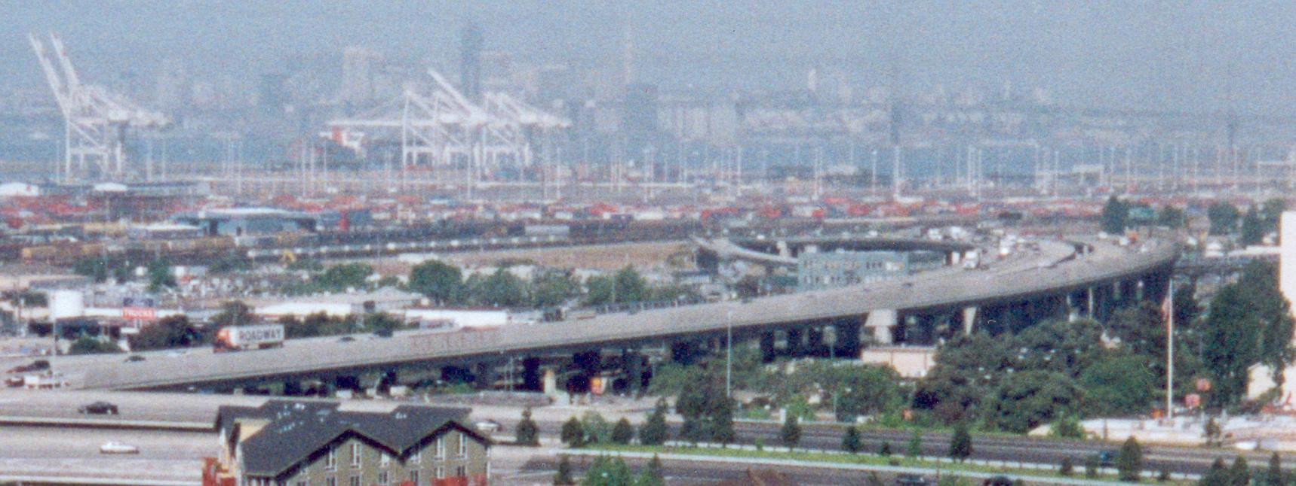
Structural Analysis Example
Another example is structural analysis in civil engineering:
  Variables are displacement of points in a building.
  Newton’s and Hook’s (spring) laws apply.
  Static modeling: exert force and determine displacement.
  Dynamic modeling: apply continuous force (earthquake).
  Eigenvalue problem: do the resonant modes of the building match an earthquake?
OpenSees project in CE at Berkeley looks at this section of 880, among others
CS267 Lecture 4
Notes:
CS267 Lecture 2
Part of 880 that collapsed in Loma Prieta Earthquake
Static: solving systems of sparse linear equations
Dynamic: solving ODEs

Slide 35
Gaming Example
Star Wars – The Force Unleashed …
  www.cs.berkeley.edu/b-cam/Papers/Parker-2009-RTD
CS267 Lecture 4
Notes:
parker-2009-RTD-video.mov
Find at cs267_Spr13/Lectures
Winner of 2015 Academy Award for Technical Achievement, for “Destruction Simulation”
Minute 1:22: smashing stone
1:38: glass
1:53: metal
2:37: plants
3:43: details
Running on Sony game station – 8-way parallelism
CS267 Lecture 2

Slide 36
Solving ODEs
In these examples, and most others, the matrices are sparse:
  i.e., most array elements are 0.
  neither store nor compute on these 0’s.
  Sparse because each component only depends on a few others
Given a set of ODEs, two kinds of questions are:
  Compute the values of the variables at some time t
    Explicit methods
    Implicit methods
  Compute modes of vibration
    Eigenvalue problems
CS267 Lecture 4
Notes:
CS267 Lecture 2
Reason for sparsity is a locality property from physics.

Slide 37
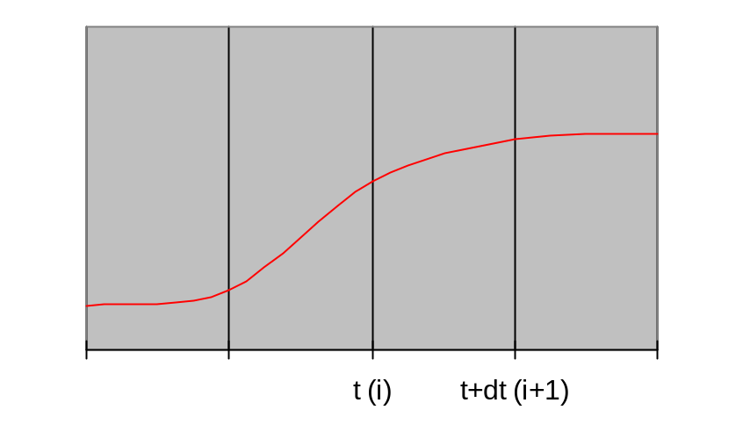
Solving ODEs: Explicit Methods
Assume ODE is x’(t) = f(x) = A*x(t), where A is a sparse matrix
  Compute x(i*dt) = x[i]
  at i=0,1,2,…
  ODE gives x’(i*dt) = slope
  x[i+1]=x[i] + dt*slope
Explicit methods, e.g., (Forward) Euler’s method.
  Approximate x’(t)=A*x(t) by (x[i+1] - x[i] )/dt = A*x[i].
  x[i+1] = x[i]+dt*A*x[i], i.e. sparse matrix-vector multiplication.
Tradeoffs:
  Simple algorithm: sparse matrix vector multiply.
  Stability problems: May need to take very small time steps, especially if system is stiff (i.e. A has some large entries, so x can change rapidly).
Use slope at x[i]
CS267 Lecture 4
Notes:
CS267 Lecture 2
Explicit: easiest to parallelize, but some numerical drawbacks
“Stiff” technical term for very steep (quickly changing) solution

Slide 38
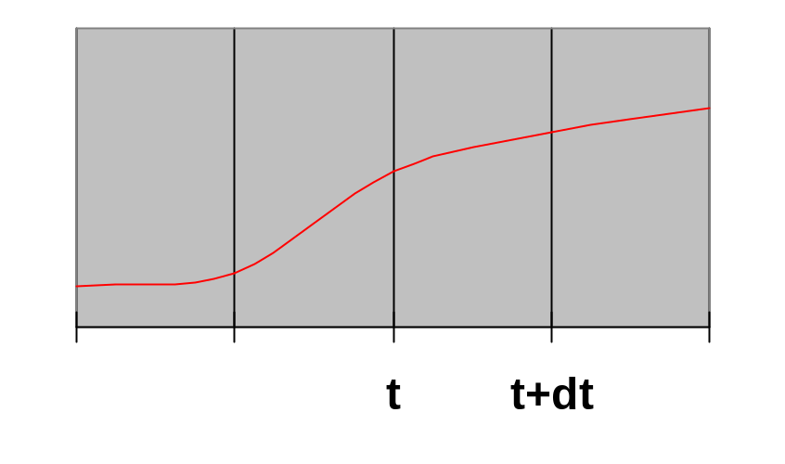
Solving ODEs: Implicit Methods
Assume ODE is x’(t) = f(x) = A*x(t) , where A is a sparse matrix
  Compute x(i*dt) = x[i]
  at i=0,1,2,…
  ODE gives x’((i+1)*dt) = slope
  x[i+1]=x[i] + dt*slope
Implicit method, e.g., Backward Euler solve:
  Approximate x’(t)=A*x(t) by (x[i+1] - x[i] )/dt = A*x[i+1].
  (I - dt*A)*x[i+1] = x[i], i.e. we need to solve a sparse linear system of equations.
Trade-offs:
  Larger timestep possible: especially for stiff problems
  More difficult algorithm: need to solve a sparse linear system of equations at each step
Use slope at x[i+1]
t (i) t + dt (i+1)
CS267 Lecture 4
Notes:
CS267 Lecture 2
Patterns: either do sparse-matrix-vector-multiply (explicit case)
Or solve sparse system of linear equations (implicit case)

Slide 39
Solving ODEs: Eigensolvers
Computing modes of vibration: finding eigenvalues and eigenvectors.
  Seek solution of d²x(t)/dt² = A*x(t) of form x(t) = sin(ω*t) * x₀, where x₀ is a constant vector
    ω called the frequency of vibration
    x₀ sometimes called a “mode shape”
  Plug in to get -ω² *x₀ = A*x₀, so that -ω² is an eigenvalue and x₀ is an eigenvector of A.
  Solution schemes reduce either to sparse-matrix multiplications, or solving sparse linear systems.
CS267 Lecture 4
Notes:
CS267 Lecture 2

Slide 40
Summary of ODE Methods
Explicit methods for ODEs need sparse-matrix-vector mult.
Implicit methods for ODEs need to solve linear systems
Direct methods (Gaussian elimination)
  Called LU Decomposition, because we factor A = L*U.
  Future lectures will consider both dense and sparse cases.
  More complicated than sparse-matrix vector multiplication.
Iterative solvers
  Will discuss several of these in future.
    Jacobi, Successive over-relaxation (SOR) , Conjugate Gradient (CG), Multigrid,...
  Most have sparse-matrix-vector multiplication in kernel.
Eigenproblems
  Future lectures will discuss dense and sparse cases.
  Also depend on sparse-matrix-vector multiplication, direct methods.
CS267 Lecture 4
Notes:
CS267 Lecture 2

Slide 41
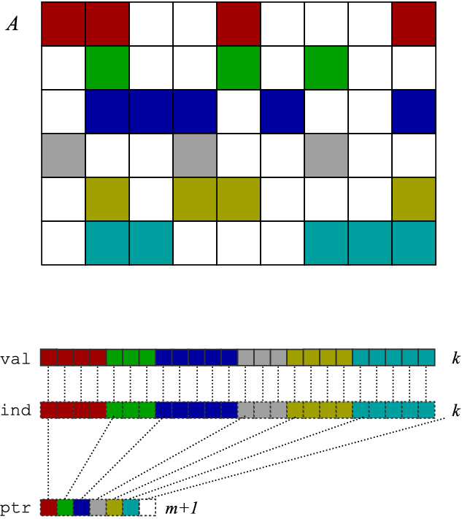
SpMV in Compressed Sparse Row (CSR) Format
SpMV: y = y + A*x, only store, do arithmetic, on nonzero entries
CSR format is simplest one of many possible data structures for A
x
Representation of A
A
y
Matrix-vector multiply kernel: y(i) ← y(i) + A(i,j)⋅x(j)
Matrix-vector multiply kernel: y(i) ← y(i) + A(i,j)⋅x(j)
for each row i
for k=ptr[i] to ptr[i+1]-1 do
y[i] = y[i] + val[k]*x[ind[k]]
Matrix-vector multiply kernel: y(i) ← y(i) + A(i,j)⋅x(j)
for each row i
for k=ptr[i] to ptr[i+1]-1 do
y[i] = y[i] + val[k]*x[ind[k]]
CS267 Lecture 4
Notes:
CS267 Lecture 2
A one-slide crash course on a basic sparse matrix data structure (compressed sparse row, or CSR, format) and a basic kernel: matrix-vector multiply.
In CSR: store each non-zero value, but also need extra index for each non-zero → less than dense, but higher “rate” of storage per non-zero.
Matrix-vector multiply (MVM): no re-use of A, just of vectors x and y, taken to be dense.
MVM with CSR storage: indirect/irregular accesses to x!
So what you’d like to do is:
Unroll the k loop → but you need to know how many non-zeors per row
Hoist y[i] → not a problem, absent aliasing
Eliminate ind[i] → it’s an extra load, but you need to know the non-zero pattern
Reuse elements of x → but you need to know the non-zero pattern

Slide 42
Parallel Sparse Matrix-vector multiplication
y = A*x, where A is a sparse n x n matrix
Questions
  which processors store
    y[i], x[i], and A[i,j]
  which processors compute
    y[i] = sum (from 1 to n) A[i,j] * x[j]
    = (row i of A) * x … a sparse dot product
Partitioning
  Partition index set {1,…,n} = N1 ∪ N2 ∪ … ∪ Np.
  For all i in Nk, Processor k stores y[i], x[i], and row i of A
  For all i in Nk, Processor k computes y[i] = (row i of A) * x
    “owner computes” rule: Processor k compute the y[i]s it owns.
x
P1
P2
P3
P4
y
May require communication
CS267 Lecture 4
Notes:
CS267 Lecture 2

Slide 43
Matrix Reordering via Graph Partitioning
“Ideal” matrix structure for parallelism: block diagonal
  p (number of processors) blocks, can all be computed locally.
  If no non-zeros outside these blocks, no communication needed
Can we reorder the rows/columns to get close to this?
  Most nonzeros in diagonal blocks, few outside
P0 P1 P2 P3 P4
P0
P1
P2
P3
P4
=
*
CS267 Lecture 4
Notes:
CS267 Lecture 2

Slide 44
Goals of Reordering
Performance goals
  balance load (how is load measured?).
    Approx equal number of nonzeros (not necessarily rows)
  balance storage (how much does each processor store?).
    Approx equal number of nonzeros
  minimize communication (how much is communicated?).
    Minimize nonzeros outside diagonal blocks
    Related optimization criterion is to move nonzeros near diagonal
  improve register and cache re-use
    Group nonzeros in small vertical blocks so source (x) elements loaded into cache or registers may be reused (temporal locality)
    Group nonzeros in small horizontal blocks so nearby source (x) elements in the cache may be used (spatial locality)
Other algorithms reorder for other reasons
  Reduce # nonzeros in matrix after Gaussian elimination
  Improve numerical stability
CS267 Lecture 4
Notes:
CS267 Lecture 2

Slide 45
Graph Partitioning and Sparse Matrices
Relationship between matrix and graph
1 2 3 4 5 6
1 1 1 1
2 1 1 1 1
3 1 1 1
4 1 1 1 1
5 1 1 1 1
6 1 1 1 1
3
4
2
1
6
5
Edges in the graph are nonzero in the matrix: here the matrix is symmetric (edges are unordered) and weights are equal (1)
If divided over 3 procs, there are 14 nonzeros outside the diagonal blocks, which represent the 7 (bidirectional) edges
CS267 Lecture 4
Notes:
CS267 Lecture 2
How to pick the best partition, that balances load and minimizes communication?
Graph partitioning problem, that we saw before, and will see many times

Slide 46
Summary: Common Problems
Load Balancing
  Statically - Graph partitioning
    Discrete systems
    Sparse matrix vector multiplication
  Dynamically – if load changes significantly during job
Linear algebra
  Solving linear systems (sparse and dense)
  Eigenvalue problems will use similar techniques
Fast Particle Methods
  O(n log n) instead of O(n²)
CS267 Lecture 4
Notes:
CS267 Lecture 2

Slide 47
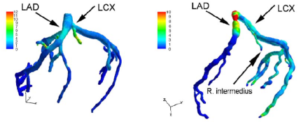
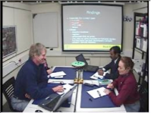

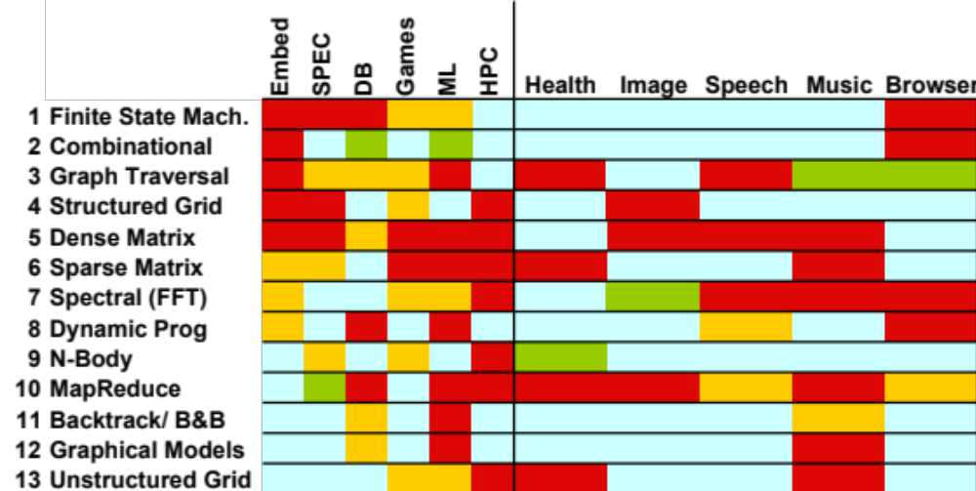

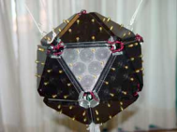
Motif/Dwarf: Common Computational Methods
(Red Hot → Blue Cool)
What do commercial and CSE applications have in common?
CS267 Lecture 4
Notes:
Some people might subdivide, some might combine them together
Trying to stretch a computer architecture then you can do subcategories as well
Graph Traversal = Probabilistic Models
N-Body = Particle Methods, …

Slide 48
Implicit Methods; Eigenproblems
Implicit methods for ODEs need to solve linear systems
Direct methods (Gaussian elimination)
  Called LU Decomposition, because we factor A = L*U.
  Future lectures will consider both dense and sparse cases.
  More complicated than sparse-matrix vector multiplication.
Iterative solvers
  Will discuss several of these in future.
    Jacobi, Successive over-relaxation (SOR) , Conjugate Gradient (CG), Multigrid,...
  Most have sparse-matrix-vector multiplication in kernel.
Eigenproblems
  Future lectures will discuss dense and sparse cases.
  Also depend on sparse-matrix-vector multiplication, direct methods.
CS267 Lecture 4
Notes:
CS267 Lecture 2

Slide 49
ODEs and Sparse Matrices
All these problems reduce to sparse matrix problems
  Explicit: sparse matrix-vector multiplication (SpMV).
  Implicit: solve a sparse linear system
    direct solvers (Gaussian elimination).
    iterative solvers (use sparse matrix-vector multiplication).
  Eigenvalue/vector algorithms may also be explicit or implicit.
Conclusion: SpMV is key to many ODE problems
  Relatively simple algorithm to study in detail
  Two key problems: locality and load balance
CS267 Lecture 4
Notes:
CS267 Lecture 2

