Slide 1
CS 267
Sources of
Parallelism and Locality in Simulation – Part 2
James Demmel
www.cs.berkeley.edu/~demmel/cs267_Spr15
2/3/2015
CS267 Lecture 5
Notes:
CS267 Lecture 2

Slide 2
Recap of Last Lecture
4 kinds of simulations
  Discrete Event Systems
  Particle Systems
  Ordinary Differential Equations (ODEs)
  Partial Differential Equations (PDEs) (today)
Common problems:
  Load balancing
    May be due to lack of parallelism or poor work distribution
    Statically, divide grid (or graph) into blocks
    Dynamically, if load changes significantly during run
  Locality
    Partition into large chunks with low surface-to-volume ratio
      To minimize communication
    Distributed particles according to location, but use irregular spatial decomposition (e.g., quad tree) for load balance
  Constant tension between these two
    Particle-Mesh method: can’t balance particles (moving), balance mesh (fixed) and keep particles near mesh points without communication
2/3/2015
CS267 Lecture 5
Notes:
CS267 Lecture 2
“particles near mesh points” means in two senses:
Close to the mesh points in physical space, and
Both on the same processor

Slide 3
Partial Differential Equations
PDEs
2/3/2015
CS267 Lecture 5
Notes:
CS267 Lecture 2

Slide 4
Continuous Variables, Continuous Parameters
Examples of such systems include
Elliptic problems (steady state, global space dependence)
  Electrostatic or Gravitational Potential: Potential(position)
Hyperbolic problems (time dependent, local space dependence):
  Sound waves: Pressure(position,time)
Parabolic problems (time dependent, global space dependence)
  Heat flow: Temperature(position, time)
  Diffusion: Concentration(position, time)
Global vs Local Dependence
  Global means either a lot of communication, or tiny time steps
  Local arises from finite wave speeds: limits communication
Many problems combine features of above
Fluid flow: Velocity,Pressure,Density(position,time)
Elasticity: Stress,Strain(position,time)
2/3/2015
CS267 Lecture 5
Notes:
CS267 Lecture 2
Which are likely to parallelize more effectively?
“Global dependence” means either a lot of communication, or taking very tiny time steps to maintain stability
“Local dependence” arises because there is a finite wave speed (eg speed of sound) that limits how much information can move in the real world, and so how much communication is needed in the algorithm.

Slide 5
Example: Deriving the Heat Equation
0
x-h
x
x+h
1
Consider a simple problem
A bar of uniform material, insulated except at ends
Let u(x,t) be the temperature at position x at time t
Heat travels from x-h to x+h at rate proportional to:
d u(x,t) (u(x-h,t)-u(x,t))/h - (u(x,t)- u(x+h,t))/h
dt h
= C *
As h → 0, we get the heat equation:
d u(x,t) d² u(x,t)
dt dx²
= C *
2/3/2015
CS267 Lecture 5
Notes:
CS267 Lecture 2
Equation comes from experimental observation (Fourier’s Law)
C is the conductivity of the bar

Slide 6
Details of the Explicit Method for Heat
d u(x,t) d² u(x,t)
dt dx²
= C *
Discretize time and space using explicit approach (forward Euler) to approximate time derivative:
(u(x,t+δ) – u(x,t))/δ = C [ (u(x-h,t)-u(x,t))/h - (u(x,t)- u(x+h,t))/h ] / h
= C [u(x-h,t) – 2*u(x,t) + u(x+h,t)]/h²
Solve for u(x,t+δ) :
u(x,t+δ) = u(x,t)+ C*δ /h² *(u(x-h,t) – 2*u(x,t) + u(x+h,t))
Let z = C*δ /h², simplify:
u(x,t+δ) = z* u(x-h,t) + (1-2z)*u(x,t) + z*u(x+h,t)
Change variable x to j*h, t to i*δ, and u(x,t) to u[j,i]
u[j,i+1]= z*u[j-1,i]+ (1-2*z)*u[j,i]+ z*u[j+1,i]
2/3/2015
CS267 Lecture 5
Notes:
CS267 Lecture 2

Slide 7
Explicit Solution of the Heat Equation
Use “finite differences” with u[j,i] as the temperature at
  time t= i*δ (i = 0,1,2,…) and position x = j*h (j=0,1,…,N=1/h)
  initial conditions on u[j,0]
  boundary conditions on u[0,i] and u[N,i]
At each timestep i = 0,1,2,...
This corresponds to
  Matrix-vector-multiply by T (next slide)
  Combine nearest neighbors on grid
i
For j=1 to N-1
u[j,i+1]= z*u[j-1,i]+ (1-2*z)*u[j,i] + z*u[j+1,i]
where z =C*δ/h²
i=5
i=4
i=3
i=2
i=1
i=0
j
u[0,0] u[1,0] u[2,0] u[3,0] u[4,0] u[5,0]
2/3/2015
CS267 Lecture 5
Notes:
CS267 Lecture 2
U[j,I+1] =

Slide 8
Matrix View of Explicit Method for Heat
u[j,i+1]= z*u[j-1,i]+ (1-2*z)*u[j,i] + z*u[j+1,i], same as:
u[ :, i+1] = T * u[ :, i] where T is tridiagonal:
L called Laplacian (in 1D)
For a 2D mesh (5 point stencil) the Laplacian is pentadiagonal
  More on the matrix/grid views later
1-2z z
z 1-2z z
z 1-2z z
z 1-2z z
z 1-2z
2 -1
-1 2 -1
-1 2 -1
-1 2 -1
-1 2
T =
= I – z*L, L =
Graph and “3 point stencil”
z
1-2z
z
2/3/2015
CS267 Lecture 5
Notes:
CS267 Lecture 2

Slide 9
Parallelism in Explicit Method for PDEs
Sparse matrix vector multiply, via Graph Partitioning
Partitioning the space (x) into p chunks
  good load balance (assuming large number of points relative to p)
  minimize communication (least dependence on data outside chunk)
Generalizes to
  multiple dimensions.
  arbitrary graphs (= arbitrary sparse matrices).
Explicit approach often used for hyperbolic equations
  Finite wave speed, so only depend on nearest chunks
Problem with explicit approach for heat (parabolic):
  numerical instability.
  solution blows up eventually if z = Cδ/h² > .5
  need to make the time step δ very small when h is small: δ < .5*h² /C
2/3/2015
CS267 Lecture 5
Notes:
CS267 Lecture 2
This is a problem for scaling problems for parallel machines, which can handle finer meshes (large memory and fast nearest-neighbor computations), because you need to decrease the time step and therefore increase number of steps

Slide 10
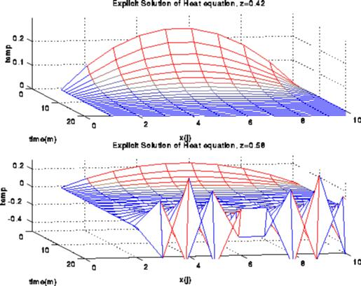
Instability in Solving the Heat Equation Explicitly
2/3/2015
CS267 Lecture 5
Notes:
CS267 Lecture 2
Note: stability of the algorithm has nothing to do with floating point round-off

Slide 11
Implicit Solution of the Heat Equation
d u(x,t) d² u(x,t)
dt dx²
= C *
Discretize time and space using implicit approach (Backward Euler) to approximate time derivative:
(u(x,t+δ) – u(x,t))/dt = C*(u(x-h,t+δ) – 2*u(x,t+δ) + u(x+h, t+δ))/h²
u(x,t) = u(x,t+δ) - C*δ/h² *(u(x-h,t+δ) – 2*u(x,t+δ) + u(x+h,t+δ))
Let z = C*δ/h² and change variable t to i*δ, x to j*h and u(x,t) to u[j,i]
(I + z *L)* u[:, i+1] = u[:,i]
Where I is identity and
L is Laplacian as before
2 -1
-1 2 -1
-1 2 -1
-1 2 -1
-1 2
L =
2/3/2015
CS267 Lecture 5
Notes:
CS267 Lecture 2

Slide 12
Implicit Solution of the Heat Equation
The previous slide derived Backward Euler
  (I + z *L)* u[:, i+1] = u[:,i]
But the Trapezoidal Rule has better numerical properties:
Again I is the identity matrix and L is:
Other problems (elliptic instead of parabolic) yield Poisson’s equation (Lx = b in 1D)
(I + (z/2)*L) * u[:,i+1]= (I - (z/2)*L) *u[:,i]
2 -1
-1 2 -1
-1 2 -1
-1 2 -1
-1 2
Graph and “stencil”
L =
-1
2
-1
2/3/2015
CS267 Lecture 5
Notes:
CS267 Lecture 2

Slide 13
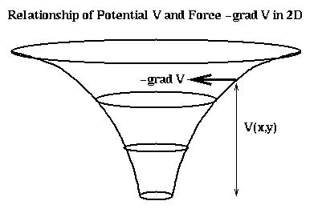
Relation of Poisson to Gravity, Electrostatics
Poisson equation arises in many problems
E.g., force on particle at (x,y,z) due to particle at 0 is
-(x,y,z)/r³, where r = sqrt(x² + y² + z²)
Force is also gradient of potential V = -1/r
= -(d/dx V, d/dy V, d/dz V) = -grad V
V satisfies Poisson’s equation (try working this out!)
d²V + d²V + d²V = 0
dx² dy² dz²
2/3/2015
CS267 Lecture 5
Notes:
CS267 Lecture 2

Slide 14
2D Implicit Method
Similar to the 1D case, but the matrix L is now
Multiplying by this matrix (as in the explicit case) is simply nearest neighbor computation on 2D grid.
To solve this system, there are several techniques.
Graph and “5 point stencil”
4 -1 -1
-1 4 -1 -1
-1 4 -1
-1 4 -1 -1
-1 -1 4 -1 -1
-1 -1 4 -1
-1 4 -1
-1 -1 4 -1
-1 -1 4
-1
-1
4
-1
L =
-1
3D case is analogous (7 point stencil)
2/3/2015
CS267 Lecture 5
Notes:
CS267 Lecture 2

Slide 15
Algorithms for 2D (3D) Poisson Equation (N vars)
Algorithm Serial PRAM Memory #Procs
Dense LU N³ N N² N²
Band LU N² (N^{7/3}) N N^{3/2} (N^{5/3}) N(N^{4/3})
Jacobi N² (N^{5/3}) N (N^{2/3}) N N
Explicit Inv. N log N N N
Conj.Gradients N^{3/2} (N^{4/3}) N^{1/2 (1/3)} *log N N N
Red/Black SOR N^{3/2} (N^{4/3}) N^{1/2} (N^{4/3}) N N
Sparse LU N^{3/2} (N²) N^{1/2} (N^{2/3}) N*log N (N^{4/3}) N(N^{4/3})
FFT N*log N log N N N
Multigrid N log² N N N
Lower bound N log N N
All entries in “Big-Oh” sense (constants omitted)
PRAM is an idealized parallel model with zero cost communication
References: James Demmel, Applied Numerical Linear Algebra, SIAM, 1997.
Decision tree to help choose algorithms:
www.netlib.org/linalg/html_templates/Templates.html
2
2
2
2/3/2015
CS267 Lecture 5
Notes:
CS267 Lecture 2
Tell office hours story

Slide 16
Overview of Algorithms
Sorted in two orders (roughly):
  from slowest to fastest on sequential machines.
  from most general (works on any matrix) to most specialized (works on matrices “like” T).
Dense LU: Gaussian elimination; works on any N-by-N matrix.
Band LU: Exploits the fact that T is nonzero only on sqrt(N) diagonals nearest main diagonal.
Jacobi: Essentially does matrix-vector multiply by T in inner loop of iterative algorithm.
Explicit Inverse: Assume we want to solve many systems with T, so we can precompute and store inv(T) “for free”, and just multiply by it (but still expensive).
Conjugate Gradient: Uses matrix-vector multiplication, like Jacobi, but exploits mathematical properties of T that Jacobi does not.
Red-Black SOR (successive over-relaxation): Variation of Jacobi that exploits yet different mathematical properties of T. Used in multigrid schemes.
Sparse LU: Gaussian elimination exploiting particular zero structure of T.
FFT (Fast Fourier Transform): Works only on matrices very like T.
Multigrid: Also works on matrices like T, that come from elliptic PDEs.
Lower Bound: Serial (time to print answer); parallel (time to combine N inputs).
Details in class notes and www.cs.berkeley.edu/~demmel/ma221.
2/3/2015
CS267 Lecture 5
Notes:
CS267 Lecture 2

Slide 17
Mflop/s Versus Run Time in Practice
Problem: Iterative solver for a convection-diffusion problem; run on a 1024-CPU NCUBE-2.
Reference: Shadid and Tuminaro, SIAM Parallel Processing Conference, March 1991.
Solver Flops CPU Time(s) Mflop/s
Jacobi 3.82x10¹² 2124 1800
Gauss-Seidel 1.21x10¹² 885 1365
Multigrid 2.13x10⁹ 7 318
Which solver would you select?
2/3/2015
CS267 Lecture 5
Notes:
CS267 Lecture 2
Sorted in opposite order, if by run-time or by Mflop rate

Slide 18
Summary of Approaches to Solving PDEs
As with ODEs, either explicit or implicit approaches are possible
  Explicit, sparse matrix-vector multiplication
  Implicit, sparse matrix solve at each step
    Direct solvers are hard (more on this later)
    Iterative solves turn into sparse matrix-vector multiplication
      Graph partitioning
Graph and sparse matrix correspondence:
  Sparse matrix-vector multiplication is nearest neighbor “averaging” on the underlying mesh
Not all nearest neighbor computations have the same efficiency
  Depends on the mesh structure (nonzero structure) and the number of Flops per point.
2/3/2015
CS267 Lecture 5
Notes:
CS267 Lecture 2
Ex: FFT is direct, multigrid is iterative

Slide 19
Comments on practical meshes
Regular 1D, 2D, 3D meshes
  Important as building blocks for more complicated meshes
Practical meshes are often irregular
  Composite meshes, consisting of multiple “bent” regular meshes joined at edges
  Unstructured meshes, with arbitrary mesh points and connectivities
  Adaptive meshes, which change resolution during solution process to put computational effort where needed
2/3/2015
CS267 Lecture 5
Notes:
CS267 Lecture 2

Slide 20
Parallelism in Regular meshes
Computing a Stencil on a regular mesh
  need to communicate mesh points near boundary to neighboring processors.
    Often done with ghost regions
  Surface-to-volume ratio keeps communication down, but
    Still may be problematic in practice
Implemented using “ghost” regions.
Adds memory overhead
2/3/2015
CS267 Lecture 5
Notes:
CS267 Lecture 2

Slide 21
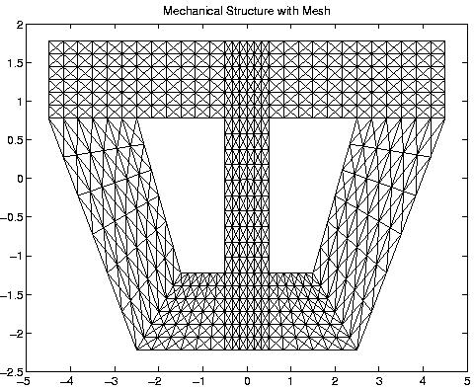
Composite mesh from a mechanical structure
2/3/2015
CS267 Lecture 5
Notes:
CS267 Lecture 2
Ex; bridge abutment

Slide 22
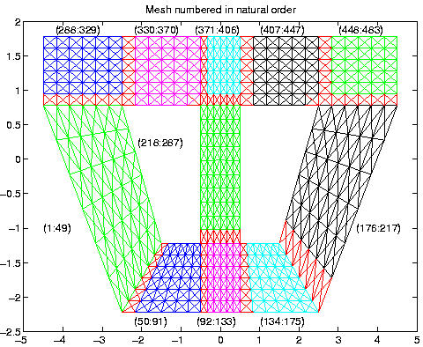
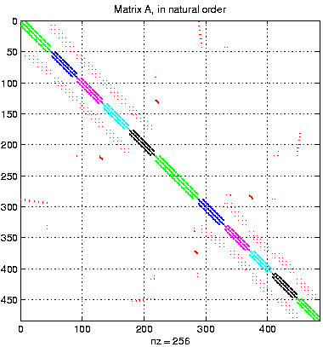
Converting the mesh to a matrix
2/3/2015
CS267 Lecture 5
Notes:
CS267 Lecture 2

Slide 23
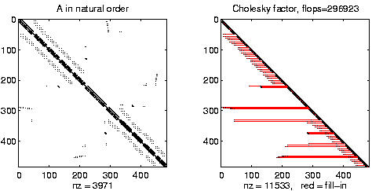
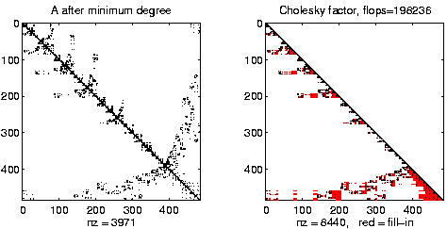
Example of Matrix Reordering Application
When performing Gaussian Elimination
Zeros can be filled ☹
Matrix can be reordered to reduce this fill
But it’s not the same ordering as for parallelism
2/3/2015
CS267 Lecture 7
Notes:
CS267 Lecture 2

Slide 24
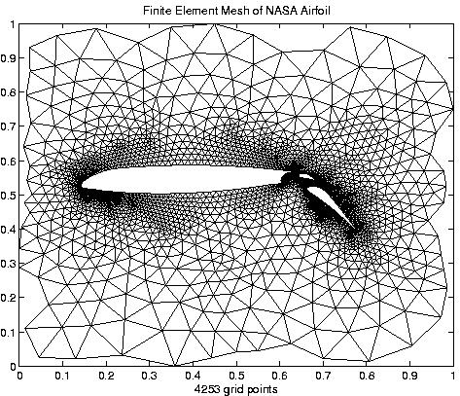
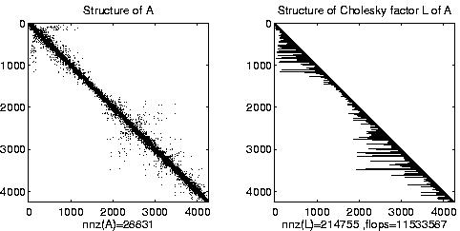
Irregular mesh: NASA Airfoil in 2D (direct solution)
2/3/2015
CS267 Lecture 5
Notes:
CS267 Lecture 2

Slide 25
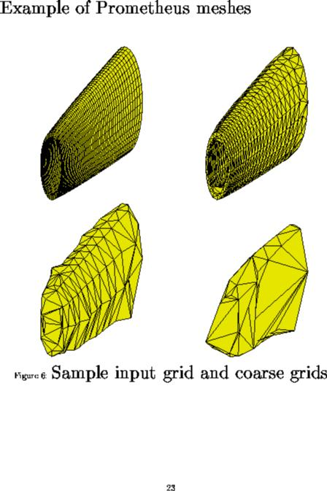
Irregular mesh: Tapered Tube (multigrid)
2/3/2015
CS267 Lecture 9
Notes:
CS267 Lecture 2

Slide 26
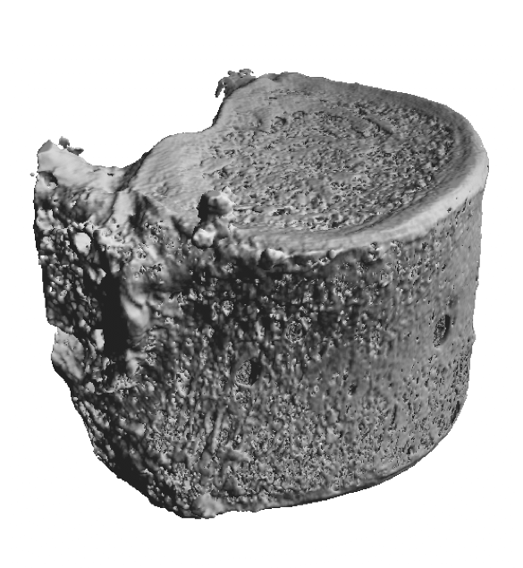
Source of Unstructured Finite Element Mesh: Vertebra
Study failure modes of trabecular Bone under stress
Source: M. Adams, H. Bayraktar, T. Keaveny, P. Papadopoulos, A. Gupta
2/3/2015
CS267 Lecture 5
Notes:
CS267 Lecture 2
Better model of whether elderly people with osteoporosis will break a bone when they fall

Slide 27
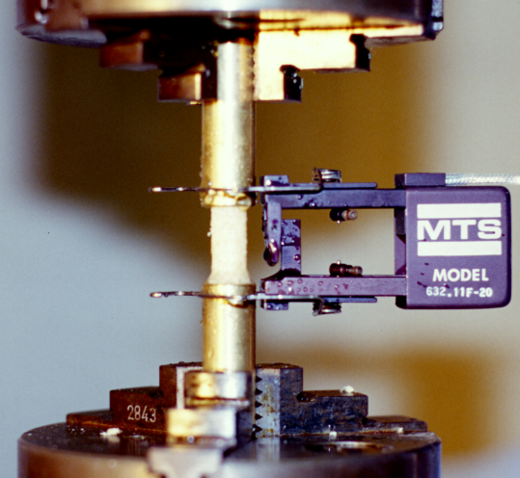
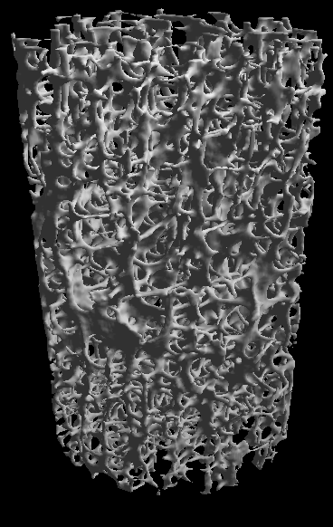
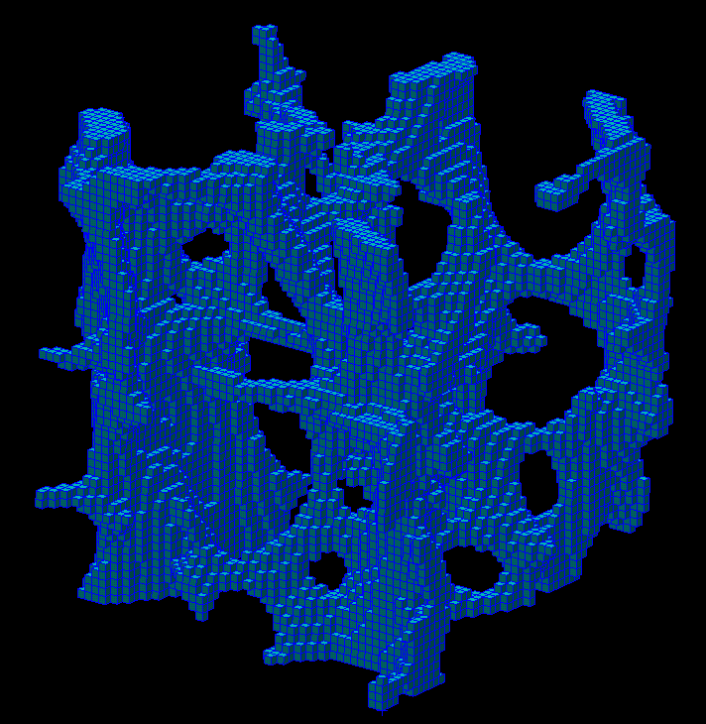
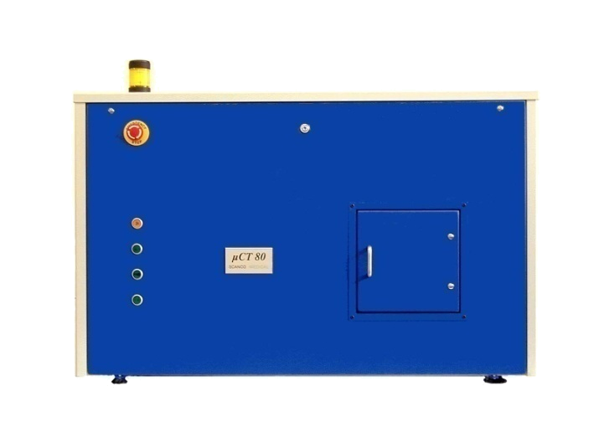
Methods: μFE modeling (Gordon Bell Prize, 2004)
Mechanical Testing
E, ε_{yield}, σ_{ult}, etc.
Source: Mark Adams, PPPL
3D image
μFE mesh
2.5 mm cube
44 μm elements
Micro-Computed Tomography
μCT @ 22 μm resolution
Up to 537M unknowns
2/3/2015
CS267 Lecture 5
Notes:
CS267 Lecture 2

Slide 28
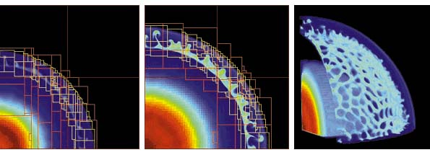
Adaptive Mesh Refinement (AMR)
Adaptive mesh around an explosion
  Refinement done by estimating errors; refine mesh if too large
Parallelism
  Mostly between “patches,” assigned to processors for load balance
  May exploit parallelism within a patch
Projects:
  Titanium (http://www.cs.berkeley.edu/projects/titanium)
  Chombo (P. Colella, LBL), KeLP (S. Baden, UCSD), J. Bell, LBL
2/3/2015
CS267 Lecture 5
Notes:
CS267 Lecture 2
Supernova explosion

Slide 29
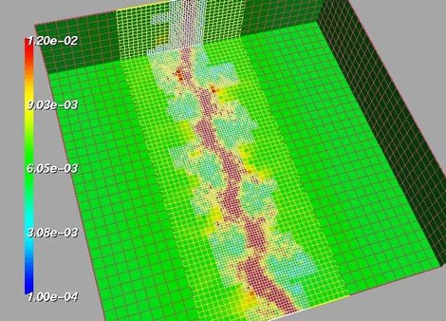
Adaptive Mesh
fluid density
Shock waves in gas dynamics using AMR (Adaptive Mesh Refinement) See: http://www.llnl.gov/CASC/SAMRAI/
2/3/2015
CS267 Lecture 5
Notes:
CS267 Lecture 2

Slide 30
Challenges of Irregular Meshes
How to generate them in the first place
  Start from geometric description of object
  Triangle, a 2D mesh partitioner by Jonathan Shewchuk
  3D harder!
How to partition them
  ParMetis, a parallel graph partitioner
How to design iterative solvers
  PETSc, a Portable Extensible Toolkit for Scientific Computing
  Prometheus, a multigrid solver for finite element problems on irregular meshes
How to design direct solvers
  SuperLU, parallel sparse Gaussian elimination
These are challenges to do sequentially, more so in parallel
2/3/2015
CS267 Lecture 5
Notes:
CS267 Lecture 2

Slide 31
Summary – sources of parallelism and locality
Current attempts to categorize main “kernels” dominating simulation codes
“Seven Dwarfs” (P. Colella)
  Structured grids
    including locally structured grids, as in AMR
  Unstructured grids
  Spectral methods (Fast Fourier Transform)
  Dense Linear Algebra
  Sparse Linear Algebra
    Both explicit (SpMV) and implicit (solving)
  Particle Methods
  Monte Carlo/Embarrassing Parallelism/Map Reduce (easy!)
2/3/2015
CS267 Lecture 5
Notes:
CS267 Lecture 2

Slide 32
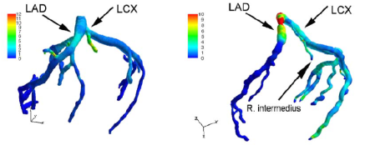
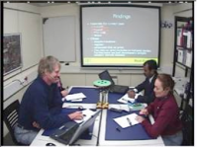

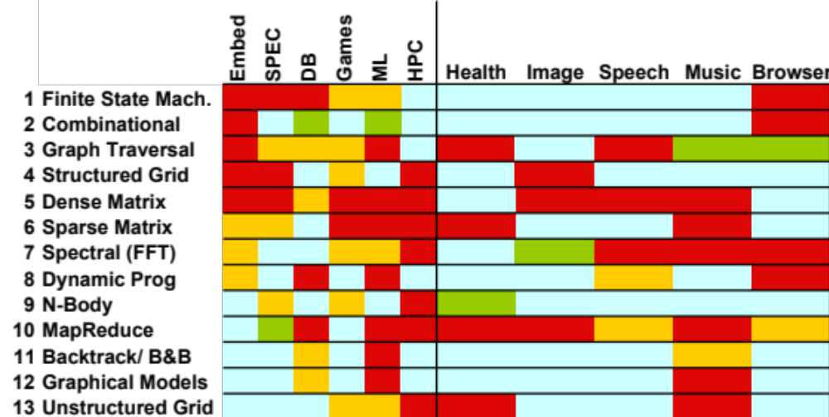

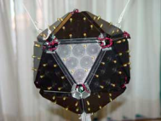
Motif/Dwarf: Common Computational Methods
(Red Hot → Blue Cool)
What do commercial and CSE applications have in common?
Notes:
Some people might subdivide, some might combine them together
Trying to stretch a computer architecture then you can do subcategories as well
Graph Traversal = Probabilistic Models
N-Body = Particle Methods, …

Slide 33
Extra Slides
2/3/2015
CS267 Lecture 5
Notes:
CS267 Lecture 2

Slide 34
CS267 Final Projects
Project proposal
  Teams of 3 students, typically across departments
  Interesting parallel application or system
  Conference-quality paper
  High performance is key:
    Understanding performance, tuning, scaling, etc.
    More important than the difficulty of problem
Leverage
  Projects in other classes (but discuss with me first)
  Research projects
2/3/2015
CS267 Lecture 5
Notes:
CS267 Lecture 2

Slide 35
Project Ideas (from 2009)
Applications
  Implement existing sequential or shared memory program on distributed memory
  Investigate SMP trade-offs (using only MPI versus MPI and thread based parallelism)
Tools and Systems
  Effects of reordering on sparse matrix factoring and solves
Numerical algorithms
  Improved solver for immersed boundary method
  Use of multiple vectors (blocked algorithms) in iterative solvers
2/3/2015
CS267 Lecture 5
Notes:
CS267 Lecture 2

Slide 36
Project Ideas (from 2009)
Novel computational platforms
  Exploiting hierarchy of SMP-clusters in benchmarks
  Computing aggregate operations on ad hoc networks (Culler)
  Push/explore limits of computing on “the grid”
  Performance under failures
Detailed benchmarking and performance analysis, including identification of optimization opportunities
  Titanium
  UPC
  IBM SP (Blue Horizon)
2/3/2015
CS267 Lecture 5
Notes:
CS267 Lecture 2

Slide 37
High-end simulation in the physical sciences = 7 numerical methods:
Phillip Colella’s “Seven dwarfs”
Structured Grids (including locally structured grids, e.g. AMR)
Unstructured Grids
Fast Fourier Transform
Dense Linear Algebra
Sparse Linear Algebra
Particles
Monte Carlo
Add 4 for embedded
  8. Search/Sort
  9. Finite State Machine
  10. Filter
  11. Combinational logic
Then covers all 41 EEMBC benchmarks
Revise 1 for SPEC
  7. Monte Carlo => Easily
  parallel (to add ray tracing)
Then covers 26 SPEC benchmarks
Well-defined targets from algorithmic, software, and architecture standpoint
Slide from “Defining Software Requirements for Scientific Computing”, Phillip Colella, 2004
2/3/2015
CS267 Lecture 5
Notes:
CS267 Lecture 2

Slide 38
Implicit Methods and Eigenproblems
Implicit methods for ODEs solve linear systems
Direct methods (Gaussian elimination)
  Called LU Decomposition, because we factor A = L*U.
  Future lectures will consider both dense and sparse cases.
  More complicated than sparse-matrix vector multiplication.
Iterative solvers
  Will discuss several of these in future.
    Jacobi, Successive over-relaxation (SOR) , Conjugate Gradient (CG), Multigrid,...
  Most have sparse-matrix-vector multiplication in kernel.
Eigenproblems
  Future lectures will discuss dense and sparse cases.
  Also depend on sparse-matrix-vector multiplication, direct methods.
2/3/2015
CS267 Lecture 5
Notes:
CS267 Lecture 2

Slide 39
ODEs and Sparse Matrices
All these problems reduce to sparse matrix problems
  Explicit: sparse matrix-vector multiplication (SpMV).
  Implicit: solve a sparse linear system
    direct solvers (Gaussian elimination).
    iterative solvers (use sparse matrix-vector multiplication).
  Eigenvalue/vector algorithms may also be explicit or implicit.
Conclusion: SpMV is key to many ODE problems
  Relatively simple algorithm to study in detail
  Two key problems: locality and load balance
2/3/2015
CS267 Lecture 5
Notes:
CS267 Lecture 2

Slide 40
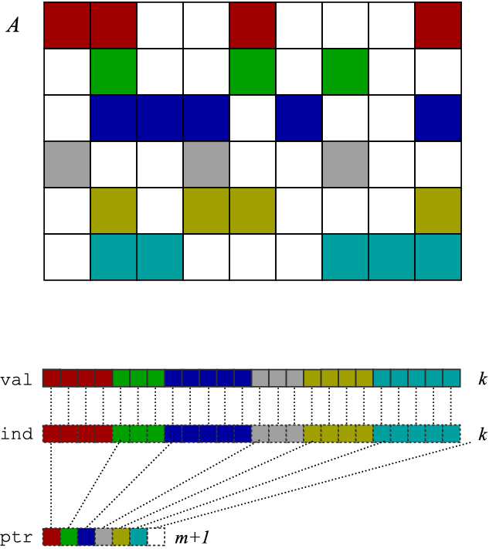
SpMV in Compressed Sparse Row (CSR) Format
CSR format is one of many possibilities
x
Representation of A
A
y
Matrix-vector multiply kernel: y(i) ← y(i) + A(i,j)⋅x(j)
Matrix-vector multiply kernel: y(i) ← y(i) + A(i,j)⋅x(j)
for each row i
for k=ptr[i] to ptr[i+1] do
y[i] = y[i] + val[k]*x[ind[k]]
Matrix-vector multiply kernel: y(i) ← y(i) + A(i,j)⋅x(j)
for each row i
for k=ptr[i] to ptr[i+1] do
y[i] = y[i] + val[k]*x[ind[k]]
2/3/2015
CS267 Lecture 5
Notes:
CS267 Lecture 2
A one-slide crash course on a basic sparse matrix data structure (compressed sparse row, or CSR, format) and a basic kernel: matrix-vector multiply.
In CSR: store each non-zero value, but also need extra index for each non-zero → less than dense, but higher “rate” of storage per non-zero.
Matrix-vector multiply (MVM): no re-use of A, just of vectors x and y, taken to be dense.
MVM with CSR storage: indirect/irregular accesses to x!
So what you’d like to do is:
Unroll the k loop → but you need to know how many non-zeors per row
Hoist y[i] → not a problem, absent aliasing
Eliminate ind[i] → it’s an extra load, but you need to know the non-zero pattern
Reuse elements of x → but you need to know the non-zero pattern

Slide 41
Parallel Sparse Matrix-vector multiplication
y = A*x, where A is a sparse n x n matrix
Questions
  which processors store
    y[i], x[i], and A[i,j]
  which processors compute
    y[i] = sum (from 1 to n) A[i,j] * x[j]
    = (row i of A) * x … a sparse dot product
Partitioning
  Partition index set {1,…,n} = N1 ∪ N2 ∪ … ∪ Np.
  For all i in Nk, Processor k stores y[i], x[i], and row i of A
  For all i in Nk, Processor k computes y[i] = (row i of A) * x
    “owner computes” rule: Processor k compute the y[i]s it owns.
x
P1
P2
P3
P4
y
May require communication
2/3/2015
CS267 Lecture 5
Notes:
CS267 Lecture 2

Slide 42
Matrix Reordering via Graph Partitioning
“Ideal” matrix structure for parallelism: block diagonal
  p (number of processors) blocks, can all be computed locally.
  If no non-zeros outside these blocks, no communication needed
Can we reorder the rows/columns to get close to this?
  Most nonzeros in diagonal blocks, few outside
P0 P1 P2 P3 P4
P0
P1
P2
P3
P4
=
*
2/3/2015
CS267 Lecture 5
Notes:
CS267 Lecture 2

Slide 43
Goals of Reordering
Performance goals
  balance load (how is load measured?).
    Approx equal number of nonzeros (not necessarily rows)
  balance storage (how much does each processor store?).
    Approx equal number of nonzeros
  minimize communication (how much is communicated?).
    Minimize nonzeros outside diagonal blocks
    Related optimization criterion is to move nonzeros near diagonal
  improve register and cache re-use
    Group nonzeros in small vertical blocks so source (x) elements loaded into cache or registers may be reused (temporal locality)
    Group nonzeros in small horizontal blocks so nearby source (x) elements in the cache may be used (spatial locality)
Other algorithms reorder for other reasons
  Reduce # nonzeros in matrix after Gaussian elimination
  Improve numerical stability
2/3/2015
CS267 Lecture 5
Notes:
CS267 Lecture 2

Slide 44
Graph Partitioning and Sparse Matrices
Relationship between matrix and graph
1 2 3 4 5 6
1 1 1 1
2 1 1 1 1
3 1 1 1
4 1 1 1 1
5 1 1 1 1
6 1 1 1 1
3
4
2
1
6
5
Edges in the graph are nonzero in the matrix: here the matrix is symmetric (edges are unordered) and weights are equal (1)
If divided over 3 procs, there are 14 nonzeros outside the diagonal blocks, which represent the 7 (bidirectional) edges
2/3/2015
CS267 Lecture 5
Notes:
CS267 Lecture 2

Slide 45
Graph Partitioning and Sparse Matrices
Relationship between matrix and graph
1 2 3 4 5 6
1 1 1 1
2 1 1 1 1
3 1 1 1
4 1 1 1 1
5 1 1 1 1
6 1 1 1 1
3
2
4
1
6
5
A “good” partition of the graph has
  equal (weighted) number of nodes in each part (load and storage balance).
  minimum number of edges crossing between (minimize communication).
Reorder the rows/columns by putting all nodes in one partition together.
2/3/2015
CS267 Lecture 5
Notes:
CS267 Lecture 2

