Slide 1
Shared Memory Programming:
Threads and OpenMP
Lecture 6
James Demmel www.cs.berkeley.edu/~demmel/cs267_Spr15/
CS267 Lecture 6
Notes:
CS267 Lecture 2
Back to middle of “stack”, which went
from HW at bottom to applications at top, now to SW tools in the middle,
in particular those for the first programming model that we discussed
in Lecture 5: Shared memory, which is the one you would use on your multicore
laptop, or a single 24-core node of Hopper.
Last third of lecture: algorithms at higher level, because next lecture,
on distributed memory programming models, will have lots of built-in
functions implementing these algorithms, like broadcasts and reductions
and other operations on trees.

Slide 2
Outline
Parallel Programming with Threads
Parallel Programming with OpenMP
  See parlab.eecs.berkeley.edu/2012bootcampagenda
    2 OpenMP lectures (slides and video) by Tim Mattson
  openmp.org/wp/resources/
  computing.llnl.gov/tutorials/openMP/
  portal.xsede.org/online-training
  www.nersc.gov/assets/Uploads/XE62011OpenMP.pdf
  Slides on OpenMP derived from: U.Wisconsin tutorial, which in turn were from LLNL, NERSC, U. Minn, and OpenMP.org
    See tutorial by Tim Mattson and Larry Meadows presented at SC08, at OpenMP.org; includes programming exercises
(There are other Shared Memory Models: CILK, TBB…)
Performance comparison
Summary
CS267 Lecture 6
Notes:
CS267 Lecture 2
Threads: portable, low level, tedious
OpenMP: recommended, examples in C, also available in C++ and Fortran
Not all details of where to put commas, etc., detailed tutorials available on-line
For homework, we will hand out working code for you to start with and modify,
so you won’t start from scratch
TBB: analogous to pthreads with more functionality, from Intel
CILK = language of the “C ilk”, by Charles Leiserson at MIT, acquired by Intel in 2009, for C++
adds work stealing, cheap thread creation when not stolen
(just a subroutine call)
Java: originally threads for concurrency, eg user interfaces,
very object oriented, parallelism added later
Additional topics in extra slides:
Shared Memory Hardware
Memory consistency: the dark side of shared memory
Hardware review and a few more details
What this means to shared memory programmers
Old link: See http://www.nersc.gov/nusers/help/tutorials/openmp/

Slide 3
Parallel Programming with Threads
CS267 Lecture 6
Notes:
CS267 Lecture 2

Slide 4
Recall Programming Model 1: Shared Memory
Program is a collection of threads of control.
  Can be created dynamically, mid-execution, in some languages
Each thread has a set of private variables, e.g., local stack variables
Also a set of shared variables, e.g., static variables, shared common blocks, or global heap.
  Threads communicate implicitly by writing and reading shared variables.
  Threads coordinate by synchronizing on shared variables
Shared memory
s
s = ...
y = ..s ...
i: 2
i: 5
Private memory
i: 8
P0
P1
Pn
CS267 Lecture 6
Notes:
CS267 Lecture 2
Example: think of a thread as a subroutine that gets called on on processor, executed on another
Like concurrent programming on a uniprocessor (as studied in CS162).

Slide 5
Shared Memory Programming
Several Thread Libraries/systems
PTHREADS is the POSIX Standard
  Relatively low level
  Portable but possibly slow; relatively heavyweight
OpenMP standard for application level programming
  Support for scientific programming on shared memory
  openmp.org
TBB: Thread Building Blocks
  Intel
CILK: Language of the C “ilk”
  Lightweight threads embedded into C
Java threads
  Built on top of POSIX threads
  Object within Java language
CS267 Lecture 6
Notes:
CS267 Lecture 2
POSIX = Portable Operating System Interface
Runs whereever UNIX runs (hint: IX)
Slow if needs to go to OS for every thread operation
OpenMP: easier to use, insert comments, or pragmas, into C, C++, Fortran code
to tell compiler that certain loop nests, for example can be done in parallel
TBB: From Intel for C++, higher level interface
CILK: adds (1) work stealing for load balancing,
(2) cheap to create threads if never stolen (cost of subroutine
call, so low overhead)
Java threads built on POSIX threads:
Are objects (like other objects in Java)
(1) create Java thread object
(2) send it a message saying “run” etc
(3) originally for concurrency, eg UIs, not parallelism

Slide 6
Common Notions of Thread Creation
cobegin/coend
  cobegin
  job1(a1);
  job2(a2);
  coend
fork/join
  tid1 = fork(job1, a1);
  job2(a2);
  join tid1;
future
  v = future(job1(a1));
  … = …v…;
Cobegin cleaner than fork, but fork is more general
Futures require some compiler (and likely hardware) support
Statements in block may run in parallel
cobegins may be nested
Scoped, so you cannot have a missing coend
Forked procedure runs in parallel
Wait at join point if it’s not finished
Future expression evaluated in parallel
Attempt to use return value will wait
CS267 Lecture 6
Notes:
CS267 Lecture 2
Examples in C, Fortran works too
How you spell “cobegin” varies from language to language
Scoped, so “coend” means wait until both job1 and job2 done, then proceed
Can be nested
Fork creates job1 to run on another processor
Tid1 = name of thread running job1, so can refer to it later to ask if done
More general patterns than simple nesting possible, also more bugs
HW support for futures? Suppose you load location containing v,
how do you know if v is done? Could have done/not-done bit associated
with each word of memory, so if v is “done”, it runs at full memory speed,
otherwise it stops and waits; this requires change to memory architecture,
but could also be done (more slowly) purely in SW

Slide 7
Overview of POSIX Threads
POSIX: Portable Operating System Interface
  Interface to Operating System utilities
PThreads: The POSIX threading interface
  System calls to create and synchronize threads
  Should be relatively uniform across UNIX-like OS platforms
PThreads contain support for
  Creating parallelism
  Synchronizing
  No explicit support for communication, because shared memory is implicit; a pointer to shared data is passed to a thread
CS267 Lecture 6
Notes:
CS267 Lecture 2
POSIX should run on any UNIX platform (hence IX).
Synchronization: more than cobegin/coend

Slide 8
Forking Posix Threads
Signature:
int pthread_create(pthread_t *,
const pthread_attr_t *,
void * (*)(void *),
void *);
Example call:
errcode = pthread_create(&thread_id; &thread_attribute
&thread_fun; &fun_arg);
thread_id is the thread id or handle (used to halt, etc.)
thread_attribute various attributes
  Standard default values obtained by passing a NULL pointer
  Sample attributes: minimum stack size, priority
thread_fun the function to be run (takes and returns void*)
fun_arg an argument can be passed to thread_fun when it starts
errorcode will be set nonzero if the create operation fails
CS267 Lecture 6
Notes:
CS267 Lecture 2
Available in C, C++, Fortran, examples in C
Sample attribute: minimum stack size, priority, ..
Void * (*) (void *) means
returns a pointer to an unknown type
taking an argument which is a pointer
and argument itself is itself a pointer to a function (read right to left)
&foo = address of foo

Slide 9
Simple Threading Example
void* SayHello(void *foo) {
printf( "Hello, world!\n" );
return NULL;
}
int main() {
pthread_t threads[16];
int tn;
for(tn=0; tn<16; tn++) {
pthread_create(&threads[tn], NULL, SayHello, NULL);
}
for(tn=0; tn<16 ; tn++) {
pthread_join(threads[tn], NULL);
}
return 0;
}
Compile using gcc –lpthread
CS267 Lecture 6
Notes:
CS267 Lecture 2
Print “Hello, World!” 16 times

Slide 10
Loop Level Parallelism
Many scientific application have parallelism in loops
  With threads:
  … my_stuff [n][n];
  for (int i = 0; i < n; i++)
  for (int j = 0; j < n; j++)
  … pthread_create (update_cell[i][j], …,
  my_stuff[i][j]);
But overhead of thread creation is nontrivial
  update_cell should have a significant amount of work
  1/p-th of total work if possible
CS267 Lecture 6
Notes:
CS267 Lecture 2
n^2 different threads named update_cell[i][j], each working on my_stuff[i][j]
Not a good idea if n large, update_cell short: prefer fewer threads working on bigger chunks
Need to explicitly decide on number of chunks, shapes pass to each processor;
tedious, OpenMP makes this easier (later)
Notes inserted into next slide:
pthread_yield();
Informs the scheduler that the thread is willing to yield its quantum, requires no arguments.
pthread_t me; me = pthread_self();
Allows a pthread to obtain its own identifier pthread_t thread;
pthread_detach(thread);
Informs the library that the threads exit status will not be needed by subsequent pthread_join calls resulting in better threads performance. For more information consult the library or the man pages, e.g., man -k pthread..

Slide 11
Some More Pthread Functions
pthread_yield();
  Informs the scheduler that the thread is willing to yield its quantum, requires no arguments.
pthread_exit(void *value);
  Exit thread and pass value to joining thread (if exists)
pthread_join(pthread_t *thread, void **result);
  Wait for specified thread to finish. Place exit value into *result.
Others:
pthread_t me; me = pthread_self();
  Allows a pthread to obtain its own identifier pthread_t thread;
pthread_detach(thread);
  Informs the library that the thread’s exit status will not be needed by subsequent pthread_join calls resulting in better thread performance. For more information consult the library or the man pages, e.g., man -k pthread
Kathy Yelick
Notes:
Pthread_yield – just a hint, can only yield own quantum,
not that of another thread’s; not likely to use if each thread gets equal amount of work
pthread_t me; me = pthread_self();
Allows a pthread to obtain its own identifier pthread_t thread; to choose disjoint subset of work
pthread_detach(thread);
Informs the library that the thread’s exit status will not be needed by subsequent pthread_join calls resulting in better thread performance. For more information consult the library or the man pages, e.g., man -k pthread.. -- deprecate in discussion
CS267 Lecture 2

Slide 12
Recall Data Race Example
static int s = 0;
Thread 1
for i = 0, n/2-1
s = s + f(A[i])
Thread 2
for i = n/2, n-1
s = s + f(A[i])
Problem is a race condition on variable s in the program
A race condition or data race occurs when:
  two processors (or two threads) access the same variable, and at least one does a write.
  The accesses are concurrent (not synchronized) so they could happen simultaneously
CS267 Lecture 6
Notes:
CS267 Lecture 2

Slide 13
Basic Types of Synchronization: Barrier
Barrier -- global synchronization
  Especially common when running multiple copies of the same function in parallel
    SPMD “Single Program Multiple Data”
  simple use of barriers -- all threads hit the same one
work_on_my_subgrid();
barrier;
read_neighboring_values();
barrier;
  more complicated -- barriers on branches (or loops)
if (tid % 2 == 0) {
work1();
barrier
} else { barrier }
  barriers are not provided in all thread libraries
CS267 Lecture 6
Notes:
CS267 Lecture 2
Barriers are in Pthreads and OpenMP
First example: divide 2D grid into subsquares
first update internal vertices, don’t need neighbor’s data
wait, then get neighbor’s data
Second example: break up vertices into odd/even or red/black

Slide 14
Creating and Initializing a Barrier
To (dynamically) initialize a barrier, use code similar to this (which sets the number of threads to 3):
  pthread_barrier_t b;
  pthread_barrier_init(&b,NULL,3);
The second argument specifies an attribute object for finer control; using NULL yields the default attributes.
To wait at a barrier, a process executes:
  pthread_barrier_wait(&b);
CS267 Lecture 6
Notes:
CS267 Lecture 2
In simple example just shown every processor needs to execute barrier, else deadlock.
But more flexibility is possible, as this slide shows.
First example: barrier with name b is created (there can be multiple barriers, need to distinguish),
initialized so that only 3 threads need to arrive at barrier in order to proceed,
give pointer to shared barrier to those 3 threads;
When 3 processors execute pthread_barrier_wait, those 3 can continue executing

Slide 15
Basic Types of Synchronization: Mutexes
Mutexes -- mutual exclusion aka locks
  threads are working mostly independently
  need to access common data structure
lock *l = alloc_and_init(); /* shared */
acquire(l);
access data
release(l);
  Locks only affect processors using them:
    If a thread accesses the data without doing the acquire/release, locks by others will not help
  Java and other languages have lexically scoped synchronization, i.e., synchronized methods/blocks
    Can’t forgot to say “release”
  Semaphores generalize locks to allow k threads simultaneous access; good for limited resources
CS267 Lecture 6
Notes:
CS267 Lecture 2
Mutex = Mutual exclusion
Acquire/release scoped like cobegin/coend in some languages, so you can’t forget to release
Semaphore:
s = number of resources available:
s initialized to some v > 0 (could be 1 for lock)
access resource: if s=0 wait, else s = s-1 (must be atomic) (called “P”)
release resource: s = s+1 (called “V”)
P and V from original Dutch (invented by Dijkstra)

Slide 16
Mutexes in POSIX Threads
To create a mutex:
#include <pthread.h>
pthread_mutex_t amutex = PTHREAD_MUTEX_INITIALIZER;
// or pthread_mutex_init(&amutex, NULL);
To use it:
int pthread_mutex_lock(amutex);
int pthread_mutex_unlock(amutex);
To deallocate a mutex
int pthread_mutex_destroy(pthread_mutex_t *mutex);
Multiple mutexes may be held, but can lead to problems:
thread1 thread2
lock(a) lock(b)
lock(b) lock(a)
deadlock
Deadlock results if both threads acquire one of their locks, so that neither can acquire the second
CS267 Lecture 6
Notes:
CS267 Lecture 2
Thread that creates amutex needs to communicate name to others who will use it
Need to deallocate when no longer needed, otherwise, if locks created inside loop,
might fill up memory with lots of unused locks, run out of heap space needed for other reasons.
Not always easy to recognize such deadlocks, debugging tools being developed

Slide 17
Summary of Programming with Threads
POSIX Threads are based on OS features
  Can be used from multiple languages (need appropriate header)
  Familiar language for most of program
  Ability to shared data is convenient
Pitfalls
  Data race bugs are very nasty to find because they can be intermittent
  Deadlocks are usually easier, but can also be intermittent
Researchers look at transactional memory an alternative
OpenMP is commonly used today as an alternative
CS267 Lecture 6
Notes:
CS267 Lecture 2
Transactional memory: can declare a section of code to be
a transaction, think of adding money to your bank account,
or withdrawing money:
acct = acct + deposit
acct = acct – withdrawal
You want each of these to be atomic, so acct is updated correctly.
Idea of transactional memory is that both threads continue
computing until a conflict is detected (a R/W access to acct);
then whoever comes second (or later) has to back out of
their transaction, undoing all the other memory updates.
Transactional memory mean HW support for detecting
these conflicting accesses, so code only slows down where
there is a conflict.

Slide 18
Parallel Programming in OpenMP
CS267 Lecture 6
Notes:
CS267 Lecture 2

Slide 19
Introduction to OpenMP
What is OpenMP?
  Open specification for Multi-Processing, latest version 4.0, July 2013
  “Standard” API for defining multi-threaded shared-memory programs
  openmp.org – Talks, examples, forums, etc.
  See parlab.eecs.berkeley.edu/2012bootcampagenda
    2 OpenMP lectures (slides and video) by Tim Mattson
  computing.llnl.gov/tutorials/openMP/
  portal.xsede.org/online-training
  www.nersc.gov/assets/Uploads/XE62011OpenMP.pdf
High-level API
  Preprocessor (compiler) directives ( ~ 80% )
  Library Calls ( ~ 19% )
  Environment Variables ( ~ 1% )
CS267 Lecture 6
Notes:
CS267 Lecture 2
Motivated by simplifying pThreads
Latest version 4.0, July 2013
Won’t do all details, lots of on-line material,
Homework will give you working code to modify
Directives: hints to compiler (look like comments) about what to parallelize
Can run sequentially, comments “parallelize following loop” are ignored
Some library calls to do specific functions in parallel
get, set #threads, get thread#,
Environment variables: hints like how many processors do I have.

Slide 20
A Programmer’s View of OpenMP
OpenMP is a portable, threaded, shared-memory programming specification with “light” syntax
  Exact behavior depends on OpenMP implementation!
  Requires compiler support (C, C++ or Fortran)
OpenMP will:
  Allow a programmer to separate a program into serial regions and parallel regions, rather than T concurrently-executing threads.
  Hide stack management
  Provide synchronization constructs
OpenMP will not:
  Parallelize automatically
  Guarantee speedup
  Provide freedom from data races
CS267 Lecture 6
Notes:
CS267 Lecture 2
Meant to run without change sequentially (hints treated as comments)
Hide stack management: i.e. figure out how to deal with private vs shared variables
but user says which is which

Slide 21
Motivation – OpenMP
int main() {
// Do this part in parallel
printf( "Hello, World!\n" );
return 0;
}
CS267 Lecture 6
Notes:
CS267 Lecture 2
Here is sequential code

Slide 22
Motivation – OpenMP
int main() {
omp_set_num_threads(16);
// Do this part in parallel
#pragma omp parallel
{
printf( "Hello, World!\n" );
}
return 0;
}
CS267 Lecture 6
Notes:
CS267 Lecture 2
Call hello world 16 times
What gets printed out?
HelloWorld[1] HelloWorld[2]…? maybe
HelloWorld[7] HelloWorld[1]… ? maybe
HelloHelloHelloWorldWorldWorld ?
Probably not, because more locks hidden in printf
(committee needed to make sure printf worked, otherwise hard to debug, wasn’t true originally)
Remove printf’s before timing your code

Slide 23
Programming Model – Concurrent Loops
OpenMP easily parallelizes loops
  Requires: No data dependencies (reads/write or write/write pairs) between iterations!
Preprocessor calculates loop bounds for each thread directly from serial source
?
#pragma omp parallel for
for( i=0; i < 25; i++ ) {
printf(“Foo”);
}
?
CS267 Lecture 6
Notes:
CS267 Lecture 2
You need to know that, eg
iteration 2 does not depend on result of iteration 1
Iterations 7 and 8 do not both write same location, etc,
because OpenMP makes no guarantees about the
order in which loops will be executed
OpenMP decides how to assign 25 loop iterations to threads, how?
Might all take different amounts of time

Slide 24
Programming Model – Loop Scheduling
schedule clause determines how loop iterations are divided among the thread team; no one best way
  static([chunk]) divides iterations statically between threads (default if no hint)
    Each thread receives [chunk] iterations, rounding as necessary to account for all iterations
    Default [chunk] is ceil( # iterations / # threads )
  dynamic([chunk]) allocates [chunk] iterations per thread, allocating an additional [chunk] iterations when a thread finishes
    Forms a logical work queue, consisting of all loop iterations
    Default [chunk] is 1
  guided([chunk]) allocates dynamically, but [chunk] is exponentially reduced with each allocation
CS267 Lecture 6
Notes:
CS267 Lecture 2
Hints on how to parallelize loop nest, because no one best way
Choosing Chunk size: too small: good load balance but high overhead
too large: poor load balance but low overhead
Guided: attempts to attain both good load balance and low overhead
details in later lecture on dynamic load balancing
Possible sequential bottleneck: central work queue
CILK: work stealing from other processors, intended to make dynamic load balancing easier
Also discuss work-stealing later

Slide 25
Programming Model – Data Sharing
Parallel programs often employ two types of data
  Shared data, visible to all threads, similarly named
  Private data, visible to a single thread (often stack-allocated)
// shared, globals
int bigdata[1024];
void* foo(void* bar) {
// private, stack
int tid;
/* Calculation goes
here */
}
int bigdata[1024];
void* foo(void* bar) {
int tid;
#pragma omp parallel \
shared ( bigdata ) \
private ( tid )
{
/* Calc. here */
}
}
PThreads:
  Global-scoped variables are shared
  Stack-allocated variables are private
OpenMP:
  shared variables are shared
  private variables are private
CS267 Lecture 6
Notes:
CS267 Lecture 2

Slide 26
Programming Model - Synchronization
OpenMP Synchronization
  OpenMP Critical Sections
    Named or unnamed
    No explicit locks / mutexes
  Barrier directives
  Explicit Lock functions
    When all else fails – may require flush directive
  Single-thread regions within parallel regions
    master, single directives
#pragma omp critical
{
/* Critical code here */
}
#pragma omp barrier
omp_set_lock( lock l );
/* Code goes here */
omp_unset_lock( lock l );
#pragma omp single
{
/* Only executed once */
}
CS267 Lecture 6
Notes:
CS267 Lecture 2
Locks: no guarantee of cache coherence, so lock may only be in your cache,
not really a lock, so need to “flush” cache to main memory (expensive)
“critical” is safer, faster
Master, single: both let only one thread execute indicated code:
Single: any thread can do it
Master (the one that spawns the other threads): only master can do it
Flush: make sure all local data consistent with main memory

Slide 27
Microbenchmark: Grid Relaxation (Stencil)
for( t=0; t < t_steps; t++) {
for( x=0; x < x_dim; x++) {
for( y=0; y < y_dim; y++) {
grid[x][y] = /* avg of neighbors */
}
}
}
#pragma omp parallel for \
shared(grid,x_dim,y_dim) private(x,y)
// Implicit Barrier Synchronization
temp_grid = grid;
grid = other_grid;
other_grid = temp_grid;
CS267 Lecture 6
Notes:
CS267 Lecture 2
Each processor gets subset of loop iterations, own values of x,y

Slide 28
Microbenchmark: Structured Grid
ocean_dynamic – Traverses entire ocean, row-by-row, assigning row iterations to threads with dynamic scheduling.
ocean_static – Traverses entire ocean, row-by-row, assigning row iterations to threads with static scheduling.
OpenMP
ocean_squares – Each thread traverses a square-shaped section of the ocean. Loop-level scheduling not used—loop bounds for each thread are determined explicitly.
ocean_pthreads – Each thread traverses a square-shaped section of the ocean. Loop bounds for each thread are determined explicitly.
PThreads
CS267 Lecture 6
Notes:
CS267 Lecture 2
Comparisons: OpenMP vs Pthreads
Big grid vs small grid (expect big grid to parallelize better)
Does assignment by rows minimize communication (surface-to-volume ratio)?
No, so let’s try square domain decomposition too;
needs explicit code loops, not automatically generated from 2 nested loops
What is the communication in shared memory? Could be between caches

Slide 29
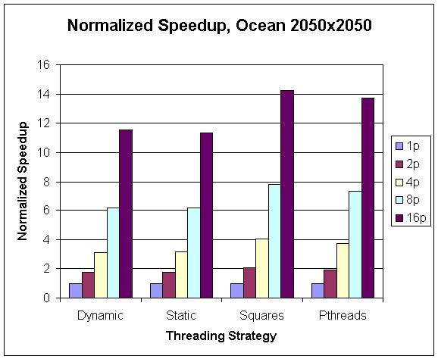
Microbenchmark: Ocean
CS267 Lecture 6
Notes:
CS267 Lecture 2
P=1 normalize to 1 in all cases
Squares beat rows, nearly perfect speedup up to 8, less at 16
OpenMP beats Pthreads, slightly
Dynamic and static about the same
Could hack Pthreads to make it about as fast as OpenMP,
but point is to avoid having to do that work

Slide 30
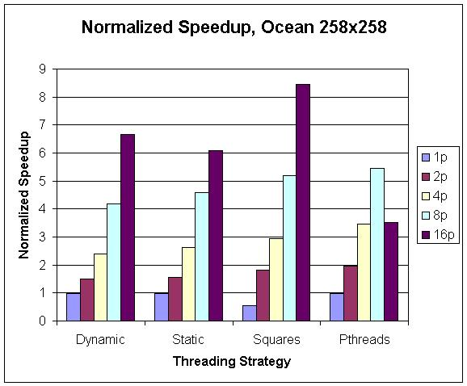
Microbenchmark: Ocean
CS267 Lecture 6
Notes:
CS267 Lecture 2
Note vertical scale goes up to 9, not 16 as before
Why is speedup for squares less than 1 for p=1?
When comparing parallel code with p=1 to sequential code, could be slower
Speedups lowers than for larger ocean
OpenMP beats pThread, because not implemented on top of pThreads,
for example OpenMP may preallocate threads, not counted in runtime
Could optimize pThreads with a lot of effort, whole point is you don’t
want to spend this effort.
Why drop in Pthreads from 8 to 16 procs? Guess that overhead from
thread generation starts to dominate, but need instrumentation tools
to really answer
Takeaway: overhead less important if problem larger

Slide 31
Evaluation
OpenMP scales to 16-processor systems
  Was overhead too high?
    In some cases, yes (when too little work per processor)
  Did compiler-generated code compare to hand-written code?
    Yes!
  How did the loop scheduling options affect performance?
    dynamic or guided scheduling helps loops with variable iteration runtimes
    static or predicated scheduling more appropriate for shorter loops
OpenMP is a good tool to parallelize (at least some!) applications
CS267 Lecture 6
Notes:
CS267 Lecture 2
Scales to 24 processors on Hopper too
Will use on HW 2

Slide 32
OpenMP Summary
OpenMP is a compiler-based technique to create concurrent code from (mostly) serial code
OpenMP can enable (easy) parallelization of loop-based code
  Lightweight syntactic language extensions
OpenMP performs comparably to manually-coded threading
  Scalable
  Portable
Not a silver bullet for all (more irregular) applications
Lots of detailed tutorials/manuals on-line
CS267 Lecture 6
Notes:
CS267 Lecture 2
Irregular: searching down search tree with unknown structure, hard to express as loop
OpenMP vs CILK: CILK does work stealing versus centralized job queue for OpenMP

Slide 33
Extra Slides
CS267 Lecture 6

Slide 34
Shared Data and Threads
Variables declared outside of main are shared
Object allocated on the heap may be shared (if pointer is passed)
Variables on the stack are private: passing pointer to these around to other threads can cause problems
Often done by creating a large “thread data” struct
  Passed into all threads as argument
  Simple example:
    char *message = "Hello World!\n";
    pthread_create( &thread1,
    NULL,
    (void*)&print_fun,
    (void*) message);
CS267 Lecture 6
Notes:
CS267 Lecture 2

Slide 35
Setting Attribute Values
Once an initialized attribute object exists, changes can be made. For example:
  To change the stack size for a thread to 8192 (before calling pthread_create), do this:
    pthread_attr_setstacksize(&my_attributes, (size_t)8192);
  To get the stack size, do this:
    size_t my_stack_size;
    pthread_attr_getstacksize(&my_attributes, &my_stack_size);
Other attributes:
  Detached state – set if no other thread will use pthread_join to wait for this thread (improves efficiency)
  Guard size – use to protect against stack overfow
  Inherit scheduling attributes (from creating thread) – or not
  Scheduling parameter(s) – in particular, thread priority
  Scheduling policy – FIFO or Round Robin
  Contention scope – with what threads does this thread compete for a CPU
  Stack address – explicitly dictate where the stack is located
  Lazy stack allocation – allocate on demand (lazy) or all at once, “up front”
Slide Sorce: Theewara Vorakosit
CS267 Lecture 6
Notes:
CS267 Lecture 2

Slide 36
Microbenchmark: GeneticTSP
Genetic heuristic-search algorithm for approximating a solution to the Traveling Salesperson Problem (TSP)
  Find shortest path through weighted graph, visiting each node once
Operates on a population of possible TSP paths
  Forms new paths by combining known, good paths (crossover)
  Occasionally introduces new random elements (mutation)
Variables:
  Np – Population size, determines search space and working set size
  Ng – Number of generations, controls effort spent refining solutions
  rC – Rate of crossover, determines how many new solutions are produced and evaluated in a generation
  rM – Rate of mutation, determines how often new (random) solutions are introduced
CS267 Lecture 6
Notes:
CS267 Lecture 2

Slide 37
Microbenchmark: GeneticTSP
while( current_gen < Ng ) {
Breed rC*Np new solutions:
Select two parents
Perform crossover()
Mutate() with probability rM
Evaluate() new solution
Identify least-fit rC*Np solutions:
Remove unfit solutions from population
current_gen++
}
return the most fit solution found
Outer loop has data dependence between iterations, as the population is not a loop invariant.
Can generate new solutions in parallel, but crossover(), mutate(), and evaluate() have varying runtimes.
Threads can find least-fit population members in parallel, but only one thread should actually delete solutions.
CS267 Lecture 6
Notes:
CS267 Lecture 2

Slide 38
Microbenchmark: GeneticTSP
dynamic_tsp – Parallelizes both breeding loop and survival loop with OpenMP’s dynamic scheduling
static_tsp – Parallelizes both breeding loop and survival loop with OpenMP’s static scheduling
OpenMP
tuned_tsp – Attempt to tune scheduilng. Uses guided (exponential allocation) scheduling on breeding loop, static predicated scheduling on survival loop.
pthreads_tsp – Divides iterations of breeding loop evenly among threads, conditionally executes survival loop in parallel
PThreads
CS267 Lecture 6
Notes:
CS267 Lecture 2

Slide 39
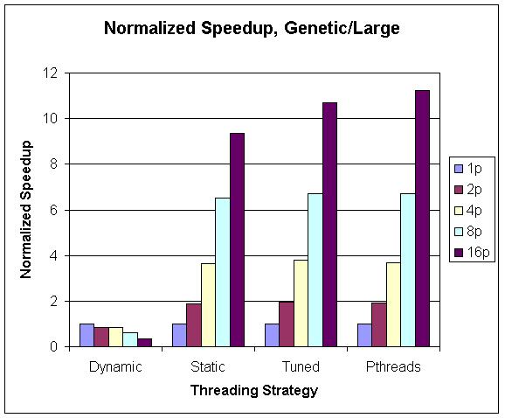
Microbenchmark: GeneticTSP
CS267 Lecture 6
Notes:
CS267 Lecture 2
Last time, for ocean modeling, dynamic beat or equalled static, now opposite

Slide 40
SpecOMP (2001)
Parallel form of SPEC FP 2000 using Open MP, larger working sets
  www.spec.org/omp
  Aslot et. Al., Workshop on OpenMP Apps. and Tools (2001)
Many of CFP2000 were “straightforward” to parallelize:
  ammp (Computational chemistry): 16 Calls to OpenMP API, 13 #pragmas, converted linked lists to vector lists
  Applu (Parabolic/elliptic PDE solver): 50 directives, mostly parallel or do
  Fma3d (Finite element car crash simulation): 127 lines of OpenMP directives (60k lines total)
  mgrid (3D multigrid): automatic translation to OpenMP
  Swim (Shallow water modeling): 8 loops parallelized
CS267 Lecture 6
Notes:
CS267 Lecture 2

Slide 41
More Information
openmp.org
  OpenMP official site
www.llnl.gov/computing/tutorials/openMP/
  A handy OpenMP tutorial
www.nersc.gov/assets/Uploads/XE62011OpenMP.pdf
  Another OpenMP tutorial and reference
CS267 Lecture 6
Notes:
CS267 Lecture 2

Slide 42
Shared Memory Hardware and
Memory Consistency
CS267 Lecture 6
Notes:
CS267 Lecture 2

Slide 43
Basic Shared Memory Architecture
Processors all connected to a large shared memory
  Where are caches?
P1
P2
Pn
interconnect
memory
Now take a closer look at structure, costs, limits, programming
CS267 Lecture 6
Notes:
CS267 Lecture 2

Slide 44
What About Caching???
P
P
1
n
$
$
Bus
Mem
I/O devices
Want high performance for shared memory: Use Caches!
  Each processor has its own cache (or multiple caches)
  Place data from memory into cache
  Writeback cache: don’t send all writes over bus to memory
Caches reduce average latency
  Automatic replication closer to processor
  More important to multiprocessor than uniprocessor: latencies longer
Normal uniprocessor mechanisms to access data
  Loads and Stores form very low-overhead communication primitive
Problem: Cache Coherence!
Slide source: John Kubiatowicz
Notes:
Writeback vs write-through cache:
writeback only sends data to main memory when evicted from cache
write-through always updates main memory on each write
CS267 Lecture 2

Slide 45
Example Cache Coherence Problem
P
1
P
2
P
3
u
= ?
u
= ?
3
$
4
$
5
$
u
:5
u
:5
u
= 7
1
I/O devices
u
:5
2
Things to note:
  Processors could see different values for u after event 3
  With write back caches, value written back to memory depends on happenstance of which cache flushes or writes back value when
How to fix with a bus: Coherence Protocol
  Use bus to broadcast writes or invalidations
  Simple protocols rely on presence of broadcast medium
Bus not scalable beyond about 64 processors (max)
  Capacity, bandwidth limitations
Memory
Slide source: John Kubiatowicz

Slide 46
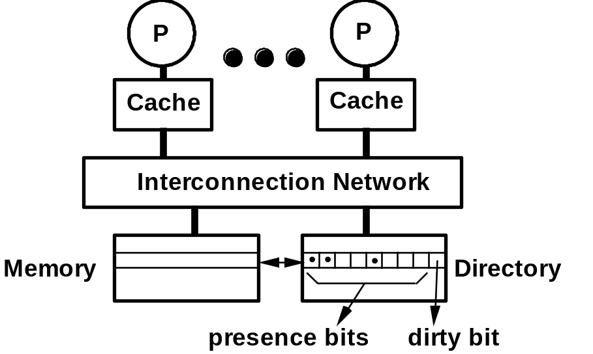
Scalable Shared Memory: Directories
• k processors.
• With each cache-block in memory:
k presence-bits, 1 dirty-bit
• With each cache-block in cache:
1 valid bit, and 1 dirty (owner) bit
Every memory block has associated directory information
  keeps track of copies of cached blocks and their states
  on a miss, find directory entry, look it up, and communicate only with the nodes that have copies if necessary
  in scalable networks, communication with directory and copies is through network transactions
Each Reader recorded in directory
Processor asks permission of memory before writing:
  Send invalidation to each cache with read-only copy
  Wait for acknowledgements before returning permission for writes
Slide source: John Kubiatowicz
Notes:
Cache block >> cache line in size
CS267 Lecture 2

Slide 47
Intuitive Memory Model
Reading an address should return the last value written to that address
Easy in uniprocessors
  except for I/O
Cache coherence problem in MPs is more pervasive and more performance critical
More formally, this is called sequential consistency:
“A multiprocessor is sequentially consistent if the result of any execution is the same as if the operations of all the processors were executed in some sequential order, and the operations of each individual processor appear in this sequence in the order specified by its program.” [Lamport, 1979]
CS267 Lecture 6
Notes:
CS267 Lecture 2

Slide 48
Sequential Consistency Intuition
Sequential consistency says the machine behaves as if it does the following
P0
P1
P2
P3
memory
CS267 Lecture 6
Notes:
CS267 Lecture 2

Slide 49
Memory Consistency Semantics
What does this imply about program behavior?
No process ever sees “garbage” values, i.e., average of 2 values
Processors always see values written by some processor
The value seen is constrained by program order on all processors
  Time always moves forward
Example: spin lock
  P1 writes data=1, then writes flag=1
  P2 waits until flag=1, then reads data
If P2 sees the new value of flag (=1), it must see the new value of data (=1)
If P2 reads flag | Then P2 may read data
0 | 1
0 | 0
1 | 1
initially: flag=0
data=0
P1
P2
data = 1
flag = 1
10: if flag=0, goto 10
…= data
CS267 Lecture 6
Notes:
CS267 Lecture 2
Write spin lock on board to refer to later

Slide 50
Are Caches “Coherent” or Not?
Coherence means different copies of same location have same value, incoherent otherwise:
p1 and p2 both have cached copies of data (= 0)
p1 writes data=1
  May “write through” to memory
p2 reads data, but gets the “stale” cached copy
  This may happen even if it read an updated value of another variable, flag, that came from memory
data = 0
data 1
data 0
data 0
p1
p2
CS267 Lecture 6
Notes:
CS267 Lecture 2

Slide 51
Snoopy Cache-Coherence Protocols
State
Address
Data
P0
Pn
$
bus snoop
$
memory bus
memory op from Pn
Mem
Mem
Memory bus is a broadcast medium
Caches contain information on which addresses they store
Cache Controller “snoops” all transactions on the bus
  A transaction is a relevant transaction if it involves a cache block currently contained in this cache
  Take action to ensure coherence
    invalidate, update, or supply value
  Many possible designs (see CS252 or CS258)
CS267 Lecture 6
Notes:
CS267 Lecture 2

Slide 52
Limits of Bus-Based Shared Memory
Assume:
1 GHz processor w/o cache
=> 4 GB/s inst BW per processor (32-bit)
=> 1.2 GB/s data BW at 30% load-store
Suppose 98% inst hit rate and 95% data hit rate
=> 80 MB/s inst BW per processor
=> 60 MB/s data BW per processor
140 MB/s combined BW
Assuming 1 GB/s bus bandwidth
∴ 8 processors will saturate bus
I/O
MEM
° ° °
MEM
140 MB/s
° ° °
cache
cache
5.2 GB/s
PROC
PROC
CS267 Lecture 6
Notes:
CS267 Lecture 2
Original slide noted 16byte cache line, but I didn’t use that in this calculation
Actual bw requirements would be higher if we take this into account
Earlier slide assumed caches were shared too, so had higher BW requirements shared part

Slide 53
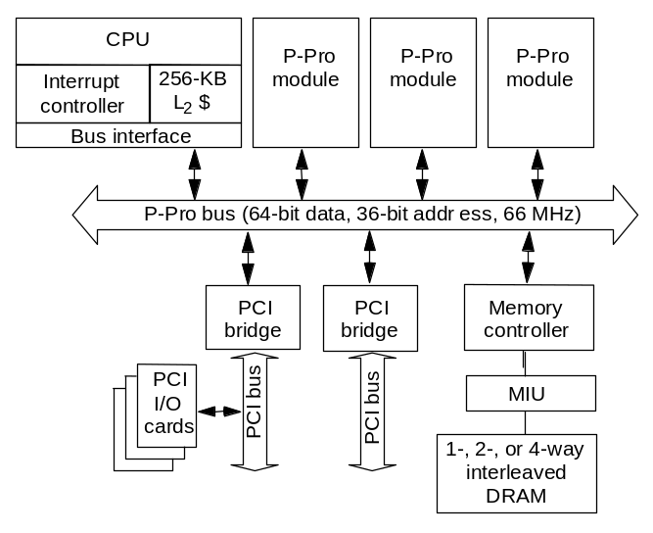
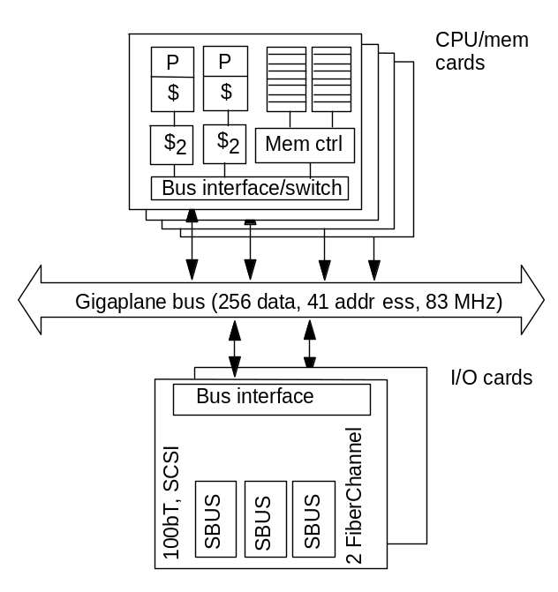
Sample Machines
Intel Pentium Pro Quad
  Coherent
  4 processors
Sun Enterprise server
  Coherent
  Up to 16 processor and/or memory-I/O cards
IBM Blue Gene/L
  L1 not coherent, L2 shared
CS267 Lecture 6
Notes:
CS267 Lecture 2
PCI = Peripheral Component Interconnect
MIU = Memory Interface Unit
Shared L2 means no need for coherence

Slide 54
Directory Based Memory/Cache Coherence
Keep Directory to keep track of which memory stores latest copy of data
Directory, like cache, may keep information such as:
  Valid/invalid
  Dirty (inconsistent with memory)
  Shared (in another caches)
When a processor executes a write operation to shared data, basic design choices are:
  With respect to memory:
    Write through cache: do the write in memory as well as cache
    Write back cache: wait and do the write later, when the item is flushed
  With respect to other cached copies
    Update: give all other processors the new value
    Invalidate: all other processors remove from cache
See CS252 or CS258 for details
CS267 Lecture 6
Notes:
CS267 Lecture 2

Slide 55
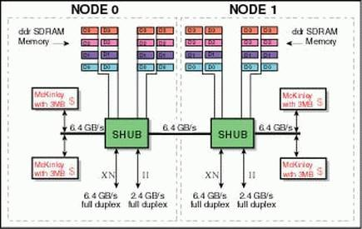

SGI Altix 3000
A node contains up to 4 Itanium 2 processors and 32GB of memory
Network is SGI’s NUMAlink, the NUMAflex interconnect technology.
Uses a mixture of snoopy and directory-based coherence
Up to 512 processors that are cache coherent (global address space is possible for larger machines)
CS267 Lecture 6
Notes:
CS267 Lecture 2
Record holder for largest cache coherent machine

Slide 56
Sharing: A Performance Problem
True sharing
  Frequent writes to a variable can create a bottleneck
  OK for read-only or infrequently written data
  Technique: make copies of the value, one per processor, if this is possible in the algorithm
  Example problem: the data structure that stores the freelist/heap for malloc/free
False sharing
  Cache block may also introduce artifacts
  Two distinct variables in the same cache block
  Technique: allocate data used by each processor contiguously, or at least avoid interleaving in memory
  Example problem: an array of ints, one written frequently by each processor (many ints per cache line)
CS267 Lecture 6
Notes:
CS267 Lecture 2

Slide 57
Cache Coherence and Sequential Consistency
There is a lot of hardware/work to ensure coherent caches
  Never more than 1 version of data for a given address in caches
  Data is always a value written by some processor
But other HW/SW features may break sequential consistency (SC):
  The compiler reorders/removes code (e.g., your spin lock, see next slide)
  The compiler allocates a register for flag on Processor 2 and spins on that register value without ever completing
  Write buffers (place to store writes while waiting to complete)
    Processors may reorder writes to merge addresses (not FIFO)
    Write X=1, Y=1, X=2 (second write to X may happen before Y’s)
  Prefetch instructions cause read reordering (read data before flag)
  The network reorders the two write messages.
  The write to flag is nearby, whereas data is far away.
  Some of these can be prevented by declaring variables “volatile”
Most current commercial SMPs give up SC
  A correct program on a SC processor may be incorrect on one that is not
CS267 Lecture 6
Notes:
CS267 Lecture 2
A program that is correct on a SC processor may be incorrect on one that is not
Example: Spin Locks

Slide 58
Example: Coherence not Enough
P
1
P
2
/*Assume initial value of A and ag is 0*/
A = 1;
while (flag == 0);
/*spin idly*/
flag = 1;
print A;
Intuition not guaranteed by coherence
expect memory to respect order between accesses to different locations issued by a given process
  to preserve orders among accesses to same location by different processes
Coherence is not enough!
  pertains only to single location
  Need statement about ordering
  between multiple locations.
P
P
1
n
Conceptual
Picture
Mem
Slide source: John Kubiatowicz

Slide 59
Programming with Weaker Memory Models than SC
Possible to reason about machines with fewer properties, but difficult
Some rules for programming with these models
  Avoid race conditions
  Use system-provided synchronization primitives
  At the assembly level, may use “fences” (or analogs) directly
The high level language support for these differs
  Built-in synchronization primitives normally include the necessary fence operations
    lock (), … only one thread at a time allowed here…. unlock()
    Region between lock/unlock called critical region
  For performance, need to keep critical region short
CS267 Lecture 6
Notes:
CS267 Lecture 2
Read fence: don’t prefetch before this point
Write fence: complete writes before going past this point

Slide 60
What to Take Away?
Programming shared memory machines
  May allocate data in large shared region without too many worries about where
  Memory hierarchy is critical to performance
    Even more so than on uniprocessors, due to coherence traffic
  For performance tuning, watch sharing (both true and false)
Semantics
  Need to lock access to shared variable for read-modify-write
  Sequential consistency is the natural semantics
    Write race-free programs to get this
  Architects worked hard to make this work
    Caches are coherent with buses or directories
    No caching of remote data on shared address space machines
  But compiler and processor may still get in the way
    Non-blocking writes, read prefetching, code motion…
    Avoid races or use machine-specific fences carefully
CS267 Lecture 6
Notes:
CS267 Lecture 2

Slide 61
Extra Slides
CS267 Lecture 6

Slide 62
Sequential Consistency Example
Processor 1
Processor 2
One Consistent Serial Order
LD₁ A ⇒ 5
LD₂ B ⇒ 7
ST₁ A,6
…
LD₃ A ⇒ 6
LD₄ B ⇒ 21
ST₂ B,13
ST₃ B,4
LD₅ B ⇒ 2
…
LD₆ A ⇒ 6
ST₄ B,21
…
LD₇ A ⇒ 6
…
LD₈ B ⇒ 4
LD₁ A ⇒ 5
LD₂ B ⇒ 7
LD₅ B ⇒ 2
ST₁ A,6
LD₆ A ⇒ 6
ST₄ B,21
LD₃ A ⇒ 6
LD₄ B ⇒ 21
LD₇ A ⇒ 6
ST₂ B,13
ST₃ B,4
LD₈ B ⇒ 4
Slide source: John Kubiatowicz

Slide 63
Multithreaded Execution
Multitasking operating system:
  Gives “illusion” that multiple things happening at same time
  Switches at a course-grained time quanta (for instance: 10ms)
Hardware Multithreading: multiple threads share processor simultaneously (with little OS help)
  Hardware does switching
    HW for fast thread switch in small number of cycles
    much faster than OS switch which is 100s to 1000s of clocks
  Processor duplicates independent state of each thread
    e.g., a separate copy of register file, a separate PC, and for running independent programs, a separate page table
  Memory shared through the virtual memory mechanisms, which already support multiple processes
When to switch between threads?
  Alternate instruction per thread (fine grain)
  When a thread is stalled, perhaps for a cache miss, another thread can be executed (coarse grain)
Slide source: John Kubiatowicz

Slide 64
Thread Scheduling
main thread
Time
Thread A
Thread B
Thread C
Thread D
Once created, when will a given thread run?
  It is up to the Operating System or hardware, but it will run eventually, even if you have more threads than cores
  But – scheduling may be non-ideal for your application
Programmer can provide hints or affinity in some cases
  E.g., create exactly P threads and assign to P cores
Can provide user-level scheduling for some systems
  Application-specific tuning based on programming model
  Work in the ParLAB on making user-level scheduling easy to do (Lithe)
Slide source: John Kubiatowicz

Slide 65
What about combining ILP and TLP?
TLP and ILP exploit two different kinds of parallel structure in a program
Could a processor oriented at ILP benefit from exploiting TLP?
  functional units are often idle in data path designed for ILP because of either stalls or dependences in the code
  TLP used as a source of independent instructions that might keep the processor busy during stalls
  TLP be used to occupy functional units that would otherwise lie idle when insufficient ILP exists
Called “Simultaneous Multithreading”
  Intel renamed this “Hyperthreading”
Slide source: John Kubiatowicz

Slide 66
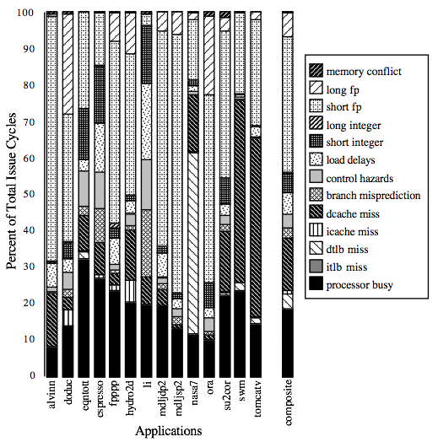
Quick Recall: Many Resources IDLE!
For an 8-way superscalar.
From: Tullsen, Eggers, and Levy,
“Simultaneous Multithreading: Maximizing On-chip Parallelism, ISCA 1995.
Slide source: John Kubiatowicz

Slide 67
Simultaneous Multi-threading ...
One thread, 8 units
Two threads, 8 units
Cycle
M
M
FX
FX
FP
FP
BR
CC
Cycle
M
M
FX
FX
FP
FP
BR
CC
1
2
3
4
5
6
7
8
9
1
2
3
4
5
6
7
8
9
M = Load/Store, FX = Fixed Point, FP = Floating Point, BR = Branch, CC = Condition Codes
Slide source: John Kubiatowicz

Slide 68
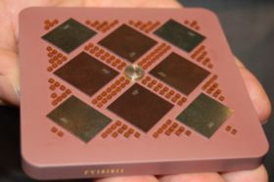
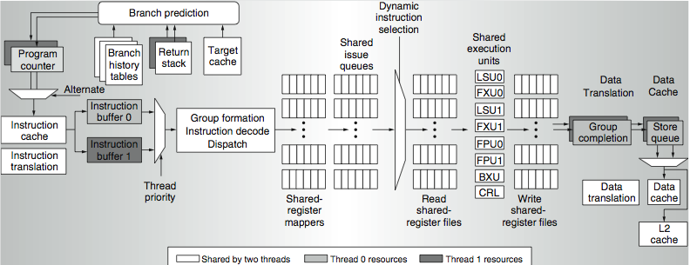
Power 5 dataflow ...
Why only two threads?
  With 4, one of the shared resources (physical registers, cache, memory bandwidth) would be prone to bottleneck
Cost:
  The Power5 core is about 24% larger than the Power4 core because of the addition of SMT support

