Slide 1
CS 267
Tricks with Trees
James Demmel
www.cs.berkeley.edu/~demmel/cs267_Spr15
02/05/2015
CS267 Lecture 6+
Notes:
Why talk about this now?
Back up stack from programming models to algorithms
Built in to distributed memory programming systems like MPI,
So let’s do this first.

Slide 2
Outline
A log n lower bound to compute any function in parallel
Reduction and broadcast in O(log n) time
Parallel prefix (scan) in O(log n) time
Adding two n-bit integers in O(log n) time
Multiplying n-by-n matrices in O(log n) time
Inverting n-by-n triangular matrices in O(log² n) time
Inverting n-by-n dense matrices in O(log² n) time
Evaluating arbitrary expressions in O(log n) time
Evaluating recurrences in O(log n) time
02/05/2015
CS267 Lecture 6+
Notes:
Parallel prefix works for any associative operator
Ex: for adding two n-bit integers, need to propagate the carries,
turns out to be 2x2 boolean matrix multiply

Slide 3
Outline
A log n lower bound to compute any function in parallel
Reduction and broadcast in O(log n) time
Parallel prefix (scan) in O(log n) time
Adding two n-bit integers in O(log n) time
Multiplying n-by-n matrices in O(log n) time
Inverting n-by-n triangular matrices in O(log² n) time
Inverting n-by-n dense matrices in O(log² n) time
Evaluating arbitrary expressions in O(log n) time
Evaluating recurrences in O(log n) time
“2D parallel prefix”, for image segmentation (Bryan Catanzaro, Kurt Keutzer)
Sparse-Matrix-Vector-Multiply (SpMV) using Segmented Scan
Parallel page layout in a browser (Leo Meyerovich, Ras Bodik)
02/05/2015
CS267 Lecture 6+
Notes:
Page layout -> parsing html, same idea on non-binary tree
Page layout on slide 22

Slide 4
Outline
A log n lower bound to compute any function in parallel
Reduction and broadcast in O(log n) time
Parallel prefix (scan) in O(log n) time
Adding two n-bit integers in O(log n) time
Multiplying n-by-n matrices in O(log n) time
Inverting n-by-n triangular matrices in O(log² n) time
Inverting n-by-n dense matrices in O(log² n) time
Evaluating arbitrary expressions in O(log n) time
Evaluating recurrences in O(log n) time
“2D parallel prefix”, for image segmentation (Bryan Catanzaro, Kurt Keutzer)
Sparse-Matrix-Vector-Multiply (SpMV) using Segmented Scan
Parallel page layout in a browser (Leo Meyerovich, Ras Bodik)
Solving n-by-n tridiagonal matrices in O(log n) time
Traversing linked lists
Computing minimal spanning trees
Computing convex hulls of point sets…
02/05/2015
CS267 Lecture 6+

Slide 5
A log n lower bound to compute any function of n variables
Assume we can only use binary operations, one per time unit
After 1 time unit, an output can only depend on two inputs
Use induction to show that after k time units, an output can only depend on 2^{k} inputs
  After log₂ n time units, output depends on at most n inputs
A binary tree performs such a computation
02/05/2015
CS267 Lecture 6+

Slide 6
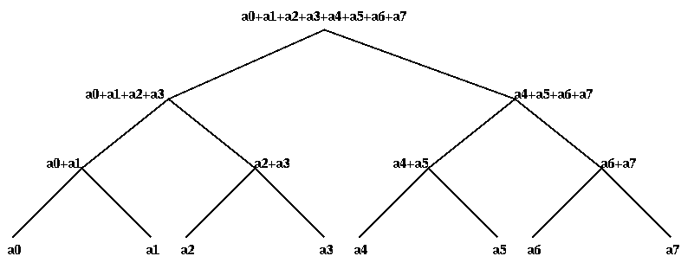
Broadcasts and Reductions on Trees
02/05/2015
CS267 Lecture 6+
Notes:
What works beside addition?
Maximum, multiplication
What is the only mathematical property I need?
Associativity – we will have lots of other examples

Slide 7
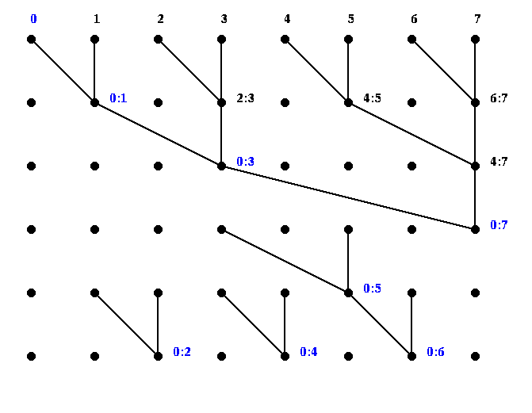
Parallel Prefix, or Scan
If “+” is an associative operator, and x[0],…,x[p-1] are input data then parallel prefix operation computes
Notation: j:k means x[j]+x[j+1]+…+x[k], blue is final value
y[j] = x[0] + x[1] + … + x[j] for j=0,1,…,p-1
02/05/2015
CS267 Lecture 6+

Slide 8
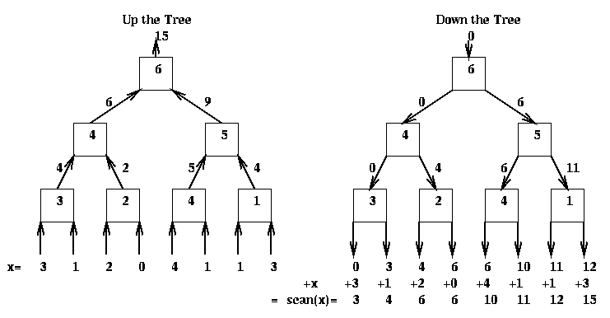
Mapping Parallel Prefix onto a Tree - Details
Up-the-tree phase (from leaves to root)
By induction, Lsave = sum of all leaves in left subtree
Down the tree phase (from root to leaves)
By induction, S = sum of all leaves to left of vertex receiving S
1) Get values L and R from left and right children
2) Save L in a local register Lsave
3) Pass sum L+R to parent
1) Get value S from parent (the root gets 0)
2) Send S to the left child
3) Send S + Lsave to the right child
02/05/2015
CS267 Lecture 6+
Notes:
Only assumed associativity
Only extra cost is 2n additions instead of n-1

Slide 9
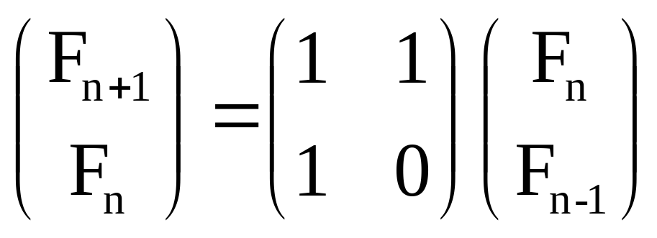

E.g., Fibonacci via Matrix Multiply Prefix
F_{n+1} = F_{n} + F_{n-1}
Can compute all F_{n} by matmul_prefix on
[ , , , , , , , , ]
then select the upper left entry
02/05/2015
CS267 Lecture 6+
Slide source: Alan Edelman, MIT
Notes:
Cost is 2n * cost(2x2 matmul) = 2*n*(8 mul and 8 adds) = 32n ops, versus n ops
But all parallel
Prelude to integer addition on all hardware built for decades, except that
we do Boolean matmul instead of integer matmul

Slide 10
Adding two n-bit integers in O(log n) time
Let a = a[n-1]a[n-2]…a[0] and b = b[n-1]b[n-2]…b[0] be two n-bit binary numbers
We want their sum s = a+b = s[n]s[n-1]…s[0]
Challenge: compute all c[i] in O(log n) time via parallel prefix
Used in all computers to implement addition - Carry look-ahead
c[-1] = 0 … rightmost carry bit
for i = 0 to n-1
c[i] = ( (a[i] xor b[i]) and c[i-1] ) or ( a[i] and b[i] ) ... next carry bit
s[i] = ( a[i] xor b[i] ) xor c[i-1]
for all (0 <= i <= n-1) p[i] = a[i] xor b[i] … propagate bit
for all (0 <= i <= n-1) g[i] = a[i] and b[i] … generate bit
c[i] = ( p[i] and c[i-1] ) or g[i] = p[i] g[i] * c[i-1] = C[i] * c[i-1]
1 1 0 1 1 1
… 2-by-2 Boolean matrix multiplication (associative)
= C[i] * C[i-1] * … C[0] * 0
1
… evaluate each P[i] = C[i] * C[i-1] * … * C[0] by parallel prefix
02/05/2015
CS267 Lecture 6+
Notes:
Same idea as Fibonacci, 2x2 matrix multiply as associate operation,
But Boolean instead of integer

Slide 11
Other applications of scan = parallel prefix
There are many applications of scans, some more obvious than others
  add multi-precision numbers (represented as array of numbers)
  evaluate recurrences, expressions
  solve tridiagonal systems (but numerically unstable!)
  implement bucket sort and radix sort
  to dynamically allocate processors
  to search for regular expression (e.g., grep)
  many others…
Names: +\ (APL), cumsum (Matlab), MPI_SCAN
Note: 2n operations used when only n-1 needed
02/05/2015
CS267 Lecture 6+
Notes:
Now we show examples, some “gee wow” but impractical, some practical

Slide 12
Multiplying n-by-n matrices in O(log n) time
For all (1 <= i,j,k <= n) P(i,j,k) = A(i,k) * B(k,j)
  cost = 1 time unit, using n³ processors
For all (1 <= i,j <= n) C(i,j) = Σ P(i,j,k)
  cost = O(log n) time, using n² trees with n³ / 2 processors
n
k =1
02/05/2015
CS267 Lecture 6+

Slide 13
Inverting triangular n-by-n matrices in O(log² n) time
-1
Fact:
Function Tri_Inv(T) … assume n = dim(T) = 2^{m} for simplicity
time(Tri_Inv(n)) = time(Tri_Inv(n/2)) + O(log(n))
  Change variable to m = log n to get time(Tri_Inv(n)) = O(log²n)
-1
A 0
C B
=
A 0
-B CA B
-1
-1
-1
If T is 1-by-1
return 1/T
else
… Write T = A 0
C B
In parallel do {
invA = Tri_Inv(A)
invB = Tri_Inv(B) } … implicitly uses a tree
newC = -invB * C * invA
Return invA 0
newC invB
02/05/2015
CS267 Lecture 6+

Slide 14
Inverting Dense n-by-n matrices in O(log n) time
2
Lemma 1: Cayley-Hamilton Theorem
  expression for A⁻¹ via characteristic polynomial in A
Lemma 2: Newton’s Identities
  Triangular system of equations for coefficients of characteristic polynomial, where matrix entries = s_{k}
Lemma 3: s_{k} = trace(A^{k}) = Σ A^{k} [i,i]
Csanky’s Algorithm (1976)
n
i=1
1) Compute the powers A², A³, …,A^{n-1} by parallel prefix
cost = O(log² n)
2) Compute the traces s_{k} = trace(A^{k})
cost = O(log n)
3) Solve Newton identities for coefficients of characteristic polynomial
cost = O(log² n)
4) Evaluate A⁻¹ using Cayley-Hamilton Theorem
cost = O(log n)
Completely numerically unstable
CS267 Lecture 6+
02/05/2015
Notes:
20x20 matrix 2*identity: get garbage in floating point,
Might be interesting over finite field…

Slide 15
Evaluating arbitrary expressions
Let E be an arbitrary expression formed from +, -, *, /, parentheses, and n variables, where each appearance of each variable is counted separately
Can think of E as arbitrary expression tree with n leaves (the variables) and internal nodes labeled by +, -, * and /
Theorem (Brent): E can be evaluated in O(log n) time, if we reorganize it using laws of commutativity, associativity and distributivity
Sketch of (modern) proof: evaluate expression tree E greedily by repeatedly
  collapsing all leaves into their parents at each time step
  evaluating all “chains” in E with parallel prefix
02/05/2015
CS267 Lecture 6+
Notes:
Another “Gee Whiz” example

Slide 16
Evaluating recurrences
Let x_{i} = f_{i}(x_{i-1}), f_{i} a rational function, x₀ given
How fast can we compute x_{n}?
Theorem (Kung): Suppose degree(f_{i}) = d for all i
  If d=1, x_{n} can be evaluated in O(log n) using parallel prefix
  If d>1, evaluating x_{n} takes Ω(n) time, i.e. no speedup is possible
Sketch of proof when d=1
Sketch of proof when d>1
  degree(x_{i}) as a function of x₀ is d^{i}
  After i parallel steps, degree(anything) ≤ 2^{i}
  Computing x_{i} take Ω(i) steps
x_{i} = f_{i}(x_{i-1}) = (a_{i} * x_{i-1} + b_{i} )/( c_{i} * x_{i-1} + d_{i} ) can be written as
x_{i} = num_{i} / den_{i} = (a_{i} * num_{i-1} + b_{i} * den_{i-1})/(c_{i} * num_{i-1} + d_{i} * den_{i-1}) or
num_{i} = a_{i} b_{i} * num_{i-1} = M_{i} * num_{i-1} = M_{i} * M_{i-1} * … * M₁* num₀
dem_{i} c_{i} d_{i} den_{i-1} den_{i-1} den₀
Can use parallel prefix with 2-by-2 matrix multiplication
02/05/2015
CS267 Lecture 6+
Notes:
Last gee whiz example, practical ones next

Slide 17
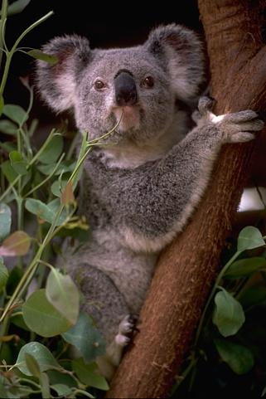
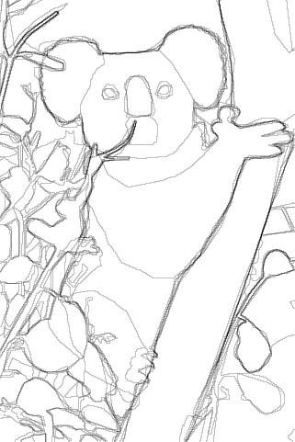
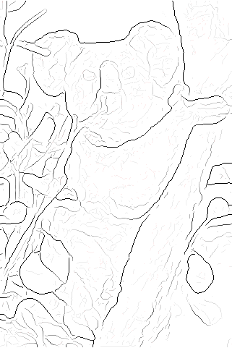
Image Segmentation (1/4)
Contours are subjective – they depend on perspective
  Surprise: Humans agree (somewhat)
Goal: generate contours automatically
  Use them to break images into separate segments (subimages)
  J. Malik’s group has leading algorithm
  Enable automatic image search and retrieval (“Find all the pictures with Fred”)
Image
Human Generated Contours
Machine Generated
Contours
02/05/2015
CS267 Lecture 6+
Notes:
Next three exampless generalize parallel prefix:
from 1D array to 2D array
to restart the sum occasionally
to nonbinary trees

Slide 18
Image Segmentation (2/4)
Think of image as matrix A(i,j) of pixels
  Each pixel has separate R(ed), G(reen), B(lue) intensities
Bottleneck (so far) of Malik’s algorithm is to compute other matrices indicating whether pixel (i,j) likely to be on contour
  Ex: C(i,j) = average “R intensity” of pixels in rectangle above (i,j) –
  average “R intensity” of pixels in rectangle below (i,j)
  C(i,j) large for pixel (i,j) marked with , so (i,j) likely to be on contour
Algorithm eventually computes eigenvectors of sparse matrix with entries computed from matrices like C
  Analogous to graph partitioning in later lecture
02/05/2015
CS267 Lecture 6+
Notes:
Use C and some similar matrices
to create graph where there is one vertex per pixel and and edge connected neighboring
vertices if they are likely to be in the same region; then we do graph partitioning (lecture later)
Today we just want to create the matrix C needed for rest of segmentation algorithm

Slide 19
Image Segmentation (3/4)
Bottleneck: Given A(i,j), compute C(i,j) where
  Sa(i,j) = sum of A(i,j) for entries in k x (2k+1) rectangle above A(i,j)
  = Σ A(r,s) for i-k ≤ r ≤ i-1 and j-k ≤ s ≤ j+k
  Sb(i,j) = similar sum of rectangle below A(i,j)
  C(i,j) = Sa(i,j) – Sb(i,j)
Approach (Bryan Catanzaro)
  Compute S(i,j) = Σ A(r,s) for r ≤ i and s ≤ j
  Then sum of A(i,j) over any rectangle (I_{low} ≤ i ≤ I_{high}, J_{low} ≤ j ≤ J_{high} ) is S(I_{high}, J_{high}) - S(I_{low} -1, J_{high}) - S(I_{high}, J_{low}-1) + S(I_{low} -1, J_{low} -1)
j
J_{low}
J_{high}
+1 -1 -1 +1 = 0
+1-1
=0
S(i,j)
I_{low}
i
I_{high}
+1 -1 = 0
+1
02/05/2015
CS267 Lecture 6+
Notes:
Obvious algorithm: n^2 (#pixels) * 4k^2 (size of box)
Goal: O(n^2)

Slide 20
Image Segmentation (4/4)
New Bottleneck: Given A(i,j), compute S(i,j) where
  S(i,j) = Σ A(r,s) for r ≤ i and s ≤ j
“2 dimensional parallel prefix”
  Do parallel prefix independently on each row of A(i,j) :
    S_{row}(i,j) = Σ A(i,s) for s ≤ j
  Do parallel prefix independently on each column of S_{row}
    S(i,j) = Σ S_{row}(r,j) for r ≤ i = Σ A(r,s) for s ≤ j and r ≤ i
j
S(i,j)
i
02/05/2015
CS267 Lecture 6+

Slide 21
Sparse-Matrix-Vector-Multiply (SpMV) y = A*x
Using Segmented Scan (SegScan)
Segscan computes prefix sums of arbitrary segments
Use CSR format of Sparse Matrix A, store x densely
Create array P of all nonzero A(i,j)*x(j) = Val(k)*x(Col_Ind(k))
Create array S showing where segments (rows) start
Compute SegScan( P, S ) =
Extract A*x = [14 61 24 ]
www.cs.cmu.edu/afs/cs.cmu.edu/project/scandal/public/papers/CMU-CS-93-173.ps.Z
Segscan ( [3, 1, 4, 5, 6, 1, 2, 3 ],
[T, F, F, T, T, F, F, T ])
= [3, 4, 8, 5, 6, 7, 9, 3]
7
8
2
1
3
0 2 3 0
2 4 0 0 5
3 0 0 0 1
Val = [ 1 2 3 2 4 5 3 1 ]
Col_Ind = [ 1 3 4 1 2 5 1 5 ]
Row_Ptr=[ 1 4 7 9 ]
x=
A =
P = [ 7 4 3 14 32 15 21 3 ]
S = [ T F F T F F T F ]
[ 7 11 14 14 46 61 21 24 ]
02/05/2015
CS267 Lecture 6+
Notes:
Last 2 slides generalized parallel prefix as follows:
1D to 2D
all leading sums to segmented
Next is a different generalization:
binary trees to arbitrary shaped trees

Slide 22
Page layout in a browser
Applying layout rules to html description of a webpage is a bottleneck, scan can help
Simplest example
  Given widths [x₁, x₂, … , x_{n}] of items to display on page, where should each item go?
  Item j starts at x₁ + x₂ + … + x_{j-1}
Real examples have complicated constraints
  Defined by general trees, since in html each object to display can be composed of other objects
  To get location of each object, need to do preorder traversal of tree, “adding up” constraints of previous objects
  Scan can do preorder traversal of any tree in parallel
    Not just binary trees
Ras Bodik, Leo Meyerovich
02/05/2015
CS267 Lecture 6+
Notes:
Generalize parallel prefix to nonbinary tree
Companies interested in using this

Slide 23
Summary of tree algorithms
Lots of problems can be done quickly - in theory - using trees
Some algorithms are widely used
  broadcasts, reductions, parallel prefix
  carry look ahead addition
Some are of theoretical interest only
  Csanky’s method for matrix inversion
  Solving tridiagonal linear systems (without pivoting)
  Both numerically unstable
  Csanky needs too many processors
Embedded in various systems
  MPI, Split-C, Titanium, NESL, other languages
  CM-5 hardware control network
02/05/2015
CS267 Lecture 6+
Notes:
Last three examples generalized parallel prefix:
from 1D array to 2D array
to restart the sum occasionally
to nonbinary trees

