Slide 1
Distributed Memory
Machines and Programming
Lecture 7
James Demmel
www.cs.berkeley.edu/~demmel/cs267_Spr15
Slides from Kathy Yelick
CS267 Lecture 7
Notes:
CS267 Lecture 2
Spr 13: 80-15=65 minutes
Spr 14: 73-9 = 64 minutes

Slide 2
Recap of Lecture 6
Shared memory multiprocessors
  Caches may be either shared or distributed.
    Multicore chips are likely to have shared caches
    Cache hit performance is better if they are distributed (each cache is smaller/closer) but they must be kept coherent -- multiple cached copies of same location must be kept equal.
  Requires clever hardware (see CS258, CS252).
  Distant memory much more expensive to access.
  Machines scale to 10s or 100s of processors.
Shared memory programming
  Starting, stopping threads.
  Communication by reading/writing shared variables.
  Synchronization with locks, barriers.
CS267 Lecture 7
Notes:
CS267 Lecture 2
Clever hardware: snooping, caches
Since only scales to 100s, need distributed memory machines

Slide 3
Outline
Distributed Memory Architectures
  Properties of communication networks
  Topologies
  Performance models
Programming Distributed Memory Machines using Message Passing
  Overview of MPI
  Basic send/receive use
  Non-blocking communication
  Collectives
CS267 Lecture 7
Notes:
CS267 Lecture 2
Performance models – of communication
MPI – standard, portable, changes slowly, backward compatible
need to know 6 basic subroutine calls, not 100

Slide 4
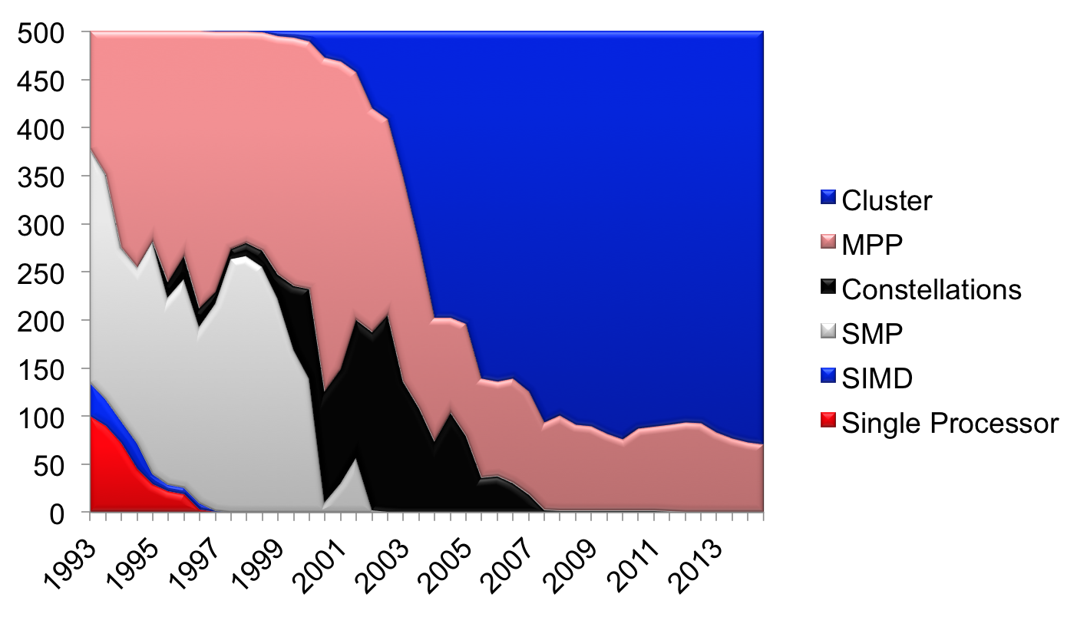
Architectures in Top 500, Nov 2014
Notes:
Constellation = cluster where #cores/SMP > #SMPs in whole platform
Nov 2012: 411 cluster = 82.2%, 89 MPP = 17.8%
MPP = distributed memory, all custom processors and interconnect
Cluster = off-the-shelf processors and network, integrated

Slide 5
Historical Perspective
Early distributed memory machines were:
  Collection of microprocessors.
  Communication was performed using bi-directional queues between nearest neighbors.
Messages were forwarded by processors on path.
  “Store and forward” networking
There was a strong emphasis on topology in algorithms, in order to minimize the number of hops = minimize time
CS267 Lecture 7
Notes:
CS267 Lecture 2
Like the postoffice, each cpu spent time as postmaster
Topology less important now, HW tries to hide it, NIC does postmaster’s job, but still worth knowing
Some algorithms need to be topology-aware for peak performance (eg matmul on 3D torus)
To have cost model (and some high performance algorithm are carefully
Tuned to topology)

Slide 6
Network Analogy
To have a large number of different transfers occurring at once, you need a large number of distinct wires
  Not just a bus, as in shared memory
Networks are like streets:
  Link = street.
  Switch = intersection.
  Distances (hops) = number of blocks traveled.
  Routing algorithm = travel plan.
Properties:
  Latency: how long to get between nodes in the network.
    Street: time for one car = dist (miles) / speed (miles/hr)
  Bandwidth: how much data can be moved per unit time.
    Street: cars/hour = density (cars/mile) * speed (miles/hr) * #lanes
    Network bandwidth is limited by the bit rate per wire and #wires
CS267 Lecture 7
Notes:
CS267 Lecture 2
Two most important parameters to model network performance: latency and bandwidth
Routing algorithm includes all-to-all (without traffic jams)
Latency of street: time it takes for one car = distance (miles) / speed (miles/hour)
Bandwidth of street: cars/hour that can travel = density (cars/mile) * speed (miles/hour) * #lanes
If you send a few large messages, bandwidth most important
If you send lots of small messages, latency most important (data later)
Generally faster for an algorithm to send a few large messages instead of many small ones
(may be easy or hard, depending on algorithm)

Slide 7
Design Characteristics of a Network
Topology (how things are connected)
  Crossbar; ring; 2-D, 3-D, higher-D mesh or torus; hypercube; tree; butterfly; perfect shuffle, dragon fly, …
Routing algorithm:
  Example in 2D torus: all east-west then all north-south (avoids deadlock).
Switching strategy:
  Circuit switching: full path reserved for entire message, like the telephone.
  Packet switching: message broken into separately-routed packets, like the post office, or internet
Flow control (what if there is congestion):
  Stall, store data temporarily in buffers, re-route data to other nodes, tell source node to temporarily halt, discard, etc.
CS267 Lecture 7
Notes:
CS267 Lecture 2
Hopper: 3D torus,
IBM BG L/P: 3D torus, BG Q: 5D torus
Edison: dragon fly, motivated by combining electrical and optical networks
Routing algorithm: example doesn’t use all wires all the time, could do better
Packet switching: internet is example, need to break up big messages into smaller ones
Flow control: analogy to highway system
may choose random intermediate node to route to, to avoid traffic jams (at a price)
Hopper is 3D network
BG/Q is 5D network
Butterfly and perfect shuffles are for FFTs

Slide 8
Performance Properties of a Network: Latency
Diameter: the maximum (over all pairs of nodes) of the shortest path between a given pair of nodes.
Latency: delay between send and receive times
  Latency tends to vary widely across architectures
  Vendors often report hardware latencies (wire time)
  Application programmers care about software latencies (user program to user program)
Observations:
  Latencies differ by 1-2 orders across network designs
  Software/hardware overhead at source/destination dominate cost (1s-10s usecs)
  Hardware latency varies with distance (10s-100s nsec per hop) but is small compared to overheads
Latency is key for programs with many small messages
CS267 Lecture 7
Notes:
CS267 Lecture 2
More about topology…
Will show diameters of sample topologies later
Extra latency from MPI: packing messages, copying, unpacking, …
How many flops in 1 microsec? 1k or 1M
Eg: EarthSimulator: 5 microsecond SW overhead vs .5 microsecond speed-of-light

Slide 9
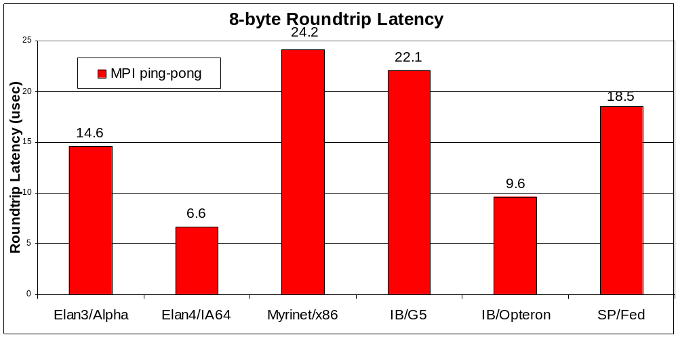
Latency on Some Machines/Networks
Latencies shown are from a ping-pong test using MPI
These are roundtrip numbers: many people use ½ of roundtrip time to approximate 1-way latency (which can’t easily be measured)
CS267 Lecture 7
Notes:
CS267 Lecture 2
Old data …
Quadrics sells Elan (spinoff of Meiko)
Myrinet (from Myricom)
IB = Inifiniband
SP = IBM Network (Federation, eg Bassi and Seaborg)
Note that performance depends not just on hardware network (eg IB),
but on attached processor (G5 or Opteron) and network software it runs
Times are 1 – 10 microseconds = 10^3 to 10^6 flops on one processor

Slide 10
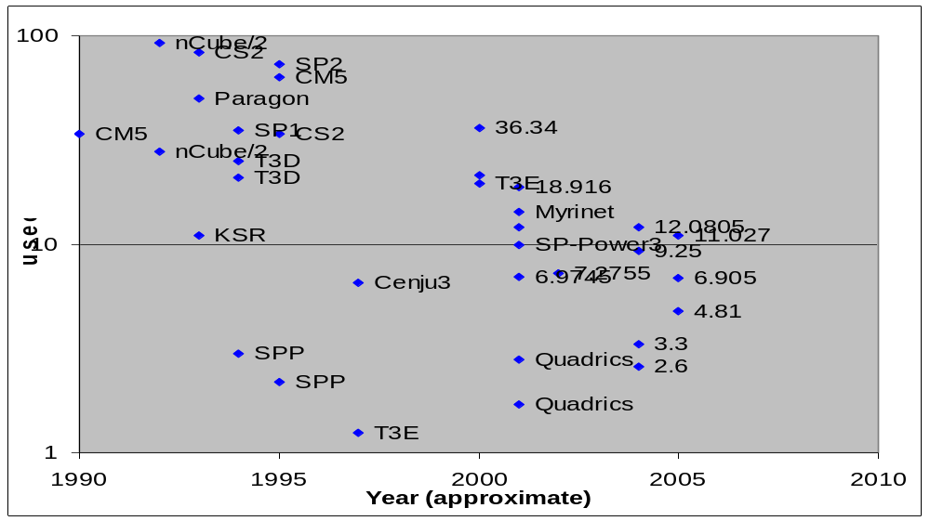
End to End Latency (1/2 roundtrip) Over Time
Latency has not improved significantly, unlike Moore’s Law
  T3E (shmem) was lowest point – in 1997
CS267 Lecture 7
Data from Kathy Yelick, UCB and NERSC
Notes:
CS267 Lecture 2
Data from literature, not always measured same way;
Point is that it is not decreasing very fast, if at all, over time.
5% better per year, sort of; no Moore’s Law
Some due to underlying physics of charging up a pin to move
a signal across a wire off-chip, some is software layer
Future technologies: photonics to speedup HW,
Eg: Earthsimulator: latency was ~10microsecs vs .5microsecs speedup of light
Hopper: 1.8 microseconds
Edison: 1.5 microseconds

Slide 11
Performance Properties of a Network: Bandwidth
The bandwidth of a link = # wires / time-per-bit
Bandwidth typically in Gigabytes/sec (GB/s), i.e., 8* 2²⁰ bits per second
Effective bandwidth is usually lower than physical link bandwidth due to packet overhead.
Routing and control header
Data payload
Error code
Trailer
Bandwidth is important for applications with mostly large messages
CS267 Lecture 7
Notes:
CS267 Lecture 2
Error code: analysis to SECDED in memory
For small messages, cost of header and trailer may dominate

Slide 12
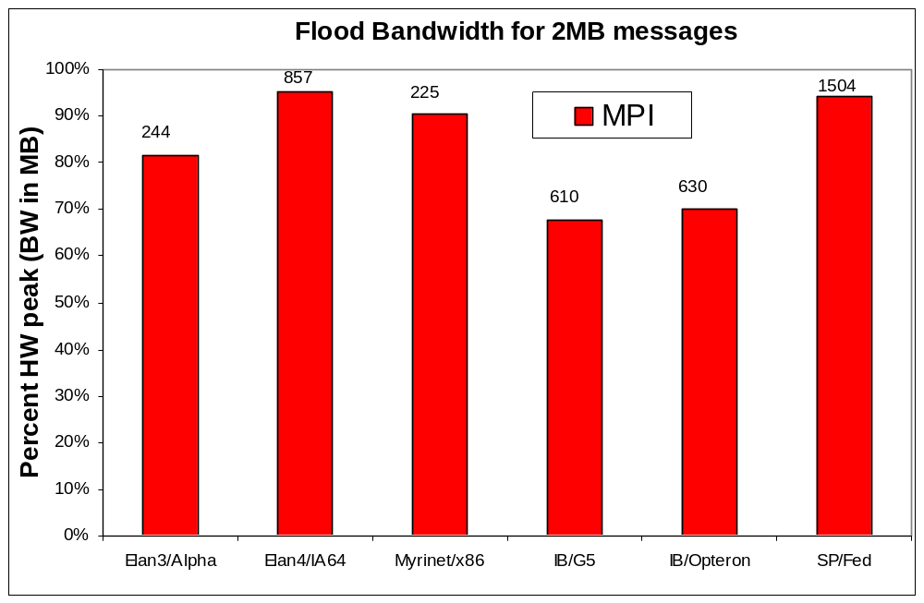
Bandwidth on Existing Networks
Flood bandwidth (throughput of back-to-back 2MB messages)
CS267 Lecture 7
Notes:
CS267 Lecture 2
Same 6 machines as before
Vertical axis = %HW peak, label is actual speed
Why < 100% peak? Software costs of packing/unpacking messages
Quadrics sells Elan (spinoff of Meiko)
Myrinet (from Myricom)
IB = Inifiniband
SP = IBM Network (Federation, eg Bassi and Seaborg)
Benchmark sends huge message so latency doesn’t matter
Recall: flops 60%/year better
network BW just 23%/year better
latency not improving much at all
Note vertical axis is fraction of HW peak (rest is overhead)

Slide 13
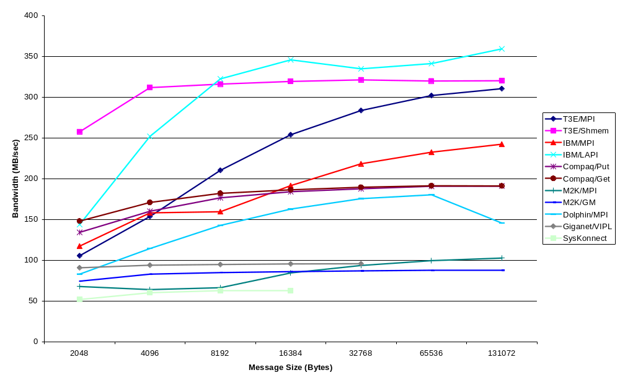
Bandwidth Chart
Note: bandwidth depends on SW, not just HW
CS267 Lecture 7
Data from Mike Welcome, NERSC
Notes:
CS267 Lecture 2
Point: larger messages have higher BW
Compare pink and blue: both T3E but different software infrastructures;
Shmem is lower level but faster than MPI for small messages
Slowness of MPI is price for writing portable code, not tuned for local HW
Although we emphasize latency in this talk, there are occasions in GAS languages where large-message bandwidth is important. This graph
Displays the characteristics of the various networks.
Compare same HW with different SW, note LAPI (from Berkeley) beats MPI a lot
Note that the IBM finally shines, but only if you use LAPI. The difference between MPI and LAPI is probably an additional data copy.
The T3E shmem performance nearly peaks out the torus bandwidth even for 4k messages.
The quadrics and Dolphin bandwidth are probably limited by the PCI bus
As well as Giganet (for older, 32 bit, 33Mhz PCI bus).
Why is Myrinet so slow?

Slide 14
Performance Properties of a Network: Bisection Bandwidth
Bisection bandwidth: bandwidth across smallest cut that divides network into two equal halves
Bandwidth across “narrowest” part of the network
not a
bisection
cut
bisection
cut
bisection bw= link bw
bisection bw = sqrt(p) * link bw
Bisection bandwidth is important for algorithms in which all processors need to communicate with all others
CS267 Lecture 7
Notes:
CS267 Lecture 2
Most stressful thing for a network, all-to-all, or transpose a matrix
Previous slides: point to point of 2 processors, rest quiet.
But most of the time multiple processor communicate
Bisection BW measure bottleneck if all procs on one side want
To talk to all on the other side
3D mesh faster than 2D faster than 1D
Graph theory problem: graph bisection problem
Usually don’t want to worry about this, but can make a big difference
in some algorithms; will show some of our SC11 results in later slide

Slide 15
Network Topology
In the past, there was considerable research in network topology and in mapping algorithms to topology.
  Key cost to be minimized: number of “hops” between nodes (e.g. “store and forward”)
  Modern networks hide hop cost (i.e., “wormhole routing”), so topology less of a factor in performance of many algorithms
Example: On IBM SP system, hardware latency varies from 0.5 usec to 1.5 usec, but user-level message passing latency is roughly 36 usec.
Need some background in network topology
  Algorithms may have a communication topology
  Example later of big performance impact
CS267 Lecture 7
Notes:
CS267 Lecture 2
Example later about topological effect on algorithms
Hide this slide?
Goal of Edison: make topology irrelevant. Did they succeed?

Slide 16
Linear and Ring Topologies
Linear array
  Diameter = n-1; average distance ~n/3.
  Bisection bandwidth = 1 (in units of link bandwidth).
Torus or Ring
  Diameter = n/2; average distance ~ n/4.
  Bisection bandwidth = 2.
  Natural for algorithms that work with 1D arrays.
CS267 Lecture 7
Notes:
CS267 Lecture 2
Show examples from simplest network, up to what people build now
Natural for some algorithms
[minute 32]

Slide 17
Meshes and Tori – used in Hopper
Two dimensional mesh
  Diameter = 2 * (sqrt( n ) – 1)
  Bisection bandwidth = sqrt(n)
Two dimensional torus
  Diameter = sqrt( n )
  Bisection bandwidth = 2* sqrt(n)
Generalizes to higher dimensions
  Cray XT (eg Hopper@NERSC) uses 3D Torus
Natural for algorithms that work with 2D and/or 3D arrays (matmul)
CS267 Lecture 7
Notes:
CS267 Lecture 2
IBM BG/P uses 3D torus, BG/Q is 5D torus
2D natural match to many matrix algorithms
Matmul needs 2D or 3D torus
Strassen needs 4D torus

Slide 18
Hypercubes
Number of nodes n = 2^{d} for dimension d.
  Diameter = d.
  Bisection bandwidth = n/2.
0d 1d 2d 3d 4d
Popular in early machines (Intel iPSC, NCUBE).
  Lots of clever algorithms.
  See 1996 online CS267 notes.
Greycode addressing:
  Each node connected to d others with 1 bit different.
110
111
010
011
100
101
000
001
CS267 Lecture 7
Notes:
CS267 Lecture 2

Slide 19
Trees
Diameter = log n.
Bisection bandwidth = 1.
Easy layout as planar graph.
Many tree algorithms (e.g., summation).
Fat trees avoid bisection bandwidth problem:
  More (or wider) links near top.
  Example: Thinking Machines CM-5.
CS267 Lecture 7
Notes:
CS267 Lecture 2
Double number of wires at each level of tree (1 to 2 to 4 to 8 in picture)
Some processors have separate tree network in addtion to something else (IBM BG/L and P, not Q)
Note that picture of planar fat tree does not have the right number of edges

Slide 20
Butterflies
Diameter = log n.
Bisection bandwidth = n.
Cost: lots of wires.
Used in BBN Butterfly.
Natural for FFT.
Ex: to get from proc 101 to 110,
Compare bit-by-bit and
Switch if they disagree, else not
O 1
O 1
O 1
O 1
butterfly switch
multistage butterfly network
CS267 Lecture 7
Notes:
CS267 Lecture 2
Why called butterfly? Look at shape of wires of 2-by-2 case
To get from 101 to 110, compare bit-by-bit and
Either go straight ahead if they agree, or switch if they don’t
(talk through example)
% (note that final order is “bit-reversed”)
(note that butterfly switch is rotated)

Slide 21
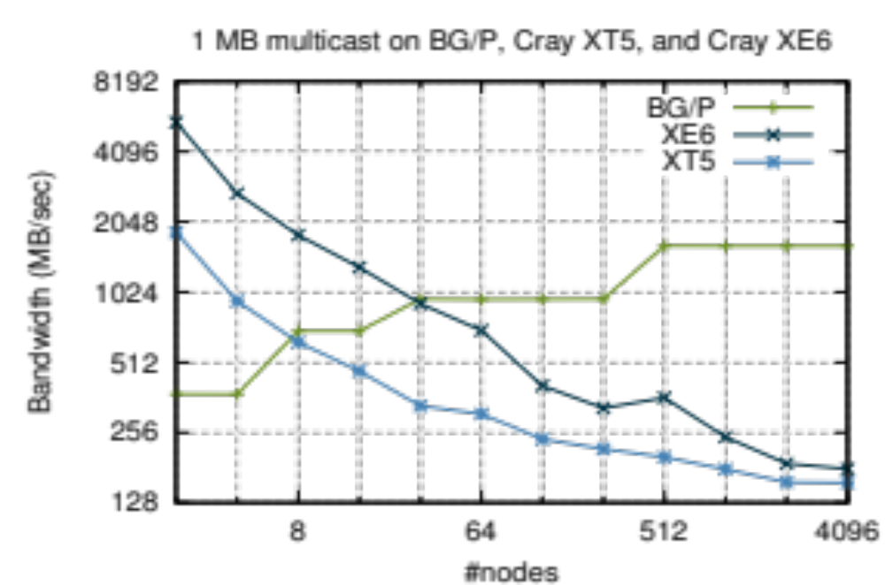
Does Topology Matter?
See EECS Tech Report UCB/EECS-2011-92, August 2011
CS267 Lecture 7
Notes:
XT5 = Franklin, XE6 = Hopper
Started as class project in CS267, ended up as
Prize-winning paper with world’s fastest parallel matmul, since it was bottleneck there
This was bottleneck in matmul algorithm
Multicast: every processor has data to send to another processor, like transposing a matrix
Why do more processors help on BG/P, not Cray? Even though all 3D tori?
Get 3D torus on BG/P when ask for 512 procs, in 8x8x8 array, and
Routing algorithm can use all the wires all the time.
But on Cray, get 512 procs, could be anywhere, uses general routing algorithms, slower
Why? Different business model: on Cray, keep all processors busy all the time, so
Get any 512 processors that are available.
But can ask for 3D torus on IBM
Ideally, wouldn’t have to worry about this, so final topology we present attempts to address this…
CS267 Lecture 2

Slide 22
Dragonflies – used in Edison
Motivation: Exploit gap in cost and performance between optical interconnects (which go between cabinets in a machine room) and electrical networks (inside cabinet)
  Optical more expensive but higher bandwidth when long
  Electrical networks cheaper, faster when short
Combine in hierarchy
  One-to-many via electrical networks inside cabinet
  Just a few long optical interconnects between cabinets
Clever routing algorithm to avoid bottlenecks:
  Route from source to randomly chosen intermediate cabinet
  Route from intermediate cabinet to destination
Outcome: programmer can (usually) ignore topology, get good performance
  Important in virtualized, dynamic environment
  Programmer can still create serial bottlenecks
  Drawback: variable performance
Details in “Technology-Drive, Highly-Scalable Dragonfly Topology,” J. Kim. W. Dally, S. Scott, D. Abts, ISCA 2008
CS267 Lecture 7
Notes:
Why name?
Dragonfly has narrow wings (optical interconnects), fat body (cabinets)
Play on “butterfly”, which is opposite
Routing algorithm by L. Valiant, SIAM J. Computing, 1982
Class project: measure data shown on last slide on Edison, see if
“topology oblivious” works, ditto for 2.5D Matmul
“Technology-Drive, Highly-Scalable Dragonfly Topology”
J. Kim. W. Dally, S. Scott, D. Abts, ISCA 2008
CS267 Lecture 2

Slide 23
Evolution of Distributed Memory Machines
Special queue connections are being replaced by direct memory access (DMA):
  Network Interface (NI) processor packs or copies messages.
  CPU initiates transfer, goes on computing.
Wormhole routing in hardware:
  NIs do not interrupt CPUs along path.
  Long message sends are pipelined.
  NIs don’t wait for complete message before forwarding
Message passing libraries provide store-and-forward abstraction:
  Can send/receive between any pair of nodes, not just along one wire.
  Time depends on distance since each NI along path must participate.
CS267 Lecture 7
Notes:
CS267 Lecture 2
Last HW slide
Initially CPUs did everything, real work + being postmasters
DMA means CPU doesn’t have to be interrupted to handle communication
Very long messages get pipelined
Congestion handled automatically, invisibly for CPU
Message passing provide abstraction (eg refer to procs 0 to 15 no matter where they are)

Slide 24
Performance Models
CS267 Lecture 7
Notes:
CS267 Lecture 2
Simple model to help understand, design algorithms
[Minute 42]

Slide 25
Shared Memory Performance Models
Parallel Random Access Memory (PRAM)
All memory access operations complete in one clock period -- no concept of memory hierarchy (“too good to be true”).
  OK for understanding whether an algorithm has enough parallelism at all (see CS273).
  Parallel algorithm design strategy: first do a PRAM algorithm, then worry about memory/communication time (sometimes works)
Slightly more realistic versions exist
  E.g., Concurrent Read Exclusive Write (CREW) PRAM.
  Still missing the memory hierarchy
CS267 Lecture 7
Notes:
CS267 Lecture 2

Slide 26
Latency and Bandwidth Model
Time to send message of length n is roughly
Topology is assumed irrelevant.
Often called “α−β model” and written
Usually α >> β >> time per flop.
  One long message is cheaper than many short ones.
  Can do hundreds or thousands of flops for cost of one message.
Lesson: Need large computation-to-communication ratio to be efficient.
LogP – more detailed model (Latency/overhead/gap/Proc.)
Time = latency + n*cost_per_word
= latency + n/bandwidth
Time = α + n*β
α + n∗β << n∗(α + 1∗β)
CS267 Lecture 7
Notes:
CS267 Lecture 2
LogP: breaks latency into part that can be overlapped with CPU,
Part that can’t be
(see hidden slides)

Slide 27
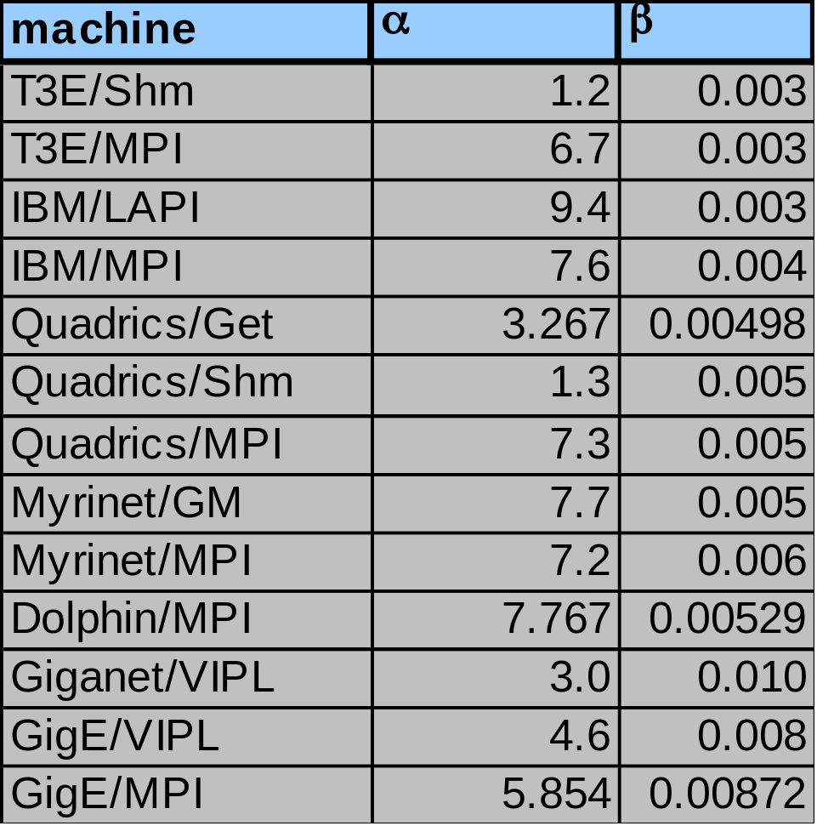
Alpha-Beta Parameters on Current Machines
These numbers were obtained empirically
α is latency in usecs
β is BW in usecs per Byte
How well does the model
Time = α + n*β
predict actual performance?
CS267 Lecture 7
Notes:
CS267 Lecture 2
Alpha = horizontal asymptote at left of previous data, measured by ping-ponging 1 word message
Beta = slope at right of previous data, measure by sending one huge message

Slide 28
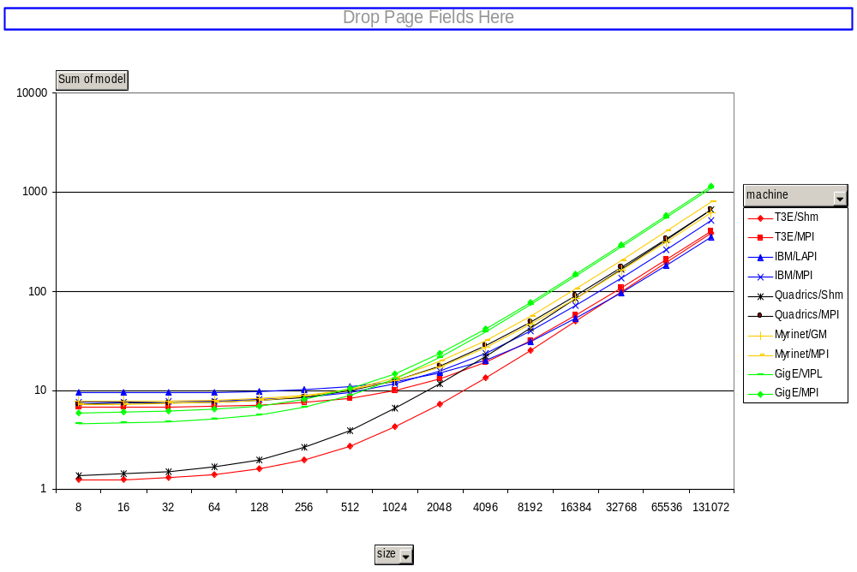
Model Time Varying Message Size & Machines
CS267 Lecture 7
Notes:
CS267 Lecture 2
LAPI lower level than MPI

Slide 29
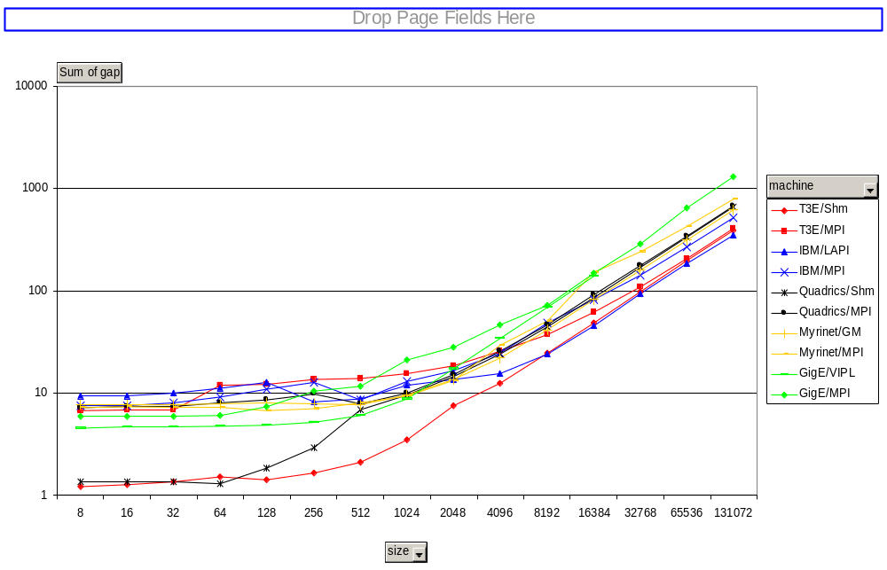
Measured Message Time
CS267 Lecture 7
Notes:
CS267 Lecture 2
Cost of one message from one processor to another,
So congestion and topology irrelevant
(unlike slide comparing multicast on Cray and IBM)

Slide 30
Programming
Distributed Memory Machines
with
Message Passing
Slides from
Jonathan Carter (jtcarter@lbl.gov),
Katherine Yelick (yelick@cs.berkeley.edu),
Bill Gropp (wgropp@illinois.edu)
CS267 Lecture 7

Slide 31
Message Passing Libraries (1)
Many “message passing libraries” were once available
  Chameleon, from ANL.
  CMMD, from Thinking Machines.
  Express, commercial.
  MPL, native library on IBM SP-2.
  NX, native library on Intel Paragon.
  Zipcode, from LLL.
  PVM, Parallel Virtual Machine, public, from ORNL/UTK.
  Others...
  MPI, Message Passing Interface, now the industry standard.
Need standards to write portable code.
CS267 Lecture 7
Notes:
CS267 Lecture 2
[Minute 47]
Some public domain, like PVM, some proprietary
Finally community decided they needed a common standard to write portable code
Called MPI, much documentation, books available,
Standard implementation to download, optimized versions already installed on
machines like Hopper
6 subroutine calls to get to working code,
But manual very long

Slide 32
Message Passing Libraries (2)
All communication, synchronization require subroutine calls
  No shared variables
  Program run on a single processor just like any uniprocessor program, except for calls to message passing library
Subroutines for
  Communication
    Pairwise or point-to-point: Send and Receive
    Collectives all processor get together to
      Move data: Broadcast, Scatter/gather
      Compute and move: sum, product, max, prefix sum, … of data on many processors
  Synchronization
    Barrier
    No locks because there are no shared variables to protect
  Enquiries
    How many processes? Which one am I? Any messages waiting?
CS267 Lecture 7
Notes:
CS267 Lecture 2
Examples all in C, hidden slides in C++, Fortran
Barrier rarely used, good for timing;
barrier, get time1, run code, barrier, get time2, time = time2-time1

Slide 33
Novel Features of MPI
Communicators encapsulate communication spaces for library safety
Datatypes reduce copying costs and permit heterogeneity
Multiple communication modes allow precise buffer management
Extensive collective operations for scalable global communication
Process topologies permit efficient process placement, user views of process layout
Profiling interface encourages portable tools
CS267 Lecture 7
Slide source: Bill Gropp, ANL
Notes:
CS267 Lecture 2
Need to be able to connect heterogeneous (old and new) processors, with
Different ISAs, etc.
Communicators support difference “societies” of processors, one group for FFT library,
another for matrix multiply, etc. and you don’t want messages from one getting
delivered to the other; can be hierarchical
Communicators let us refer to procs 0-15, no matter which physical processors you get
And develop libraries independently, that do not interfere with one another
Datatypes: not all datatypes look alike, even ints (big-endian vs little-endian:
Taken from Jonathan Swift’s “Gulliver’s Travels”, where the kingdoms of Lilliput and Blefuscu
fought over which end of a soft boiled egg to open: people from Blefuscu opened the
big end first, and were called big-endians; in our case it refers to the byte order of integers)
and MPI hides all this from the user
Modes: put in network, come back after delivered, or
put in network, return right away, buffer copied so reusable
put in network, return right away, but promise not to overwrite the buffer before sent
Can give system hints about topologies (there is a 2D mesh!) or ignore it
David Skinner and Richard Gerber will talk about perf monitoring next week

Slide 34
MPI References
The Standard itself:
  at http://www.mpi-forum.org
  All MPI official releases, in both postscript and HTML
  Latest version MPI 3.0, released Sept 2012
Other information on Web:
  at http://www.mcs.anl.gov/mpi
  pointers to lots of stuff, including other talks and tutorials, a FAQ, other MPI pages
CS267 Lecture 7
Slide source: Bill Gropp, ANL
Notes:
CS267 Lecture 2
100s of pages,
Just tell you about 6 subroutines you need to know
All installed already

Slide 35
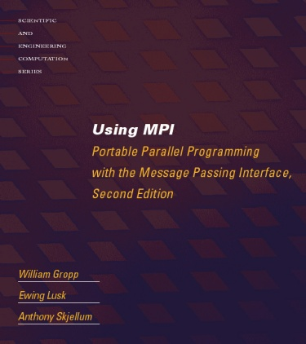
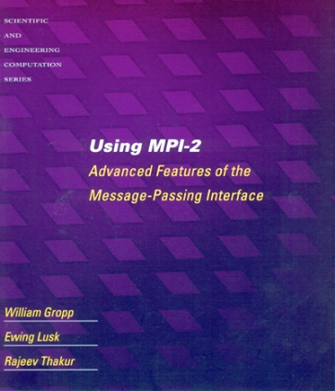


Books on MPI
Using MPI: Portable Parallel Programming
with the Message-Passing Interface (2nd edition),
by Gropp, Lusk, and Skjellum, MIT Press,
1999.
Using MPI-2: Portable Parallel Programming
with the Message-Passing Interface, by Gropp,
Lusk, and Thakur, MIT Press, 1999.
MPI: The Complete Reference - Vol 1 The MPI Core, by Snir, Otto, Huss-Lederman, Walker, and Dongarra, MIT Press, 1998.
MPI: The Complete Reference - Vol 2 The MPI Extensions, by Gropp, Huss-Lederman, Lumsdaine, Lusk, Nitzberg, Saphir, and Snir, MIT Press, 1998.
Designing and Building Parallel Programs, by Ian Foster, Addison-Wesley, 1995.
Parallel Programming with MPI, by Peter Pacheco, Morgan-Kaufmann, 1997.
CS267 Lecture 7
Slide source: Bill Gropp, ANL
Notes:
CS267 Lecture 2

Slide 36
Finding Out About the Environment
Two important questions that arise early in a parallel program are:
  How many processes are participating in this computation?
  Which one am I?
MPI provides functions to answer these questions:
  MPI_Comm_size reports the number of processes.
  MPI_Comm_rank reports the rank, a number between 0 and size-1, identifying the calling process
CS267 Lecture 7
Slide source: Bill Gropp, ANL
Notes:
CS267 Lecture 2

Slide 37
Hello (C)
#include "mpi.h"
#include <stdio.h>
int main( int argc, char *argv[] )
{
int rank, size;
MPI_Init( &argc, &argv );
MPI_Comm_rank( MPI_COMM_WORLD, &rank );
MPI_Comm_size( MPI_COMM_WORLD, &size );
printf( "I am %d of %d\n", rank, size );
MPI_Finalize();
return 0;
}
Note: hidden slides show Fortran and C++ versions of each example
CS267 Lecture 7
Slide source: Bill Gropp, ANL
Notes:
CS267 Lecture 2
Need header files
One of input arguments argc, argv might be “initialize with 4 processors”
MPI_Init should always be first thing done, MPI_Finalize is last, to release resources
MPI_COMM_WORLD = communicator, means “get me all the processors available, not a subset”

Slide 38
Hello (Fortran)
program main
include 'mpif.h'
integer ierr, rank, size
call MPI_INIT( ierr )
call MPI_COMM_RANK( MPI_COMM_WORLD, rank, ierr )
call MPI_COMM_SIZE( MPI_COMM_WORLD, size, ierr )
print *, 'I am ', rank, ' of ', size
call MPI_FINALIZE( ierr )
end
CS267 Lecture 7
Slide source: Bill Gropp, ANL
Notes:
CS267 Lecture 2

Slide 39
Hello (C++)
#include "mpi.h"
#include <iostream>
int main( int argc, char *argv[] )
{
int rank, size;
MPI::Init(argc, argv);
rank = MPI::COMM_WORLD.Get_rank();
size = MPI::COMM_WORLD.Get_size();
std::cout << "I am " << rank << " of " << size <<
"\n";
MPI::Finalize();
return 0;
}
CS267 Lecture 7
Slide source: Bill Gropp, ANL
Notes:
CS267 Lecture 2

Slide 40
Notes on Hello World
All MPI programs begin with MPI_Init and end with MPI_Finalize
MPI_COMM_WORLD is defined by mpi.h (in C) or mpif.h (in Fortran) and designates all processes in the MPI “job”
Each statement executes independently in each process
  including the printf/print statements
The MPI-1 Standard does not specify how to run an MPI program, but many implementations provide
mpirun –np 4 a.out
CS267 Lecture 7
Slide source: Bill Gropp, ANL
Notes:
CS267 Lecture 2
Note: a library would have its own communicator (sub world of processors)
Output (“I am 0 of 4”, “I am 1 of 4” etc) could appear in any order
IO: if proc i refers to file i, no problem
New standard MPI-2 deals with parallel file I/O better (not our problem this semester)
MPI-1 didn’t deal with IO, assumed all output done by processor 1 (not scalable)
Mpirun –np 4 a.out means run a.out with #procs = 4

Slide 41
MPI Basic Send/Receive
We need to fill in the details in
Things that need specifying:
  How will “data” be described?
  How will processes be identified?
  How will the receiver recognize/screen messages?
  What will it mean for these operations to complete?
Process 0
Process 1
Send(data)
Receive(data)
CS267 Lecture 7
Slide source: Bill Gropp, ANL
Notes:
CS267 Lecture 2
How is data formatted?
Who is destination?
How to received only desired message, i.e. screen?
MPI needs to deal with heterogenous machines, eg big-endian and little-endian integers

Slide 42
Some Basic Concepts
Processes can be collected into groups
Each message is sent in a context, and must be received in the same context
  Provides necessary support for libraries
A group and context together form a communicator
A process is identified by its rank in the group associated with a communicator
There is a default communicator whose group contains all initial processes, called MPI_COMM_WORLD
CS267 Lecture 7
Slide source: Bill Gropp, ANL
Notes:
CS267 Lecture 2
2-level hierarchy: groups and contexts
(society needs groups to organize communication too, usually more than 2 layers)
How to have messages from FFT routines not delivered to matmul subroutine,
Even if both referring to processors 0 through 7:
need “contexts” (eg FFT context, matmul context etc) to guarantee correct delivery

Slide 43
MPI Datatypes
The data in a message to send or receive is described by a triple (address, count, datatype), where
An MPI datatype is recursively defined as:
  predefined, corresponding to a data type from the language (e.g., MPI_INT, MPI_DOUBLE)
  a contiguous array of MPI datatypes
  a strided block of datatypes
  an indexed array of blocks of datatypes
  an arbitrary structure of datatypes
There are MPI functions to construct custom datatypes, in particular ones for subarrays
May hurt performance if datatypes are complex
CS267 Lecture 7
Slide source: Bill Gropp, ANL
Notes:
CS267 Lecture 2
Strided access: column of rowwise-stored matrix
What would it mean to send a linked list? What do pointers mean?
You’d have to write packing/unpacking routine to figure it out
MPI does whatever copying/packing/unpacking is needed.

Slide 44
MPI Tags
Messages are sent with an accompanying user-defined integer tag, to assist the receiving process in identifying the message
Messages can be screened at the receiving end by specifying a specific tag, or not screened by specifying MPI_ANY_TAG as the tag in a receive
Some non-MPI message-passing systems have called tags “message types”. MPI calls them tags to avoid confusion with datatypes
CS267 Lecture 7
Slide source: Bill Gropp, ANL
Notes:
CS267 Lecture 2
Why more layers? Need to build more complex systems
Tags: bills, checks to cash, junk mail, …
Ex: tag could indicate datatype of received object, so matches destination

Slide 45
MPI Basic (Blocking) Send
A(10)
B(20)
MPI_Send( A, 10, MPI_DOUBLE, 1, …)
MPI_Recv( B, 20, MPI_DOUBLE, 0, … )
MPI_SEND(start, count, datatype, dest, tag, comm)
The message buffer is described by (start, count, datatype).
The target process is specified by dest, which is the rank of the target process in the communicator specified by comm.
When this function returns, the data has been delivered to the system and the buffer can be reused. The message may not have been received by the target process.
CS267 Lecture 7
Slide source: Bill Gropp, ANL
Notes:
CS267 Lecture 2
Proc 1 willing to receive up to 20 words, can ask how many actually were delivered later;
error if Proc 0 had tried to send 21
Proc 1 receiving from Proc 0, but could have been “wild-card”
Other flavors of “send” return before A can be reused, and you
have to call another routine to ask if it can be reused yet.

Slide 46
MPI Basic (Blocking) Receive
A(10)
B(20)
MPI_Send( A, 10, MPI_DOUBLE, 1, …)
MPI_Recv( B, 20, MPI_DOUBLE, 0, … )
MPI_RECV(start, count, datatype, source, tag, comm, status)
Waits until a matching (both source and tag) message is received from the system, and the buffer can be used
source is rank in communicator specified by comm, or MPI_ANY_SOURCE
tag is a tag to be matched or MPI_ANY_TAG
receiving fewer than count occurrences of datatype is OK, but receiving more is an error
status contains further information (e.g. size of message)
CS267 Lecture 7
Slide source: Bill Gropp, ANL
Notes:
CS267 Lecture 2
Note can ask for at most 20 words, get only 10 words, ask later via status
(error if proc 0 tries to send more than 20 words)
Receive only returns when data arrives (may deadlock if none sent).
Status: sender id, if wild-card used

Slide 47
A Simple MPI Program
#include “mpi.h”
#include <stdio.h>
int main( int argc, char *argv[])
{
int rank, buf;
MPI_Status status;
MPI_Init(&argv, &argc);
MPI_Comm_rank( MPI_COMM_WORLD, &rank );
/* Process 0 sends and Process 1 receives */
if (rank == 0) {
buf = 123456;
MPI_Send( &buf, 1, MPI_INT, 1, 0, MPI_COMM_WORLD);
}
else if (rank == 1) {
MPI_Recv( &buf, 1, MPI_INT, 0, 0, MPI_COMM_WORLD,
&status );
printf( “Received %d\n”, buf );
}
MPI_Finalize();
return 0;
}
CS267 Lecture 7
Slide source: Bill Gropp, ANL
Notes:
CS267 Lecture 2
Simple program: send a number 123456 from process 0 to process 1
Need branch, because every processor executing same program
See hidden slides for Fortran and C++ versions

Slide 48
A Simple MPI Program (Fortran)
program main
include ‘mpif.h’
integer rank, buf, ierr, status(MPI_STATUS_SIZE)
call MPI_Init(ierr)
call MPI_Comm_rank( MPI_COMM_WORLD, rank, ierr )
C Process 0 sends and Process 1 receives
if (rank .eq. 0) then
buf = 123456
call MPI_Send( buf, 1, MPI_INTEGER, 1, 0,
* MPI_COMM_WORLD, ierr )
else if (rank .eq. 1) then
call MPI_Recv( buf, 1, MPI_INTEGER, 0, 0,
* MPI_COMM_WORLD, status, ierr )
print *, “Received “, buf
endif
call MPI_Finalize(ierr)
end
CS267 Lecture 7
Slide source: Bill Gropp, ANL
Notes:
CS267 Lecture 2

Slide 49
A Simple MPI Program (C++)
#include “mpi.h”
#include <iostream>
int main( int argc, char *argv[])
{
int rank, buf;
MPI::Init(argv, argc);
rank = MPI::COMM_WORLD.Get_rank();
// Process 0 sends and Process 1 receives
if (rank == 0) {
buf = 123456;
MPI::COMM_WORLD.Send( &buf, 1, MPI::INT, 1, 0 );
}
else if (rank == 1) {
MPI::COMM_WORLD.Recv( &buf, 1, MPI::INT, 0, 0 );
std::cout << “Received “ << buf << “\n”;
}
MPI::Finalize();
return 0;
}
CS267 Lecture 7
Slide source: Bill Gropp, ANL
Notes:
CS267 Lecture 2

Slide 50
Retrieving Further Information
Status is a data structure allocated in the user’s program.
In C:
  int recvd_tag, recvd_from, recvd_count;
  MPI_Status status;
  MPI_Recv(..., MPI_ANY_SOURCE, MPI_ANY_TAG, ..., &status )
  recvd_tag = status.MPI_TAG;
  recvd_from = status.MPI_SOURCE;
  MPI_Get_count( &status, datatype, &recvd_count );
CS267 Lecture 7
Slide source: Bill Gropp, ANL
Notes:
CS267 Lecture 2
Receive data from anyone, ask later who sent it, how much, which tag

Slide 51
MPI is Simple
Many parallel programs can be written using just these six functions, only two of which are non-trivial:
  MPI_INIT
  MPI_FINALIZE
  MPI_COMM_SIZE
  MPI_COMM_RANK
  MPI_SEND
  MPI_RECV
CS267 Lecture 7
Slide source: Bill Gropp, ANL
Notes:
CS267 Lecture 2
Send/Receive use 3 level hierarchy to identify source/destination processors:
communicator = group + context, eg “MPI_Comm_World
tag, eg “MPI_Any_Tag”
Two more: broadcast and reduce

Slide 52
Another Approach to Parallelism
Collective routines provide a higher-level way to organize a parallel program
Each process executes the same communication operations
MPI provides a rich set of collective operations…
CS267 Lecture 7
Slide source: Bill Gropp, ANL
Notes:
CS267 Lecture 2
Recall tricks with trees,

Slide 53
Collective Operations in MPI
Collective operations are called by all processes in a communicator
MPI_BCAST distributes data from one process (the root) to all others in a communicator
MPI_REDUCE combines data from all processes in communicator and returns it to one process
In many numerical algorithms, SEND/RECEIVE can be replaced by BCAST/REDUCE, improving both simplicity and efficiency
CS267 Lecture 7
Slide source: Bill Gropp, ANL
Notes:
CS267 Lecture 2
Every processor in communicator needs to call broadcast, blocks until done,
If one processor does not call broadcast, error
Only one processor should identify itself as root
Reduce can use existing associative operators, or you can make up your own

Slide 54
Alternative Set of 6 Functions
Claim: most MPI applications can be written with only 6 functions (although which 6 may differ)
You may use more for convenience or performance
Using point-to-point:
  MPI_INIT
  MPI_FINALIZE
  MPI_COMM_SIZE
  MPI_COMM_RANK
  MPI_SEND
  MPI_RECEIVE
Using collectives:
  MPI_INIT
  MPI_FINALIZE
  MPI_COMM_SIZE
  MPI_COMM_RANK
  MPI_BCAST
  MPI_REDUCE
CS267 Lecture 7
Notes:
CS267 Lecture 2

Slide 55
Example: Calculating Pi
E.g., in a 4-process run, each process gets every 4th interval. Process 0 slices are in red.
Simple program written in a data parallel style in MPI
  E.g., for a reduction (recall “tricks with trees” lecture), each process will first reduce (sum) its own values, then call a collective to combine them
Estimates pi by approximating the area of the quadrant of a unit circle
Each process gets 1/p of the intervals (mapped round robin, i.e., a cyclic mapping)
CS267 Lecture 7

Slide 56
Example: PI in C – 1/2
#include "mpi.h"
#include <math.h>
#include <stdio.h>
int main(int argc, char *argv[])
{
int done = 0, n, myid, numprocs, i, rc;
double PI25DT = 3.141592653589793238462643;
double mypi, pi, h, sum, x, a;
MPI_Init(&argc,&argv);
MPI_Comm_size(MPI_COMM_WORLD,&numprocs);
MPI_Comm_rank(MPI_COMM_WORLD,&myid);
while (!done) {
if (myid == 0) {
printf("Enter the number of intervals: (0 quits) ");
scanf("%d",&n);
}
MPI_Bcast(&n, 1, MPI_INT, 0, MPI_COMM_WORLD);
if (n == 0) break;
CS267 Lecture 7
Slide source: Bill Gropp, ANL
Notes:
CS267 Lecture 2
MPI_Bcast(data to broadcast, size, type, source processor, communicator)

Slide 57
Example: PI in C – 2/2
h = 1.0 / (double) n;
sum = 0.0;
for (i = myid + 1; i <= n; i += numprocs) {
x = h * ((double)i - 0.5);
sum += 4.0 * sqrt(1.0 - x*x);
}
mypi = h * sum;
MPI_Reduce(&mypi, &pi, 1, MPI_DOUBLE, MPI_SUM, 0,
MPI_COMM_WORLD);
if (myid == 0)
printf("pi is approximately %.16f, Error is .16f\n",
pi, fabs(pi - PI25DT));
}
MPI_Finalize();
return 0;
}
CS267 Lecture 7
Slide source: Bill Gropp, ANL
Notes:
CS267 Lecture 2
MPI_Reduce(local contribution, global result, size of data, type, operation, root processor, who participates)
Very simple, the “hello world” of reductions

Slide 58
Example: PI in Fortran – 1/2
program main
include ‘mpif.h’
integer done, n, myid, numprocs, i, rc
double pi25dt, mypi, pi, h, sum, x, z
data done/.false./
data PI25DT/3.141592653589793238462643/
call MPI_Init(ierr)
call MPI_Comm_size(MPI_COMM_WORLD,numprocs, ierr )
call MPI_Comm_rank(MPI_COMM_WORLD,myid, ierr)
do while (.not. done)
if (myid .eq. 0) then
print *,”Enter the number of intervals: (0 quits)“
read *, n
endif
call MPI_Bcast(n, 1, MPI_INTEGER, 0,
* MPI_COMM_WORLD, ierr )
if (n .eq. 0) goto 10
CS267 Lecture 7
Slide source: Bill Gropp, ANL
Notes:
CS267 Lecture 2

Slide 59
Example: PI in Fortran – 2/2
h = 1.0 / n
sum = 0.0
do i=myid+1,n,numprocs
x = h * (i - 0.5)
sum += 4.0 / (1.0 + x*x)
enddo
mypi = h * sum
call MPI_Reduce(mypi, pi, 1, MPI_DOUBLE_PRECISION,
* MPI_SUM, 0, MPI_COMM_WORLD, ierr )
if (myid .eq. 0) then
print *, "pi is approximately “, pi,
* “, Error is “, abs(pi - PI25DT)
enddo
continue
call MPI_Finalize( ierr )
end
CS267 Lecture 7
Slide source: Bill Gropp, ANL
Notes:
CS267 Lecture 2

Slide 60
Example: PI in C++ - 1/2
#include "mpi.h"
#include <math.h>
#include <iostream>
int main(int argc, char *argv[])
{
int done = 0, n, myid, numprocs, i, rc;
double PI25DT = 3.141592653589793238462643;
double mypi, pi, h, sum, x, a;
MPI::Init(argc, argv);
numprocs = MPI::COMM_WORLD.Get_size();
myid = MPI::COMM_WORLD.Get_rank();
while (!done) {
if (myid == 0) {
std::cout << "Enter the number of intervals: (0 quits) ";
std::cin >> n;;
}
MPI::COMM_WORLD.Bcast(&n, 1, MPI::INT, 0 );
if (n == 0) break;
CS267 Lecture 7
Slide source: Bill Gropp, ANL
Notes:
CS267 Lecture 2

Slide 61
Example: PI in C++ - 2/2
h = 1.0 / (double) n;
sum = 0.0;
for (i = myid + 1; i <= n; i += numprocs) {
x = h * ((double)i - 0.5);
sum += 4.0 / (1.0 + x*x);
}
mypi = h * sum;
MPI::COMM_WORLD.Reduce(&mypi, &pi, 1, MPI::DOUBLE,
MPI::SUM, 0);
if (myid == 0)
std::cout << "pi is approximately “ << pi <<
“, Error is “ << fabs(pi - PI25DT) << “\n”;
}
MPI::Finalize();
return 0;
}
CS267 Lecture 7
Slide source: Bill Gropp, ANL
Notes:
CS267 Lecture 2

Slide 62
Synchronization
MPI_Barrier( comm )
Blocks until all processes in the group of the communicator comm call it.
Almost never required in a parallel program
  Occasionally useful in measuring performance and load balancing
CS267 Lecture 7
Notes:
CS267 Lecture 2

Slide 63
Synchronization (Fortran)
MPI_Barrier( comm, ierr )
Blocks until all processes in the group of the communicator comm call it.
CS267 Lecture 7
Notes:
CS267 Lecture 2

Slide 64
Synchronization (C++)
comm.Barrier();
Blocks until all processes in the group of the communicator comm call it.
CS267 Lecture 7
Notes:
CS267 Lecture 2

Slide 65
Collective Data Movement
P0
A
A
P1
Broadcast
A
P2
A
P3
A
P0
A
B
C
D
Scatter
A
P1
B
P2
C
Gather
P3
D
CS267 Lecture 7
Notes:
CS267 Lecture 2

Slide 66
Comments on Broadcast, other Collectives
All collective operations must be called by all processes in the communicator
MPI_Bcast is called by both the sender (called the root process) and the processes that are to receive the broadcast
  “root” argument is the rank of the sender; this tells MPI which process originates the broadcast and which receive
CS267 Lecture 7
Notes:
CS267 Lecture 2
If one processor does not call collective, program hangs
MPI_Bcast is not a “multisend”

Slide 67
More Collective Data Movement
P0
A
A
B
C
D
P1
B
Allgather
A
B
C
D
P2
C
A
B
C
D
P3
D
A
B
C
D
P0
A0
A1
A2
A3
A0
B0
C0
D0
P1
B0
B1
B2
B3
Alltoall
A1
B1
C1
D1
P2
C0
C1
C2
C3
A2
B2
C2
D2
P3
D0
D1
D2
D3
A3
B3
C3
D3
CS267 Lecture 7
Notes:
CS267 Lecture 2
Allgather could be done with p broadcasts, but is more efficient
All-to-all is transpose, generalizes scatter and gather

Slide 68
Collective Computation
P0
A
ABCD
P1
Reduce
B
P2
C
P3
D
P0
A
A
P1
B
AB
Scan
P2
C
ABC
P3
D
ABCD
CS267 Lecture 7
Notes:
CS267 Lecture 2
Lecture on scan later, aka parallel prefix

Slide 69
MPI Collective Routines
Many Routines: Allgather, Allgatherv, Allreduce, Alltoall, Alltoallv, Bcast, Gather, Gatherv, Reduce, Reduce_scatter, Scan, Scatter, Scatterv
All versions deliver results to all participating processes, not just root.
V versions allow the chunks to have variable sizes.
Allreduce, Reduce, Reduce_scatter, and Scan take both built-in and user-defined combiner functions.
MPI-2 adds Alltoallw, Exscan, intercommunicator versions of most routines
CS267 Lecture 7
Notes:
CS267 Lecture 2
Each routine has All_ version and _v version
Allgatherv –variable amounts of data on each processor
Allreduce – everyone gets copy of sum; faster than reduce + broadcast
Reduce-Scatter – element-wise reduction on vector across all tasks,
then result vector split and distributed among tasks
Alltoallw – allows different data types,
Exscan – proc i get sum of values 0 through i-1

Slide 70
MPI Built-in Collective Computation Operations
MPI_MAX
MPI_MIN
MPI_PROD
MPI_SUM
MPI_LAND
MPI_LOR
MPI_LXOR
MPI_BAND
MPI_BOR
MPI_BXOR
MPI_MAXLOC
MPI_MINLOC
Maximum
Minimum
Product
Sum
Logical and
Logical or
Logical exclusive or
Binary and
Binary or
Binary exclusive or
Maximum and location
Minimum and location
CS267 Lecture 7
Notes:
CS267 Lecture 2
Logical is single boolean value
Binary is bit-wise over a word
Can build own operations

Slide 71
Extra slides
CS267 Lecture 7

Slide 72
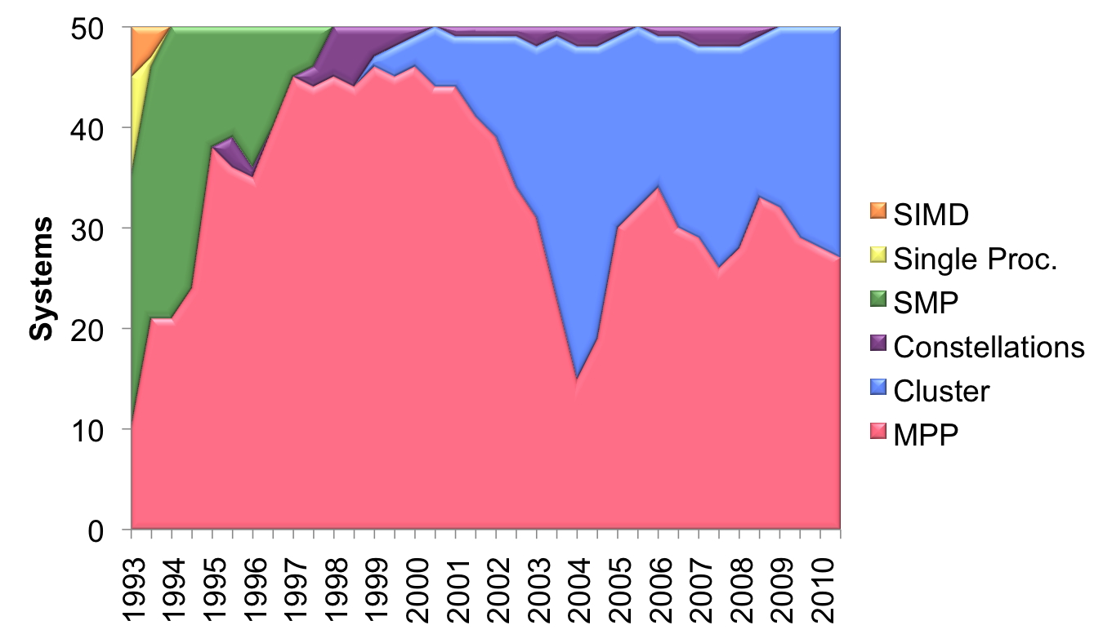
Architectures (TOP50)
Top500 similar: 100% Cluster + MPP since 2009
Notes:
Constellation = cluster where #cores/SMP > #SMPs in whole platform
Nov 2012: 411 cluster = 82.2%, 89 MPP = 17.8%
MPP = distributed memory, all custom processors and interconnect
Cluster = off-the-shelf processors and network, integrated
CS267 Lecture 2

Slide 73
Tags and Contexts
Separation of messages used to be accomplished by use of tags, but
  this requires libraries to be aware of tags used by other libraries.
  this can be defeated by use of “wild card” tags.
Contexts are different from tags
  no wild cards allowed
  allocated dynamically by the system when a library sets up a communicator for its own use.
User-defined tags still provided in MPI for user convenience in organizing application
CS267 Lecture 7
Slide source: Bill Gropp, ANL
Notes:
CS267 Lecture 2
3 levels of hierarchy: Groups/context/tags
First version of MPI just had tags, but this meant
That every programmer had to know the funny tag names
Used internally by every other library, didn’t scale,

Slide 74
Topologies in Real Machines
Cray XT3 and XT4 | 3D Torus (approx)
Blue Gene/L | 3D Torus
SGI Altix | Fat tree
Cray X1 | 4D Hypercube*
Myricom (Millennium) | Arbitrary
Quadrics (in HP Alpha server clusters) | Fat tree
IBM SP | Fat tree (approx)
SGI Origin | Hypercube
Intel Paragon (old) | 2D Mesh
BBN Butterfly (really old) | Butterfly
older newer
Many of these are approximations:
E.g., the X1 is really a “quad bristled hypercube” and some of the fat trees are not as fat as they should be at the top
CS267 Lecture 7
Notes:
CS267 Lecture 2
Converging to torus or fat tree
Cray X1 had 4D hypercube with small fat tree at each corner
Cray XT4 includes Franklin at NERSC

Slide 75
LogP Parameters: Overhead & Latency
Non-overlapping overhead
Send and recv overhead can overlap
P0
o_{send}
P0
o_{send}
L
o_{recv}
o_{recv}
P1
P1
EEL = End-to-End Latency
= o_{send} + L + o_{recv}
EEL = f(o_{send}, L, o_{recv})
≥ max(o_{send}, L, o_{recv})
CS267 Lecture 7
Notes:
CS267 Lecture 2
Invented here by Culler, Karp, others
LogP model help understand cost of multiple messages, and
How communication and computation might overlap
L = latency
O = overhead
G = gap
P = # processors
Although it is tempting to think that a message in transit from P0 to P1 will progress through the separate stages of Osend, L and Orecv in sequence, this may not be the case for some networks.
Part of the send overhead may occur after the message has been sent. This may involve reading send descriptors and reclaiming buffer memory.
Part of the receive overhead may occur before the message is sent. This may involve allocating receive buffers and posting receive descriptors.
We will generally assume the diagram on the left, but will note when evidence indicates otherwise, such as the appearance of negative wire latencies.
EEL is measured by taking half of round-trip latency, which is why it depends on o_send even if there is overlap with latency as shown.

Slide 76
LogP Parameters: gap
The Gap is the delay between sending messages
Gap could be greater than send overhead
  NIC may be busy finishing the processing of last message and cannot accept a new one.
  Flow control or backpressure on the network may prevent the NIC from accepting the next message to send.
No overlap ⇒
  time to send n messages (pipelined) =
P0
o_{send}
gap
gap
(o_{send} + L + o_{recv} - gap) + n*gap = α + n*β
P1
CS267 Lecture 7
Notes:
CS267 Lecture 2
Gap = beta = reciprocal of bandwidth for small messages

Slide 77
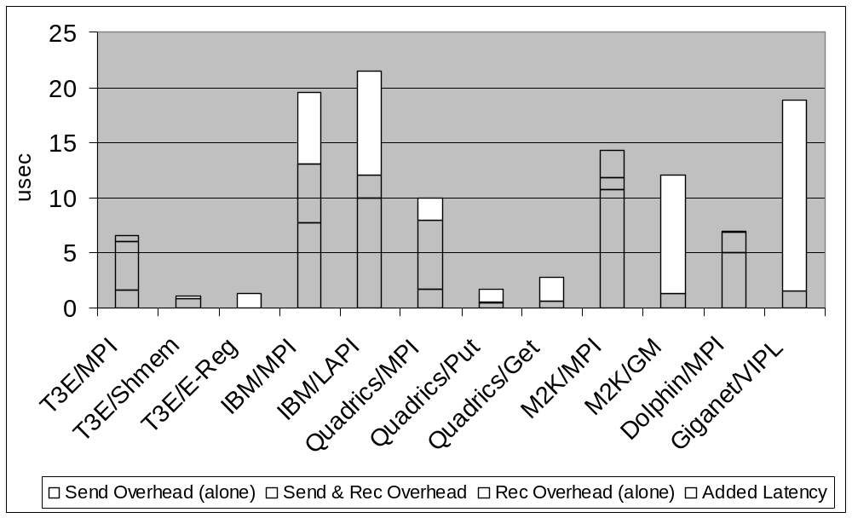
Results: EEL and Overhead
CS267 Lecture 7
Data from Mike Welcome, NERSC
Notes:
CS267 Lecture 2
The height of bars = end-to-end one-way latency.
Red is send overhead alone
Blue is recv overhead alone
Purple shows overlap of send and receive overhead
White is wire latency, or the part of the end-to-end latency that is not explained by send and receive overhead in the CPU. This will include latency incurred on the network as well as by the NICs on both nodes.
Note that many of the high performance systems have no measurable receive overhead. On the T3E, the data is placed directly in the remote processors E-registers so there is nothing for that processor to do. For quadrics, myrinet and Giganet, the NIC performs DMA to the application host memory so receive overhead is low. Note that all MPI implementations have receive overhead because, at a minimum, send/recv matching operations must be performed.
Note also the latency hiding effects of communication networks in which send and receive overhead overlap in time.

Slide 78
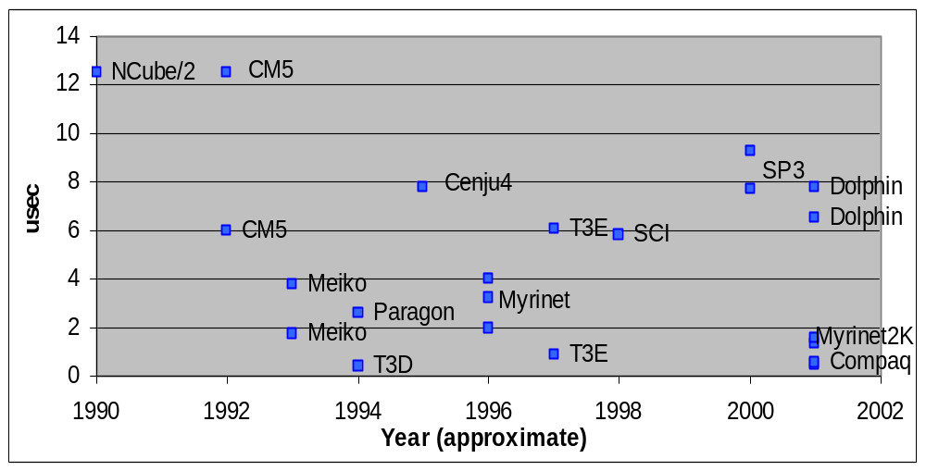
Send Overhead Over Time
Overhead has not improved significantly; T3D was best
  Lack of integration; lack of attention in software
CS267 Lecture 7
Data from Kathy Yelick, UCB and NERSC
Notes:
CS267 Lecture 2

Slide 79
Limitations of the LogP Model
The LogP model has a fixed cost for each message
  This is useful in showing how to quickly broadcast a single word
  Other examples also in the LogP papers
For larger messages, there is a variation LogGP
  Two gap parameters, one for small and one for large messages
  The large message gap is the β in our previous model
No topology considerations (including no limits for bisection bandwidth)
  Assumes a fully connected network
  OK for some algorithms with nearest neighbor communication, but with “all-to-all” communication we need to refine this further
This is a flat model, i.e., each processor is connected to the network
  Clusters of multicores are not accurately modeled
CS267 Lecture 7
Notes:
CS267 Lecture 2
LogP ignore contention of many procs sending messages at same time
Not good for clusters of multicore, since doesn’t distinguish local or remote processors

Slide 80
Programming With MPI
MPI is a library
  All operations are performed with routine calls
  Basic definitions in
    mpi.h for C
    mpif.h for Fortran 77 and 90
    MPI module for Fortran 90 (optional)
First Program:
  Write out process number
  Write out some variables (illustrate separate name space)
CS267 Lecture 7
Slide source: Bill Gropp, ANL
Notes:
CS267 Lecture 2
Slides for C, Fortran, C++, skip the Fortran and C++ (in slide deck)

Slide 81
Retrieving Further Information
Status is a data structure allocated in the user’s program.
In Fortran:
  integer recvd_tag, recvd_from, recvd_count
  integer status(MPI_STATUS_SIZE)
  call MPI_RECV(..., MPI_ANY_SOURCE, MPI_ANY_TAG, .. status, ierr)
  tag_recvd = status(MPI_TAG)
  recvd_from = status(MPI_SOURCE)
  call MPI_GET_COUNT(status, datatype, recvd_count, ierr)
In C++:
  int recvd_tag, recvd_from, recvd_count;
  MPI::Status status;
  Comm.Recv(..., MPI::ANY_SOURCE, MPI::ANY_TAG, ...,
  status )
  recvd_tag = status.Get_tag();
  recvd_from = status.Get_source();
  recvd_count = status.Get_count( datatype );
CS267 Lecture 7
Slide source: Bill Gropp, ANL
Notes:
CS267 Lecture 2
Tags could match accidentally, but context cannot, so can’t get someone else’s mail by mistake

Slide 82
Notes on Hello World
All MPI programs begin with MPI_Init and end with MPI_Finalize
MPI_COMM_WORLD is defined by mpi.h (in C) or mpif.h (in Fortran) and designates all processes in the MPI “job”
Each statement executes independently in each process
  including the printf/print statements
I/O not part of MPI-1but is in MPI-2 and MPI-3
  print and write to standard output or error not part of either MPI-1 or MPI-2
  output order is undefined (may be interleaved by character, line, or blocks of characters),
The MPI-1 Standard does not specify how to run an MPI program, but many implementations provide
mpirun –np 4 a.out
CS267 Lecture 7
Slide source: Bill Gropp, ANL
Notes:
CS267 Lecture 2
Note: a library would have its own communicator (sub world of processors)
Output (“I am 0 of 4”, “I am 1 of 4” etc) could appear in any order
IO: if proc i refers to file i, no problem
New standard MPI-2 deals with parallel file I/O better (not our problem this semester)
MPI-1 didn’t deal with IO, assumed all output done by processor 1 (not scalable)
Mpirun –np 4 a.out means run a.out with #procs = 4

Slide 83
Running MPI Programs
The MPI-1 Standard does not specify how to run an MPI program, just as the Fortran standard does not specify how to run a Fortran program.
In general, starting an MPI program is dependent on the implementation of MPI you are using, and might require various scripts, program arguments, and/or environment variables.
mpiexec <args> is part of MPI-2, as a recommendation, but not a requirement, for implementors.
Use
mpirun –np # -nolocal a.out
for your clusters, e.g.
mpirun –np 3 –nolocal cpi
CS267 Lecture 7
Slide source: Bill Gropp, ANL
Notes:
CS267 Lecture 2

Slide 84
MPI Collective Communication
Communication and computation is coordinated among a group of processes in a communicator.
Groups and communicators can be constructed “by hand” or using topology routines.
Tags are not used; different communicators deliver similar functionality.
No non-blocking collective operations.
Three classes of operations: synchronization, data movement, collective computation.
CS267 Lecture 7
Notes:
CS267 Lecture 2

Slide 85
More on Message Passing
Message passing is a simple programming model, but there are some special issues
  Buffering and deadlock
  Deterministic execution
  Performance
CS267 Lecture 7
Slide source: Bill Gropp, ANL
Notes:
CS267 Lecture 2

Slide 86
Buffers
When you send data, where does it go? One possibility is:
Process 0
Process 1
User data
Local buffer
the network
Local buffer
User data
CS267 Lecture 7
Slide source: Bill Gropp, ANL
Notes:
CS267 Lecture 2
Doubles storage, but safe

Slide 87
Avoiding Buffering
Avoiding copies uses less memory
May use more or less time
Process 0
Process 1
User data
the network
User data
This requires that MPI_Send wait on delivery, or that MPI_Send return before transfer is complete, and we wait later.
CS267 Lecture 7
Slide source: Bill Gropp, ANL
Notes:
CS267 Lecture 2
Time-space tradeoff
[ended here]

Slide 88
Blocking and Non-blocking Communication
So far we have been using blocking communication:
  MPI_Recv does not complete until the buffer is full (available for use).
  MPI_Send does not complete until the buffer is empty (available for use).
Completion depends on size of message and amount of system buffering.
CS267 Lecture 7
Slide source: Bill Gropp, ANL
Notes:
CS267 Lecture 2

Slide 89
Sources of Deadlocks
Send a large message from process 0 to process 1
  If there is insufficient storage at the destination, the send must wait for the user to provide the memory space (through a receive)
What happens with this code?
Process 0
Send(1)
Recv(1)
Process 1
Send(0)
Recv(0)
This is called “unsafe” because it depends on the availability of system buffers in which to store the data sent until it can be received
CS267 Lecture 7
Slide source: Bill Gropp, ANL
Notes:
CS267 Lecture 2
Doubles the memory to be able to continue computing past send()

Slide 90
Some Solutions to the “unsafe” Problem
Order the operations more carefully:
Process 0
Send(1)
Recv(1)
Process 1
Recv(0)
Send(0)
Supply receive buffer at same time as send:
Process 0
Sendrecv(1)
Process 1
Sendrecv(0)
CS267 Lecture 7
Slide source: Bill Gropp, ANL
Notes:
CS267 Lecture 2
Trouble with sendrecv: need to be paired up, called about the same time

Slide 91
More Solutions to the “unsafe” Problem
Supply own space as buffer for send
Process 0
Bsend(1)
Recv(1)
Process 1
Bsend(0)
Recv(0)
Use non-blocking operations:
Process 0
Isend(1)
Irecv(1)
Waitall
Process 1
Isend(0)
Irecv(0)
Waitall
CS267 Lecture 7
Notes:
CS267 Lecture 2
Buffered send: Bsend: supply buffer space yourself
Immediate send: you promise not to touch it until done (need to call waitall later)
Immediate recv: returns right away, you promise not to touch it until done (need to call waitall later)
Riskier (race conditions possible) but allows more overlap

Slide 92
MPI’s Non-blocking Operations
Non-blocking operations return (immediately) “request handles” that can be tested and waited on:
MPI_Request request;
MPI_Status status;
MPI_Isend(start, count, datatype,
dest, tag, comm, &request);
MPI_Irecv(start, count, datatype,
dest, tag, comm, &request);
MPI_Wait(&request, &status);
(each request must be Waited on)
One can also test without waiting:
MPI_Test(&request, &flag, &status);
Accessing the data buffer without waiting is undefined
CS267 Lecture 7
Slide source: Bill Gropp, ANL
Notes:
CS267 Lecture 2
Routines to ask about message status, so you don’t just have to wait and hope

Slide 93
MPI’s Non-blocking Operations (Fortran)
Non-blocking operations return (immediately) “request handles” that can be tested and waited on:
integer request
integer status(MPI_STATUS_SIZE)
call MPI_Isend(start, count, datatype,
dest, tag, comm, request,ierr)
call MPI_Irecv(start, count, datatype,
dest, tag, comm, request, ierr)
call MPI_Wait(request, status, ierr)
(Each request must be waited on)
One can also test without waiting:
call MPI_Test(request, flag, status, ierr)
CS267 Lecture 7
Slide source: Bill Gropp, ANL
Notes:
CS267 Lecture 2

Slide 94
MPI’s Non-blocking Operations (C++)
Non-blocking operations return (immediately) “request handles” that can be tested and waited on:
MPI::Request request;
MPI::Status status;
request = comm.Isend(start, count,
datatype, dest, tag);
request = comm.Irecv(start, count,
datatype, dest, tag);
request.Wait(status);
(each request must be Waited on)
One can also test without waiting:
flag = request.Test( status );
CS267 Lecture 7
Notes:
CS267 Lecture 2

Slide 95
Multiple Completions
It is sometimes desirable to wait on multiple requests:
MPI_Waitall(count, array_of_requests,
array_of_statuses)
MPI_Waitany(count, array_of_requests,
&index, &status)
MPI_Waitsome(count, array_of_requests,
array_of indices, array_of_statuses)
There are corresponding versions of test for each of these.
CS267 Lecture 7
Notes:
CS267 Lecture 2

Slide 96
Multiple Completions (Fortran)
It is sometimes desirable to wait on multiple requests:
call MPI_Waitall(count, array_of_requests,
array_of_statuses, ierr)
call MPI_Waitany(count, array_of_requests,
index, status, ierr)
call MPI_Waitsome(count, array_of_requests,
array_of indices, array_of_statuses, ierr)
There are corresponding versions of test for each of these.
CS267 Lecture 7
Notes:
CS267 Lecture 2

Slide 97
Communication Modes
MPI provides multiple modes for sending messages:
  Synchronous mode (MPI_Ssend): the send does not complete until a matching receive has begun. (Unsafe programs deadlock.)
  Buffered mode (MPI_Bsend): the user supplies a buffer to the system for its use. (User allocates enough memory to make an unsafe program safe.
  Ready mode (MPI_Rsend): user guarantees that a matching receive has been posted.
    Allows access to fast protocols
    undefined behavior if matching receive not posted
Non-blocking versions (MPI_Issend, etc.)
MPI_Recv receives messages sent in any mode.
See www.mpi-forum.org for summary of all flavors of send/receive
CS267 Lecture 7
Notes:
CS267 Lecture 2
See www.mpi-forum.org web page for summary of all flavors of send

Slide 98
Other Point-to Point Features
MPI_Sendrecv
  Exchange data
MPI_Sendrecv_replace
  Exchange data in place
MPI_Cancel
  Useful for multibuffering
Persistent requests
  Useful for repeated communication patterns
  Some systems can exploit to reduce latency and increase performance
CS267 Lecture 7
Notes:
CS267 Lecture 2
sendReplace: exchange data in same location

Slide 99
MPI_Sendrecv
Allows simultaneous send and receive
Everything else is general.
  Send and receive datatypes (even type signatures) may be different
  Can use Sendrecv with plain Send or Recv (or Irecv or Ssend_init, …)
  More general than “send left”
Process 0
SendRecv(1)
Process 1
SendRecv(0)
CS267 Lecture 7
Notes:
CS267 Lecture 2

Slide 100
What MPI Functions are in Use?
For simple applications, these are common:
  Point-to-point communication
    MPI_Irecv, MPI_Isend, MPI_Wait, MPI_Send, MPI_Recv
  Startup
    MPI_Init, MPI_Finalize
  Information on the processes
    MPI_Comm_rank, MPI_Comm_size, MPI_Get_processor_name
  Collective communication
    MPI_Allreduce, MPI_Bcast, MPI_Allgather
CS267 Lecture 7
Notes:
CS267 Lecture 2

Slide 101
Notes on C and Fortran
C and Fortran bindings correspond closely
In C:
  mpi.h must be #included
  MPI functions return error codes or MPI_SUCCESS
In Fortran:
  mpif.h must be included, or use MPI module
  All MPI calls are to subroutines, with a place for the return code in the last argument.
C++ bindings, and Fortran-90 issues, are part of MPI-2.
CS267 Lecture 7
Slide source: Bill Gropp, ANL
Notes:
CS267 Lecture 2

Slide 102
Not Covered
Topologies: map a communicator onto, say, a 3D Cartesian processor grid
  Implementation can provide ideal logical-to-physical mapping
Rich set of I/O functions: individual, collective, blocking and non-blocking
  Collective I/O can lead to many small requests being merged for more efficient I/O
One-sided communication: puts and gets with various synchronization schemes
  Implementations not well-optimized and rarely used
  Redesign of interface is underway
Task creation and destruction: change number of tasks during a run
  Few implementations available
CS267 Lecture 7
Notes:
MPI2 talks about I/O
Lecture later on one-sided communication
Puts and gets popularized here in Split-C, now in other languages, lecture later
CS267 Lecture 2

Slide 103
Experience and Hybrid Programming
CS267 Lecture 7

Slide 104
Basic Performance Numbers (Peak + Stream BW)
Franklin (XT4 at NERSC)
  quad core, single socket 2.3 GHz (4/node)
  2 GB/s / core (8 GB/s/socket 63% peak)
Jaguar (XT5 at ORNL)
  hex-core, dual socket 2.6 Ghz (12/node)
  1.8 GB/s/core (10.8 GB/s/socket 84%)
Hopper (XE6 at NERSC)
  hex-core die, 2/MCM, dual socket 2.1 GHz (24/node)
  2.2 GB/s/core (13.2 GB/s/socket 62% peak)
Notes:
Interlagos up to 80% of peak

Slide 105
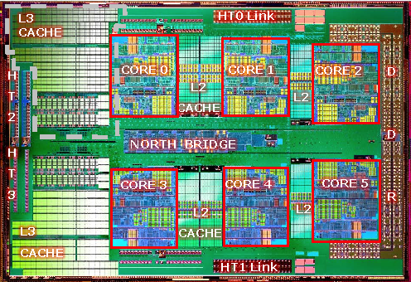
Hopper Memory Hierarchy
“Deeper” Memory Hierarchy
  NUMA: Non-Uniform Memory Architecture
  All memory is transparently accessible but...
  Longer memory access time to “remote” memory
  – A process running on NUMA node 0 accessing NUMA node 1 memory can adversely affect performance.
2xDDR1333 channel
21.3 GB/s
NUMA NODE
NUMA NODE
Memory
P0
P2
Memory
3.2GHz x16 lane HT
12.8 GB/s bidirectional
Memory
Memory
3.2GHz x8 lane HT
6.4 GB/s bidirectional
Memory
NUMA NODE
NUMA NODE
Memory
P1
P3
Memory
Memory
Hopper Node

Slide 106
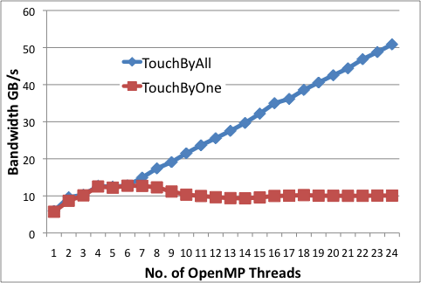
Stream NUMA effects - Hopper

Slide 107
Stream Benchmark
double a[N],b[N],c[N];
…….
#pragma omp parallel for
for (j=0; j<VectorSize; j++) {
a[j] = 1.0; b[j] = 2.0; c[j] = 0.0;
}
#pragma omp parallel for
for (j=0; j<VectorSize; j++) {
a[j]=b[j]+d*c[j];
}
…

Slide 108
MPI Bandwidth and Latency
Franklin & Jaguar – Seastar2
  ~7 us MPI latency
  1.6 GB/s/node
    0.4 GB/s/core Franklin 0.13 GB/s/core Jaguar
Hopper – Gemini
  1.6 us MPI latency
  3.5 GB/s (or 6.0GB/s with 2 MB pages)
    0.14 (0.5) GB/s/core
Other differences between networks
  Gemini has better fault tolerance
  Hopper also additional fault tolerance features

Slide 109
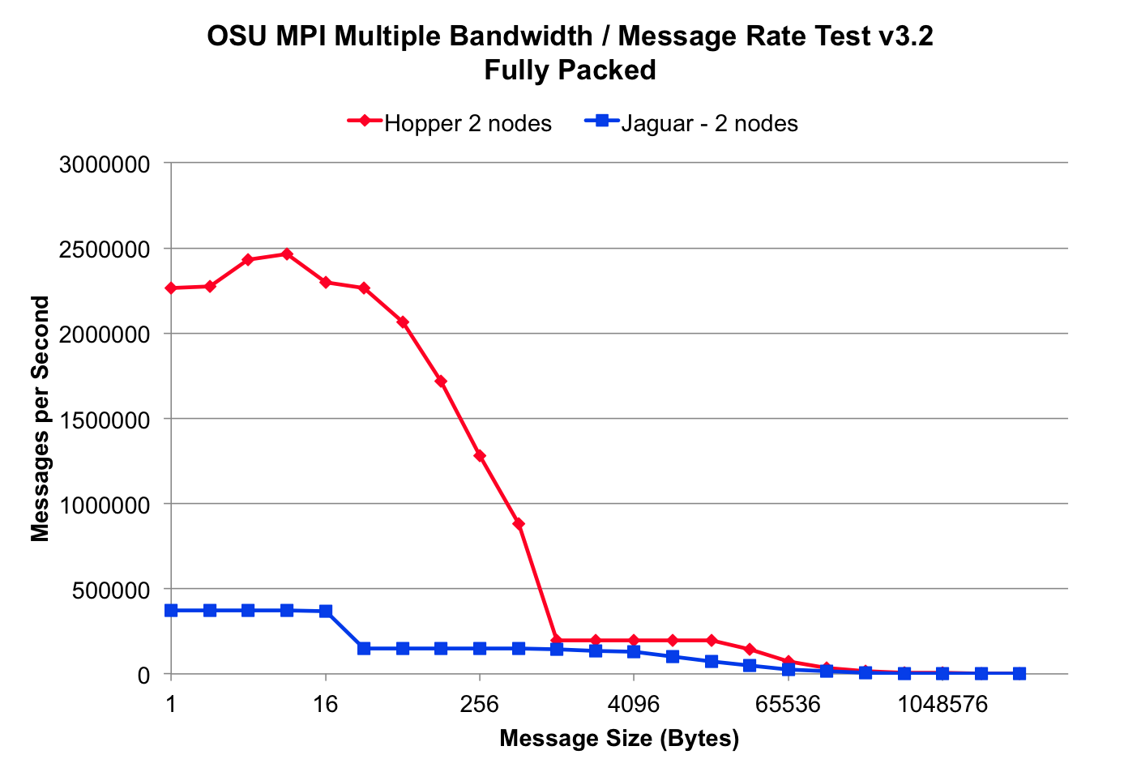


Slide 110
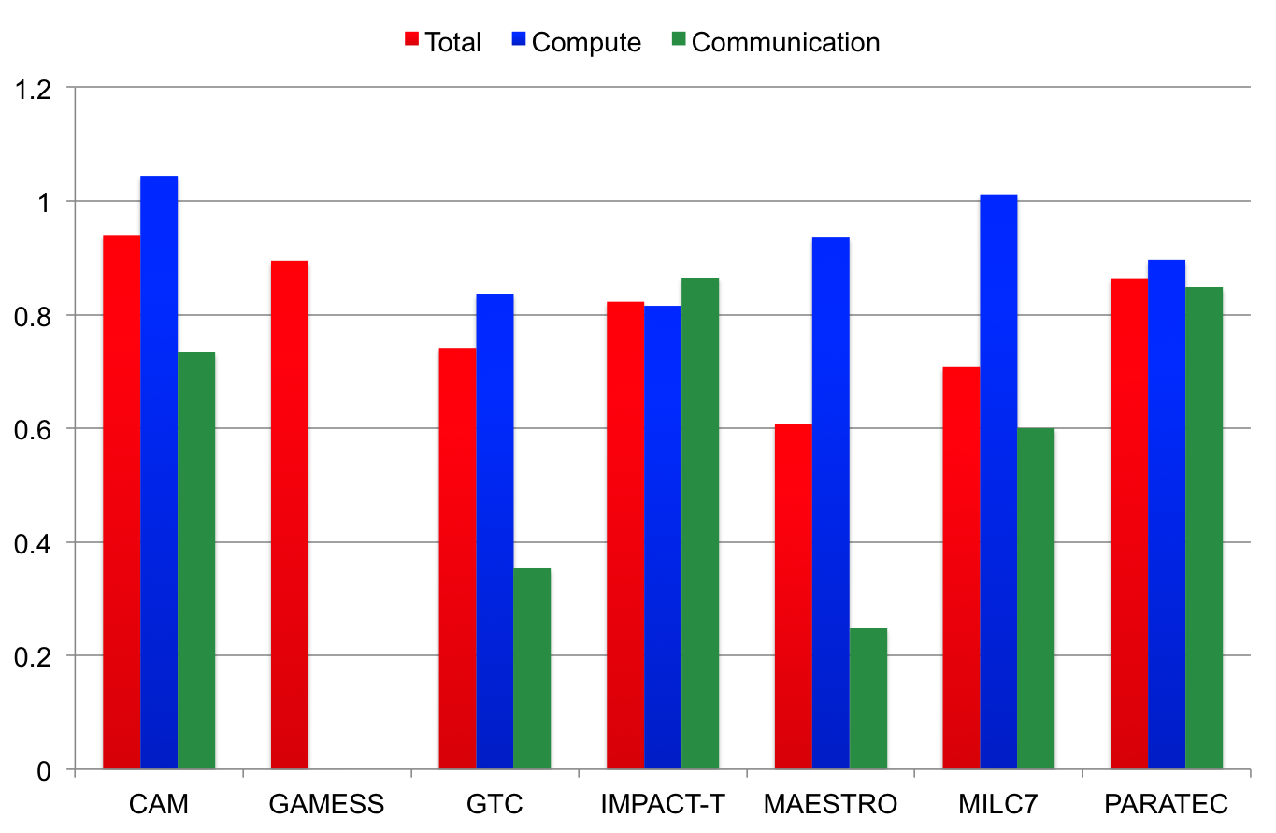
Hopper / Jaguar Performance Ratios
G
O
O
D

Slide 111
Understanding Hybrid
MPI/OPENMP Model
  T(N_{MPI},N_{OMP}) = t(N_{MPI}) + t(N_{OMP}) + t(N_{MPI},N_{OMP}) + t_{serial}
  count=G/N_{MPI}
  Do i=1,count
  count=G/N_{OMP}
  !$omp do private (i)
  Do i=1,G
  count=G/(N_{OMP}*N_{MPI})
  !$omp do private (i)
  Do i=1,G/N_{MPI}
  count=G
  Do i=1,G
Serial
Parallel
Serial
MPI
Serial
Parallel
Serial
Notes:
Merge somewhat with previous – add pics

Slide 112
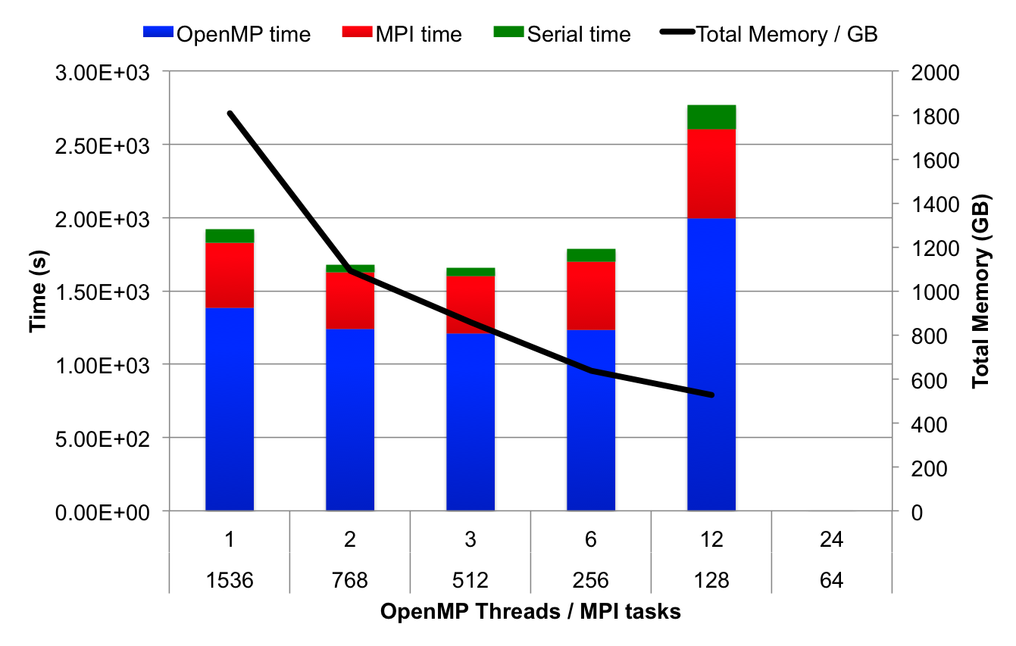
GTC – Hopper
G
O
O
D

Slide 113
Backup Slides
(Implementing MPI)
CS267 Lecture 7
Notes:
CS267 Lecture 2

Slide 114
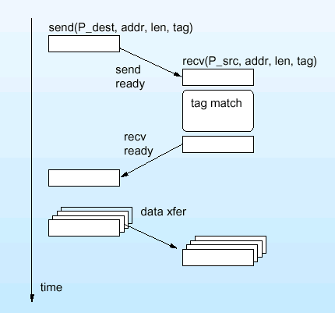
Implementing Synchronous Message Passing
Send operations complete after matching receive and source data has been sent.
Receive operations complete after data transfer is complete from matching send.
source destination
1) Initiate send send (P_{dest}, addr, length,tag) rcv(P_{source}, addr,length,tag)
2) Address translation on P_{dest}
3) Send-Ready Request send-rdy-request
4) Remote check for posted receive tag match
5) Reply transaction
receive-rdy-reply
6) Bulk data transfer
data-xfer
CS267 Lecture 7
Notes:
CS267 Lecture 2

Slide 115
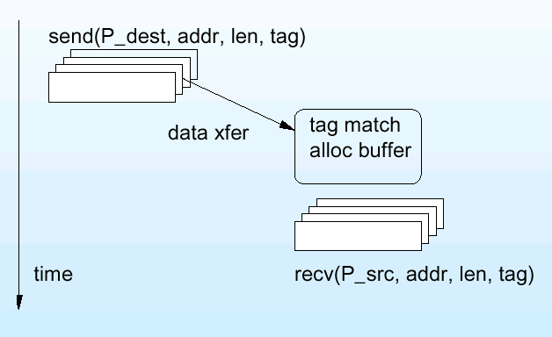
Implementing Asynchronous Message Passing
Optimistic single-phase protocol assumes the destination can buffer data on demand.
source destination
1) Initiate send send (P_{dest}, addr, length,tag)
2) Address translation on P_{dest}
3) Send Data Request data-xfer-request
tag match
allocate
4) Remote check for posted receive
5) Allocate buffer (if check failed)
6) Bulk data transfer
rcv(P_{source}, addr, length,tag)
CS267 Lecture 7
Notes:
CS267 Lecture 2
What could go wrong? Not enough space to buffer large message

Slide 116
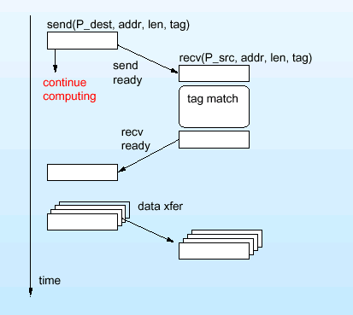
Safe Asynchronous Message Passing
Use 3-phase protocol
Buffer on sending side
Variations on send completion
  wait until data copied from user to system buffer
  don’t wait -- let the user beware of modifying data
source destination
Initiate send
Address translation on P_{dest}
Send-Ready Request send-rdy-request
4) Remote check for posted receive return and continue tag match
record send-rdy computing
5) Reply transaction
receive-rdy-reply
6) Bulk data transfer
CS267 Lecture 7
Notes:
CS267 Lecture 2

