Slide 1
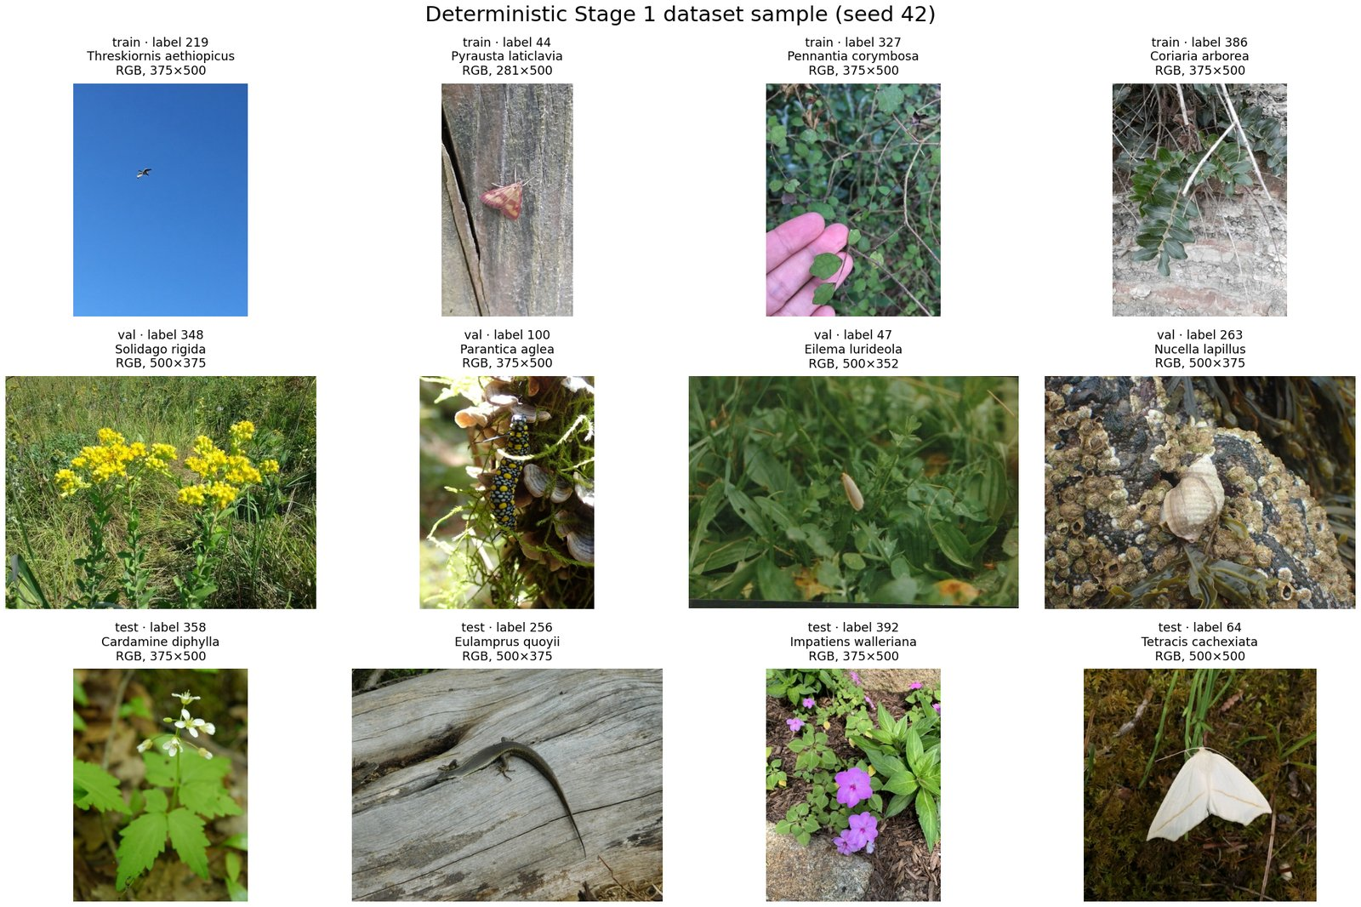
COMP9517 COMPUTER VISION
Fine-Grained
Species Recognition
at Scale
Traditional baselines / transfer learning / robustness / Grad-CAM
Yuan Cao / Kaishi Yang / Aditya Winata
Jialin Guo / Yuzhe Qiu
Frozen 500-species subset / deterministic seed 42
2026 Term 2
1
Notes:
Hello, I'm Yuan Cao, and I'll introduce our project, Fine-Grained Species Recognition at Scale. We compare classical features with deep transfer learning on a controlled 500-species task.
[Sources]
- results/final_report_figures/dataset_examples.jpg
- data/splits/split_summary.json
- report/cvpr_latex/main.tex (canonical project title and verified roster)

Slide 2
PROBLEM AND LITERATURE · P1
Species recognition is fine-grained by design
BETWEEN SPECIES
LITERATURE PROGRESSION
A small marking, edge, or local structure can change the label.
1
Colour + texture
fixed summaries
WITHIN SPECIES
2
SIFT + BoVW
local invariance
Pose, life stage, scale, lighting, occlusion, and background all vary.
3
Classical classifiers
margin + ensembles
DECISION SPACE
500 visually similar classes; only 40 training images per class.
4
CNNs + transfer
learned hierarchy
5
Robustness + Grad-CAM
failure evidence
Citations: Van Horn et al. (CVPR 2018, 2021); Lowe (2004); He et al. (2016); Tan & Le (2019); Selvaraju et al. (2017)
2
Notes:
Species recognition is a fine-grained problem. Different species may differ by a small wing marking, leaf shape, or plumage cue, while the same species changes with pose, life stage, background, scale, lighting, and occlusion. With 500 labels, a model must choose among many visually similar alternatives. This matters for biodiversity monitoring and community-science collections, where manual identification does not scale.
The literature moves from fixed colour and texture summaries, through local SIFT descriptors and bag-of-visual-words, to margin classifiers and random forests. CNNs then learn features end to end; ResNet makes deep optimisation practical, ImageNet supports transfer, and EfficientNet scales capacity efficiently. Robustness benchmarks and Grad-CAM extend evaluation beyond a clean accuracy number.
[Sources]
- report/cvpr_latex/sections/01_introduction.tex
- report/cvpr_latex/sections/02_literature_review.tex
- report/cvpr_latex/references.bib

Slide 3
DATASET AND QUESTIONS · P1
A leakage-safe 40 / 10 / 10 protocol frames four questions
RESEARCH QUESTIONS
TRAIN
INTERNAL VAL
HELD-OUT TEST
1
How far do traditional CV methods perform?
20,000
5,000
5,000
2
How much does a scratch CNN improve?
40 / class
10 / class
10 / class
train_mini
train_mini
official val
3
What observed gain comes with ImageNet transfer?
500 classes / seed 42 / zero cross-split overlap
4
How robust and interpretable are the final models?
Current binding: validation selects. Stage 3 froze before test.
Sources: data/splits/split_summary.json; train.csv; val.csv; test.csv; report Dataset and Protocol
3
Notes:
We use iNaturalist 2021 Mini. Seed 42 selects 500 classes deterministically. For every class, 40 train and 10 internal-validation images come from train_mini, while 10 official-validation images form the held-out test set: 20,000, 5,000, and 5,000 images. The manifests are disjoint. Stage 3 freeze-before-test is verified; historical Stage 2 pre-test locking is not independently established. Our questions are: how far classical vision goes; how much a scratch CNN improves; what ImageNet transfer adds descriptively; and how robust and interpretable the final models are. P2 will now explain the classical baselines.
[Sources]
- data/splits/split_summary.json
- data/splits/train.csv; data/splits/val.csv; data/splits/test.csv
- report/cvpr_latex/sections/03_dataset_protocol.tex

Slide 4
TRADITIONAL PIPELINE · P2
Classical baselines expose the limits of fixed descriptors
TRAIN ONLY
Validation-only model selection
Input
image
EXIF
correction
Branch
resize
Feature
blocks
Power
norm
Classifier
500-way
scores
Frozen test
metrics
Same frozen split, class mapping, and metric definitions as deep learning
Handcrafted branch: RGB, direct 128 x 128 / BoVW branch: grayscale SIFT, aspect-preserving max side 256
No validation or test descriptors fit the power normaliser or BoVW vocabulary.
Current Stage 2 manifest binds exactly 19 validation configurations; historical pre-test locking is not independently established.
Sources: report Methods; Stage 2 freeze, selection manifest, and validation grid
4
Notes:
Hello, I'm Kaishi Yang, and I'll cover the traditional pipeline. Every image receives deterministic EXIF correction and RGB conversion. The handcrafted branch resizes directly to 128 by 128, while the SIFT-BoVW branch uses grayscale, aspect-preserving resizing with maximum side 256. We extract spatial colour, multi-scale texture, HOG shape, and train-fitted local SIFT-BoVW evidence. Validation controls model and ablation choices; the current Stage 2 manifest binds that selection and the resulting held-out evidence.
[Sources]
- report/cvpr_latex/sections/04_methods.tex
- results/metrics/stage2_freeze.json
- results/metrics/stage2_selection_manifest.json
- results/tables/traditional_validation_grid.csv

Slide 5
FEATURES AND CLASSIFIERS · P2
Handcrafted features are meaningful - but low-capacity
3,704-D PRIMARY COMBINED DESCRIPTOR
Primary LinearSVC
HOG 1764
BoVW 1280
3,704-D combined descriptor
Block-wise power norm; alpha = 0.3
Colour 520 + texture 140 + HOG 1,764 + BoVW 1,280
Robustness Random Forest
VALIDATION TOP-1 ABLATION
300 trees; 2,424-D handcrafted only
Per-image corruption features can be recomputed
Texture
3.56%
Colour
6.08%
SIFT-BoVW LinearSVC
HOG
2.92%
1,280-D; 256-word train-only vocabulary
Top-3 soft assignment; 1 + 2 x 2 pooling
Full
12.94%
Metrics: top-1 / top-5 / macro P / R / F1
Citations: Lowe (2004); Csurka et al. (2004); Dalal & Triggs (2005); Ojala et al. (2002); Cortes & Vapnik (1995); Breiman (2001)
5
Notes:
The handcrafted descriptor has 2,424 dimensions: 520 from spatial joint H-S and V histograms, 140 from two uniform-LBP scales, and 1,764 from HOG. A 256-word SIFT vocabulary uses top-three soft assignment over a whole-image plus two-by-two spatial pyramid, adding 1,280 dimensions. The primary 3,704-dimensional pipeline applies block-wise power normalisation with validation-selected alpha 0.3, then fits LinearSVC. The robustness comparator is a 300-tree Random Forest over handcrafted features only.
The vocabulary is fitted from training images only: four deterministic images per class and at most 100 descriptors per image. The current Stage 2 manifest binds validation selection across exactly 19 configurations; historical pre-test locking is not independently established. Test descriptors never fit a vocabulary, normaliser, or configuration.
Validation-only ablations isolate colour, texture, and HOG; the complete four-block descriptor is the selected reference. We report top-1, top-5, and macro precision, recall, and F1. These baselines test fixed cues, local invariance, and linear versus nonlinear classifiers under strict leakage controls. P3 will show what learned representations change.
[Sources]
- results/features/traditional_feature_config.json
- results/features/bovw/bovw_feature_config.json
- results/tables/final_report_ablation_results.csv
- report/cvpr_latex/sections/04_methods.tex

Slide 6
DEEP PIPELINE · P3
Deep learning learns visual features end to end
TRAINING BRANCHES
Input
image
Train-time
augmentation
CNN
backbone
500-class
head
Best val
checkpoint
Frozen test
evaluation
Random initialisation
ImageNet pretraining
Scratch ResNet18
ResNet18 / EfficientNet-B0
Validation macro F1 selects checkpoints; held-out test never tunes the model.
Citations: He et al. (CVPR 2016); Deng et al. (CVPR 2009); Tan & Le (ICML 2019)
6
Notes:
Hello, I'm Aditya Winata, and I'll cover deep learning. The deep pipeline starts with augmentation, passes a 224-pixel crop through a CNN, and replaces the original classifier with a 500-class head. Validation macro F1 selects the best checkpoint; top-1, top-5, loss, and earlier epoch break ties. Once the selected model set is frozen, the held-out test is evaluated without further tuning.
[Sources]
- report/cvpr_latex/sections/04_methods.tex
- results/metrics/deep_learning/stage3_freeze.json
- results/metrics/deep_learning/stage3_test_access.json

Slide 7
MODELS AND SELECTION · P3
Transfer matters when each class has only 40 images
MODEL SET
MATCHED AUGMENTATION ABLATION
Scratch ResNet18
test
random weights
BASIC
STRONG
Random crop
Horizontal flip
Wider crop + colour
Affine + random erasing
Pretrained ResNet18
test
full fine-tuning
Pretrained EfficientNet-B0
test
full fine-tuning
66.16%
67.54%
Frozen-head ResNet18
basic ResNet18 validation top-1
strong ResNet18 validation top-1
val only
linear head only
+1.38 percentage points / one-factor transform comparison
Best checkpoint: validation macro F1 / configuration hashes frozen before test
Sources: final_report_ablation_results.csv; deep YAML/resolved configs; report Methods and Experimental Setup
7
Notes:
We compare ResNet18 trained from random weights with ImageNet-pretrained ResNet18 and pretrained EfficientNet-B0. A frozen-backbone ResNet18 ablation tests how useful pretrained features are before adaptation, while the main transfer runs fine-tune all layers.
Basic augmentation uses random crop and horizontal flip. Strong augmentation widens the crop range and adds moderate colour jitter, affine rotation, and random erasing, while avoiding vertical flips and extreme crops. In the matched ResNet18 comparison, strong augmentation changes validation top-1 from 66.16 percent to 67.54 percent.
Transfer is especially valuable here because each class offers only 40 training images. ImageNet supplies reusable edges, textures, and parts before task-specific fine-tuning. However, scratch and pretrained schedules differ, so their gap is descriptive rather than a controlled one-factor estimate. Exact learning rates, epoch limits, optimisers, and parameter counts are in the appendix. This makes the selection logic explicit without treating validation as a second test set. The test set was accessed only after checkpoint and configuration hashes were frozen. P4 will now present the held-out evidence and its limits.
[Sources]
- results/tables/final_report_ablation_results.csv
- configs/deep_resnet18_scratch.yaml
- configs/deep_resnet18_pretrained_strong_aug.yaml
- configs/deep_efficientnet_b0_pretrained.yaml
- report/cvpr_latex/sections/05_experimental_setup.tex

Slide 8
MAIN RESULTS · P4
Held-out comparison across frozen methods
Held-out test method
Top-1
Top-5
Macro F1
72.74%
3,704-D handcrafted + BoVW LinearSVC
12.52%
26.78%
11.16%
best held-out top-1
2,424-D handcrafted Random Forest
8.22%
20.26%
6.54%
90.26%
1,280-D SIFT-BoVW LinearSVC
4.76%
10.82%
4.14%
best held-out top-5
ResNet18 - scratch
29.88%
53.64%
29.28%
+5.14 pts
ResNet18 - ImageNet + strong
67.60%
86.24%
67.28%
EfficientNet vs pretrained ResNet18 top-1
EfficientNet-B0 - ImageNet + strong
72.74%
90.26%
72.35%
Descriptive differences only
1 seed / no confidence intervals
Source: results/tables/final_report_main_results.csv (manifest-bound frozen aggregate; exact decimals in Appendix A6)
8
Notes:
Hello, I'm Jialin Guo, and I'll summarise the results. The rewritten primary traditional comparison is the 3,704-dimensional LinearSVC, which reaches 12.52 percent top-1, 26.78 percent top-5, and 11.16 percent macro F1. Scratch ResNet18 reaches 29.88 percent top-1, selected pretrained ResNet18 reaches 67.60 percent, and EfficientNet-B0 (ImageNet pretrained) is strongest at 72.74 percent top-1. The observed 5.14-point EfficientNet-versus-pretrained-ResNet18 difference is descriptive; with one seed and no confidence intervals, we do not claim statistical significance.
[Sources]
- results/tables/final_report_main_results.csv
- results/tables/final_report_tables_manifest.json
- results/metrics/traditional_linear_svm_metrics.json
- results/metrics/traditional_random_forest_metrics.json
- results/metrics/traditional_sift_bovw_svm_metrics.json
- results/metrics/deep_learning/resnet18_scratch_basic_test_metrics.json
- results/metrics/deep_learning/resnet18_pretrained_strong_aug_test_metrics.json
- results/metrics/deep_learning/efficientnet_b0_pretrained_strong_aug_test_metrics.json
- report/cvpr_latex/sections/06_results.tex

Slide 9
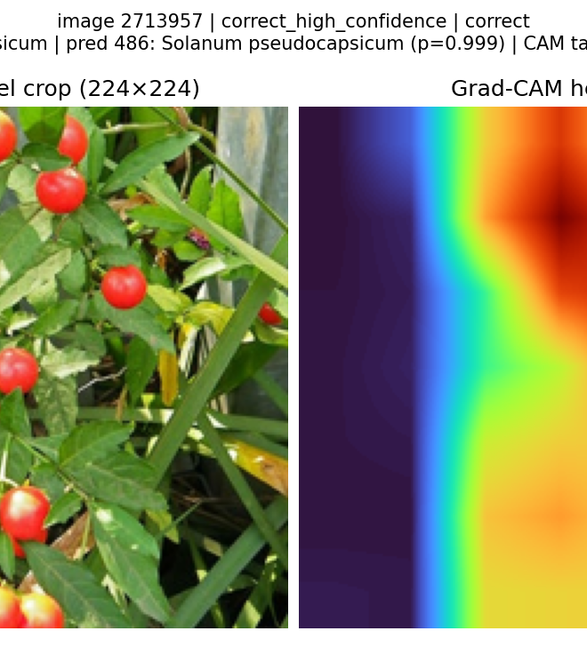
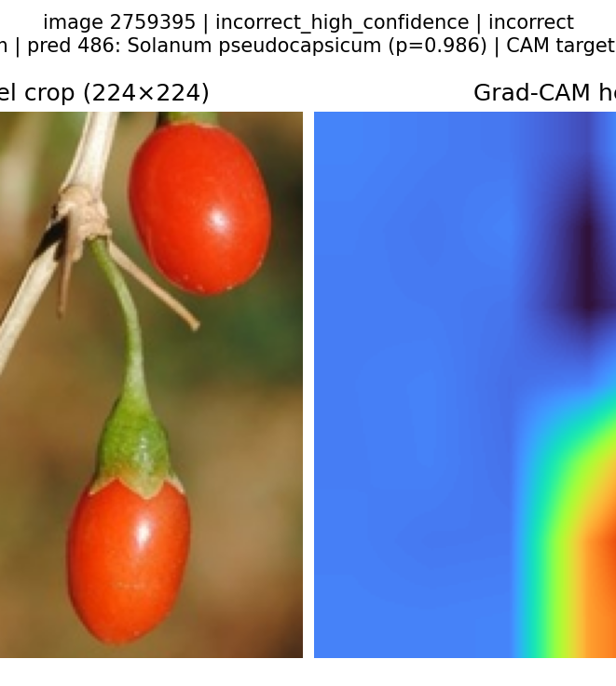
ROBUSTNESS, EXPLAINABILITY, LIMITS · P4
Corruption reveals a separate reliability problem
MEAN TOP-1 ACROSS 16 CORRUPTED CONDITIONS
GRAD-CAM: CLASS-CONDITIONAL DIAGNOSTIC
EffNet-B0
Pretrained R18
Scratch R18
RF
Correct
Jerusalem cherry -> same
p = 0.999
Confident error
matrimony vine -> Jerusalem cherry
p = 0.986
EfficientNet-B0: Motion Blur severity 4
72.74% clean -> 18.94% top-1
Qualitative / coarse / non-causal / not segmentation
Limits: one seed | 10 test images/class | no confidence intervals | 4 synthetic corruption families
Sources: final_report_robustness_summary.csv; robustness protocol; gradcam_selected_examples.csv; persisted Grad-CAM maps
9
Notes:
Robustness uses four frozen models across Gaussian noise, Gaussian blur, JPEG compression, and motion blur, each at four severities. EfficientNet-B0 ranks first on the regenerated robustness evidence at 56.34 percent mean corrupted top-1. Its worst condition is Motion Blur severity 4, where top-1 falls to 18.94 percent. Clean accuracy is therefore not a reliability guarantee.
Grad-CAM adds qualitative inspection. Correct cases often focus on the organism, while the matrimony-vine error attends to visually similar red fruit and predicts Jerusalem cherry with high confidence. These maps are class-conditional and useful for forming hypotheses, but they are coarse, non-causal, and not segmentations.
The main conclusion is that the frozen tables support a transparent comparison across traditional, scratch, and transfer-learning systems, while the regenerated Stage 4 tables expose reliability under corruption. In this evidence snapshot, EfficientNet-B0 (ImageNet pretrained) leads clean held-out top-1 and EfficientNet-B0 leads mean corrupted top-1. Limitations are one principal seed, only ten test images per class, no repeated runs or confidence intervals, four synthetic corruption families, and qualitative Grad-CAM. P5 will close with reproducibility and the software demonstration.
[Sources]
- results/tables/final_report_robustness_summary.csv
- results/metrics/stage4_robustness_protocol.json
- results/tables/gradcam_selected_examples.csv
- results/figures/gradcam/correct_high_confidence/2713957__row-4863__target-predicted-label-486_gradcam.png
- results/figures/gradcam/incorrect_high_confidence/2759395__row-4855__target-predicted-label-486_gradcam.png
- report/cvpr_latex/sections/07_discussion.tex

Slide 10
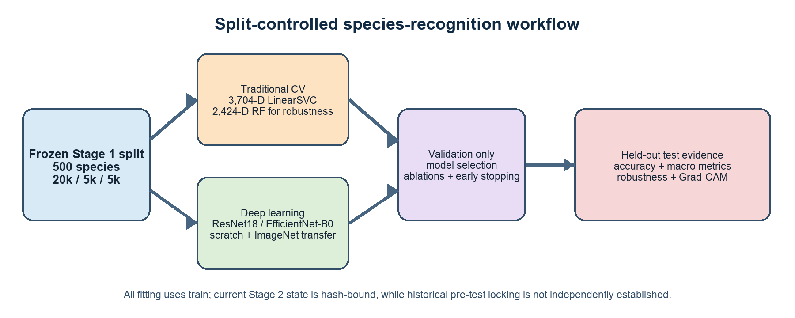
REPORT AND REPRODUCIBILITY · P5
Every reported result is connected to frozen evidence
TRACEABLE EVIDENCE CHAIN
Seed-42 split manifests
Stage 2 selection + Stage 3 freeze
Final predictions + metric JSON
Manifest-bound tables + figures
CVPR REPORT
Final PDF and generated tables require the post-refresh evidence audit.
Focused evidence-contract checks
Deterministic source ZIP excludes data, checkpoints, caches, and predictions.
Focused integrity checks must pass against the refreshed evidence contract before recording.
Pre-recording action: rehearse all five handovers, then run the strict evidence check.
Sources: README.md; Stage 2 / Stage 3 freezes; final evidence manifests and focused contract tests
10
Notes:
Hello, I'm Yuzhe Qiu. I'll finish with reproducibility and the demo. Seed 42 deterministically builds immutable train, validation, and test manifests. The Stage 2 selection and Stage 3 freeze files bind the approved configurations and checkpoints; final table and figure manifests bind metric sources and repository outputs. Before recording, the generator verifies declared hashes, exact row sets, estimator identities, Stage 4 protocol linkage, and copied presentation-figure bytes. The CVPR report and deterministic source ZIP exclude data, checkpoints, caches, and predictions.
[Sources]
- README.md
- results/metrics/stage2_freeze.json
- results/metrics/deep_learning/stage3_freeze.json
- results/metrics/stage4_robustness_protocol.json
- results/tables/stage4_summary.csv
- results/tables/final_report_tables_manifest.json
- results/final_report_figures/figure_manifest.json

Slide 11
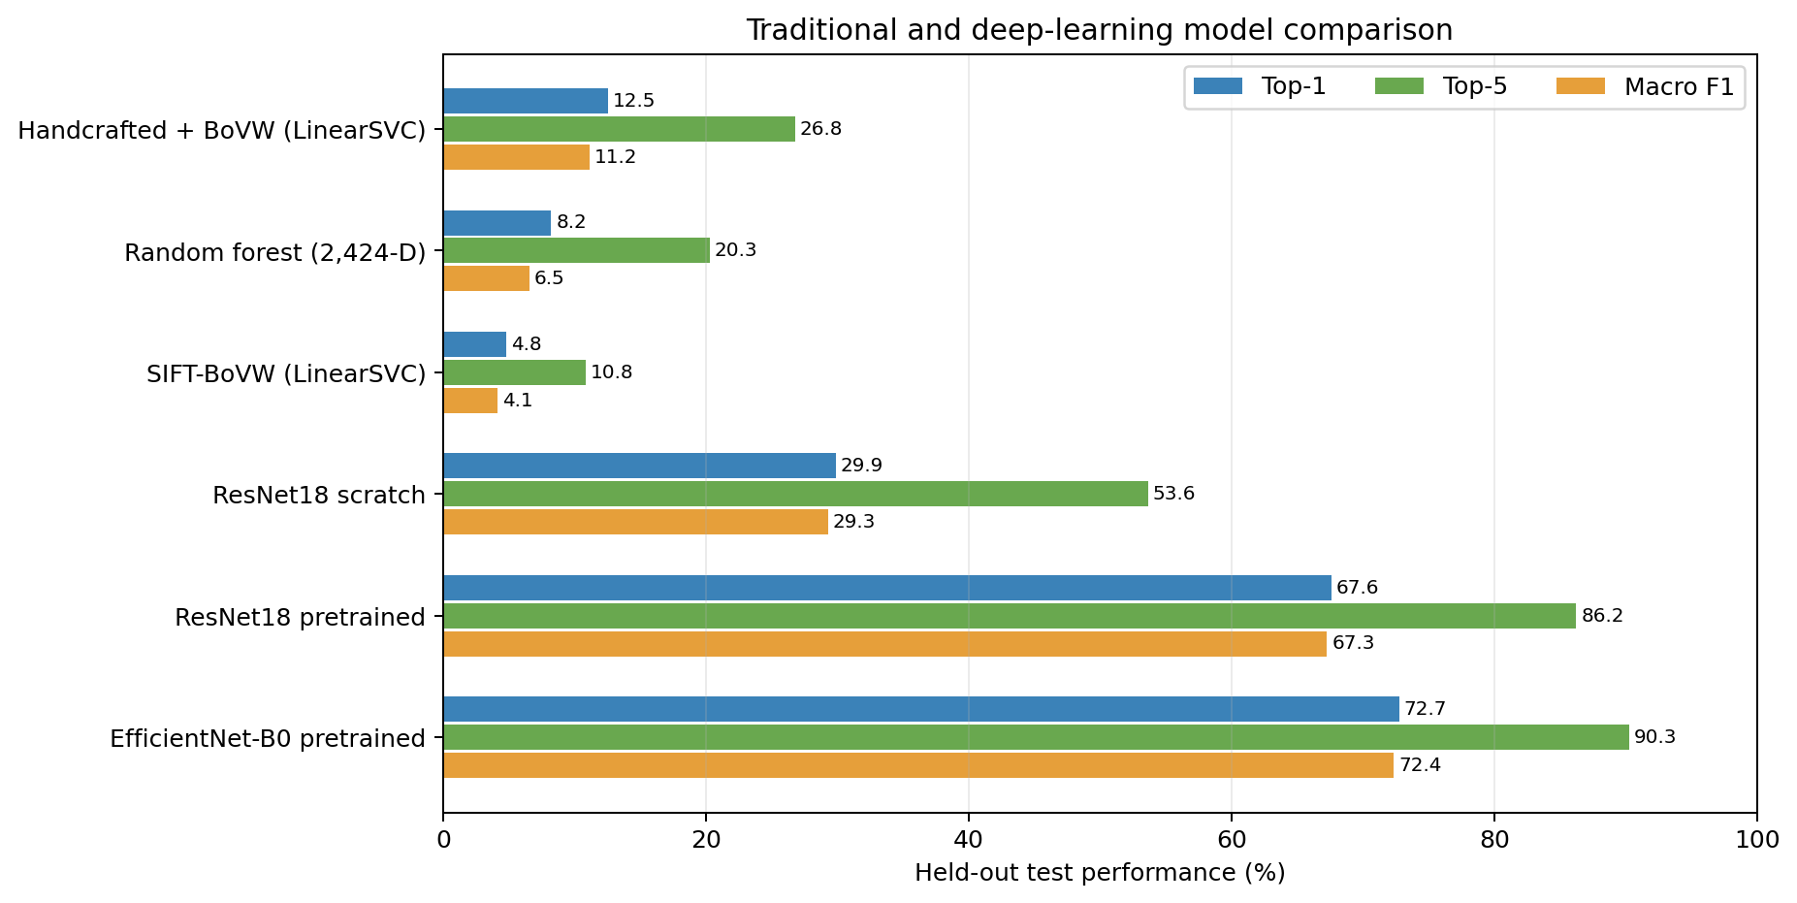
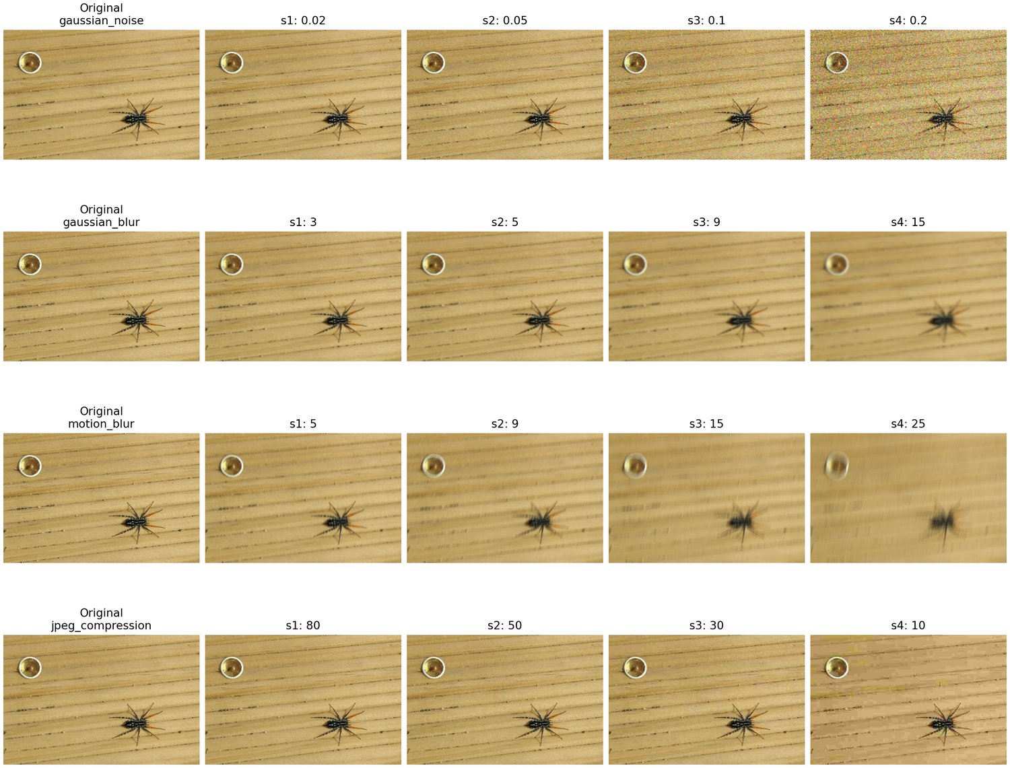
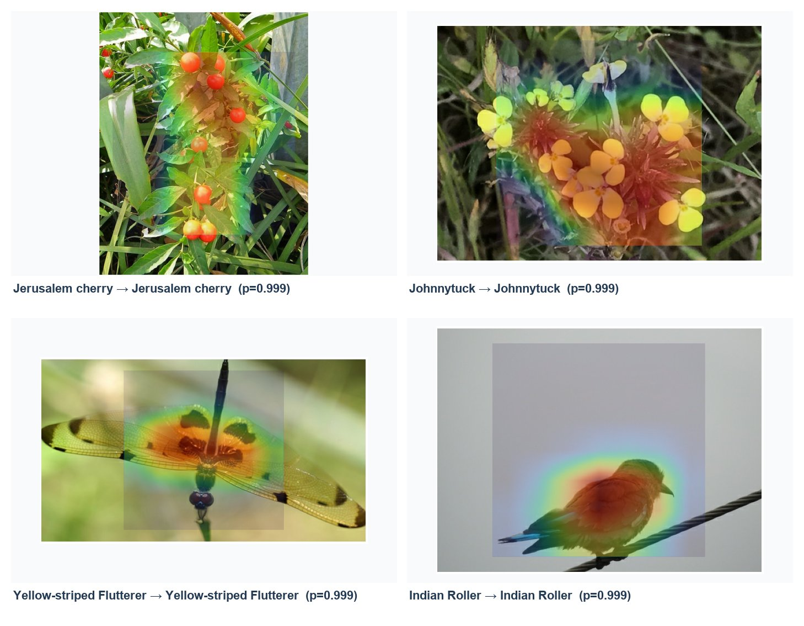
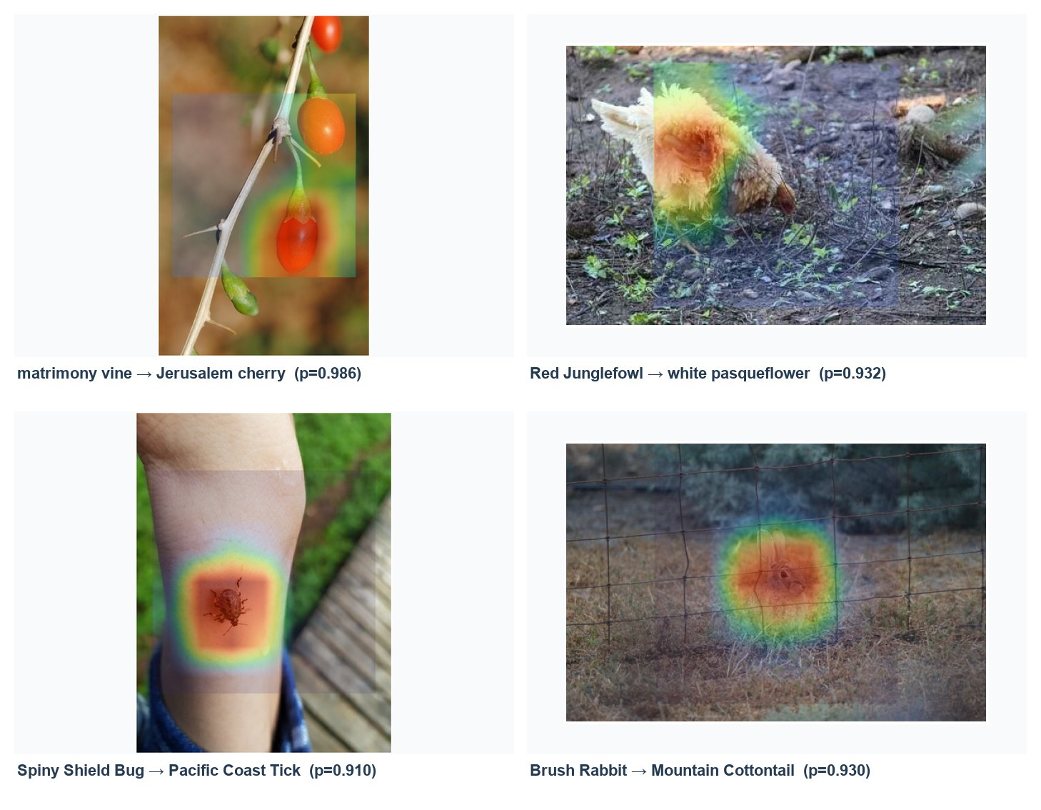
SOFTWARE DEMONSTRATION · P5
Demo: verify hashes, then inspect persisted outputs
READ-ONLY CHECK / CAPTURED 0.388s PASS
SHOW, DON'T RECOMPUTE
comp9517 % T=tests.test_stage5_tables.FrozenEvidenceTests
comp9517 % .venv/bin/python -m unittest -v \
"$T.test_every_contracted_hash_matches" \
"$T.test_all_nested_manifest_bindings_match_and_deduplicate"
... test_every_contracted_hash_matches ... ok
... test_all_nested_manifest_bindings ... ok
Ran 2 tests in 0.388s
OK
Frozen comparison
Robustness artifacts
6 held-out methods
4 corruptions x 4 severities
Correct Grad-CAM
Failure Grad-CAM
organism attention
qualitative shortcut clue
No training / no full evaluation / no robustness inference / no Grad-CAM regeneration / no network
Exact commands, expected output, durations, narration, and fallbacks: presentation/DEMO_RUNBOOK.md
11
Notes:
Here is the repository, organised into source code, tests, reports, and persisted results. I'll run one read-only validation: these tests recompute artifact hashes and nested manifest bindings. The two checks must pass against the refreshed evidence contract before recording. The table and comparison figure then show the six frozen held-out methods, led by EfficientNet-B0 (ImageNet pretrained) at 72.74 percent top-1. Our robustness artifact covers four frozen models, four corruption types, and four severities; its ranking and worst condition come directly from the regenerated Stage 4 tables. Finally, this correct Grad-CAM attends to the organism, whereas the confident error focuses on visually similar fruit. These maps are qualitative, not causal. Nothing here retrains a model or reruns inference.
[Sources]
- tests/test_stage5_tables.py (two focused read-only hash-binding tests)
- presentation/assets/demo_validation_output.txt
- report/cvpr_latex/generated/main_results_table.tex
- results/final_report_figures/final_model_comparison.png
- results/final_report_figures/corruption_examples.jpg
- results/final_report_figures/gradcam_correct_examples.jpg
- results/final_report_figures/gradcam_incorrect_examples.jpg

Slide 12
FINAL TAKEAWAYS · P5
Clean and corrupted results answer different questions
01
Traditional features
Handcrafted + BoVW (LinearSVC): 12.52% held-out top-1
02
Scratch deep learning
ResNet18 (scratch): 29.88% held-out top-1
03
Held-out leader
EfficientNet-B0 (ImageNet pretrained): 72.74% held-out top-1
04
Beyond clean accuracy
EfficientNet-B0 leads regenerated mean corrupted top-1
Thank you. Questions?
Conclusion source: frozen held-out metrics, robustness aggregates, Grad-CAM selection, and final report
12
Notes:
Together, the project provides a transparent traditional reference, a held-out comparison led by EfficientNet-B0 (ImageNet pretrained), and regenerated robustness evidence alongside qualitative Grad-CAM diagnostics. Thank you; we welcome your questions.
[Sources]
- results/tables/final_report_main_results.csv
- results/tables/final_report_robustness_summary.csv
- results/tables/gradcam_selected_examples.csv
- report/cvpr_latex/sections/08_conclusion.tex

Slide 13
APPENDIX
Evidence for
questions
Split protocol / feature details / hyperparameters / ablations / full metrics / robustness / Grad-CAM
13 / A1
Notes:
Appendix divider. Not included in the ten-minute timing.
[Sources]
- All appendix evidence is derived from frozen repository artifacts listed on the following slides.

Slide 14
A2 / Exact dataset construction and leakage controls
DETERMINISTIC CONSTRUCTION
AUDITED LEAKAGE CONTROLS
All 10,000 classes meet the 50 train_mini + 10 official-val threshold.
Partition
Rows
Per class
PCG64 seed 42 samples 500 original category IDs; selected IDs are sorted.
Train / train_mini
20,000
40
Internal val / train_mini
5,000
10
Per-class deterministic permutation selects 40 train + 10 internal val.
Held-out test / official val
5,000
10
Ten official-validation images per class become the held-out test set.
Cross-partition overlap
0
PASS
Labels map contiguously to 0-499; manifests retain scientific names and IDs.
No overlap by image ID, path, UUID filename, or independently checked byte hash.
Train-only fitting for scalers, vocabulary, classifiers, and CNN optimisation.
Chronology: Stage 3 checkpoint/config hashes were verified before test access. Stage 2 is hash-bound now; historical pre-test locking was not independently established.
Sources: split_summary.json; split manifests; report Dataset and Protocol
14 / A2
Notes:
Untimed appendix evidence.
[Sources]
- data/splits/split_summary.json
- data/splits/train.csv; data/splits/val.csv; data/splits/test.csv
- report/cvpr_latex/sections/03_dataset_protocol.tex

Slide 15
A3 / Traditional feature dimensions and BoVW configuration
Feature
Dim.
Configuration
Normalisation / role
Spatial colour
520
joint H-S 12x8 + V 8; 1 + 2x2 cells
raw nonnegative block
Uniform LBP
140
P=8/R=1 and P=16/R=2; 1 + 2x2
raw multi-scale texture
HOG
1,764
9 orientations; 16px cells; 2x2 blocks
L2-Hys; shape
Handcrafted
2,424
colour -> texture -> HOG
Random-Forest comparator
Combined
3,704
handcrafted -> BoVW
power norm alpha=.3 + LinearSVC
SIFT-BoVW
Aspect-preserving resize (long side 256) / grayscale SIFT / 256-word MiniBatchKMeans vocabulary / 4 train images per class / <=100 descriptors per vocabulary image / top-3 soft assignment / whole + 2x2 pooling / 1,280-D
Vocabulary fitting is train-only; the current manifest binds validation selection across exactly 19 configurations. Historical pre-test locking is not independently established.
Sources: Stage 2 freeze; selection manifest; validation grid; traditional and BoVW feature configs; report Methods
15 / A3
Notes:
Untimed appendix evidence.
[Sources]
- results/metrics/stage2_freeze.json
- results/metrics/stage2_selection_manifest.json
- results/metrics/traditional_validation_grid.csv
- results/features/traditional_feature_config.json
- results/features/bovw/bovw_feature_config.json
- report/cvpr_latex/sections/04_methods.tex

Slide 16
A4 / Deep-learning hyperparameters and checkpoint selection
Run
LR
Epoch cap
Aug.
Trainable
Best epoch
Test status
ResNet18 scratch
1e-3
25
basic
11.43M
23
tested
ResNet18 pretrained
1e-4
15
basic
11.43M
15
val only
ResNet18 pretrained
1e-4
15
strong
11.43M
14
tested
ResNet18 frozen head
1e-3
10
basic
0.257M
10
val only
EfficientNet-B0 pretrained
1e-4
15
strong
4.65M
14
tested
COMMON
224 x 224 crop / batch 32 / AdamW / weight decay 1e-4 / cosine schedule / gradient clip 1.0 / seed 42 / validation macro F1 checkpoint selection
Sources: five deep YAML configs; five resolved-config JSONs; report Methods and Experimental Setup
16 / A4
Notes:
Untimed appendix evidence.
[Sources]
- configs/deep_resnet18_scratch.yaml
- configs/deep_resnet18_pretrained_basic.yaml
- configs/deep_resnet18_pretrained_strong_aug.yaml
- configs/deep_resnet18_pretrained_frozen_head.yaml
- configs/deep_efficientnet_b0_pretrained.yaml
- results/metrics/deep_learning/resnet18_scratch_basic_resolved_config.json
- results/metrics/deep_learning/resnet18_pretrained_basic_resolved_config.json
- results/metrics/deep_learning/resnet18_pretrained_strong_aug_resolved_config.json
- results/metrics/deep_learning/resnet18_pretrained_frozen_head_resolved_config.json
- results/metrics/deep_learning/efficientnet_b0_pretrained_strong_aug_resolved_config.json

Slide 17
A5 / Validation-only ablations preserve test isolation
Validation experiment
Top-1
Top-5
Macro F1
Interpretation
Full 3,704-D combined reference
12.94%
27.02%
11.54%
combined
Colour only
6.08%
15.42%
4.06%
colour
Texture only
3.56%
11.88%
1.77%
texture
HOG only
2.92%
8.52%
1.98%
single block
ResNet18 scratch / basic
28.74%
52.74%
27.96%
descriptive
ResNet18 pretrained / basic
66.16%
85.38%
66.08%
reference
ResNet18 pretrained / strong
67.54%
86.46%
67.37%
+1.38 pts
ResNet18 pretrained / frozen
57.46%
79.34%
57.25%
val only
Only basic vs strong pretrained ResNet18 is a matched one-factor augmentation comparison. No significance claim: one principal seed, no repeated runs.
Source: results/tables/final_report_ablation_results.csv
17 / A5
Notes:
Untimed appendix evidence.
[Sources]
- results/tables/final_report_ablation_results.csv
- report/cvpr_latex/generated/ablation_results_table.tex
- results/tables/final_report_tables_manifest.json

Slide 18
A6 / Complete held-out test metrics
Method
Top-1
Top-5
Macro P
Macro R
Macro F1
3,704-D handcrafted + BoVW LinearSVC
0.1252
0.2678
0.1090
0.1252
0.1116
2,424-D handcrafted Random Forest
0.0822
0.2026
0.0683
0.0822
0.0654
1,280-D SIFT-BoVW LinearSVC
0.0476
0.1082
0.0390
0.0476
0.0414
ResNet18 scratch / basic
0.2988
0.5364
0.3053
0.2988
0.2928
ResNet18 pretrained / strong
0.6760
0.8624
0.6911
0.6760
0.6728
EfficientNet-B0 pretrained / strong
0.7274
0.9026
0.7399
0.7274
0.7235
Balanced support means macro recall equals top-1 here. Per-class recall moves in 0.1 steps because the test split contains ten images per class.
Source: final_report_main_results.csv; cross-checked against six metric JSONs and generated report tables
18 / A6
Notes:
Untimed appendix evidence.
[Sources]
- results/tables/final_report_main_results.csv
- results/metrics/traditional_linear_svm_metrics.json
- results/metrics/traditional_random_forest_metrics.json
- results/metrics/traditional_sift_bovw_svm_metrics.json
- results/metrics/deep_learning/resnet18_scratch_basic_test_metrics.json
- results/metrics/deep_learning/resnet18_pretrained_strong_aug_test_metrics.json
- results/metrics/deep_learning/efficientnet_b0_pretrained_strong_aug_test_metrics.json

Slide 19
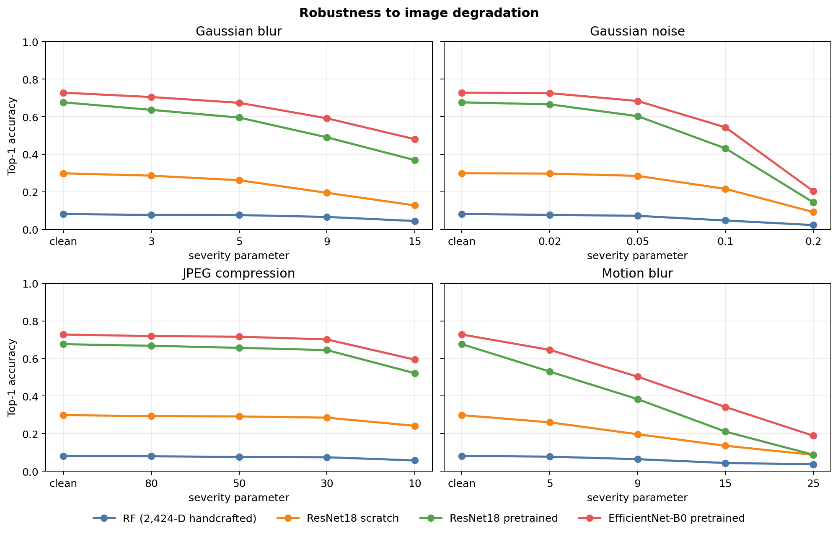
A7 / Robustness: 4 corruptions x 4 severities x 4 models
SEVERITY SCHEDULE
Gaussian blur
kernel 3 / 5 / 9 / 15
Gaussian noise
sigma .02 / .05 / .10 / .20
JPEG
quality 80 / 50 / 30 / 10
Motion blur
length 5 / 9 / 15 / 25
EfficientNet-B0 worst condition
Motion Blur severity 4
0.7274 -> 0.1894
Sources: Stage 4 protocol; robustness_results.csv; final robustness summary
19 / A7
Notes:
Untimed appendix evidence.
[Sources]
- results/figures/robustness/robustness_top1_curves.png
- results/metrics/stage4_robustness_protocol.json
- results/tables/final_report_robustness_summary.csv
- results/tables/robustness_results.csv

Slide 20
A8 / Grad-CAM selection and reproducibility Q&A
DETERMINISTIC SELECTION
33
54
unique images
target-specific maps
12 correct + 12 incorrect + 9 confused-pair representatives
EfficientNet-B0 layer features.8
Predicted-target map for all; true-target map for every error
Class-conditional, coarse, qualitative, non-causal
FAST READ-ONLY DEMO COMMAND
.venv/bin/python -m unittest -v \
tests.test_stage5_tables.FrozenEvidenceTests.test_every_contracted_hash_matches \
tests.test_stage5_tables.FrozenEvidenceTests.test_all_nested_manifest_bindings_match_and_deduplicate
Sources: gradcam_selected_examples.csv; Grad-CAM manifests; hash-bound report composites; test_stage5_tables.py
20 / A8
Notes:
Untimed appendix evidence.
[Sources]
- results/tables/gradcam_selected_examples.csv
- results/metrics/explainability/gradcam_selection_manifest.json
- results/metrics/explainability/gradcam_manifest.json
- results/final_report_figures/figure_manifest.json
- tests/test_stage5_tables.py

