Slide 1
Clustering
June 18, 2019

Slide 2
Clustering
Clustering is the method of grouping objects such that the objects in the same cluster are more similar as compared to objects in other clusters.

Slide 3
Examples
Segment customers based on brands purchased.
Web pages on UMN website grouped based on departmental affiliation.
Taxonomy of living things – kingdom, phylum …. Genus, species.

Slide 4
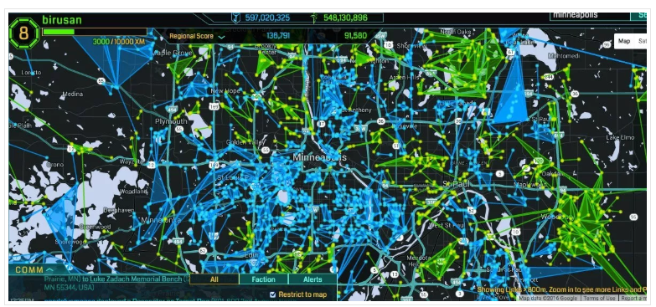
Example
Ingress Enlightened (green) and Resistance (blue) Targets. Source: https://streets.mn/2016/07/20/the-surprising-urban-geography-of-pokemon-go/

Slide 5
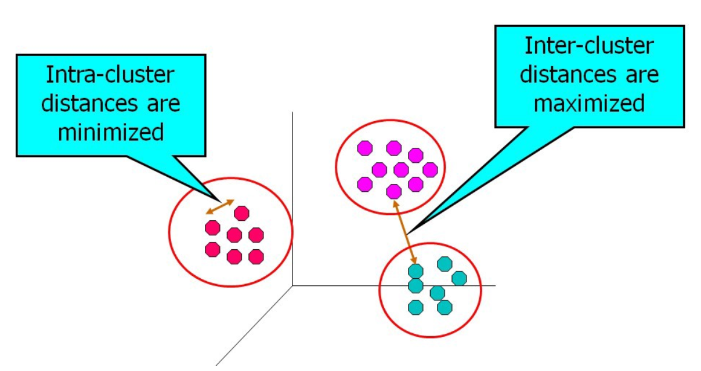
Clustering Objective

Slide 6
Types of Clusters
Partitional Vs Hierarchical
Exclusive Vs Overlapping Vs Fuzzy
Complete Vs Partial

Slide 7
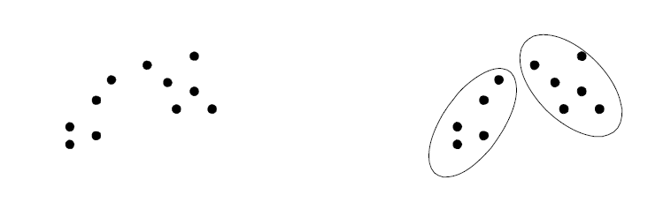
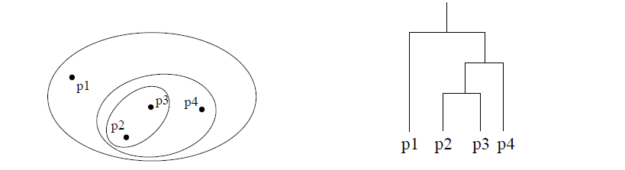
Partitional Vs Hierarchical

Slide 8
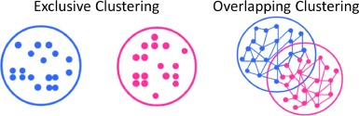
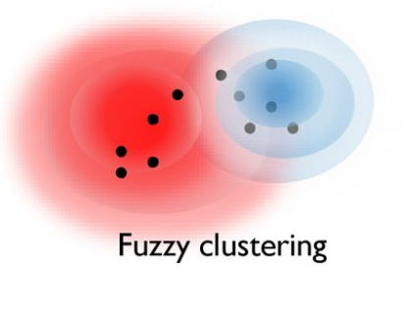
Exclusive Vs Overlapping
https://doi.org/10.1016/j.eswa.2016.09.025

Slide 9
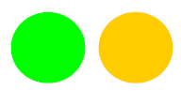
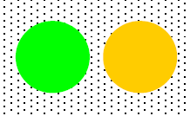
Complete Vs Partial

Slide 10
Clustering Algorithms
K – Means
Hierarchical
Density Based

Slide 11
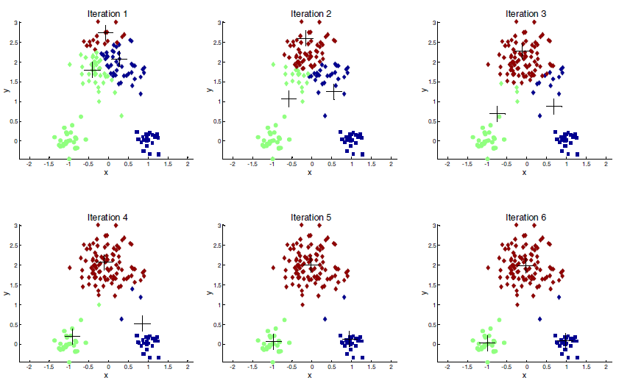
K Means
Introduction to Data Mining, 2nd Edition
Tan, Steinbach, Karpatne, Kumar

Slide 12
K - Means
Partitional
Choose K
Each cluster is associated with a centroid (center point)
In the K means algorithm, each point is assigned to closest center
‘Closeness’ is measured by Euclidean distance, cosine similarity, correlation, etc.

Slide 13
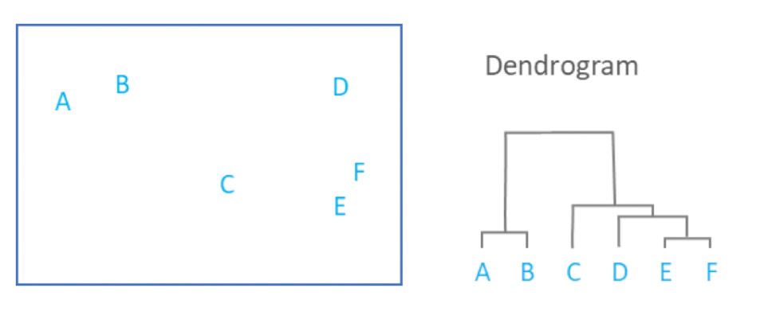
Hierarchical Clustering
https://www.displayr.com/what-is-hierarchical-clustering/

Slide 14
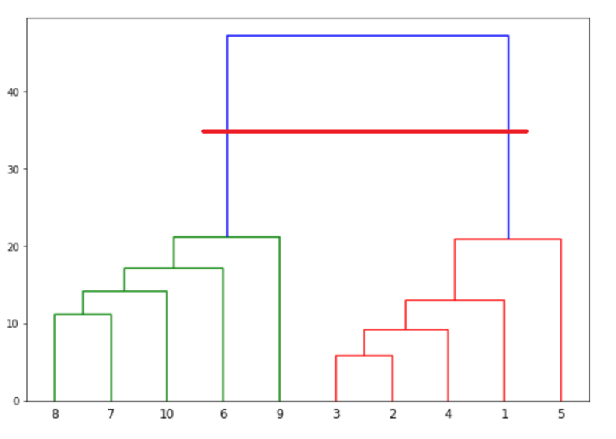
Hierarchical Clustering

Slide 15
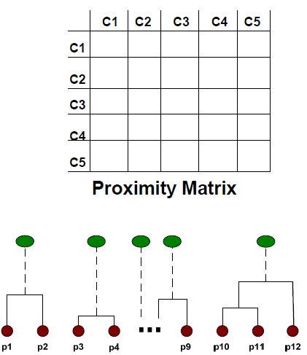
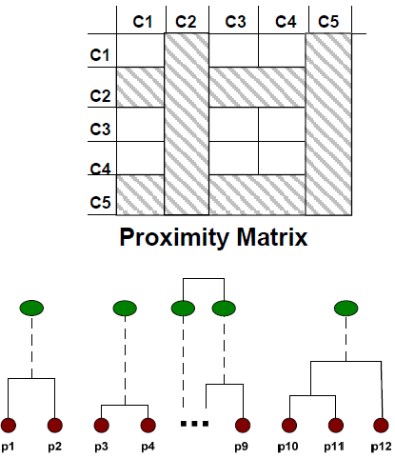
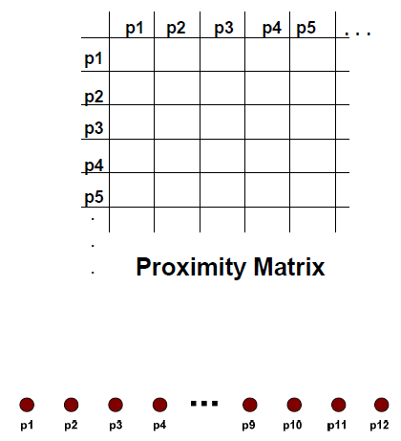
Proximity Matrix

Slide 16
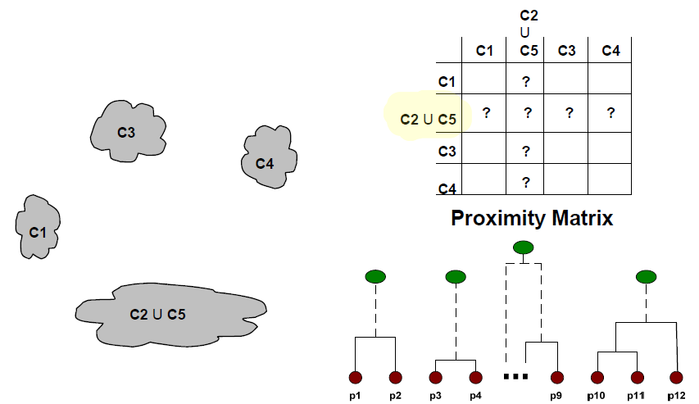
After Merging first two clusters/points

Slide 17
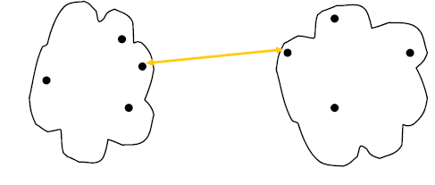
Inter Cluster Distances for Hierarchical Clusters
MIN (or single linkage) ~ Minimum distance
MAX (or complete linkage) ~ Maximum distance
Group average
Ward’s Distance (objective drive – squared error)
MIN/ Single Linkage approach

Slide 18
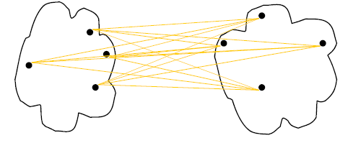
Group Average Linkage

