Slide 1
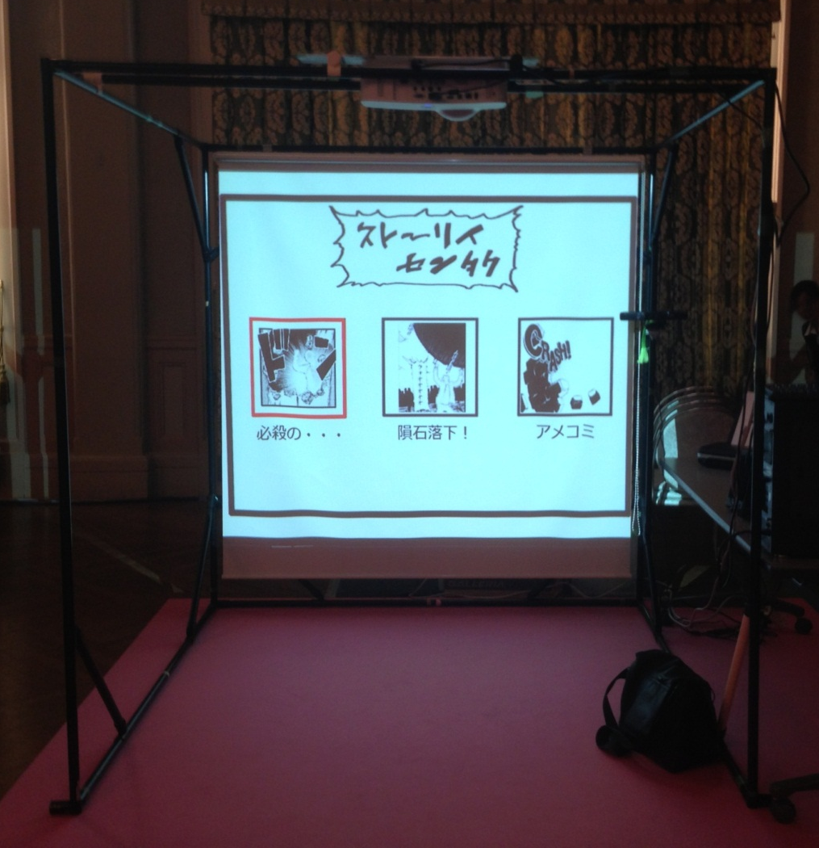
Floor Installation -Top View-
Please for installation in rear projection using a rental screen and projector.
1000mm
Projector
Operator
Desk
This picture is an example of a front projection.
PC
Screen
Projector
Kinect
Printer
1500m
Screen
Play Space
4000mm
3000mm

Slide 2
