Slide 1
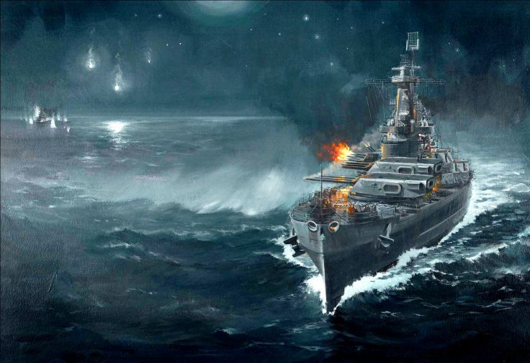
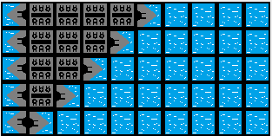
Welcome to Sea Wars Battlefront II
Objective:
>> Shoot down the Supreme Order ships.
Rules:
This is a 10 x 10 Board Game. Pick your war machines’ location accordingly in the 10 x 10 battlefield. You have the following five war machines to place with their respective length:
>> Aircraft Carrier
>> JFK Destroyer
>> Plasma Battleship
>> Nuclear-Powered Submarine
>> Drone Boat
READY

Slide 2
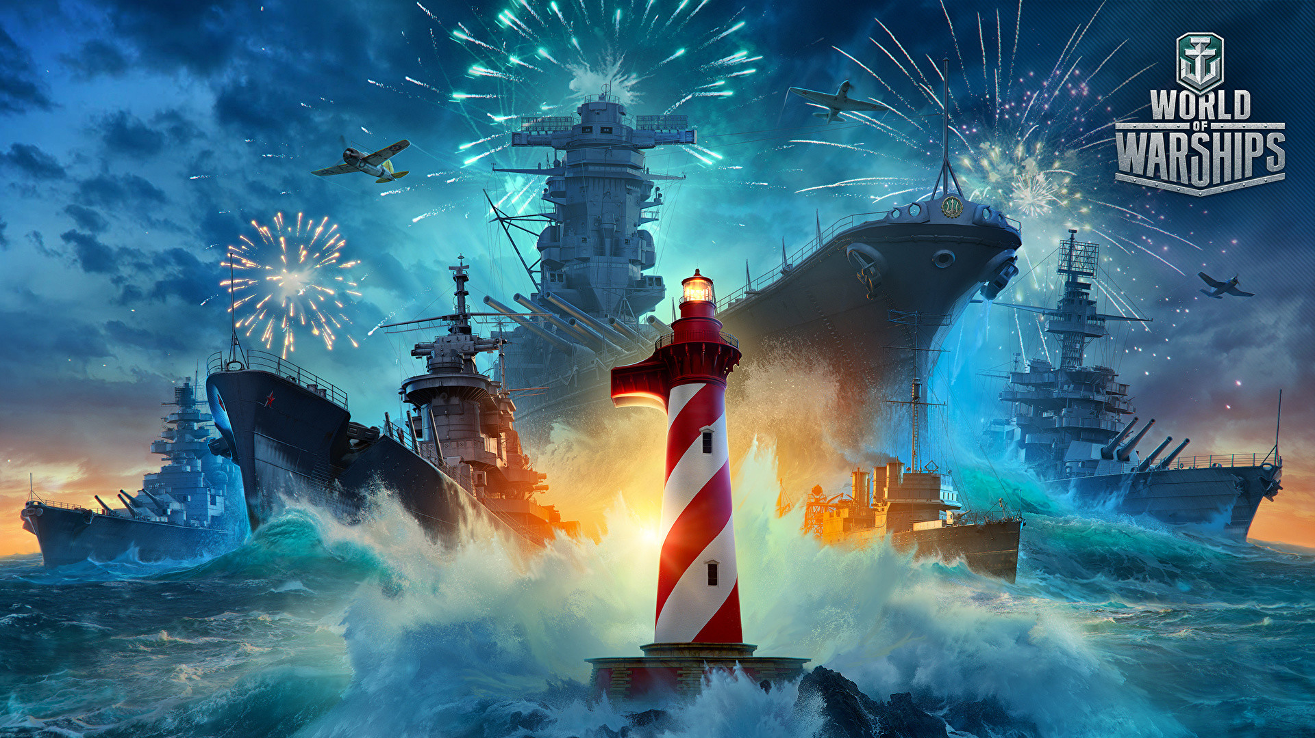
Congratulations!
You have defeated all enemies.
RETURN

Slide 3
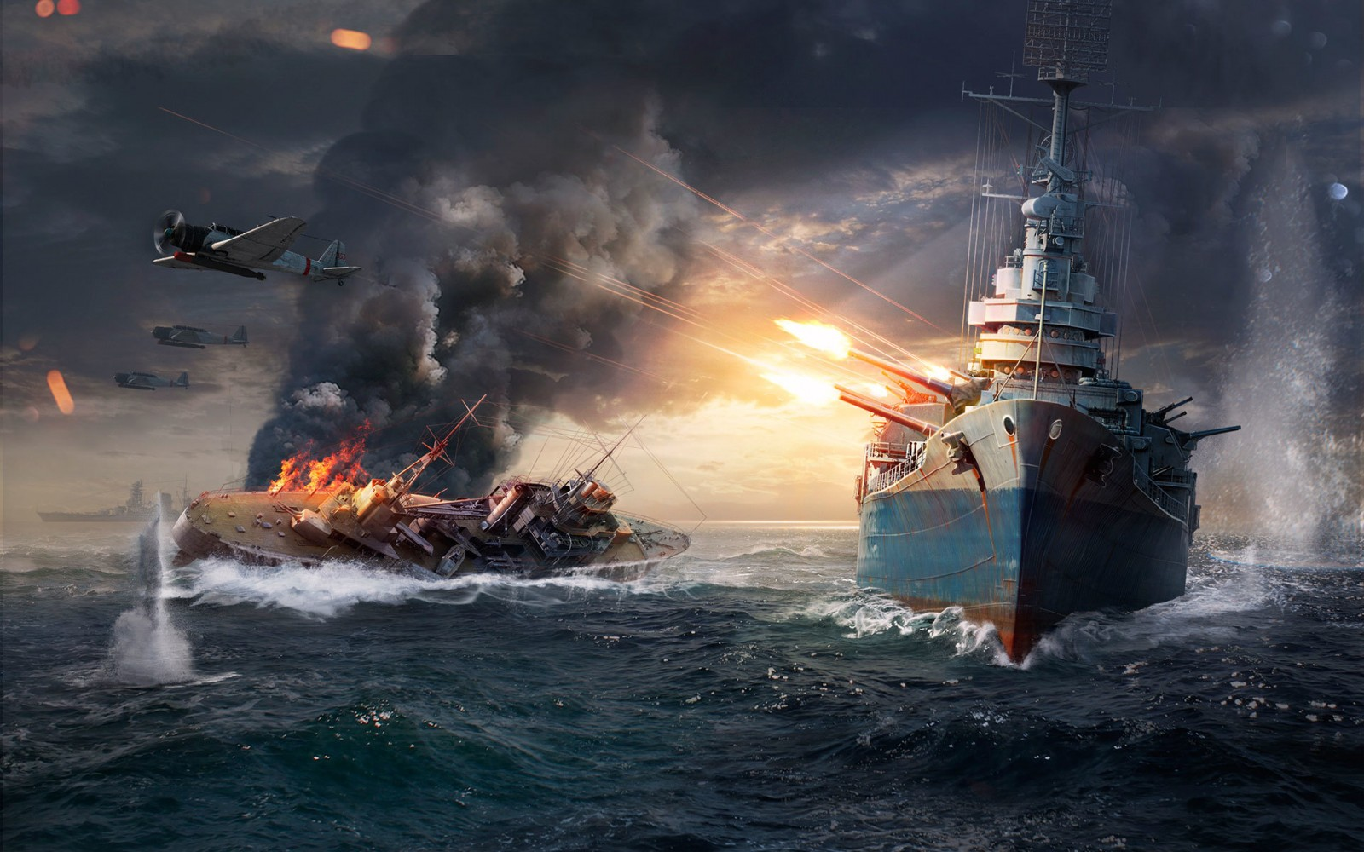

You Are Defeated…
Congratulations!
You have defeated all enemies.
RETURN
RETURN

