Slide 1


DESIGNING SOLUTIONS WITH
MURAL TEMPLATE
Topic:- Booking Local Service Providers
Submitted by:-
AYUSHI SINGH
MANSI KAITHWAS
SOMYA VERMA
[BA-IBM] III-C
Submitted to:-
Mr. Lokesh Pal Arya

Slide 2
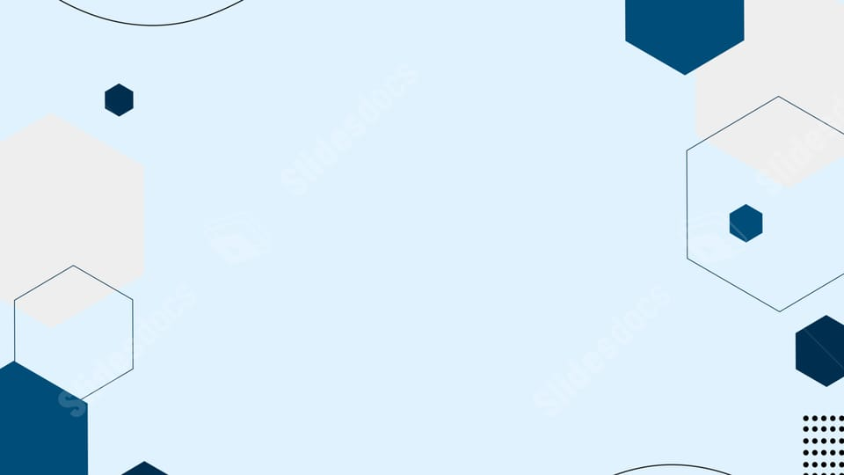
EMPATHY MAP
• An Empathy Map in Mural is a visual collaboration tool used to understand your users or customers more deeply — what they say, think, feel, and do about a product, service, or situation. It helps teams step into the user’s shoes and uncover their needs, pain points, motivations, and emotions. In Mural, this is represented using a pre-designed template divided into sections you fill with digital sticky notes.
• The Four Quadrants of Mural Empathy Map:-
1.SAYS: What the user says out loud quotes, feedback, or comments. Example: "I hate waiting for service confirmation.“
2.THINKS: What the user is thinking but might not say directly - their worries, motivations, or desires. Example: "Can I trust this app with my personal info?“
3.DOES: The actions or behaviors of the user how they currently solve their problem. Example: Calls multiple providers or searches on Google.
4.FEELS: The user's emotions ,frustrations, fears, joys, or hopes. Example: Feels stressed when services are delayed; relieved when it's quick and easy.

Slide 3

Aim:-
The main aim of creating an Empathy Map in Mural is to:
Build empathy for your users
Discover real problems before designing solutions
Align your team's understanding of the target user
Generate human-centered ideas for product or service improvement
Here the aim is to develop an easy-to-use mobile app that allows users to book local service providers (like electricians, plumbers, cleaners, tutors, etc.) quickly, safely, and affordably within their city.
Steps to Create an Empathy Map :-
• Step 1: Define the Goal or Objective. Identify why you're creating the empathy map.
• Step 2: Identify Your Target User (Persona)Choose a specific user type or customer segment you want to understand. Give them a name, age, role, and background.
• Step 3: Gather User Data.Collect information from: User interviews Surveys or feedback forms. Observation or user journey analysis. Use real quotes and behaviors, not assumptions, whenever possible.
• Step 4: Create the Empathy Map Layout.Draw or open the Mural Empathy Map Template. Divide it into four main sections: SAYS What the user says aloud, THINKS - What goes on in their mind, DOES - What actions they take, FEELS - How they feel emotionally
• Step 5: Fill Each Section. Use sticky notes (in Mural) or handwritten notes for each area.
• Step 6: Identify Patterns and Insights. Review all the notes.Group similar ideas (e.g., trust issues, time-saving needs).Highlight main pain points and user desires.
• Step 7: Derive Opportunities or Solutions. Turn insights into actionable ideas.

Slide 4
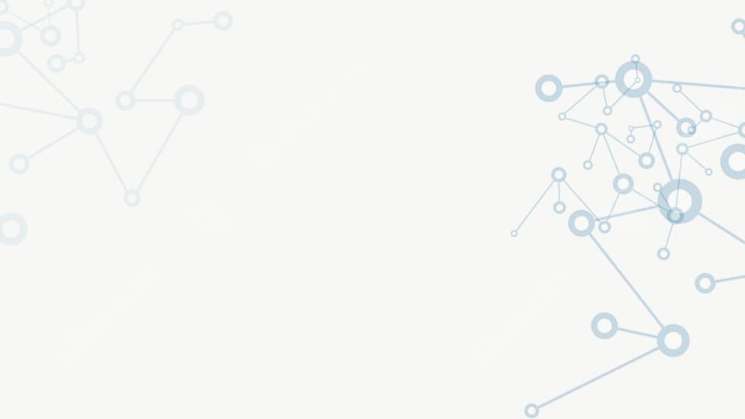
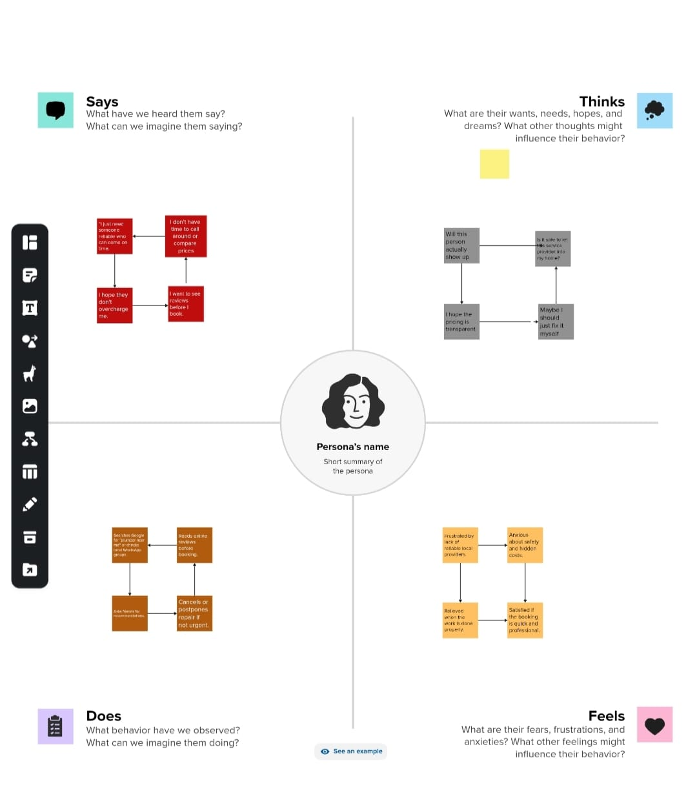
EMPATHY MAP :-

Slide 5

HOW MIGHT WE QUESTIONS
• The “How Might We” template in Mural is a design thinking tool used to frame challenges as opportunities for creative problem solving. It helps teams move from identifying problems to asking the right questions that spark innovation.
• The Mural “How Might We” template typically contains these main areas:
1.Problem or Insight Section: Write the user problem, need, or insight discovered through research or empathy mapping.
2.Formulation of HMW Questions: Reframe each problem into one or more “How Might We” questions.
3.Clustering or Grouping Area :Group similar HMW questions together under broader themes like Technology, Engagement, Accessibility, etc. This helps focus brainstorming sessions.
4.Prioritization Section: Team members can vote or rate which HMW questions have the most potential for impact and feasibility.
Aim:-To design an intuitive, efficient, and reliable mobile app for booking local service providers (like plumbers, electricians, cleaners, tutors, etc.) that ensures easy discovery, secure payment, and timely service delivery.

Slide 6

Steps to use How Might We Questions :-
• Step 1: Define the Problem "How might we simplify the process of finding and booking trusted local service providers quickly and affordably? "Users struggle to find reliable local help. Lack of transparent pricing. Delays and cancellations create frustration.
• Step 2: Brainstorm Ideas Use sticky notes in Mural to generate ideas under different “How Might We” questions.
• Step 3: Cluster Ideas. Group similar ideas into thematic clusters in Mural. Each cluster represents a broader solution area
• Step 4: Prioritization Grid. Now, place all clusters or ideas on the Mural Prioritization Grid, using axes: X-axis: Feasibility (Low → High)Y-axis: Impact (Low → High)
• Step 5: Final Solution Concept. Based on the prioritized ideas, create a solution outline.

Slide 7
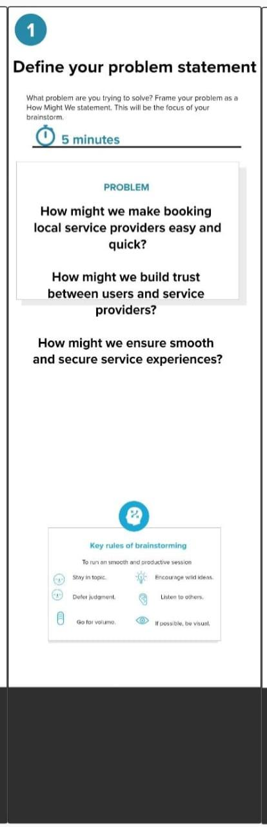
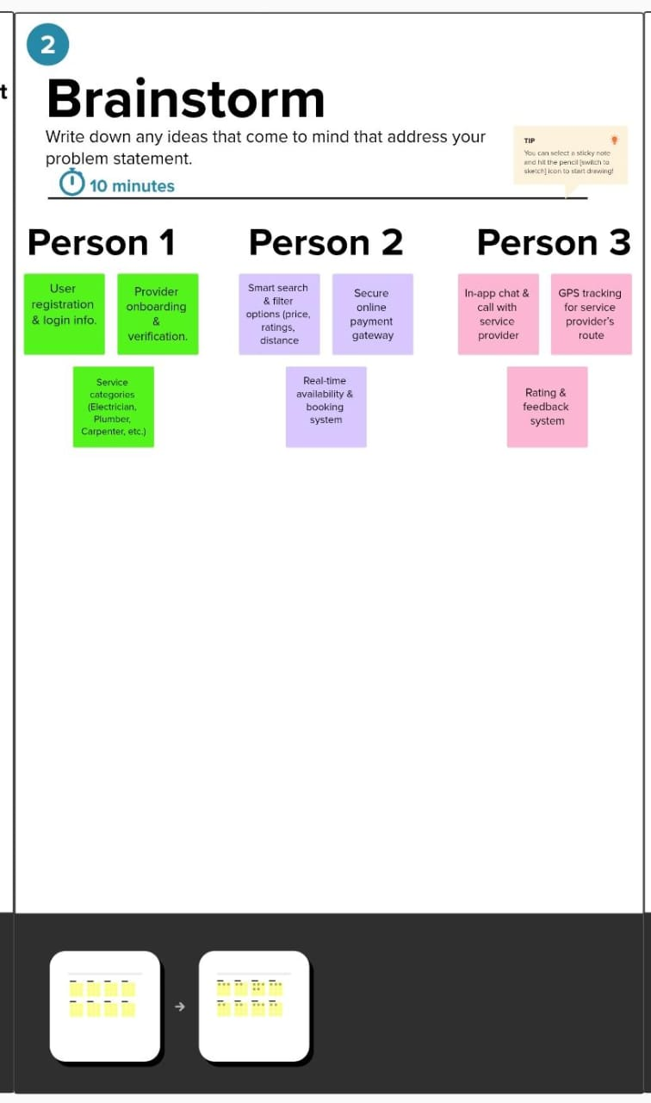
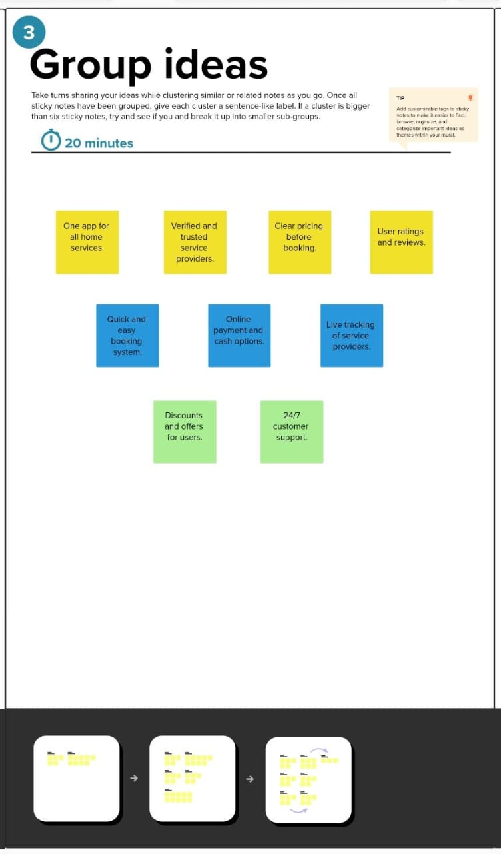

Slide 8

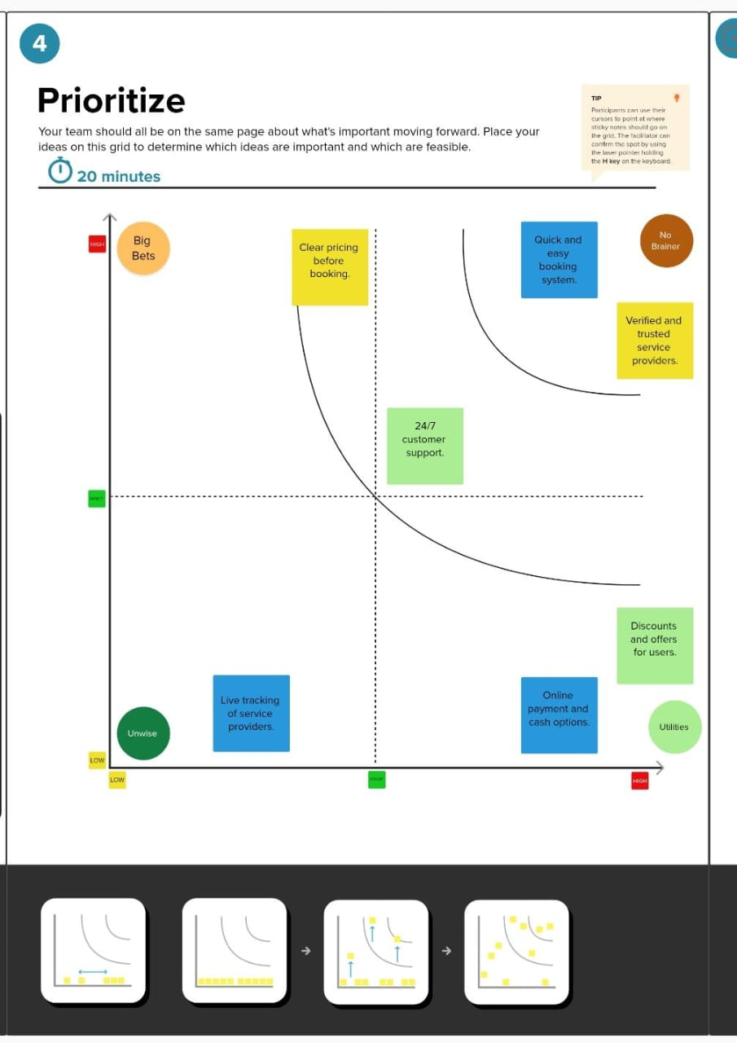

Slide 9
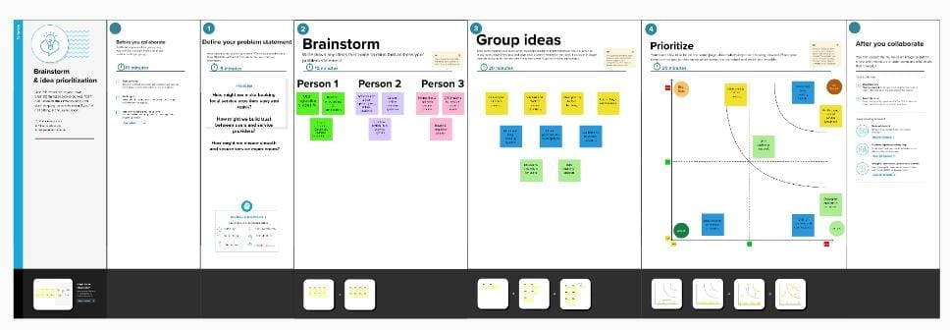
FULL VIEW OF BRAINSTORM AND IDEA PRIORTIZATION TEMPLATE :-

Slide 10
STORYBOARDING
• A storyboarding template in Mural is a digital canvas with structured frames (or panels) that help you illustrate each step of a process or story visually. Each panel represents a moment, action, or interaction in a sequence. You can use text boxes, sticky notes, icons, sketches, or images to fill each frame — showing what happens, what the user feels, and what problems or opportunities appear.
• Aim:-To develop an easy-to-use mobile app that allows users to book local service providers (e.g., electricians, plumbers, beauticians, tutors, cleaners, etc.) efficiently, ensuring trust, convenience, affordability, and quick access to verified professionals nearby.
• Storyboarding Steps (for Mural Template):-
You can organize your storyboard in Mural using 6–8 frames or panels, each representing a step in the user journey.

Slide 11
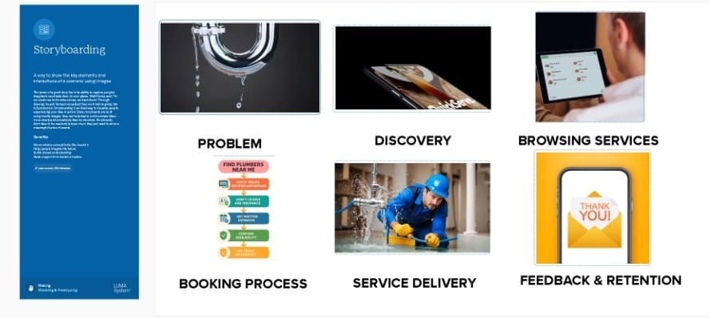
STORYBOARDING:-

Slide 12


