Slide 1


“2005”

Slide 2

Faith
Hebrews 11

Slide 3

Repentance

Slide 4

The Good Confession

Slide 5





Baptism

Slide 6
Why?
Baptism

Slide 7


Why?
Baptism

Slide 8


U.S. Census Bureau
1950
2000
256
3000+

Slide 9

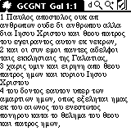

Baptism

Slide 10
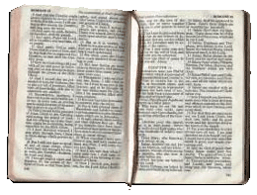

Baptism

Slide 11
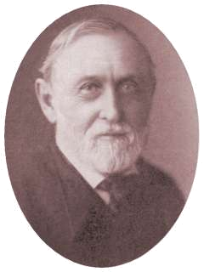
Baptism

Slide 12
Baptism
Read all the New Testament
Watch for the subject
Examine the context
Put it all together
This is the Lord teaching me!

Slide 13

Baptism

Slide 14





Baptism

Slide 15

Matthew
Baptism

Slide 16

Matthew
Baptism
Matt 3:5 Then went out unto him Jerusalem, and all Judaea, and all the region round about the Jordan;
Matt 3:6 and they were baptized of him in the river Jordan, confessing their sins.

Slide 17
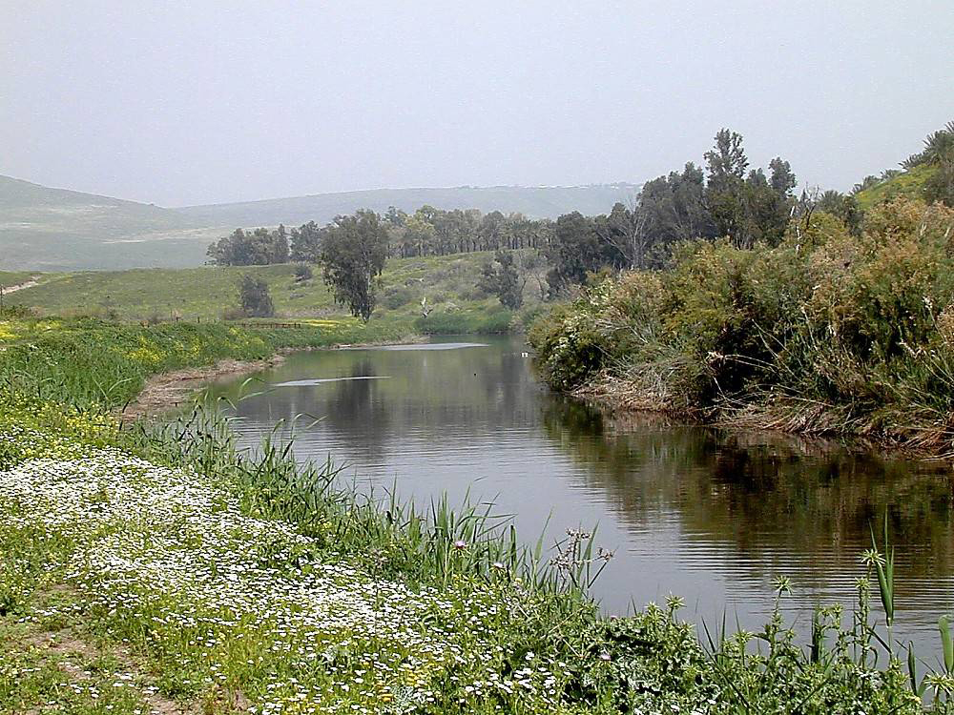
Matthew
Baptism
Matthew 3:5-6
“river Jordan”

Slide 18
Matthew
Baptism
Matthew 3:5-6
3:11
“river Jordan”
“with water”

Slide 19
Matthew
Baptism
Matthew 3:13
“river Jordan”
“with water”
“went up straightway from the water”

Slide 20
Matthew
Baptism
Matthew 28:18-19
“baptize in all the nations ”
“into the name of the Father, and the Son and of the Holy Spirit ”

Slide 21

Matthew
Baptism
Matthew 28:18-19
“a universal thing ”
“a solemn matter ”

Slide 22
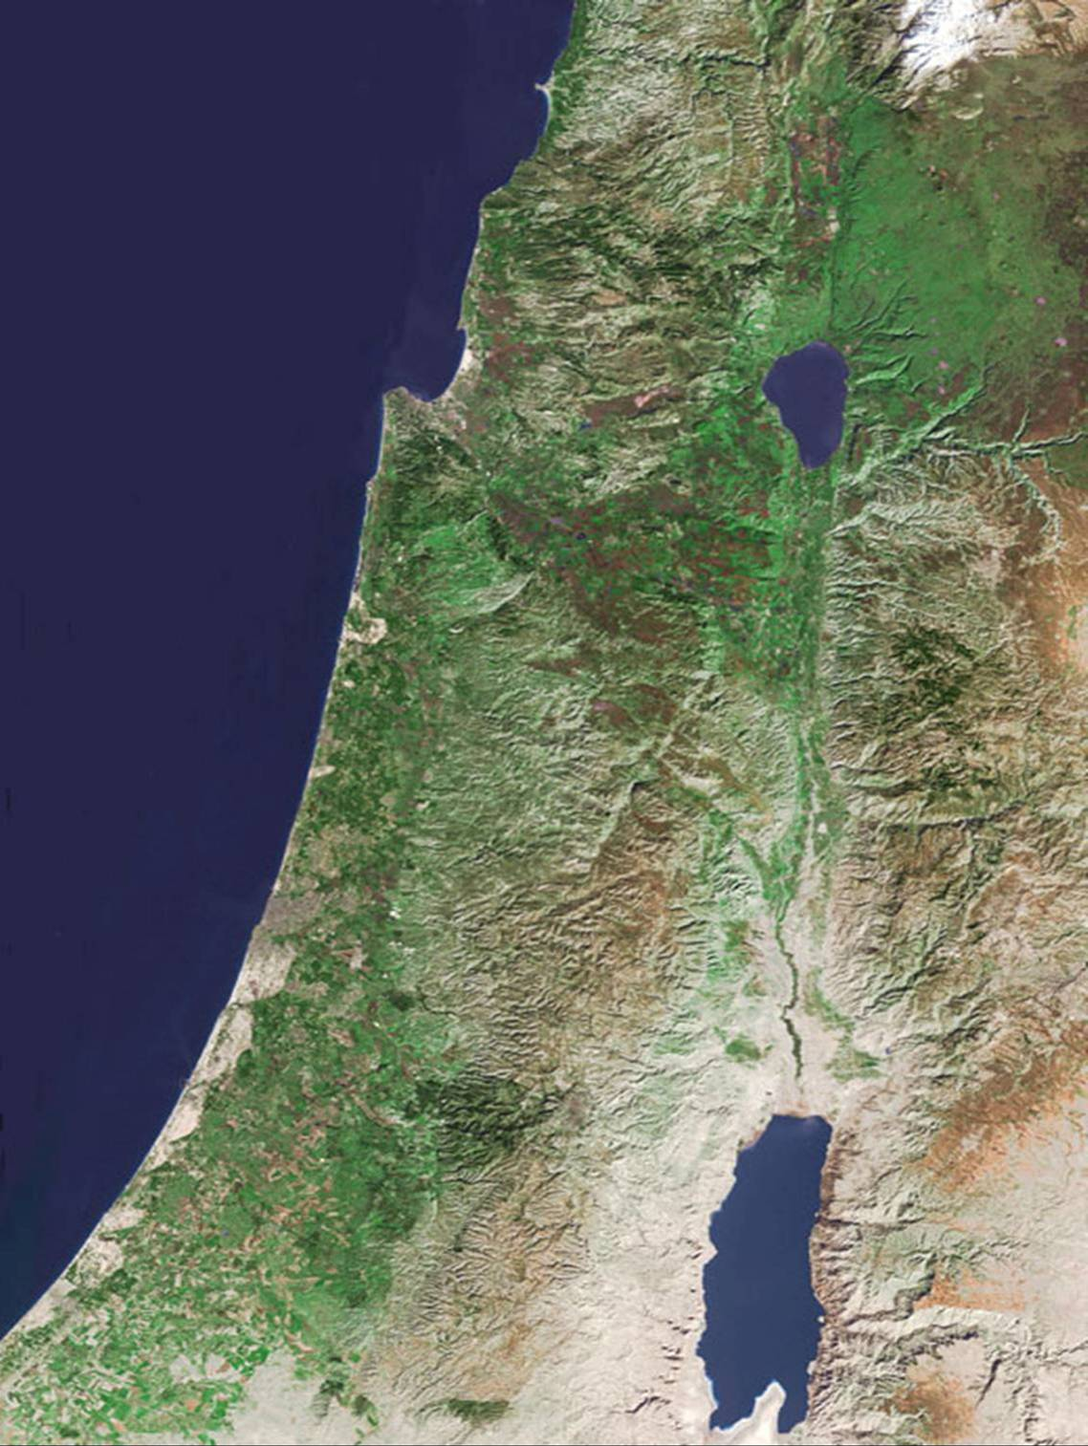
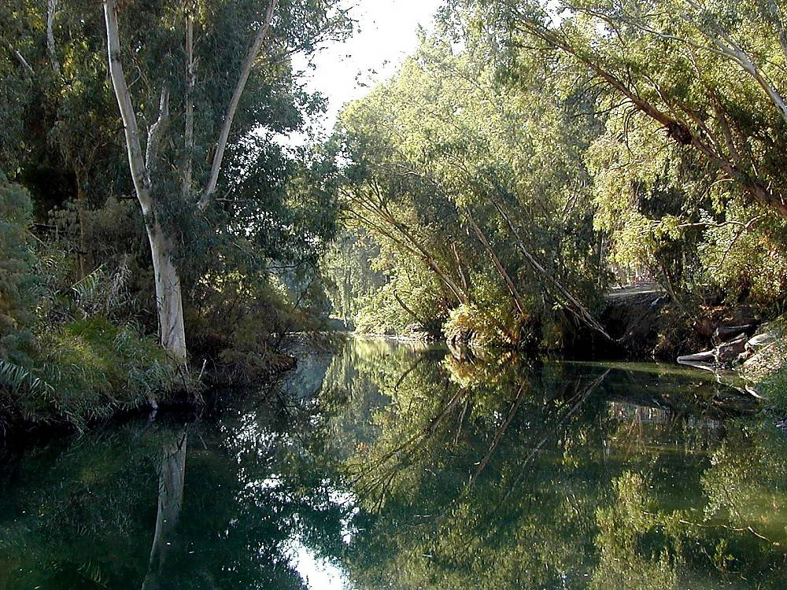
Matthew
Baptism
Mark
Mark 1:4
“in the wilderness ”

Slide 23
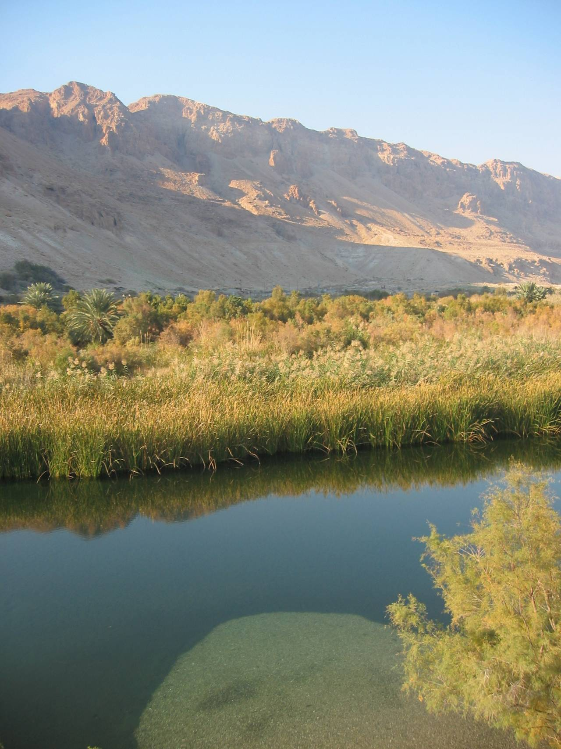
Matthew
Baptism
Mark
Mark 1:4
“in the wilderness ”
Mark 1:5
Mark 1:8
Mark 1:9
“in the river Jordan”
“with water”
“coming up out of water”

Slide 24
Matthew
Baptism
Mark
Mark 16:15-16
“universality ”
Go ye into all the world, and preach the gospel to the whole creation.
He that believeth and is baptized shall be saved; but he that disbelieveth shall be condemned.

Slide 25
Matthew
Mark
Baptism
Luke
Luke 3:3
And he came into all the region round about the Jordan, preaching the baptism of repentance unto remission of sins;

Slide 26
Matthew
Mark
Baptism
Luke
Luke 3:3
“repentance preceded ”
BAPTISM
“unto the remission of sins ”

Slide 27
Matthew
Mark
Baptism
Luke
John
John 3:22 & 23
Jesus baptized
“water”
“much water”

Slide 28
Matthew
Mark
Baptism
Luke
John
Acts
Acts 2:41
The Apostles did as Jesus commanded
Acts 2:38

Slide 29
Matthew
Mark
Baptism
Luke
John
Acts
Acts 8:12
Acts 8:36
“Water”
“went down into the water”
“came up out of the water”
?? What was done? What happened? ??

Slide 30
Baptism
In the River Jordan
Done with water
Much water
Went down into the water
“Baptism” (what ever that is)
After “baptism” -- Went up out of the water
A solemn and universal thing
Repentance preceded
Unto the remission of sins
*

Slide 31
Matthew
Mark
Baptism
Luke
John
Acts
Acts 9
Saul / Paul
Acts 10
Cornelius
Acts 16
Lydia
Acts 16
Philippian jailor

Slide 32
Matthew
Mark
Baptism
Luke
John
Acts
Romans
Romans 6:3-4
Or are ye ignorant that all we who were baptized into Christ Jesus were baptized into his death?
“baptized into Christ Jesus”
“baptized into his death”

Slide 33
Matthew
Mark
Baptism
Luke
John
Acts
Romans
Romans 6:3-4
Or are ye ignorant that all we who were baptized into Christ Jesus were baptized into his death?
We were buried therefore with him through baptism unto death: that like as Christ was raised from the dead through the glory of the Father, so we also might walk in newness of life.

Slide 34

Baptism
In the River Jordan
Done with water
Much water
Went down into the water
“Baptism” (what ever that is)
“Baptism”
After “baptism” -- Went up out of the water
A solemn and universal thing
Repentance preceded
Unto the remission of sins
*

Slide 35
Baptism
In the River Jordan
Done with water
Much water
Went down into the water
-- a burial
“Baptism” (what ever that is)
“Baptism”
After “baptism” -- Went up out of the water
Bury a man in water?
A solemn and universal thing
Repentance preceded
Unto the remission of sins
*

Slide 36
Matthew
Mark
Baptism
Luke
John
Acts
Romans
Romans 6:3-4
Baptism is a burial of a man in water

Slide 37
Matthew
Mark
Baptism
Luke
John
Acts
Romans
Colossians 2:12
Colossians
Having been buried with him in baptism, wherein ye were also raised with him through faith in the working of God, who raised him from the dead.

Slide 38
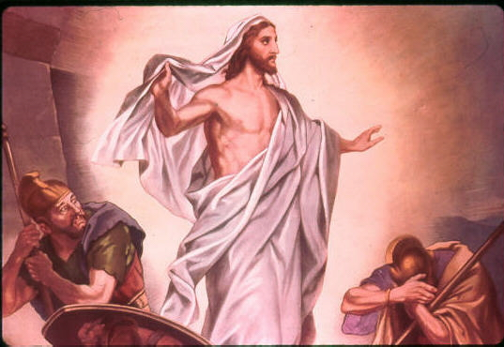
Matthew
Mark
Baptism
Luke
John
Acts
Romans
Colossians 2:12
Colossians

Slide 39
Matthew
Mark
Baptism
Luke
John
Acts
Romans
Colossians 2:12
Colossians
… buried with him in baptism,
… raised with him

Slide 40
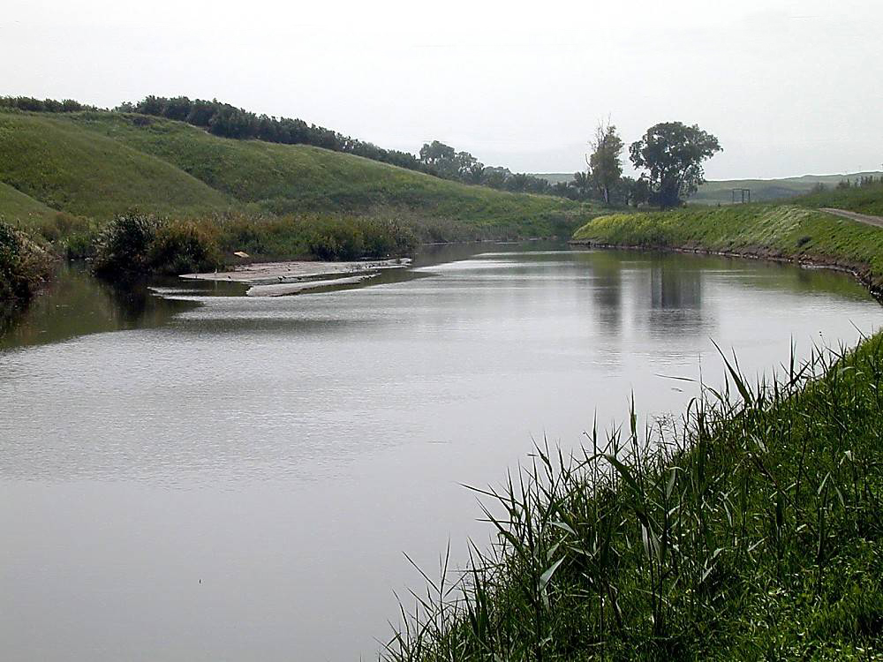
Baptism
In the River Jordan
Much water
Went down into the water
In baptism – buried with Christ
Raised to a new life
Come up out of the water

Slide 41
Baptism
BLESSINGS RECEIVED
1. Raised to a new life - Rom. 6
2. Unto remission of sins – Acts 2
3. Saved – Mark 16:16
4. Into Christ – Rom. 6
5. “Into the name of the Father, and the Son, and the Holy Spirit”

Slide 42
Baptism

Slide 43
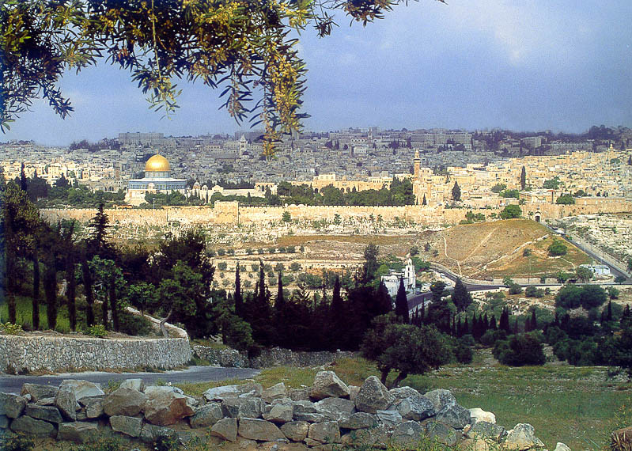

Slide 44
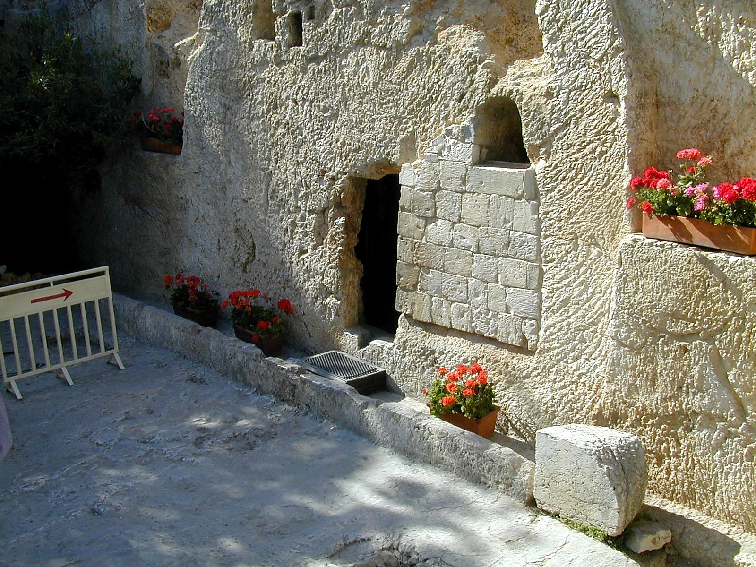

Slide 45
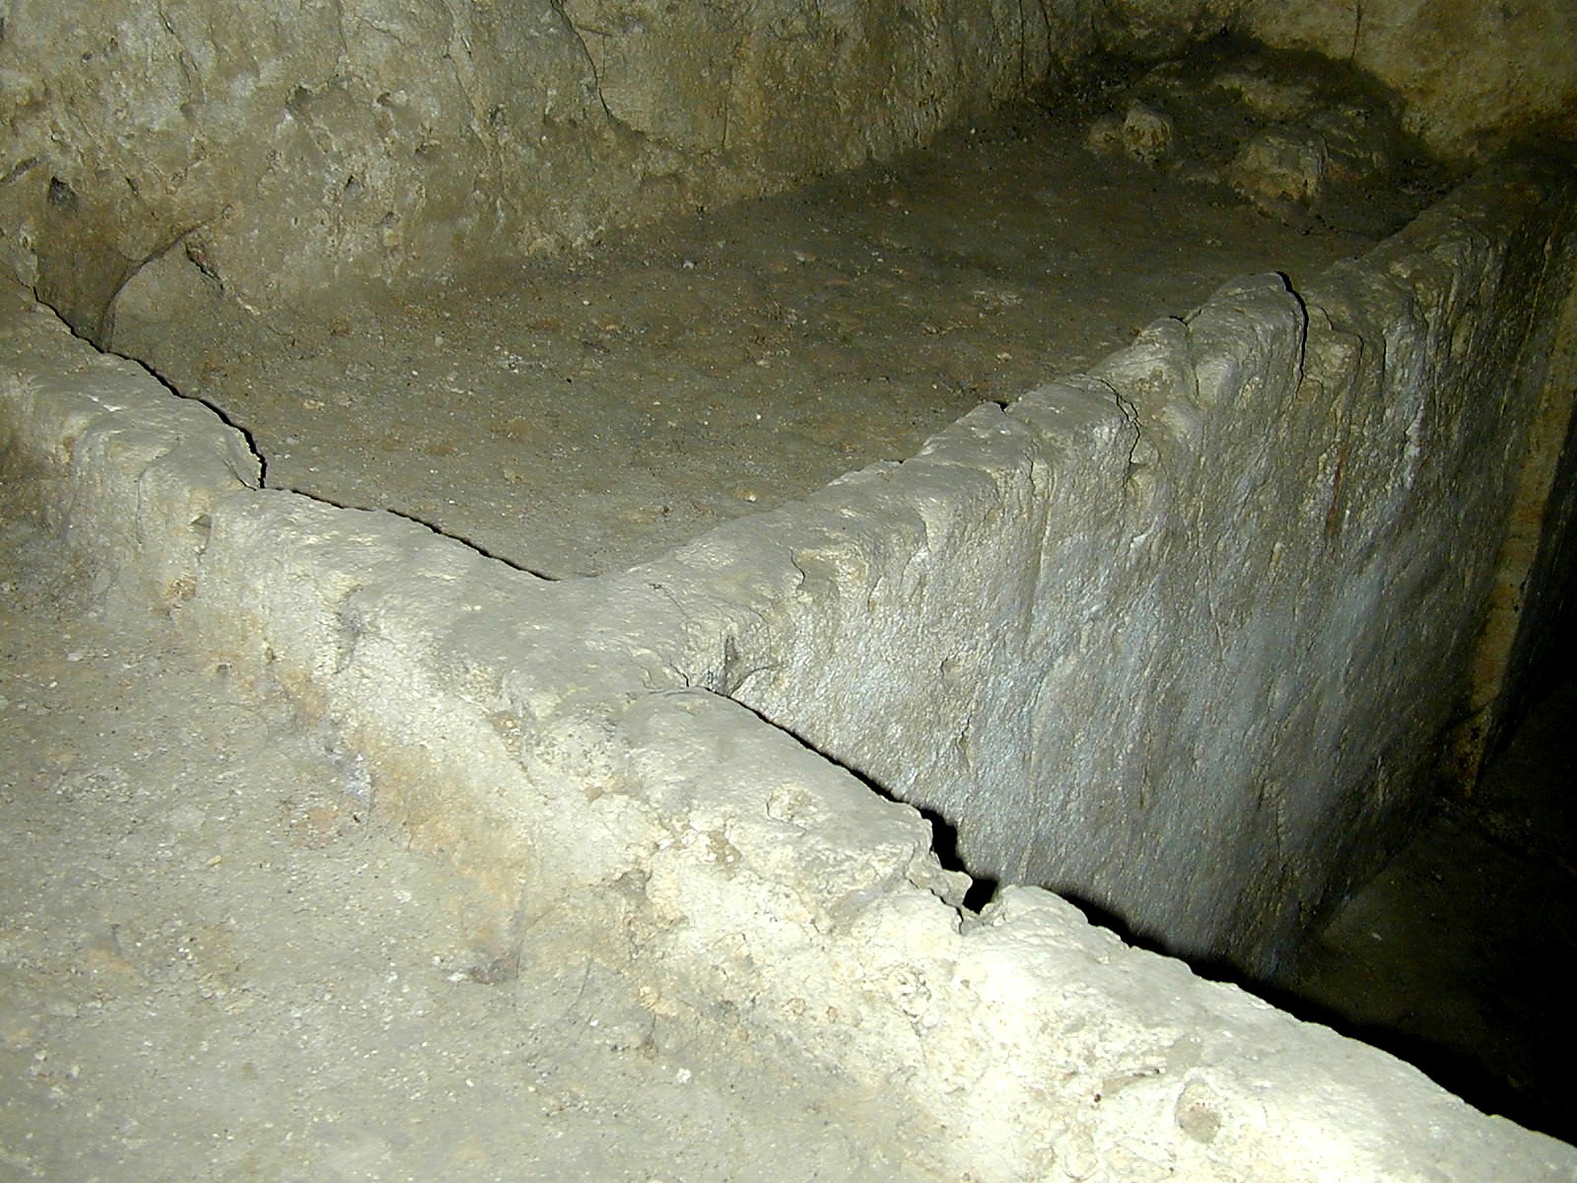

Slide 46
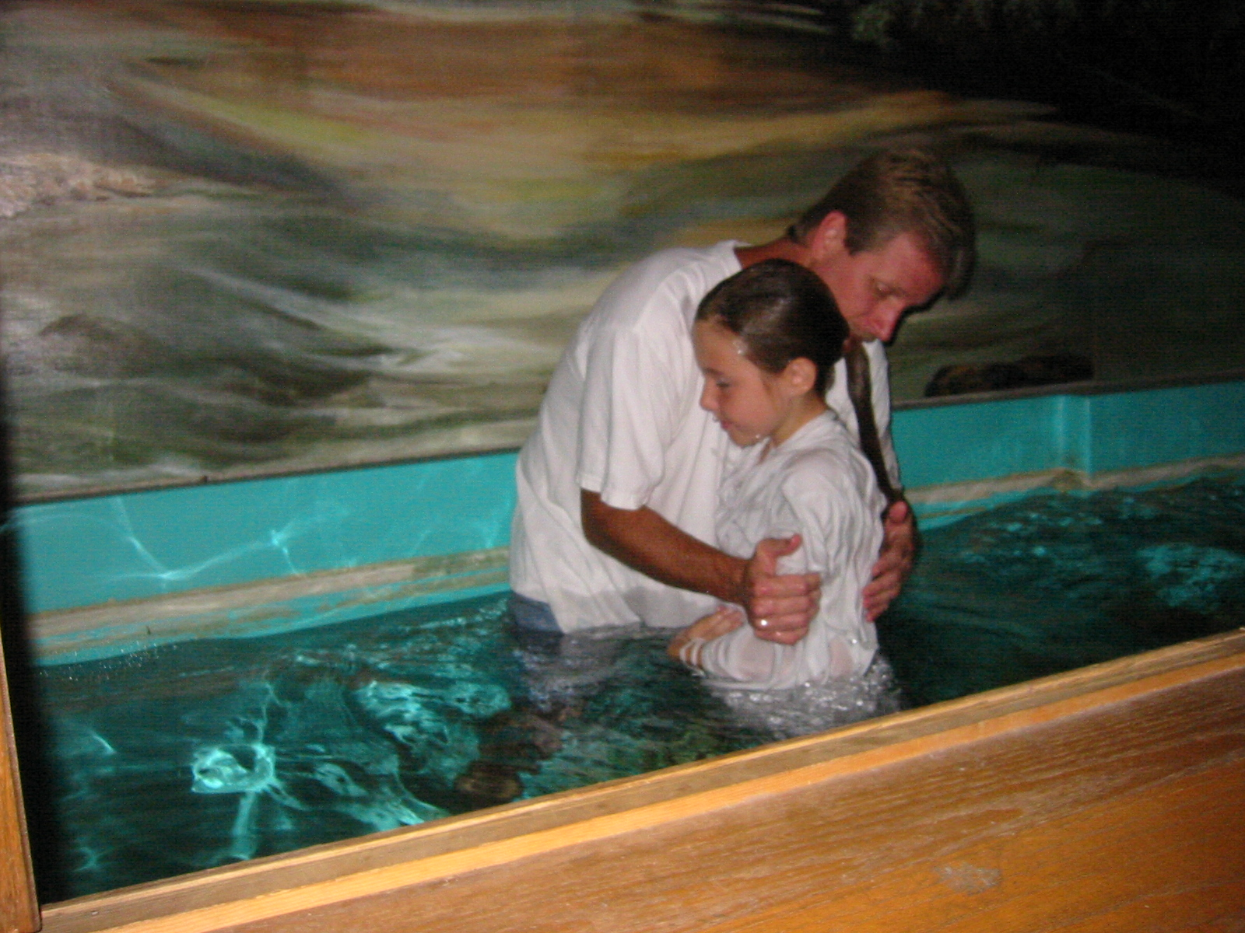
“Baptized into His death”
“Raised to a new life”

Slide 47
Baptism

Slide 48
Believe
Repent
Confess Christ
Baptism

Slide 50


