Slide 1
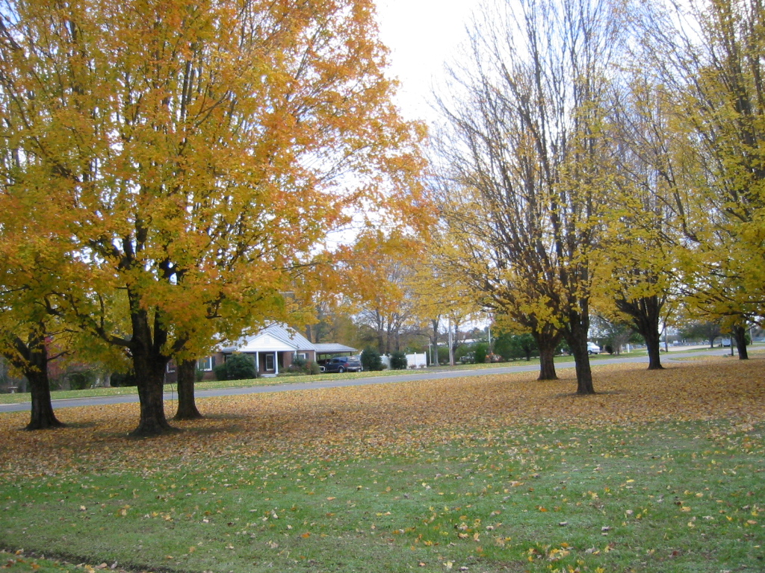
Sunday Nov. 28, 2004

Slide 2

Faith
Hebrews 11

Slide 3
Faith
Hebrews 11
Mark 16:15-16
Go ye into all the world, and preach the gospel to every creature.
He that believeth and is baptized shall be saved; but he that believeth not shall be damned.

Slide 4
Faith
Hebrews 11
1. What is faith?
2. How do I come by faith?
3. What part does faith play in my salvation?

Slide 5
1. What is faith?
Hebrews 11
DEFINITION
ILLUSTRATES

Slide 6
1. What is faith?
Hebrews 11
“Now faith is the substance of things hoped for, the evidence of things not seen.” KJV
DEFINITION
“Now faith is the assurance of things hoped for, the conviction of things not seen.” NASB

Slide 7
1. What is faith?
Hebrews 11
“Now faith is the substance of things hoped for, the evidence of things not seen.” KJV
DEFINITION
“Faith means being sure of the things we hope for and knowing that something is real even if we do not see it.” NCV

Slide 8
1. What is faith?
Hebrews 11
Edward Robinson
“Faith is confidence as to things hoped for; conviction as to things not seen.”
DEFINITION
1. Things hoped for
2. Things unseen

Slide 9
1. What is faith?
Hebrews 11
Edward Robinson
“Faith is confidence as to things hoped for; conviction as to things not seen.”
DEFINITION
1. Things hoped for -- confidence
1. Things hoped for -- confidence
2. Things unseen -- conviction

Slide 10
1. What is faith?
Hebrews 11
Things Unseen
DEFINITION
HELL
Things
Hoped
For
Heaven

Slide 11
1. What is faith?
Hebrews 11
“Conviction”
Things Unseen
DEFINITION
HELL
Things
Hoped
For
Heaven
“Confidence”

Slide 12
1. What is faith?
Hebrews 11
ILLUSTRATIONS
Hebrews 11:1-14
ILLUSTRATIONS
The Worlds
Abel
Enoch
Noah
Abraham

Slide 13
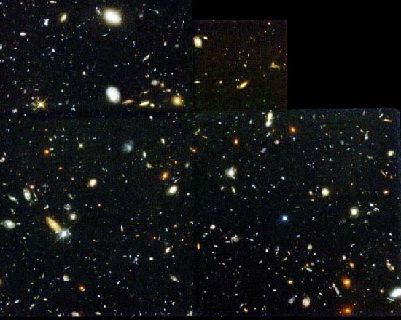
1. What is faith?
Hebrews 11:3
“By faith we understand that the worlds were prepared by the word of God, so that what is seen was not made out of things which are visible.”
ILLUSTRATIONS

Slide 14
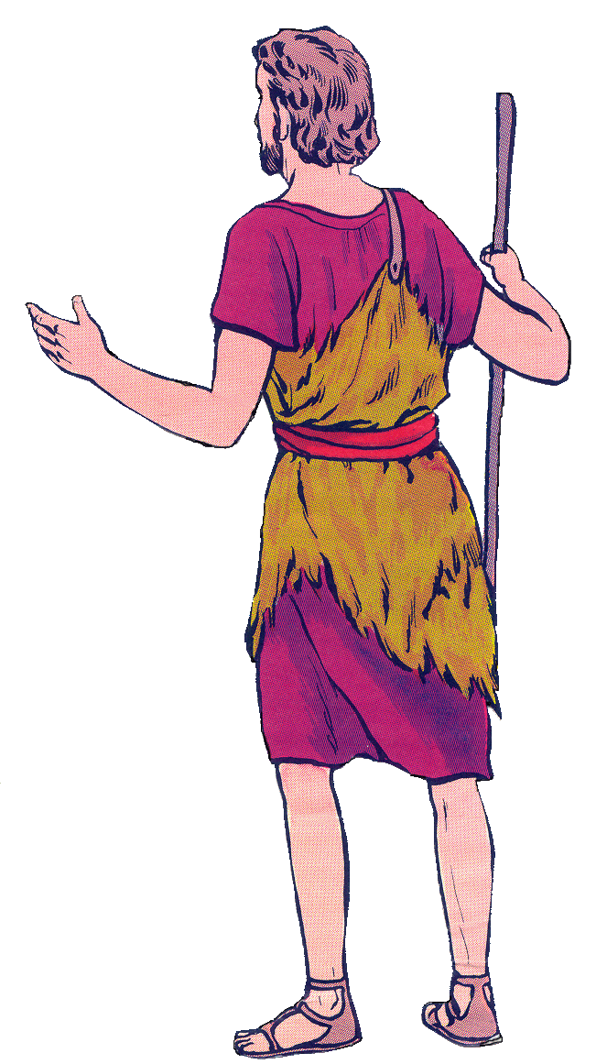

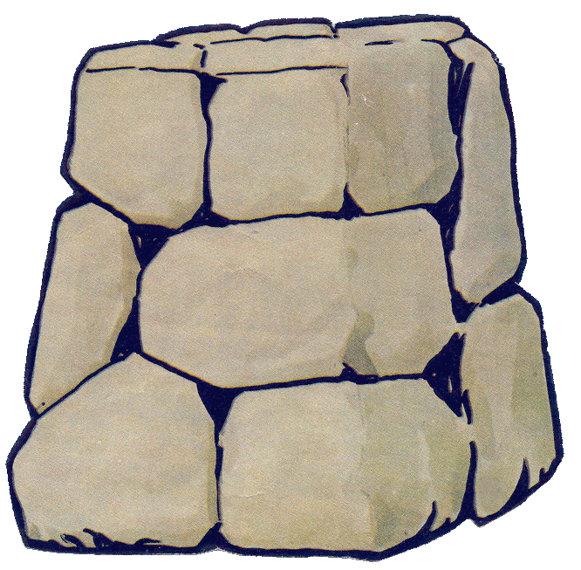
1. What is faith?
Hebrews 11:4
“By faith Abel offered to God a better sacrifice than Cain, through which he obtained the testimony that he was righteous, God testifying about his gifts, and through faith, though he is dead, he still speaks.”
ILLUSTRATIONS

Slide 15
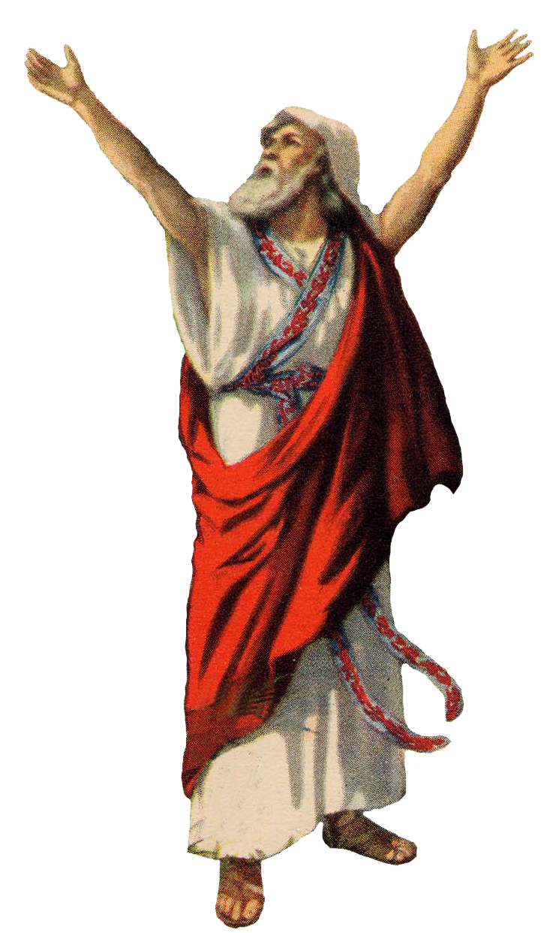
1. What is faith?
Hebrews 11:5
“By faith Enoch was translated that he should not see death; and was not found, because God had translated him: for before his translation he had this testimony, that he pleased God.” KJV
ILLUSTRATIONS
“By faith Enoch was taken up so that he would not see death;…” NASB

Slide 16
1. What is faith?
Hebrews 11:6
Enoch had Faith
“But without faith it is impossible to please him: for he that cometh to God must believe that he is, and that he is a rewarder of them that diligently seek him.” KJV
ILLUSTRATIONS

Slide 17
1. What is faith?
Hebrews 11:5
Enoch had Faith
He believed that God is –
conviction of the unseen
He believed God is a rewarder—
confidence in his hope
ILLUSTRATIONS

Slide 18
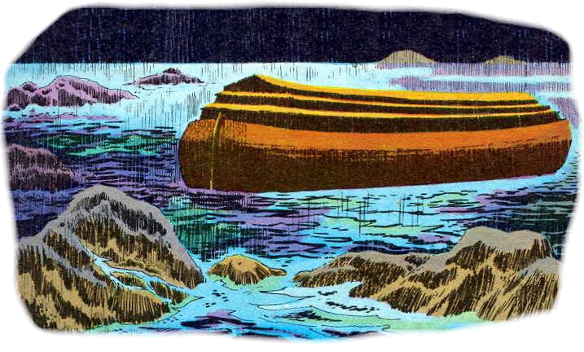
1. What is faith?
Hebrews 11:7
“By faith Noah, being warned of God of things not seen as yet, moved with fear, prepared an ark to the saving of his house;”
ILLUSTRATIONS

Slide 19
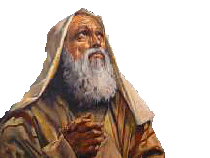
1. What is faith?
Hebrews 11:8
“ By faith Abraham, when he was called to go out into a place which he should after receive for an inheritance, obeyed; and he went out, not knowing whither he went.”
ILLUSTRATIONS

Slide 20
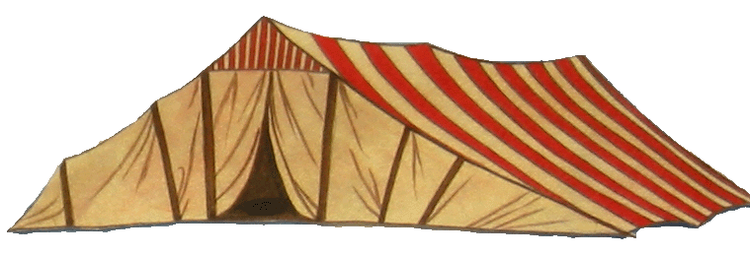
1. What is faith?
Hebrews 11:9-10
“By faith he lived as an alien in the land of promise, as in a foreign land, dwelling in tents with Isaac and Jacob, fellow heirs of the same promise; for he was looking for the city which has foundations, whose architect and builder is God.” NASB
ILLUSTRATIONS

Slide 21
Faith
Hebrews 11
1. What is faith?
2. How do I come by faith?
3. What part does faith play in my salvation?

Slide 22
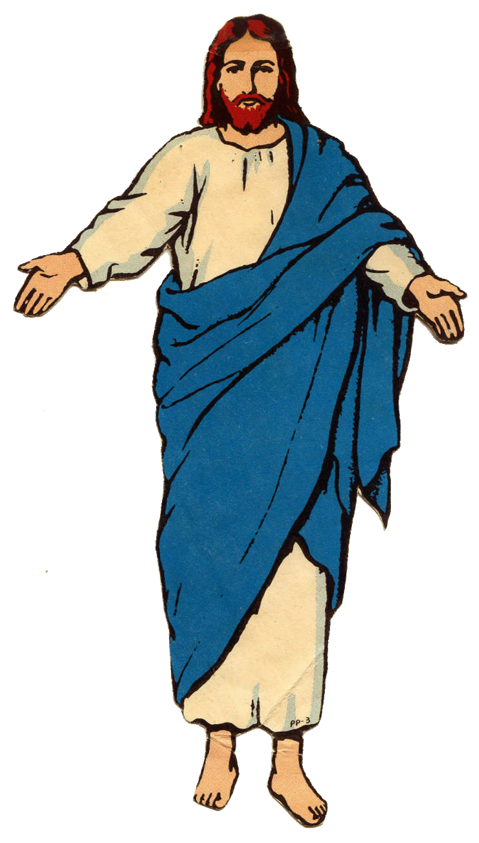
Faith
Hebrews 11
What is the object of our faith?
“Simon Peter answered, "You are the Christ, the Son of the living God." And Jesus said to him, "Blessed are you, Simon Barjona, because flesh and blood did not reveal his to you, but My Father who is in heaven.”
Matthew 16:16-17 NASB

Slide 23
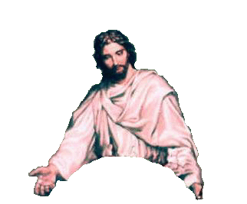
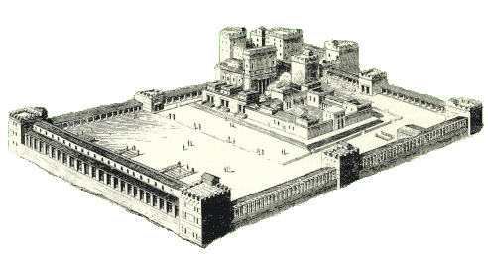

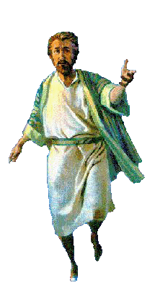
Faith
Hebrews 11
Jesus paints a picture --

Slide 24
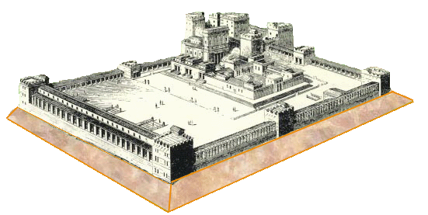
Faith
Hebrews 11
Jesus paints a picture --
Jesus Christ is the Son of God
Rock – Truth - Foundation

Slide 25
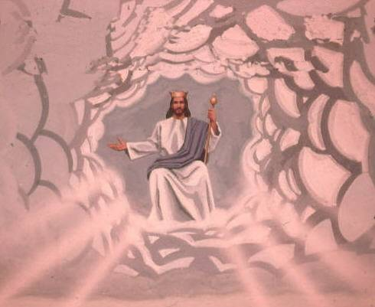
Faith
Hebrews 11
Jesus Christ, the Son of the Living God
Head over all things . . .

Slide 26
Faith
Hebrews 11
Jesus Christ, the Son of the Living God
Head over all things . . .
Our FAITH is a “conviction” of these unseen truths

Slide 27
Faith
Hebrews 11
Jesus Christ, the Son of the Living God
Head over all things . . .
Our hope rests on Him, our “confidence” is in Him.
This is our FAITH!

Slide 28

Faith
Hebrews 11
2. How does one come to faith?
“In the beginning God created the heavens and the earth.”
Genesis 1:1

Slide 29
Faith
Hebrews 11
2. How does one come to faith?
God Revealed His Will

Slide 30
Faith
Hebrews 11
2. How does one come to faith?
God Revealed His Will
“Faith comes by hearing . . .”
Rom. 10:17
Enoch

Slide 31
Faith
Hebrews 11
2. How does one come to faith?

Slide 32
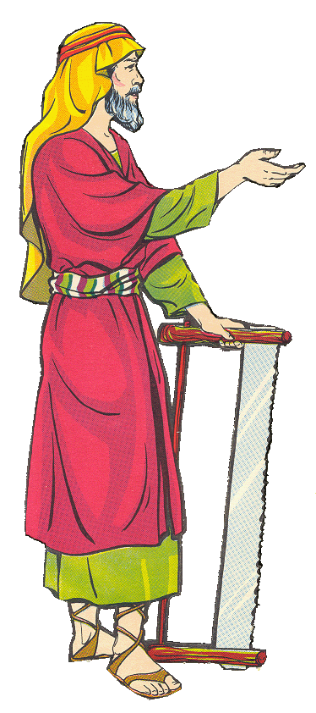

Faith
Hebrews 11
2. How does one come to faith?
God told him . . .
Genesis 6:7, 13-14

Slide 33

Faith
Hebrews 11
2. How does one come to faith?
God told him
“Conviction”
“Confidence”
Genesis 12:1

Slide 34

Faith
Hebrews 11
2. How does one come to faith?

Slide 35
Faith
Hebrews 11
2. How does one come to faith?

Slide 36
Faith
Hebrews 11
2. How does one come to faith?
John 5:24 “ Verily, verily, I say unto you, He that heareth my word, and believeth on him that sent me, hath everlasting life,

Slide 37
Faith
Hebrews 11
2. How does one come to faith?
John 6:45 “It is written in the prophets, And they shall be all taught of God. Every man therefore that hath heard, and hath learned of the Father, cometh unto me.”

Slide 38

Faith
Hebrews 11
2. How does one come to faith?
“Conviction” and “Confidence”
“Faith comes by hearing, and hearing by the word of God.” Romans 10:17.
“Thy word have I hid in my heart, that I might not sin against Thee.”
Psalms 119:11.

Slide 39
Faith
Hebrews 11
3. How does faith relate to salvation?
Abel
Noah
Enoch
Our Faith
Abraham

Slide 40


Faith
Hebrews 11
3. How does faith relate to salvation?
Jesus Christ is the object of our faith?
“Conviction” and “Confidence”

Slide 41
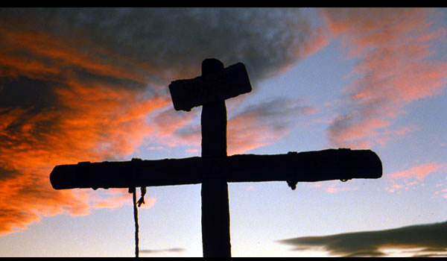
Faith
Hebrews 11
3. How does faith relate to salvation?
Jesus Christ is the object of our faith?
“Conviction” and “Confidence”

Slide 42
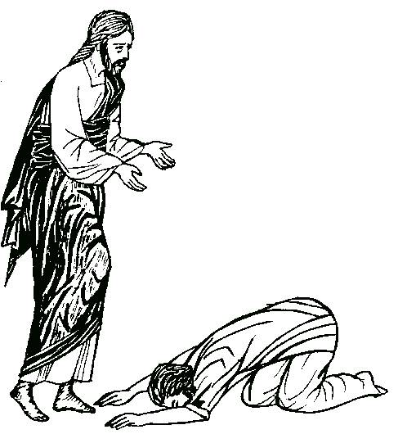
Faith
Hebrews 11
3. How does faith relate to salvation?
We must act in harmony with our faith!
“Conviction” and “Confidence”

Slide 43
Faith
Hebrews 11
Romans 12:1. “I beseech you therefore, brethren, by the mercies of God, that ye present your bodies a living sacrifice, holy, acceptable unto God,…”

Slide 44
Faith
Hebrews 11
Rev. 2:10b “ be thou faithful unto death, and I will give thee a crown of life.”

Slide 45
Faith
Hebrews 11
John 14:2, 3
“I go to prepare a place for you. And if I go and prepare a place for you, I will come again, and receive you unto myself; that where I am, there ye may be also.”

Slide 46
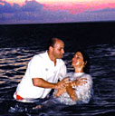
Faith
Hebrews 11
Mark 16:15-16
He that believeth and is baptized shall be saved--

Slide 48
Faith
Hebrews 11

