Slide 1

The Good Confession

Slide 2

Romans 10:9-10
9 That if thou shalt confess with thy mouth the Lord Jesus, and shalt believe in thine heart that God hath raised him from the dead, thou shalt be saved.
10 For with the heart man believeth unto righteousness; and with the mouth confession is made unto salvation.

Slide 3
The Good Confession
1 Timothy 6:12-14

Slide 4
1Timothy 6:12-14
12 Fight the good fight of faith, lay hold on eternal life, whereunto thou art also called, and hast professed a good profession before many witnesses.
13 I give thee charge in the sight of God, who quickeneth all things, and before Christ Jesus, who before Pontius Pilate witnessed a good confession;
14 That thou keep this commandment without spot, unrebukeable, until the appearing of our Lord Jesus Christ:

Slide 5
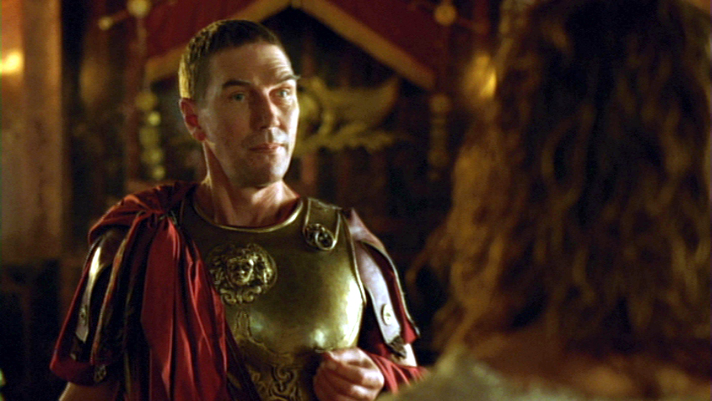
The Good Confession

Slide 6
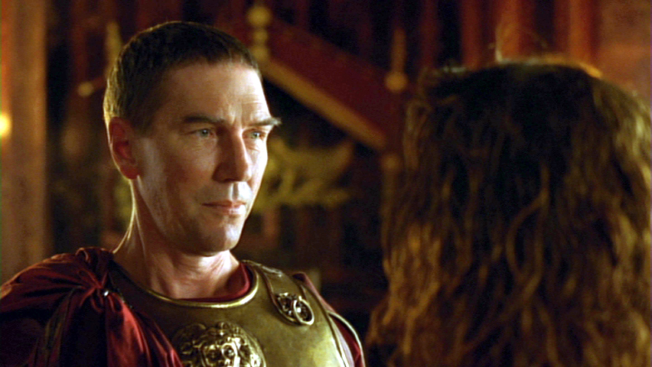
The Good Confession

Slide 7
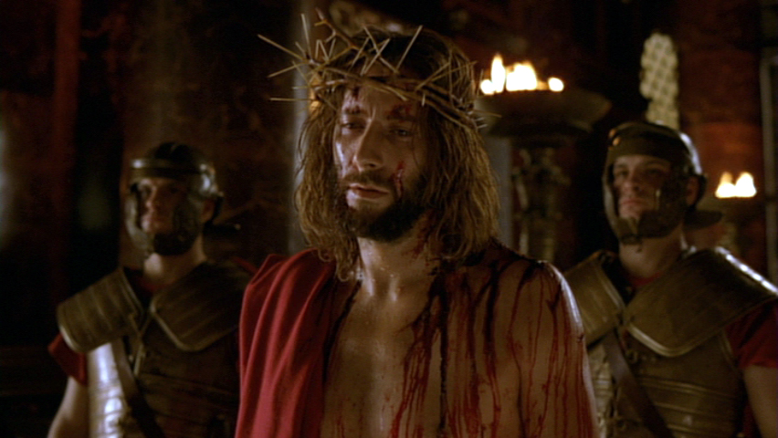
The Good Confession
Matt. 26:63-66;
Luke 22:70;
John 19:7.

Slide 8
The Good Confession
What The Good Confessions Means
Notes:
What the Good Confession Means

Slide 9
The Good Confession
What The Good Confessions Means
1. Jesus is “the Christ”
the anointed Messiah
2. Jesus is “the Son of God”
3. Jesus is “the Son of
the Living God”
Notes:
What the Good Confession Means

Slide 10
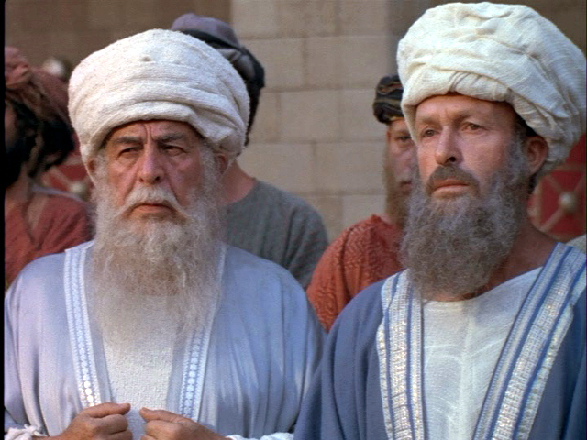
The Good Confession
What The Good Confessions Means
So filled with meaning . . .
“ that if any man did confess that he was Christ, he should be put out of the synagogue”
John 9:22
Notes:
What the Good Confession Means

Slide 11
The Good Confession
The Evidence For Its Truth
“What think ye of Jesus Christ;
whose Son is He?”
Matthew 22:42
Notes:
2 The Evidence For Its Truth

Slide 12

The Good Confession
The Evidence For Its Truth
Friends
Enemies
Good Men and Bad
Hypocritical and Indifferent men
Rulers
Angels and Demons
Notes:
2 The Evidence For Its Truth

Slide 13
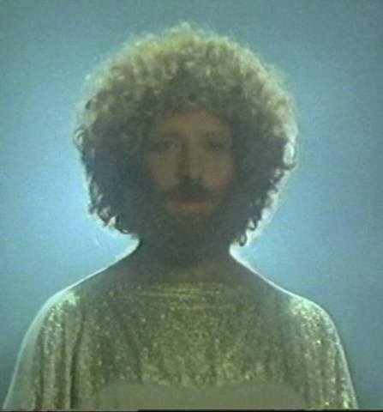
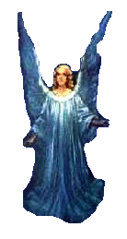
The Good Confession
The Witness of N.T. Characters
Angels
Matthew 1:20-21
Luke 1:26
Notes:
3 The Witnesses of New Testament Characters

Slide 14


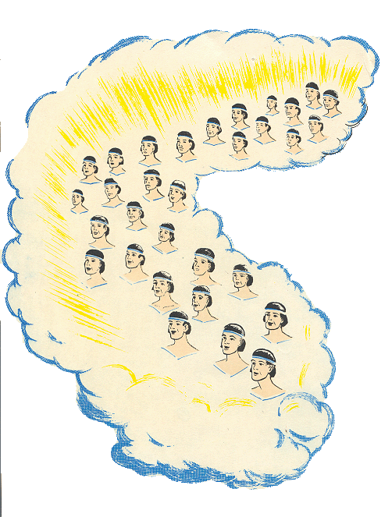
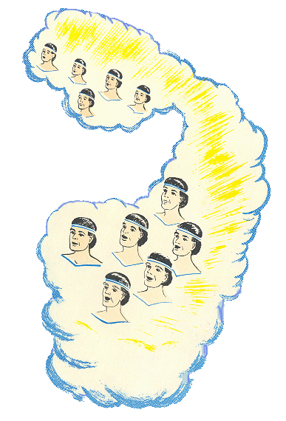
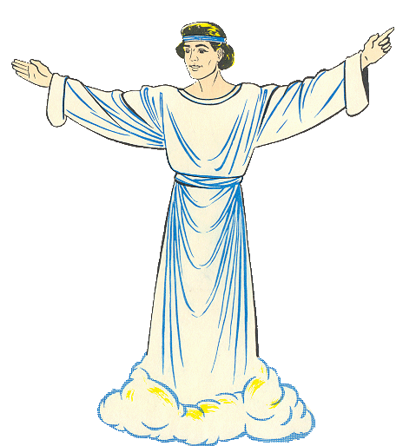
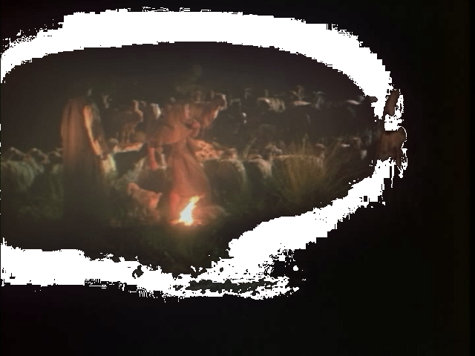
The Good Confession

Slide 15
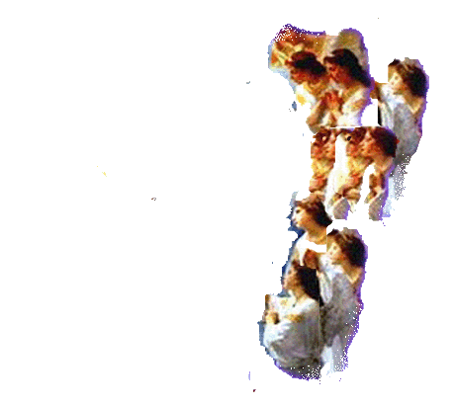
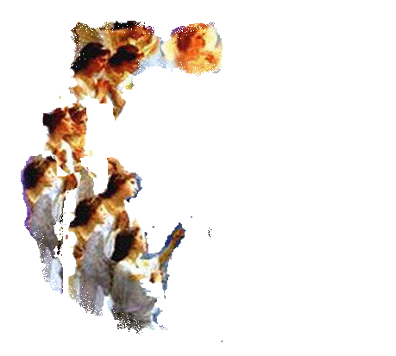
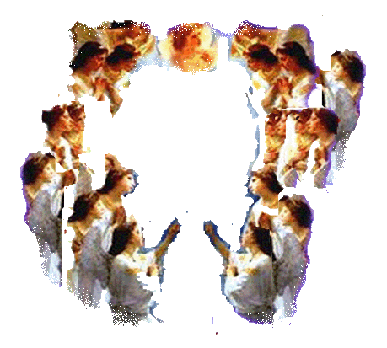

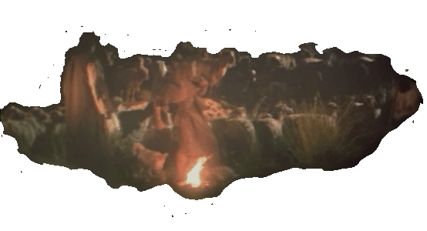
The Good Confession
Luke 2:13
Luke 2:10

Slide 16
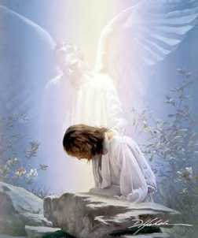
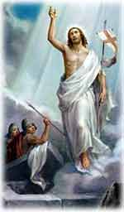
The Good Confession
The Witness of N.T. Characters
Angels
Luke 22:43
Matthew 28:2
Notes:
3 The Witnesses of New Testament Characters

Slide 17
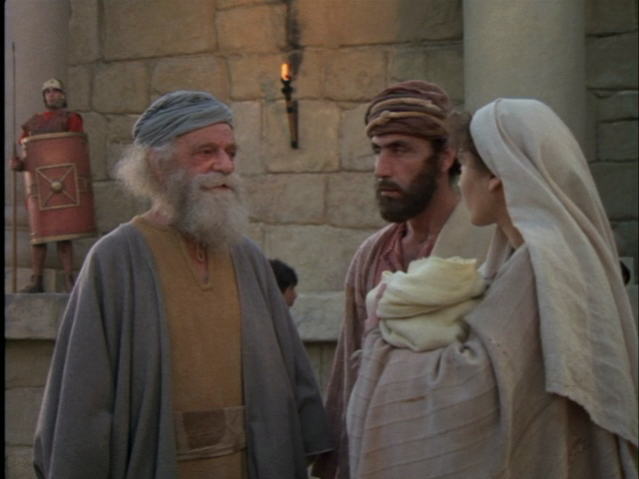
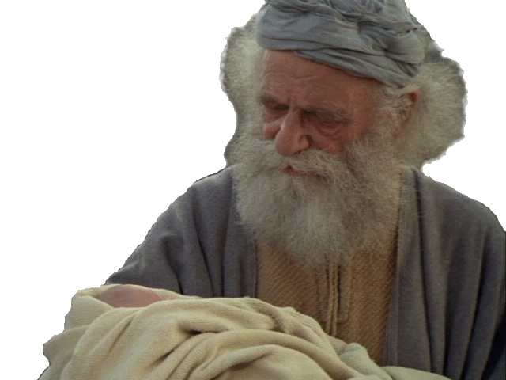
The Good Confession
The Witness of N.T. Characters
Simeon – in the temple
Luke 2:25-35
Notes:
3 The Witnesses of New Testament Characters

Slide 18
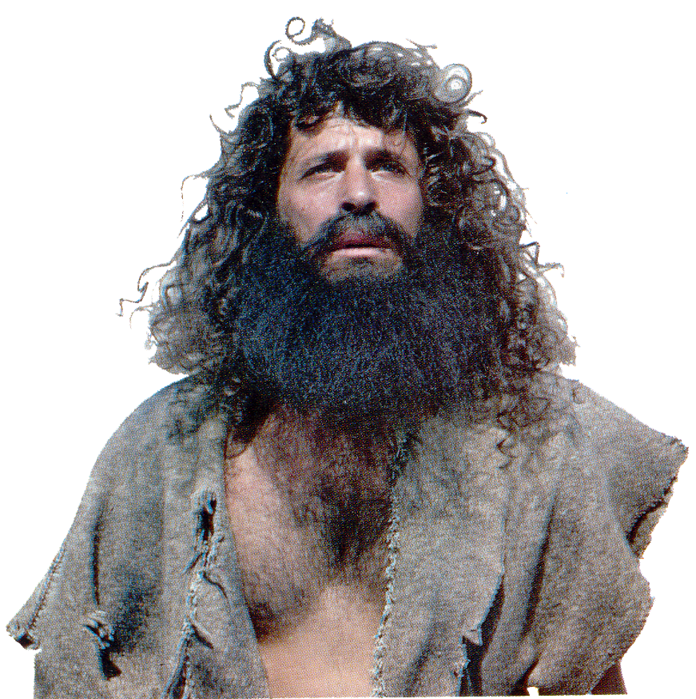
The Good Confession
The Witness of N.T. Characters
John the Baptist –
voice in the wilderness
John 1:31-34
Notes:
3 The Witnesses of New Testament Characters

Slide 19
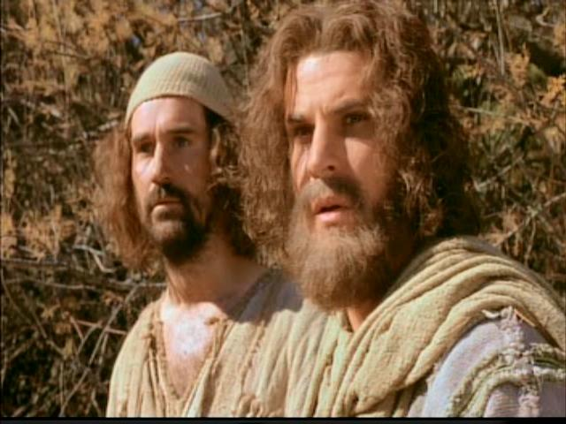
The Good Confession
The Witness of N.T. Characters
John’s disciples
John 1:45, 49
John and Andrew
Notes:
3 The Witnesses of New Testament Characters

Slide 20
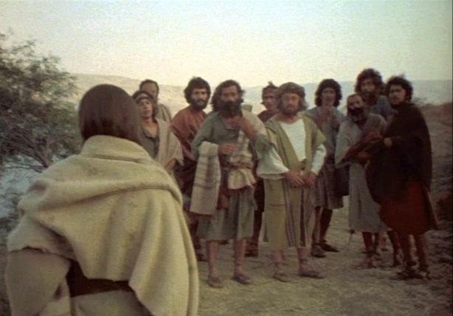
The Good Confession
The Foundation Truth of Christianity
Matthew 16:13-16
Notes:
4 The Foundation Truth of Christianity

Slide 21
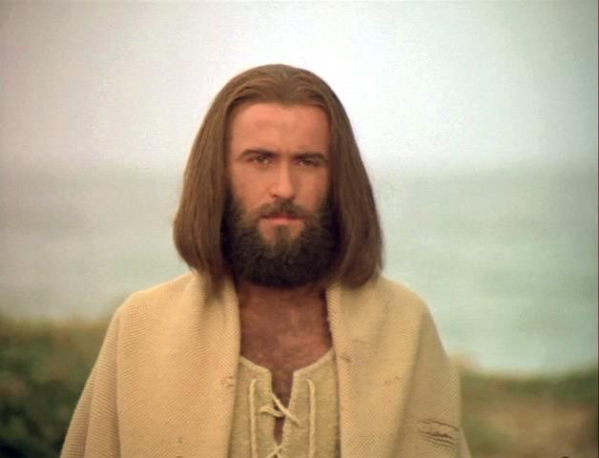
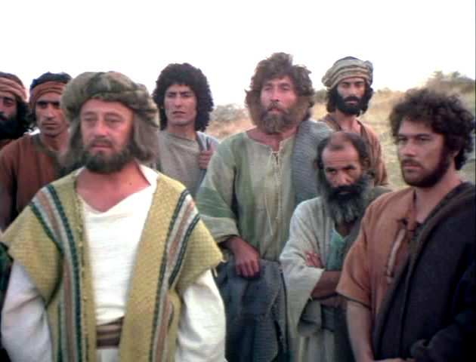
The Good Confession
The Foundation Truth of Christianity
Matthew 16:13-16
Notes:
4 The Foundation Truth of Christianity

Slide 22
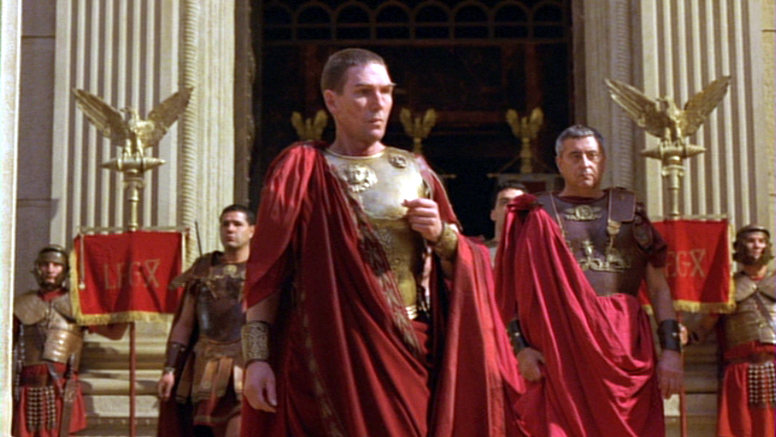
The Good Confession
Other Witnesses
Pontius Pilate
Luke 23:14
Notes:
5. Other Witnesses

Slide 23
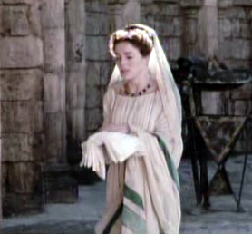
The Good Confession
Other Witnesses
Pilate’s wife
Matthew 27:19
Notes:
5. Other Witnesses

Slide 24
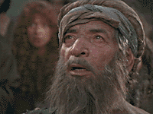
The Good Confession
Other Witnesses
Blind Bartimaeus
Mark 10:46-48
Notes:
5. Other Witnesses

Slide 25
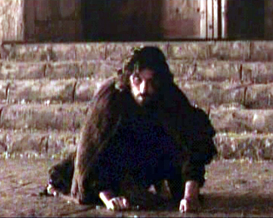
The Good Confession
Other Witnesses
Judas
Matthew 27:4
Notes:
5. Other Witnesses

Slide 26
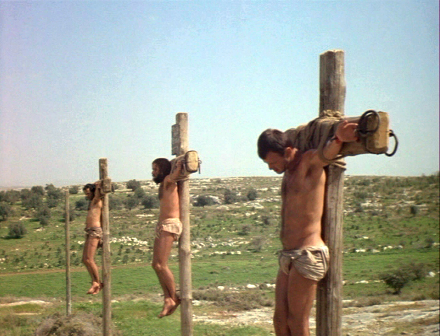
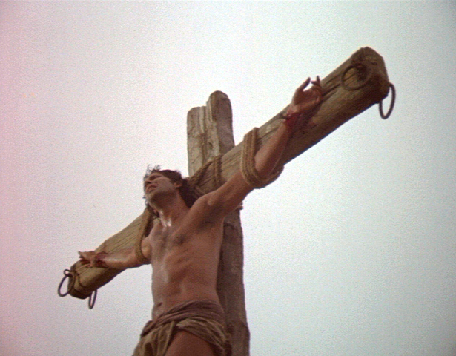
The Good Confession
Other Witnesses
Thief
Luke 23:41
Notes:
5. Other Witnesses

Slide 27
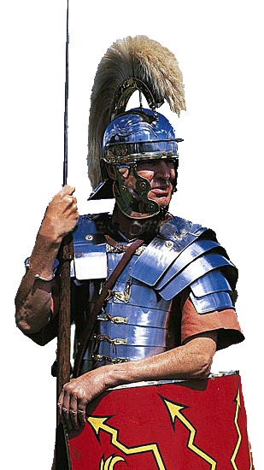
The Good Confession
Other Witnesses
Centurion
Matthew 27:54
Notes:
5. Other Witnesses

Slide 28
The Good Confession
Other Witnesses
Centurion
Matthew 27:54
Notes:
5. Other Witnesses

Slide 29
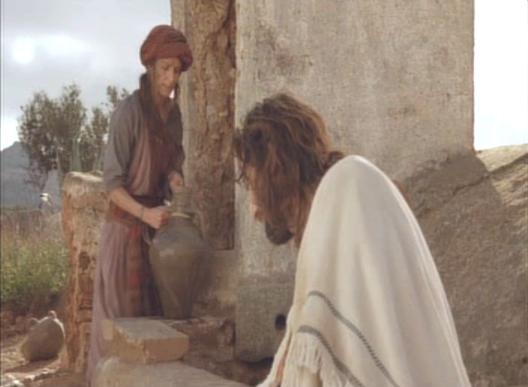
The Good Confession
The Most Important Witness
Jesus
John 4:25-29
Mark 14:61-64
Notes:
6. The Most Important Witness

Slide 30

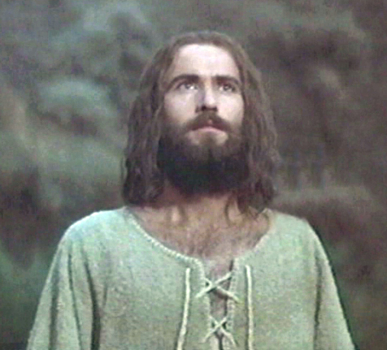
The Good Confession
The Most Important Witness
GOD
Matthew 3:17
Notes:
6. The Most Important Witness

Slide 31
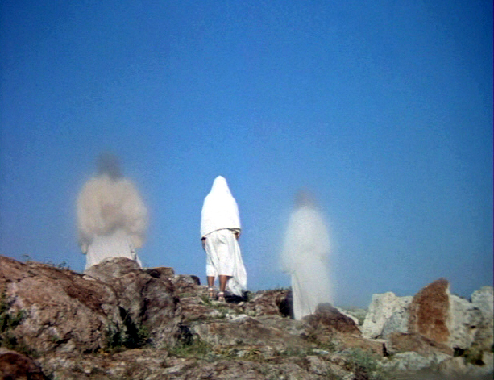
The Good Confession
The Most Important Witness
GOD
Matthew 17:5
Notes:
6. The Most Important Witness

Slide 32
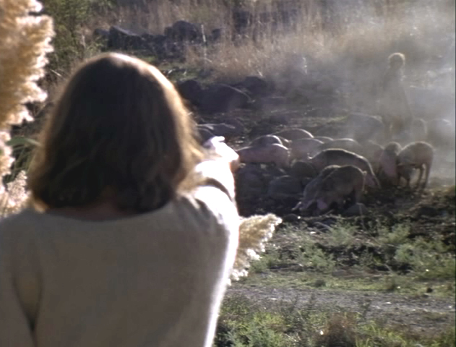
The Good Confession
Other Witnesses
Demons
Matthew 8:28-34
Notes:
5. Other Witnesses

Slide 33
The Good Confession
Other Witnesses
Demons
Matthew 8:28-34
Notes:
5. Other Witnesses

Slide 34
The Good Confession
Why Call It The "Good" Confession?
First: the evidence is overwhelming, and many died for their witness to its truth.
Notes:
7. Why Call It The “Good Confession”

Slide 35
The Good Confession
Why Call It The "Good" Confession?
Second: … because it leads to everlasting life.
Romans 10:10
Notes:
7. Why Call It The “Good Confession”

Slide 36
The Good Confession
Why Call It The "Good" Confession?
Third: … because God’s name is behind the decree to confess Jesus
Philippians 2:9-11
Notes:
7. Why Call It The “Good Confession”

Slide 37
The Good Confession
Why Call It The "Good" Confession?
Fourth: … because it contains a summary of the whole truth of Christianity
1 John 4:15
Notes:
7. Why Call It The “Good Confession”

Slide 38


The Good Confession
Are You Willing To Confess Him?
Notes:
Are You Willing To Confess Him?

Slide 39
The Good Confession
Two Different Kinds of Confessions
1. The confession the alien sinner makes of his belief in Jesus as the Son of God.
2. The confession of sins the erring Christian makes when he repents and prays to be restored.

Slide 40
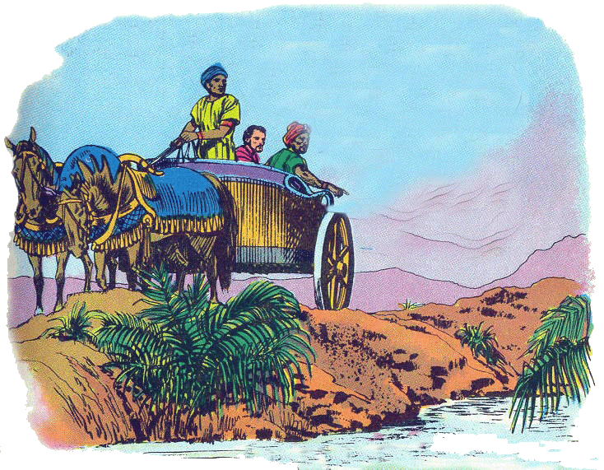
The Good Confession
Two Different Kinds of Confessions
1. The confession the alien sinner makes of his belief in Jesus as the Son of God.
Acts 8

Slide 41
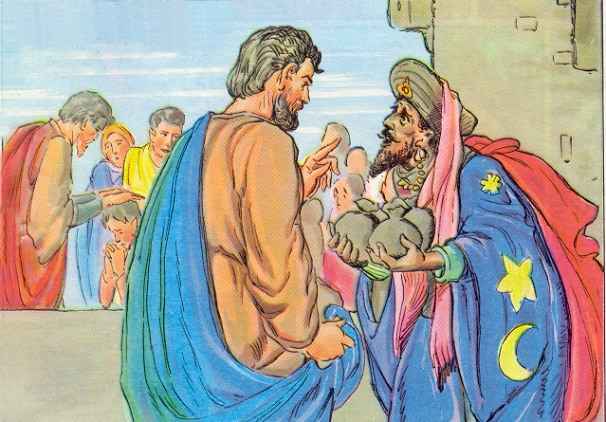
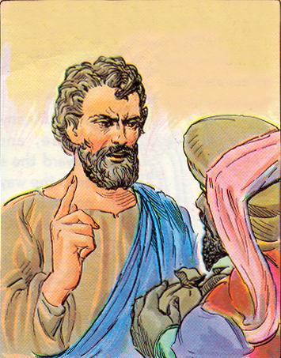
The Good Confession
Two Different Kinds of Confessions
Acts 8
2. The confession of sins the erring Christian makes when he repents and prays to be restored.

Slide 42
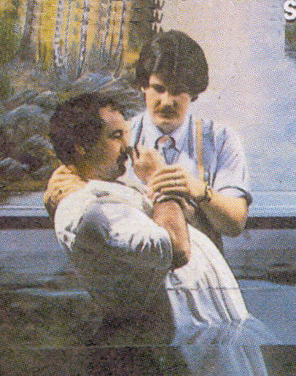
The Good Confession
Are You Willing To Confess Him?
NOT a Confession …
“that God has for Christ’s sake already pardoned your sins”
But a confession that you believe in Jesus as the Son of God
Notes:
Are You Willing To Confess Him?

Slide 43
The Good Confession
Are You Willing To Confess Him?
These are the Lord’s commands …
1. That men BELIEVE in Christ
2. Turn away from sin in REPENTANCE
3. CONFESS their faith in Christ
4. Be buried in BAPTISM for the remission of sins
Notes:
Are You Willing To Confess Him?

Slide 44

The Good Confession
Are You Willing To Confess Him?
Jesus said:
“ Whosoever therefore shall confess me before men, him will I confess also before my Father which is in heaven. But whosoever shall deny me before men, him will I also deny before my Father which is in heaven.”
Notes:
Are You Willing To Confess Him?

Slide 45
Jesus said:
“ Whosoever therefore shall confess me before men, him will I confess also before my Father which is in heaven. But whosoever shall deny me before men, him will I also deny before my Father which is in heaven.”
Are You Willing To Confess Him?

Slide 47


Slide 48
The Good Confession
What The Good Confessions Means
The Evidence For Its Truth
The Witness of N.T. Characters
The Foundation Truth of Christianity
Other Witnesses
The Most Important Witness

Slide 49
The Good Confession
Why Call It The "Good" Confession?
Are You Willing To Confess Him?
The Foundation Truth of Christianity
Other Witnesses
The Most Important Witness

Slide 50
The Good Confession

