Slide 1


VBS – 2004
Roebuck Parkway

Slide 2


Slide 3
Lesson Themes:
Jacob: A Pioneer With Purpose
Elijah: A Pioneer Of Commitment
Daniel: A Pioneer Of Purity
Nehemiah: A Pioneer Of Leadership
John the Baptist: A Pioneer With A Message

Slide 4
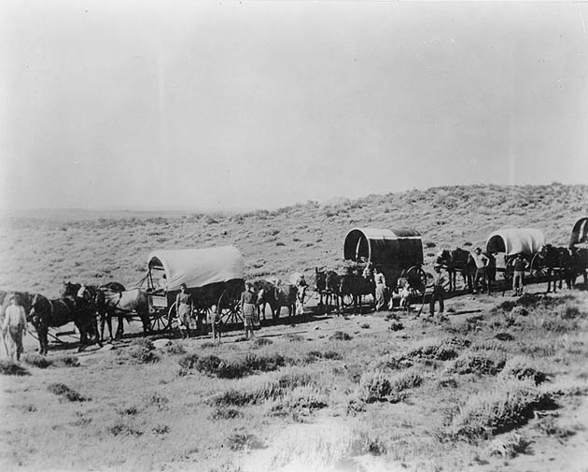
Pioneers heading for the new Frontier
A Pioneer by definition is a leader

Slide 5
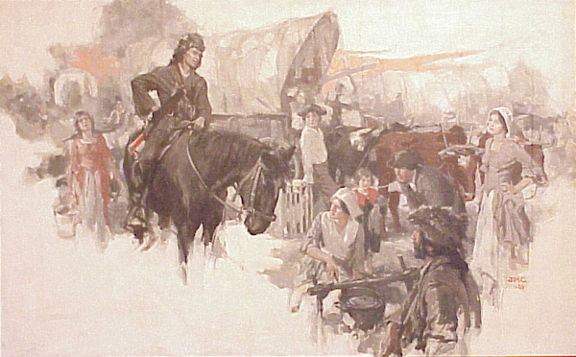

Slide 6
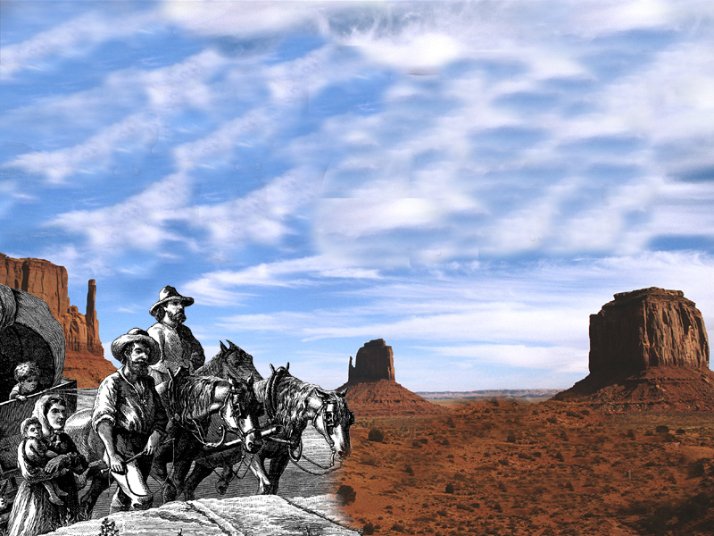
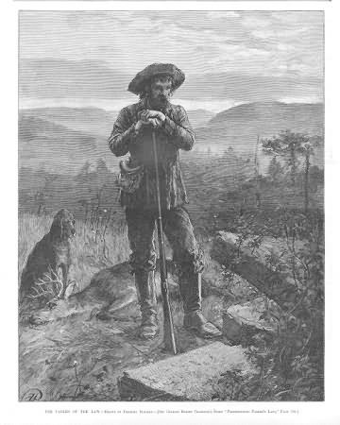
The Pioneers Had Their Leaders

Slide 7
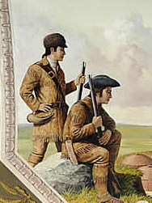
The Pioneers Had Their Leaders
Lewis and Clark

Slide 8
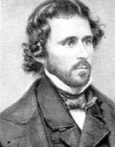
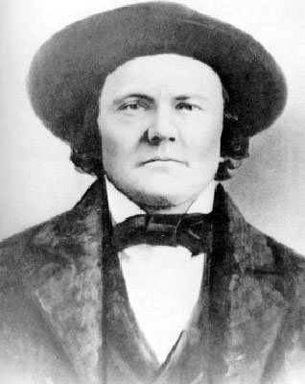
The Pioneers Had Their Leaders
John C Fremont
Kit Carson

Slide 9
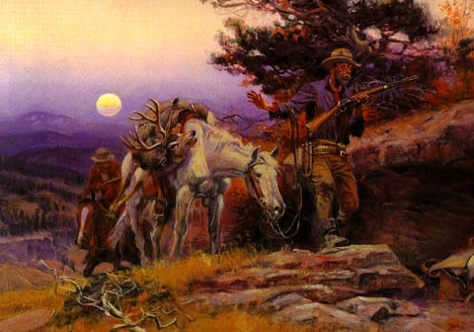
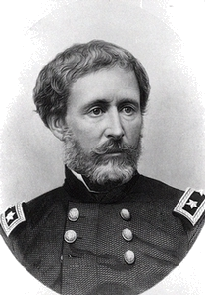
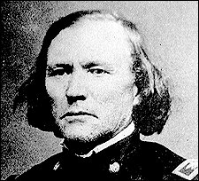
John C Fremont
Kit Carson

Slide 10

The Pioneers had many dangers to face

Slide 11
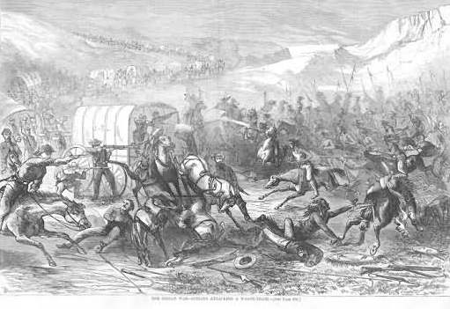
What did the leaders need to know?

Slide 12
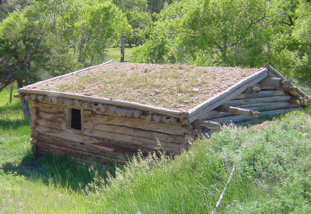
The Pioneers were builders . . .
They built their houses . . .

Slide 13
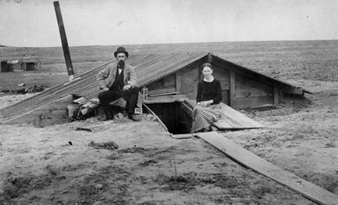
The Pioneers were builders . . .
They used what materials they had

Slide 14
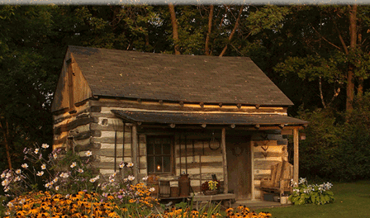
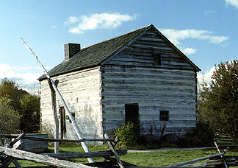
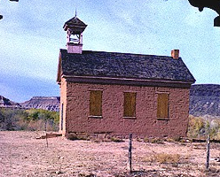

Slide 15
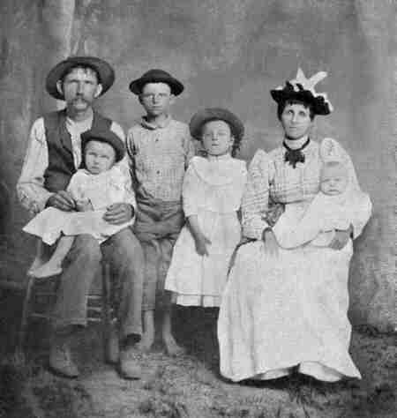
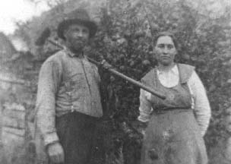
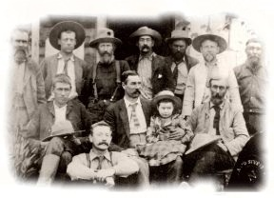
These Pioneers were “Leaders” and “Builders”

Slide 16
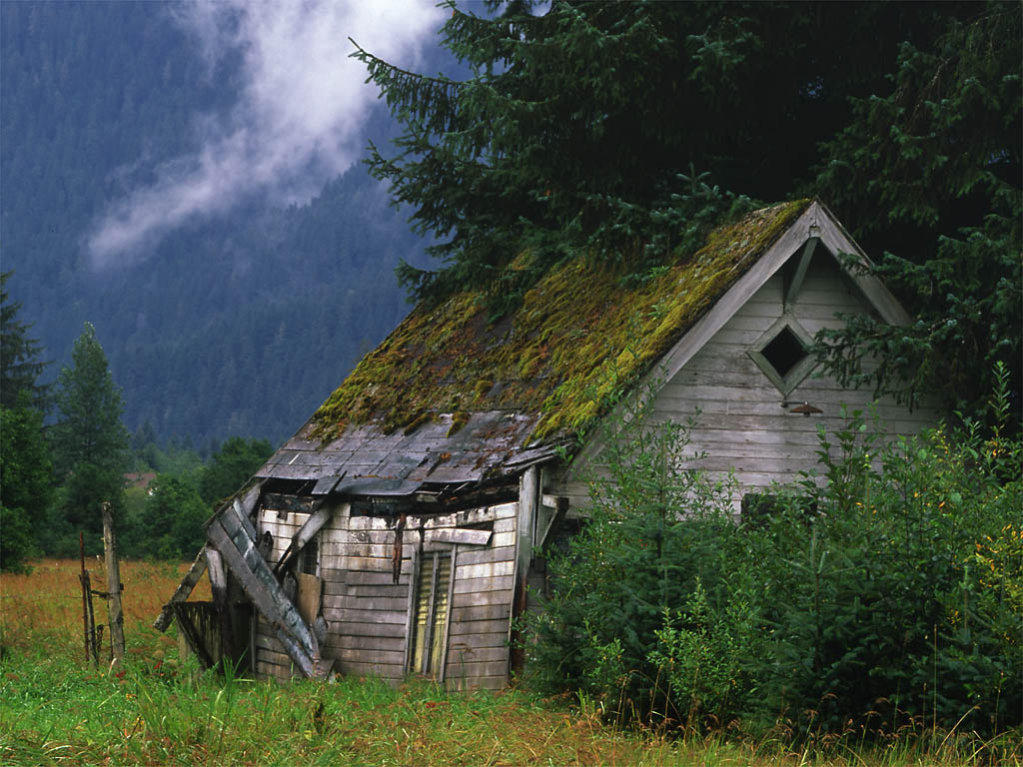
They built for protections

Slide 17
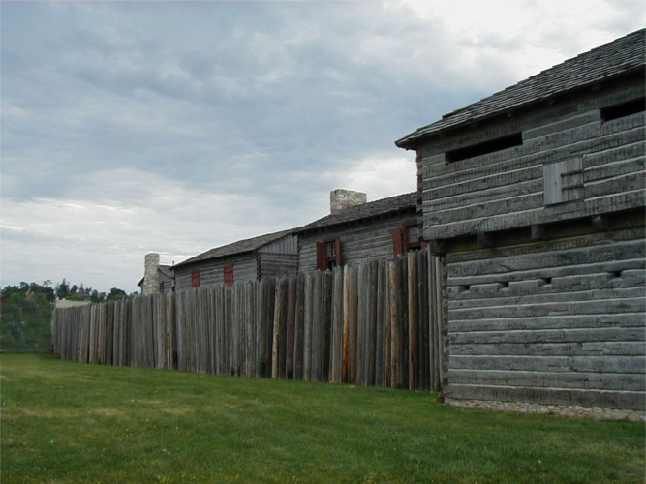
They learned early the value of walls . . .

Slide 18
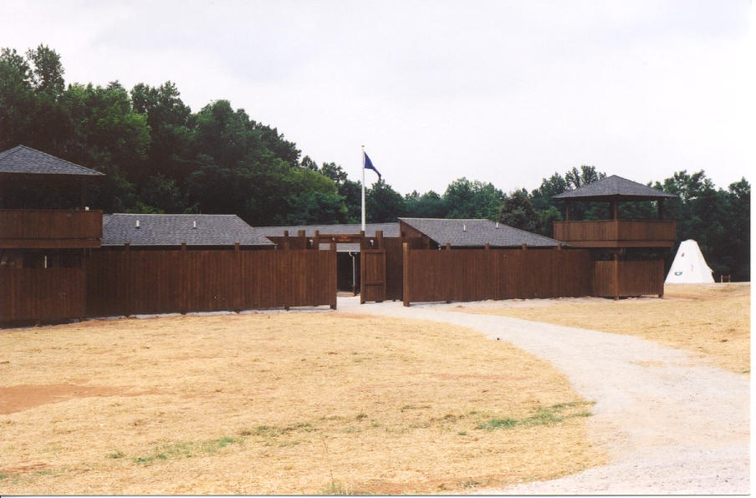
The learned the value of “walls” . . .

Slide 19
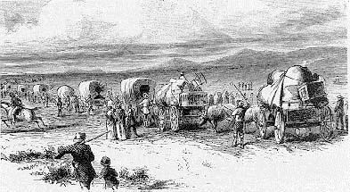
One of the greatest Western Movements . . .
. . . has not been filmed!

Slide 20
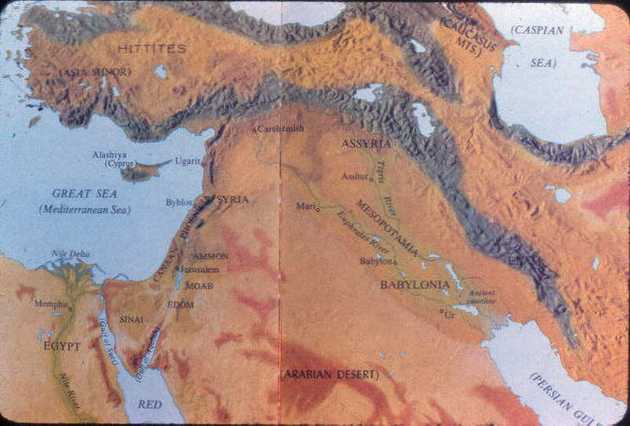
Zerubbabel and 50,000 head west!

Slide 21
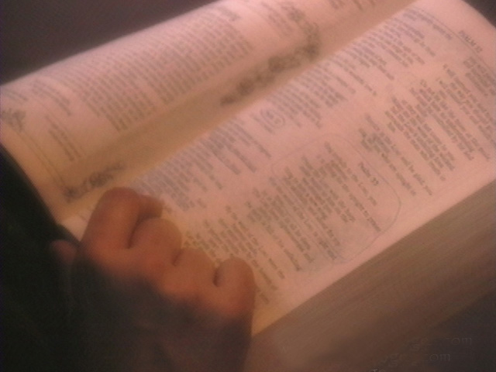
Nehemiah

Slide 22
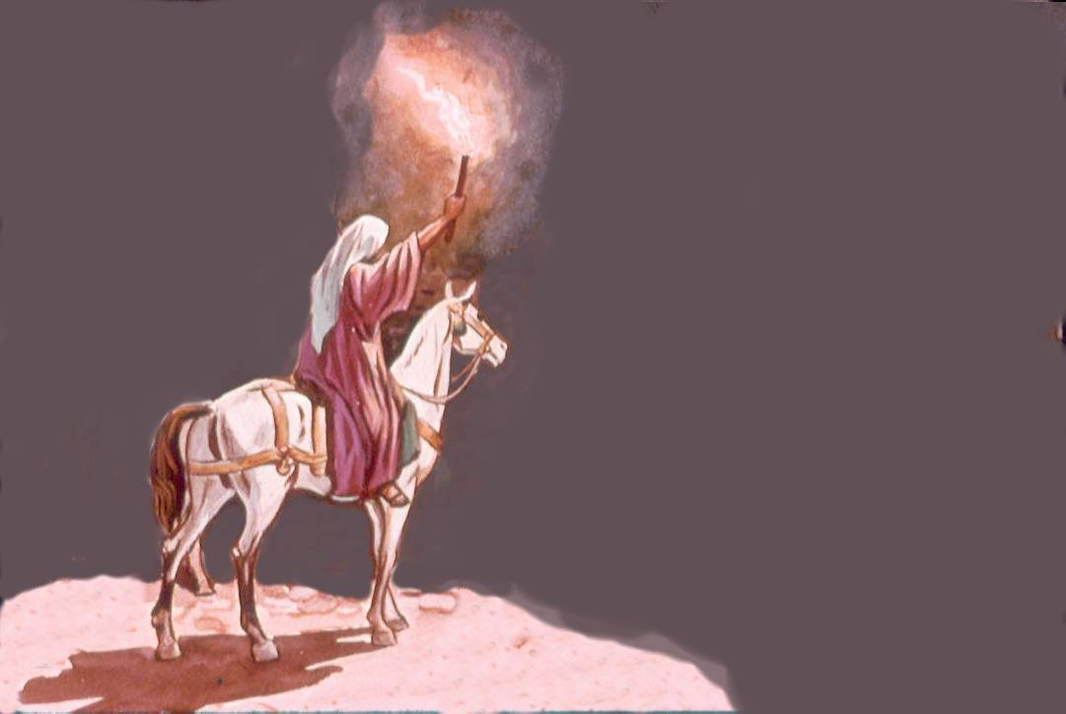
A Leader and a
Builder
Nehemiah

Slide 23
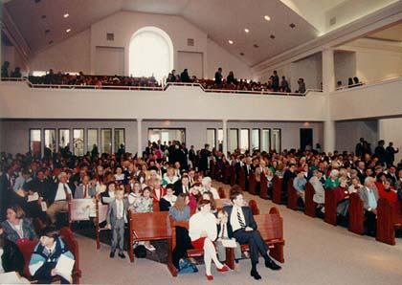
Who is this lesson for?

Slide 24

Nehemiah --
Showing the way to Lead

Slide 25
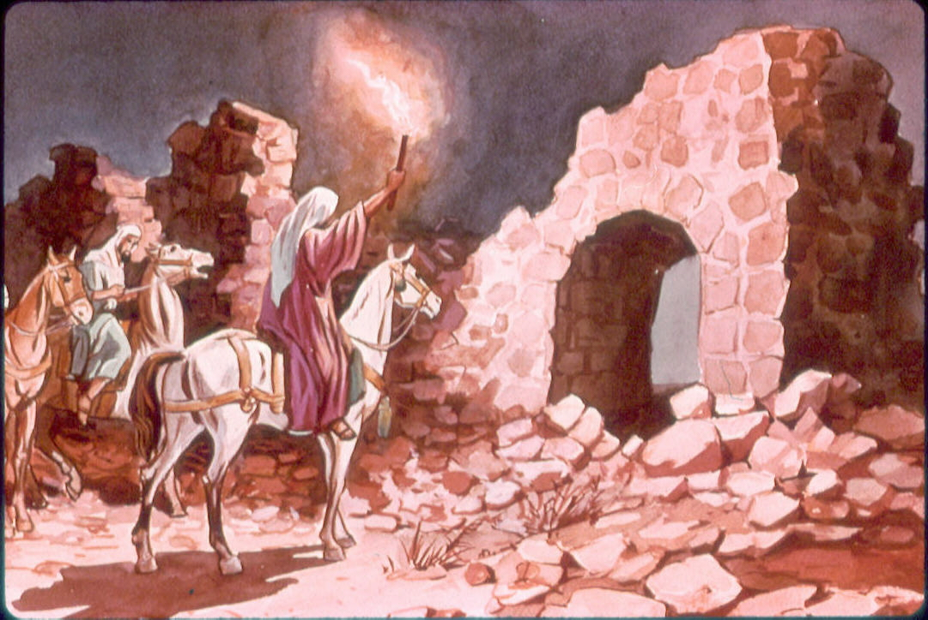
Nehemiah –
Pioneer of Leadership

Slide 26
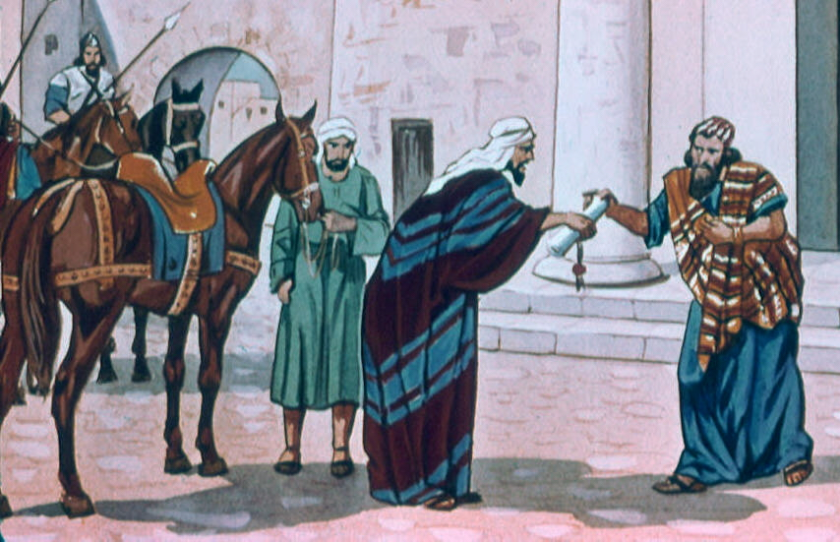
Nehemiah, Chapter 1
1 The words of Nehemiah, the son of Hacaliah. In the month Chislev of the twentieth year, I was in the citadel of Susa
2 when Hanani, one of my brothers, came with other men from Judah. I asked them about the Jews, the remnant preserved after the captivity, and about Jerusalem,
Notes:
1

Slide 27
Nehemiah Chapter 1
3 and they answered me: “The survivors of the captivity there in the province are in great distress and under reproach. Also, the wall of Jerusalem lies breached, and its gates have been gutted with fire.”
4 When I heard this report, I began to weep and continued mourning for several days; I fasted and prayed before the God of heaven.
1. He had a personal concern for the people
Notes:
1

Slide 28
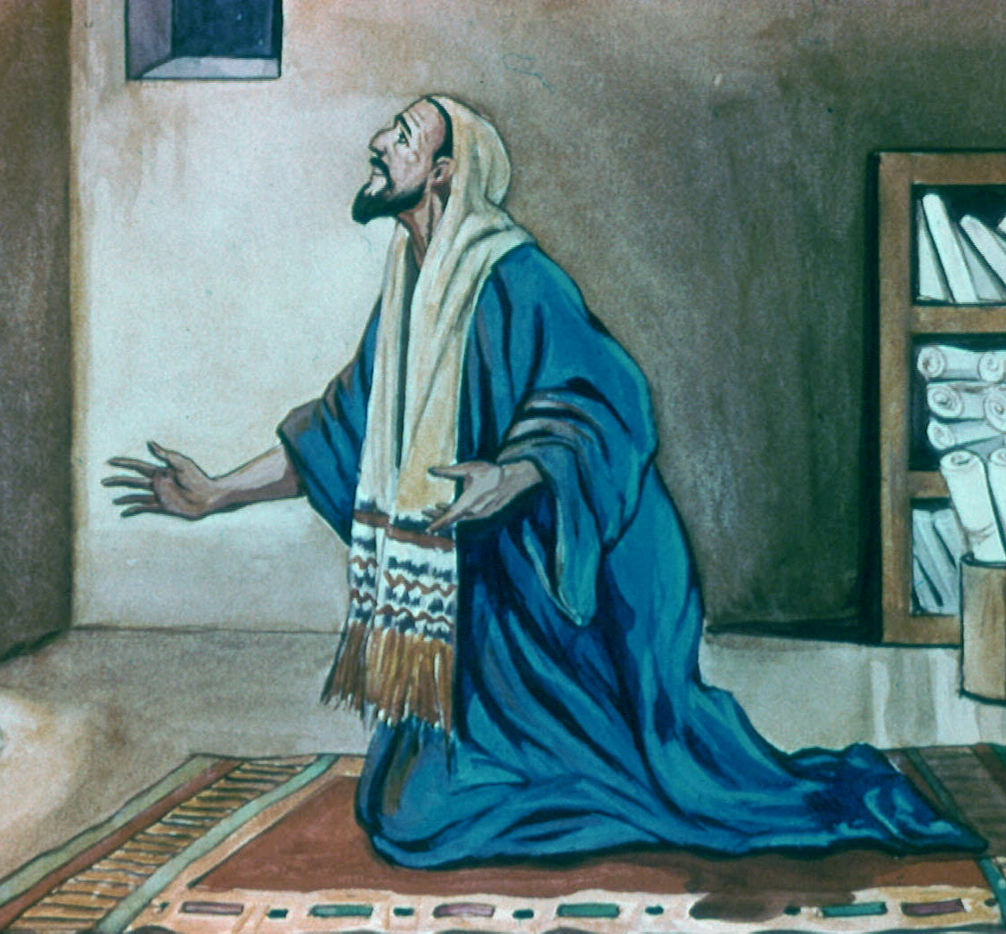
Nehemiah Chapter 1
5 I prayed: “O LORD, God of heaven, great and awesome God, you who preserve your covenant of mercy toward those who love you and keep your commandments,
6 may your ear be attentive, and your eyes open, to heed the prayer which I, your servant, now offer in your presence day
2. He was a man of prayer
Notes:
2

Slide 29
Nehemiah
2:4 I prayed to the God of heaven
… sometimes short prayers, and sometimes long.
Notes:
2b

Slide 30
Nehemiah
[ One verse ]
5:19 Remember me, O my God, for good, all that I have done for this people.
… sometimes short prayers,
Notes:
2c

Slide 31
Nehemiah
9:5b – v. 38
[Longest prayer in the Bible]
… sometimes they were long prayers
Notes:
2d

Slide 32
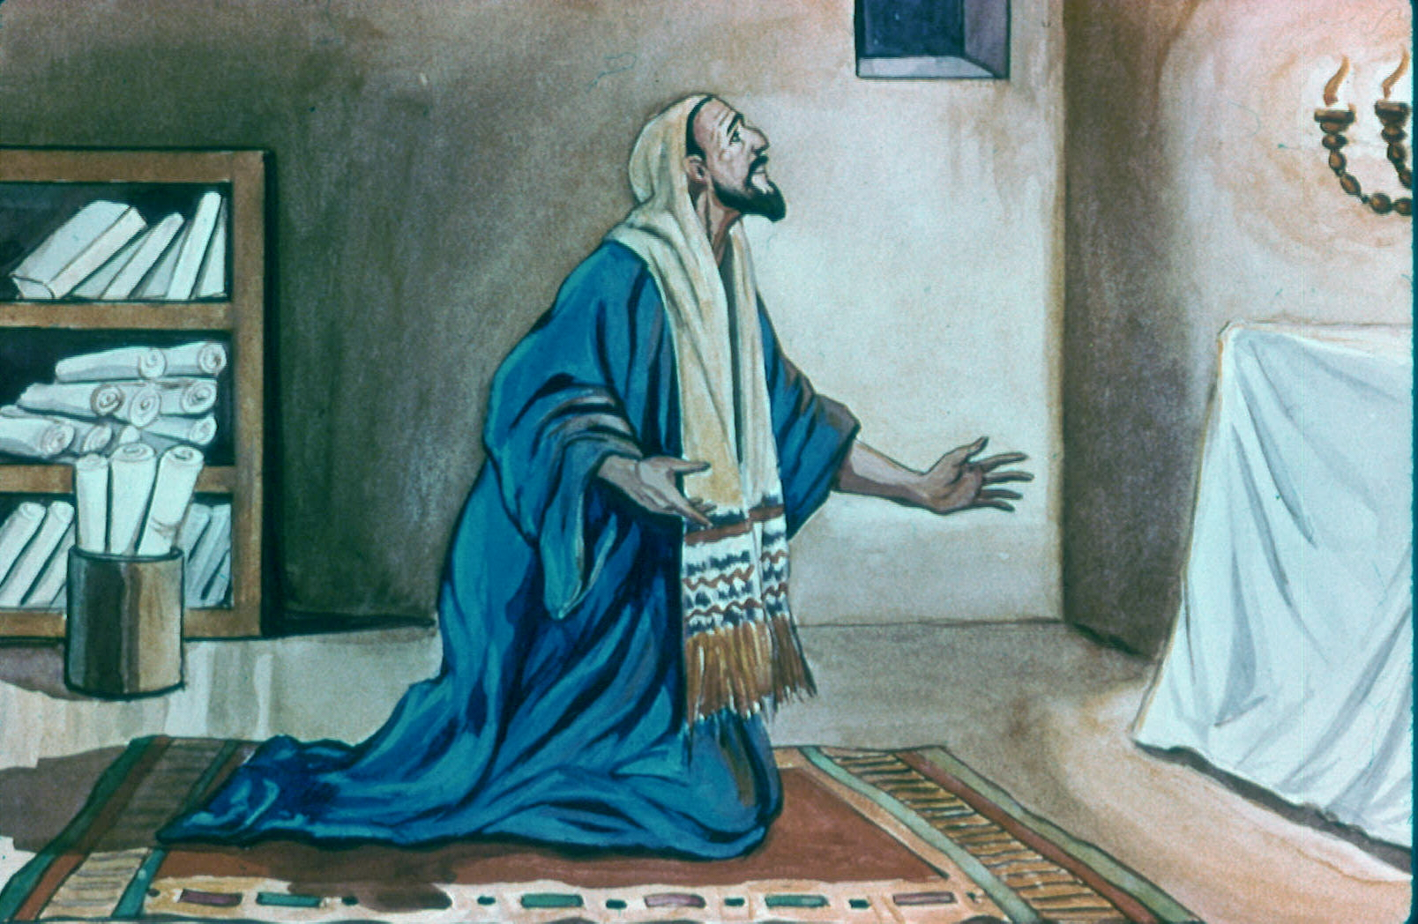
Nehemiah
4:9 But we made our prayer unto God.
… sometimes we don’t know their length . . .
Notes:
2e

Slide 33
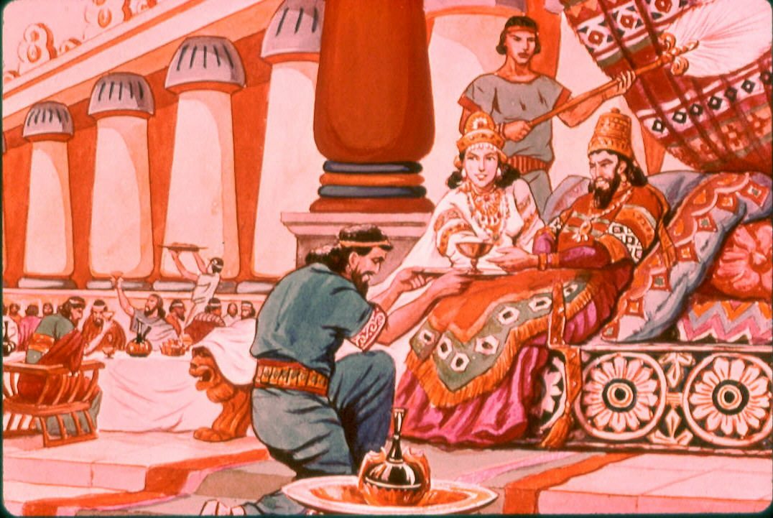
Nehemiah 1:11 b
1:11b “Now I was cupbearer to the king.”
3. He was a trustworthy man
Notes:
3

Slide 34
Nehemiah 2:11-12
2:11-12 11 So I came to Jerusalem and was there three days. 12 Then I arose in the night, I and a few men with me; I told no one what my God had put in my heart to do at Jerusalem; nor was there any animal with me, except the one on which I rode.
He surveyed
the situation
Notes:
4

Slide 35
Nehemiah 2:13-14
2:13-14 13 And I went out by night through the Valley Gate to the Serpent Well and the Refuse Gate, and viewed the walls of Jerusalem which were broken down and its gates which were burned with fire. 14 Then I went on to the Fountain Gate and to the King’s Pool, but there was no room for the animal under me to pass.
He surveyed the situation
and formulated his plans
Notes:
4b

Slide 36
Nehemiah 2:7-8, 14
Neh 2:7 And I said to the king, If it please the king, let letters be given me to the governors beyond the river, that they may set me forward till I come into Judah;
Neh 2:8 and a letter to Asaph the keeper of the king's forest, that he may give me timber to make beams for the gates of the palace which appertains to the house, and for the wall of the city, and for the house that I shall enter into. And the king granted me, according to the good hand of my God upon me.
5. He was a planner
Notes:
5

Slide 37
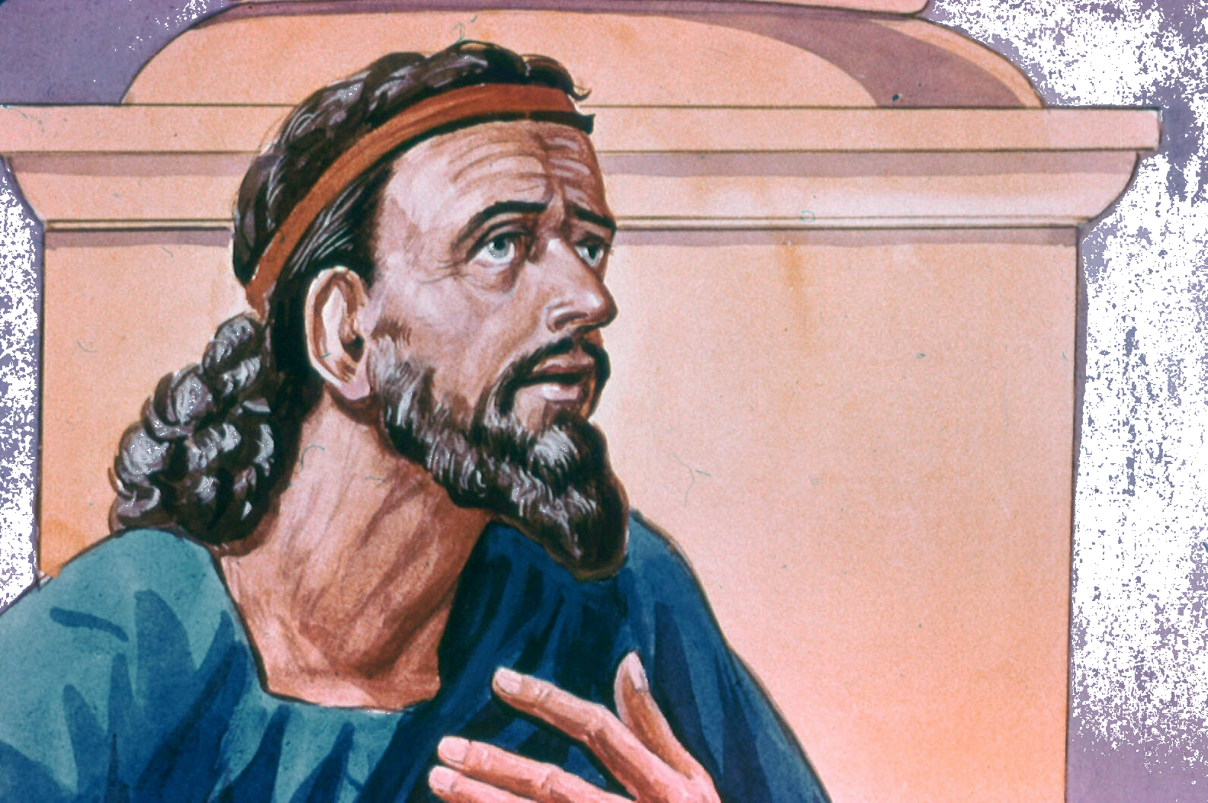
Nehemiah 2:17-18
Neh 2:17 And I said to them, Ye see the distress that we are in, that Jerusalem lies waste, and its gates are burned with fire. Come, and let us build up the wall of Jerusalem, that we be no more a reproach.
Neh 2:18 And I told them of the hand of my God which had been good upon me
6. He appealed to the people
Notes:
6

Slide 38
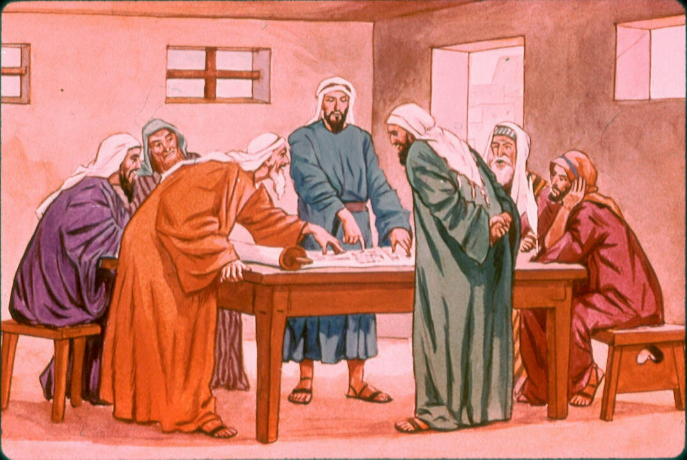
Nehemiah 2:18
2:18 … So they said, “Let us rise up and build.” Then they set their hands to this good work.
7. The people responded to him
Notes:
7

Slide 39
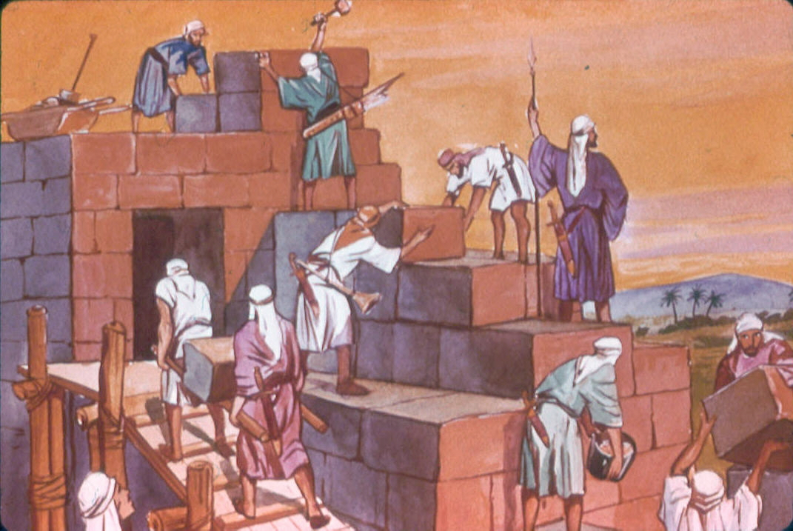
Let us enthusiastically say to our leaders!
“Let us rise up and build.”

Slide 40
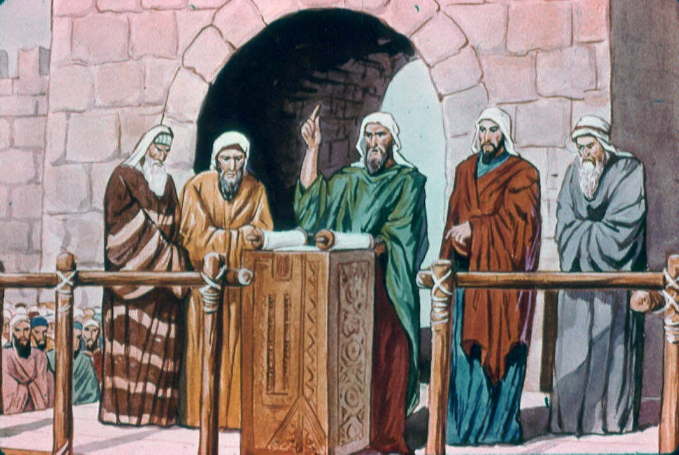

8. Notice how Nehemiah motivated the people.
He shared information – v.17-18
Neh. 2:18 And I told them how the hand of my God had been favorable to me, and also about the king’s words which he had spoken to me.
Notes:
8

Slide 41
8. Notice how Nehemiah motivated the people.
He shared information – v.17-18
He helped the people see the need – v.17
“You see the bad situation we are in, that Jerusalem is desolate and its gates burned by fire. . .”
Notes:
8

Slide 42
8. Notice how Nehemiah motivated the people.
He shared information – v.17-18
He helped the people see the need – v.17
He made the goal clear – v.17
“… let us rebuild the wall of Jerusalem …”
Notes:
8

Slide 43
8. Notice how Nehemiah motivated the people.
He shared information – v.17-18
He helped the people see the need – v.17
He made the goal clear – v.17
Success was visualized – v.17
“. . . that we may no longer be a reproach.”
Notes:
8

Slide 44
8. Notice how Nehemiah motivated the people.
He shared information – v.17-18
He helped the people see the need – v.17
He made the goal clear – v.17
Success was visualized – v.17
He was enthused for the goal – v. 17
“Come, let us rebuild the wall of Jerusalem . . .”
Notes:
8

Slide 45
8. Notice how Nehemiah motivated the people.
He shared information – v.17-18
He helped the people see the need – v.17
He made the goal clear – v.17
Success was visualized – v.17
He was enthused for the goal – v. 17
  The people mirrored his enthusiasm - v.18
Then they said, “Let us arise and build.” So they put their hands to the good work.
Notes:
8

Slide 46
9. As a Leader He Identified With the People
Nehemiah 2:17-18
“let us”
“Come, let us rebuild the wall of Jerusalem that we may no longer be a reproach.”
Notes:
9

Slide 47
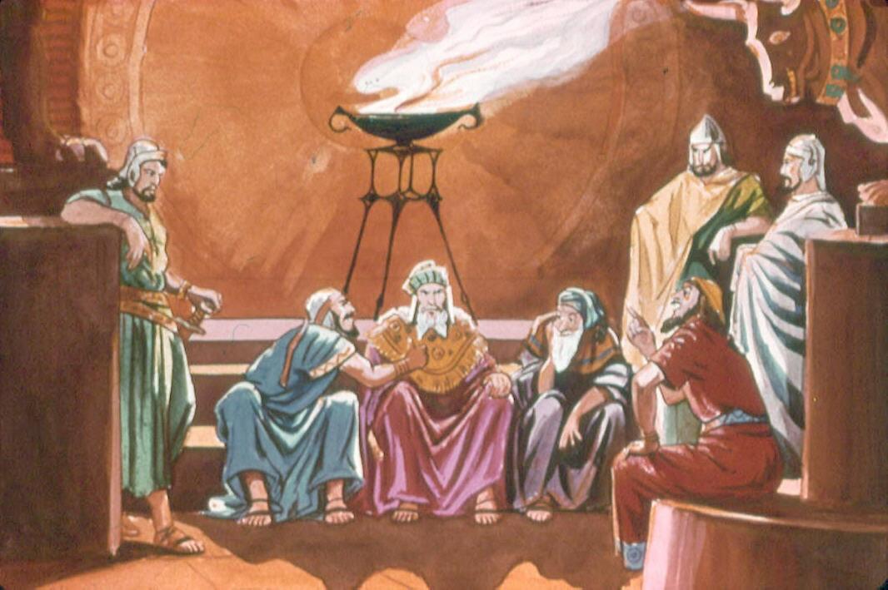
10. Nehemiah Was Able to Handle Criticism
Nehemiah 2:19-20
Sanballet, Tobiah and Geshem “they mocked and ridiculed us…” said Nehemiah.
Notes:
10

Slide 48
10. Nehemiah Was Able to Handle Criticism
Nehemiah 2:19-20
Sanballet, Tobiah and Geshem “they mocked and ridiculed us…” said Nehemiah.
20 So I answered them and said to them, “The God of heaven will give us success; therefore we His servants will arise and build,”
Notes:
10

Slide 49
10. Nehemiah Was Able to Handle Criticism
Nehemiah 2:19-20
Nehemiah was a leader who took God into his plans.
20 So I answered them and said to them, “The God of heaven will give us success; therefore we His servants will arise and build,”
Notes:
10

Slide 50
Are YOU taking God into your plans?
Nehemiah always took God into his plans.

Slide 51
11. Nehemiah Was Able to Organize the People
Nehemiah 3:1-32
Notes:
11

Slide 52
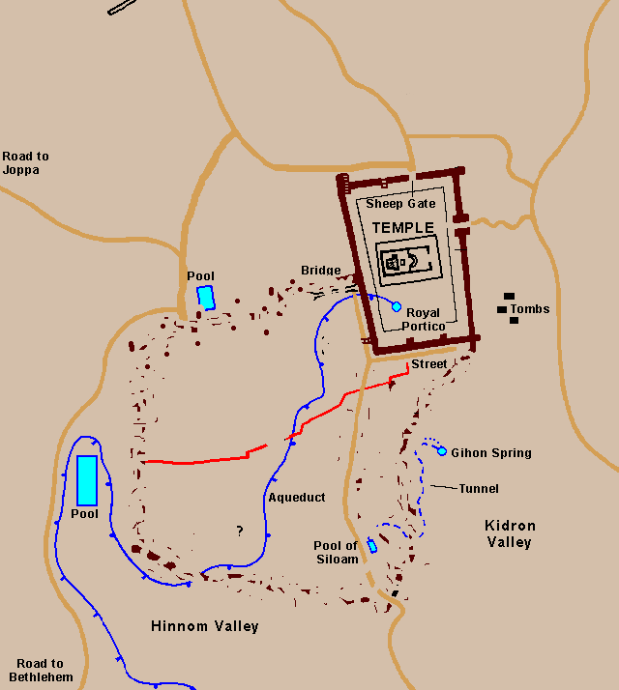
11. Nehemiah Was Able to Organize the People
Nehemiah 3:1-32
He called on others for help
He didn’t spend all his time planning
Notes:
11

Slide 53
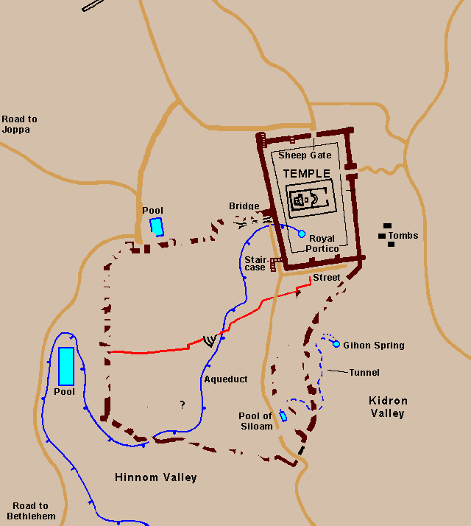
11. Nehemiah Was Able to Organize the People
Nehemiah 3:1-32
The work of the various people was integrated into a whole
Notes:
11

Slide 54
11. Nehemiah Was Able to Organize the People
Nehemiah 3:1-32
The work of the various people was integrated into a whole
4:6 “so we built the wall; and all the wall was joined together unto half the height thereof: for the people had a mind to work.”
Notes:
11

Slide 55
11. Nehemiah Was Able to Organize the People
Nehemiah 3:1-32
4:6 “so we built the wall; and all the wall was joined together unto half the height thereof: for the people had a mind to work.”
Notes:
11

Slide 56
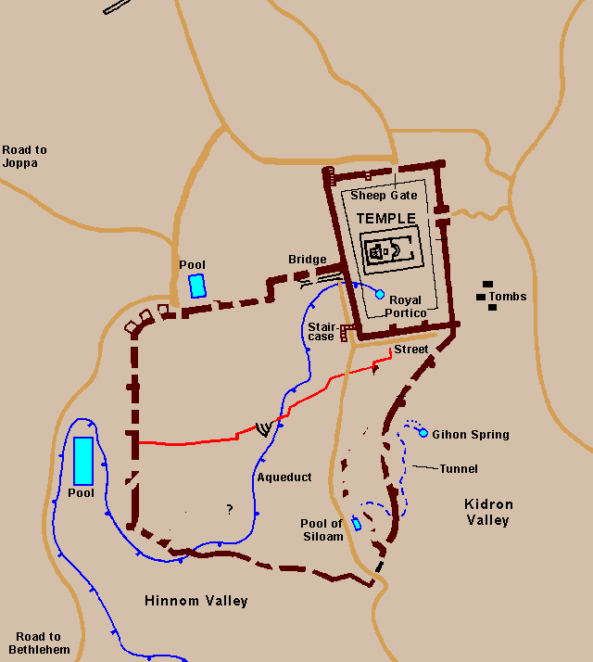
11. Nehemiah Was Able to Organize the People
Nehemiah 3:1-32
He helped them visualize how their part of the work was strategic to the whole
Notes:
11

Slide 57
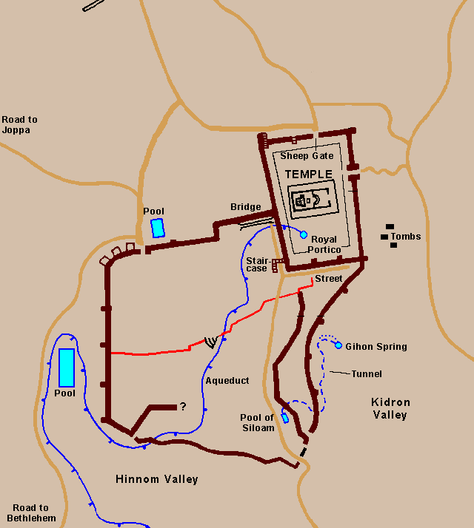
12. Nehemiah Was Able to Do a Great work because the People had a Mind to Work
Nehemiah 6:15
6:15 “So the wall was finished in the twenty fifth day of the of month of Elul, in fifty two days.”
Notes:
12

Slide 58
4:6 “… for the people
had a mind to work.”
Notes:
12

Slide 59
Pioneer of Leadership
Nehemiah

Slide 60
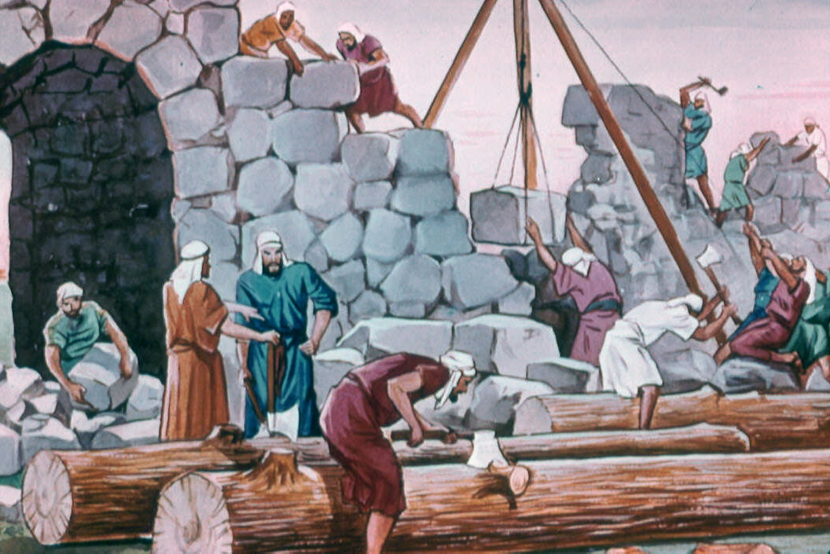
12. Nehemiah Knew How To Deal With Problems
He had to discriminate between good and evil
(2:19-20)
2. He had to deal with mockery and ridicule.
(4:1-6)
Notes:
12

Slide 61
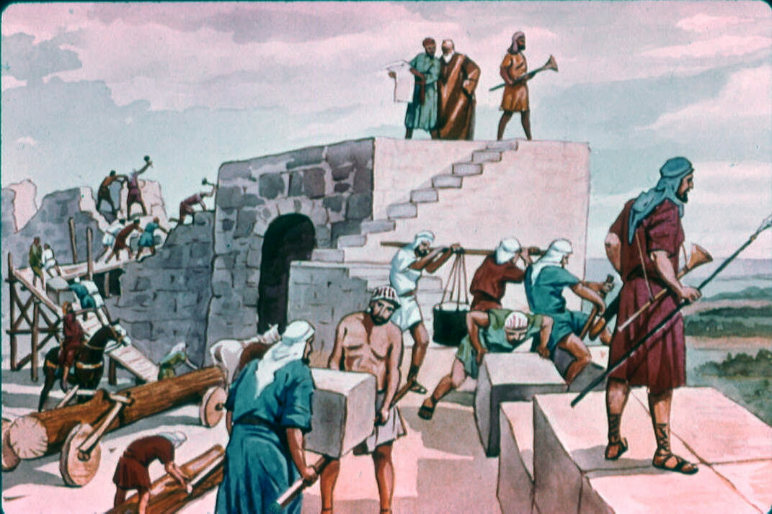
12. Nehemiah Knew How To Deal With Problems
3. He faced a threat of violent force
(4:7-10, 15-23)
4. His enemies conspired against him
(4:8)
Notes:
12

Slide 62
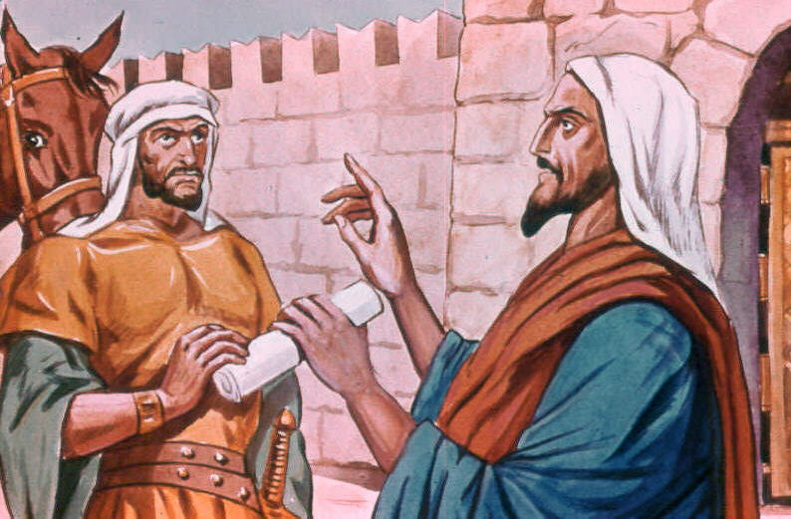
12. Nehemiah Knew How To Deal With Problems
5. There were appeals for him to compromise
(6:1-4)
Then his enemies tried slander
(Instigated rumors and untrue accusations)
(6:5-9)
Notes:
12

Slide 63
12. Nehemiah Knew How To Deal With Problems
These problems came from without -- But ...
He also had to deal with problems from within --
Notes:
12

Slide 64
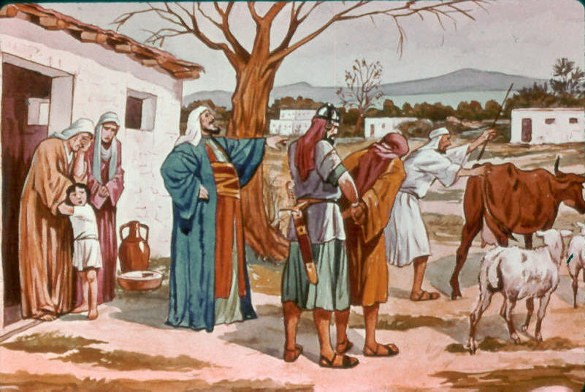
12. Nehemiah Knew How To Deal With Problems
Problems from within --
7. Complaints of cruel greed
(5:1-19)
Notes:
12

Slide 65
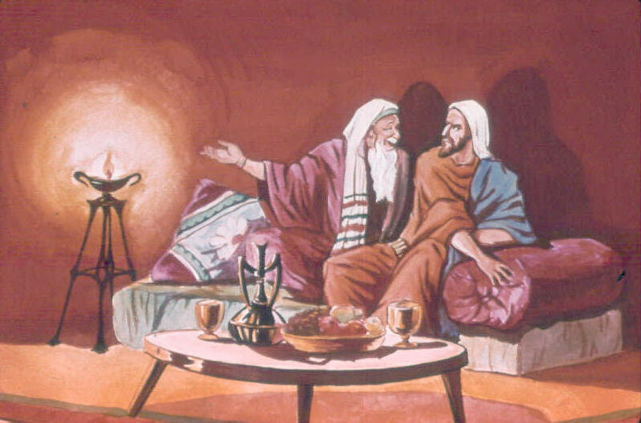
12. Nehemiah Knew How To Deal With Problems
Problems from within --
8. Attempts to discredit him
(6:10-15)
Notes:
12

Slide 66
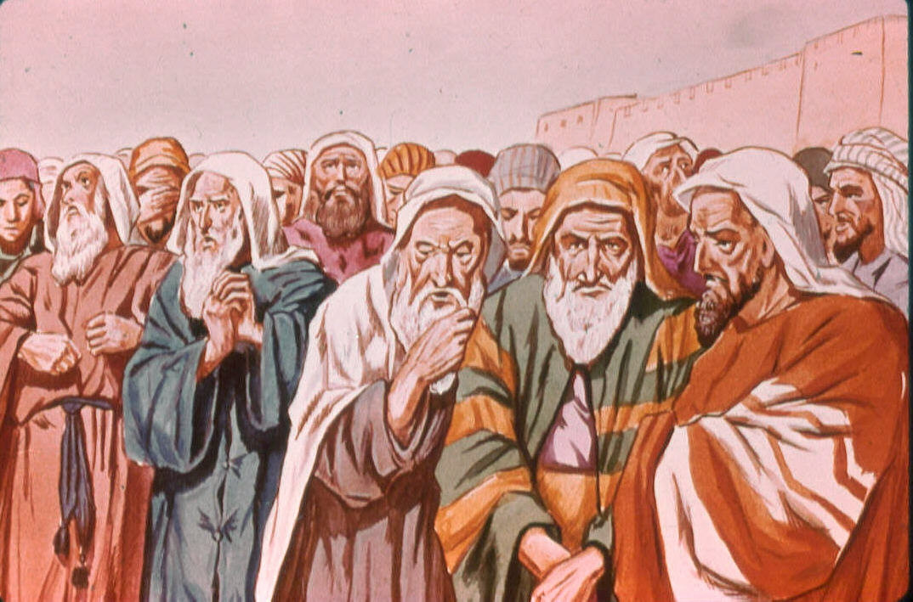
12. Nehemiah Knew How To Deal With Problems
Problems from within --
9. Spies who told his every word to his enemies - -
(6:16-19)
Notes:
12

Slide 67
13. Nehemiah Had To Deal With The People’s Discouragement
Four Causes For Their Discouragement – 4:10-14
A Loss of Strength
A Loss of Vision
A Loss of Confidence
A Loss of Security
Notes:
13

Slide 68
13. Nehemiah Had To Deal With The People’s Discouragement
OVERCOMING DISCOURAGEMENT – 4:9-15
Presence of God
People of God
Promises of God
Providence of God
Notes:
13

Slide 69
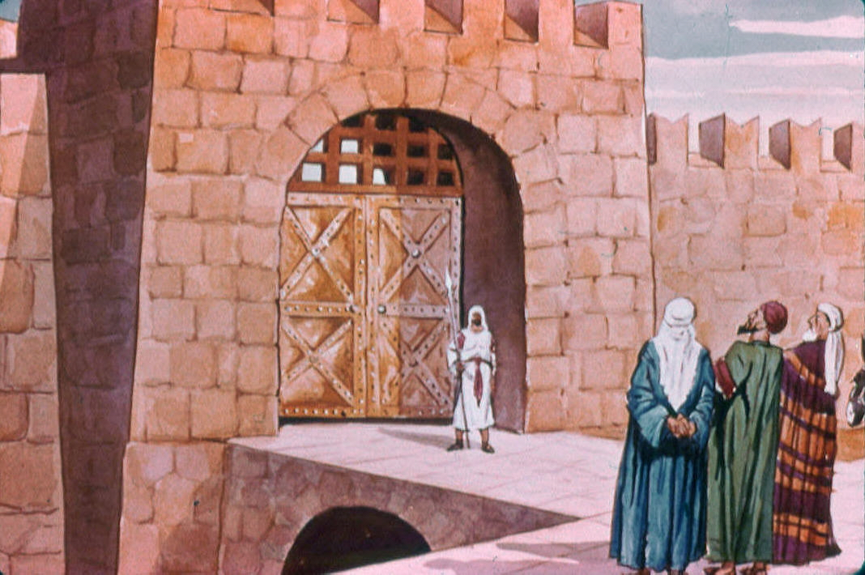
People are blessed when they have good leaders!
The goal is reached!
6:15 “So the wall was finished in the twenty-fifth day of Elul, in fifty-two days.”
Notes:
13

Slide 70
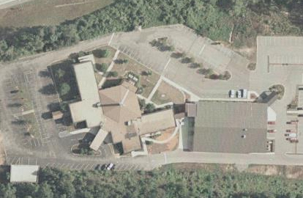
Churches today are blessed when they have good leaders!
The goal is reached!
6:15 “So the wall was finished in the twenty-fifth day of Elul, in fifty-two days.”
Notes:
13

Slide 71
Nehemiah:
A Leader Who Was
Faithful To God

Slide 72
We’ve already noted:
1. Nehemiah was Trustworthy

Slide 73
We’ve already noted:
1. Nehemiah was Trustworthy
2. He was Moral and Ethical
5:16

Slide 74
Nehemiah The Man:
1. Nehemiah was Trustworthy
2. He was Moral and Ethical
3. He Didn’t Use His Position
for Personal Gain
5:14-18

Slide 75
Nehemiah: A Faithful Leader
Leaders Will Accomplish Great Feats
6:15-16

Slide 76
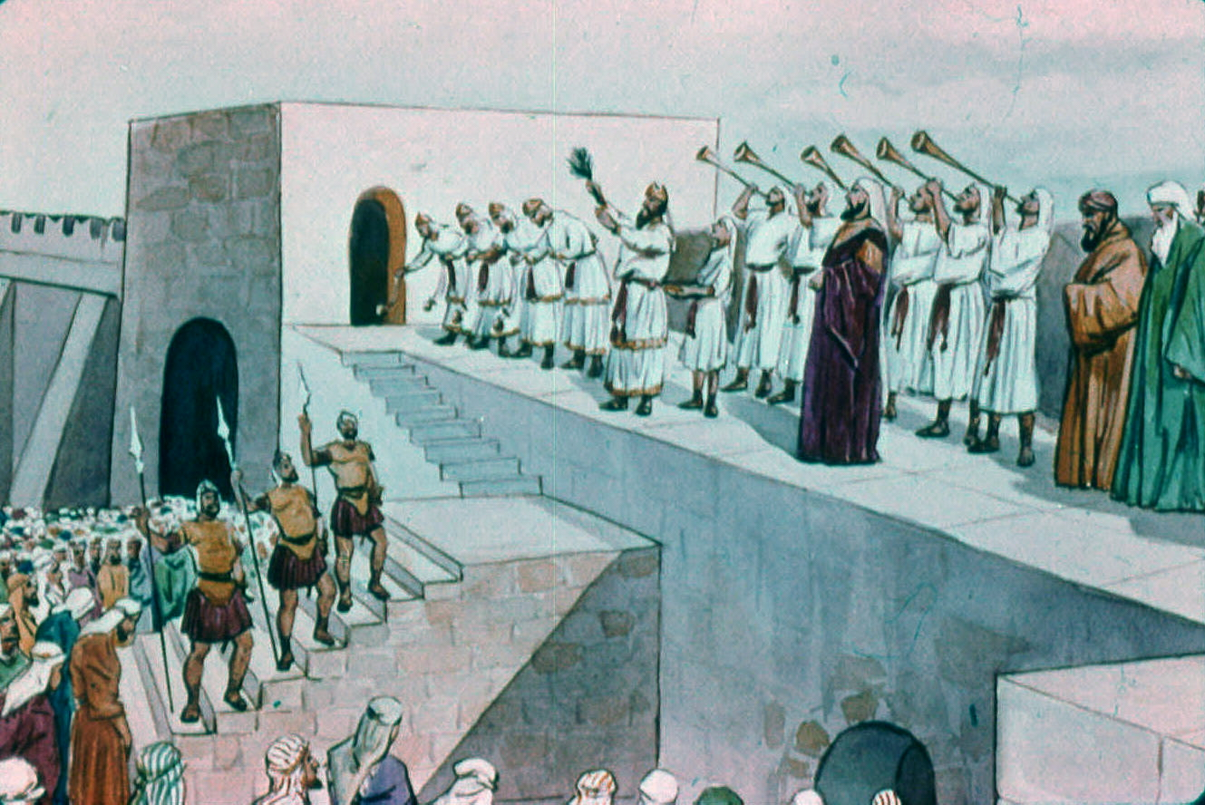
Nehemiah: A Faithful Leader
Leaders Will Accomplish Great Feats
Leaders Want People to
Rejoice in a Work Well Done
12:27, 31, 38, 42-43

Slide 77
Nehemiah: A Faithful Leader
Leaders Will Accomplish Great Feats
Leaders Want People to
Rejoice in a Work Well Done
Leaders Lead in Revival

Slide 78
Leaders like Nehemiah
Lead In Revival
They Lead in Studying God’s Word
People Respond to Their Guidance
They Lead to Make A Commitment

Slide 79
Leaders like Nehemiah
Lead In Revival
They Lead in Studying God’s Word
8:1-18
We notice their attention
We notice their reverence
We notice the preparation
We notice the participation
We notice the emotional experience

Slide 80
Leaders like Nehemiah
Lead In Revival
People Respond to Their Guidance
8:1-18
An intellectual response – v. 1-8
An emotional response – v. 9-12
An obedient response – v. 13-18

Slide 81
Leaders like Nehemiah
Lead In Revival
People Respond to Their Guidance
8:1-18
C. An obedient response – v. 13-18
“And all the assembly of them that were come again out of the captivity made booths, and dwelt in the booths … And there was very great gladness. Also day by day, from the first day unto the last, he read in the book of the law of God. And they kept the feast seven days; and on the eighth day was a solemn assembly, according unto the ordinance.” (8:17-18 ASV)

Slide 82
Leaders like Nehemiah
Lead In Revival
The People Made A Commitment
9:1-4, 38; 10:1, 28-32
They confessed their sins – 9:1-3
They promised to obey – 9:38; 10:1
They cleaned up their lives – 10:28-32

Slide 83

Nehemiah:
A Pioneer Leader!
A man of prayer

Slide 84
Key Verse
4:6 “… for the people
had a mind to work.”
Notes:
12

Slide 85

Great Leaders, and Great Workers
will make a GREAT Congregation!

