Slide 1

Repentance
Monotype Corsiva Font

Slide 2
Repentance

Slide 3

Repentance
Why Preach on Repentance?
Romans 3:23
Sinners need to repent
1 John 1:8
Back-sliding Christians need to repent

Slide 4
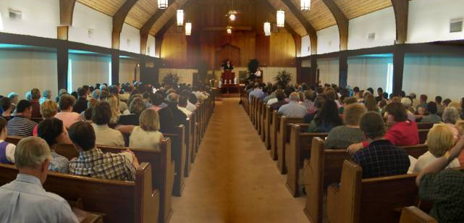
Repentance
Why Preach on Repentance?
Difficult to persuade people to repent!

Slide 5
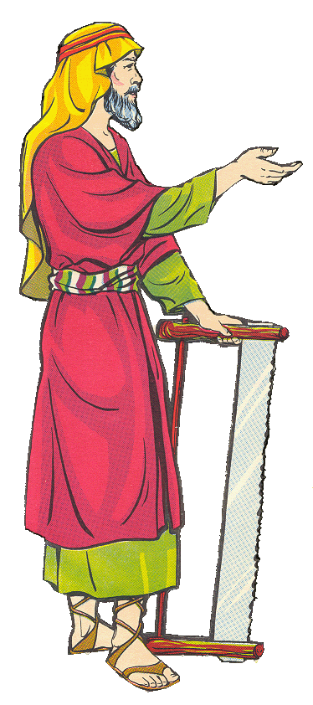
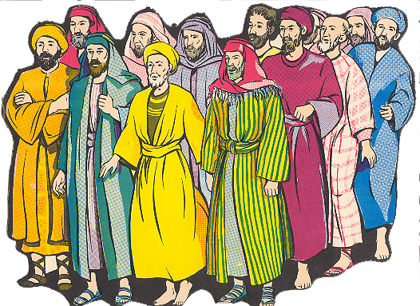

Great Men Have Preached “Repentance”
2 Peter 2:5
Noah was a preacher

Slide 6
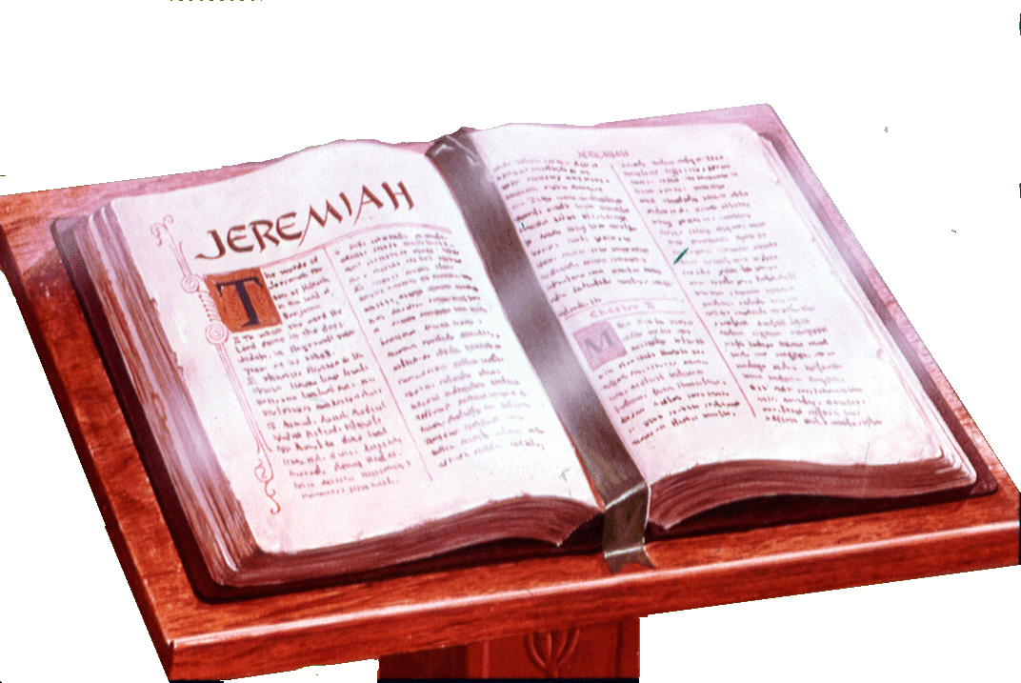
Great Men Have Preached “Repentance”
Jeremiah

Slide 7
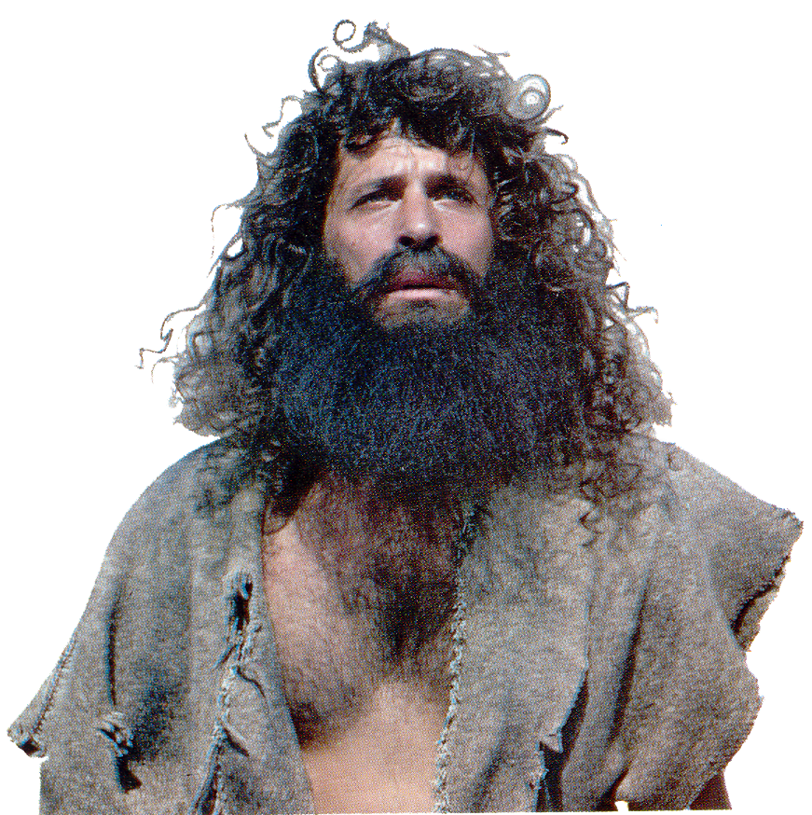
Great Men Have Preached “Repentance”
Mark 6:12 - 29
John the Baptist

Slide 8
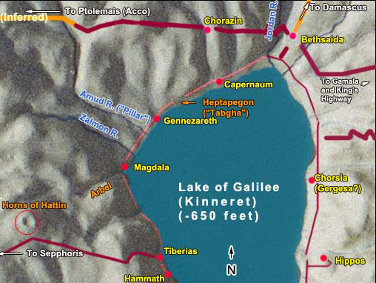
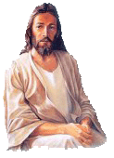
Repentance
Matthew 11:20-24

Slide 9
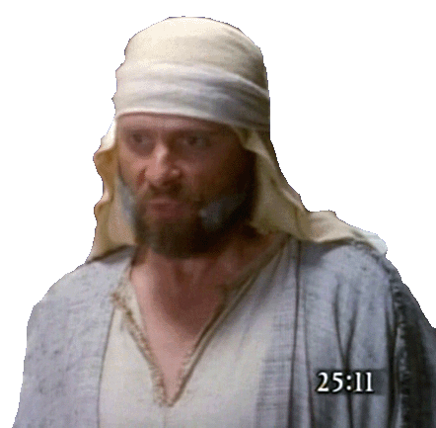
Great Men Have Preached “Repentance”
Acts 24
Paul before Felix
Acts 26
Paul before King Agrippa

Slide 10
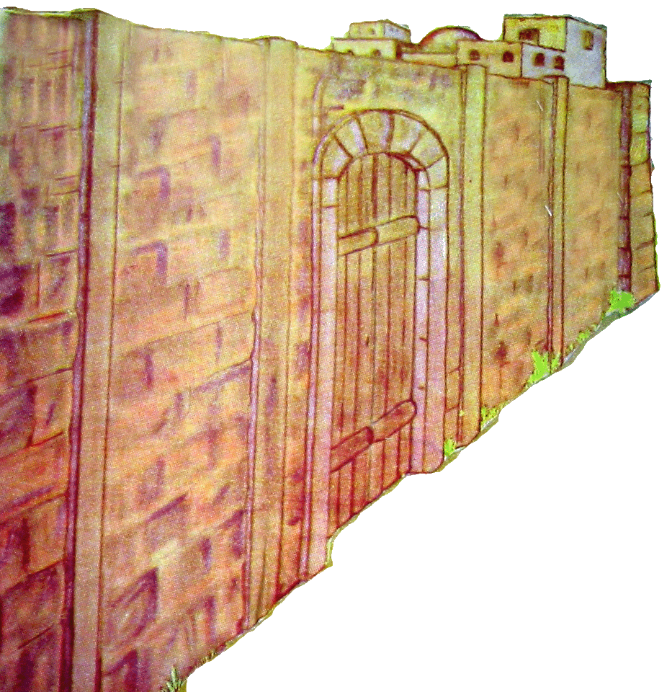
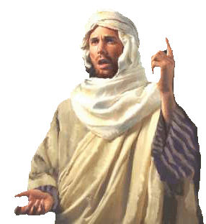
Great Men Have Preached “Repentance”
Jonah 3:4
Jonah at Niveveh

Slide 11
Great Men Have Preached “Repentance”
Matthew 3:2
“Repent ye, for the kingdom of heaven is at hand.”
Luke 13:1-5
“Except ye repent, ye shall in like manner perish.”

Slide 12
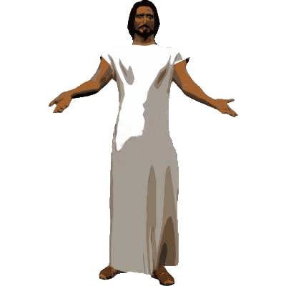
Great Men Have Preached “Repentance”
Luke 24:47
“…repentance and remissions of sins should be preached in his name unto the nations, beginning from Jerusalem.”

Slide 13
Great Men Have Preached “Repentance”
Acts 2:38
Peter at Pentecost
Acts 17:30
Paul at Mars Hill in Athens

Slide 14
Repentance
Why Preach on Repentance?
What Repentance Is NOT

Slide 15
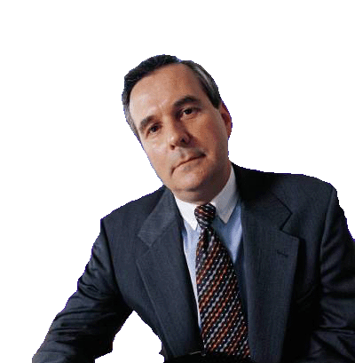
Repentance
What Repentance Is NOT
What is repentance?
“Sorrow”
Mark 6:26
“exceedingly sorry”

Slide 16

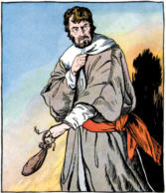
Repentance
What Repentance Is NOT
What is repentance?
Matthew 27
“I have betrayed innocent blood.”
“Sorrow, along with confession”

Slide 17
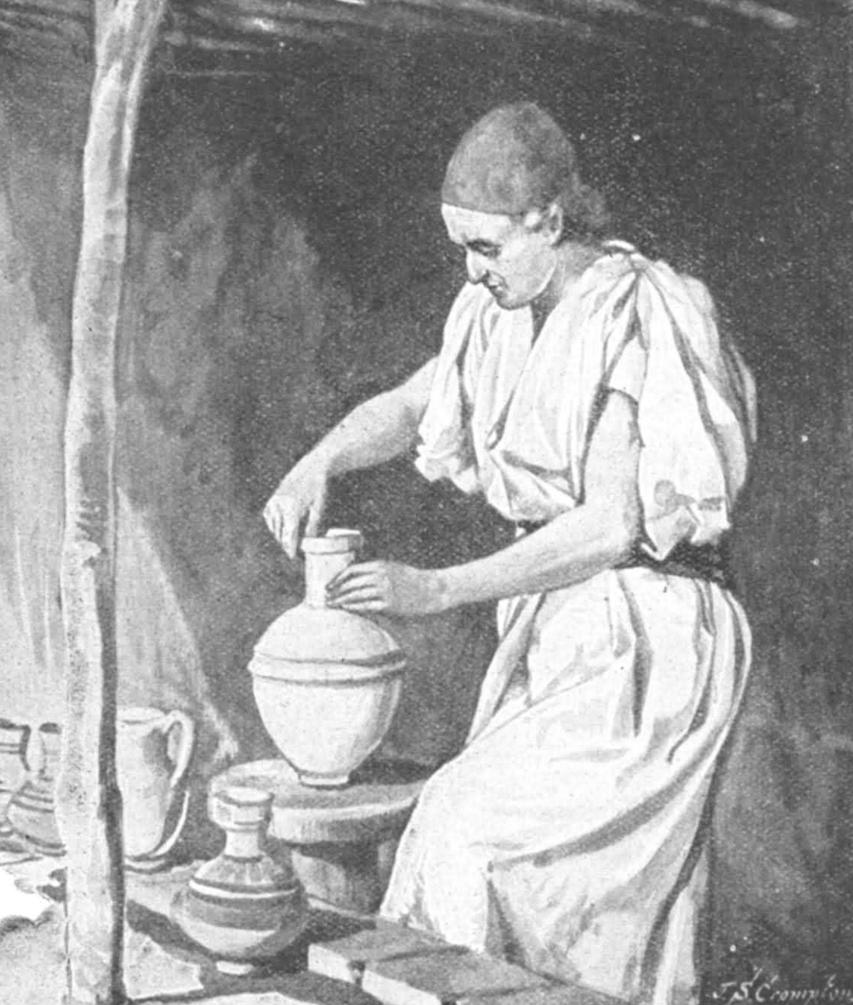
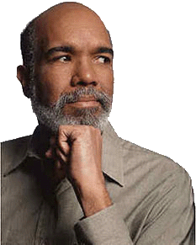
Repentance
What Repentance Is NOT
What is repentance?
“Godly sorrow”
2 Cor. 7:10
“godly sorrow worketh repentance unto salvation…”

Slide 18
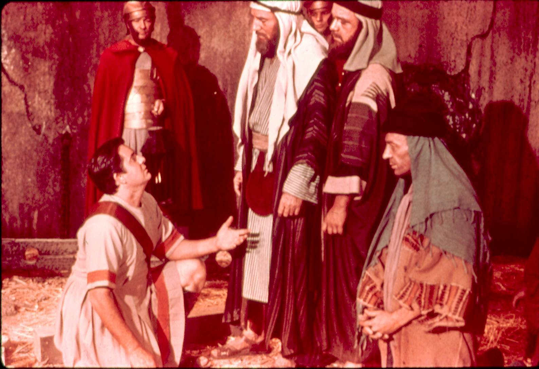

Repentance
What Repentance Is NOT
What is repentance?
“Restitution and reformation of life”
Matt. 3:8
“Bring forth fruits worthy of repentance.”

Slide 19
Repentance
What Repentance Is NOT

Slide 20
Repentance
What Repentance IS
REPENTANCE
Godly Sorrow
Restitution & Reformation

Slide 21
Repentance
What Repentance IS
Matthew 12:41

Slide 22
Repentance
What Repentance IS
Jonah 3:5
They believed Jonah
“FAITH”

Slide 23
Repentance
What Repentance IS
Jonah 3:8
“turned every man from his evil works”
“cried mightily unto God”

Slide 24
Repentance
What Repentance IS
Turning from that which is wrong, to God!

Slide 25

Repentance
What Repentance IS
1 Thess. 1:9
“ye turned to God from idols to serve the living and true God.”
Acts 20:21

Slide 26
Repentance
What Repentance IS
Repentance = “a change of mind which results in a change of conduct”

Slide 27
Repentance
What Repentance IS
“a change of mind”
… thinking is changed
… emotions are changed
… man’s will is changed
Matthew 21:28-31 -- Jesus illustrated

Slide 28
Repentance
How Are Men Moved To Repent?
Acts 11:18
God granted
Acts 2:38
God commanded

Slide 29
Repentance
How Are Men Moved To Repent?
God grants us the privilege
God gives motives for repentance
Jonah 3:4 -- Fear
Acts 3:19 -- Hope of reward
Romans 2:4 -- God’s goodness
Luke 15:10 -- Joy to others

Slide 30
Repentance
Why Preach on Repentance?
What Repentance Is NOT
What Repentance IS
How Are Men Moved To Repent?

Slide 31
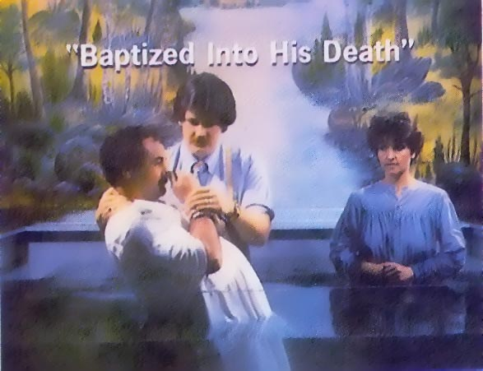
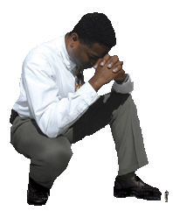
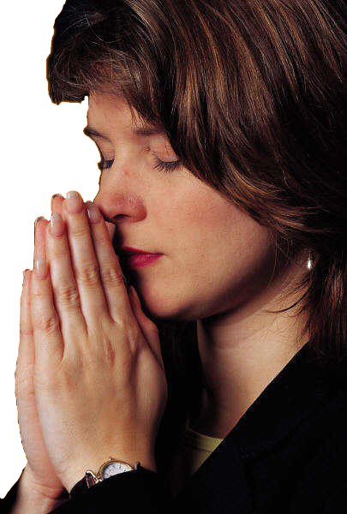
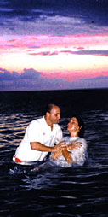
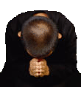
Repentance
Conclusion
Luke 17:4

Slide 32









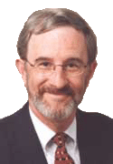
Repentance
What Repentance Is NOT

Slide 33
Repentance

