Slide 1
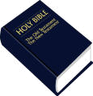
THE BIBLE
Old Testament
New Testament
1 2 3 4 5 6 7 8 9 10 11 12 13

Slide 2
THE BIBLE
1 2 3 4 5 6 7 8 9 10 11 12 13

Slide 3
THE BIBLE
Old Testament
New Testament
1 2 3 4 5 6 7 8 9 10 11 12 13

Slide 4
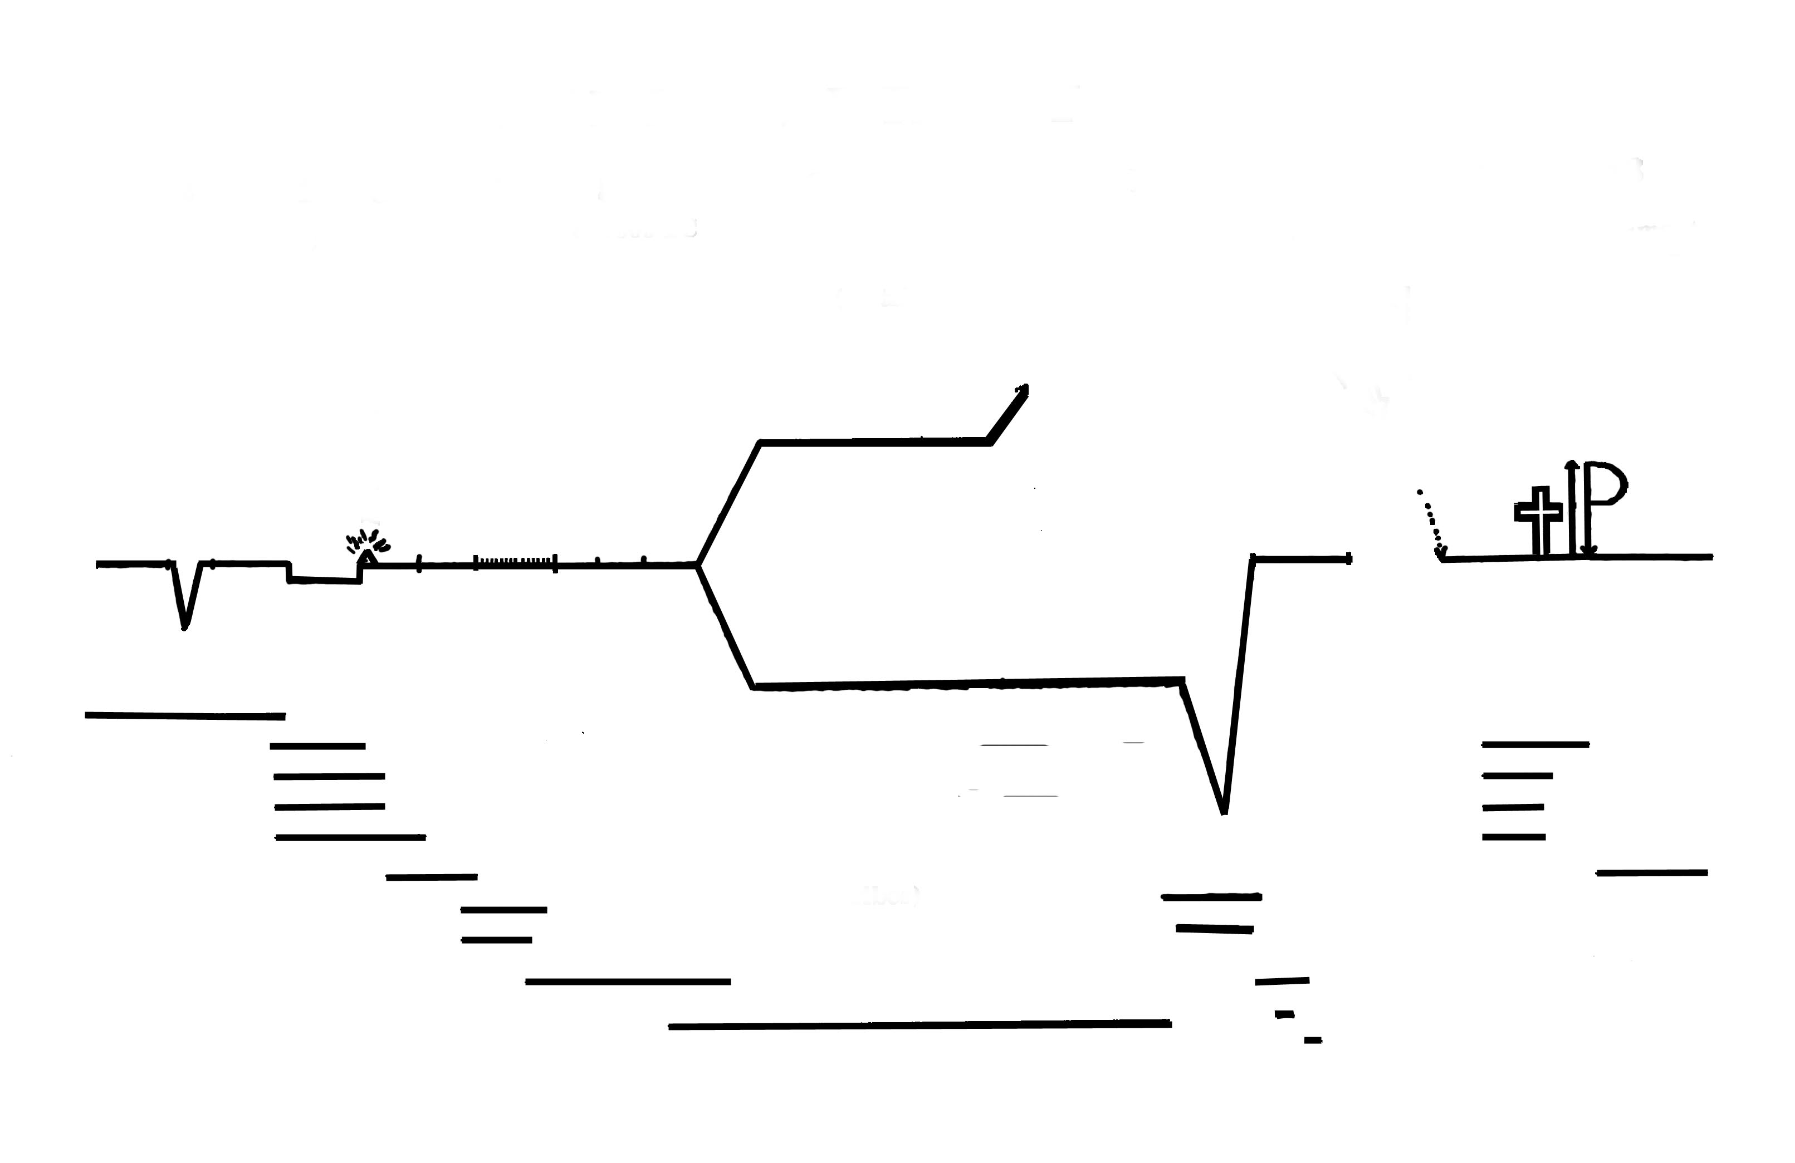
THE BIBLE
1 2 3 4 5 6 7 8 9 10 11 12 13
C

Slide 5
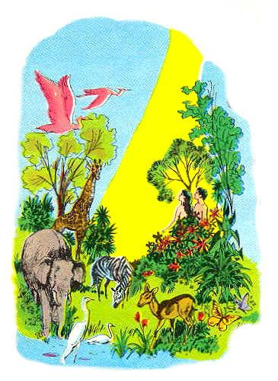
THE BIBLE
1 2 3 4 5 6 7 8
A,E
E
C
Pre Flood
PERIOD BEFORE THE FLOOD
Gen. 1-5 [?? - ?? B.C.] Adam
Creation, Garden of Eden, Adam & Eve, Sin, First civilization
Genesis

Slide 6
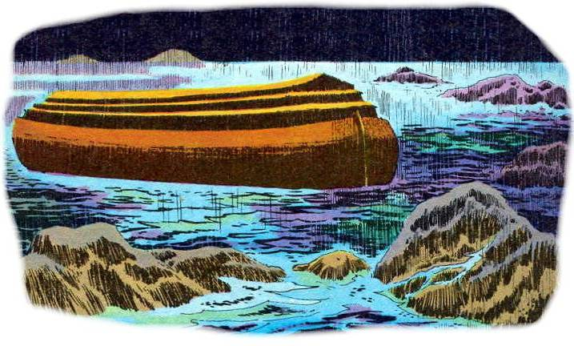
THE BIBLE
1 2 3 4 5 6 7 8
A,E
E
N
C
Pre Flood
THE FLOOD
Gen. 6 - 11 [?? BC - 2000 B.C.] Noah
Wickedness; Warning; The Ark; Ham, Shem & Jappeth; Mt. Ararat, Babel (languages)
F
Genesis

Slide 7
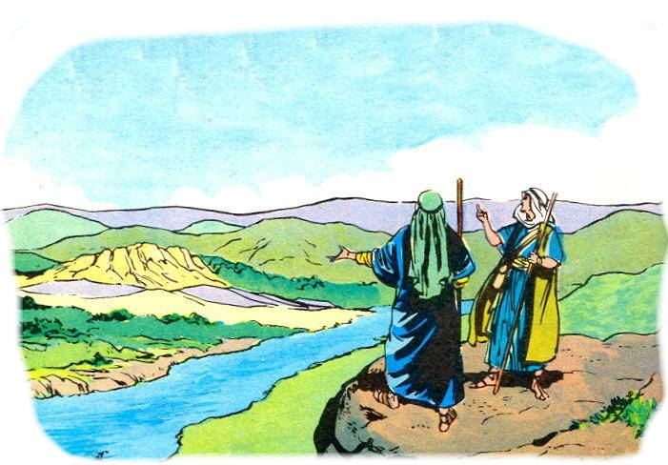
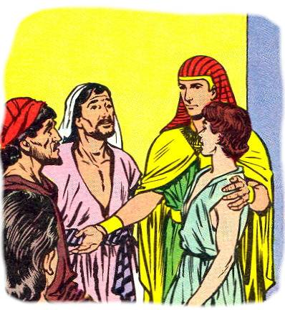
THE BIBLE
1 2 3 4 5 6 7 8
A,E
E
N
A
J J
C
Pre Flood
CF
THE CHOSEN FAMILY
Gen. 12 - 46 [ 2000 BC - 1800 B.C.] Abraham is called; Promises made
Isaac; Jacob & his 12 sons (Joseph)
F
Genesis

Slide 8
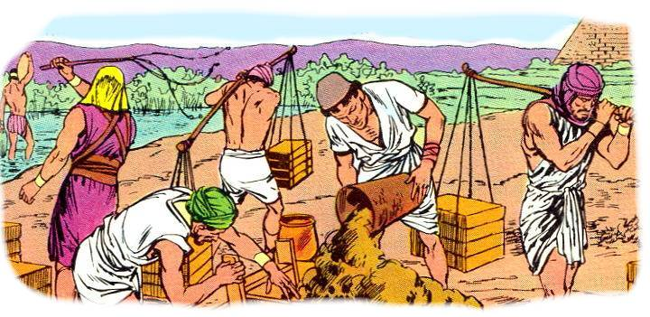
THE BIBLE
1 2 3 4 5 6 7 8
A,E
E
N
A
J
J - M
C
Pre Flood
CF
EB
F
EGYPTIAN BONDAGE
Gen. 47 – Ex 14 [ 1800 BC - 1446 B.C.] Joseph
Move to Egypt; Enslaved; Cry for Deliverance
Genesis

Slide 9
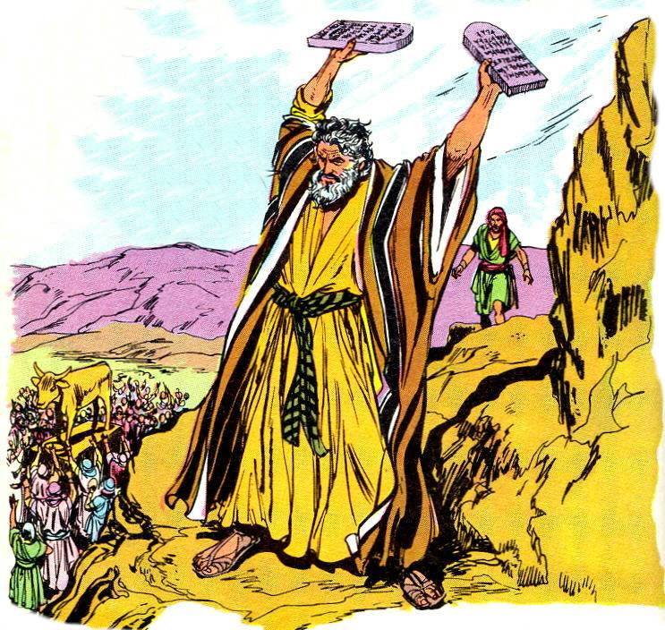
THE BIBLE
1 2 3 4 5 6 7 8
J J
M
A,E
E
N
A
C
Pre Flood
CF
WW
EB
WILDERNESS WANDERING
Ex 15 – Deut.
[ 1445 BC - 1405 B.C.] Moses
Deliverance; Red Sea; Aaron; Sinai; Mosaic Law; Tabernacle
F
Exodus
Leviticus
Genesis
Numbers
Deuteronomy

Slide 10
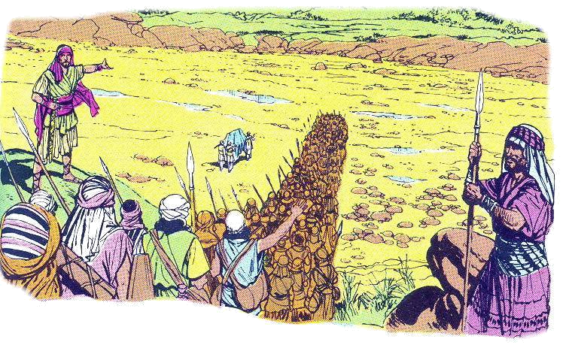
THE BIBLE
1 2 3 4 5 6 7 8
J J
M
J
A,E
E
N
A
C
Pre Flood
CF
WW
EB
CC
Joshua
F
Exodus
Leviticus
Genesis
CONQUEST OF CANAAN
Joshua [ c. 1400 BC ] Joshua
Gilgal; Jericho; Ai; Conquest Campaigns; Tribes receive land
Numbers
Deuteronomy

Slide 11
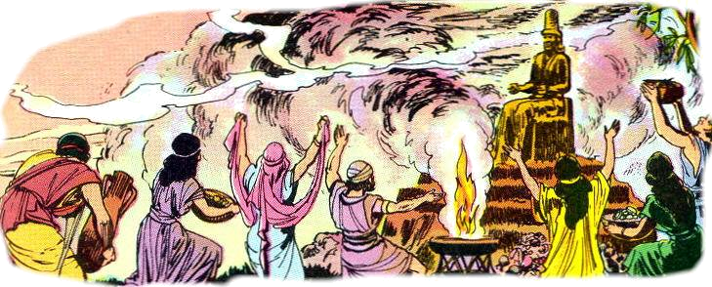
THE BIBLE
1 2 3 4 5 6 7 8
J J
M
J
Ju
A,E
E
N
A
C
Pre Flood
CF
WW
EB
CC
Judges
Joshua
F
Exodus
TIME OF THE JUDGES
Judges & Ruth [c. 1400 - 1043 BC ]
Othniel; Deborah; Gideon; Samson; Samuel
Judges
Leviticus
Genesis
Numbers
Deuteronomy

Slide 12
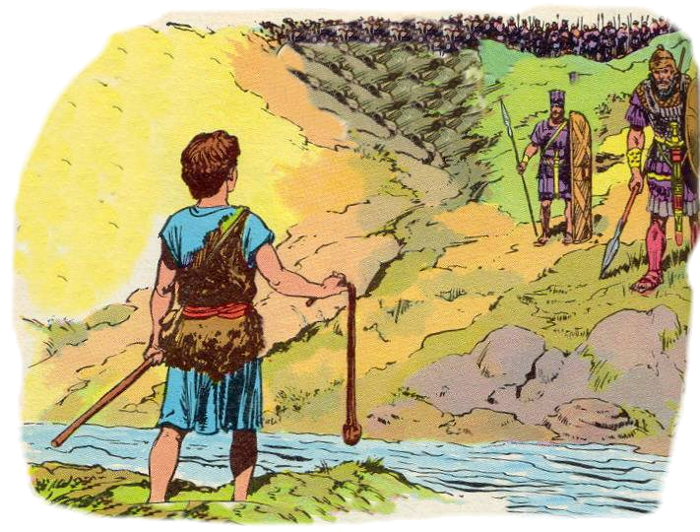
THE BIBLE
1 2 3 4 5 6 7 8
J J
M
J
Ju
S
D
S
A,E
E
N
A
C
Pre Flood
CF
WW
UK
EB
CC
Judges
Joshua
F
Exodus
THE UNITED KINGDOM
1 & 2 Samuel – 1Ki. 11 [c. 1043 - 932 BC ]
Saul; David; Solomon; Israel powerful & rich
Judges
Leviticus
Genesis
1Sam
Numbers
2Sam
Deuteronomy
1Ki

Slide 13
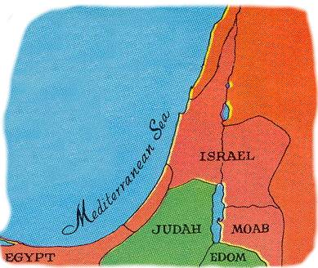
THE BIBLE
. . . Old Testament
8 9 10 11
Israel
A
J2
J
THE DIVIDED KINGDOM
1Ki. 12 – 2Ki 15 [c. 931 - 721 BC ]
Israel 10 tribes; @ 20 kings; Jeroboam; Ahab
Judah 2 tribes; Rehoboam; Jehoash; Hezekiah
S
D
S
UK
R
J
H
Judah
(2 tribes)
Divided Kingdom
1 Kings;---------2 Kings-------------------------

Slide 14
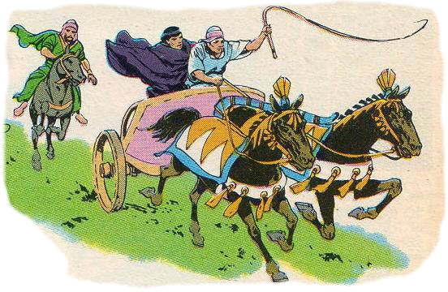
THE BIBLE
. . . Old Testament
8 9 10 11
Israel
Assyrian Captivity
A
J2
J
E
E
S
D
S
UK
I
J
R
E
J
H
D
Judah
(2 tribes)
THE DIVIDED KINGDOM
PROPHETS: [c. 931 - 721 BC ]
Elijah; Elisha; Jonah; Amos; Hosea; Isaiah; Micah
Babylonian Captivity
Divided Kingdom
1 Kings;---------2 Kings-------------------------

Slide 15
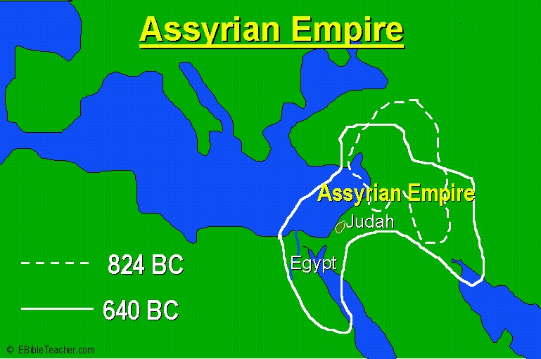

Slide 16
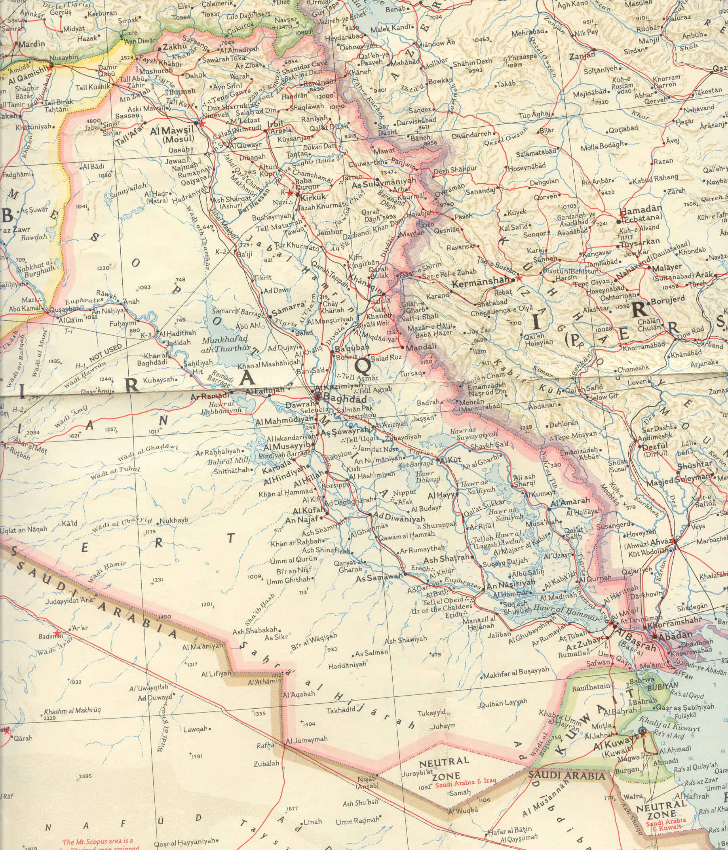

Slide 18
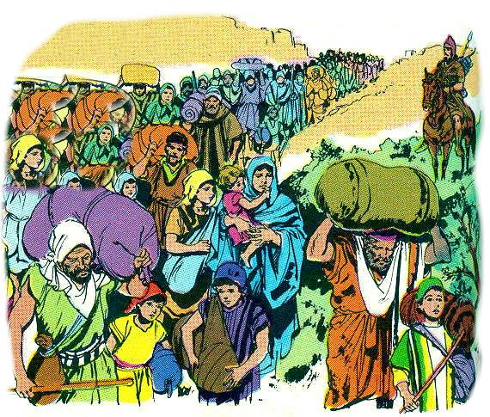
THE BIBLE
. . . Old Testament
8 9 10 11
Israel
Assyrian Captivity
A
J2
J
E
E
S
D
S
UK
I
J
R
E
H
H
J
Z
D
Judah
(2 tribes)
JUDAH ALONE and CAPTIVITY
2 Kings 15 – 25 [ 721 BC - 536 BC ]
Kings: Hezekiah; Josiah;
Prophets: Jeremiah, Daniel; Ezekiel
Babylonian Captivity
Divided Kingdom
1 Kings;---------2 Kings-------------------------

Slide 19
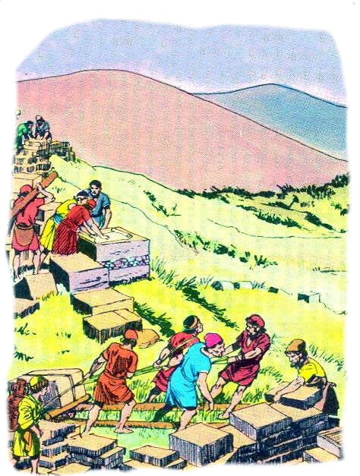
THE BIBLE
. . . Old Testament
8 9 10 11
Israel
Assyrian Captivity
A
J2
J
RESTORATION (Return from Exile)
Ezra, Neh. Esther [536 BC - 400 BC ]
Persia conquers Babylon
Zerubabel rebuilds the temple
Ezra rebuilds the people
Nehemiah rebuilds the walls
Prophets: Haggai, Zechariah, Malachi
E
E
S
D
S
Z
E
N
UK
I
J
M
H
R
E
Z
H
H
J
Z
D
Judah
(2 tribes)
Restoration
Babylonian Captivity
Divided Kingdom
1 Kings;---------2 Kings-------------------------

Slide 20
THE BIBLE
Old Testament
New Testament
1 2 3 4 5 6 7 8 9 10 11

Slide 21
THE BIBLE
New Testament
12 13
The Gospels
The Church

Slide 22
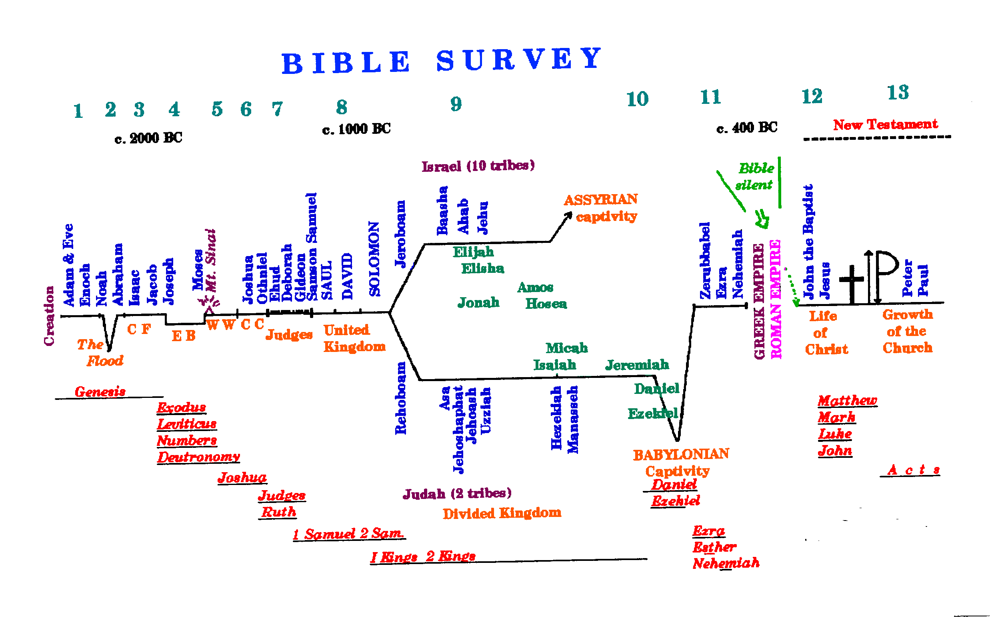

Slide 23

^{Romans} 15:⁴ For whatsoever things were written aforetime were written for our learning, that we through patience and comfort of the scriptures might have hope.

Slide 24

God’s Love, Mercy, and Compassion
Is affirmed in the Old Testament
We can be sure of his grace toward us.

