Slide 1
Intro to Python & Jupyter
Jason Kai
September 20, 2019
Notes:
General point: break down figures a bit more

Slide 2
Why Python
Free & open-source
Reproducible code
Large number of use-developed packages (eg. Nibabel, nilearn, dipy)
Easy interaction with neuroimaging software (eg. FSL, ANTS)
Goal is not to teach everything about Python, but introduce the language, as well as potential applications
Notes:
<number><number><number>

Slide 3
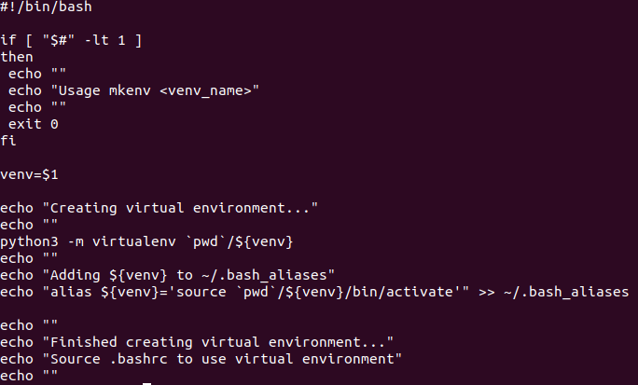
Virtual Environment
Isolated python environments
  Keeps dependencies for different projects separate
  Need to install dependencies for each environment
For this tutorial, a virtual environment has already been created on Graham with required dependencies...
Notes:
<number><number><number>

Slide 4
Tutorial on Graham
Source /scratch/tkai/scwg2018_python_neuroimaging/setup_workshop
Notes:
<number><number><number>

Slide 5
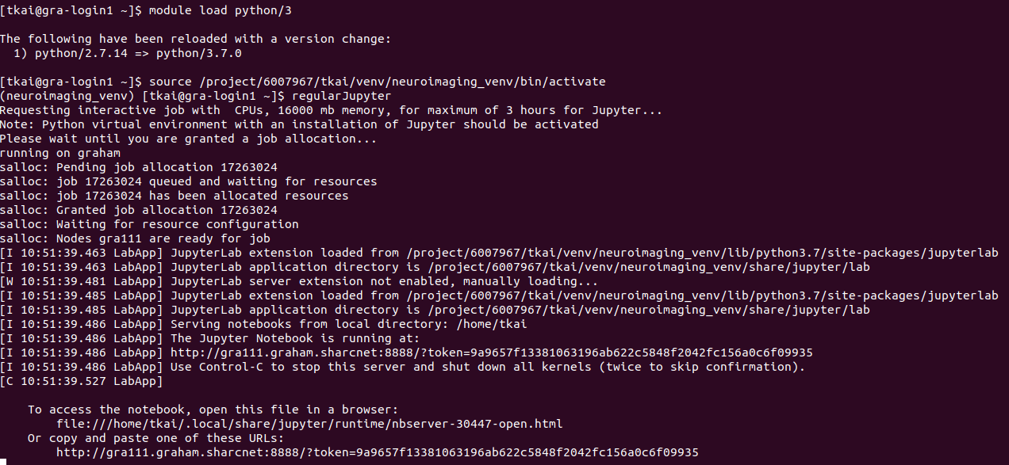
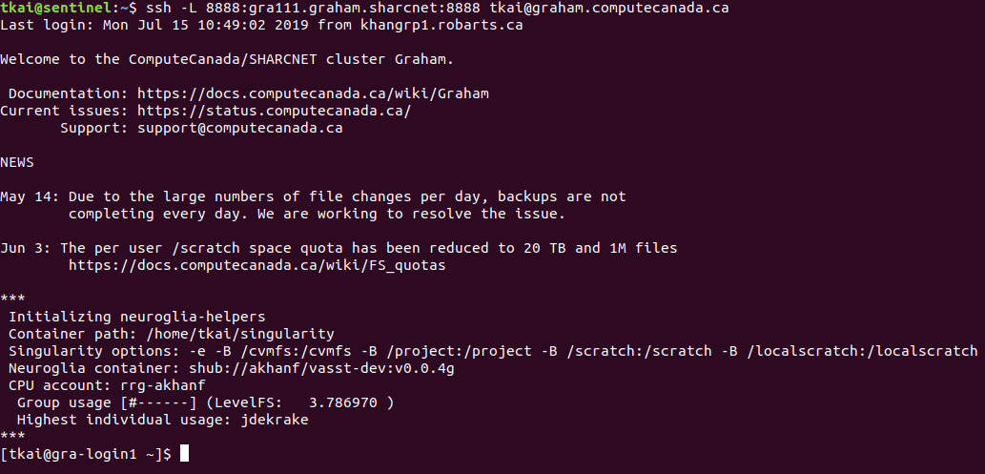
Jupyter on Graham (https://tinyurl.com/graham-jupyter)
Detailed instructions for setting up on Graham in above link
1
2
3
Notes:
<number><number><number>

Slide 6
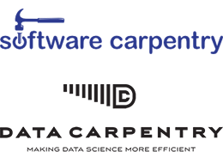

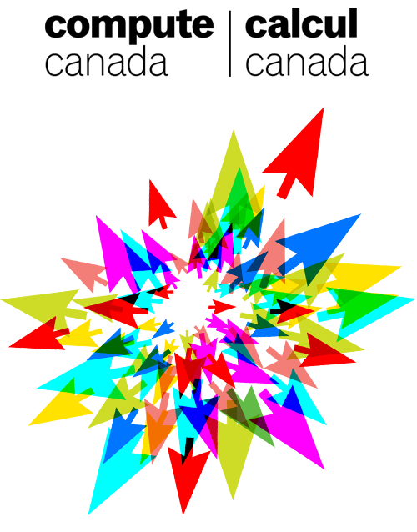

Acknowledgements
Jerry Jeyachandra
(https://github.com/jerdra)
Michael Joseph
(https://github.com/josephmje)
Olivia Stanley
(https://github.com/ostanley)
Roy Haast
(https://github.com/royhaast)
Notes:
<number><number><number>

