Slide 1
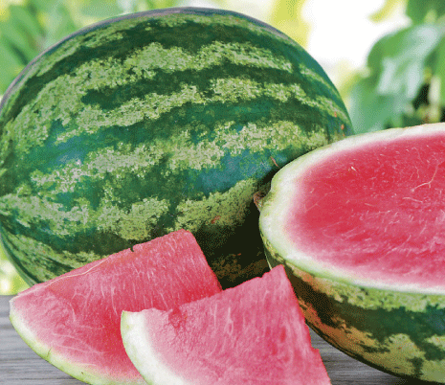
Watermelon Ripeness Tester

Slide 2
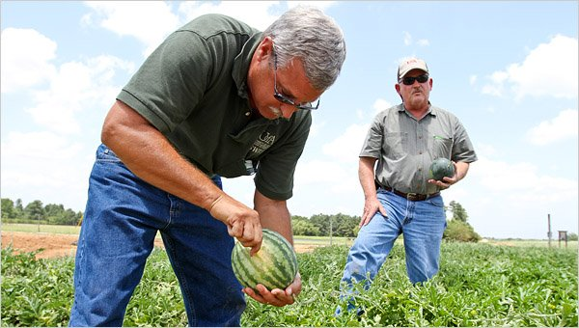
Goal
Produce an autonomous machine that determines harvestability of watermelons using sound waves.

Slide 3
Current Techniques Used by Farmers
Currently, farmers have about a 10% waste ratio when testing watermelons for ripeness.
To ensure quality, one in ten watermelons have to be broken open and tested for ripeness. They guess ripeness based on color, shape, and size but have no way to accurately test without producing large amounts of waste.

Slide 4
Method
To test the watermelon in an unobtrusive way, we used soundwaves to determine the ripeness of the watermelon.
We send the sound in on one side, and use a microphone to determine the frequency returned on the other side of the watermelon. Depending on the frequency, we can determine if the watermelon is ripe and ready to harvest, or if it is not yet ready.

Slide 5
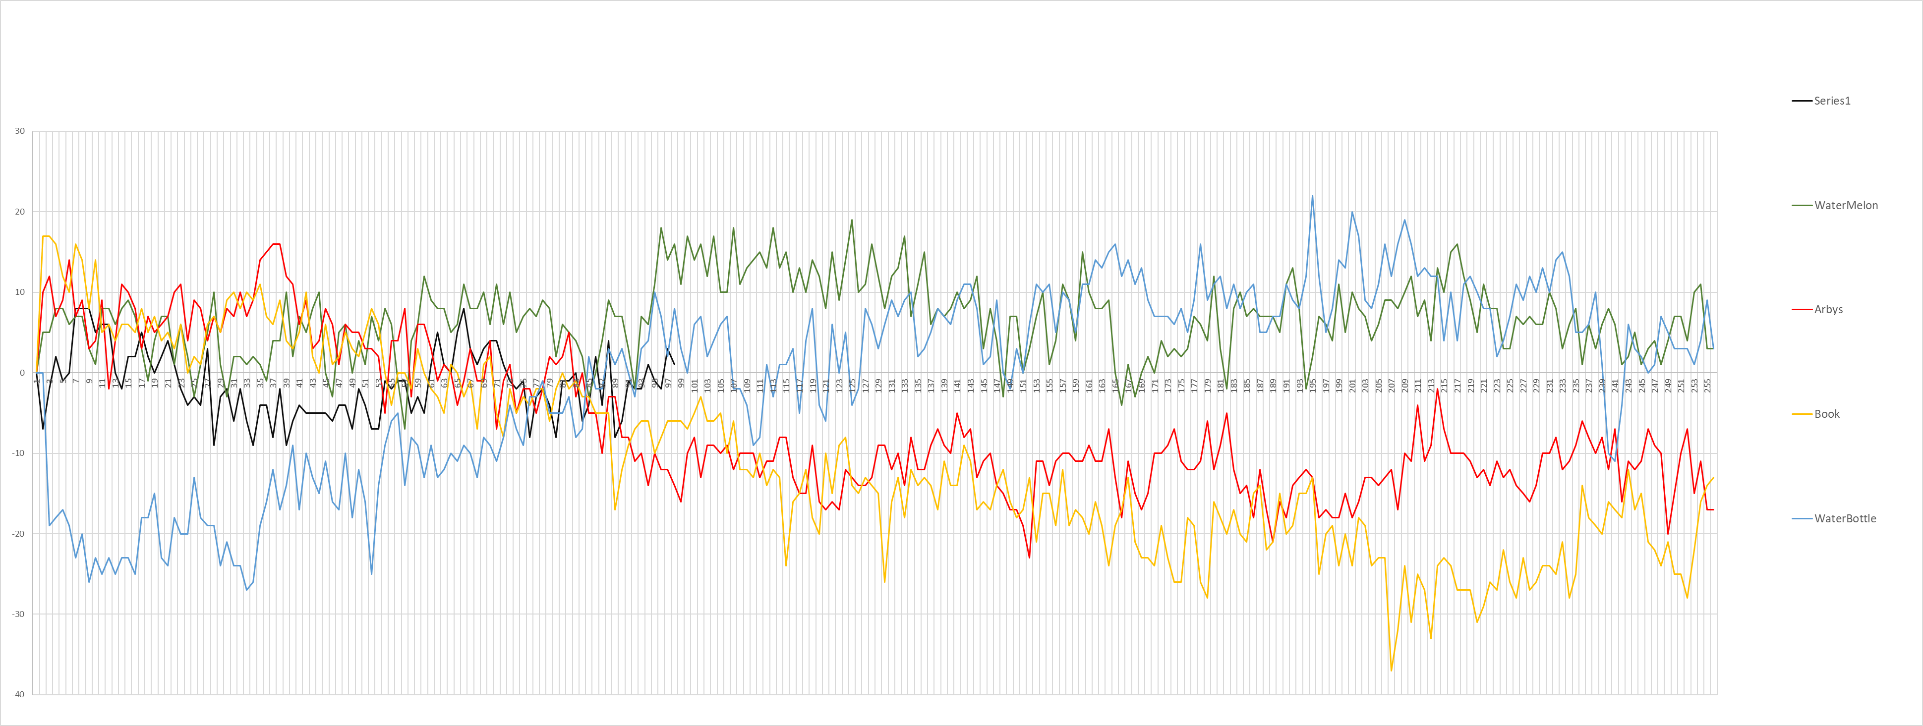
Results: Initial Testing

Slide 6
Results: Final Watermelon Testing

Slide 7
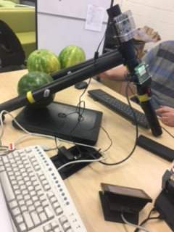
Product
Our prototype can detect the difference between a ripe and not ripe watermelon.
Components of the prototype include two Raspberry Pis, and a USB speaker and a USB microphone.

Slide 8
Improvements
Improve accuracy
1
Be able to determine difference between ripe, under ripe and over ripe.
2
Improve functionality with adjustments such as making prototype waterproof so watermelon farmers can use it out in their farm.
3

