Slide 1
THE KITTY CABIN
Kaitlin Hoffmann
Team ID: 12
Folder: b-f19-06
E-Business, Professor Pham, Fall 2019

Slide 2
OUTLINE
1. Business Model
1.1 Business Context and Goals
1.2 Technical Requirements & Technologies
2. Architecture
2.1 Website
2.2 API
3. Protocols
3.1 Descriptions
3.2 Diagrams
4. Databases
5. Schedule

Slide 3
BUSINESS MODEL 1.1 BUSINESS CONTEXT AND GOALS
What kind of business are we?
A retail e-business meant for cat lovers in need of some comfortable sleep wear who want to have the cutest cats on their clothes…my cats!
Target Demographic:
Adults and children, men and women, anyone is a potential customer! Unless you hate cats.
We don’t want your service. There were over 61 million households in 2017-2018 that owned
a cat in the United States according to a survey from the American Veterinary Medical
Association. All potential cat lovers and customers!!
Catalog Items:
Pajama Bottoms: Available in either shorts or long pants. Bottoms are layered images of Gigi and her cute face.
Night Shirts: Shirts with a picture of Harry in his coolest pose.
Tank Tops: Tanks with an image of Earl hanging out enjoying life.
Socks: Socks with a headshot of Jerry and his blank expression.

Slide 4
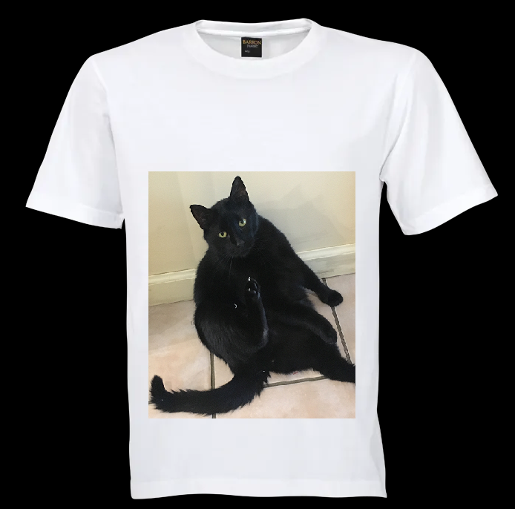
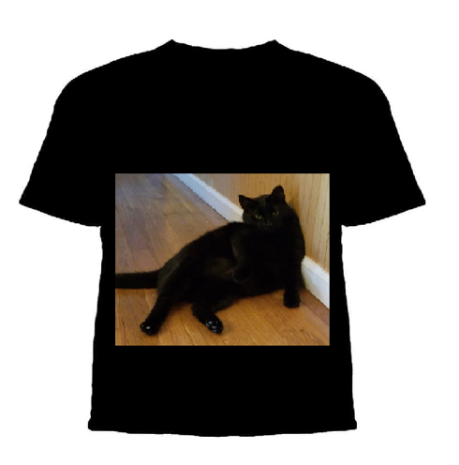
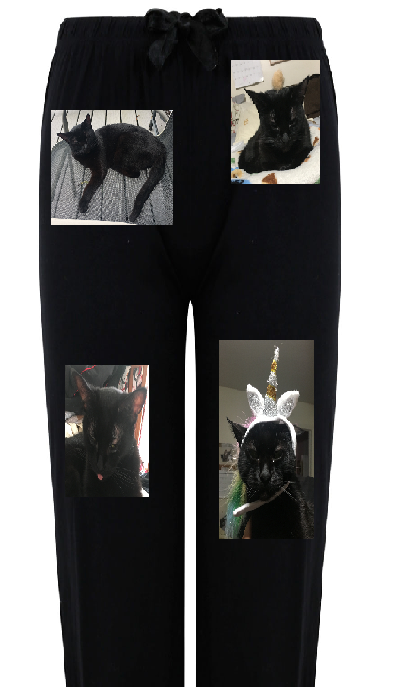
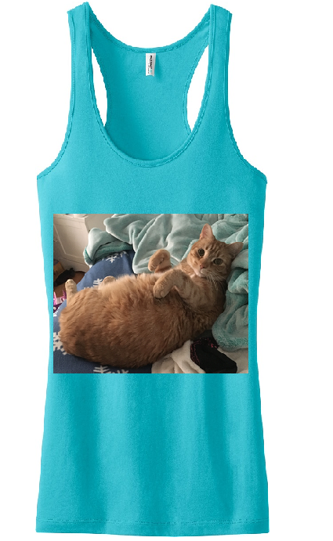
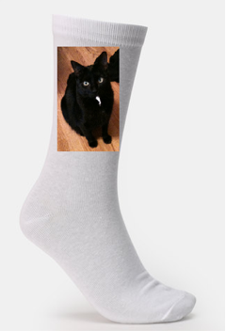

Slide 5
BUSINESS MODEL 1.2 TECHNICAL TECHNOLOGIES & REQUIREMENTS
Platform and Specifications:
Apache server with Linux OS
We’re expecting a few hundred customers daily so At least 16 GB of RAM with 2 intel core CPUs (2.66 GHz).
Middleware:
Keeping it simple! CGI. Not intending to use a framework.
Programming Languages:
Web Pages: HTML, CSS, JavaScript
CGI: Python
SOCKETS: Java
Database: MySQL

Slide 6
BUSINESS MODEL 1.2 TECHNICAL TECHNOLOGIES & REQUIREMENTS
The Kitty Cabin e-business system will have a Website and a socket based API
A. Website:
Users: Admin, Public and Registered Customers
Components: Home Page, Registration, Login, View Catalog, Shop (add/delete items from cart), Checkout, Order and Pay for items.
B. API:
Users: Retail and service businesses such as Shipping, Bank, Mayor and IT Services businesses.
Components:
Client Socket that connects to a server socket to ask a question. Allows The Kitty Cabin to connect to the Shipping, Bank, Mayor and IT Services businesses in order to use their services.
Server Socket that connects to client socket to give a response. Allows other businesses to order from The Kitty Cabin.

Slide 7
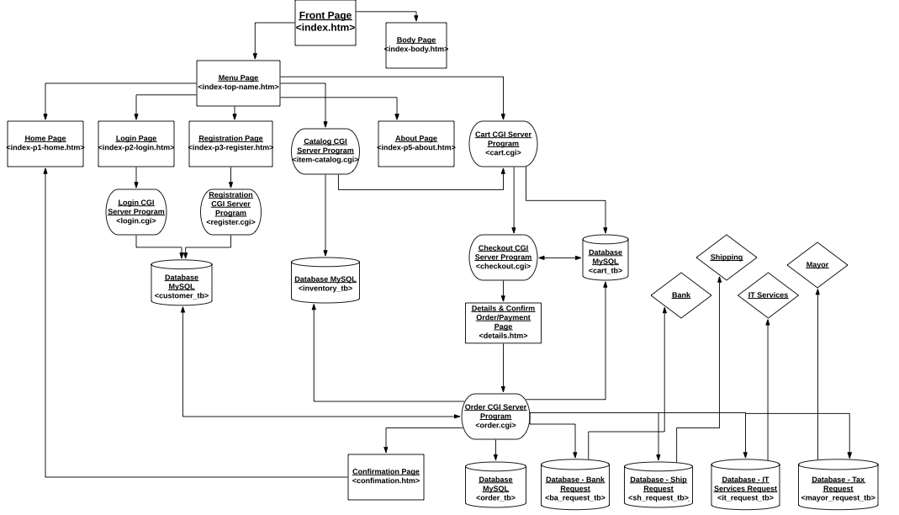
ARCHITECTURE WEBSITE

Slide 8
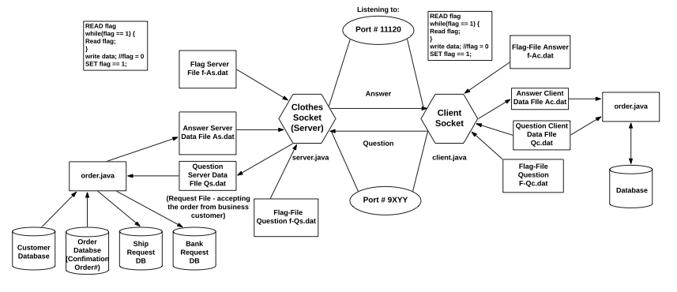
ARCHITECTURE API THE KITTY CABIN AS THE SERVER

Slide 9
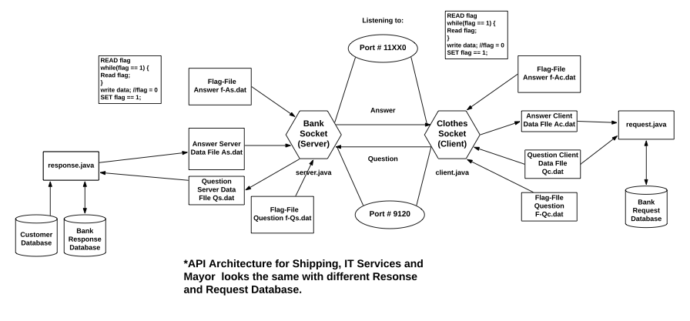
ARCHITECTURE: API THE KITTY CABIN AS THE CLIENT

Slide 10
PROTOCOLS 3.1 TRANSACTIONS
T0: Registration
Allows customers to create an account in order to shop and buy items. Customer must fill form out with name, password, address, debit card number.
T1: Login
Allows customers to log into their account allowing them to shop and purchase items. Must fill out form with name and password. Uses Customer database.
T2: View Catalog
Customers can look at item pages that are created through catalog CGI program. Uses Inventory Database.
T3: Shop (add/delete)
Customers can add and delete items from their cart. Uses a cart CGI program. Uses inventory and cart database.
T4: Payment/Checkout
Customers provide and/or confirm debit card information through a checkout form created from a checkout CGI program. Uses customer database.
T5: Confirm Order:
Allows customers to confirm orders and input bank information. Order CGI program updates inventory, cart, order and customer database. Fetches data from customer table. Ship and bank requests are sent through sockets. Shipping and banking companies sends confirmation number allowing payment to be confirmed. Customer is sent back to the homepage.

Slide 11
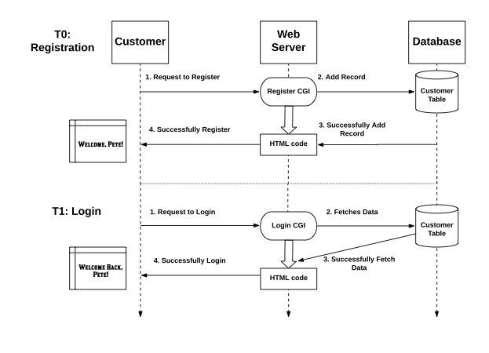
PROTOCOLS 3.2 DIAGRAMS

Slide 12
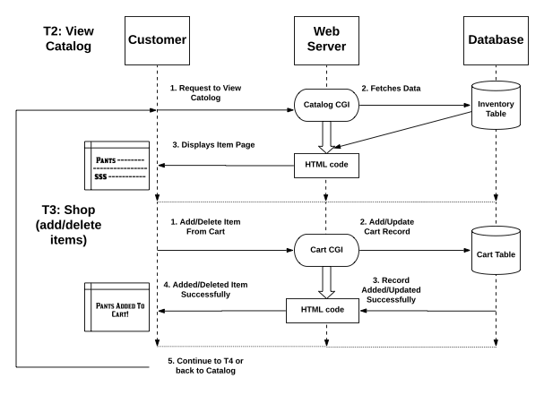
PROTOCOLS 3.2 DIAGRAMS

Slide 13
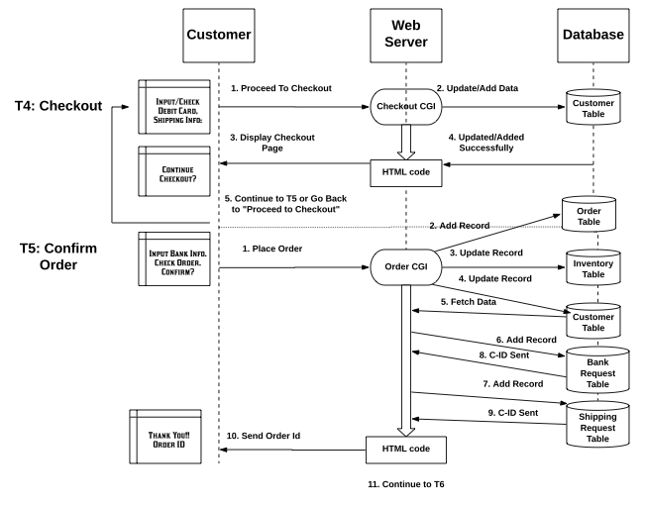
PROTOCOLS 3.2 DIAGRAMS

Slide 14
DATABASES
Customer Record - customer_tb:
customer_id | password | name | address | debit_card_num | orders
120001 | pirAtes532@ | Pete Johnson | 1 Cherry Avenue | 344698613060116 | 122001
120002 | catzRUle123!# | Amy Vaquez | 3 Kentucky Road | 6011496656186172 | 122002
Inventory Record - inventory_tb:
item_id | current_quantity | current_price | size | in | out | item_name | item_picture
121001 | 352 | 19.95 | M | 400 | 48 | harry shirt2 | cottonshirt.jpg
121002 | 286 | 24.95 | M | 300 | 14 | gigi bottom | pajamabottom.jpg
Order Record - order_tb:
order_id | customer_id | item_id_ordered | quantity | ship_method | ship_address | debit_card_num
122001 | 120001 | 121001 | 48 | 2 | 1 Cherry Avenue | 344698613060116
122002 | 120002 | 121002 | 14 | 1 | 3 Kentucky Road | 6011496656186172
Cart Record - cart_tb:
cart_id | customer_id | item_id_added | quantity
123001 | 120001 | 121002 | 2
123002 | 120002 | 121001 | 5

Slide 15
DATABASES
Shipping Requests - ship_request_tb:
customer_id | password | c_request_id | item_id_ordered | quantity | ship_method | ship_address
120001 | pirAtes532@ | 121000-3 | 121001 | 48 | 2 | 1 Cherry Avenue
120002 | catzRUle123!# | 121000-3 | 121002 | 14 | 1 | 3 Kentucky Road
Bank Requests - bank_request_tb:
customer_id | password | c_request_id | payee_account_num | payer_account_num | Amount
120001 | pirAtes532@ | 121000-3 | 10023451 | 30492930 | 10000
120002 | catzRUle123!# | 121000-3 | 10024673 | 67392018 | 63401

Slide 16
SCHEDULE
Date | To Do | File Type
October 29 | Proposal Presentation | PDF
October 30 - November 2 | Customer Interface, Test | HTML
November 3-5 | Databases, Test | MySQL
November 6-8 | Web Server, Test | HTML, CGI
November 9 | Test
November 10-11 | Prepare Powerpoint/Demo | PDF
November 12 | Give Presentation and Demo
November 13-22 | Shop at other businesses
November 23-30 | Work on Final Report | Zip File
December 13 | Submit Final Report | Zip File

Slide 17
PICTURE REFERENCES

