Slide 1


Balancing Novelty and Replication: Insights from Evolutionary Simulations
Kati Harper, Felix Schönbrodt

Slide 2
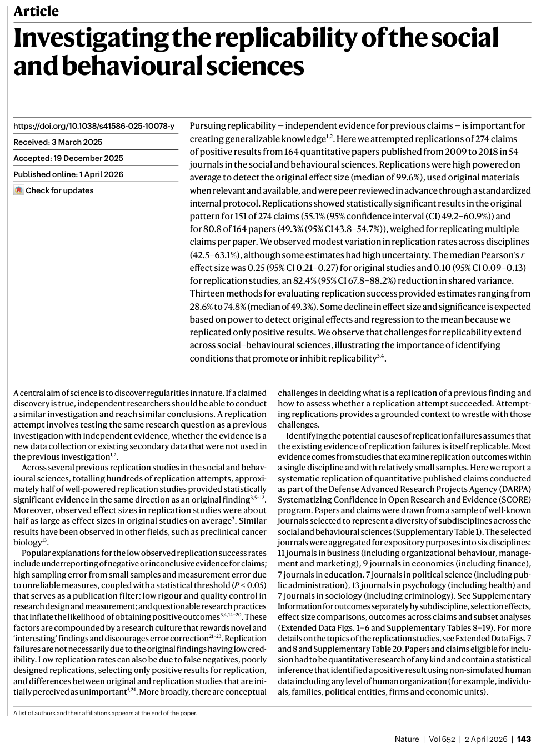
BACKGROUND
Given limited resources, what’s the ideal proportion of replication research?
Notes:
* DIRECT replications!!
With low prior odds, small sample sizes, and flexible analyses, the positive predictive value is less than 50%
Can we trust original published results?
Estimated positive predictive value is less than 50% (Ioannidis, 2005)
Considering all replications (n = 307), 64% reported statistically significant evidence in the same direction, with effect sizes 68% as large as in the original studies (Nosek et al., 2022)
0-3% of published research are replications (Makel et al., 2012; Hardwicke et al., 2020)
Debate about value of replications (Zwaan et al., 2018)
Direct replications provide a false sense of certainty about the robustness of the underlying idea
The current obsession with replication is a red herring, distracting attention from the real threats to the validity of cumulative knowledge
Replication studies – and especially failed replications – may have reputational costs for the authors of the original studies
Conducting replication studies may not be desirable – or even possible – merely because of practical concerns
Given fixed, limited resources: what’s the ideal proportion of replication research?

Slide 3
AGENT-BASED MODELLING
What is it?
Formalization of theories
Individual agents follow simple rules over many iterations
Micro interactions → system-level outcomes emerge
Has been used in metascience to simulate scientific ecosystems, funding schemes, researcher incentives, hypothesis choice…
Our approach
Selection pressure for truthful research via hiring practices
Observe the emergent ideal rate of replicator researchers
Notes:
Instead of hiring based on # of publications, what if hirers had “god-mode” and could hire researchers who contributed the most to actual knowledge gain

Slide 4
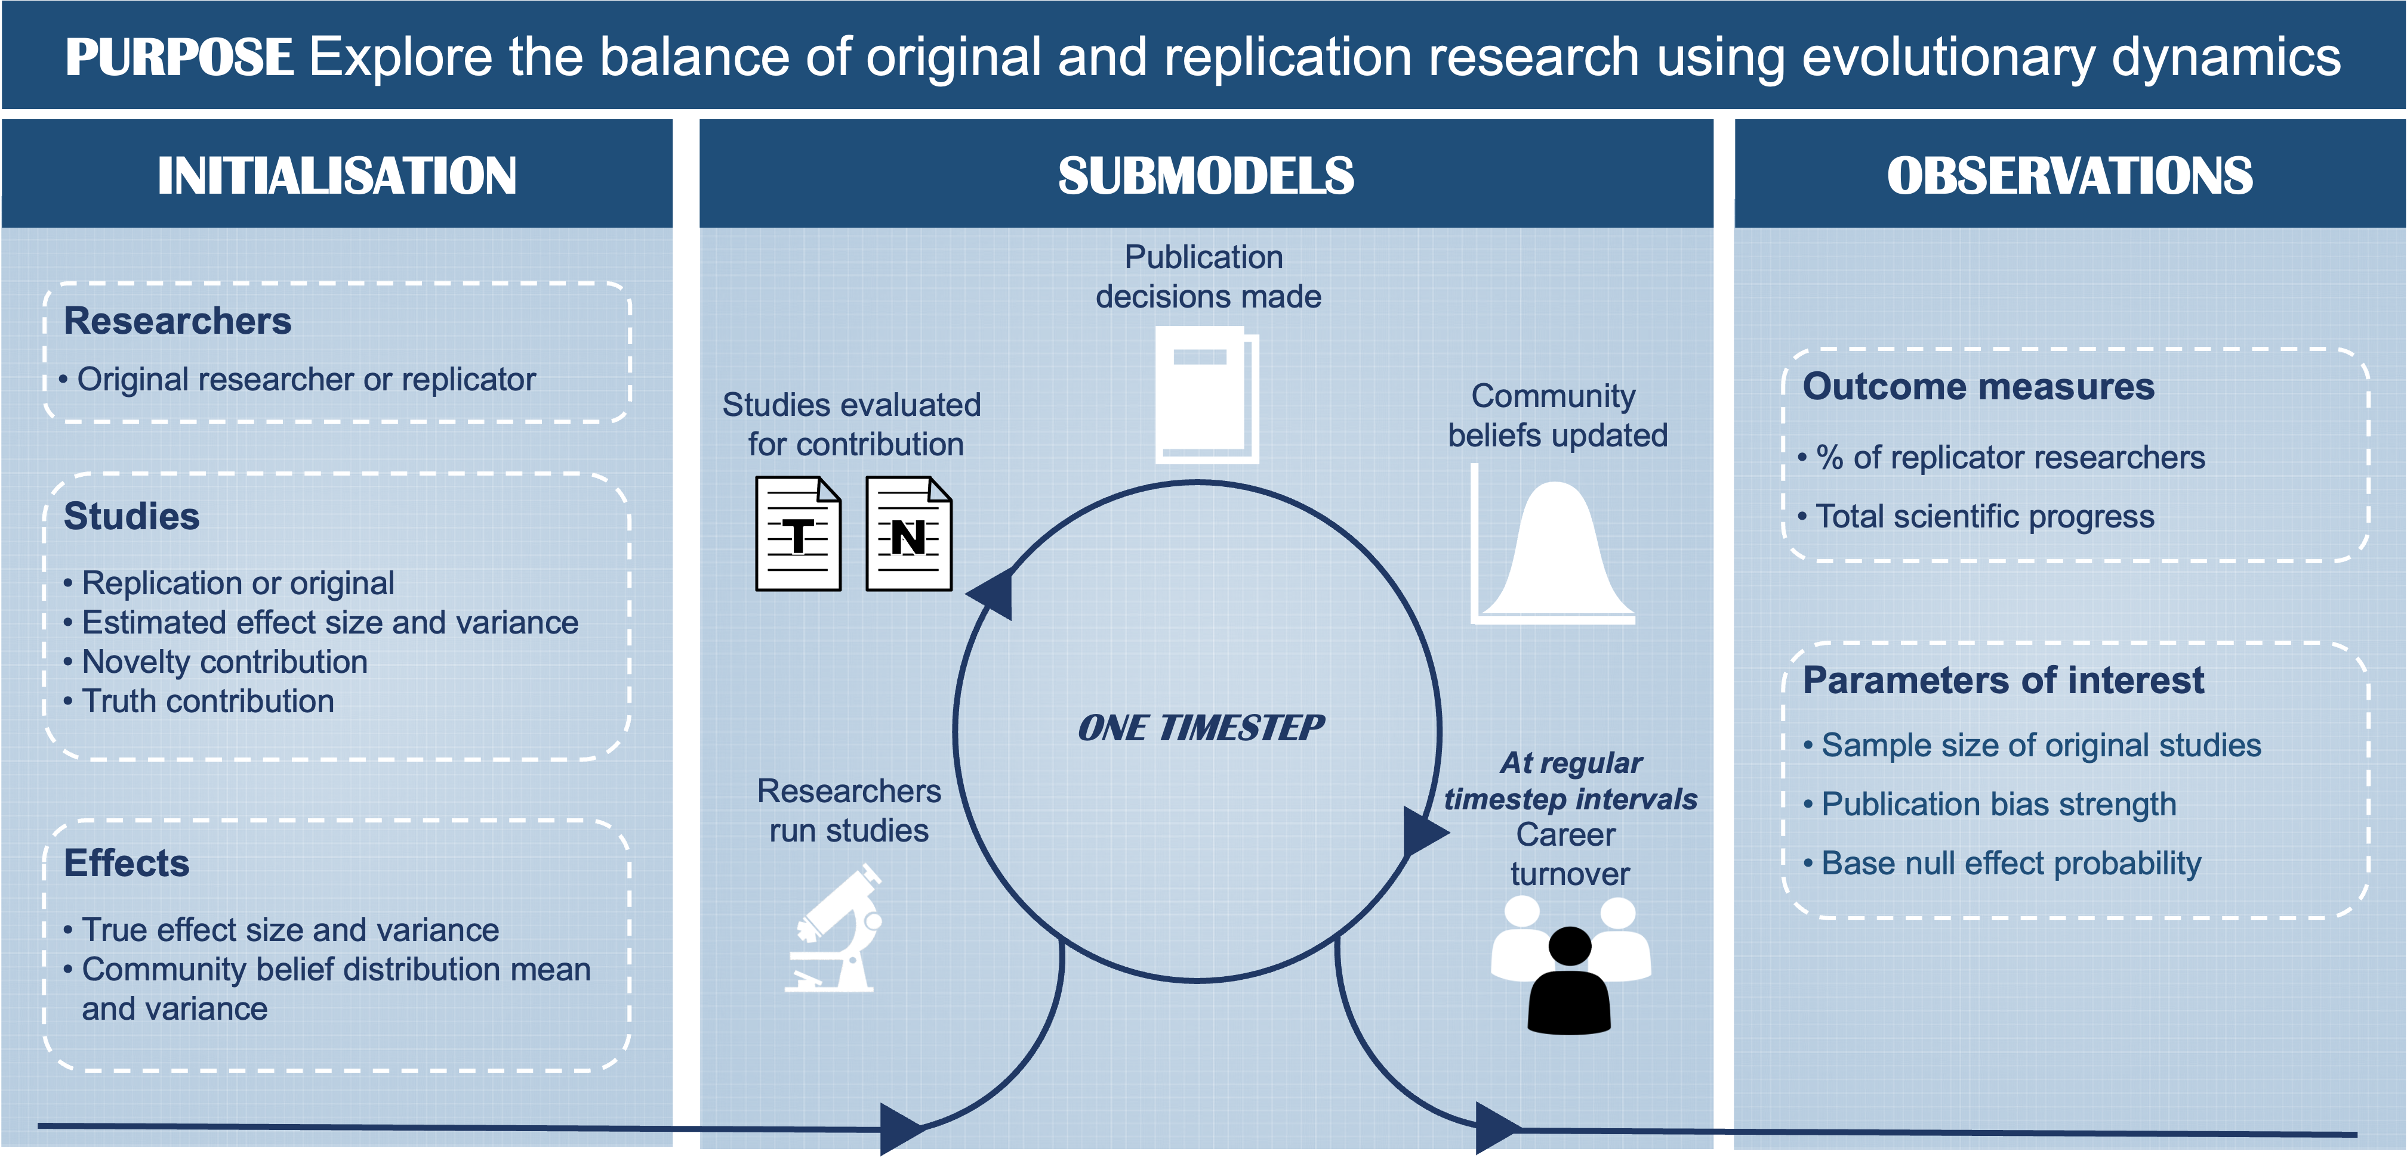
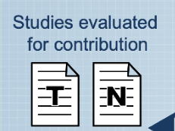
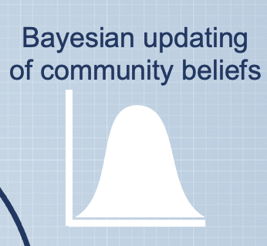

MODEL DIAGRAM
(ODD: OVERVIEW, DESIGN CONCEPTS, AND DETAILS; SZANGOLIES ET AL., 2024)
ENTITIES
Notes:
Bayesian belief updating

Slide 5
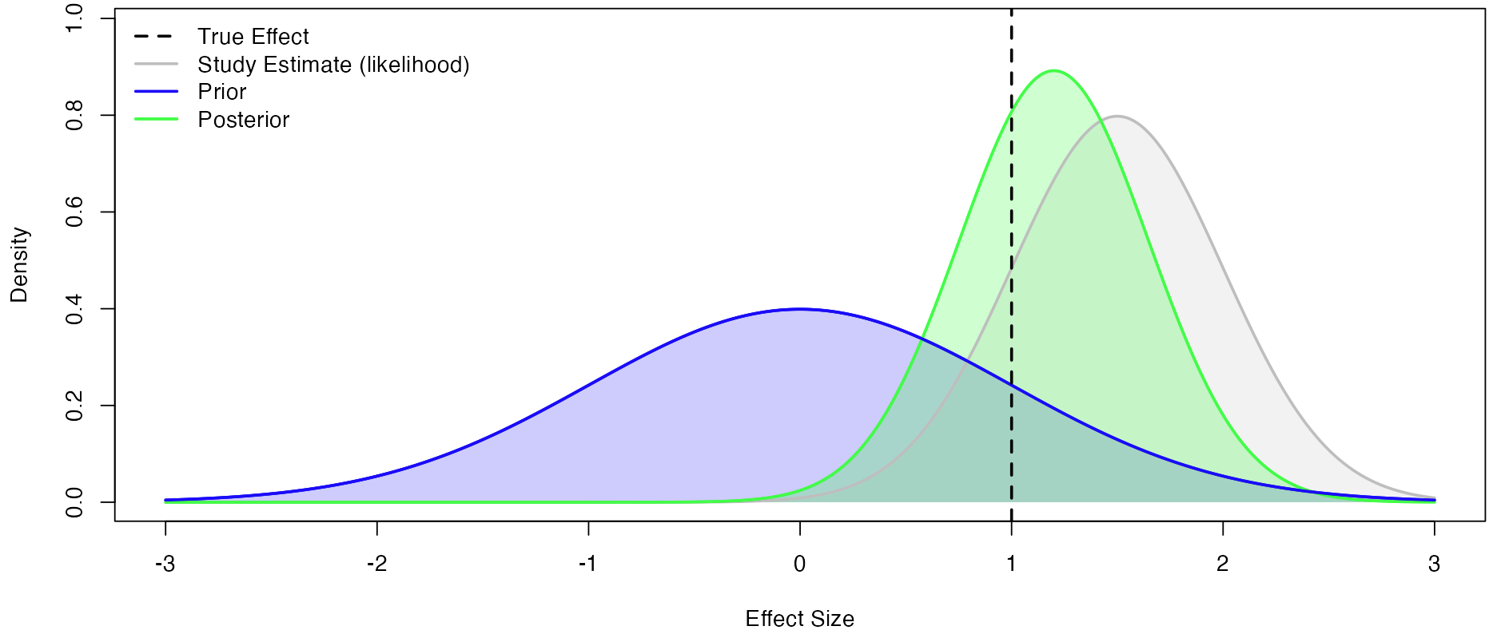
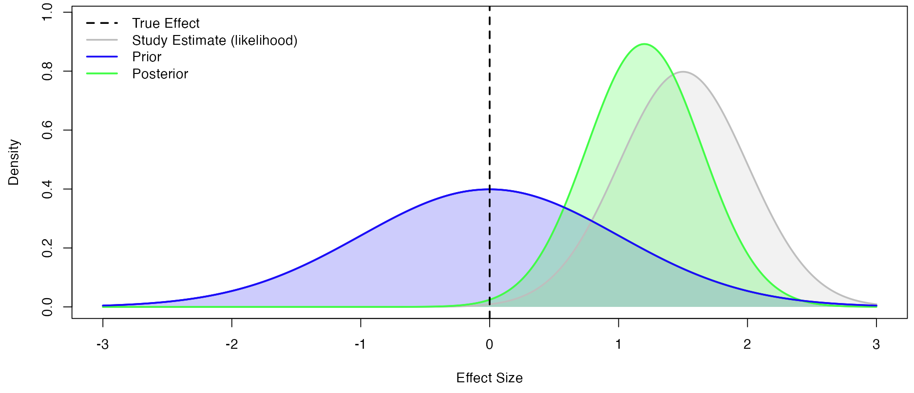


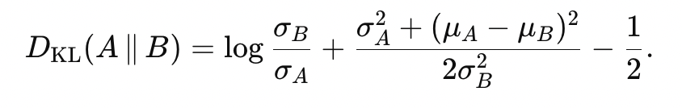
KEY MECHANISMS: Bayesian updating
Novelty: 1.1
Truth: -2.8
Novelty: 1.1
Truth: 1.2
Novelty contribution
Kullback-Leibler (KL) divergence: how surprised would we be if we believe (B) while (A) generates the data?
Truth contribution
The log Savage-Dickey density ratio at the true effect: the difference between the log density of the posterior at the true effect and the log density of the prior at the true effect.
Notes:
Where we were – where we are now
If positive, where we were was larger, therefore we were more wrong than we are now
If negative, where we are now is larger, therefore we are more wrong now than we were

Slide 6
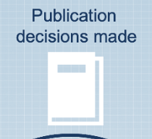
MODEL DIAGRAM
(ODD: OVERVIEW, DESIGN CONCEPTS, AND DETAILS; SZANGOLIES ET AL., 2024)
ENTITIES

Slide 7
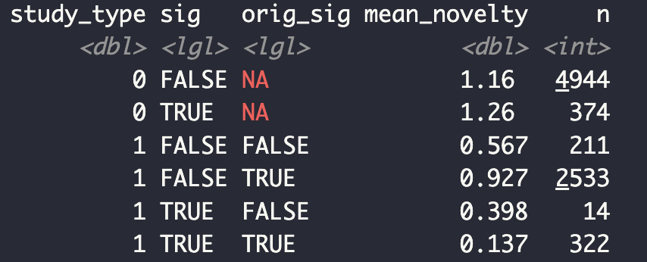
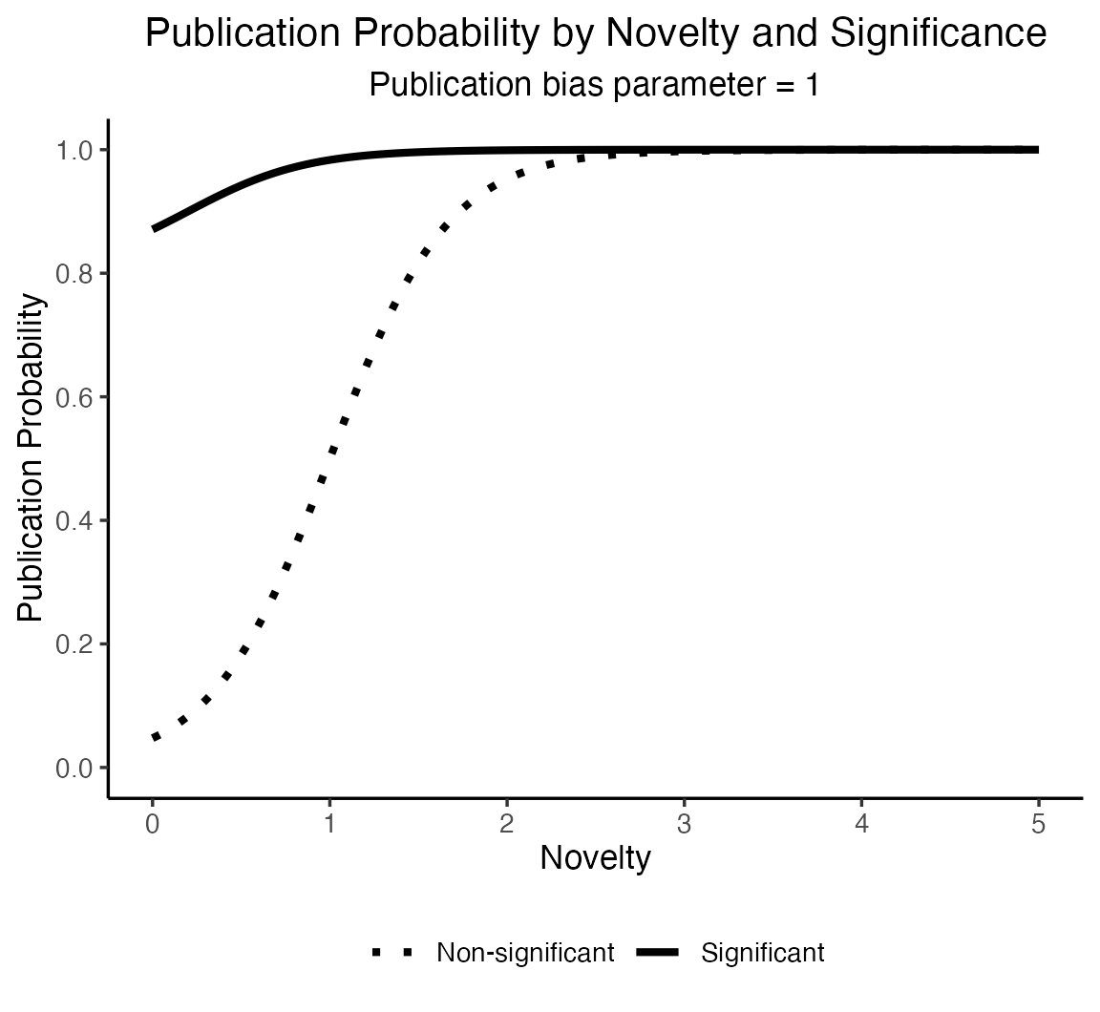
KEY MECHANISMS: Publication bias
Original
Significant
99%
Replication
Significant
85%
Replication
Non-significant
50%
Original
Non-significant
60%
Replication
Significant
90%
Replication
Non-significant
20%

Slide 8
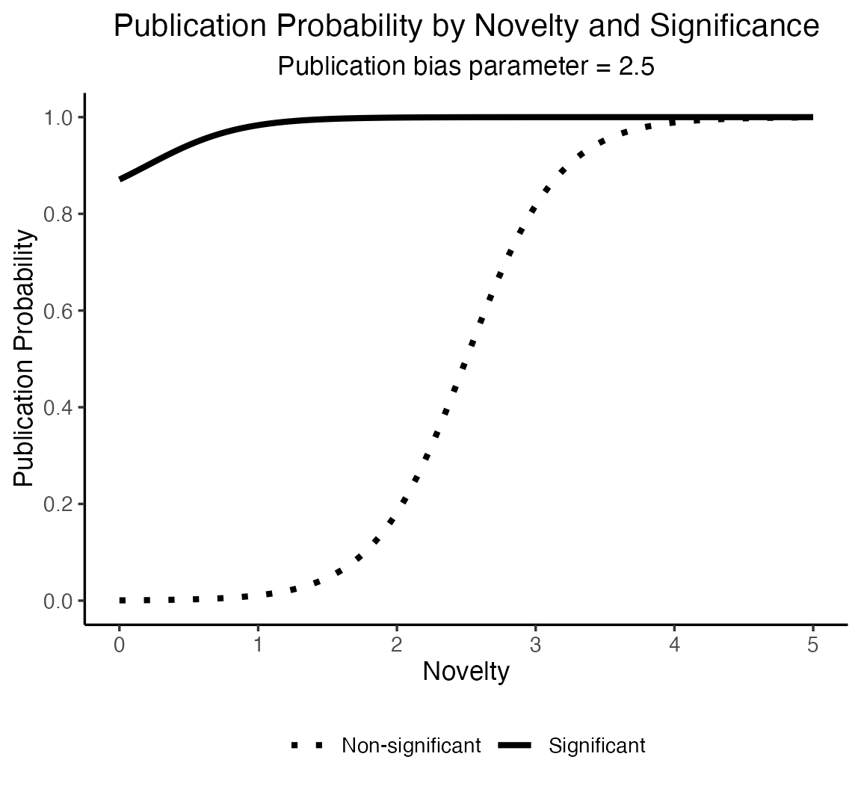
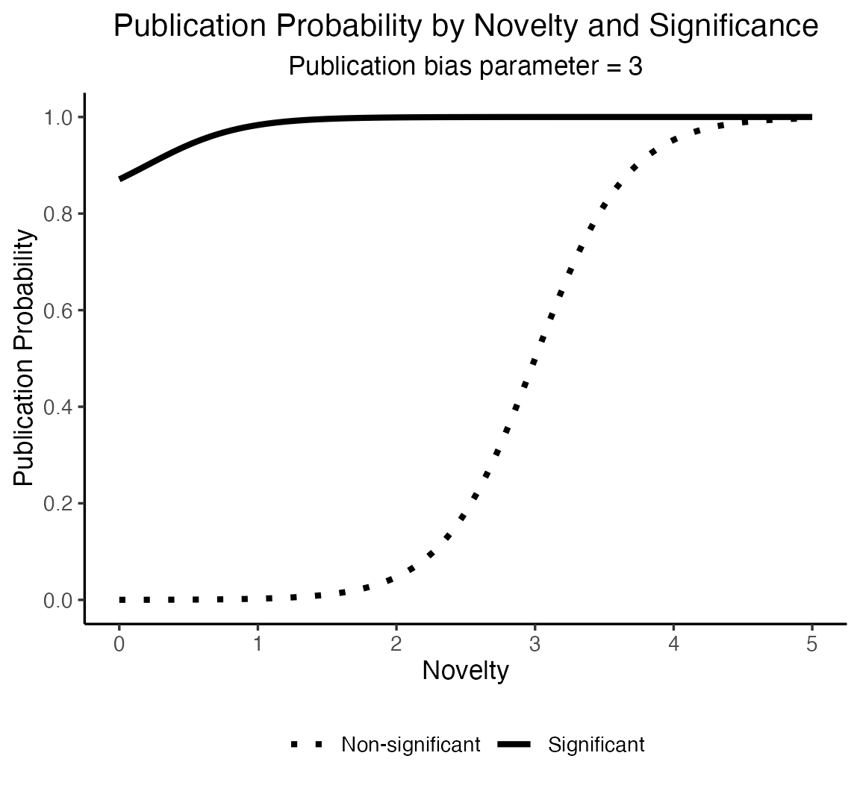

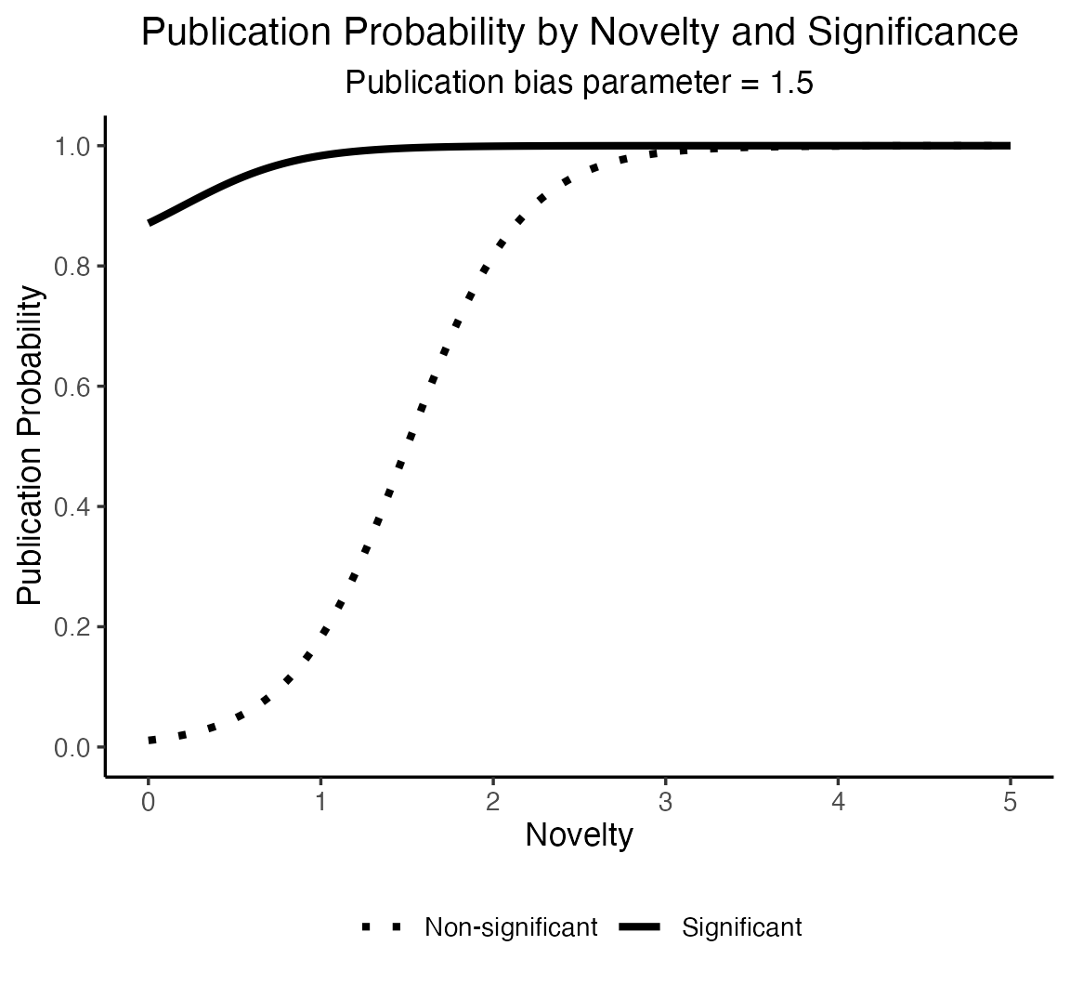
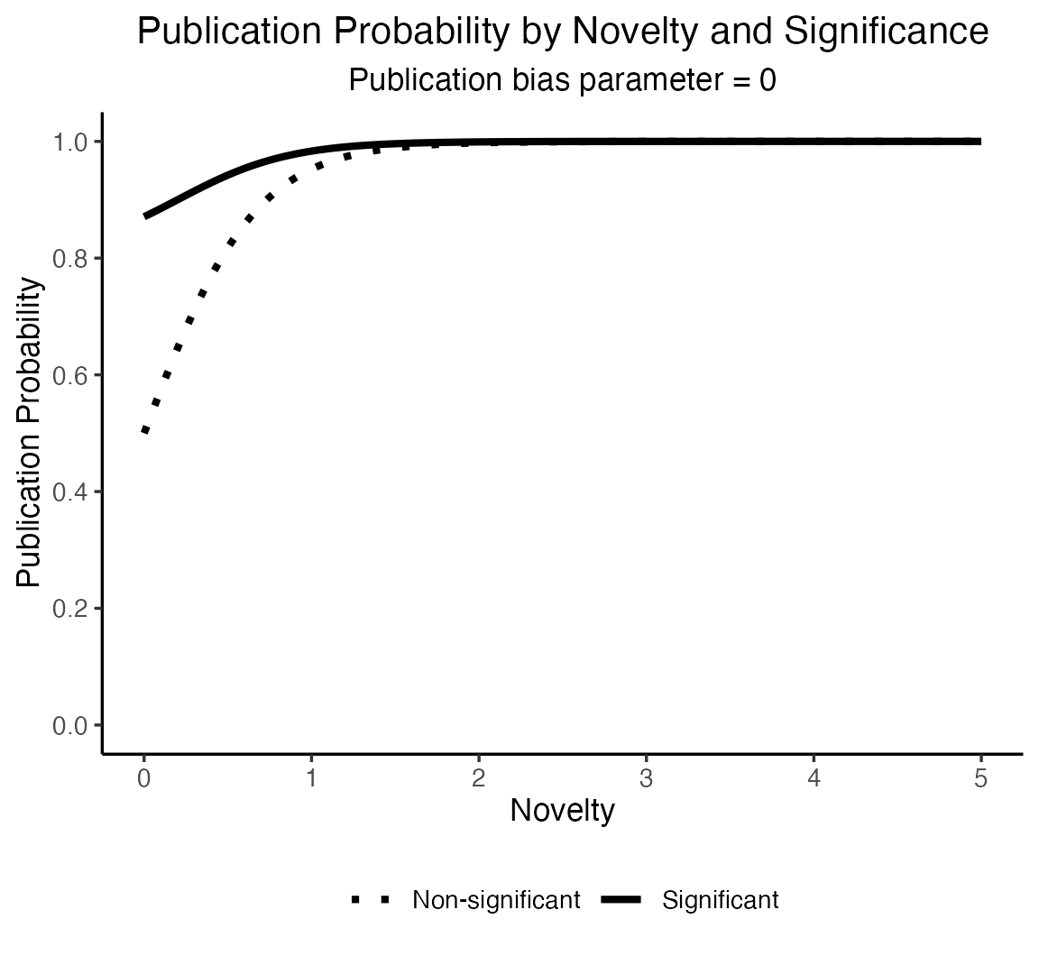
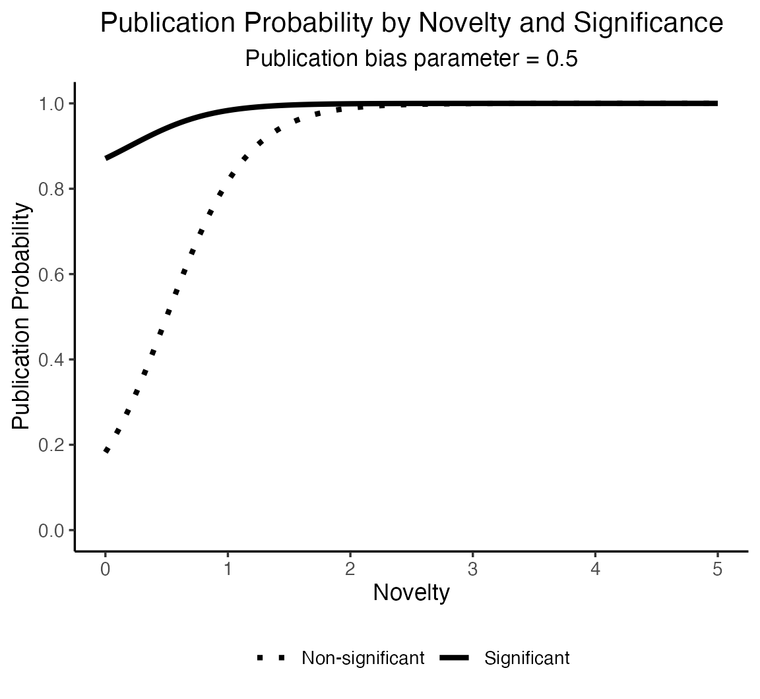
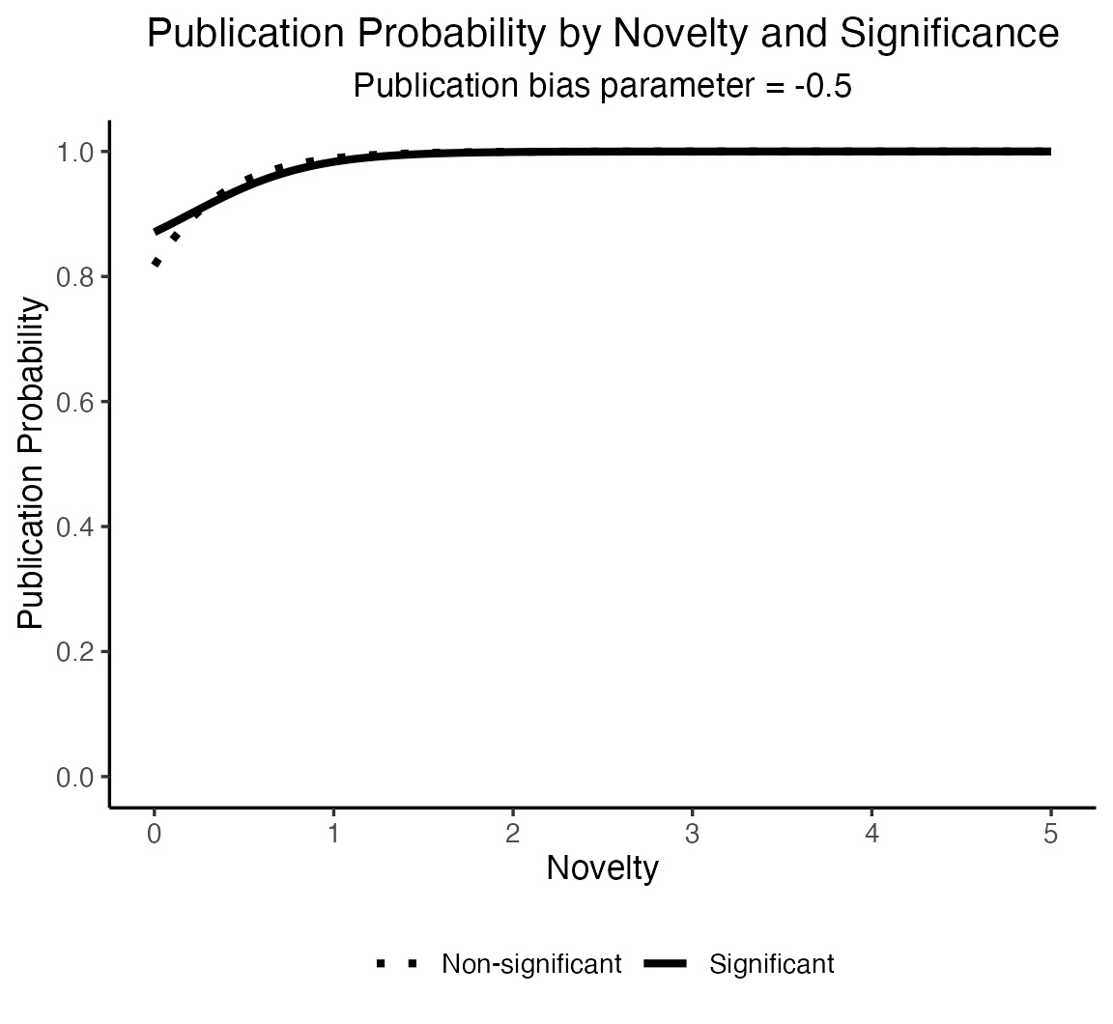
KEY MECHANISMS: Publication bias

Slide 9
MODEL DIAGRAM
(ODD: OVERVIEW, DESIGN CONCEPTS, AND DETAILS; SZANGOLIES ET AL., 2024)
ENTITIES

Slide 10
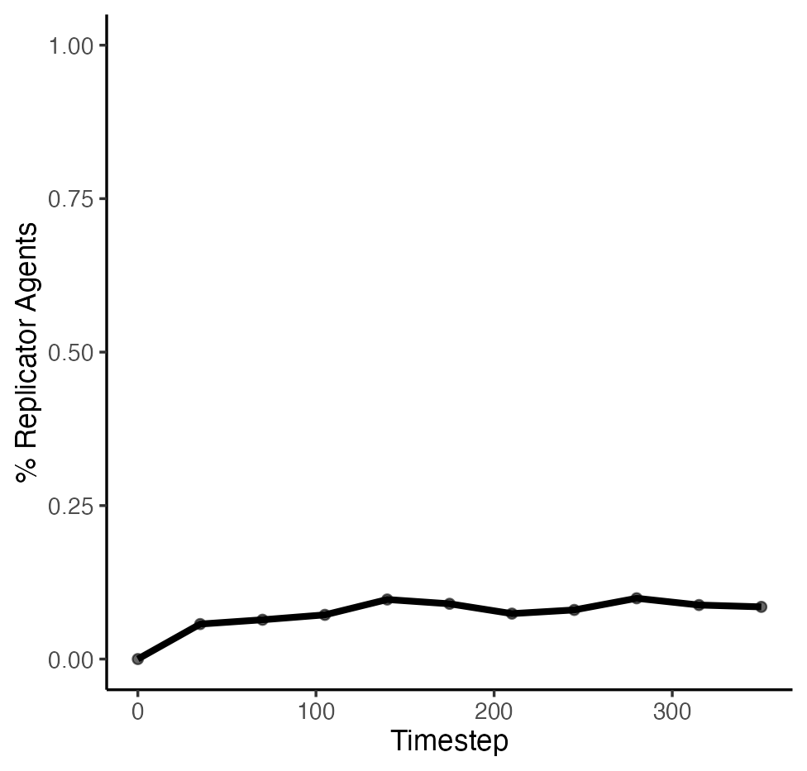
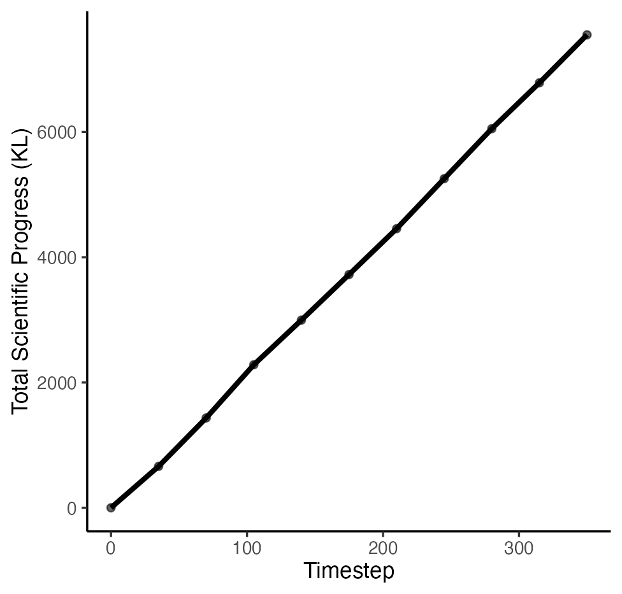
RESULTS: Single simulation
Sample size = 30 per group
Publication bias = 1.5 (medium)
Base null probability = 0.9

Slide 11
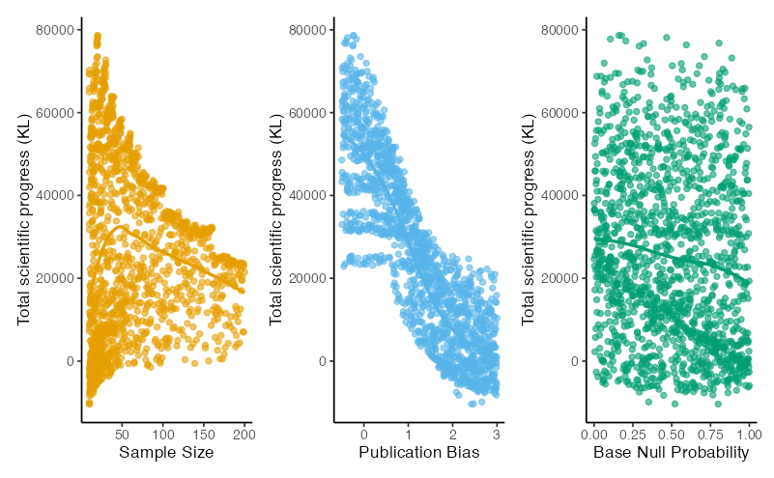
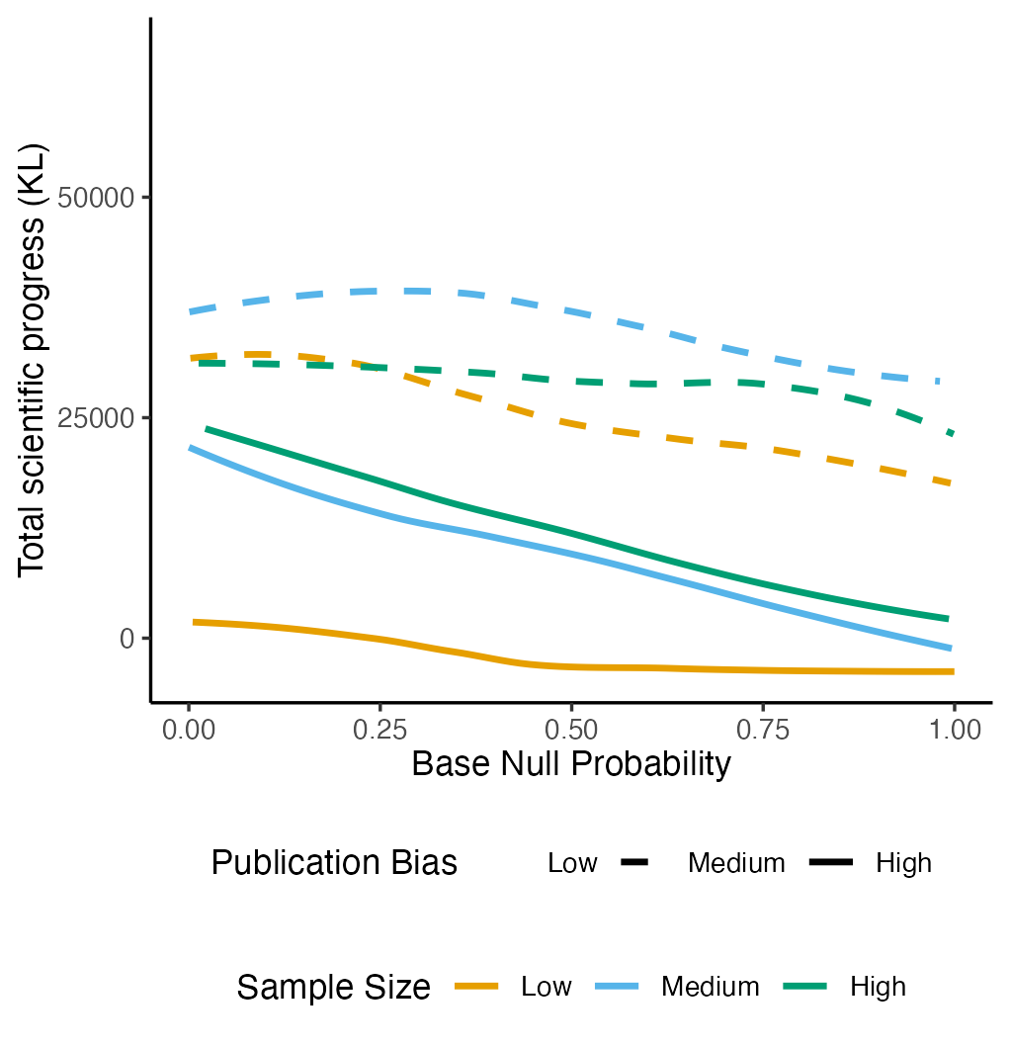
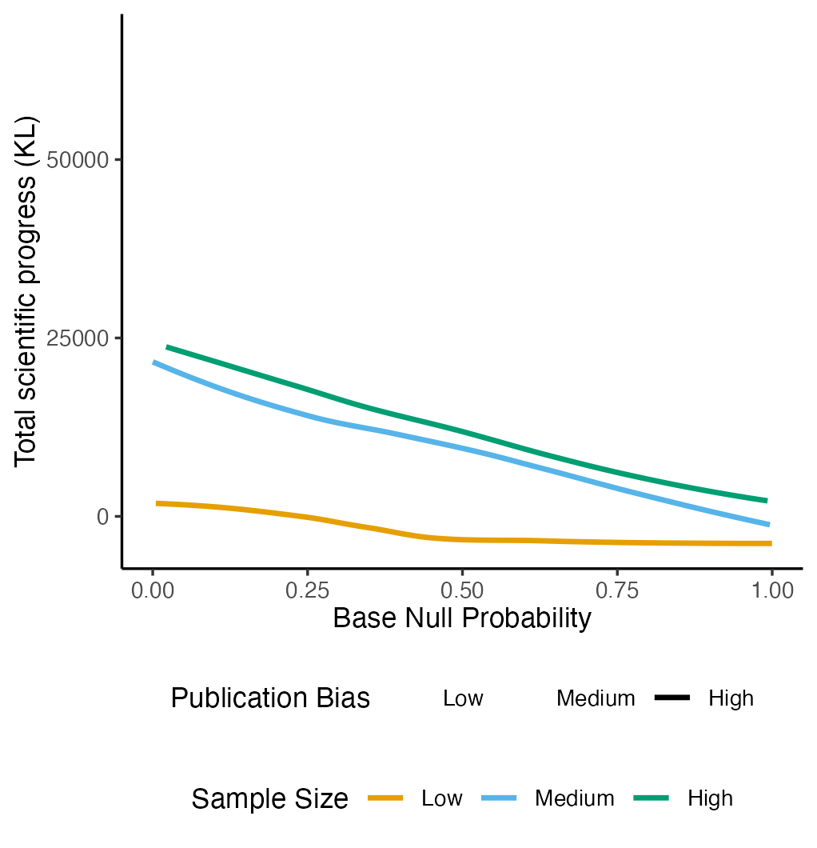
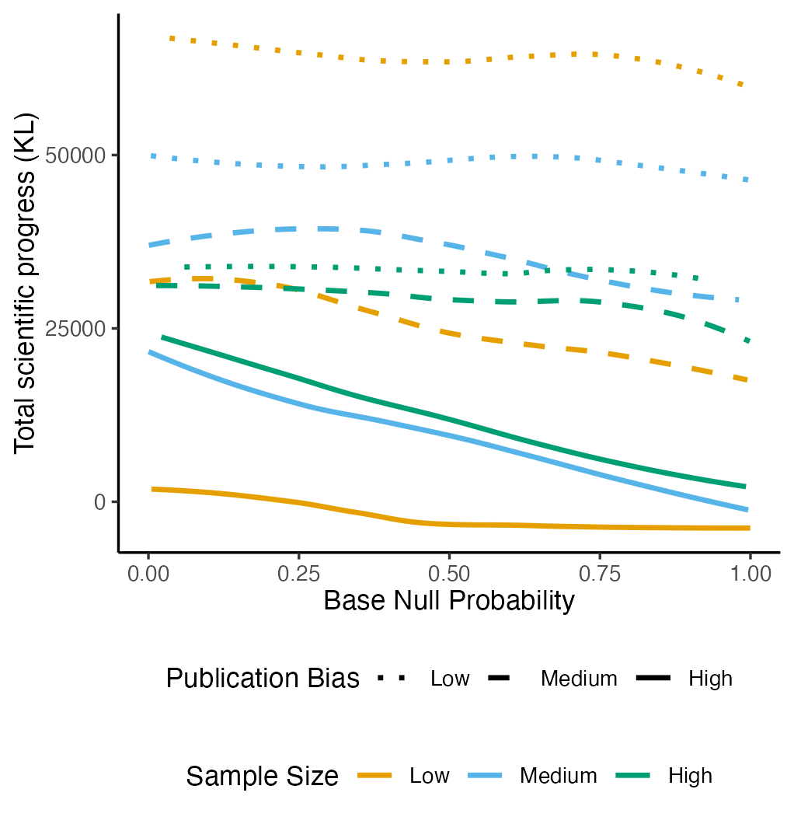
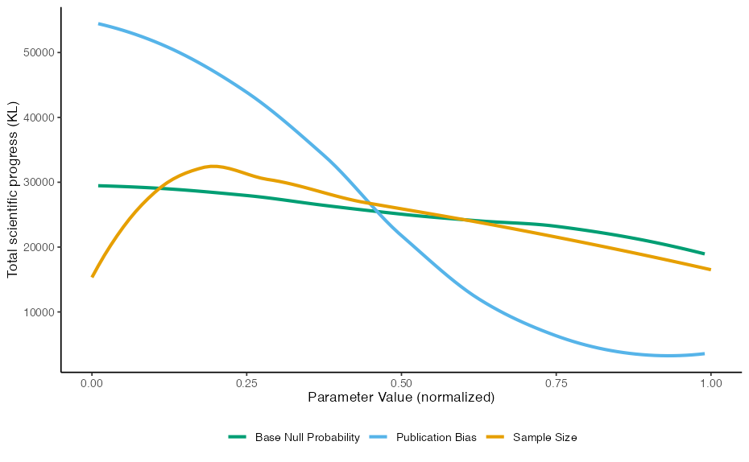
RESULTS: Total scientific progress
Effects broken down by scenario
Marginal Effects
sample size ≈ 50

Slide 12
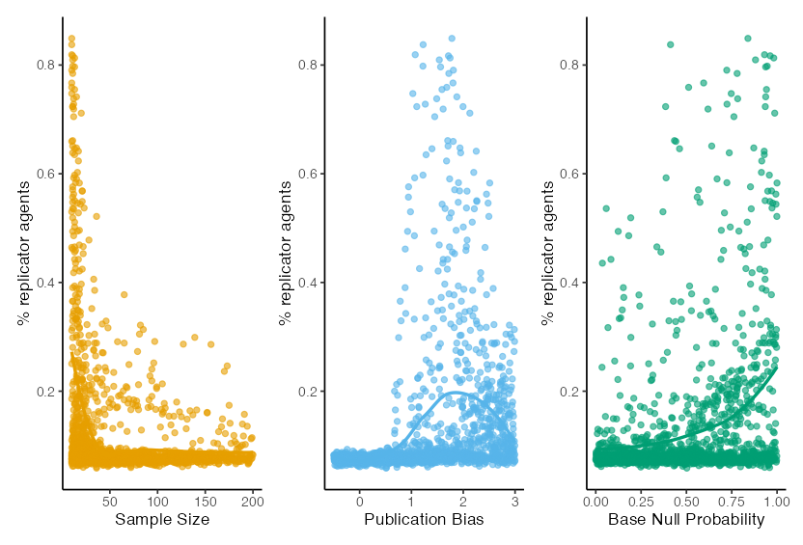
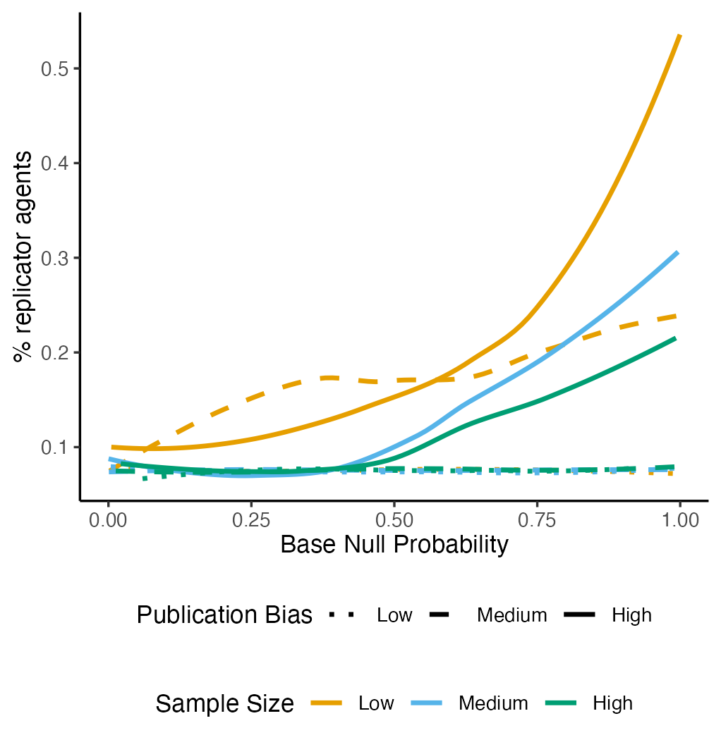
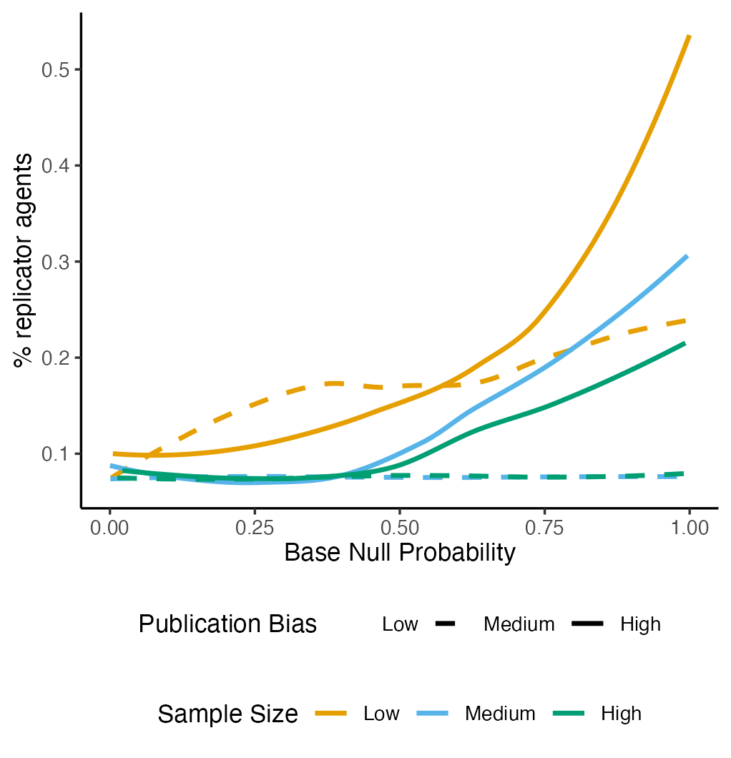
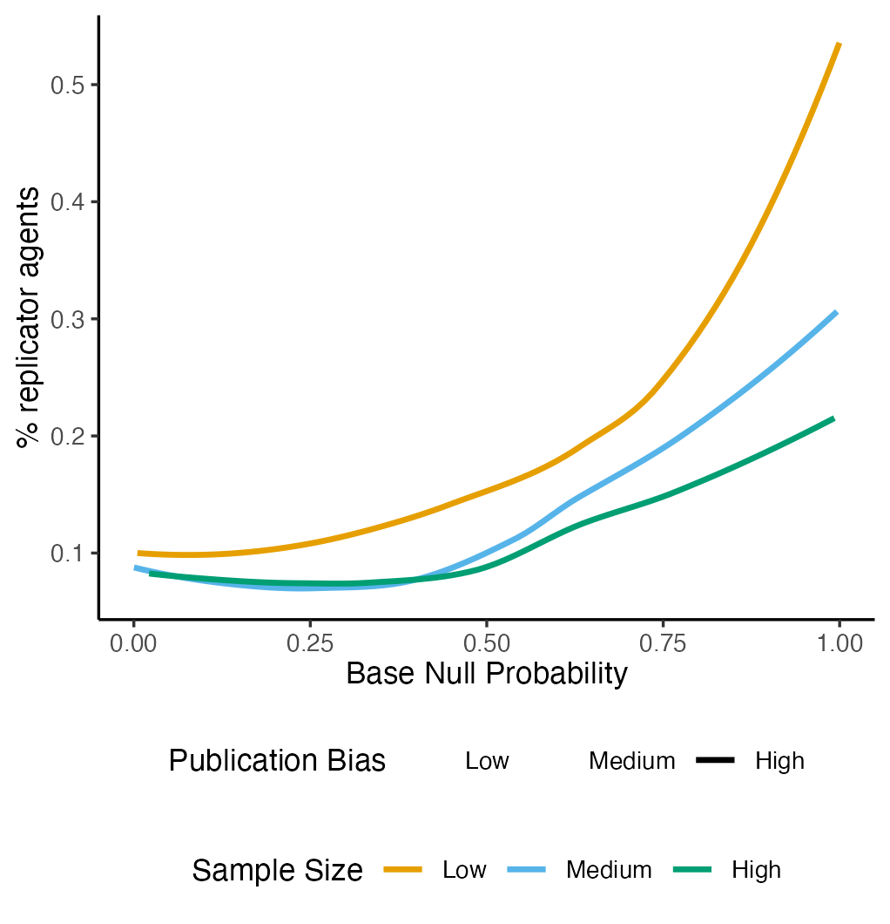
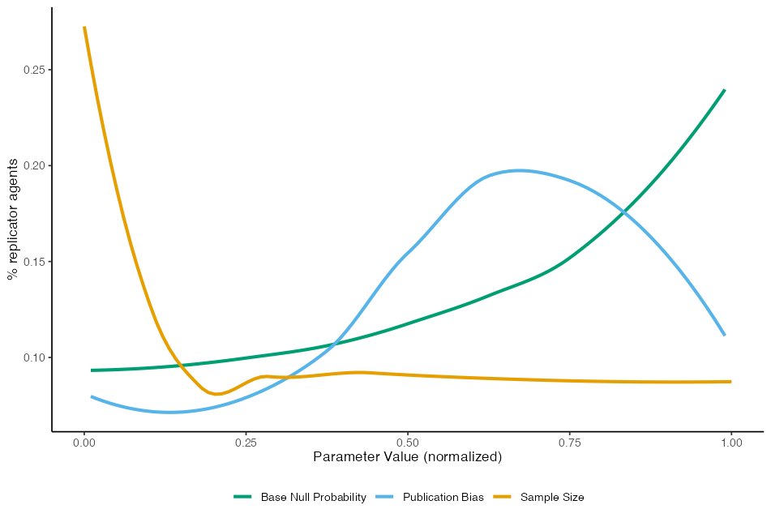
RESULTS: Replication rate
Effects broken down by scenario
Marginal Effects

Slide 13
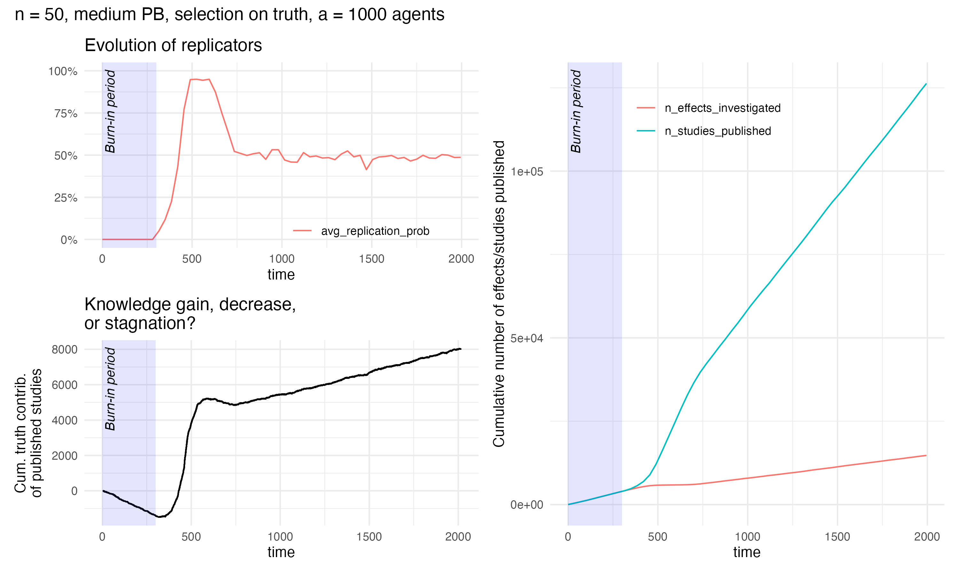
Corrective Condition
Sample size = 30 per group
Publication bias = 2 (medium/strong)
Base null probability = 0.9
Burn-in period = 100 timesteps (only original studies)
Evolution of replicators
Scientific progress
% replicator agents
Cumulative truth contribution (KL)
Notes:
Best outcome overall (pay attention to how we define this – includes broad and shallow or deep and narrow, but some fields prefer one or the other) would be no publication bias, no replications, and smallish sample sizes so that we can investigate many effects

Slide 14
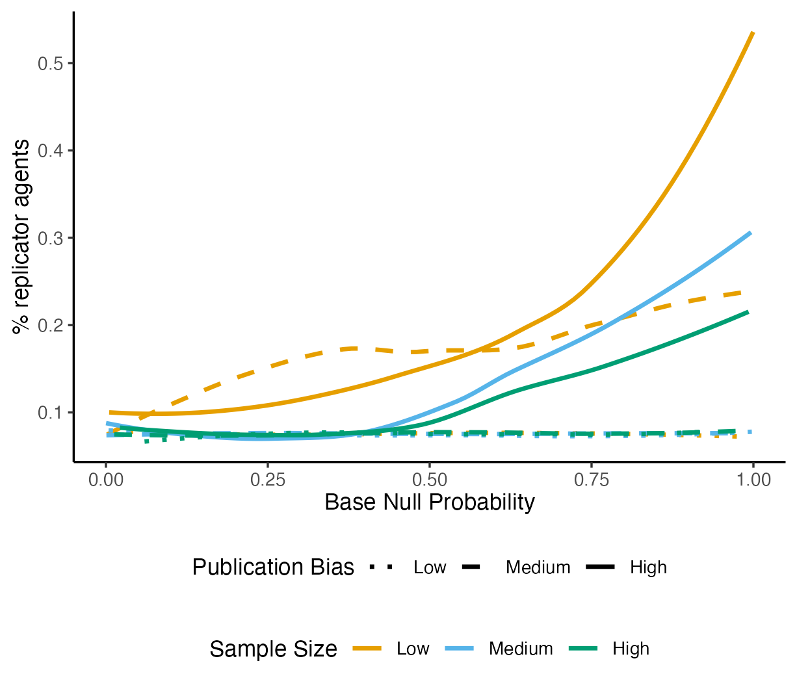
TAKEAWAYS
How much replication do we need?
Around 20-40% under medium-high publication bias (which probably describes the current situation in many fields)
Caveats
It depends on your definition of scientific progress
Depth vs breadth of literature
It depends on the sources of error present
It depends on the context
Without publication bias, replications wouldn’t be needed
Best scientific progress: no publication bias, no replications, modest sample sizes
Maybe we need replication as a corrective crutch, but not forever
Notes:
Best outcome overall (pay attention to how we define this – includes broad and shallow or deep and narrow, but some fields prefer one or the other) would be no publication bias, no replications, and smallish sample sizes so that we can investigate many effects
BUT!
Without publication bias, there would be very little need for direct replications at all
The best scientific progress comes from models with no publication bias, no replications, and modest sample sizes (depending on your definition of scientific progress…)

Slide 15


THANK YOU
Kati Harper
kaitlyn.harper@psy.lmu.de
Felix Schönbrodt
felix.Schoenbrodt@psy.lmu.de

Slide 16
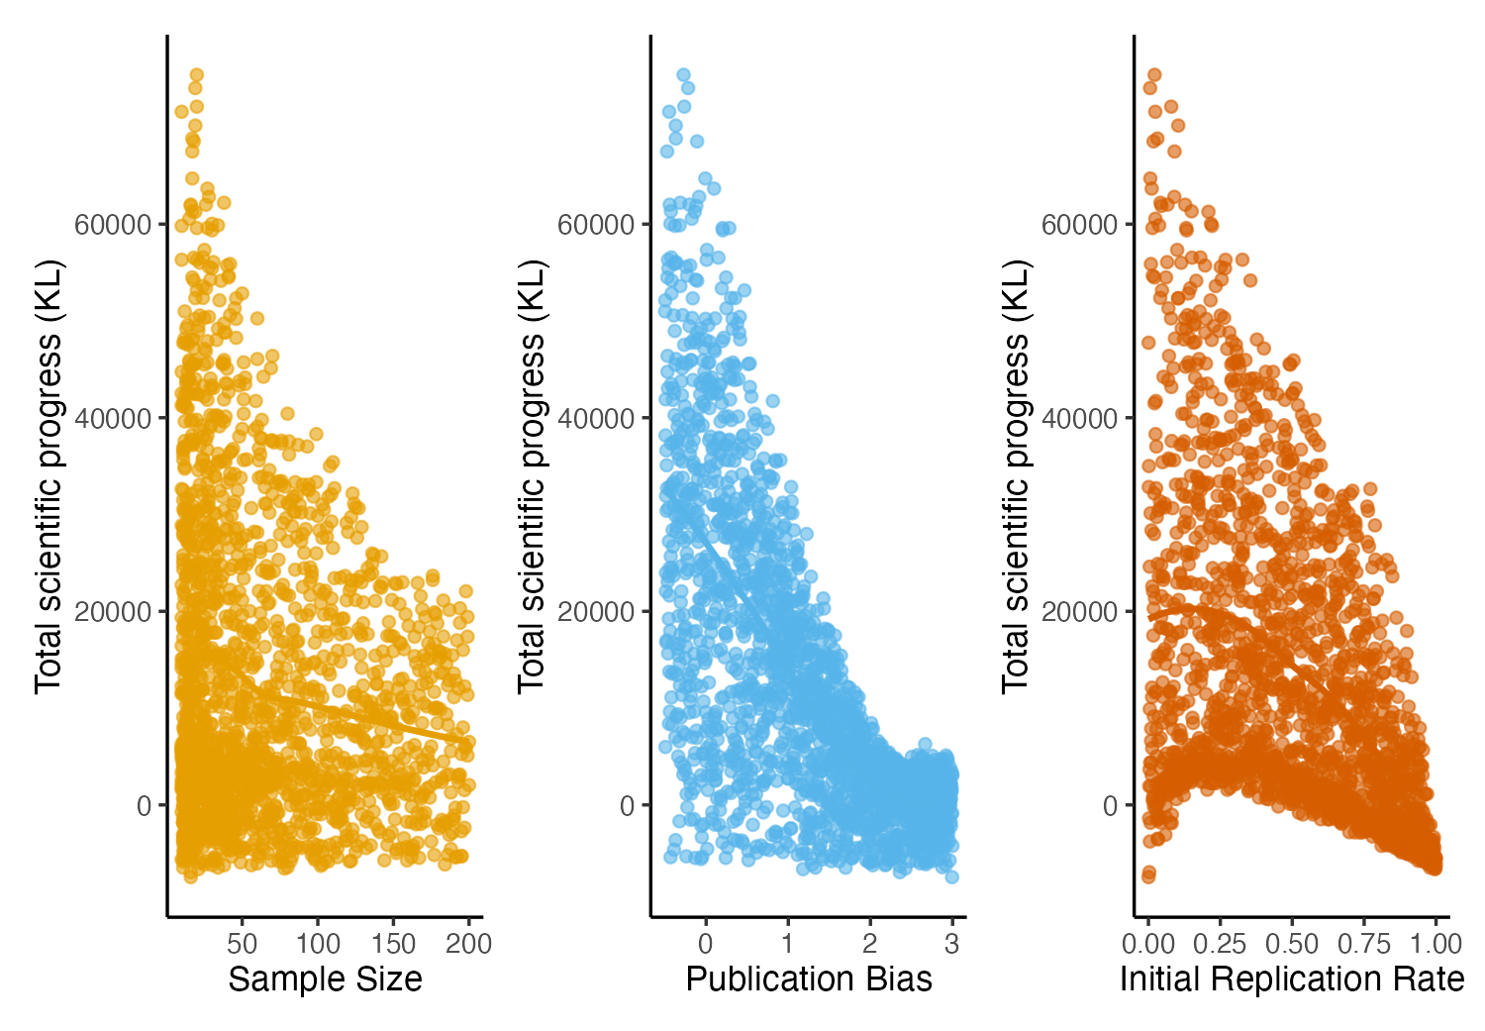
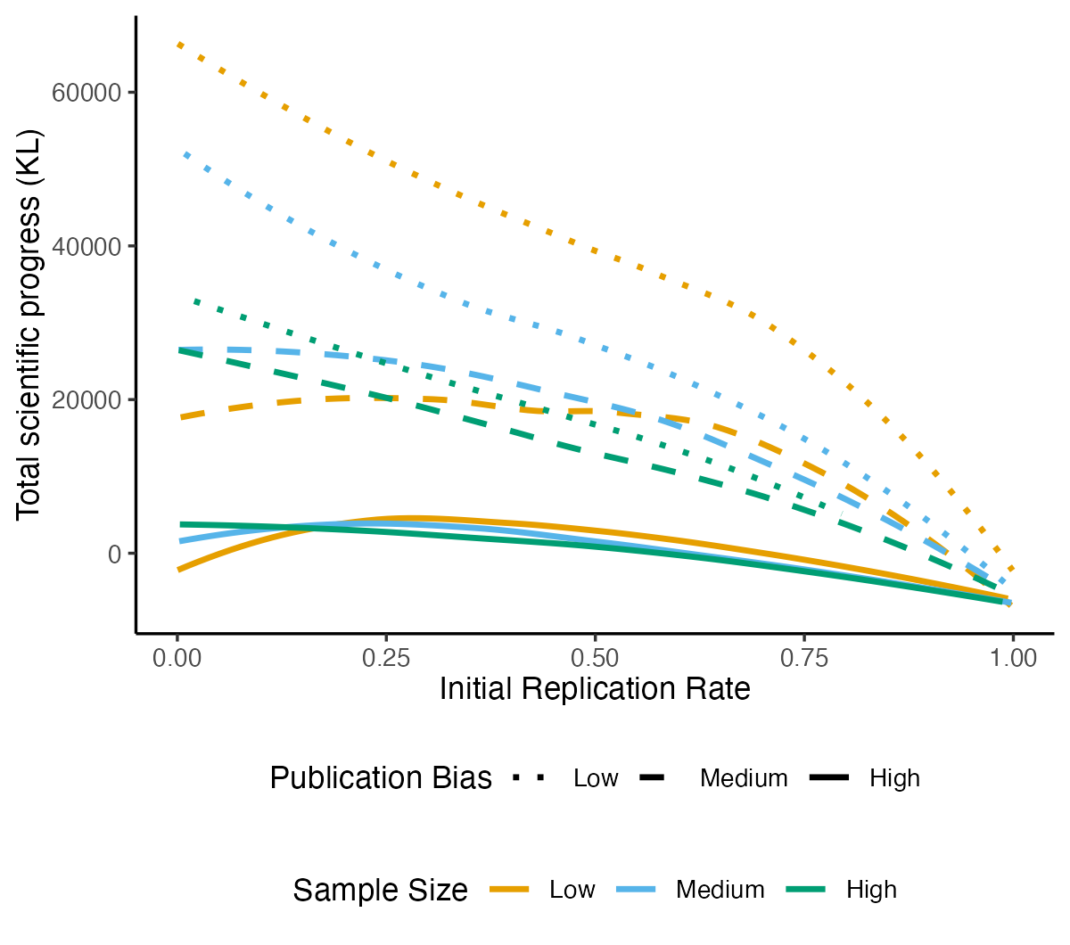
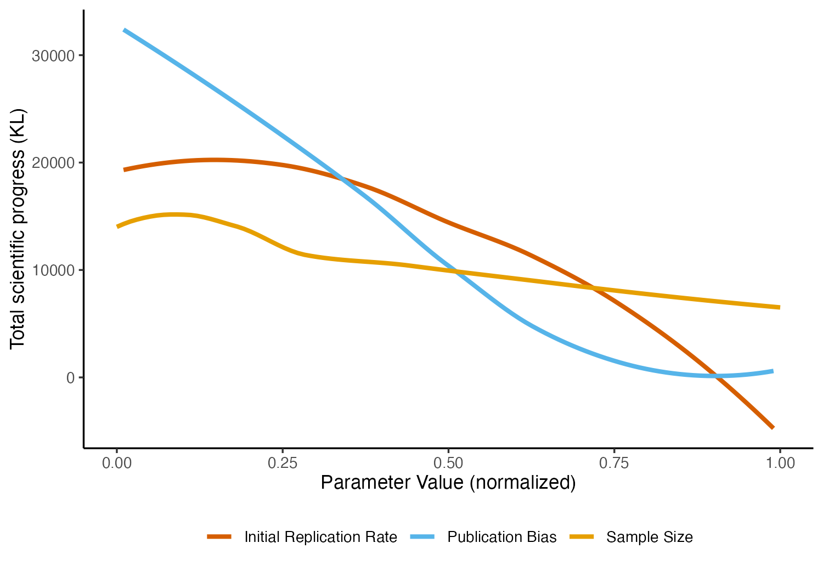
*All replications
get published
* Base null held at 0.9
Notes:
High publication bias
Calibrate publication bias such that 93% of published original studies are significant
0-3% replications

