Slide 1
Number Systems

Slide 2
How can we relate to the terms Bits and Bytes?
“This computer has a 64-bit processor with 4 Gigabytes of RAM and 200 Gigabytes of hard disk space”
“My parents played Atari (8-bit) and I play Nintendo (64-bit)”

Slide 3
Bit
bit = From a shortening of the words “binary digit”
the basic unit of information for computers
1 or 0 are the only values

Slide 4
Byte
Byte = 8 bits
Each keyboard character is stored as a Byte
Example → A = 01000001

Slide 5
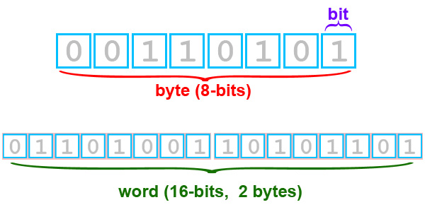
This is an excellent diagram

Slide 6
UNITS → Big & Way Big Bytes
Byte a grouping of eight bits
for instance --> 0110 0001
Kb (kilobyte) about 1000 bytes
Mb (megabyte) about one thousand Kb
or one million bytes
Gb (gigabyte) about one thousand Mb
or one billion bytes
Tb (terabyte) is about one thousand Gb
or one trillion bytes
Is this right ?

Slide 7
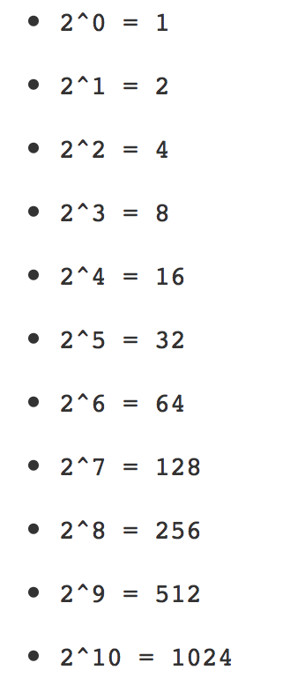
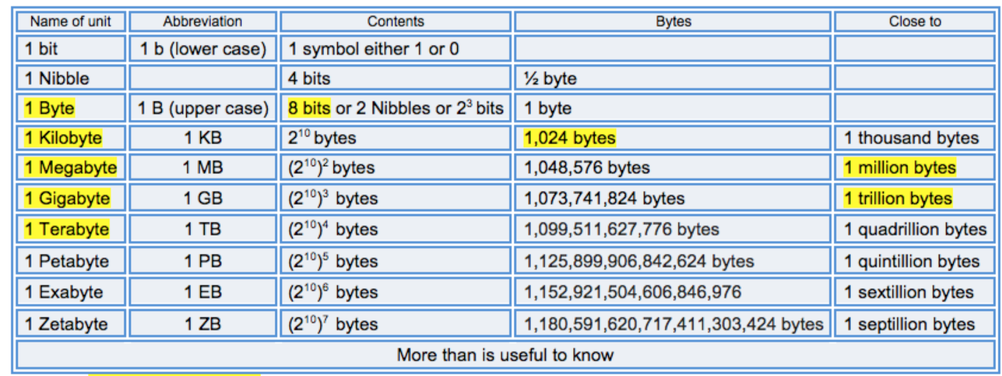
1 Kb is equal to: 1024 bytes
Computers are based on the binary system
That means hard drives and memory are measured in powers of 2

Slide 8
Common Number Systems
System | Base | Symbols | Used by humans? | Used in computers?
Decimal | 10 | 0, 1, … 9 | Yes | No
Binary | 2 | 0, 1 | No | Yes
Octal | 8 | 0, 1, … 7 | No | No
Hexa- decimal | 16 | 0, 1, … 9, A, B, … F | No | No

Slide 9
Quantities/Counting (1 of 3)
Decimal | Binary | Octal | Hexa- decimal
0 | 0 | 0 | 0
1 | 1 | 1 | 1
2 | 10 | 2 | 2
3 | 11 | 3 | 3
4 | 100 | 4 | 4
5 | 101 | 5 | 5
6 | 110 | 6 | 6
7 | 111 | 7 | 7

Slide 10
Quantities/Counting (2 of 3)
Decimal | Binary | Octal | Hexa- decimal
8 | 1000 | 10 | 8
9 | 1001 | 11 | 9
10 | 1010 | 12 | A
11 | 1011 | 13 | B
12 | 1100 | 14 | C
13 | 1101 | 15 | D
14 | 1110 | 16 | E
15 | 1111 | 17 | F

Slide 11
Quantities/Counting (3 of 3)
Decimal | Binary | Octal | Hexa- decimal
16 | 10000 | 20 | 10
17 | 10001 | 21 | 11
18 | 10010 | 22 | 12
19 | 10011 | 23 | 13
20 | 10100 | 24 | 14
21 | 10101 | 25 | 15
22 | 10110 | 26 | 16
23 | 10111 | 27 | 17
Etc.

Slide 12
Conversion Among Bases
The possibilities:
Decimal
Octal
Binary
Hexadecimal

Slide 13
Quick Example
25₁₀ = 11001₂ = 31₈ = 19₁₆
Base

Slide 14
Decimal to Decimal (just for fun)
Decimal
Octal
Binary
Hexadecimal

Slide 15
Weight
125₁₀ => 5 x 10⁰ = 5
2 x 10¹ = 20
1 x 10² = 100
125
Base

Slide 16
Binary to Decimal
Decimal
Octal
Binary
Hexadecimal

Slide 17
Binary to Decimal
Technique
  Multiply each bit by 2^{n}, where n is the “weight” of the bit
  The weight is the position of the bit, starting from 0 on the right
  Add the results

Slide 18
Example
Bit “0”
101011₂ => 1 x 2⁰ = 1
1 x 2¹ = 2
0 x 2² = 0
1 x 2³ = 8
0 x 2⁴ = 0
1 x 2⁵ = 32
43₁₀

Slide 19
Octal to Decimal
Decimal
Octal
Binary
Hexadecimal

Slide 20
Octal to Decimal
Technique
  Multiply each bit by 8^{n}, where n is the “weight” of the bit
  The weight is the position of the bit, starting from 0 on the right
  Add the results

Slide 21
Example
724₈ => 4 x 8⁰ = 4
2 x 8¹ = 16
7 x 8² = 448
468₁₀

Slide 22
Hexadecimal to Decimal
Decimal
Octal
Binary
Hexadecimal

Slide 23
Hexadecimal to Decimal
Technique
  Multiply each bit by 16^{n}, where n is the “weight” of the bit
  The weight is the position of the bit, starting from 0 on the right
  Add the results

Slide 24
Example
ABC₁₆ => C x 16⁰ = 12 x 1 = 12
B x 16¹ = 11 x 16 = 176
A x 16² = 10 x 256 = 2560
2748₁₀

Slide 25
Decimal to Binary
Decimal
Octal
Binary
Hexadecimal

Slide 26
Decimal to Binary
Technique
  Divide by two, keep track of the remainder
  First remainder is bit 0 (LSB, least-significant bit)
  Second remainder is bit 1
  Etc.

Slide 27
Example
125₁₀ = ?₂
2 125
62 1
2
31 0
2
15 1
2
7 1
2
3 1
2
1 1
2
0 1
125₁₀ = 1111101₂

Slide 28
Octal to Binary
Decimal
Octal
Binary
Hexadecimal

Slide 29
Octal to Binary
Technique
  Convert each octal digit to a 3-bit equivalent binary representation

Slide 30
Example
705₈ = ?₂
7 0 5
111 000 101
705₈ = 111000101₂

Slide 31
Hexadecimal to Binary
Decimal
Octal
Binary
Hexadecimal

Slide 32
Hexadecimal to Binary
Technique
  Convert each hexadecimal digit to a 4-bit equivalent binary representation

Slide 33
Example
10AF₁₆ = ?₂
1 0 A F
0001 0000 1010 1111
10AF₁₆ = 0001000010101111₂

Slide 34
Decimal to Octal
Decimal
Octal
Binary
Hexadecimal

Slide 35
Decimal to Octal
Technique
  Divide by 8
  Keep track of the remainder

Slide 36
Example
1234₁₀ = ?₈
8 1234
154 2
8
19 2
8
2 3
8
0 2
1234₁₀ = 2322₈

Slide 37
Decimal to Hexadecimal
Decimal
Octal
Binary
Hexadecimal

Slide 38
Decimal to Hexadecimal
Technique
  Divide by 16
  Keep track of the remainder

Slide 39
Example
1234₁₀ = ?₁₆
16 1234
77 2
16
4 13 = D
16
0 4
1234₁₀ = 4D2₁₆

Slide 40
Binary to Octal
Decimal
Octal
Binary
Hexadecimal

Slide 41
Binary to Octal
Technique
  Group bits in threes, starting on right
  Convert to octal digits

Slide 42
Example
1011010111₂ = ?₈
1 011 010 111
1 3 2 7
1011010111₂ = 1327₈

Slide 43
Binary to Hexadecimal
Decimal
Octal
Binary
Hexadecimal

Slide 44
Binary to Hexadecimal
Technique
  Group bits in fours, starting on right
  Convert to hexadecimal digits

Slide 45
Example
1010111011₂ = ?₁₆
10 1011 1011
B B
1010111011₂ = 2BB₁₆

Slide 46
Octal to Hexadecimal
Decimal
Octal
Binary
Hexadecimal

Slide 47
Octal to Hexadecimal
Technique
  Use binary as an intermediary

Slide 48
Example
1076₈ = ?₁₆
1 0 7 6
001 000 111 110
2 3 E
1076₈ = 23E₁₆

Slide 49
Hexadecimal to Octal
Decimal
Octal
Binary
Hexadecimal

Slide 50
Hexadecimal to Octal
Technique
  Use binary as an intermediary

Slide 51
Example
1F0C₁₆ = ?₈
1 F 0 C
0001 1111 0000 1100
1 7 4 1 4
1F0C₁₆ = 17414₈

Slide 52
Assigment
Decimal | Binary | Octal | Hexa- decimal
33
 | 1110101
 |  | 703
 |  |  | 1AF
Don’t use a calculator!

Slide 53
Exercise – Convert …
Answer
Decimal | Binary | Octal | Hexa- decimal
33 | 100001 | 41 | 21
117 | 1110101 | 165 | 75
451 | 111000011 | 703 | 1C3
431 | 110101111 | 657 | 1AF

