Slide 1
CS 383
Computer Organization and Programming
CPU Design & Organization

Slide 2
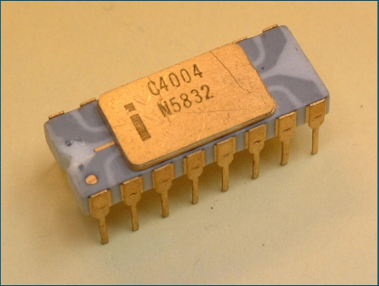
History of CPU
First true CPU: C4004 by intel 4 bit at 740,000 cycles/second
Next step: 8086 by intel
16 bit at 10 Mz
○ Introduced x86 instruction set
i386 (intel)
32 bit (4 GB memory access)
Pentium Series 64 bit - pushed Gz limits
Core series took over from here i3 i5 i7

Slide 3
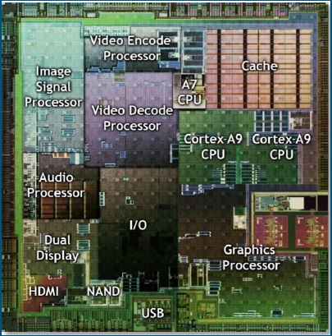
CPU map
CPU’s currently contain billions of transistors
Moore’s law - Every 12-18 months the number of transistors per inch doubles Running out of time with this rule however
Commonly dual or quad core
Gz wall currently sits around 4 give or take with overclocking
32 bit vs 64 bit is mainly related to amount of maximum memory

Slide 4
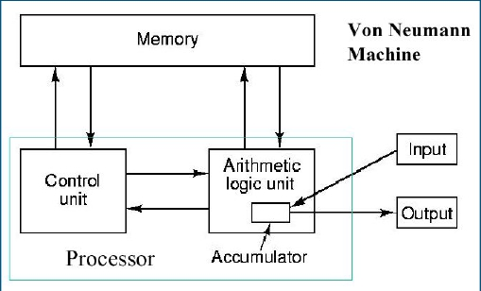
Basic CPU Info
Clock
Wire that turns on and off at steady rate (Clock speed)
Basic data input and output
Retrieves info by requesting memory address in RAM, the enable wires prompts the data to be retrieved, which then move to CPU via data bus
Writes data by doing same order but instead of enable wire, the set wire to send bits out the data bus
Instruction Set
Load - loads number from Ram to CPU
Add, Store, compare
ump or Jump if (big one) - if statement is true,
requests another address
Out and In (inputs)

Slide 5
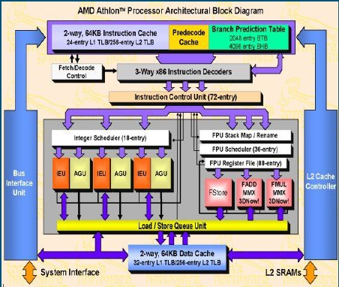
What Exactly are the steps?
Instruction Fetch
Retrieve next instruction code from memory
Decode
Translates instruction for CPU
Execute
Performs arithmetic or flag operation
Memory Access
Data retrieved or stored in cache or memory
Write Back
Output data is stored in register if needed

Slide 6
Parts of CPU In depth
Program Counter (Instruction Pointer)
Holds address of next instruction once current is completed
Accumulator
Stores results from calculations
Registers
Super fast storage that stores in the magnitude of bytes
In CPU and very close to ALU and key components for quick access
Memory Address Register
Address of data or instruction that is needed
Memory Data Register
Essentially the buffer of input and output data between CU and rest of CPU/memory
Memory Buffer Register
Stores data coming or going from memory

Slide 7
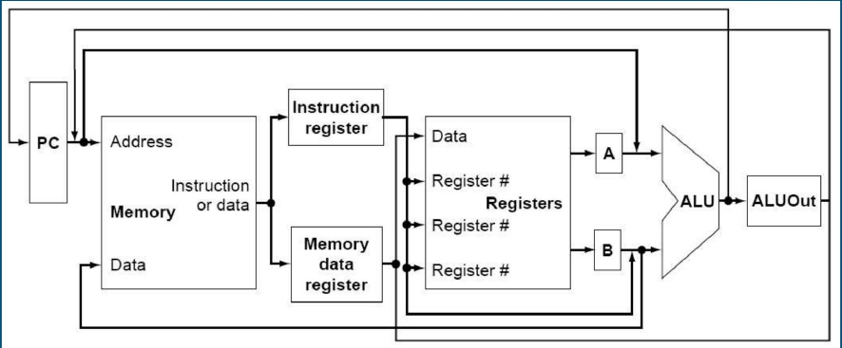
Parts of CPU In depth

Slide 8
Control Unit
Takes instructions from RAM and translates to instructions for CPU parts
Hardwired
Enable for retrieving data and writing to bus
Instruction Address Register
stores location of next instruction
Interrupt processing
Allows for priority events to jump to the front and interrupt current process

Slide 9
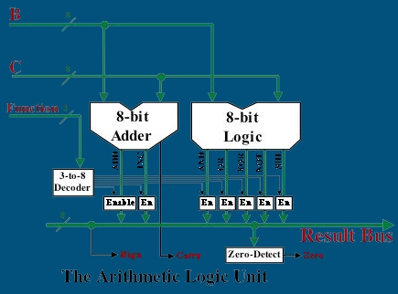
Arithmetic Logic Unit (ALU)
Receives 2 numbers from registers and performs operation specified by Control Unit
Outputs either arithmetic answer or flag if the numbers were compared
Opcode is the bus that inputs the instructions for the operation
● Status
Extra information about output
○Overflow, carry, or zero
●

Slide 10
Limitations
It only gets so small
Transistors have been getting smaller and smaller but eventually the laws of physics will make it impossible to go any smaller
Current architectures sit at generally 14 nanometer
Past generations were 32 and 22 and not 14 nanometer, getting closer to the wall of 5 nm
What do we do?
What do we do?

Slide 11
Going Extreme to the Future
Spintronics
Instead of relying on electron charge, rely on spin direction of electrons
Much more energy efficient and would make cooler CPU’s
Quantum Computer
Extremely trivial at the current time BUT
In theory would exponentially speed up certain calculation

Slide 12
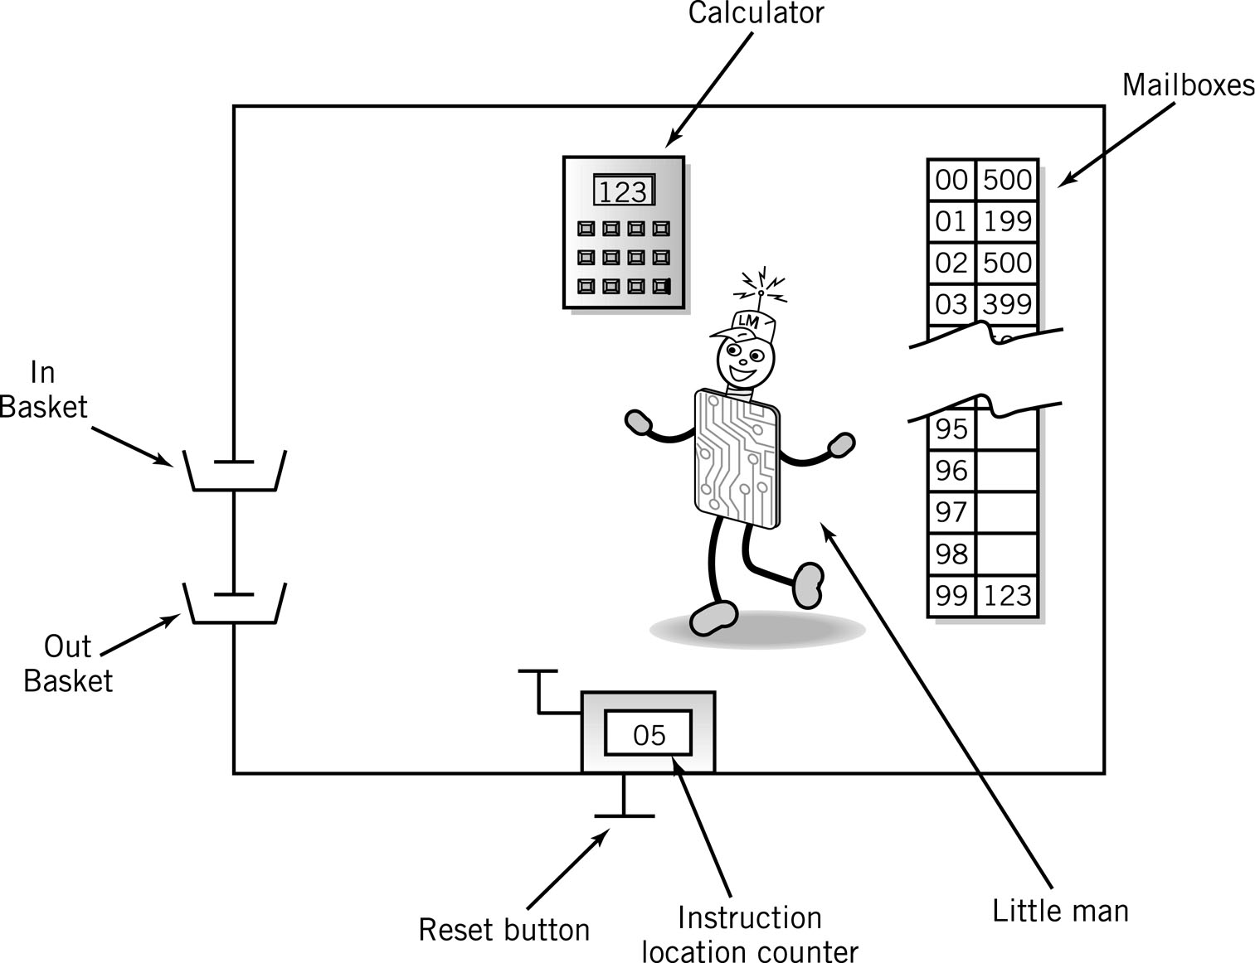
The Little Man Computer

Slide 13
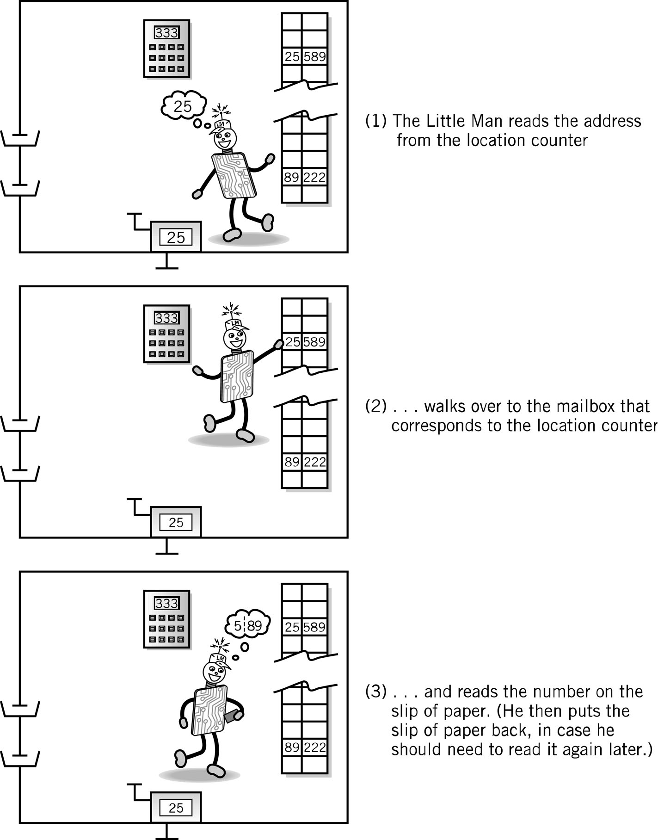
Instruction Cycle
Fetch: Little Man finds out what instruction he is to execute
Execute: Little Man performs the work.
1. Little Man reads the address from the location counter
2. He walks over to the mailbox that corresponds to the location counter

Slide 14
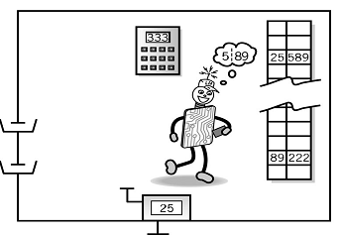
Fetch, cont.
3. And reads the number on the slip of paper (he puts the slip back in case he needs to read it again later)

Slide 15
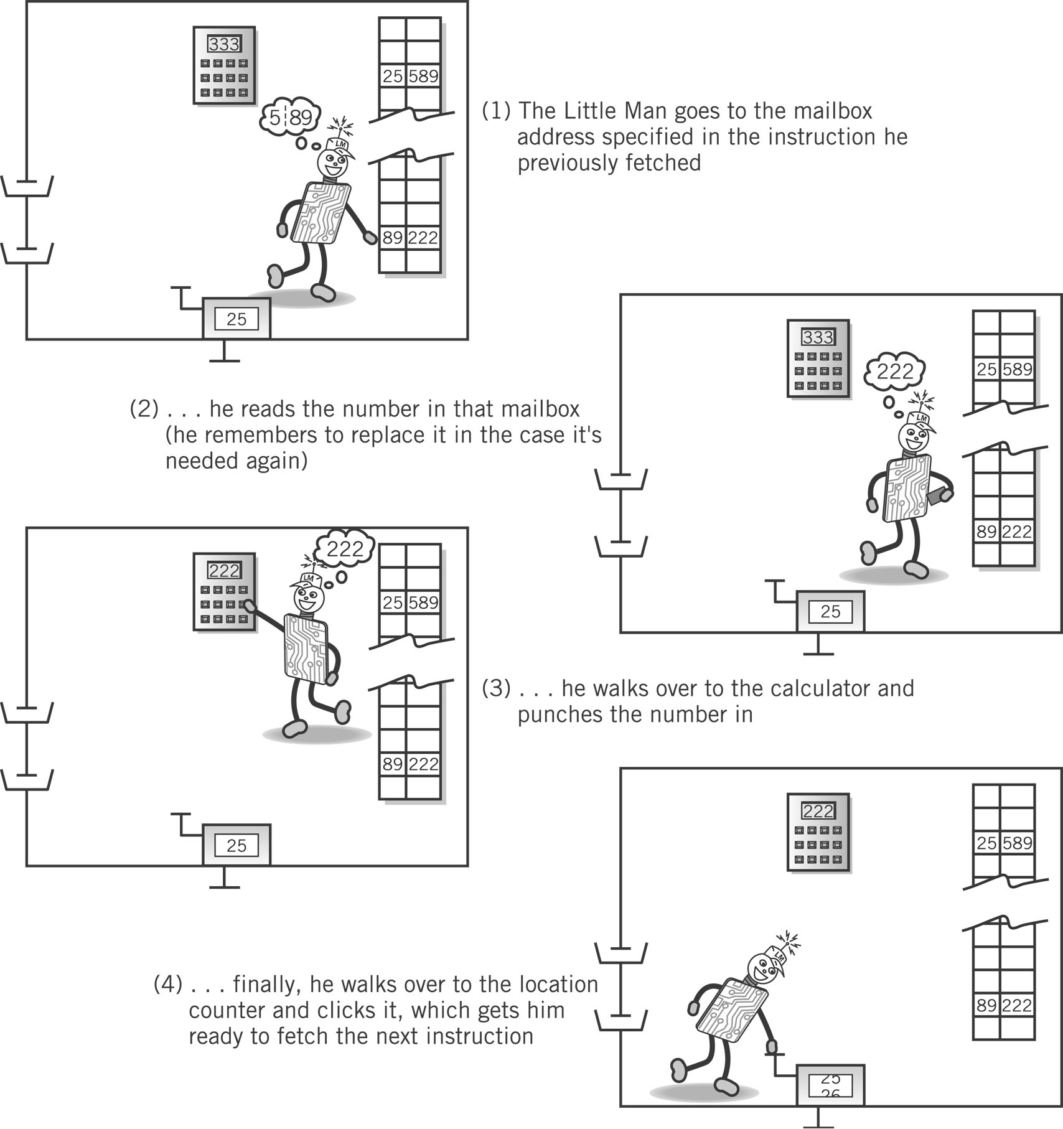
Execute Portion
1. The Little Man goes to the mailbox address specified in the instruction he just fetched.
2. He reads the number in that mailbox (he remembers to replace it in case he needs it later).

Slide 16
Execute, cont.
3. He walks over to the calculator and punches the number in.
4. He walks over to the location counter and clicks it, which gets him ready to fetch the next instruction.

Slide 17
Address vs. Content
Addresses are consecutive starting at 00 and ending at 99
Content may be
Data, a three digit number, or
Instructions
Address | Content

Slide 18
Instructions
Op code (Operation code)
In LMC, represented by a single digit Operation code
Operand
In LMC, represented by two digits following the op code
Object to be manipulated
Data or
Address of data
Address | Content
 | Op code | Operand

Slide 19
Assembly Language
Specific to a CPU
1 to 1 correspondence between assembly language instruction and binary (machine) language instruction
Mnemonics (short character sequence) represent instructions
Used when programmer needs precise control over hardware, e.g., device drivers

Slide 20
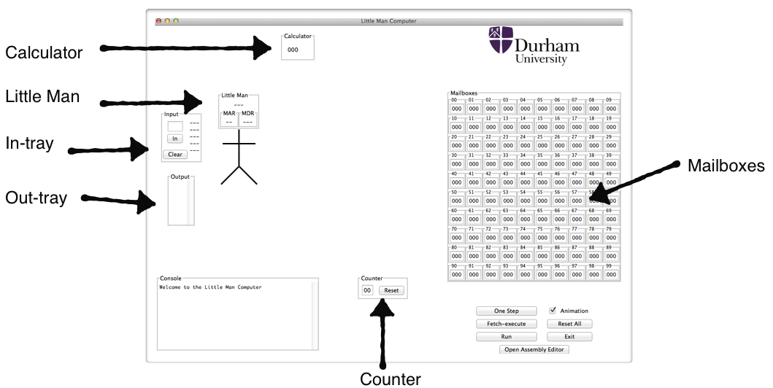
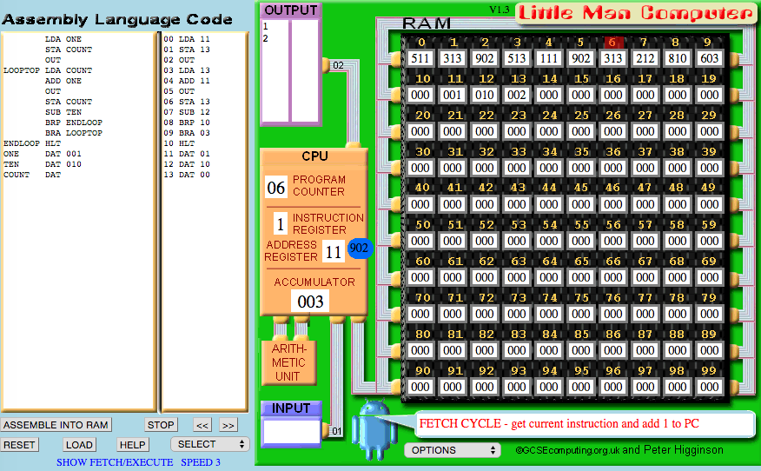
LMC Architecture
LMC 1.2
LMC 1.3
LMC 1.2: http://community.dur.ac.uk/m.j.r.bordewich/LMC.html
LMC 1.3: http://peterhigginson.co.uk/LMC/

Slide 21
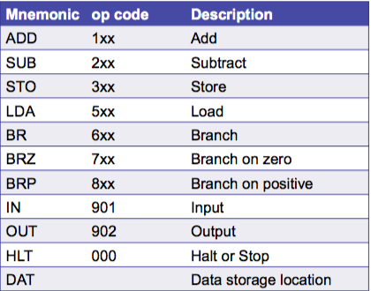
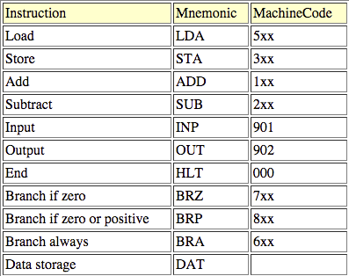
LMC Instruction Set
LMC 1.2
LMC 1.3

Slide 22
Instruction Set
Arithmetic | 1xx | ADD
 | 2xx | SUB
Data Movement | 3xx | STORE
 | 5xx | LOAD
Input/Output | 901 | INPUT
 | 902 | Output
Machine Control (coffee break) | 000 | HALT COB

Slide 23
Input/Output
Move data between calculator and in/out baskets
 |  | Content
 |  | Op Code | Operand (address)
IN (input) |  | 9 | 01
OUT (output) |  | 9 | 02

Slide 24
LMC Input/Output
IN
OUT

Slide 25
Internal Data Movement
Between mailbox and calculator
 |  | Content
 |  | Op Code | Operand (address)
STO (store) |  | 3 | xx
LDA (load) |  | 5 | xx

Slide 26
LMC Internal Data
LDA
STO

Slide 27
Arithmetic Instructions
Read mailbox
Perform operation in the calculator
 |  | Content
 |  | Op Code | Operand (address)
ADD |  | 1 | xx
SUB |  | 2 | xx

Slide 28
LMC Arithmetic Instructions
ADD
SUB

Slide 29
Load and add 2 numbers
INP
STA 99
INP
ADD 99
OUT

Slide 30
Data storage location
Physically identical to instruction mailbox
Identified by DAT mnemonic
INP ; input first number
STA 06 ; save in memory
INP ; input second number
ADD 06 ; add first number
OUT ; output sum
DAT 942 ; initialize memory with junk

Slide 31
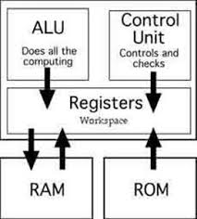
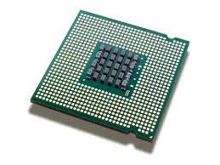


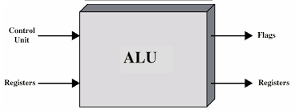
CPU
Registers is a small amount of Storage available as part of the CPU
FLAGS or Status Register

Slide 32
Program Control
Branching (executing an instruction out of sequence)
Changes the address in the Counter
 |  | Content
 |  | Op Code | Operand (address)
BR (Jump) |  | 6 | xx
BRZ (Branch on 0) |  | 7 | xx
BRP (Branch on +) |  | 8 | xx

Slide 33
Branching
BRANCH Always
Set the contents of the accumulator (calculator) to the given address.
BRANCH if ZERO
If the contents of the accumulator (calculator) are 000, the PC (program counter) will be set to the given address.
BRANCH IF ZERO OR POSITIVE
If the contents of the accumulator (calculator) are 000 or positive (i.e. the negative flag is not set), the PC (program counter) will be set to the given address.
FLAGS or Status Register

Slide 34
LMC Instruction Set
Arithmetic | 1xx | ADD
 | 2xx | SUB
Data Movement | 3xx | STORE
 | 5xx | LOAD
BR | 6xx | JUMP
BRZ | 7xx | BRANC ON 0
BRP | 8xx | BRANCH ON +
Input/Output | 901 | INPUT
 | 902 | OUTPUT
Machine Control (coffee break) | 000 | HALT COB

Slide 35
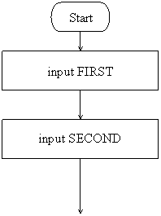
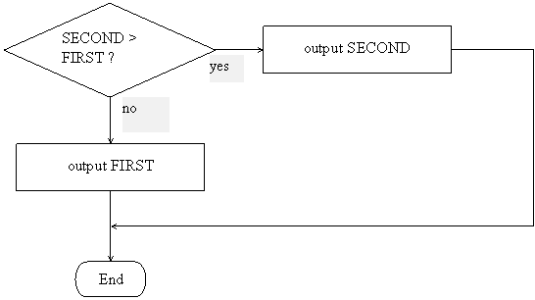
Making decisions
Output the largest of two input values.
5
7
BRP
7
5
7-5 =2 -> 1
5-7= -2-> -1

Slide 36
Write this program using LMC
Output the largest of two input values.
5
7
BRP
7
5
7-5 =2 -> 1
5-7= -2-> -1

Slide 37
Solution
LMC 1.3
LMC 1.2
INP
STA FIRST
INP
STA SECOND
SUB FIRST
BRP SECONDBIG
LDA FIRST
OUT
BRA PROGRAMEND
SECONDBIG LDA SECOND
OUT
PROGRAMEND HLT
FIRST DAT
SECOND DAT
IN
STO FIRST
IN
STO SECOND
SUB FIRST
BRP SECONDBIG
LDA FIRST
OUT
BR PROGRAMEND
SECONDBIG LDA SECOND
OUT
PROGRAMEND HLT
FIRST DAT
SECOND DAT

Slide 38
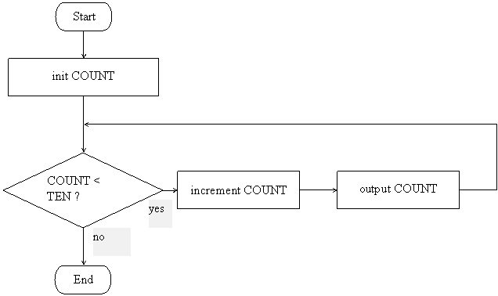
Implementing loops
The following is the flowchart for a program that will output the values from 1 to 10.

Slide 39
Write this program in LMC
The following is the flowchart for a program that will output the values from 1 to 10.

Slide 40
Solution
LMC 1.3
LMC 1.2
LDA ONE
STO COUNT
OUT
LOOPTOP LDA COUNT
ADD ONE
OUT
STO COUNT
SUB TEN
BRP ENDLOOP
BR LOOPTOP
ENDLOOP HLT
ONE DAT 001
TEN DAT 010
COUNT DA
LDA ONE STA COUNT
OUT LOOPTOP LDA COUNT ADD ONE OUT STA COUNT SUB TEN BRP ENDLOOP BRA LOOPTOP ENDLOOP HLT ONE DAT 001 TEN DAT 010 COUNT DAT

Slide 41
LMC Instruction Set
LMC 1.2
LMC 1.3

Slide 42
Quiz
The triangular numbers are as follows:
1 = 1
3 = 1 + 2
6 = 1 + 2 + 3
10 = 1 + 2 + 3 + 4
15 = 1 + 2 + 3 + 4 + 5
21 = 1 + 2 + 3 + 4 + 5 + 6
etc.
The series begins with 1 (the first triangular number).
To calculate the n^{th} triangular number, n is added to the previous triangular number.
For example, the fourth triangular number is calculated by adding 4 to the third triangular number (which is 6), i.e. 10 = (1 + 2 + 3) + 4.
Write a program that takes a single value (greater or equal to zero) as input and outputs which triangular number it is or 0 if it is not a trinangular number.
For example, if the input is 15, the output will be 5 (15 is the 5th triangular number); and if the input is 7, the output will be 0 (7 is not a triangular number).

Slide 43
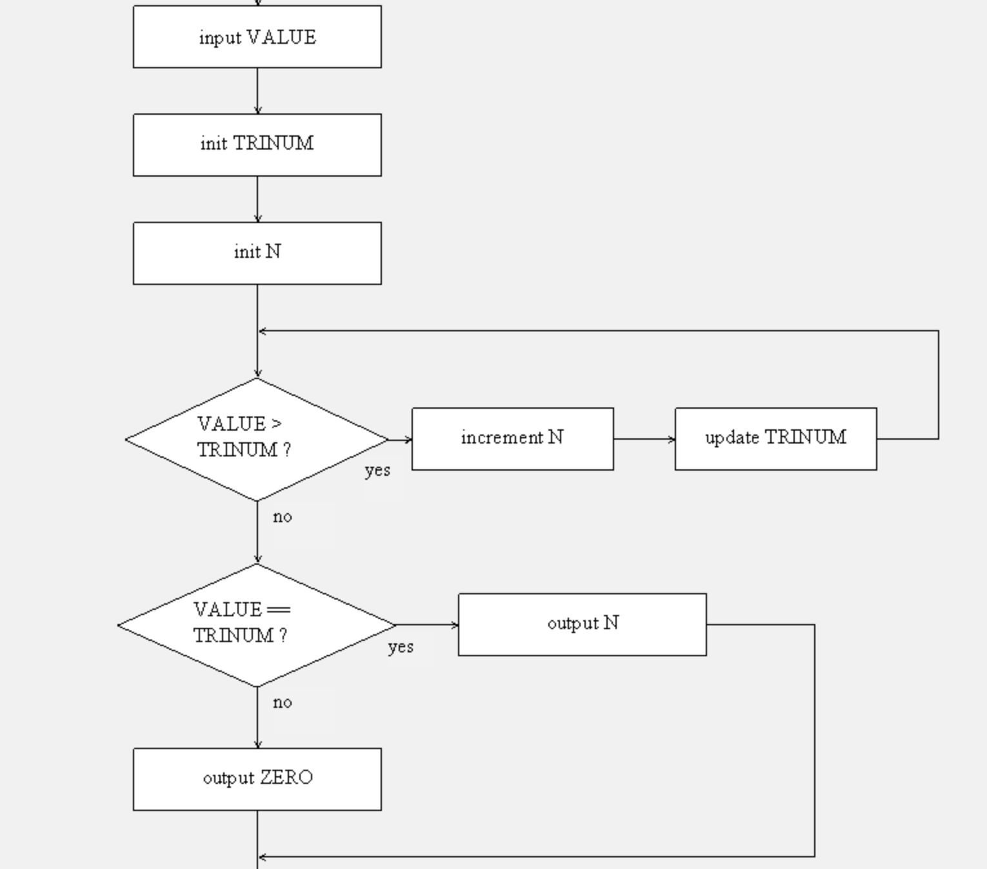
Triangular numbers - Flowchart

