Slide 1
Assembly

Slide 2





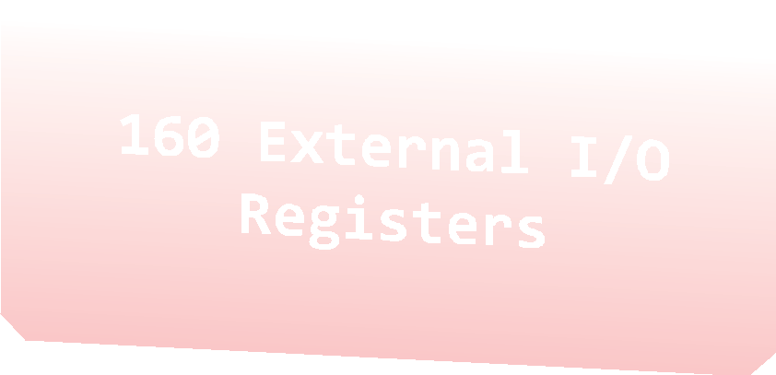

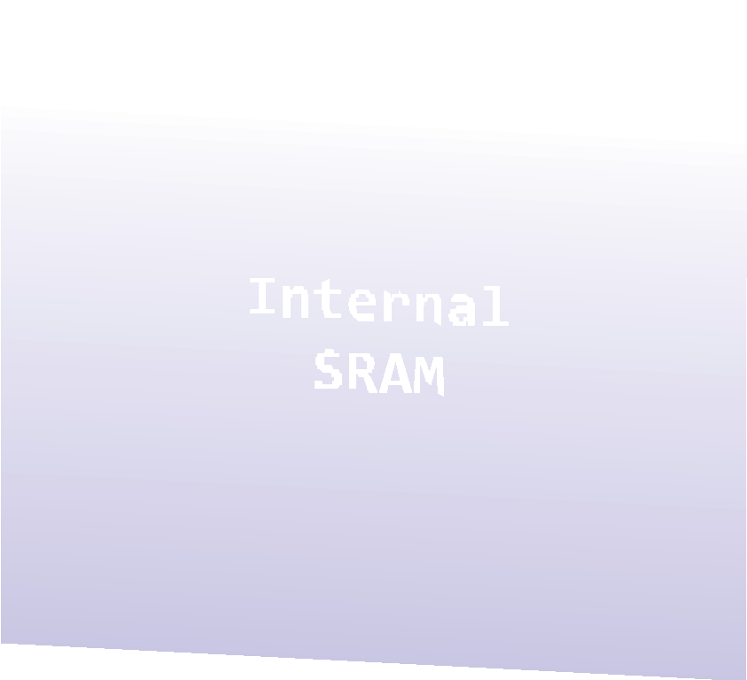
Memory Map
0x0000 0x0020 | -­‐ -­‐ | 0x001F 0x005F
0x0060 | -­‐ | 0x00FF
0x0100 -­‐ 0x08FF

Slide 3


Arduino MCU Register
0x00 | R0
0x01 | R1
0x02 | R2
0x0D | R13
0x0E | R14
0x0F | R15
0x10 | R16
0x11 | R17
0x1A | R26 | X-register | Low byte
0x1B | R27 | X-register | High byte
0x1C | R28 | Y-register | Low byte
0x1D | R29 | Y-register | High byte
0x1E | R30 | Z-register | Low byte
0x1F | R31 | Z-register | High byte
...
...
...
...

Slide 4
Status Register
I | T | H | S | V | N | Z | C
Global Interrupt Enable/ Disable
Half Carry Flag
For signed tests
Negative Flag
Transfer bit used
Zero Flag
Carry Flag
complement overflow indicator

Slide 5
ASM Code
;Col_1
Col_2 Col_3 Col_4
Begin:
 | add | R16, | R17 | ; | Add R17 into R16
 | dec | R17 |  | ; | Decrement the value contained in R17
 | mov | R18, | R16 | ; | Copy the value in R16 to R18
END: | jmp | Begin |  | ; | Jump to the label END
Column 1 used for labels.
Column 2 used for the instruction/directive
[Column 3 used for operands]
Column 4 used for comments

Slide 6
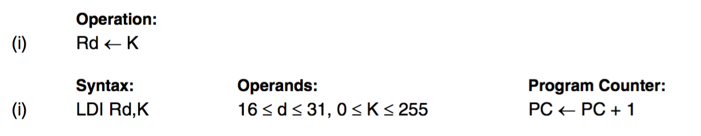
LDI – Load Immediate
Loads an 8 bit constant directly to register 16 to 31.
Example:
ldi r16, 0x42 ; Load 0x42 to r16
10

Slide 7
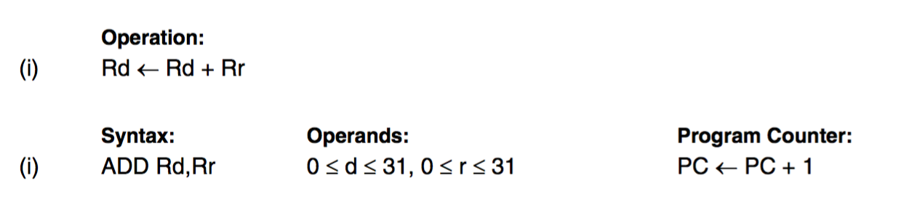
ADD – Add without Carry
Adds two registers without the C Flag and places the result in the destination register Rd.
Example:
add r1,r2 ; Add r2 to r1 (r1=r1+r2)
add r28,r28 ; Add r28 to itself (r28=r28+r28)

Slide 8
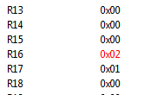
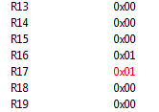
Do addition
.include "m328Pdef.inc"
; m328Pdef.inc indicate that we are using ATmega328P instructions
.include "m328Pdef.inc"
main:
ldi r16, 1
ldi r17, 1
add r16, r17
In the Processor View, you can see how addition works.

Slide 9
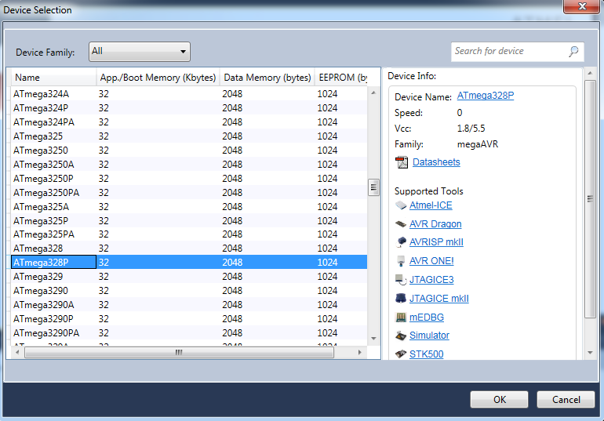
Create a new assembler project
Open Atmel Studio
Click “File” -> “New” -> “Project”, select “Assembler” -> “AVR Assembler Project” and click “OK” to create a new project.
In “Device Selection” Window, choose “ATmega328P” device and click “OK”.

Slide 10
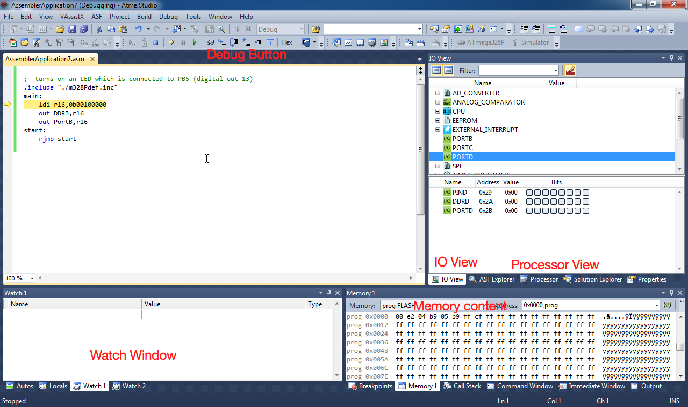
Atmel

Slide 11
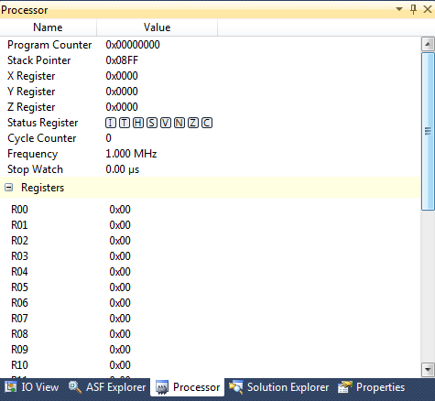

Atmel

Slide 12
Arithmetic Calculations
Expressions
z = 2x − xy − x²
Load
Multiply
Substract
Move

Slide 13
What instructions do you need?
Substract
Multiply
Load
Move
sub
mul
ldi
mov

Slide 14
Copy Register
mov Rd, Rr
Rd, Rr ∈{r0,r1,…,r31}
Rd←Rr
Syntax:
Operands:
Operation:
Flag affected: None
Words:
Cycles:
1
1

Slide 15
Subtract without Carry
sub Rd, Rr
Rd, Rr ∈{r0, r1, …, r31}
Rd←Rd–Rr
Syntax:
Operands:
Operation:
Flags affected: H, S, V, N, Z, C
Words:
Cycles:
1
1

Slide 16
Multiply Unsigned
mul Rd, Rr
Rd, Rr ∈{r0, r1, …, r31}
r1:r0←Rr*Rd
Syntax:
Operands:
Operation:
(unsigned←unsigned * unsigned )
Flags affected: Z, C
C is set if bit 15 of the result is set; cleared
otherwise.

Slide 17
Arithmetic calculation
AVR code for z = 2x − xy − x²
Assume that all numbers are 8-bit unsigned
For x, y, z use registers r16, r17, and r18.
.include "m325Pdef.inc"
Main:
ldi r16,$15
ldi r17,$3
ldi r18,0X23
ldi r19, 2
mul r19,r16
mov r20,r0
mul r16,r17
sub r20,r0
mul r16,r16
sub r20,r0
mov r21,r20

Slide 18
Execution Time
Compute the execution time for the following code snippet:
ldi r16, 0xff
ldi r17, 0xee
add r17, r16
mov r20, r17
Execution Time = (4)/(16MHz) = 0.26μsec
MegaHertZ (MHz) One million cycles per second.
A one-megahertz clock (1 MHz) means some number of bits can be manipulated at least one million times per second.

Slide 19
Execution Time ?
;Col_1
Col_2 Col_3 Col_4
Begin:
 | add | R16, | R17 | ; | Add R17 into R16
 | dec | R17 |  | ; | Decrement the value contained in R17
 | mov | R18, | R16 | ; | Copy the value in R16 to R18
END: | jmp | END |  | ; | Jump to the label END
Execution time for 1 complete loop ???

