Slide 1
CS 383
Computer Organization and Programming
CPU Design & Organization

Slide 2
Presentations
Introduction (1 slide)
Background (1 slide)
Main topic (~10-15 slides)
Limitations or Issues of the technology (1 slide)
Current and Future Research topics (1 slide)
Question for Discussion (1 slide)

Slide 3
Arithmetic calculation
AVR code for z = 2x − xy − x²
Assume that all numbers are 8-bit unsigned
For x, y, z use registers r16, r17, and r18.

Slide 4
Arithmetic calculation
AVR code for z = 2x − xy − x²
Assume that all numbers are 8-bit unsigned
For x, y, z use registers r16, r17, and r18.
.include "m325Pdef.inc"
Main:
ldi r16,$15
ldi r17,$3
ldi r18,0X23
ldi r19, 2
mul r19,r16
mov r20,r0
mul r16,r17
sub r20,r0
mul r16,r16
sub r20,r0
mov r21,r20

Slide 5
Execution Time
Compute the execution time for the following code snippet:
ldi r16, 0xff
ldi r17, 0xee
add r17, r16
mov r20, r17
Execution Time = (4)/(16MHz) = 0.26μsec
MegaHertZ (MHz) One million cycles per second.
A one-megahertz clock (1 MHz) means some number of bits can be manipulated at least one million times per second.

Slide 6
Execution Time ?
;Col_1
Col_2 Col_3 Col_4
Begin:
 | add | R16, | R17 | ; | Add R17 into R16
 | dec | R17 |  | ; | Decrement the value contained in R17
 | mov | R18, | R16 | ; | Copy the value in R16 to R18
END: | jmp | END |  | ; | Jump to the label END
Execution time for 1 complete loop ???

Slide 7
Data representation
Hex numbers
0x or 0X
Put $ in front of the number
Binary numbers
0b10011001
Decimal numbers
Just the number
ASCII numbers
‘9’
LDI R16, 0x99
LDI R16, $22
LDI R16, 0b10011001
LDI R16, 6
LDI R16, ‘9’

Slide 8
Assembly directives
An assembly program can include directives
For symbol definitions
All symbols used in a program will be replaced by the real values when assembling
For program and data organization
.org, .cseg, .dseg
For data/variable memory allocation
.db, .dw

Slide 9
Assembly directives
Define an alias for a register
.def temp = r15
Define symbols for values
.equ length = 2
Once set, the symbol cannot be redefined to other value later in the program
Define symbols for values
.set input = 5
The symbol can be changed to represent other values later in the program.

Slide 10
Program/data memory organization
AVR has three different memories
Program memory – instructions
Data memory – variable data
EEPROM memory – non- volatile data memory
Memory segment directives specify which memory segment to use
.dseg - Data segment
.cseg - Code segment
.eseg - EEPROM segment

Slide 11
Constants & Variables
Specify the memory locations/sizes for:
Constants - In program/EEPROM memory
Variables - In data memory
Store data in program/EEPROM memory
.db - Store byte constants
.dw - Store word (16-bit) constants
Reserve bytes in data memory
.byte - Reserve a number of bytes for a variable

Slide 12
Program/data memory organization
.dseg ; Start data segment
vartab: .byte 4 ; Reserve 4 bytes in SRAM
.cseg ; Start code segment
; default start location is 0x0000
as: .db 'C'
const: .dw 10, 0x10, 0b10, -1
; Write 10, 16, 2, -1 in program
; memory, each value takes
; 2 bytes.

Slide 13
CLR – Clear Register
Clears a register. This instruction performs an Exclusive OR between a register and itself. This will clear all bits in the register.
Operation:
Rd ← Rd ⊕ Rd
Program Counter:
PC ← PC + 1
Example:
clr r16

Slide 14
SER – Set all Bits in Register
Loads $FF directly to register Rd.
Operation:
(i) Rd ← $FF
Program Counter:
PC ← PC + 1
Example:
ser r17

Slide 15
NOP – No Operation
This instruction performs a single cycle No Operation.
Operation:
Program Counter:
PC ← PC + 1
Example:
nop

Slide 16
Status Register
I | T | H | S | V | N | Z | C
Global Interrupt Enable/ Disable
Half Carry Flag
For signed tests
Negative Flag
Transfer bit used
Zero Flag
Carry Flag
complement overflow indicator

Slide 17
Status flags
Add the numbers :
$38 + $2F
$9C + $64
$88 + $ 93
Load 4 to a register
Decrease 4 times

Slide 18
Conditional Branching
1

Slide 19
Control Structure
IF-THEN-ELSE control structure
if (a < 0)
b = 1;
else
b = 3;
Numbers x, z are 8-bit integers and stored in registers. You need to decide which registers to use.
Instructions interested
Compare
Conditional branch
Unconditional jump

Slide 20
Compare
Syntax:
Operands:
Operation:
cp Rd, Rr
Rd ∈{r0, r1, …, r31}
Rd–Rr
Flags affected: H, S, V, N, Z, C
Words:
Cycles:
Example:
cp r4, r5 brne noteq
...
noteq: nop
1
1
; Compare r4 with r5
; Branch if r4 ≠ r5
; Branch destination (do nothing)

Slide 21
Compare with Immediate
Syntax:
Operands:
k ≤ 255
Operation:
cpi Rd, k
Rd ∈{r16, r17, …, r31} and 0≤
Rd – k
Flags affected: H, S, V, N, Z, C
Words:
Cycles:
1
1
This instruction performs a compare between register Rd and a constant.
cpi r19,3 ; Compare r19 with 3
brne error ; Branch if r19⇔3 ...
error: nop ; Branch destination (do nothing)

Slide 22
BREQ - Branch if Equal
BRNE - Branch if Not Equal
BRGE - Branch if Greater or Equal Signed)
BRLO - Branch if Lower (Unsigned)

Slide 23
Conditional Branch
Syntax:
Operands:
Operation:
brge k
-64 ≤ k < 64
If Rd≥Rr (N⊕V=0) then PC←PC+k+1, else PC ← PC+1 if condition is false
Branch if Greater or Equal Signed)
Flag affected: None
Words:
Cycles:
1
1 if condition is false; 2 if condition is true
cp r11,r12 ; Compare registers r11 and r12
brge greateq ; Branch if r11 ≥ r12 (signed)
...
greateq: nop ; Branch destination (do nothing)

Slide 24
Jump
Syntax:
Operands:
Operation:
jump k
PC ← k
JMP k 0 ≤ k < 4M PC ← k Unchanged
Flag affected: None
Words:
Cycles:
2
3
mov r1,r0 ; Copy r0 to r1
jmp farplc ; Unconditional jump
...
farplc: nop ; Jump destination (do nothing)

Slide 25
Relative Jump
Syntax:
Operands:
Operation:
rjmp k
-2K ≤ k < 2K PC ← PC+k+1
Flag affected: None
Words:
Cycles:
1
2
cpi r16,$42 ; Compare r16 to $42
brne error ; Branch if r16 ⇔ $42
rjmp ok ; Unconditional branch
error: addr16,r17 ; Add r17 to r16
incr16 ; Increment r16
ok: nop ; Destination for rjmp (do nothing)

Slide 26
Control
IF-THEN-ELSE control structure
if (a < 0)
b = 1;
else
b = 3;
Numbers x, z are 8-bit signed integers and stored in registers. You need to decide which registers to use.
.def .def | a = b = cpi | r16 r17 a, 0 | ; | a - 0
 | brge | ELSE | ; | if a ≥ | 0
 | ldi | b, 1 | ; | b = 1
 | rjmp | END | ; | end of | IF statement
ELSE: | ldi | b, 3 | ; | b = 3
END: | … |  |  |  | 61

Slide 27
Ports

Slide 28
AVR Registers (cont.)
General purpose registers
The following register pairs can work as address
indexes
● X, r26:r27
● Y, r28:r29
● Z, r30:r31
The following registers can be applied for specific
use
r1:r0 store the result of multiplication instruction
r0 stores the data loaded from the program memory

Slide 29
OUT
Stores data from register Rr in the Register File to I/O Space (Ports, Timers, Configuration Registers etc.).
Operation:
I/O(A) ← Rr
Program Counter:
PC ← PC + 1
Example:
clr r16 ser r17 out $18,r16
nop out $18,r17

Slide 30
IN - Load an I/O Location to Register
Loads data from the I/O Space (Ports, Timers, Configuration Registers etc.) into register Rd in the Register File.
Operation:
Rd ← I/O(A)
Program Counter:
PC ← PC + 1
Example:
in r16, PinD

Slide 31
Port Registers
PORTD maps to Arduino digital pins 0 to 7
DDRD - The Port D Data Direction Register - read/write
PORTD - The Port D Data Register - read/write
PIND - The Port D Input Pins Register - read only
PORTB maps to Arduino digital pins 8 to 13 The two high bits (6 & 7) map to the crystal pins and are not usable
DDRB - The Port B Data Direction Register - read/write
PORTB - The Port B Data Register - read/write
PINB - The Port B Input Pins Register - read only
PORTC maps to Arduino analog pins 0 to 5. Pins 6 & 7 are only accessible on the Arduino Mini
DDRC - The Port C Data Direction Register - read/write
PORTC - The Port C Data Register - read/write
PINC - The Port C Input Pins Register - read only
Each bit of these registers corresponds to a single pin; e.g. the low bit of DDRB, PORTB, and PINB refers to pin PB0(digital pin 8)

Slide 32
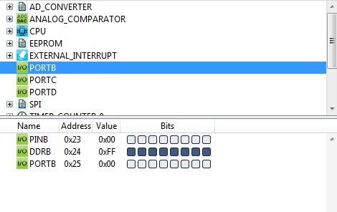
Input and Output
.include "m328Pdef.inc"
Init:
ser r16
out DDRB, r16
ldi r16, 0b11111110
out DDRD, r16
clr r16
out PortB, r16
ldi r16, 0b00000001
out PortD, r16
Main:
in r16, PinD
out PortB, r16
rjmp Main
We use the last bit of D as input
We use the whole bits of B as output
For the first run of the code, nothing happened.
PortB and PortD should look like this:
Prefix 0b followed by a series of 0 and 1digits, e.g. 0b11 == 3.
Constants B0 through B11111111

Slide 33
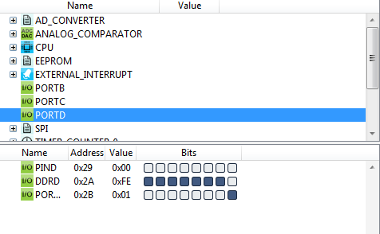
Input and Output
.include "m328Pdef.inc"
Init:
ser r16
out DDRB, r16
ldi r16, 0b11111110
out DDRD, r16
clr r16
out PortB, r16
ldi r16, 0b00000001
out PortD, r16
Main:
in r16, PinD
out PortB, r16
rjmp Main
We use the last bit of D as input
We use the whole bits of B as output
For the first run of the code, nothing happened.
PortB and PortD should look like this:

Slide 34
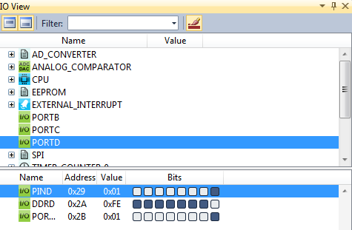
Input and Output
.include "m328Pdef.inc"
Init:
ser r16
out DDRB, r16
ldi r16, 0b11111110
out DDRD, r16
clr r16
out PortB, r16
ldi r16, 0b00000001
out PortD, r16
Main:
in r16, PinD
out PortB, r16
rjmp Main
When the code runs to the point “rjmp Main”, click the last bit of the PIND to light up the bit as an input:

Slide 35
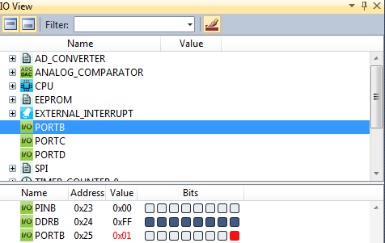
Input and Output
.include "m328Pdef.inc"
Init:
ser r16
out DDRB, r16
ldi r16, 0b11111110
out DDRD, r16
clr r16
out PortB, r16
ldi r16, 0b00000001
out PortD, r16
Main:
in r16, PinD
out PortB, r16
rjmp Main
then continue to execute the program, you can see that the r16 register becomes 1, which means it reads the bit we modified, then you can see the last bit of PortB lights up.

