Slide 1
CS 383
Computer Organization and Programming
SDRAM, Branching, Loops, & Status Register

Slide 2
Roadmap
Address Space - SDRAM
Conditional and unconditional branching in assembly
Using branching to implement loops
Status Register (SREG) in AVR Assembly

Slide 3
Address Space - SDRAM

Slide 4





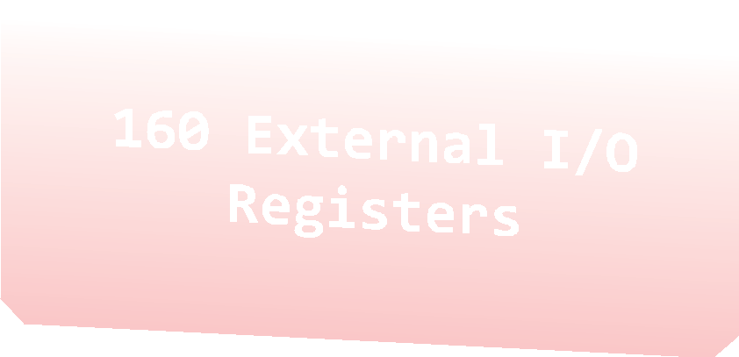

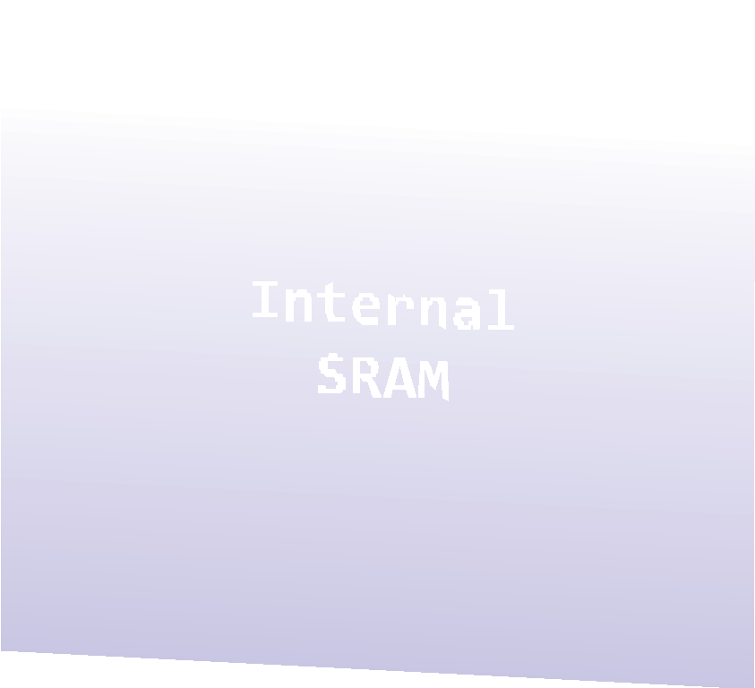
Address Space
0x0000 0x0020 | -­‐ -­‐ | 0x001F 0x005F
0x0060 | -­‐ | 0x00FF
0x0100 -­‐ 0x08FF

Slide 5
LDS – Load Direct from Data Space
Loads one byte from the data space to a register. For parts with SRAM, the data space consists of the Register File, I/O memory and internal SRAM (and external SRAM if applicable).
Loads one byte from the data space to a register
A 16-bit address must be supplied
lds r2,$0100 ;Load r2 with the contents of data space location $0100
add r2,r1 ; add r1 to r2

Slide 6
STS - Store Direct to data space
Loads one byte from the data space to a register
A 16-bit address must be supplied
lds r2,$0100 ;Load r2 with the contents of data space location $0100
add r2,r1 ; add r1 to r2
sts $0100,r2 ; Write back

Slide 7
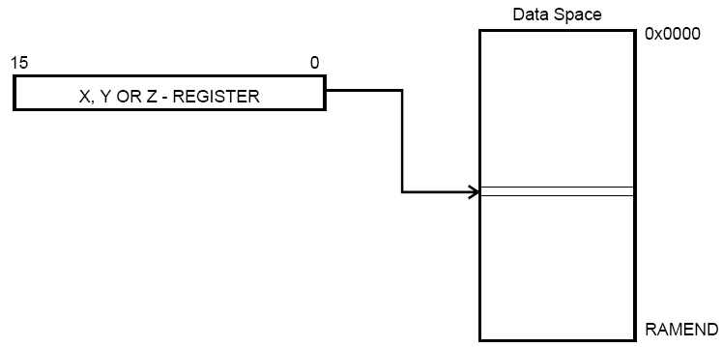
X, Y, Z
0x00 | R0
0x01 | R1
0x02 | R2
0x0D | R13
0x0E | R14
0x0F | R15
0x10 | R16
0x11 | R17
0x1A | R26 | X-register | Low byte
0x1B | R27 | X-register | High byte
0x1C | R28 | Y-register | Low byte
0x1D | R29 | Y-register | High byte
0x1E | R30 | Z-register | Low byte
0x1F | R31 | Z-register | High byte

Slide 8
Using register Z
Write an assembly language program that gets the numbers from the Data Space with memory address 0x0100. Use register z to get number.
.include "m325Pdef.inc”
init:
ldi r22, 0x20
sts 0x0100, r22
main:
ldi zh, 0x01
ldi zl, 0x00
clr r22
ld r22, z

Slide 9
Branching

Slide 10
Jump
Syntax:
Operands:
Operation:
jump k
PC ← k
JMP k 0 ≤ k < 4M PC ← k Unchanged
Flag affected: None
Words:
Cycles:
2
3
mov r1,r0 ; Copy r0 to r1
jmp farplc ; Unconditional jump
...
farplc: nop ; Jump destination (do nothing)

Slide 11
Relevant Instructions
brne – Branch if not equal
breq – Branch if equal
brlt – Branch if less than
brge – Branch if greater than or equal
cp – Compare
cpi – Compare with immediate
jmp – Jump

Slide 12
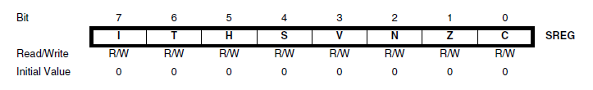
Status Register
How do comparisons and branching actually work inside the processor?
The processor has a special Status Register (SREG), where each bit contains information about the previous ALU (Arithmetic & Logic Unit) operation.

Slide 13
Status Register
Bit 2 (N): Negative Flag – Set if the result of the previous operation is negative
Bit 1 (Z): Zero Flag – Set if the result of the previous operation is zero
Bit 0 (C): Carry Flag – Indicates a carry in an arithmetic operation

Slide 14
SREG (cont.)
For an instruction such as “cp r16,r17”, the actual operation being performed is r16 - r17.
This sets various bits in the status register.
For example, if r16 - r17 = 0, the Z bit gets set to 1.
If you execute a breq instruction after this, it will check the Z bit and jump to the specified location if it is set.
Similarly, a brge instruction will check to see if the S bit is equal to 0, meaning that r16 - r17 ≥ 0 (since S is only set to 1 when the result is negative).

Slide 15
Compare
Syntax:
Operands:
Operation:
cp Rd, Rr
Rd ∈{r0, r1, …, r31}
Rd–Rr
Flags affected: H, S, V, N, Z, C
Words:
Cycles:
Example:
cp r4, r5 brne noteq
...
noteq: nop
1
1
; Compare r4 with r5
; Branch if r4 ≠ r5
; Branch destination (do nothing)

Slide 16
Compare with Immediate
Syntax:
Operands:
k ≤ 255
Operation:
cpi Rd, k
Rd ∈{r16, r17, …, r31} and 0≤
Rd – k
Flags affected: H, S, V, N, Z, C
Words:
Cycles:
1
1
This instruction performs a compare between register Rd and a constant.
cpi r19,3 ; Compare r19 with 3
brne error ; Branch if r19⇔3 ...
error: nop ; Branch destination (do nothing)

Slide 17
If-else Conditions
// C code example
int i = 5;
int j = 0;
if (i < 0)
j = 1;
else
j = 2;
...
; AVR Assembly example
.def i = r16 ; let i refer to r16
.def j = r17 ; let j refer to r17
MAIN:
ldi i,5 ; i = 5
ldi j,0 ; j = 0
cpi i,0 ; compare value in i to 0
brge ELSE ; jump to ELSE if i >= 0
ldi j,1 ; load 1 into j
rjmp END ; jump to END (skips over
; ELSE)
ELSE:
ldi j,2 ; load 2 into j
END:
...

Slide 18
Exercise
Find the maximum of two numbers stored in r16 and r17. Store the answer in r18.

Slide 19
Exercise (Solution)
main:
cp r16,r17 ; compare values in r16 and r17
brge r16_greater ; if r16 is greater or equal, jump to label
mov r18,r17 ; copy value from r17 to r18
rjmp end ; jump to end
r16_greater:
mov r18,r16 ; copy value from r16 to r18
end:
ret ; return

Slide 20
DEC- Decrement
Operation: Rd ← Rd – 1
Subtracts one -1- from the contents of register Rd and places the result in the destination register Rd.
The C flag in SREG is not affected by the operation,
dec r17 ; Decrement r17

Slide 21
INC- Increment
Operation: Rd ← Rd + 1
Adds one -1- to the contents of register Rd and places the result in the destination register Rd.
inc r22 ; increment r22

Slide 22
Loops
// C code example
int i = 1;
int sum = 0;
while (i <= 10)
{
sum = sum + i;
i = i + 1;
}
; AVR Assembly example
.def i = r16
.def sum = r17
main:
ldi i,1 ; i = 1
ldi sum,0 ; sum = 0
rjmp loop ; jump to loop
loop:
add sum,i ; sum = sum + i
cpi i,10 ; compare i and 10
breq end ; if i == 10, jump to end
inc i ; increment i
rjmp loop ; jump to top of loop
end:
ret ; return

