Slide 1
CS 383
Computer Organization and Programming
Memory

Slide 2
Memory
Sequential circuits
A flip-flop can store one bit of information
A register can store a single “word”
typically 32 or 64 bits
Memory stores a large number of words

Slide 3
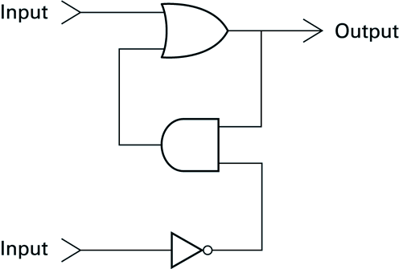
A simple flip-flop circuit
Set
Reset

Slide 4
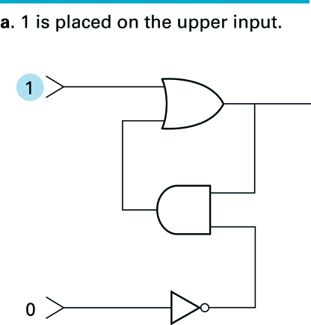
Setting the output of a flip-flop to 1

Slide 5
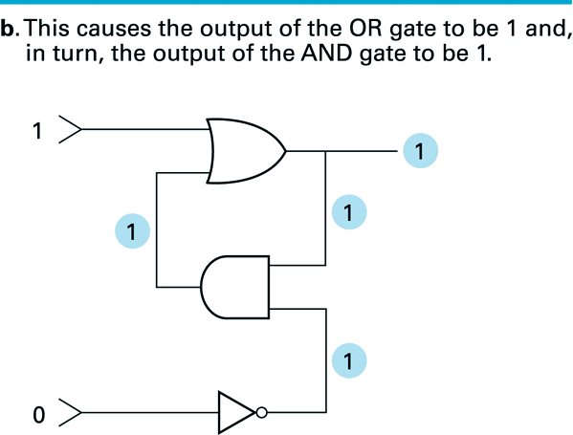
Setting the output of a flip-flop to 1 (continued)

Slide 6
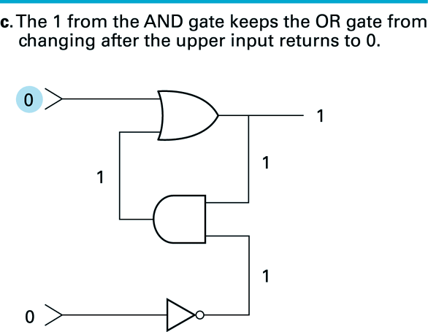
Setting the output of a flip-flop to 1

Slide 7
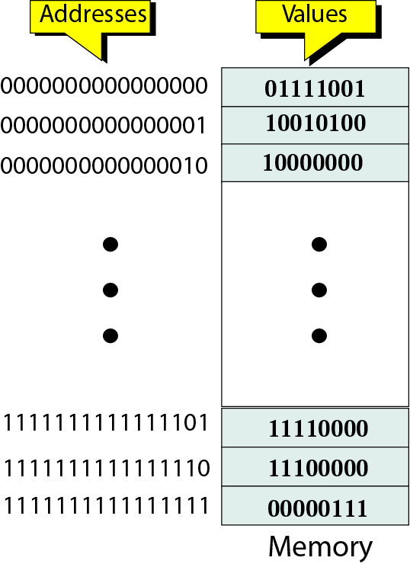
Memory
You can think of memory as being one big array (list) of data
The address serves as an array index
Each address refers to one word of data
You can read (or modify) the data at any given memory address, just like you can read (or modify) the contents of an array at any given index

Slide 8
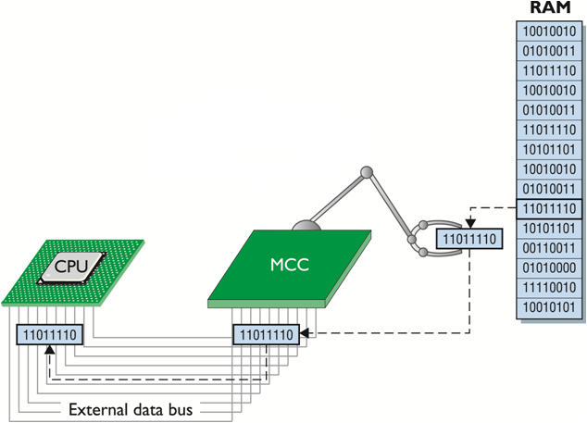
CPU and Memory
The memory controller chip (MCC) handles the flow of data from the RAM to the CPU
MCC takes care of the physical access
CPU doesn’t care if it’s one chip or eight chips!

Slide 9
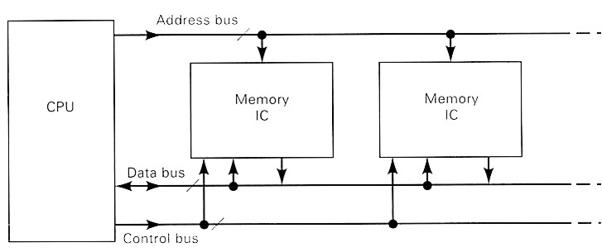
Memory
Memory is not a single chip (device)
Made up of many identical or similar devices
A specific device (part of memory) is selected by control signals and the address lines (bus)
All devices are connected to the same bus, and see the signals at the same time

Slide 10
Size matters!
Memory sizes are usually specified in numbers of bytes (1 byte= 8 bits).
With the abbreviations below, this is equivalent to 32 megabytes.

Slide 11
Memory
Memory signals fall into three groups:
Address bus - selects one of many memory locations
Data bus -
Read (ROM/RAM): the selected location’s stored data is put on the data bus
Write (RAM): The data on the data bus is stored into the selected location
Control signals - specifies what the memory is to do
Most common signals are:
CS: Chip Select; must be active to do anything
OE: Output Enable; active to read data
WR: Write; active to write data

Slide 12
Performance
Access time
Time between presenting the address and getting the valid data
Memory Cycle time
Time may be required for the memory to “recover” before next access
Cycle time is access + recovery
Transfer Rate
Rate at which data can be moved

Slide 13
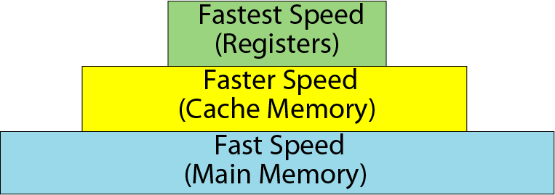
Memory hierarchy

Slide 14
Concept of Registers
Small, permanent storage locations within the CPU used for a particular purpose
Manipulated directly by the Control Unit
Size in bits or bytes (not MB like memory)
Can hold data, an address or an instruction
How many registers does the LMC have?

Slide 15
Registers
Use of Registers
Scratchpad for currently executing program
Holds data needed quickly or frequently
Stores information about status of CPU and currently executing program
Address of next program instruction
Signals from external devices
General Purpose Registers
User-visible registers
Hold intermediate results or data values, e.g., loop counters

Slide 16
Memory Types
RAM (Random access memory):
SRAM (Static RAM) (flip-flop gates)
DRAM (Dynamic RAM)
ROM (Read only memory)
PROM (programmable)
EPROM (erasable programmable)
EEPROM (electronically erasable programmable)

Slide 17
RAM: Random Access Memory
DRAM (Dynamic RAM)
Most common, cheap
Volatile: must be refreshed (recharged with power) 1000’s of times each second
SRAM (static RAM)
Faster than DRAM and more expensive than DRAM
Volatile
Frequently small amount used in cache memory for high-speed access used

Slide 18
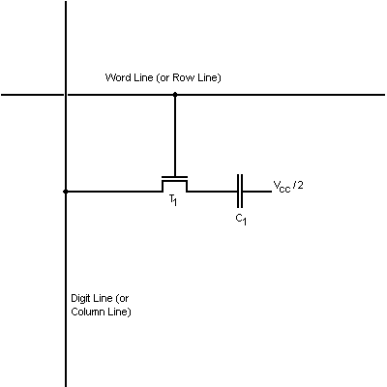
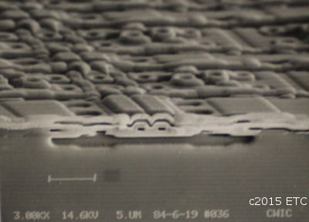
DRAM Cell Design
Consists of a capacitor connected by a pass transistor to the digit line
Stores information in the form of a charge in the capacitor

Slide 19
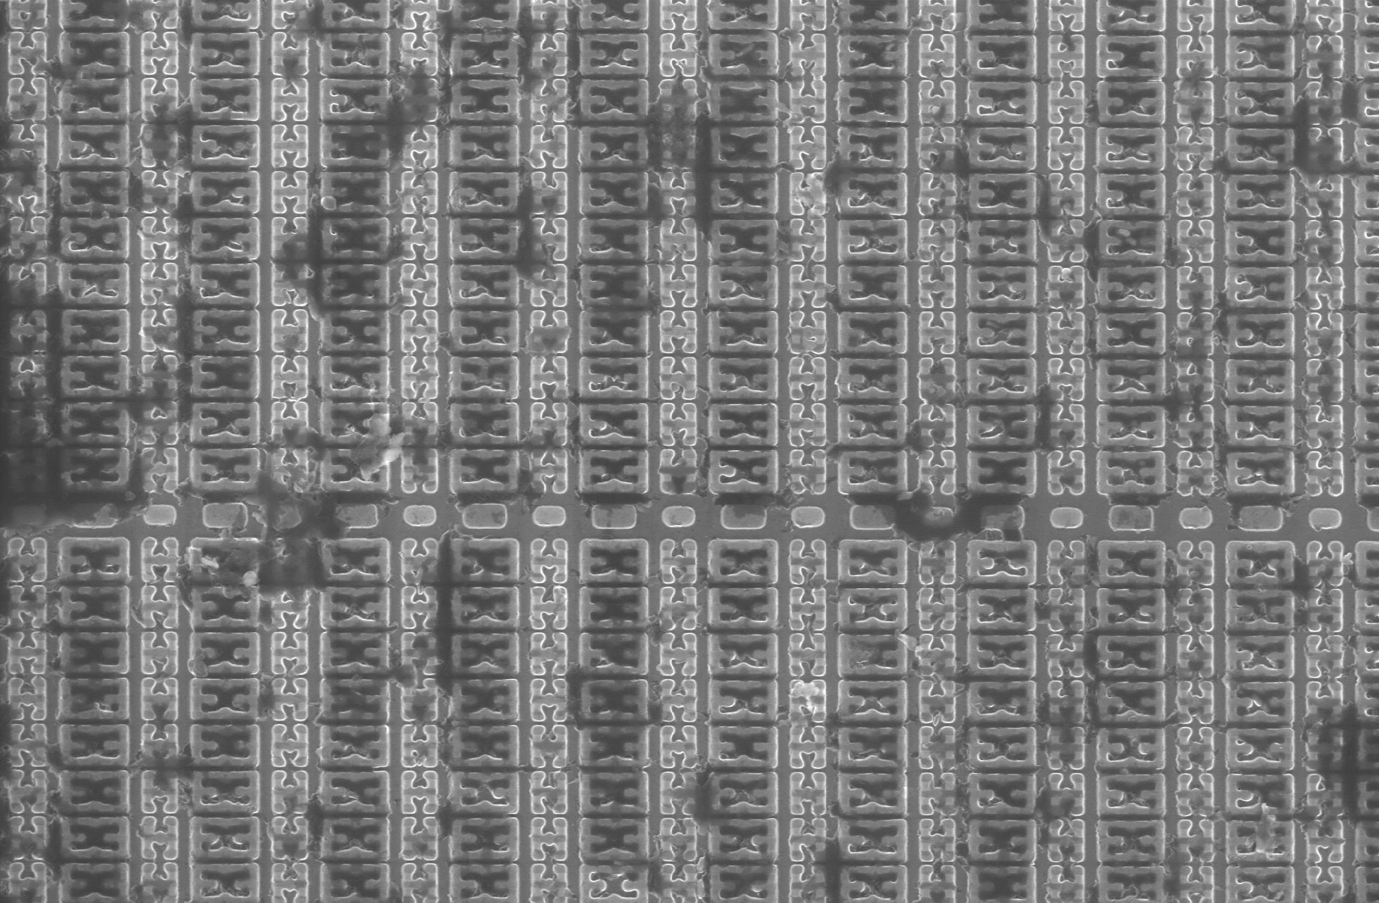
SRAM
Uses bistable multivibrator
A flip-flop can be made to change state by signals applied to one or more control inputs and will have one or two outputs
Much faster than DRAM

Slide 20
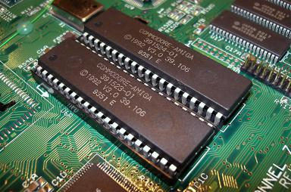
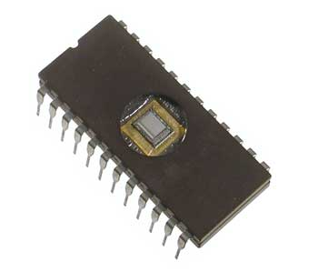
ROM
Read Only Memory
Manufacturing dictates data stored
Difficult to rewrite, and sometimes impossible
Read rate is slow than RAM

Slide 21
ROM - Read Only Memory
Non-volatile memory to hold software that is not expected to change over the life of the system
EEPROM
Electrically Erasable Programmable ROM
Slower and less flexible than Flash ROM
Flash ROM
Faster than disks but more expensive
Uses
BIOS: initial boot instructions and diagnostics
Digital cameras, Smartphone, Modern computers

Slide 22
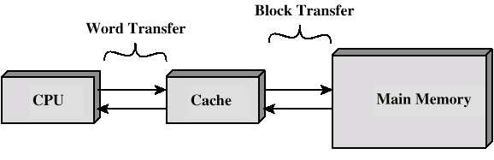
Cache
Small amount of fast memory
Sits between normal main memory and CPU
May be located on CPU chip or module

Slide 23
Cache Design
Size
Mapping Function
Replacement Algorithm
Number of Caches

Slide 24
Main Memory Organizations
C
P
U
C
P
U
C
P
U
M
u
l
t
i
p
l
e
x
o
r
C
a
c
h
e
C
a
c
h
e
C
a
c
h
e
B
u
s
B
u
s
B
u
s
M
e
m
o
r
y
M
e
m
o
r
y
M
e
m
o
r
y
M
e
m
o
r
y
M
e
m
o
r
y
b
a
n
k
0
b
a
n
k
1
b
a
n
k
2
b
a
n
k
3
wide memory organization
interleaved memory organization
M
e
m
o
r
y
one-word wide memory organization
DRAM access time >> bus transfer time

Slide 25
Attendance Quiz
Which are the key modules of a CPU, explain in 2-3 lines.

