Slide 1
CS 383
Computer Organization and Programming
Stack, Time Delay

Slide 2
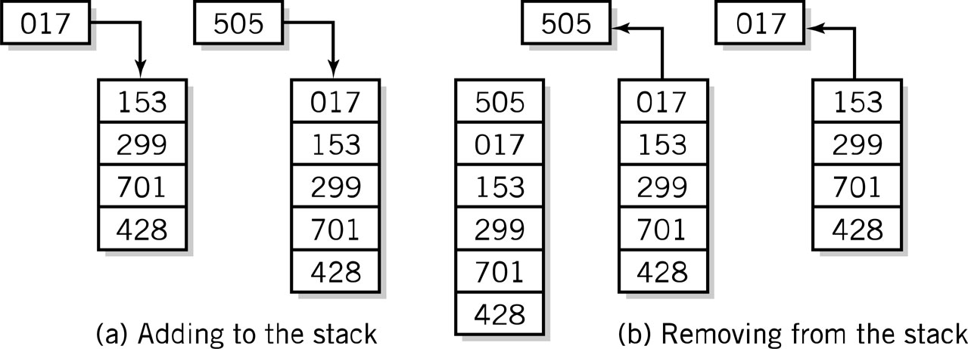
Stack
Stack instructions
LIFO method for organizing information
Items removed in the reverse order from that in which they are added
Push Pop

Slide 3
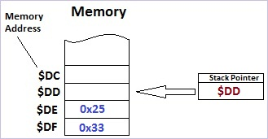
Stack
Section of RAM used by the CPU to store information temporarily
Information could be data(ex Integer) or an address(ex. reference to memory)
Purpose: need this storage because limited amount of registers

Slide 4
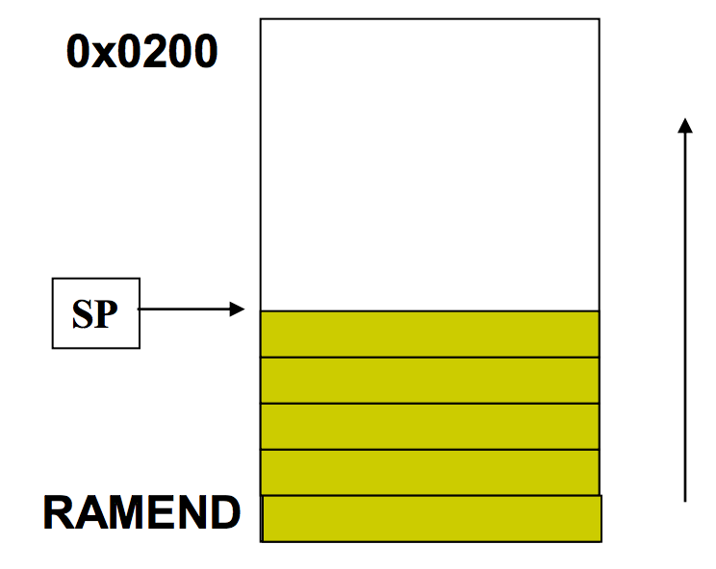
Stack Bottom
The stack usually grows from higher addresses to lower addresses
The stack bottom is the location with the highest address in the stack
In AVR, 0x0200 is the lowest address for stack
i.e. in AVR, stack bottom >=0x0200

Slide 5

Assembly Instructions
How to Access Stack?
SP – a register dedicated to be the stack pointer(decides where the stack starts from in memory)
Actually represented by two bytes in AVR
SPL- the low byte of the SP
SPH-the high byte of the SP

Slide 6
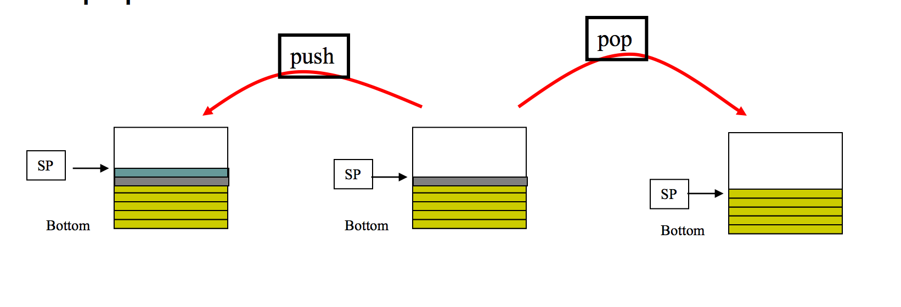
Stack Operations
There are two stack operations:
Push
Pop

Slide 7
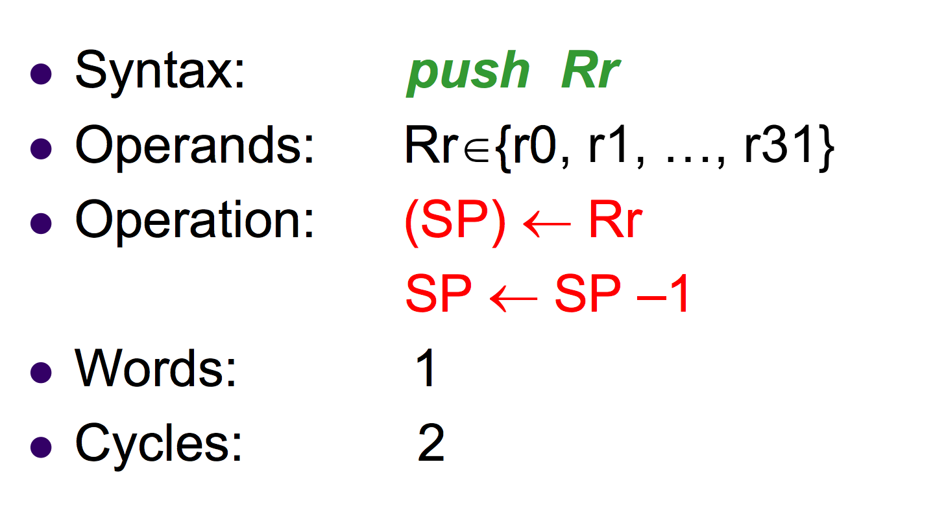
PUSH instruction

Slide 8
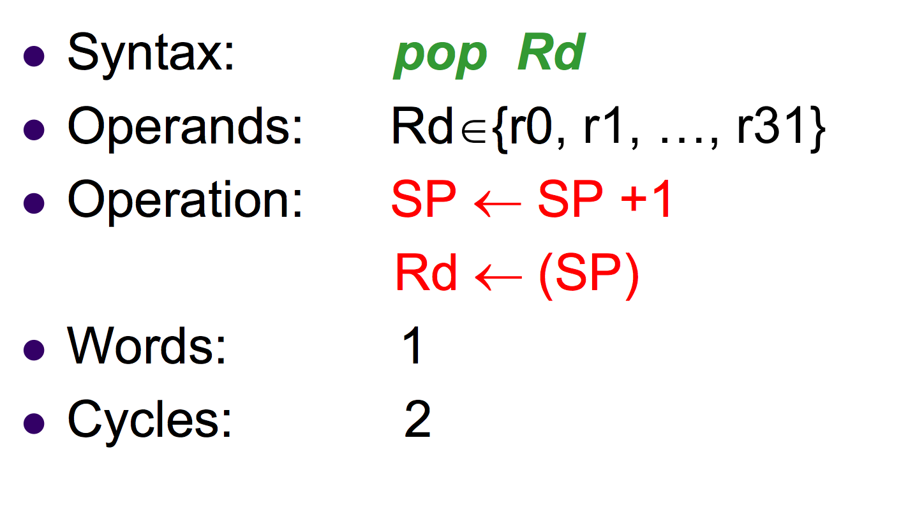
POP instruction

Slide 9
RAMEND
RAMEND- the last value of RAM which differs per machine
RAMEND is a label that represents the address of the last memory location in SRAM.
RAMEND is a 16-bit word
The functions low() and high() are use by the assembler to return the low byte and high byte respectively of a 16-bit word.

Slide 10
Code example for Stack
.include "m328Pdef.inc"
main:
//set up stack pointer
ldi r16,low(RAMEND)
out spl,r16
ldi r16,high(RAMEND)
out sph,r16
ldi r16, $33
ldi r17, $25
add r16, r17
ldi r18, $0A
push r16
push r17
pop r17
push r18
end: nop

Slide 11
Attendance quiz
Using the stack, reverse the order of 4 number stored in the Ram memory space and display the numbers in Port B.

Slide 12
Time Delay
Time delay is affected by two factors:
The number of cycle the instructions take
The frequency (speed) of the micro processor(crystal in microprocessor) to execute one instruction cycle
For example: For 8 instruction cycles calculate the time delay for the following crystal frequencies
A) 8 MHz
B) 16 MHz
C) 10 MHs
D) 1 MHz

Slide 13
Time Delay
A) 8 MHz = 1/8 μs
8*1/8= 1 μs
A) 16 MHz = 1/16 μs
8*1/16= 0.5 μs
A) 10 MHz = 1/10 μs
8*1/10= 0.8 μs
A) 1 MHz = 1 μs
8*1= 8 μs

Slide 14
Time Delay
Instruction | Instruction cycles | Time to execute(1 MHz)
LDI | 1 | 1 x 1 μs = 1 μs
DEC | 1 | 1 x 1 μs = 1 μs
OUT | 1 | 1 x 1 μs = 1 μs
ADD | 1 | 1 x 1 μs = 1 μs
NOP | 1 | 1 x 1 μs = 1 μs
JMP | 3 | 3 x 1 μs = 3 μs
CALL | 4 | 4 x 1 μs = 4 μs
BRNE | 2/1 | 2 μs if taken or 1 μs if not taken
.DEF | 0 | 0 μs

Slide 15
Time Delay
Calculate the time delay with a 5 MHz crystal frequency
Instruction Cycles
.Def Count R20 0
Delay: LDI Count, 0xFF 1
Again: NOP 1
NOP 1
DEC Count 1
BRNE Again 2/1
RET 4

Slide 16
Time Delay
For an estimate
[1+((1+1+1+2) x 255)+4] x 0.2 μs = 256.0 μs
For real time
[1+((1+1+1+2) x 255 -1)+4] x 0.2 μs = 255.8 μs

Slide 17
Time Delay – Nested Loops
Calculate the time delay for a 1MHz crystal frequency
Instruction Cycles
Delay: LDI R16,10 1
Again: LDI R17, 15 1
Here: NOP 1
NOP 1
NOP 1
DEC R17 1
BRNE Here 2/1
DEC R16 1
BRNE Again 2/1
RET 4

Slide 18
Time Delay
For Estimation:
[1+(1+(1+1+1+1+2) x 15 +1 +2) x 20 +4] x 1 μs = 1885 μs
For Real:
[1+(1+(1+1+1+1+2) x 15 -1 +1 +2) x 20 -1 +4] x 1 μs = 1864 μs

